Slide 1
Continuous integration (CI)
Chun-Hung
20180906

Slide 2
CI introduction
Objective :
ensure everyone’s change to the master branch work
確保每個branch merge進的品質是ok的
Reduce merge conflicts
How to make it?
merging in small code changes frequently, rather than merging in a large change at the end of a development cycle.
一次的commit的內容不會很大
CD (C Delivery) : Deployment 持續交付. Deployment means to publish to public

Slide 3
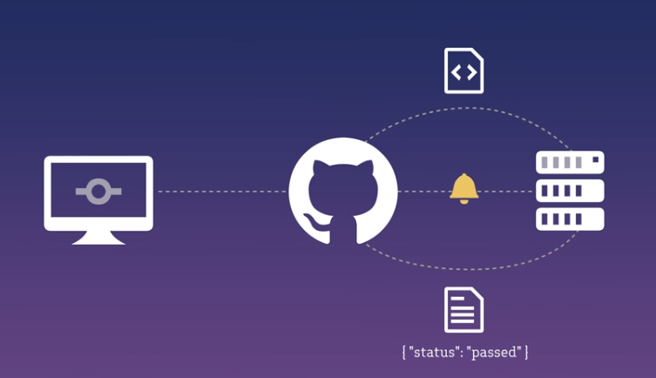
CI structure
CI clone a copy from git repo
Local
CI server

Slide 4
CI on Github and Gitlab

Slide 5
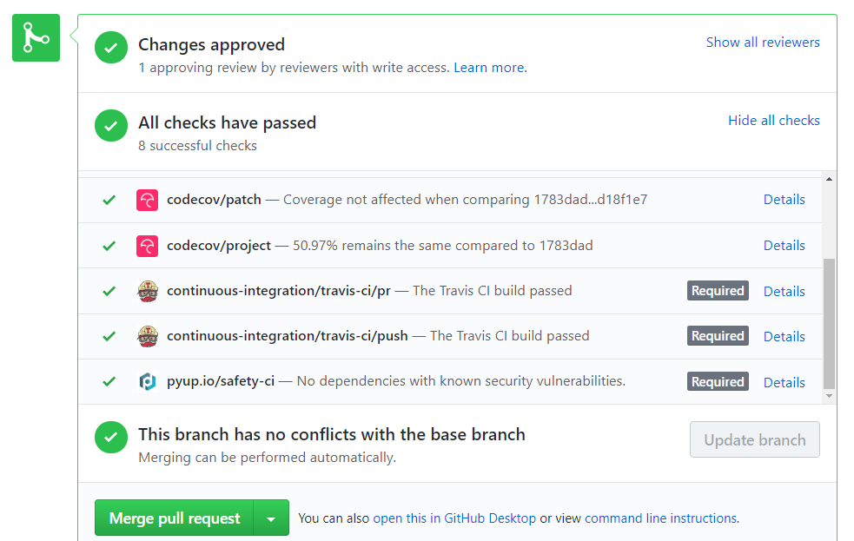
TravisCI for genomics-workspace on github

Slide 6
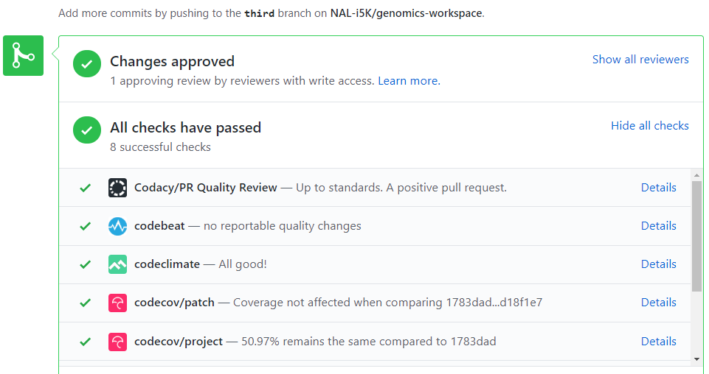
genomics-workspace/.codacy.yml
genomics-workspace/.codebeatignore
genomics-workspace/.codeclimate.yml

Slide 7
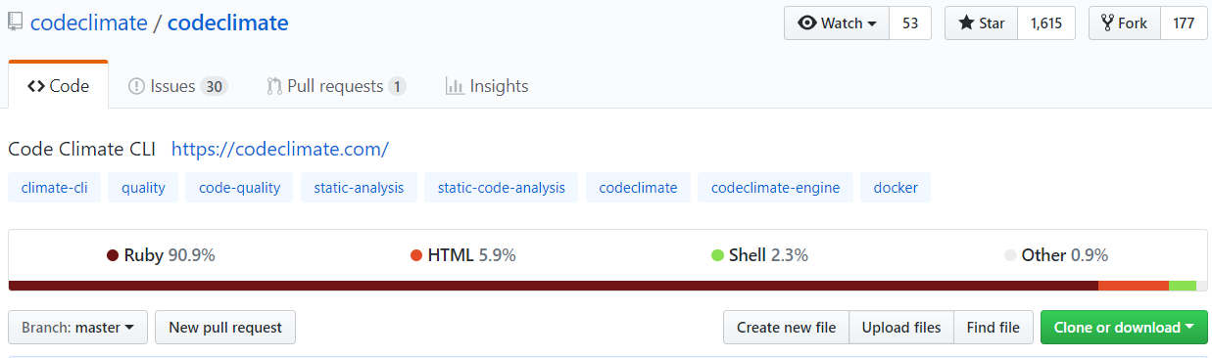
Using Code Climate with Travis CI
Why use Code Climate? I saw a discount on travis website
As a Travis CI customer, you get 20% off for your first three months!
It keeps an eye on your code’s overall quality
Notes:
https://docs.travis-ci.com/user/code-climate/
https://github.com/codeclimate/codeclimate

Slide 8
Gitlab CI
.gitlab-ci.yml file define the pipeline
pipeline
stage
job
Notes:
https://scarletsky.github.io/2016/07/29/use-gitlab-ci-for-continuous-integration/

Slide 9
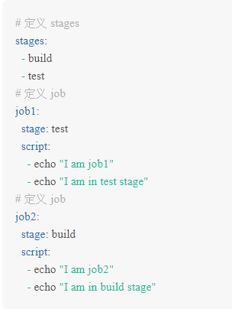
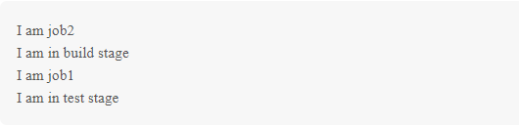
Example of Gitlab-CI
.gitlab-ci.yml :
Use keyword “stages” to define how the pipeline work.
Use keyword “stage” to specify the job correspond to which stage.

Slide 10
Compare between those CI

Slide 11
Continuous integration Tool : Jenkins , Travis CI, CircleCI
 | Pros or Features | Cons
CircleCI | Fast start, lightweight easily readable YAML config | Need 3rd party software to achieve customizations
Travis CI | YAML config Supports more languages than Circle CI good for open-source project Build matrix | Price higher than CircleCI Customization (for some stuff you’ll need 3rd parties) Only support Github
Jenkins | self-contained Java-based program for Windows, Mac OS X and other Unix-like OS RESTful API (Representational State Transfer) Customization Plugins system | Non quick-start Dedicated server 專屬主機(or several servers) are required, which results in additional expense
Notes:
https://hackernoon.com/continuous-integration-circleci-vs-travis-ci-vs-jenkins-41a1c2bd95f5

Slide 12
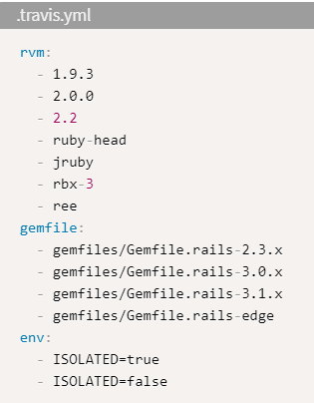
Build matrix in TravisCI
a tool that gives an opportunity to run tests with different versions of language and packages
All build matrixes are currently limited to a maximum of 200 jobs
EX : a build matrix that expands to 56 individual (7 * 4 * 2) jobs.
Notes:
https://docs.travis-ci.com/user/customizing-the-build/#the-build-lifecycle

Slide 13
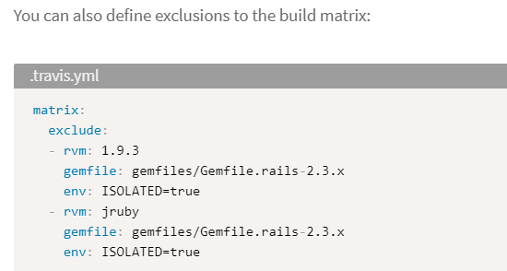
Exclude 2 jobs , 56 -2 = 54 Jobs

Slide 14
So……, what CI should I choose?
CircleCI is recommended for small projects
Travis CI is recommended for cases when you are working on the open-source projects, that should be tested in different environments.
Jenkins is recommended for the big projects, where you need a lot of customizations that can be done by usage of various plugins

Slide 15
Travis CI

Slide 16
Travis CI Introduction
Travis CI supports 31 languages
Travis CI uses .travis.yml to learn about your project and how you want your builds to be executed
Builds, Jobs, Stages and Phases
Jobs - ??
build - a group of jobs.
phase - the sequential steps of a job. ☹
stage - a group of jobs that run in parallel.
Notes:
https://docs.travis-ci.com/user/languages

Slide 17
Travis CI, first demo step by step
[go to travis CI’s website and login with github account] https://travis-ci.com/
[Click the green Activate button, and select the repositories you want to use with Travis CI]
vim test.py [add some code inside]
vim .travis.yml
language: python
python:
- "2.7“
install : true
script:
- python test.py
git push origin dev
Notes:
https://travis-ci.com/
https://github.com/softwaresaved/build_and_test_examples/blob/master/travis/HelloWorld.md

Slide 18
How to write .travis.yml ? The format
Example :
Install:
- if [[ "$TRAVIS_OS_NAME" == "linux" ]]; then sudo apt-get install npm; fi
script:
- python test.py
[title]:
[two space][hyphen][one space]<content>

Slide 19
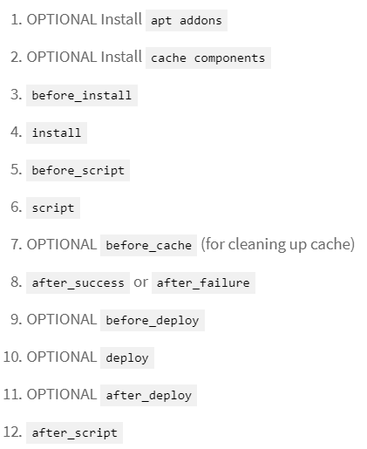
Travis CI the build-lifecycle
Travis CI is made up of two steps:
4. install: install any dependencies required
6. script: the command be excuted
The complete building cycle (12 Steps):
Notes:
https://docs.travis-ci.com/user/customizing-the-build/

Slide 20
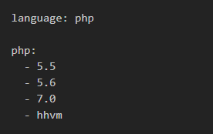
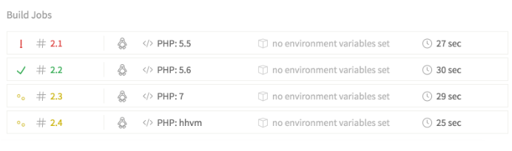
Advantage of CI
It can help you check from version to version of a language
For example, we create 4 different environment, parallel computing
We see the result, and maybe we can decide to give up PHP 5.5

Slide 21
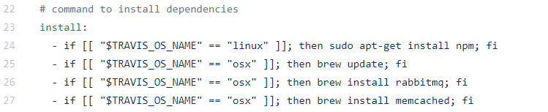
Issue of TravisCI
The TravisCI build-up environment is Ubuntu, not CentOS, which our server actually runs.
TravisCI supports Docker, to meet CentOS
Notes:
https://docs.travis-ci.com/user/reference/overview/

Slide 22
Other

Slide 23
Format comparison -- JSON vs YAML.
JSON (JavaScript Object Notation)
YAML (Yet Another Markup Language)
Both JSON and YAML aim to be human readable data interchange formats
Both are config files
YAML is a superset of JSON, that is, every JSON file is also a valid YAML file
Let’s look the difference :
http://sangsoonam.github.io/2017/03/13/yaml-vs-json.html

Slide 24
End

Slide 25
Future topic 1
pytest, for unitest py.test
https://docs.python.org/3/library/unittest.html
https://docs.pytest.org/en/latest/getting-started.html

Slide 26
Reference
Youtube – FunFunFunction
https://www.youtube.com/watch?v=ymPOI4gWQFY
https://www.youtube.com/watch?v=Uft5KBimzyk

