Slide 1
Testing
Chun-Hung
20180918

Slide 2
Outline
Main idea of testing
Category of testing
Pytest introduction
Demo
Testing in our github repo
Pesticide Paradox
Conclusion

Slide 3
Outline
Main idea of testing
Category of testing
Pytest introduction
Demo
Testing in our github repo
Pesticide Paradox
Conclusion

Slide 4
Main idea of testing
Software testing, is an activity to check that the software system is defect-free.
“To err is human, to really foul things up requires a computer.”
Test Driven Development (TDD):
writes a test before any production code
advantage :
For programmer, make the goal clearer
For documentation, better describe what your product is doing
Notes:
https://www.youtube.com/watch?v=TDynSmrzpXw
https://smartbear.com/learn/automated-testing/what-is-unit-testing/

Slide 5
Category of testing
Unit testing
test every single piece of function
testing some inputs, and then check what the function outputs is correct
super reliable
Integration testing
test how parts of the system work together
to test two or more separate systems together
use integration test, if a piece of code is too complex to unit test
recommend fixing the code so it’s easy to unit test instead
Functional testing (End-to-end testing, browser testing)
simulating user scenario
Notes:
https://www.youtube.com/watch?v=QSDYfToJI7w

Slide 6
Outline
Main idea of testing
Category of testing
Pytest introduction
Demo
Testing in our github repo
Pesticide Paradox
Conclusion

Slide 7
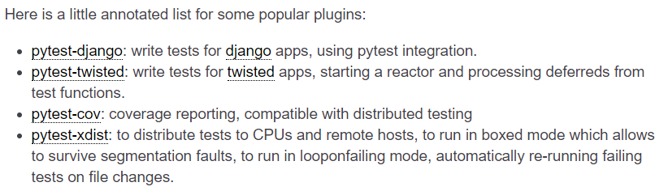

pytest introduction
Feature : Lots of “assert”
pytest can support from easy Unitesting to complicated Functional testing
many plugins to make pytest a powerful tool
pip install pytest-NAME
e.g. pytest-selenium ……
Notes:
https://docs.pytest.org/en/latest/plugins.html

Slide 8
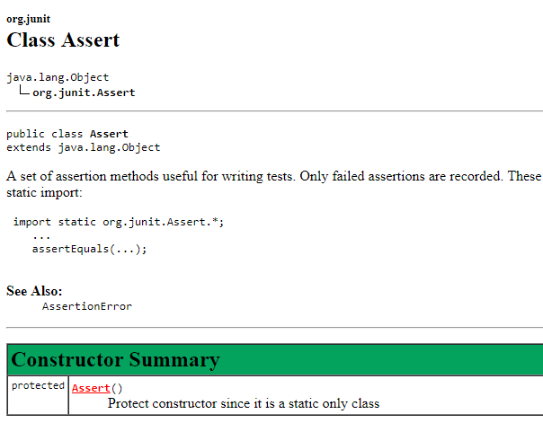
pytest is easy to write than others
e.g. Junit API
A framework of unittest in Java

Slide 9
pytest getting started
$ pip install -U pytest
$ pytest –version
Notes:
https://blog.csdn.net/hekaiyou/article/details/79231898

Slide 10
Outline
Main idea of testing
Category of testing
pytest introduction
demo
testing in our github repo
Pesticide Paradox
Conclusion

Slide 11
demo1
$ cd /home/johnbamboobilly/self4/demo1
$ vim test_sample.py
def func(x):
return x + 1
def test_answer():
assert func(3) == 5
$ pytest [run all files of the form test_*.py or *_test.py in the current directory and its subdirectories]
Notes:
pytest使用入门
https://blog.csdn.net/hekaiyou/article/details/79231898

Slide 12
demo2 -- Group multiple tests in a class
$ cd /home/johnbamboobilly/self4/demo2
$ vim test_class.py
class TestClass(object):
def test_one(self):
x = "this"
assert 'h' in x
def test_two(self):
x = "hello"
assert hasattr(x, 'check')
$ pytest -q test_class.py
Verbosity : failing or warning

Slide 13
Outline
Main idea of testing
Category of testing
pytest introduction
demo
testing in our github repo
Pesticide Paradox
Conclusion

Slide 14
NAL_RNA_seq_annotation_pipeline/tests/
@hsiaoyi , could you explain more about the design idea??
genomics-workspace/hmmer/tests.py
python manage.py test
Pytest nosetest
Notes:
https://github.com/NAL-i5K/NAL_RNA_seq_annotation_pipeline

Slide 15
Outline
Main idea of testing
Category of testing
pytest introduction
demo
testing in our github repo
Pesticide Paradox
Conclusion

Slide 16
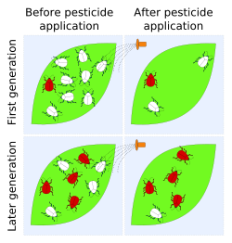
Pesticide Paradox
Bugs no longer be killed by the long-used pesticide, in software development is the same as in daily life.
To overcome, the test cases needed to be regularly reviewed, revised and adding new and different testing cases
Notes:
Seven Testing Principles: Software Testing
https://www.youtube.com/watch?v=rFaWOw8bIMM

Slide 17
Outline
Main idea of testing
Category of testing
pytest introduction
demo
testing in our github repo
Pesticide Paradox
Conclusion and Future work

Slide 18
Conclusion
Testing shows presence of defects, which could help the development team know which parts to be modified.
Even if no defects are found, it increase the confidence of the production.

Slide 19
Future work
pytest-Django
pytest with CI, after a good-developed pytest
To try Unitest to our current framework?? Is it a huge project??
→ We use Unitest in genomics-workspace

Slide 20
Reference
https://docs.pytest.org/en/latest/getting-started.html
https://blog.csdn.net/liuchunming033/article/details/46501653
pytest, for unitest
https://docs.python.org/3/library/unittest.html
https://docs.pytest.org/en/latest/getting-started.html
快快樂樂成為 Coding Ninja (by pytest) - Chun-Yu Tseng (PyCon APAC 2015)
https://www.youtube.com/watch?v=pX1_I_sEi8k

