Slide 1


Celery
Chun-Hung
Date : 2018/10/01

Slide 2


Slide 3
Outline
Introduction
Architecture
Demo
Celery worker options
Message broker : RabbitMQ
Future work

Slide 4
Introduction
Celery is an asynchronous task queue
The idea : to respond to the user as quick as possible, i.e., always keep the server ready to respond to new requests
How it works? passing the time-consuming tasks to the queue to be executed in the background

Slide 5
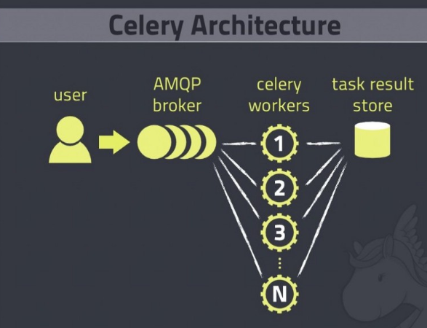
Advanced Message Queuing Protocol (AMQP)
Broker : receives messages from the Client and delivers it to the workers when requested
Workers run tasks asynchronously
Notes:
Executing time-consuming tasks
https://medium.com/@ffreitasalves/executing-time-consuming-tasks-asynchronously-with-django-and-celery-8578eebab356

Slide 6
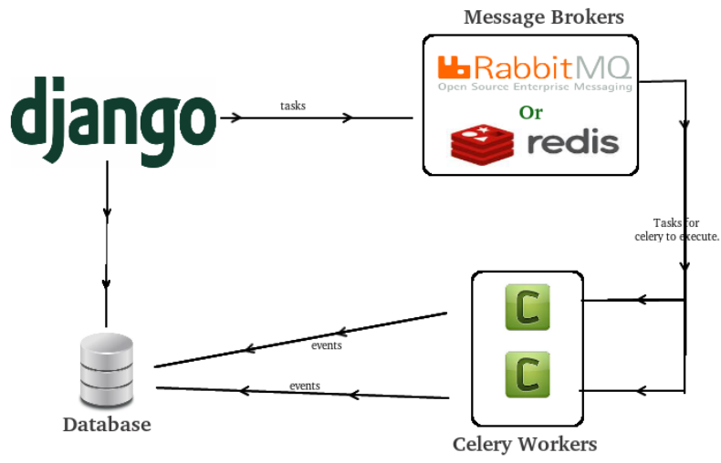
Notes:
http://my-django-python.blogspot.com/2015/10/asynchronous-tasks-with-django-and.html

Slide 7
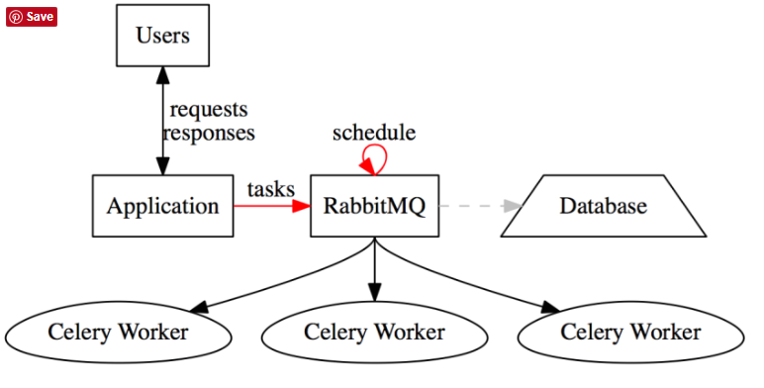
Architecture
Notes:
https://chatasweetie.com/2016/09/02/celery-distributed-task-queue/

Slide 8
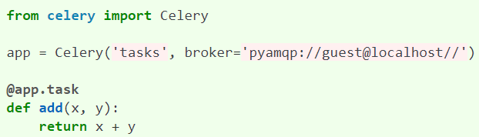
Demo -- worker’s console and user’s console
[worker’s console, Create Celery instance]
$ cd /home/johnbamboobilly/self_celery
$ touch tasks.py
$ celery -A tasks worker --loglevel=info
[user’s console, interactive python interface to simulate “Calling the tasks”]
>>> from tasks import add
>>> add.delay(4, 4)
Notes:
http://docs.celeryproject.org/en/latest/getting-started/first-steps-with-celery.html
實例化@App.task
https://blog.csdn.net/Jmilk/article/details/79297541

Slide 9
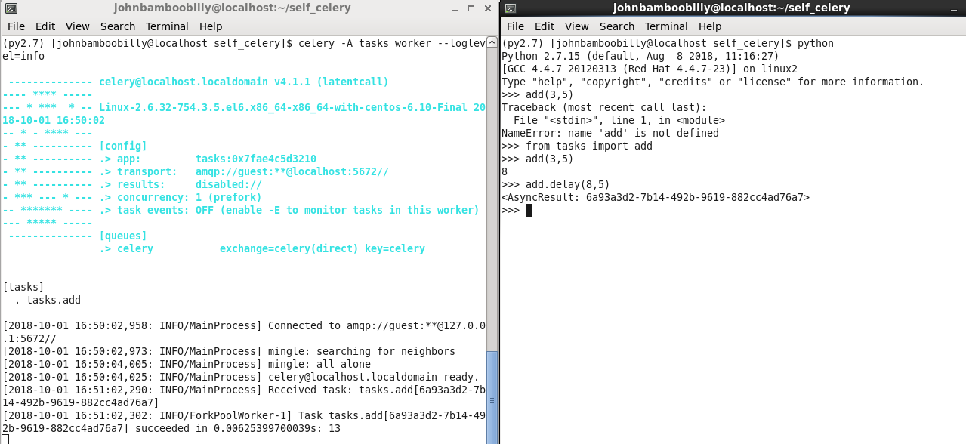
Demo – Result (left-worker’s console, right-user’s console)

Slide 10
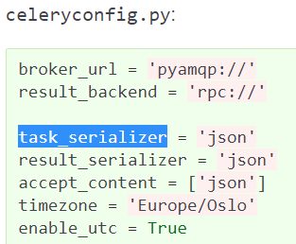
Demo(Future Work)
Keeping result :
To keep track of the tasks’ states, Celery needs to store or send the states somewhere.
Configuration :

Slide 11
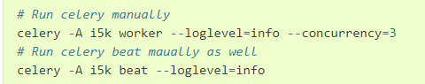
Celery worker options
celery worker --help
-l, --loglevel
Logging level, choose between DEBUG, INFO, WARNING, ERROR, CRITICAL, or FATAL.
Print address (e.g. 127.0.0.1:5672) on local terminal.
-c, --concurrency
Number of child processes in the queue. The default is the number of CPUs available on system
Notes:
http://docs.celeryproject.org/en/latest/reference/celery.bin.worker.html

Slide 12

To work with Celery, we also need to install RabbitMQ because Celery requires an external solution to send and receive messages
Backend database
Rabbit MQ
Message broker
Celery
Worker
Tasks

Slide 13

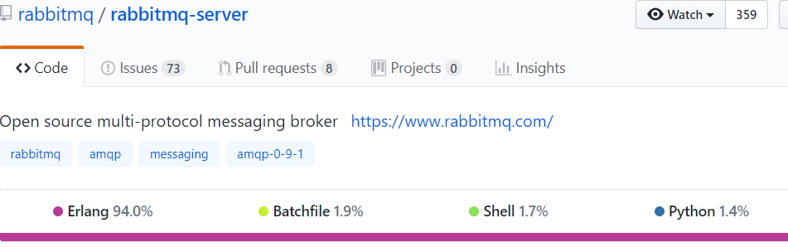
What is RabbitMQ ?
RabbitMQ(Message Queue) is the open source message broker
As a message broker, it accepts and forwards messages
RabbitMQ is mainly written in Erlang language
Notes:
https://github.com/rabbitmq/rabbitmq-server

Slide 14
RabbitMQ setup
sudo yum -y install rabbitmq-server
sudo chkconfig rabbitmq-server on

Slide 15
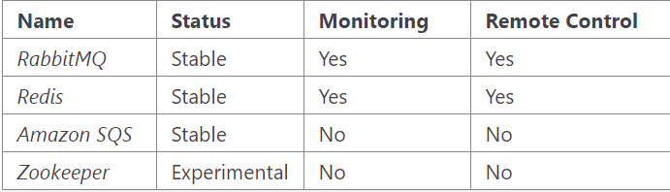
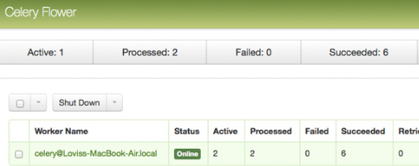
Broker, which Celery supports
Monitoring : e.g. Flower, celery events, celerymon with event-based monitoring tools
Remote Control : the ability to inspect and manage workers at runtime using celery inspect and celery control command tools without “Remote Control” using other remote control API
Notes:
http://docs.celeryproject.org/en/latest/getting-started/brokers/#broker-toc

Slide 16
Future work
Next Steps Guide, Using Celery in Django Application
Implement RabbitMQ tutorial example to know it well

Slide 17
Reference
Twtrubiks https://github.com/twtrubiks/django-celery-tutorial
Github repo https://github.com/celery/celery
How to Use Celery and RabbitMQ with Django https://simpleisbetterthancomplex.com/tutorial/2017/08/20/how-to-use-celery-with-django.html

Slide 18
Reference -- org
Celery Next Steps http://docs.celeryproject.org/en/latest/getting-started/next-steps.html#next-steps
Celery User Guide http://docs.celeryproject.org/en/latest/userguide/index.html#guide
RabbitMQ tutorial https://www.rabbitmq.com/getstarted.html

