Slide 1
Npm Node Package Manager
Chun-Hung

Slide 2
npm is a package manager for the JavaScript programming language
Npm 可以下載各種Javascript套件使用

Slide 3
Article link :
https://ithelp.ithome.com.tw/articles/10191682
Npm init 創造初始的開發樣子
Npm install安裝某套件後，有三件事情改變了
1. package.json裡面的dependencies記錄下工具與版本
2. node_module
3. package-lock.json

Slide 4
Why a directory node_modules?
Take the module selenium for example
If the developer use python env, pip default install the package on path usr/local/lib
However, it has a potential drawbacks, if the package selenium have more than two versions, the new version would overwrite the old version in usr/local/lib
Therefore, pip solve the issue by creating a requirements.txt, which write down all the package and its corresponding versions
Npm organize the package by directory
Notes:
pip install -r requirements.txt

Slide 5
We don’t need to push mode_modules/ to repo, because we can download it online.
If we git clone the project.git, we get package.json , all we need to do is ‘npm install’, then the node_modules file is created.

Slide 6
Conclusion : npm to deal with many included library
Consider when move the project into a new environment to develop futher
We only need to clone package.json and some code we write
When we insert “npm install” , npm would download all the dependencies written in package.json

Slide 7
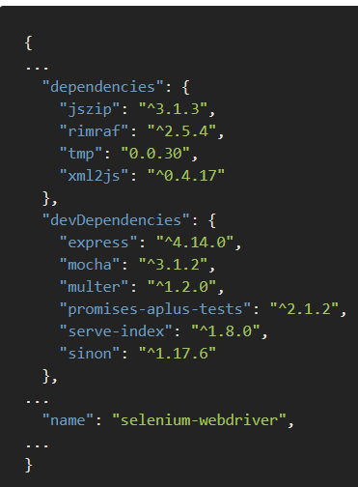
Continue development
For example, this is package.json in selenium.json
The developers of selenium follow the npm rule and use some packages, like jszip and express……
Therefore, when we “npm install” , we recursively install all tools, for example, if jszip need other dependencies , then it keep installing, so it take time to install

Slide 8
What is package-lock.json??

Slide 9
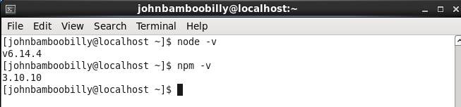
Check if successful install
node -v
npm -v

Slide 10
npm init
Create package.json file
npm init –yes
Create default setting
npm install <package> –save
npm install -g <package>
download packages globally
npm uninstall <package> --save

Slide 11
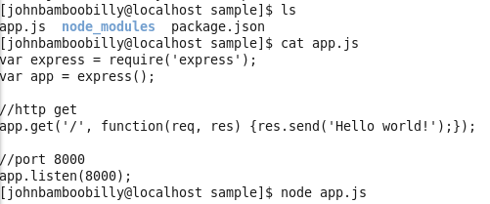
vim app.js
Create the first Node.js program
存成app.js放在sample專案下
node app.js
The open localhost:8000

Slide 12
npm start
Go to package.json to find the key “start”
If not found, default running “node server.js”
npm publish
A upload process, contrary to npm install

Slide 13
npm-coding-style
Indentation
Two-spaces. ~= python Four-spaces
curly brackets
Bad:
function ()
{
Good:
function () {
Use single quotes ‘’
Bad:
var notOk = "Just double quotes"
dd
https://docs.npmjs.com/misc/coding-style
Notes:
英文小教室
小括號parentheses
中括號square brackets
大括號curly brackets

Slide 15
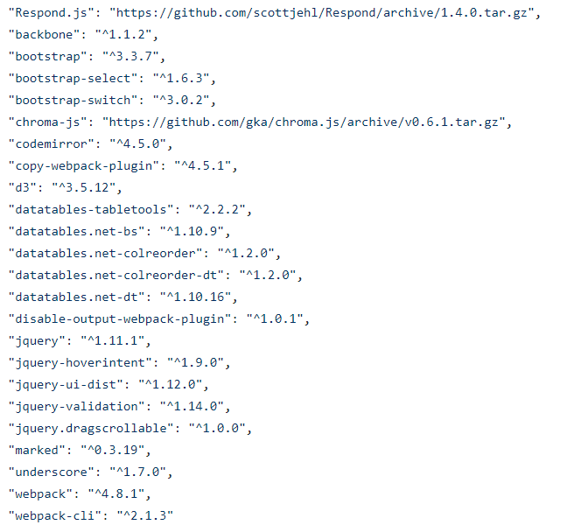
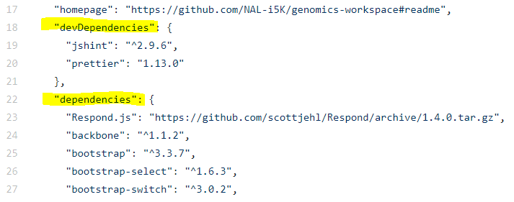
genomics-workspace/package.json
Totally, 24 dependencies
“key” : “value”
Notes:
https://github.com/NAL-i5K/genomics-workspace/blob/master/package.json

Slide 16
"jquery": "^1.11.1“
"jquery": "^1.11.1“
Initial release in 2006
a cross-platform JavaScript library designed to simplify the scripting of HTML
Can support common browser, Chrome Firefox Safari
Notes:
https://github.com/jquery/jquery/blob/master/package.json

Slide 17
"webpack": "^4.8.1"
Notes:
https://github.com/webpack/webpack/blob/master/package.json
https://ithelp.ithome.com.tw/articles/10193115

Slide 18
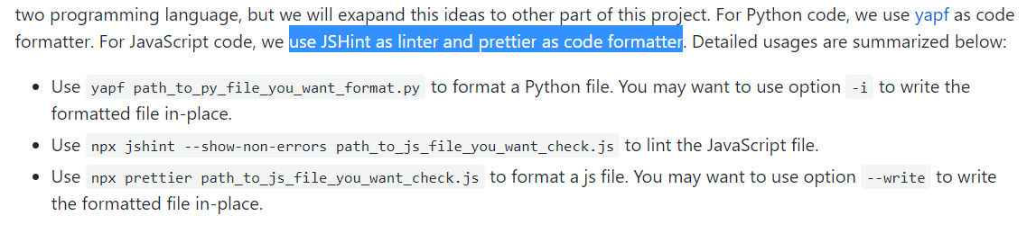
devDependencies
devDependencies are not directly used in production, just supporting
Jshint : Javascript Hint, for checking if JavaScript source code complies with coding rules.
Prettier
In genomics-workspace/CONTRIBUTING.md

Slide 19
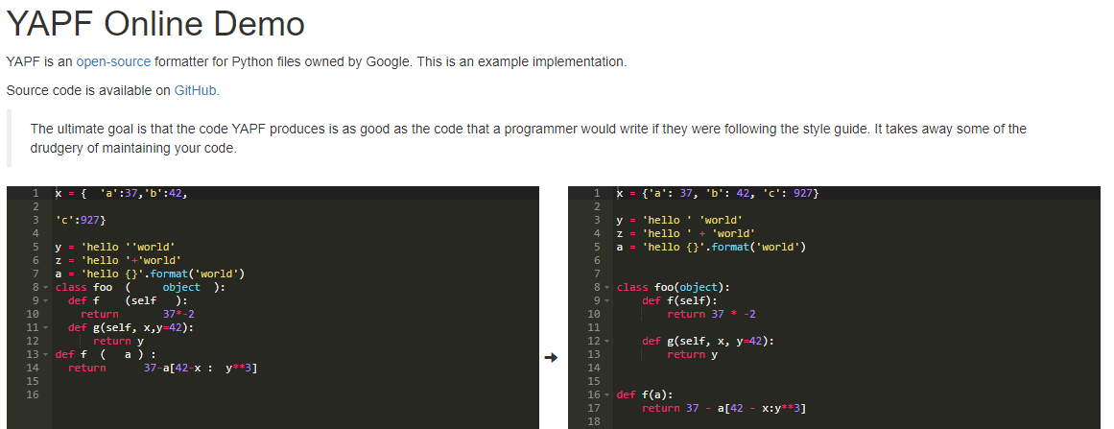
Those in devDependencies help the code in project become more good-looking.
Take yapf code formatter for python as an example.

Slide 21
What is the role of npm?
Backend and Frontend relation
frontend of Django app in a project, like genomics-workspace project
Those dependicies written in package.json file are needed for scripts, which place in path :
genomics-workspace/blast/static/blast/scripts/<.js file>

Slide 22
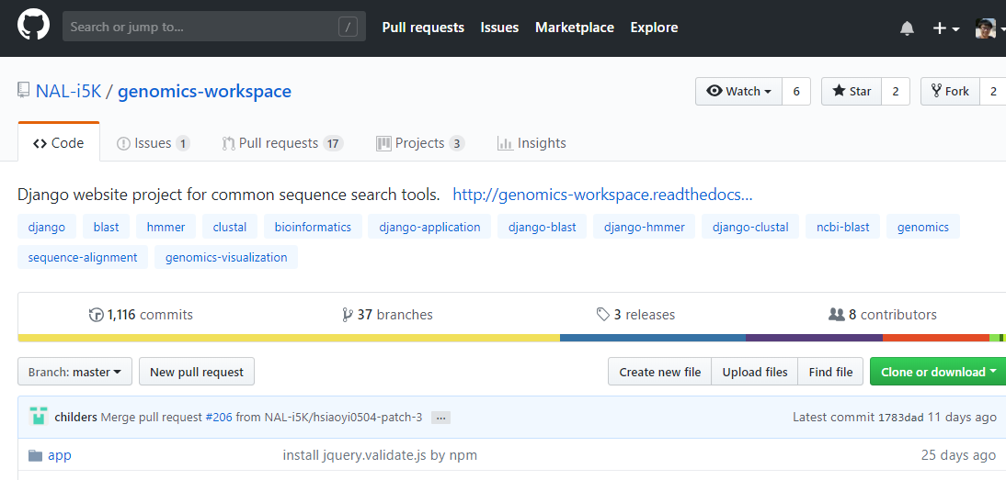
Question??
1. What are those reference on page github/genomics-workspace?
2. What is github/app?

Slide 23
3. genomics-workspace/blast/permissions.py is empty

Slide 24
Reference
https://docs.npmjs.com/
http://expressjs.com/en/guide/routing.html

