Slide 1
Test Continuous integration (CI)
Chun-Hung

Slide 2
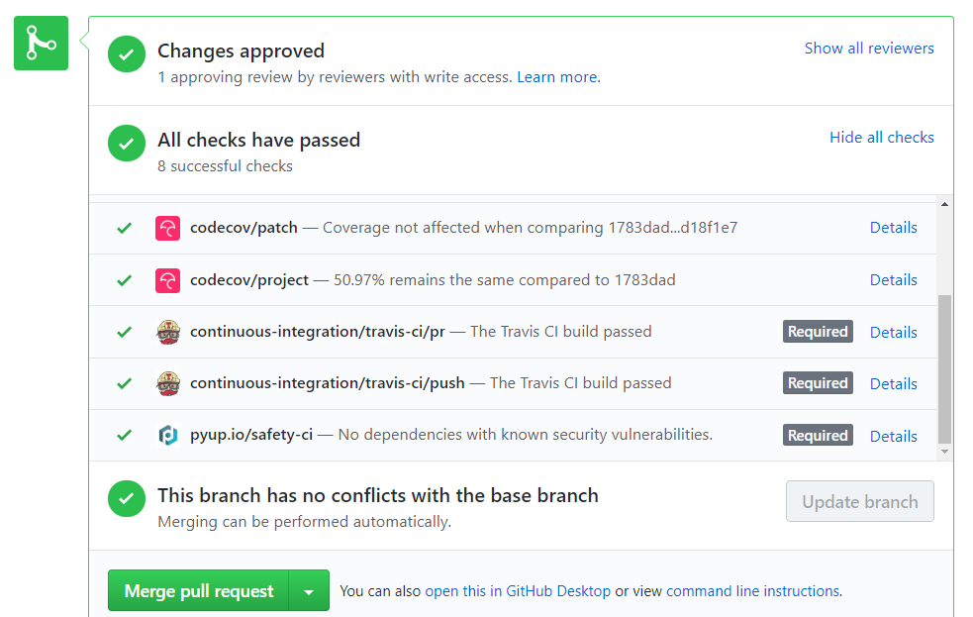
TravisCI for genomics-workspace on github

Slide 3
Continuous integration Tool : Jenkins , Travis CI, CircleCI, Bamboo
 | Pro or Feature | Con
CircleCI | Fast start, lightweight easily readable YAML config | Need 3rd party software to achieve customizations
Travis CI | YAML config Supports more languages than Circle CI Build matrix | Price higher than CircleCI Customization (for some stuff you’ll need 3rd parties)
Jenkins | self-contained Java-based program for Windows, Mac OS X and other Unix-like OS RESTful API (Representational State Transfer) Customization Plugins system | Non quick-start Dedicated server 專屬主機(or several servers) are required, which results in additional expense
Notes:
https://hackernoon.com/continuous-integration-circleci-vs-travis-ci-vs-jenkins-41a1c2bd95f5

Slide 4
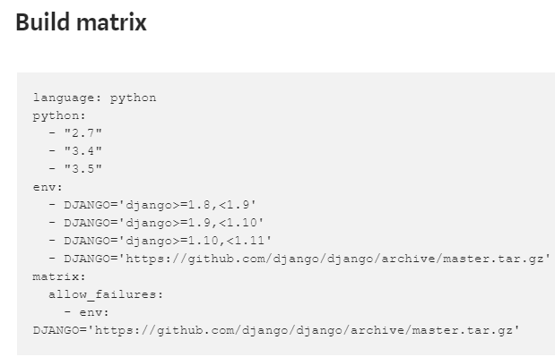
What is Build matrix ?
a tool that gives an opportunity to run tests with different versions of language and packages
Give notification, but not fail the build

Slide 5
So……, what CI should I choose?
CircleCI is recommended for small projects
Travis CI is recommended for cases when you are working on the open-source projects, that should be tested in different environments.
Jenkins is recommended for the big projects, where you need a lot of customizations that can be done by usage of various plugins

Slide 6
YML file of travis
genomics-workspace/.travis.yml
https://github.com/NAL-i5K/genomics-workspace/blob/master/.travis.yml
Add a .travis.yml file to the repository to tell Travis CI what to do.
Inside .travis.yml:
Some commands to build up a test environment
When success, output a coverage report
Can also Using Docker in Builds, but how Docker work?
Notes:
https://docs.travis-ci.com/user/docker/

Slide 7
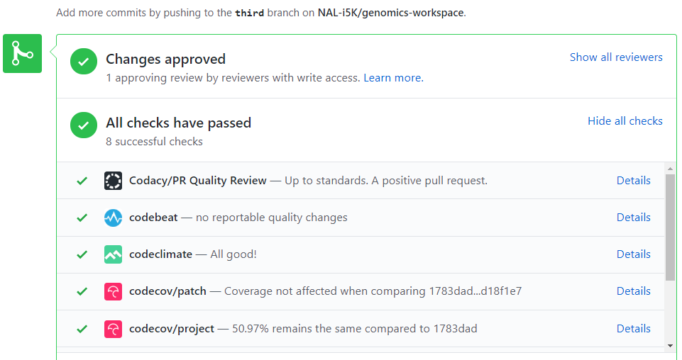
genomics-workspace/.codacy.yml
genomics-workspace/.codebeatignore
genomics-workspace/.codeclimate.yml

Slide 8
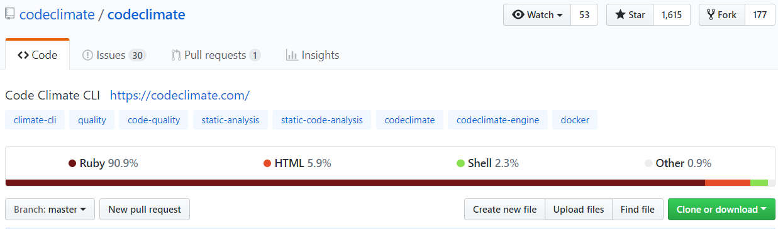
Using Code Climate with Travis CI
Why use Code Climate? I saw a discount on travis website
As a Travis CI customer, you get 20% off for your first three months!
Notes:
https://docs.travis-ci.com/user/code-climate/
https://github.com/codeclimate/codeclimate

Slide 9
JSON vs YAML.
Both are config files
YAML is a superset of JSON, which means you can parse JSON with a YAML parser. YAML → JSON

Slide 11
CI solves monster merges, which is time-consuming
Divide all bugs you find into different small commits
Able to merge multiple times per day
Need Automated verification system before dev-version merge into master
Adding remote verification, ex. CircleCI

Slide 12
Demo : https://circleci.com/dashboard
circleCI is listening my update on my github repo

Slide 13
Reference
Youtube – FunFunFunction
https://www.youtube.com/watch?v=ymPOI4gWQFY

