Slide 1
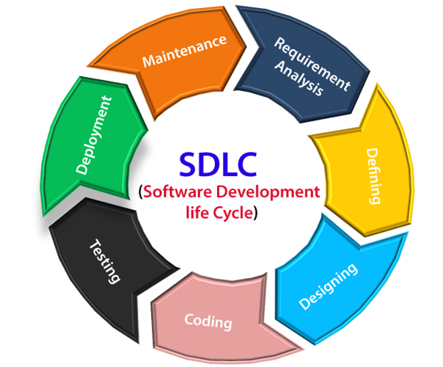
SDLC Implementation
LAB – 1
SOC-III
Aim : To understand the Software development significance in Software Project Development
Software: Software is a set of computer programs and associated documentation and data.
Software Project: Software is a set of computer programs and associated documentation and data.
Software Development Life Cycle:
A collection of phases in a sequence
SDLC describes project planning, development, refine, maintain and deployment phases
SDLC consists of 6 stages namely
PLANNING
DEFINING,
DESIGNING
BUILDING
TESTING and DEPLOYMENT

Slide 2
SDLC Implementation
LAB – 1
SOC-III
Planning: Basing on the client needs preliminary surveys and analysis conducted in this phase to initiate Project.
Feasibility Study
Domain Study
Requirement Analysis
Technical Resources Analysis
Risk associations Identification
Defining: The SRS (Software Requirement Specification) document is prepared in this phase by Software Engineer with assistance of System Analyst.
Requirement Report Verification
Market Analysis
Product Requirements
Resource Requirements
Cost Estimation
Staff Estimation
Build Assets Requirements

Slide 3
SDLC Implementation
LAB – 1
SOC-III
Designing: Based on SRS Designing process modularizes the project based on several constraints. Design Document Specification generated at the end of this phase.
Best Architecture Recognition
Stakeholders Parameters
Product Robustness
Design Modularity
Budget Constraints
Data Flow among Modules
Collaboration of Modules
Module dependencies
Developing: In this stage of SDLC the actual development starts and the product is built. The Developing Product Specification generated at the end of phase
Different HLL software used by developers
Coding developed under guidelines of System Analyst
Team Leaders manages individual modules with collaboration to other teams
Organization programming tools used for code generation
Code Optimization conducted
Necessary Compilers, IDEs, Languages and Packages are employed in code generation

Slide 4
SDLC Implementation
LAB – 1
SOC-III
Testing: This stage is usually a subset of all the stages as in the modern SDLC models, the testing activities are mostly involved in all the stages of SDLC.
Unit testing
Integration Testing
System Testing
UAT - User Acceptance Testing
Deployment & Maintenance: In this phase product is released into market with maintenance and help desk support services. The maintenance is done by customer.
Alpha Release ( Within R & D environments and developing zones)
Beta Release ( Inside the territory with survey of feedback from customers)
Customer Assistance ( After Global release)
Help Desk (Suggestions and improvement strategies)
Target Market strategies ( market analysis of product usage)
Real business environment ( Product Working environments)

Slide 5
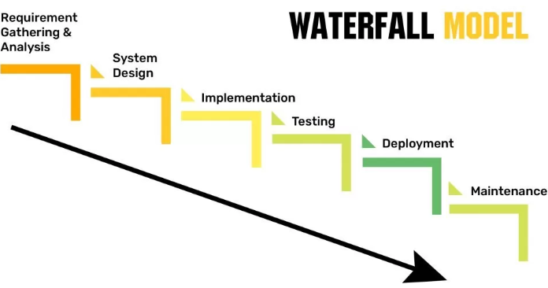
SDLC Implementation
LAB – 1
SOC-III
SDLC Models: WATER-FALL model

Slide 6
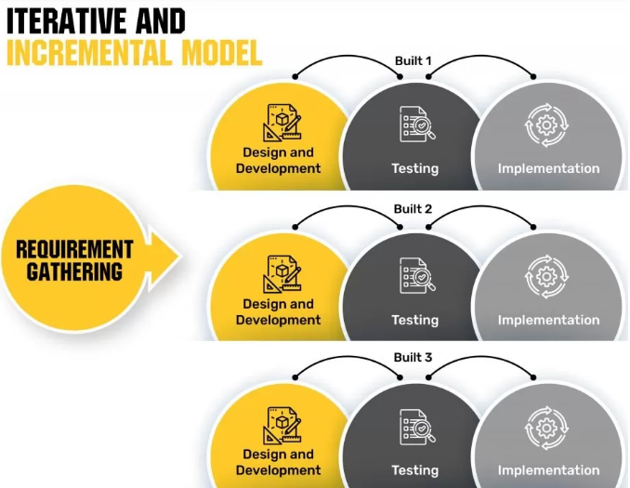
SDLC Implementation
LAB – 1
SOC-III
SDLC Models: ITERATIVE and INCREMENTAL model

Slide 7
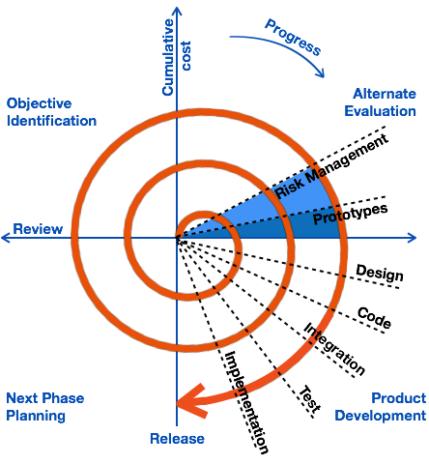
SDLC Implementation
LAB – 1
SOC-III
SDLC Models: The SPIRAL MODEL

Slide 8
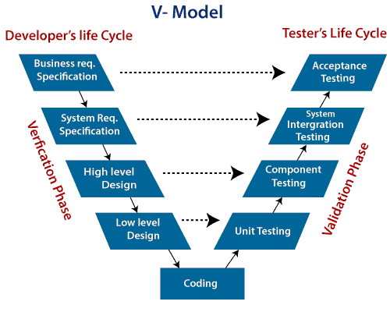
SDLC Implementation
LAB – 1
SOC-III
SDLC Models: The V-MODEL

Slide 9
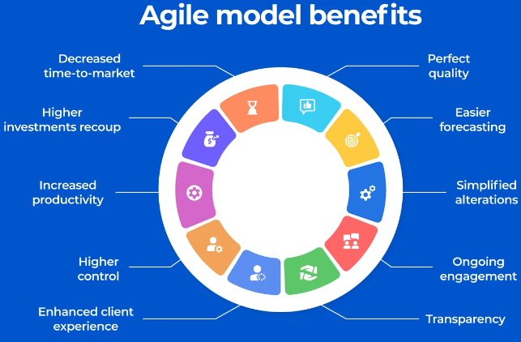
SDLC Implementation
LAB – 1
SOC-III
SDLC Models: The AGILE MODEL
Combination of Iterative and Incremental process models
Process adaptability high
Customer satisfaction with rapid delivery
Increment builds based
Minimizes Failures
High Quality modules
Low Cost and Risk
Continuous Adaptability to
Technologies

