Slide 1
Predicting Public Transit Reliability
Data 245 In-class Project Presentation
Team: [Add team names]

Slide 2
Problem and Goal
Goal: Predict whether a transit stop event will be delayed
Business value: Better rider communication and dispatch planning
Dataset size: 1086 rows and 13 columns

Slide 3
Data Pipeline and Feature Engineering
Merged schedule + realtime + weather data
Engineered time, trip progression, weather, and speed features
Balanced classes with SMOTE in feature engineering pipeline

Slide 4
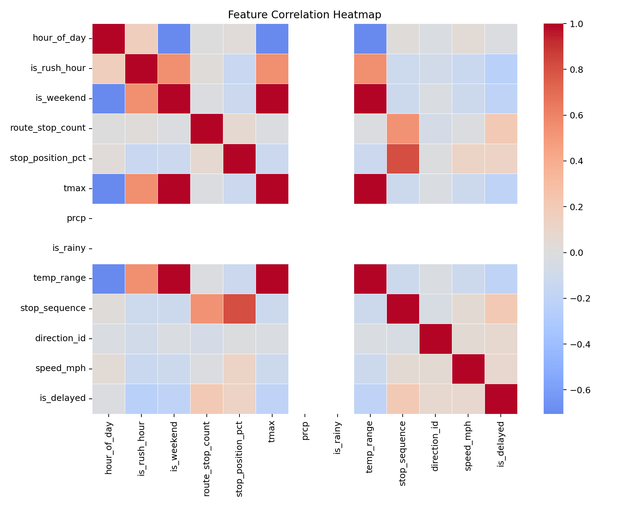
Exploratory Data Analysis: Correlation Heatmap
Heatmap used to identify feature relationships and potential multicollinearity.

Slide 5
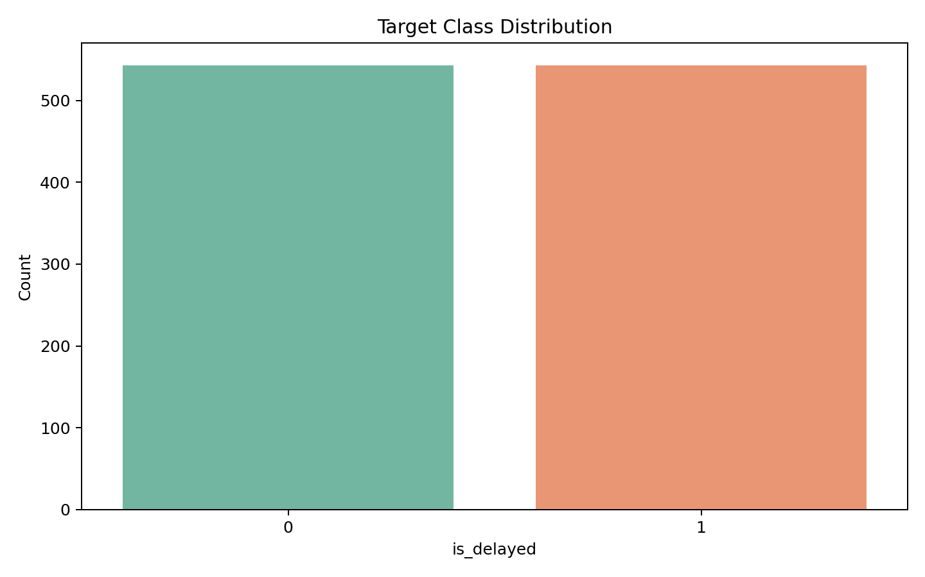
Target Distribution
Balanced delay classes used for robust model training.

Slide 6
Model Results (Multiple Metrics)
Best model: random_forest
F1: 0.930, ROC-AUC: 0.977, PR-AUC: 0.980
Compared Logistic Regression, Random Forest, and Gradient Boosting
Detailed metrics are in project_outputs/tables/model_metrics.csv

Slide 7
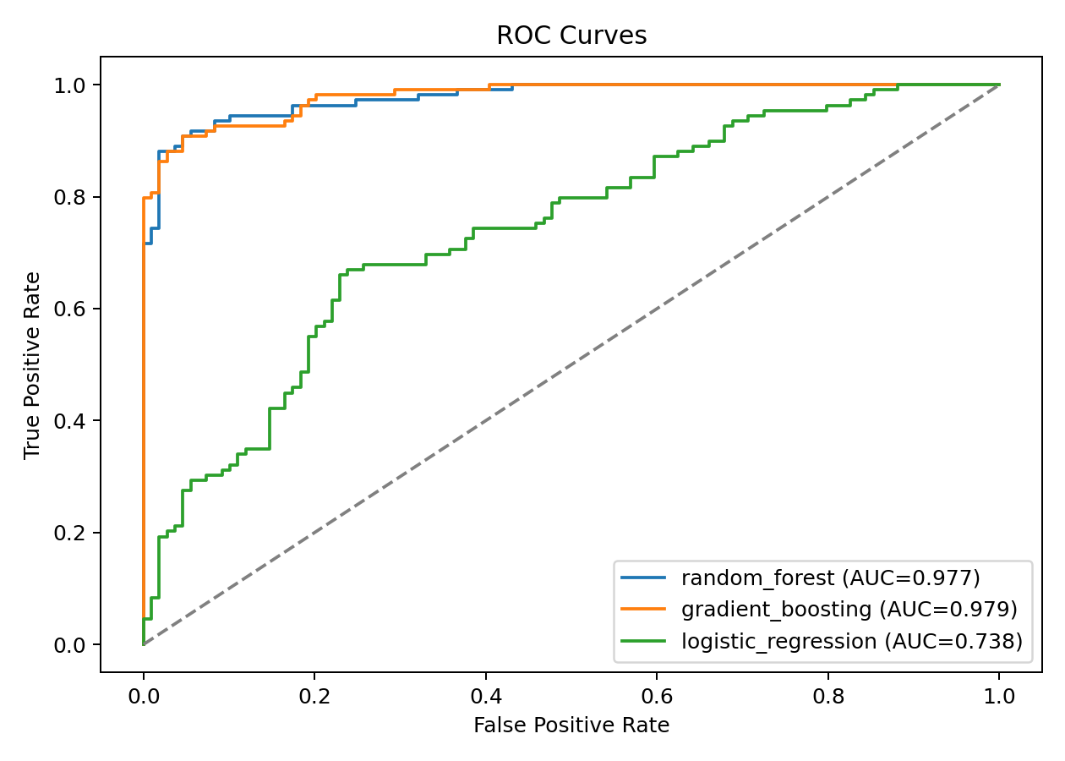
Model Quality: ROC Curves
ROC curves for all candidate models.

Slide 8
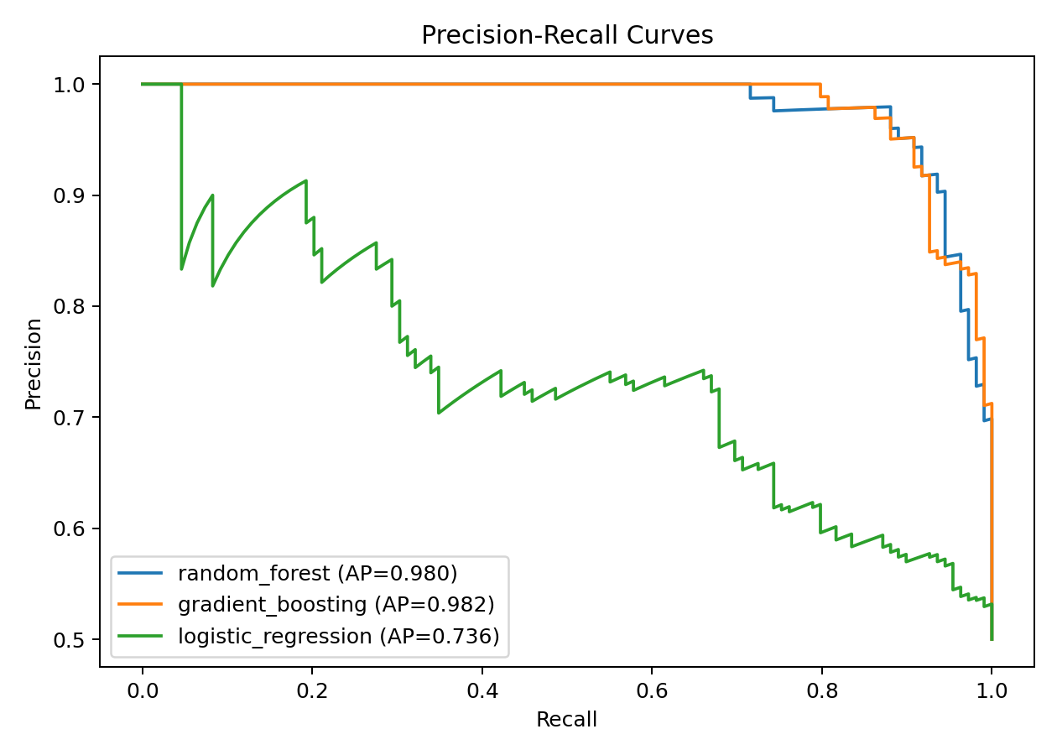
Model Quality: Precision-Recall Curves
PR curves emphasize positive-class performance.

Slide 9
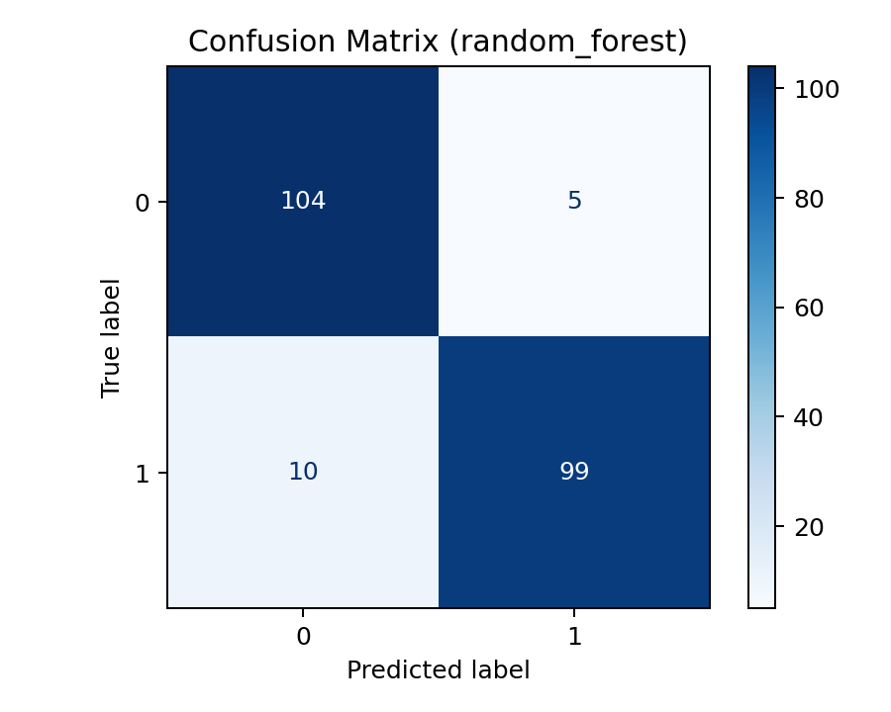
Best Model Confusion Matrix
Classification behavior on held-out test data.

Slide 10
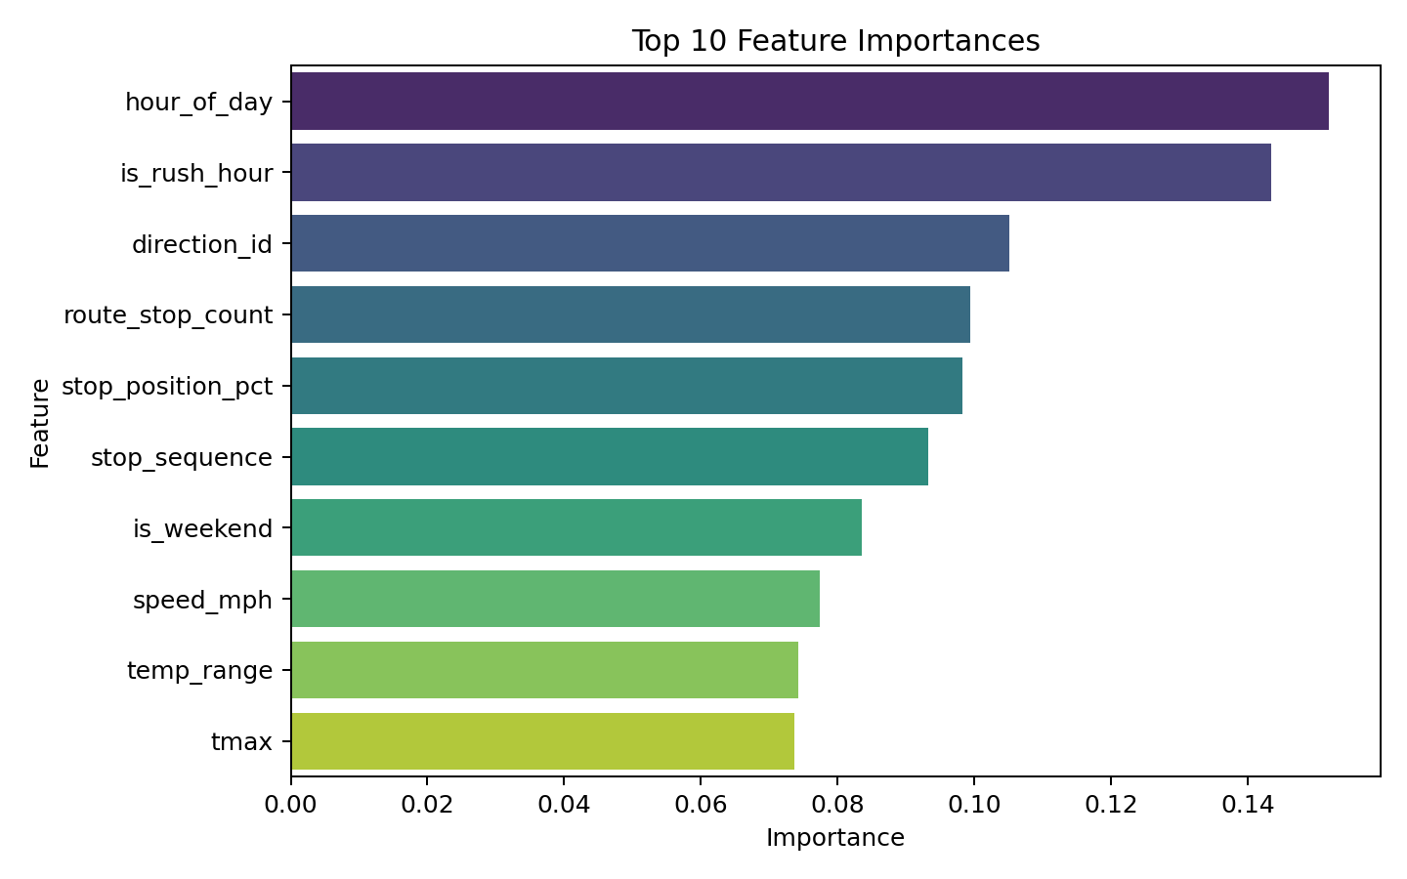
Feature Importance (Best Tree-Based Model)
Top contributors to transit delay prediction.

Slide 11
Code Walkthrough and Demo Plan
Step 1: Run 08_modeling_and_reporting.py to train/evaluate models
Step 2: Show saved model file and quick inference script execution
Step 3: Walk through key functions: preprocessing, metrics, and model selection

Slide 12
Lessons Learned and Technical Difficulties
Realtime transit data quality required careful filtering and joins
Class imbalance initially hurt recall before resampling
Best practice: track multiple metrics, not only accuracy
Future work: route-specific models and temporal cross-validation

Slide 13
Teamwork, Agile, and Pair Programming Evidence
Add sprint board link (Trello/Jira) and sprint artifacts
Add pair-programming screenshots or VS Code LiveShare evidence
Add commit history snapshots from GitHub and role ownership notes

Slide 14
CRediT Contributor Roles Statement
[Name 1] Conceptualization, Data Curation, and Investigation
[Name 2] Methodology, Software, and Validation
[Name 3] Visualization, Writing, and Presentation
Replace placeholders with exact team member contributions

Slide 15
Appendix: Rubric Criteria Mapping
Code Walkthrough (5): 08_modeling_and_reporting.py and end-to-end pipeline scripts
Presentation Skills/Time Mgmt (5): Use speaker notes and timed dry run
Discussion/Q&A (5): Prepare trade-off answers for model selection and metrics
Demo (5): Run model script + show saved model inference
Visualization (2): Heatmap, target distribution, ROC/PR, confusion matrix
Version Control (3): Add public GitHub repo URL in this slide before submission
Lessons Learned (5): Included in dedicated lessons-learned slide
Teamwork + Pair Programming (2): Add screenshots/logs in appendix
Agile/Scrum (3): Add sprint board URL, meeting notes, backlog evidence
Slides (5): This .pptx deck exported and submitted
Saved model for quick demo (3): project_outputs/models/best_transit_delay_model.pkl
Creative presentation techniques (2): Add transitions/animations before final export
CRediT statement: Included in dedicated contributor roles slide
Generative AI usage transparency: List tools and exactly where they were used

Slide 16
Appendix: External Evidence Links
GitHub repo URL: [insert public URL]
Sprint board URL: [insert Trello/Jira URL]
Elevator pitch video URL: [insert link]
Cloud model URL (if model >2MB): [insert link + file size]
Generative AI tools used and where: [insert transparent disclosure]

