Slide 1
DATA 245 · MACHINE LEARNING
Predicting Public Transit Reliability
361k
merged stop records
Using Traditional Machine Learning for VTA Delay Risk
591
Goal: classify on-time vs. delayed buses, estimate delay minutes, and identify the drivers of unreliability.
observed delay labels
3
Team: Naman Vipul Chheda · Nikhil Kanaparthi · Naeem Mannan
traditional ML model families
Santa Clara Valley Transportation Authority (VTA) · GTFS + GTFS-Realtime + weather/temporal features
01
Notes:
Opening: this is not a deep learning or full-stack-only project. It is an end-to-end traditional ML pipeline with a simple frontend demo.

Slide 2
Why transit reliability matters
Unpredictable delays reduce trust in public transportation and hurt dependent riders most.
PROBLEM
OUR ML FRAMING
Can we predict whether a VTA bus stop event is likely to be delayed — and explain why?
Classification
Delay risk
Regression
Delay minutes
Late buses cause missed transfers, late arrivals to work/school, and lower ridership confidence.
Clustering
Bottleneck stops
Reliability is measurable as a classification task: delayed vs. on-time.
Delay minutes can also be predicted as a regression task.
Planner-friendly outputs: risk score, predicted delay, and feature importance.
DATA 245 · Traditional ML · Public Transit Reliability
02
Notes:
Explain the business/social need and then connect it directly to course ML tasks.

Slide 3
Project scope: traditional ML, interpretable outputs
The project intentionally avoids deep learning and focuses on models covered in DATA 245.
0
3
2
1
CNN/RNN/LSTM models
classification algorithms
regression algorithms
clustering workflow
ALGORITHMS IMPLEMENTED
WHY THIS FITS THE COURSE
Logistic Regression baseline for interpretable delay risk.
End-to-end ML pipeline: cleaning → feature engineering → model training → metrics → model saving → demo.
Random Forest for nonlinear tabular patterns and feature importance.
SVM with RBF kernel as an additional traditional classifier.
Evaluation emphasizes F1, recall, ROC-AUC, MAE, RMSE, and honest discussion of imbalanced data.
Linear Regression and Random Forest Regressor for delay minutes.
K-Means clustering to group stops by delay severity.
DATA 245 · Traditional ML · Public Transit Reliability
03
Notes:
This slide directly addresses the assignment reminder not to use deep learning for this course.

Slide 4
Data engineering pipeline
Static schedules, realtime observations, and engineered time/spatial features are merged into one modeling dataset.
GTFS static
schedules
GTFS-Realtime
vehicle logs
Feature
engineering
Modeling
dataset
FINAL DATASET COVERAGE
361,885
591
33
402
merged stop records
observed delay labels
routes observed
stops observed
Observation window: Apr 5–23, 2026. Current dataset is usable for a prototype but should be expanded for stronger final claims.
DATA 245 · Traditional ML · Public Transit Reliability
04
Notes:
Be transparent: the merged dataset is large, but labels from realtime matching are the bottleneck.

Slide 5
EDA: delay labels are highly imbalanced
Only 48 observed stop events are delayed, so recall and F1 are more important than accuracy alone.
TARGET DEFINITION
543
Delayed = observed arrival more than 5 minutes later than the scheduled time.
observed on-time rows
On-time examples dominate the sample, so a model can look accurate while missing delays.
48
We used class-weighting / balanced evaluation to avoid predicting “on-time” for everything.
observed delayed rows
The final deck reports both model performance and data limitations honestly.
Delay rate: 8.1%
Observed rows: 591 · Delayed rows: 48 · On-time rows: 543
DATA 245 · Traditional ML · Public Transit Reliability
05
Notes:
Explain why precision is low: there are very few positive delayed examples. Emphasize recall and ROC-AUC.

Slide 6
Feature engineering: turning transit logs into ML signals
Features combine temporal patterns, trip context, stop context, and realtime vehicle conditions.
TEMPORAL
ROUTE / TRIP
REALTIME
WEATHER NOTE
hour_of_day
route_short_name
vehicle speed
Weather was included in the original plan, but final claims should merge weather by realtime observation date, not GTFS service start date.
is_weekend
route_stop_count
occupancy label
is_rush_hour
stop_sequence
realtime stop match
raw timestamps
delay minutes
delay label
ML matrix
Outcome: one row per observed stop event with engineered predictors and target labels.
DATA 245 · Traditional ML · Public Transit Reliability
06
Notes:
Walk through a concrete example: scheduled time + observed time = delay minutes; delay minutes > 5 = delayed.

Slide 7
Experiment design and evaluation
Train/test split plus cross-validation; model selection favors useful delay detection, not just high accuracy.
CLASSIFICATION METRICS
DATA IMBALANCE HANDLING
F1
Recall
ROC-AUC
Because delayed examples are rare, the model is evaluated on its ability to find delays. Accuracy alone is misleading.
balance precision + recall
catch delayed cases
rank delay risk
class-weighted models
REGRESSION METRICS
stratified train/test split
MAE
RMSE
R²
cross-validation where feasible
saved .joblib models for quick demo
average minute error
penalize large errors
variance explained
DATA 245 · Traditional ML · Public Transit Reliability
07
Notes:
This slide supports the “use many evaluation metrics” requirement.

Slide 8
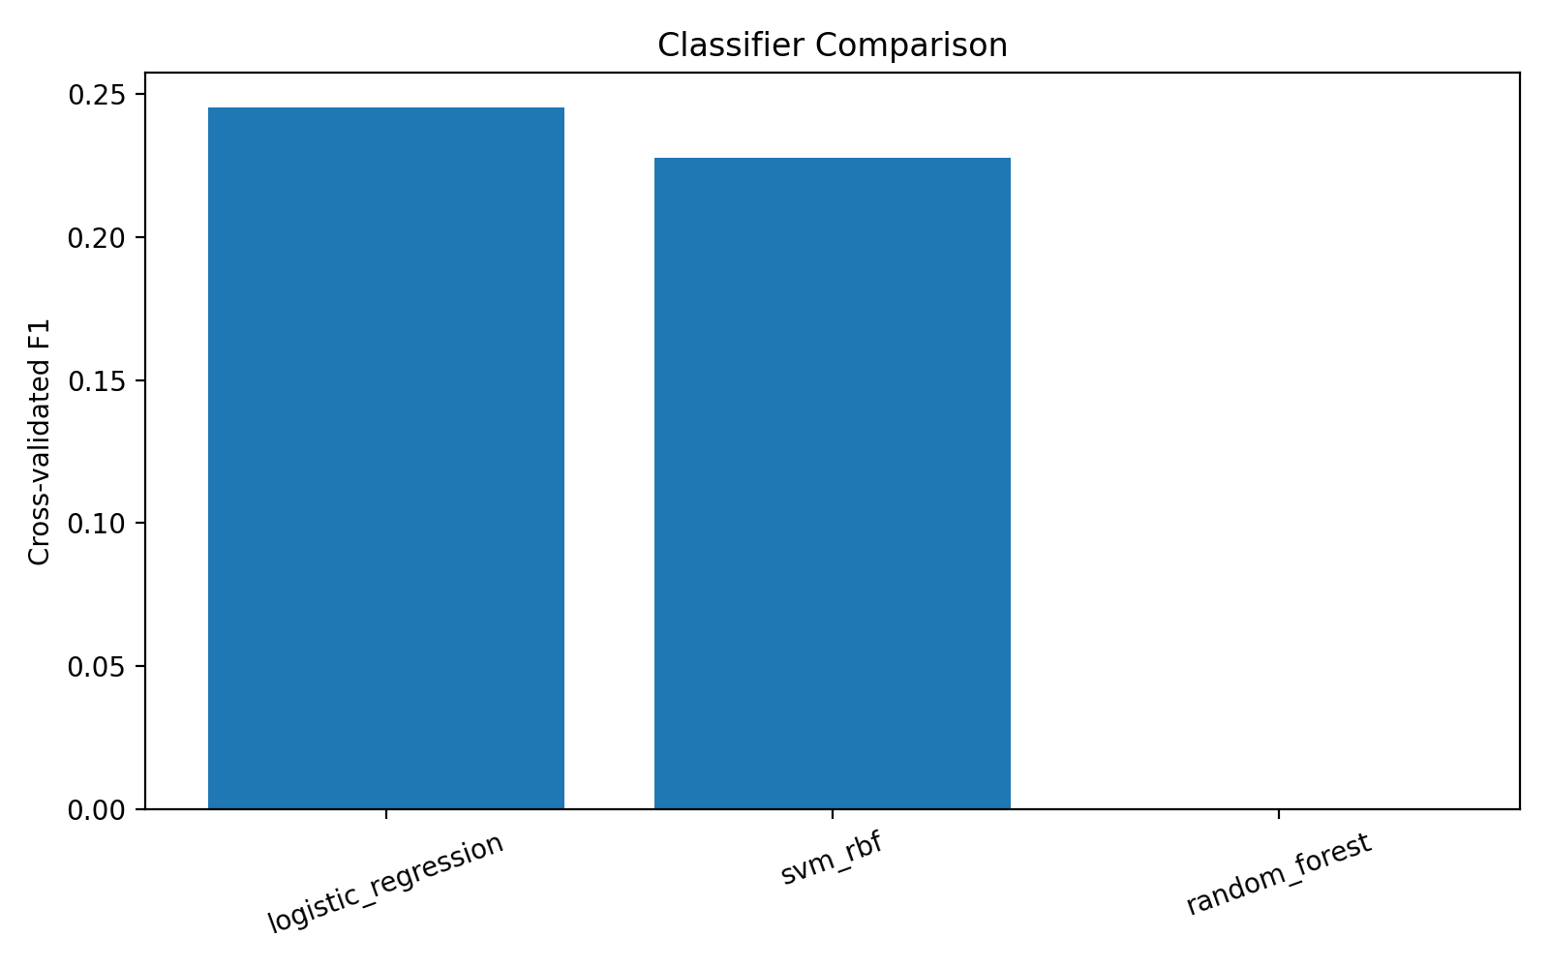
Classification result: Logistic Regression selected for delay risk
Best practical balance of interpretability, recall, F1, and ROC-AUC on the current sample.
0.271
0.667
test F1
test recall
0.725
47
test ROC-AUC
predicted delayed rows
Interpretation: Logistic Regression intentionally catches more true delays, accepting more false positives. This is reasonable when missed delays are costly for riders.
DATA 245 · Traditional ML · Public Transit Reliability
08
Notes:
Do not oversell the score. Say it is a prototype with promising ROC-AUC and high recall for the small labeled sample.

Slide 9
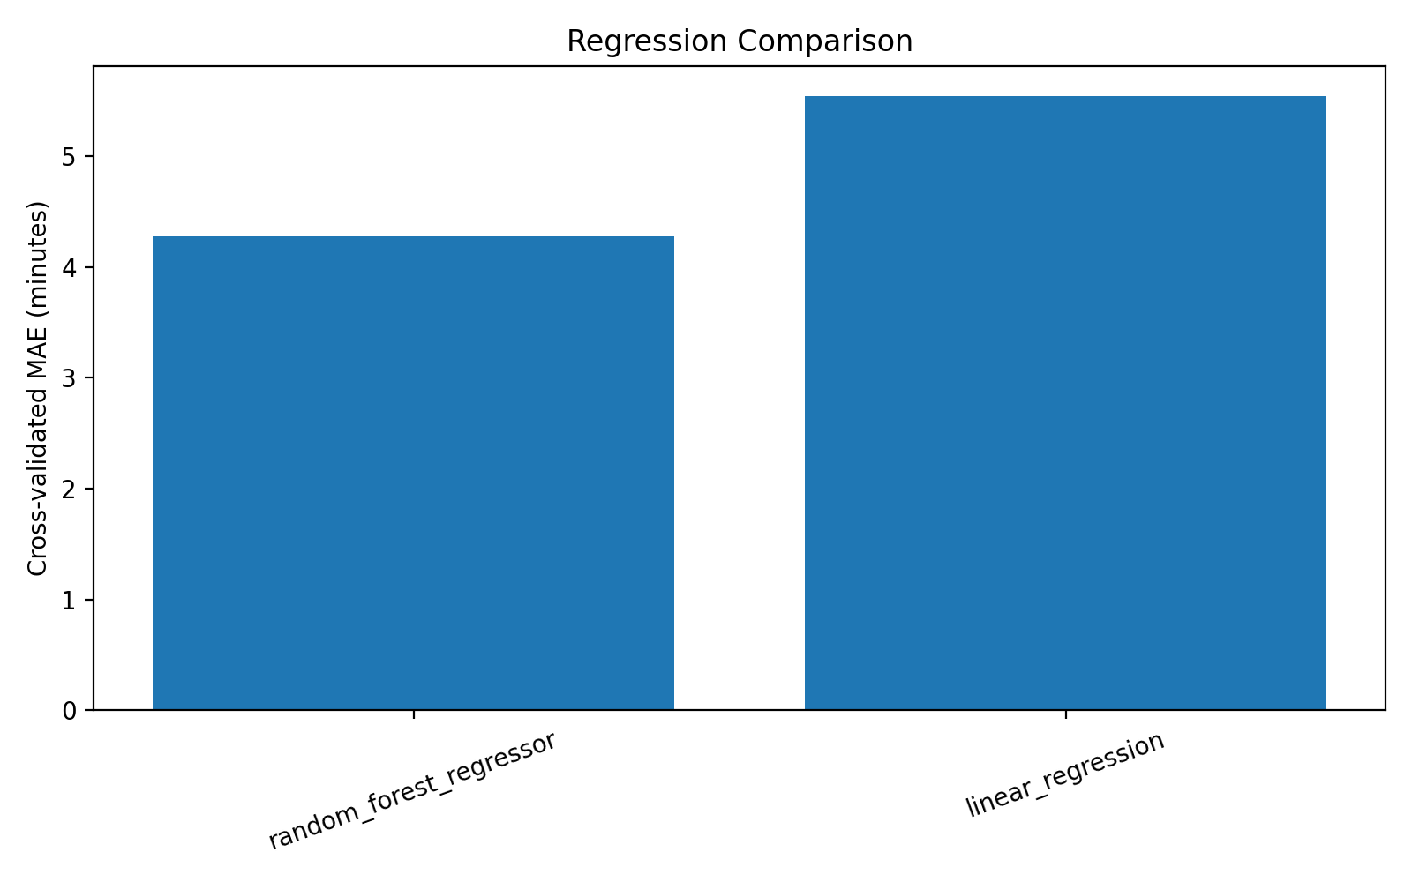
Regression result: Random Forest predicts delay minutes best
The regression model estimates how many minutes late a stop event may be.
4.94
17.61
test MAE minutes
test RMSE minutes
0.080
148
test R²
test rows
Interpretation: MAE is useful for demo-level planning, but RMSE shows that extreme delays remain hard to predict with limited labeled data.
DATA 245 · Traditional ML · Public Transit Reliability
09
Notes:
Explain the difference between MAE and RMSE. Say large rare delays drive RMSE.

Slide 10
Key drivers of unreliability
The most useful signals combine route identity, time patterns, trip position, speed, and occupancy.
TOP SIGNALS FROM MODEL OUTPUTS
Route identity
Rush-hour flag
Specific routes show stronger risk patterns.
Congestion-sensitive feature.
Weekend flag
Stop sequence
Schedule/reliability behavior differs on weekends.
Delay accumulates along a route.
Hour of day
Speed + occupancy
Time windows affect likelihood of delay.
Vehicle state adds realtime context.
Important: feature importance explains patterns in the current labeled sample; it is not a causal claim.
DATA 245 · Traditional ML · Public Transit Reliability
10
Notes:
This answers “identify the key drivers of unreliability.” Explain interpretation vs. causation.

Slide 11
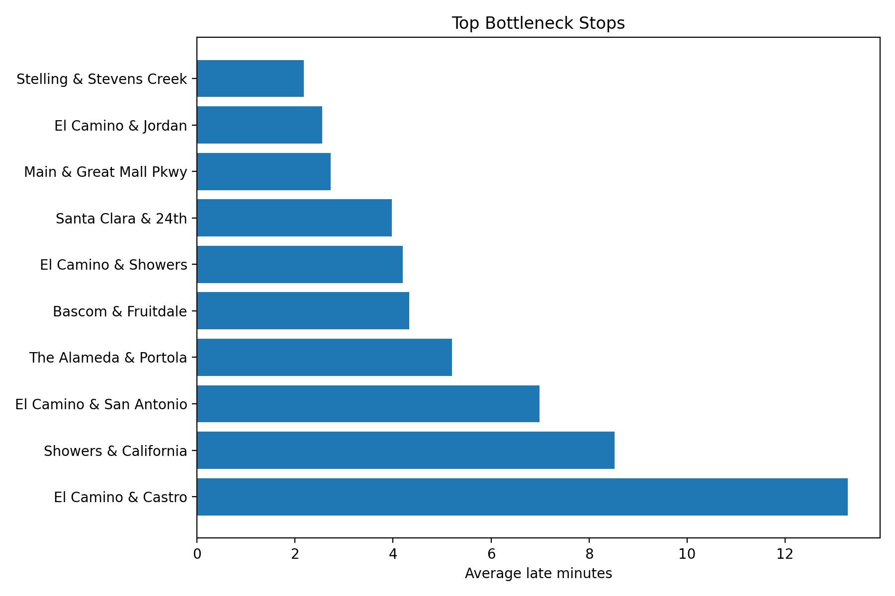
Clustering: geographic bottleneck stop candidates
K-Means groups stops by delay severity to find locations that deserve planner attention.
HIGHEST-RISK SAMPLE STOPS
1. El Camino & Castro
2. Showers & California
3. El Camino & San Antonio
4. The Alameda & Portola
5. Bascom & Fruitdale
6. El Camino & Showers
7. Santa Clara & 24th
Use these as a starting point for route-level review, not as definitive citywide bottlenecks until more realtime labels are collected.
DATA 245 · Traditional ML · Public Transit Reliability
11
Notes:
This slide supports visualization and clustering. Keep the limitation clear.

Slide 12
Frontend demo: delay risk dashboard
Streamlit wraps the saved models into a simple interface for quick project demonstration.
DEMO FLOW
VTA Delay Risk Dashboard
Select route, time, weekday/weekend, rush hour, speed, and occupancy.
Route 40
Rush hour
Full occupancy
Click predict to show delay-risk probability and predicted delay minutes.
Show feature importance and bottleneck-stop tables from saved outputs.
Delay risk
High
Delay
minutes
RUN COMMAND
python -m streamlit run app.py
Feature importance + bottleneck stops below
DATA 245 · Traditional ML · Public Transit Reliability
12
Notes:
Open Streamlit for the demo. Make sure to use python -m streamlit so the active .venv is used.

Slide 13
Code walkthrough: what each file does
The submitted code is organized into reproducible scripts instead of one large notebook.
1_prepare_modeling_data.py
4_cluster_stops.py
Creates modeling_dataset.csv and summary JSON.
Clusters stops and exports bottleneck-stop tables.
2_train_classifier.py
5_make_figures.py
Trains Logistic Regression, Random Forest, SVM; saves classifier.
Creates PNG charts for report and presentation.
3_train_regressor.py
app.py
Trains regression models; saves delay-minutes regressor.
Streamlit frontend for live risk prediction demo.
Suggested live walkthrough: config.py → prepare data → train classifier → show saved .joblib model → launch app.py.
DATA 245 · Traditional ML · Public Transit Reliability
13
Notes:
This supports the code walkthrough rubric item. Walk through the folder structure in VS Code during presentation.

Slide 14
Lessons learned and technical difficulties
The strongest learning came from data integration, imbalance, and honest evaluation.
TECHNICAL DIFFICULTIES
BEST PRACTICES DISCOVERED
GTFS-Realtime matching produced far fewer labeled examples than the full schedule table.
Start with a baseline model before tuning complex models.
Delay classes were imbalanced, so accuracy was not enough.
Save intermediate CSVs and summaries to make debugging easier.
Model files must be loaded in the same Python/sklearn environment used to train them.
Report limitations clearly rather than overclaiming.
Weather alignment needs the realtime observation date for defensible weather claims.
Use reproducible scripts and saved models for a quick demo.
Next step: collect more GTFS-Realtime snapshots over 2–4 weeks, rerun the exact scripts, and update the dashboard metrics.
DATA 245 · Traditional ML · Public Transit Reliability
14
Notes:
This directly addresses the lessons learned requirement.

Slide 15
Team roles and responsible AI disclosure
CRediT-style contribution statement plus transparent AI use.
CREDIT CONTRIBUTION STATEMENT
GENERATIVE AI DISCLOSURE
Naman Vipul Chheda
Data sourcing, cleaning, EDA, proposal development.
AI assistance was used for brainstorming project framing, slide drafting, debugging guidance, and packaging code. Final code, results, model decisions, and presentation claims must be reviewed and owned by the team.
Nikhil Kanaparthi
Feature engineering, baseline modeling, clustering, frontend integration.
Do not claim results that are not supported by outputs.
Naeem Mannan
Advanced modeling, tuning, evaluation, metrics interpretation.
List all AI tools used in the final report appendix.
Keep model/data limitations visible in Q&A.
DATA 245 · Traditional ML · Public Transit Reliability
15
Notes:
This addresses CLO 8 and the required CRediT statement.

Slide 16
Appendix: rubric criteria and evidence checklist
Listed in the same order as the assignment. Replace placeholder links before submission.
Code Walkthrough
Slide 13; scripts 1–6 + app.py submitted.
Presentation Skills
Timed story: problem → data → models → demo → limitations.
Discussion / Q&A
Backup explanation on imbalance, metrics, weather limitation.
Demo
Streamlit app.py + saved .joblib models.
Visualization
Slides 5, 8, 9, 11; generated PNG figures.
Version Control
Add public GitHub URL here before submitting.
Lessons learned
Slide 14.
Teamwork
Slide 15 CRediT statement.
Pair programming
Add screenshot/notes if practiced; otherwise do not claim.
Agile / Scrum
Add Trello/sprint backlog/meeting minutes if available.
Slides
This deck.
Saved model
Classifier 5.7 KB; regressor 6.8 MB — cloud link recommended for regressor.
Creative presentation
Live dashboard demo + visual ML pipeline.
Honesty note: Do not claim GitHub, agile/scrum, or pair programming points unless accessible evidence is added.
DATA 245 · Traditional ML · Public Transit Reliability
16
Notes:
Before submitting, update this appendix with accessible evidence links.

Slide 17
Appendix: submission package checklist
Use this slide to avoid missing Canvas requirements.
UPLOAD TO CANVAS
EVIDENCE LINKS TO ADD
Presentation deck: .pptx or exported .pdf.
GitHub repository URL.
Code files: .py scripts and app.py; include notebook + converted .py if using notebooks.
Trello or sprint backlog link if claiming agile/scrum.
Small model file: delay_risk_classifier.joblib can be uploaded directly.
Pair programming evidence if claiming it.
Large model file: delay_minutes_regressor.joblib should be shared by accessible cloud link if Canvas size is an issue.
Model file cloud link if not directly uploaded.
Presentation close: “Our prototype identifies delay risk and bottleneck patterns, but the next data collection cycle is needed for stronger production-level performance.”
DATA 245 · Traditional ML · Public Transit Reliability
17
Notes:
Use this as a final check before submission.

