Slide 1

SMART INDIA HACKATHON 2026
TITLE PAGE
Problem Statement ID – SIH26119
Problem Statement Title- Indigenous GPU-Accelerated Optimization Solver (Sovereign Alternative to Express / CEPLEX)
Theme- Smart Automation
PS Category- Software
Team ID- 127364
Team Name (Registered on portal)- VIGHNAX

Slide 2
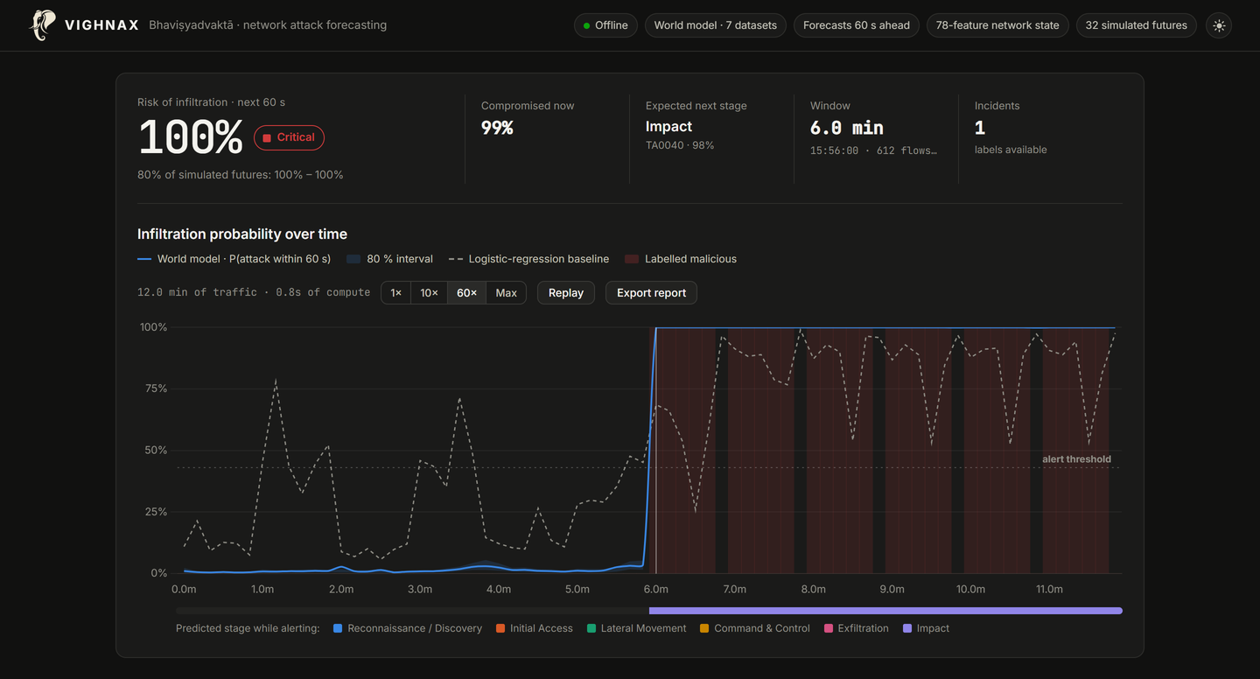
SAMADHAN: a sovereign, GPU-first optimization solver built from scratch
VIGHNAX
Proposed Solution (Describe your Idea/Solution/Prototype)
Detailed explanation of the proposed solution
Own solver core, no borrowed engine: MPS reader, scaling and every algorithm written by us; no CPLEX, Gurobi, Xpress, HiGHS or CBC code inside
GPU LP engine (working today): restarted primal-dual hybrid gradient (PDLP); needs only sparse matrix-vector products, so it runs fully on an NVIDIA GPU
MILP started, QP next: our branch-and-bound on our own simplex already proves the same optimum as HiGHS on 10/10 refinery MILPs; cuts, heuristics and QP follow
How it addresses the problem
Built for refinery planning: solves crude-blending and product-dispatch LPs up to 1.2 million variables on a laptop GPU
Faster where it matters: on the largest model, 5.1× faster than HiGHS with cost within 0.00016% of optimal; 22× faster in fast mode
Innovation and uniqueness of the solution
GPU-first, factorisation-free: memory-light and massively parallel, scales past the limits of simplex and interior point
Transparent and tunable: open, auditable code that Indian engineers can inspect and adapt to MRPL's own models
Working prototype; same models, same laptop. Each solver credited with its faster method.
5.1×
faster than HiGHS on 1.2M variables
22×
faster in fast mode (1e-4)
0.00019%
worst cost error vs optimum (1e-6)

Slide 3
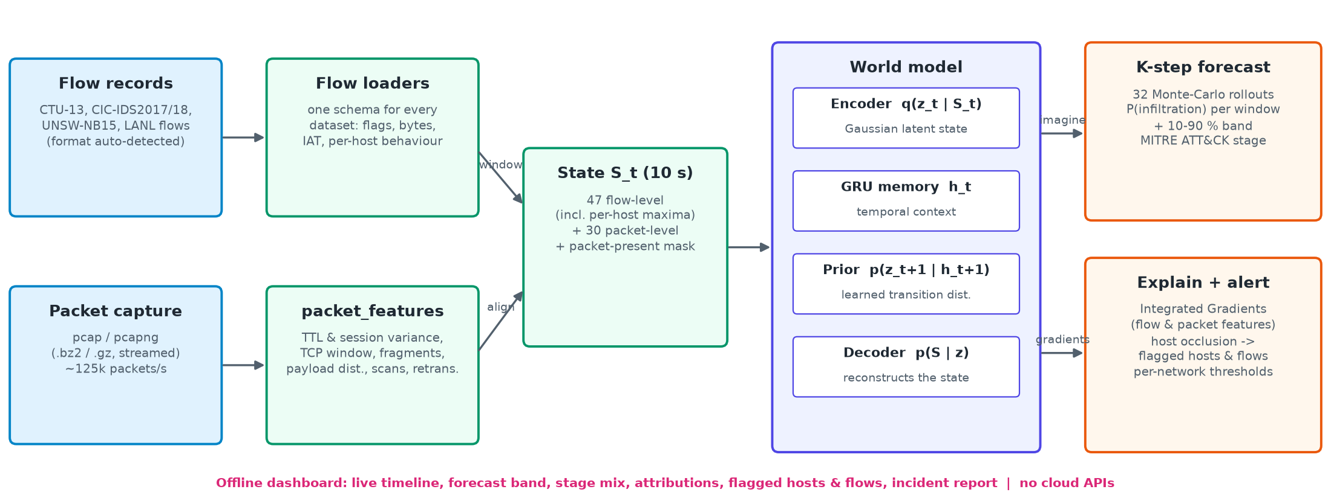
TECHNICAL APPROACH
VIGHNAX
Technologies to be used
Solver core: Python 3 + PyTorch CUDA sparse kernels (prototype), moving hot loops to C++/CUDA; NumPy/SciPy only as data containers
Interfaces: Python API, command-line tool, MPS/LP files; REST service for plant planning systems
Hardware: any NVIDIA GPU (tested on RTX 5050 Laptop, 8 GB); the same code runs on CPU-only servers
Methodology and process for implementation
Model input
MPS / LP files, Python API, MRPL planning data
Scaling
Ruiz and Pock-Chambolle equilibration (presolve added in build phase)
GPU LP engine
restarted PDHG, adaptive steps and restarts, all on CUDA
Polish + crossover
dual simplex on CPU for exact vertex solutions
Result + audit
solution, duals, KKT certificate, logs
MILP layer: branch-and-bound on our own simplex (built; exact on 10/10 test MILPs). Next: cuts (Gomory, MIR, cover), presolve, heuristics (feasibility pump, RINS), GPU LP for large relaxations
QP layer: primal-dual QP (PDQP) on the same GPU kernels; later MIQP and NLP
Legend
■ built and tested today
■ planned, SIH build phase
Every stage is our own code. HiGHS is used only as an outside benchmark to check answers and speed.

Slide 4
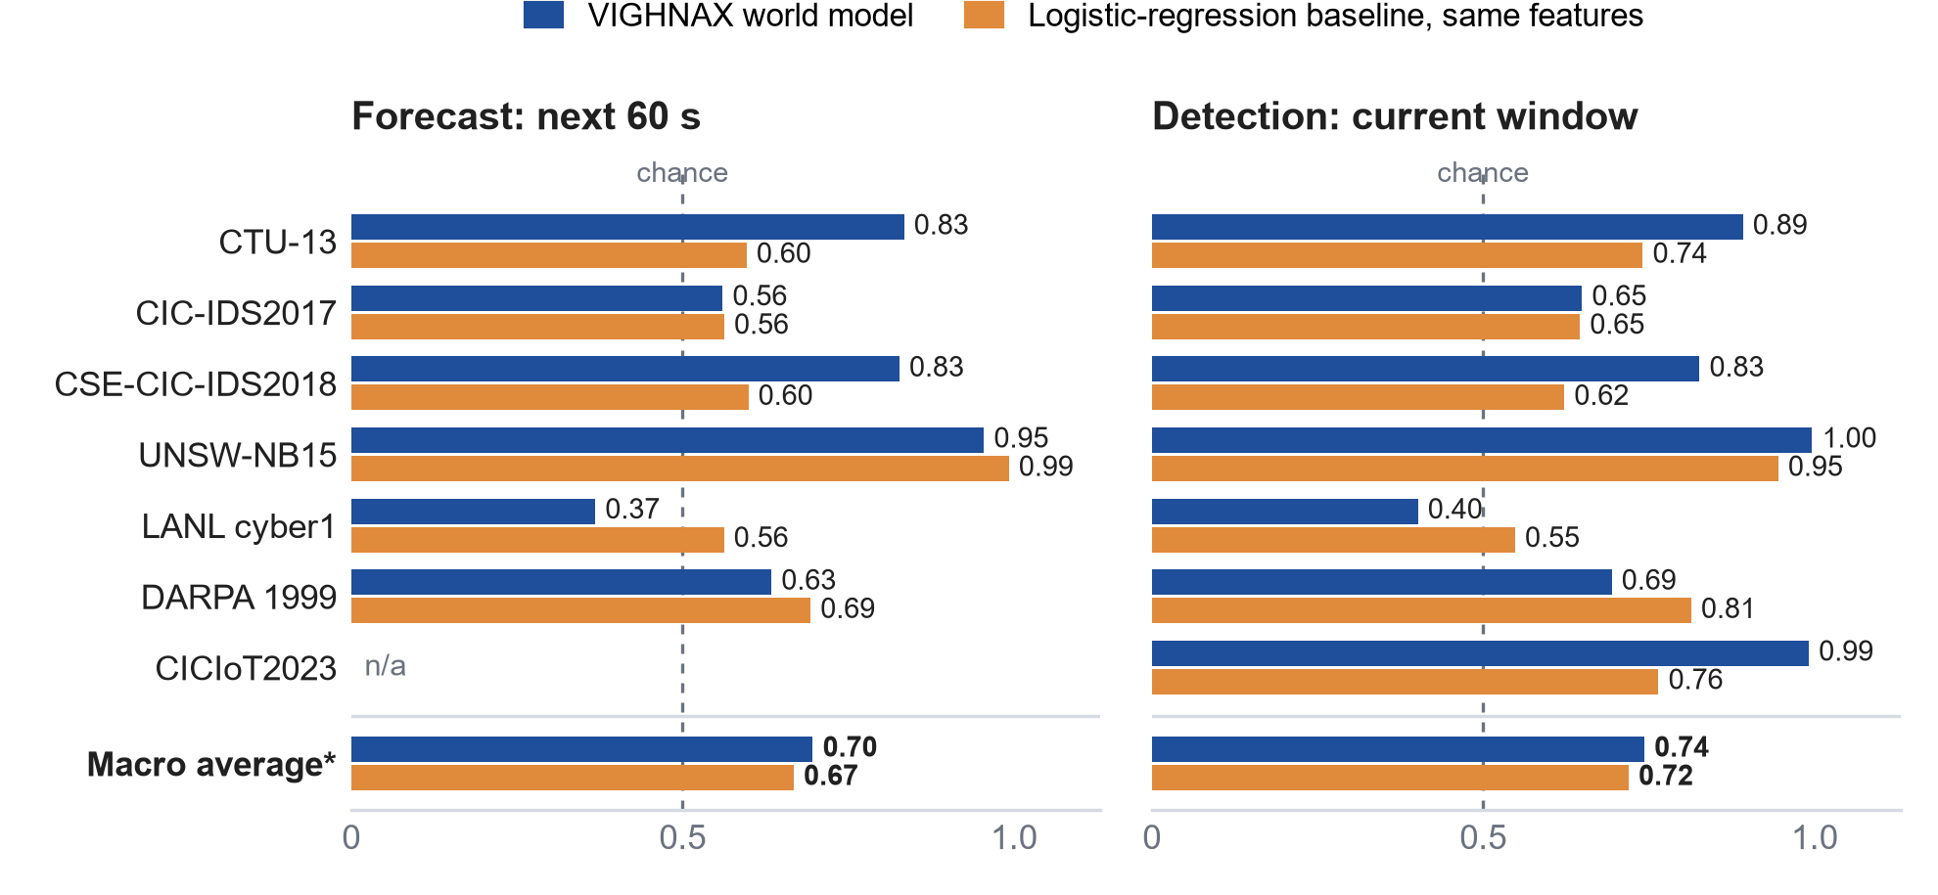
FEASIBILITY AND VIABILITY
VIGHNAX
Analysis of the feasibility of the idea
Already working: every refinery test LP solved, cost within 0.00019% of the true optimum
Modest hardware: 1.2M variables, 2.3M nonzeros on one 8 GB laptop GPU
Proven, published algorithms: PDLP-type methods are peer-reviewed and used in commercial solvers
Clear plan: LP done, MILP working on small models; cuts, QP and scale-up next
Risk | How we handle it
First-order methods give moderate accuracy | Restarts and tight KKT checks, then simplex crossover for exact vertices
Hard MILPs need years of tuning | Start with the MIPLIB 'easy' set and refinery MILPs; add cuts and heuristics step by step
Degenerate or ill-conditioned models | Ruiz scaling, float64, presolve; crossover for Netlib's hard cases (pilot4, perold, greenbea)
No GPU at a site | Same code runs on CPU; GPU only where it is measurably faster
Netlib: 86/91 LPs solved to 1e-4 relative KKT (80 within 0.1% of optimum); MPS reader matches HiGHS on 91/91. The 5 left are ill-conditioned cases for our simplex crossover.
MILP: 10/10 refinery MILPs proven optimal by our branch-and-bound, same cost as HiGHS.
Refinery LP | Variables | Nonzeros | HiGHS (best) | Accurate 1e-6 | Cost error | Speed-up | Fast 1e-4 | Cost error | Speed-up
Size S | 13,296 | 25,416 | 0.2 s | 2.2 s | 0.000069% | 0.1× | 0.7 s | 0.013% | 0.3×
Size M | 109,536 | 214,092 | 8.5 s | 12.6 s | 0.00019% | 0.7× | 1.8 s | 0.017% | 4.8×
Size L | 406,080 | 796,512 | 63.9 s | 30.7 s | 0.000035% | 2.1× | 5.3 s | 0.015% | 12×
Size XL | 1,157,120 | 2,273,888 | 323 s | 63.7 s | 0.00016% | 5.1× | 15.0 s | 0.070% | 22×
Measured today on one laptop (RTX 5050 8 GB GPU). HiGHS: faster of dual simplex and interior point, all CPU threads. SAMADHAN: faster of its two GPU methods, at 1e-6 or 1e-4 relative KKT. Cost error vs HiGHS optimum.

Slide 5
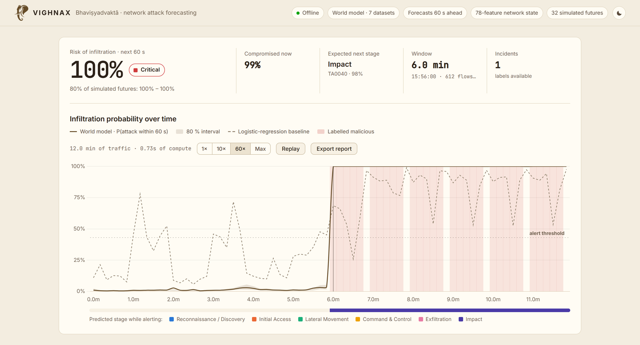

IMPACT AND BENEFITS
VIGHNAX
Potential impact on the target audience
MRPL and other refineries: faster crude selection, blending and dispatch plans; more what-if scenarios per planning cycle
Power, logistics, steel, railways: the same engine serves unit commitment, routing and production planning
Strategic users: runs air-gapped and on-premise, with no licence server and no data leaving the site
Benefits of the solution (social, economic, environmental, etc.)
Economic
No per-core or per-user licence fees; GPU speed-ups cut planning time
Sovereignty
Indian-owned solver code that can be audited, changed and certified
Refinery planning LPs from 13k to 1.16M variables. The gap widens with size, which is where real plant-wide models live.
Environmental
Better crude and energy plans mean less fuel, flaring and waste
Social
Builds Indian skills in optimisation software, a rare capability
Every licence we replace is money saved each year, and every model we solve in-house stays under Indian control.

Slide 6


RESEARCH AND REFERENCES
VIGHNAX
Details / Links of the reference and research work
LP on GPUs (our core)
PDLP: Applegate, Díaz, Hinder, Lu, Lubin, O'Donoghue, Schudy, Practical Large-Scale Linear Programming using Primal-Dual Hybrid Gradient, NeurIPS 2021
cuPDLP: Lu & Yang, cuPDLP.jl: A GPU Implementation of Restarted PDHG for Linear Programming, arXiv:2311.12180 (2023)
PDHG and scaling: Chambolle & Pock, J. Math. Imaging Vision 40 (2011); Ruiz, A scaling algorithm to equilibrate both rows and columns norms in matrices, RAL-TR-2001-034
MILP and QP (build phase)
Branch-and-cut: Achterberg, Constraint Integer Programming, PhD thesis, TU Berlin (2007); Bixby, A Brief History of Linear and Mixed-Integer Programming Computation, Doc. Math. (2012)
Dual simplex: Huangfu & Hall, Parallelizing the dual revised simplex method, Math. Prog. Comp. 10 (2018)
QP: Lu & Yang, A Practical and Optimal First-Order Method for Large-Scale Convex QP (PDQP), arXiv:2311.07710; Stellato et al., OSQP, Math. Prog. Comp. 12 (2020)
Benchmarks the PS asks for
MIPLIB 2017: Gleixner et al., Math. Prog. Comp. 13 (2021), miplib.zib.de
Netlib LP and Mittelmann benchmarks: netlib.org/lp • plato.asu.edu/bench.html
Source code and benchmarks
github.com/NAMAN-THAKUR-1944/
SIH2026-SIH26119-SAMADHAN
Reproduce every number
python -m samadhan demo --size L
python bench_final.py S M L XL
python bench_netlib.py
python bench_milp.py

