Slide 1

SMART INDIA HACKATHON 2026
TITLE PAGE
Problem Statement ID – SIH26153
Problem Statement Title- AI based Network Attack Forecasting from Network Traffic Data
Theme- Blockchain & Cybersecurity
PS Category- Software
Team ID- 127364
Team Name (Registered on portal)- VIGHNAX

Slide 2
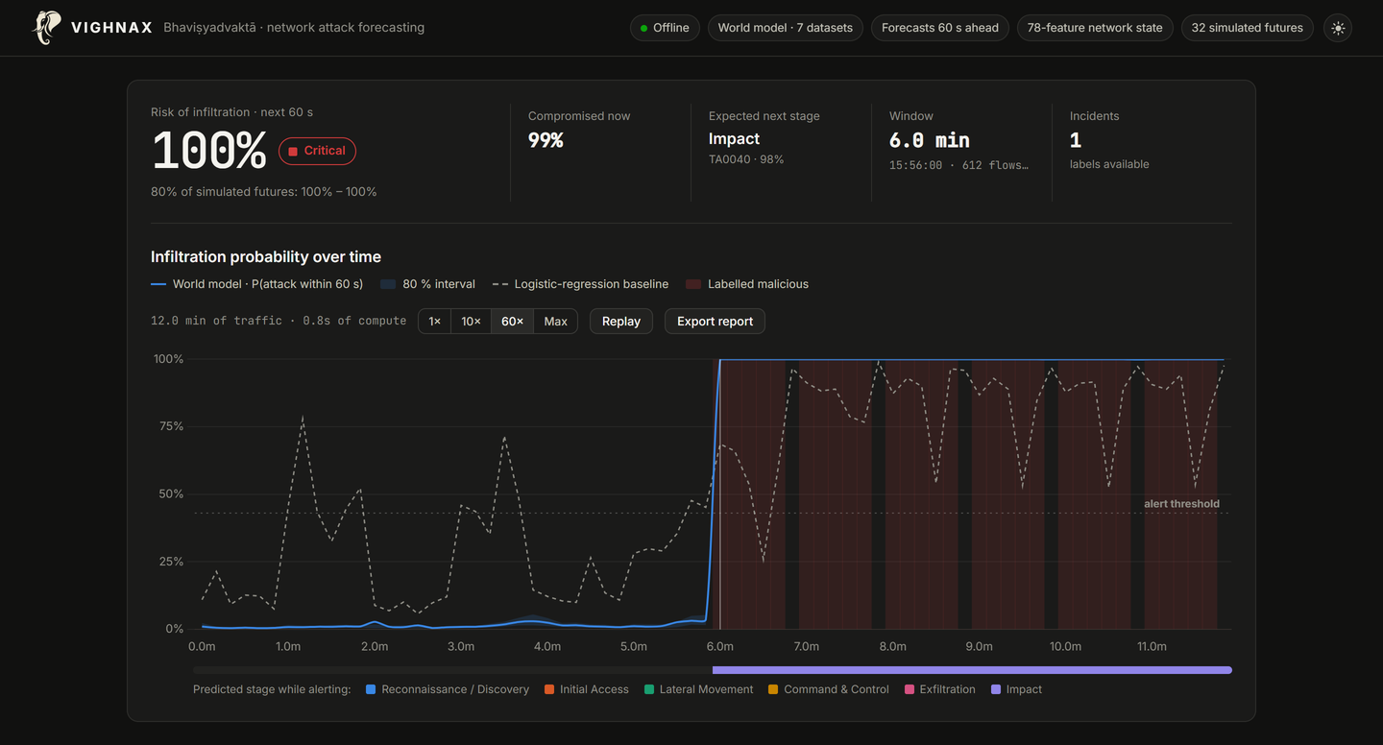
VIGHNAX: a world model that forecasts network attacks before they complete
VIGHNAX
Proposed Solution (Describe your Idea/Solution/Prototype)
Detailed explanation of the proposed solution
A world model of the network: every 10 s it reads a 78-feature state from flow records and/or packets
Simulates 32 futures, 60 s ahead: attack probability with an uncertainty band, and the next MITRE ATT&CK stage
Explains every alert: Integrated Gradients, plus the hosts and flows responsible
How it addresses the problem
Early warning, not after-the-fact detection: 54 of 201 unseen attack onsets forecast before they began (baseline: 17)
One model, all seven PS datasets: tested only on days, captures and botnets it never saw
Innovation and uniqueness of the solution
'What-if' simulation of the whole network, not a per-flow classifier
Answers who, not only what: re-forecasting without each host ranks the hosts behind an alert
Air-gap ready: laptop CPU, SHA-256-verified weights, one-click incident report
Working prototype on an unseen CIC-IDS2017 day: risk turns critical as the DDoS begins.
54/201
attack onsets warned before they began
3.2×
more early warnings than the baseline (17)
~8 ms
per 10 s window on a laptop CPU

Slide 3
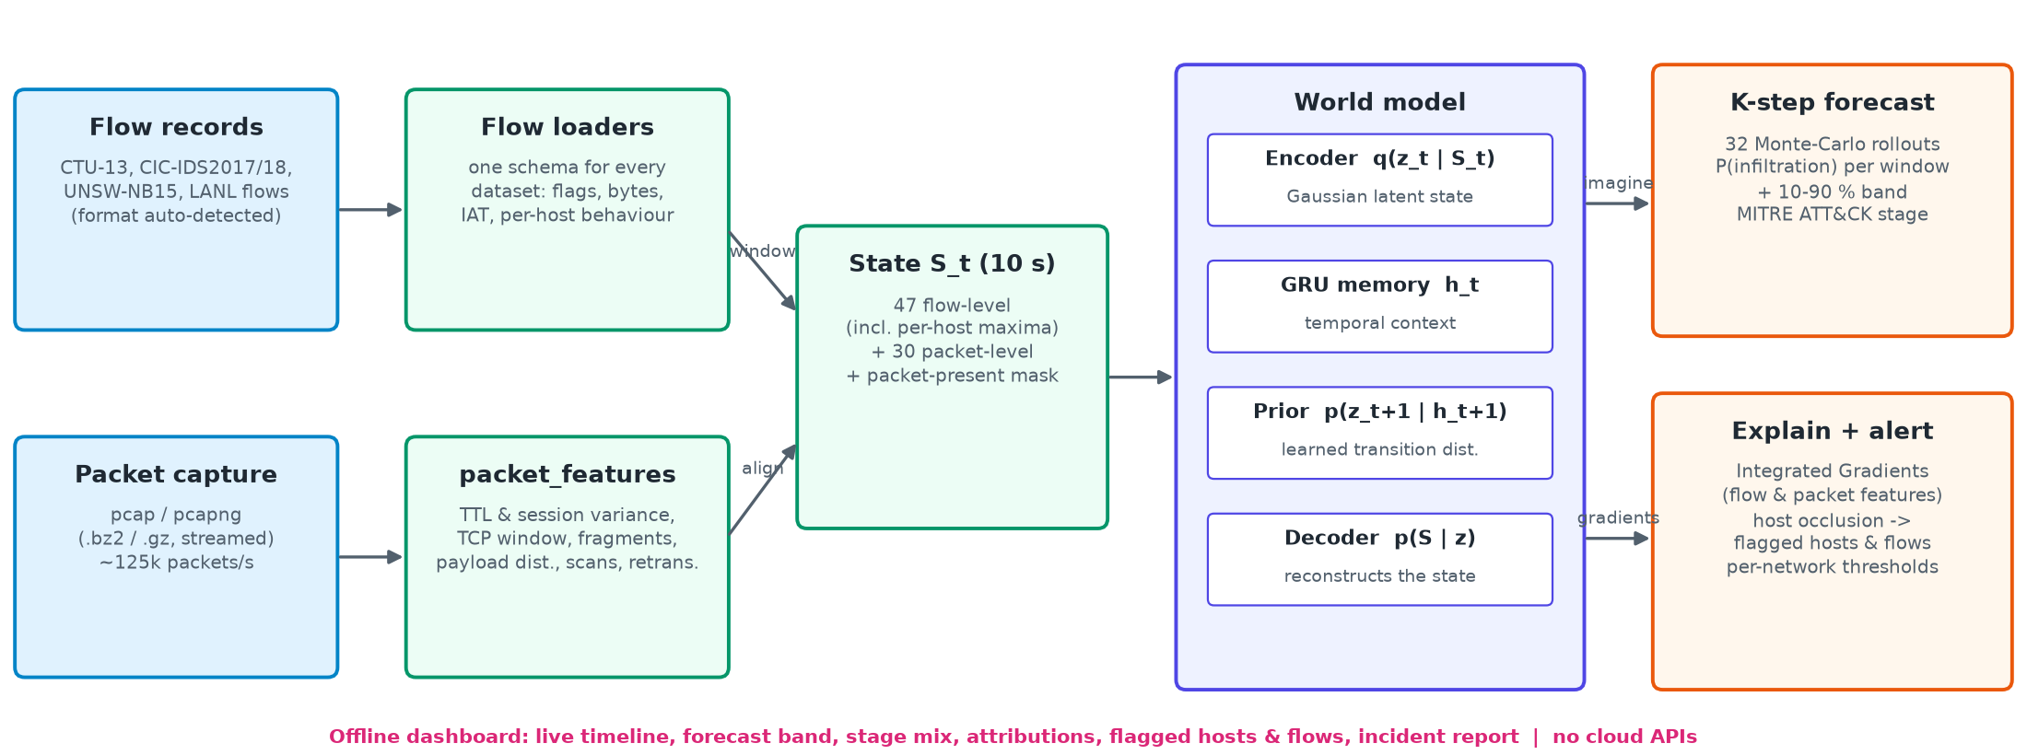
TECHNICAL APPROACH
VIGHNAX
Technologies to be used (e.g. programming languages, frameworks, hardware)
Model: Python, PyTorch (world model), scikit-learn (baseline); dpkt / Scapy for PCAP, pandas / NumPy
Interface: Flask + Chart.js dashboard with bundled fonts and scripts, no internet or cloud API
Hardware: any laptop CPU (~8 ms per 10 s window); a GPU only speeds up training
Methodology and process for implementation (Flow Charts/Images/ working prototype)

Slide 4
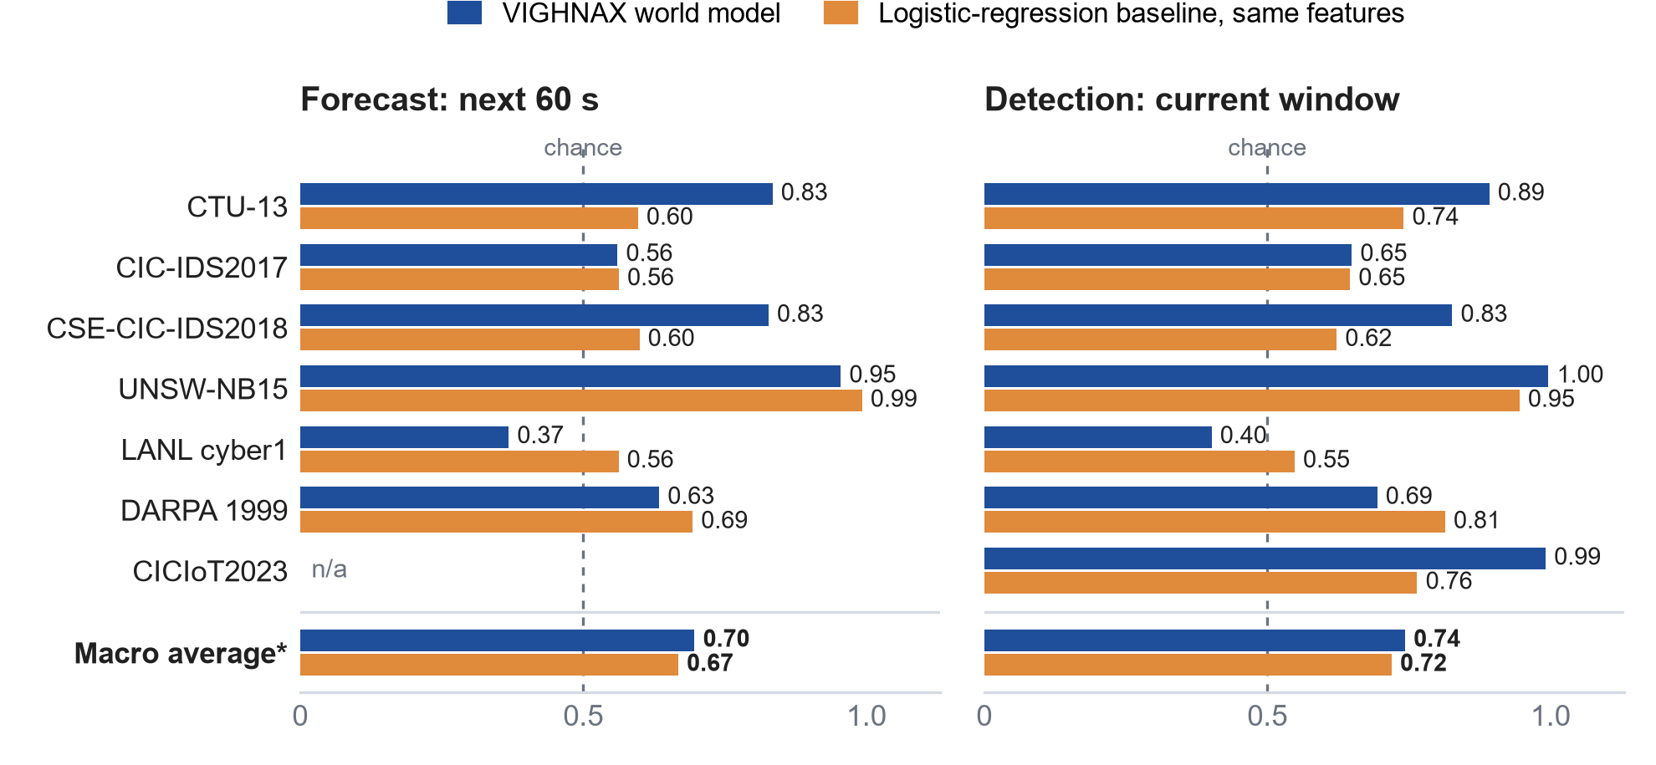
FEASIBILITY AND VIABILITY
VIGHNAX
Analysis of the feasibility of the idea
Already built: working prototype, trained weights and the full benchmark are public on GitHub
Tested on unseen data: macro forecast AUROC 0.70 vs 0.67 for the baseline, detection 0.74 vs 0.72
Fast and light: one laptop CPU core processes traffic over 1,000× faster than real time
Easy to deploy: one-click launch; PCAP or flow CSV in; no GPU, cloud or internet needed
Honest evaluation: scored only on traffic it never saw; weaker results are shown, not hidden
AUROC on unseen test data; 0.5 = chance. CICIoT2023 episodes are composed, so only detection is scored. *Mean over the six temporal datasets.
Potential challenges and risks | Strategies for overcoming these challenges
Some attack types: weak on LANL (authentication-based red team), behind the baseline on DARPA 1999 | Authentication-log and per-host modelling; these limits are reported openly, not hidden
New networks: more false alarms where the model was not calibrated; behaviour drifts over time | Per-network alert calibration on the site's own traffic (built in); periodic retraining
Encryption: payloads are hidden in encrypted traffic | Flow-level features need no payload, so the model works on encrypted and flow-only input

Slide 5
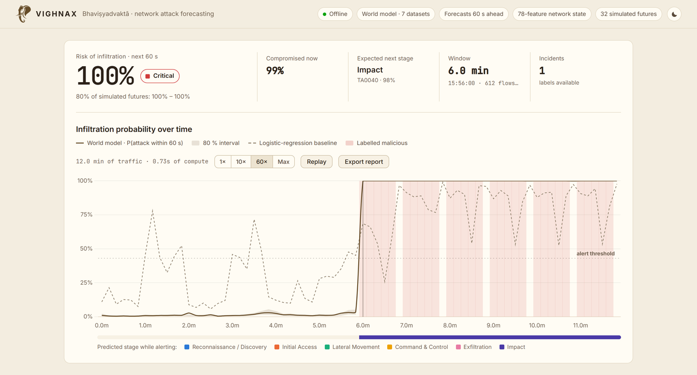

IMPACT AND BENEFITS
VIGHNAX
Potential impact on the target audience
Early warning for NTRO, NCIIPC, CERT-In and critical-infrastructure SOCs, with time to isolate hosts
Faster triage: every alert comes with its reasons and the hosts and flows behind it
Deployable anywhere: air-gapped, on ordinary hardware, including classified networks
Benefits of the solution (social, economic, environmental, etc.)
Security
Earlier containment of botnets, DDoS and lateral movement on national infrastructure
Social
Protects power, banking, health and e-governance services that citizens use
A real CIC-IDS2017 day never seen in training: risk stays low for six minutes, then goes critical as the DDoS starts; the baseline (dashed) raises false spikes.
Economic
Open source: no licence or cloud cost; one CPU core per network segment
Sovereignty
Indigenous, auditable AI; verified weights; no data leaves the network
Watch the 2-minute demo
https://youtu.be/pPTe-d_TByU
Scan the code or click the link

Slide 6

RESEARCH AND REFERENCES
VIGHNAX
Details / Links of the reference and research work
Research
World models: Ha & Schmidhuber, World Models (2018); Hafner et al., recurrent state-space model, Learning Latent Dynamics for Planning from Pixels, ICML 2019
Explainability: Sundararajan, Taly & Yan, Axiomatic Attribution for Deep Networks (Integrated Gradients), ICML 2017
Attack stages and guidance: MITRE ATT&CK Enterprise matrix (attack.mitre.org); NCIIPC (nciipc.gov.in)
Datasets: all seven named in the PS
CTU-13 (Garcia et al., 2014) · CIC-IDS2017 (Sharafaldin et al., 2018) · CSE-CIC-IDS2018 (CIC & AWS, 2018) · UNSW-NB15 (Moustafa & Slay, 2015)
LANL cyber1 (Kent, 2015) · DARPA 1999 (Lippmann et al., 2000) · CICIoT2023 (Neto et al., 2023)
Our work
Source code, weights, benchmark: https://github.com/NAMAN-THAKUR-1944/SIH2026-SIH26153-VIGHNAX
Demo video (2 min): https://youtu.be/pPTe-d_TByU
Reproducible: one configuration (configs/default.yaml, seed 42); python evaluate.py regenerates every number in this deck from the public datasets
Source code
GitHub · weights · benchmark
Demo video
YouTube · 2 minutes

