Slide 1
VIGHNAX — forecasting attacks before they complete
SIH 2026 · SIH26153 (NTRO) · AI-based Network Attack Forecasting from Network Traffic Data · Team VIGHNAX (127364)
Problem: IDS models label each flow in isolation and fire after the fact; an infiltration is a process unfolding over time.
Idea: learn a world model of network state dynamics P(S_t+1 | S_≤t) from flow + packet telemetry, and simulate K steps ahead.
Output: P(infiltration in next 60 s) with an uncertainty band, predicted MITRE ATT&CK stage, driving features, flagged hosts/flows.
Evidence: one model, all 7 PS datasets, unseen test data: forecast macro AUROC 0.70 vs 0.67 (LR); 54/201 attack onsets forecast before they began (LR 17).
Practical: open source (MIT), fully offline: ~8 ms per 10 s window on a laptop CPU, 0.04 ms batched on GPU; ~125k packets/s ingestion.

Slide 2
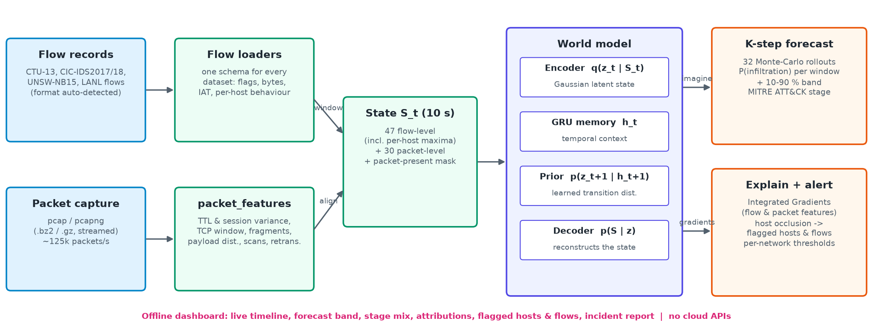
Architecture: telemetry → network state → world model → forecast
any PS dataset format or PCAP · flow-level + packet-level features fused into S_t every 10 s (78 dims)
Flow level: 5-tuple, flags, bytes, packets, duration, IAT, fwd/bwd ratios + per-host maxima (a single bot is not diluted).
Packet level: TTL & session variance, TCP window, fragments, payload distribution, port-scan signatures, retransmissions.

Slide 3
World model: learn the dynamics, then imagine the future
RSSM-style latent state-space model (cf. World Models, Dreamer), trained on seven datasets' attack timelines
Transition model: encoder q(z_t|S_t), GRU memory h_t, prior p(z_t+1|h_t+1) (learned transition distribution), decoder p(S|z).
Supervised dynamics: attack + ATT&CK-stage heads trained on observed states AND on imagined K-step rollouts against the true future labels.
Forward simulation: 32 Monte-Carlo trajectories, K = 6 x 10 s: probability per future window, 10–90 % band, stage mix.
Explainability: Integrated Gradients (Aumann–Shapley/SHAP family) vs a benign reference state; host-occlusion flags the responsible hosts.
Robustness: dataset-balanced training, modality dropout (CSV-only inputs), volume augmentation, per-site alert calibration.
Stages: Recon · Initial Access · Lateral Movement · C2 · Exfiltration · Impact — all present across the seven datasets.

Slide 4
Results: seven datasets, test data unseen in training
AUROC world model / logistic regression on the same features; thresholds calibrated on validation only
Dataset (unseen test data) | Forecast WM / LR | Early warning WM / LR | Detection WM / LR
CTU-13 | 0.83 / 0.60 | 0.82 / 0.48 | 0.89 / 0.74
CIC-IDS2017 | 0.56 / 0.56 | 0.47 / 0.47 | 0.65 / 0.65
CSE-CIC-IDS2018 | 0.83 / 0.60 | 0.57 / 0.55 | 0.83 / 0.62
UNSW-NB15 | 0.95 / 0.99 | 0.63 / 0.71 | 1.00 / 0.95
LANL cyber1 | 0.37 / 0.56 | 0.34 / 0.57 | 0.40 / 0.55
DARPA 1999 | 0.63 / 0.69 | 0.60 / 0.61 | 0.69 / 0.81
CICIoT2023 | n/a | n/a | 0.99 / 0.76
Macro average (temporal) | 0.70 / 0.67 | 0.57 / 0.57 | 0.74 / 0.72
Forecasting: ahead on 2/6 datasets; early warning ahead on 2/6.
Before onset: 54/201 attacks forecast before they began (LR 17).
Honest: detection: LR better on LANL cyber1, DARPA 1999.
Note: CICIoT2023 episodes are composed, so detection only.

Slide 5
Demo, deployment and next steps
python server.py → http://127.0.0.1:5000 (no internet needed)
Demo: drop any PS dataset file or PCAP (format auto-detected) or pick one of 8 bundled real captures → timeline, forecast fan, ATT&CK stage mix, IG attributions and flagged hosts & flows all update live as each window is processed.
Reproducible: fetch_datasets.sh → prepare_data.py / prepare_all.py → train.py → evaluate.py; seeded YAML config; weights + results in the repo; pytest suite.
Enterprise / CII fit: streams captures in bounded memory, CPU or GPU, fully offline, explains every alert, per-site threshold profiles.
Limitations: CICIoT2023 episodes are composed; LANL labels come from authentication-based red-team events; alert thresholds need per-site calibration.
Next: graph (host-level GNN) state, online threshold calibration, streaming NetFlow/IPFIX collector, SOC integration (syslog/STIX).

