Slide 1




JANSEVA-X
From citizen intent to completed government application.
Intent
Consent
Completion
Intent-first. Consent-based. Officer-controlled.

Slide 2


THE HUMAN PROBLEM
The citizen should not have to
learn the system before using it.
Every extra step turns a simple public service into a test of patience, memory, and persistence.
01
Deadlines become pressure.
Urgency rises when the next step is unclear.
02
Repeated fields create frustration.
Document hunting slows everything down.
03
Queues add uncertainty.
The burden is not just paperwork.
It is uncertainty at every step.
Without clear status, citizens are left waiting and wondering.
A better public service starts with less cognitive load. 01 / THE CASE FOR GUIDANCE

Slide 3




THE CITIZEN JOURNEY
The need is simple. The journey is fragmented.
A straightforward request becomes a sequence of portals, requirements, documents, and repeated data entry.
01
02
03
Understand requirements
Find the right portal
Gather documents
The first challenge is knowing where to begin.
Guidance is scattered before the application even starts.
Proof, forms, and records must be assembled manually.
Then the same information is entered repeatedly — across disconnected steps.

Slide 4




JANSEVA-X · THE POSITIONING
Tell JANSEVA-X what you need.
From navigating portals to completing an intent-led public-service journey.
01
Intent replaces portal hunting
Citizens describe the outcome they need; JANSEVA-X routes the application.
02
Consent keeps control visible
Every next step is clear, deliberate, and owned by the citizen.
One guided journey. The right service, at the right moment.
The citizen starts with a need — not a department.

Slide 5



JANSEVA-X · PRODUCT WORKFLOW
What JANSEVA-X actually does
A guided public-service journey from citizen intent to officer-owned completion.
01 · UNDERSTAND
02 · PREPARE
03 · COMPLETE
Start with intent
Build with consent
Move to resolution
Citizens explain what they need in their own words, by voice or text.
JANSEVA-X prepares the application and smartly assembles the right attachments.
Citizens draft, track, and complete requests with clear officer ownership.
•Service discovery made simple
•Consent stays visible and explicit
•Status stays easy to follow
•Guided routing to the right service
•Fewer gaps before submission
•Every request has an owner

Slide 6
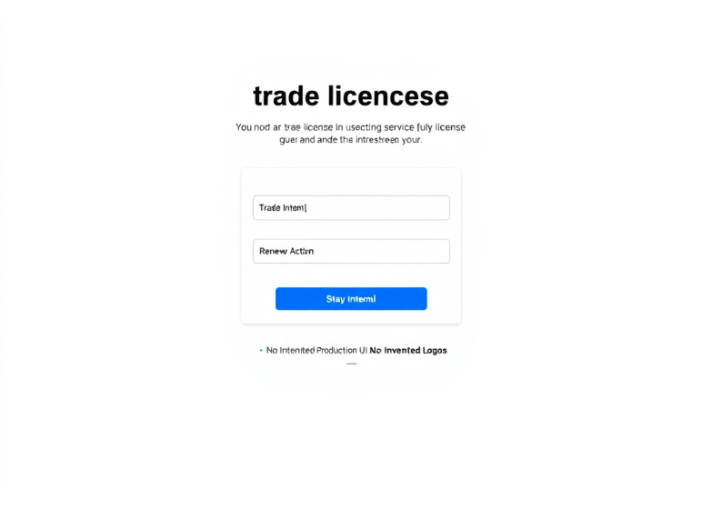
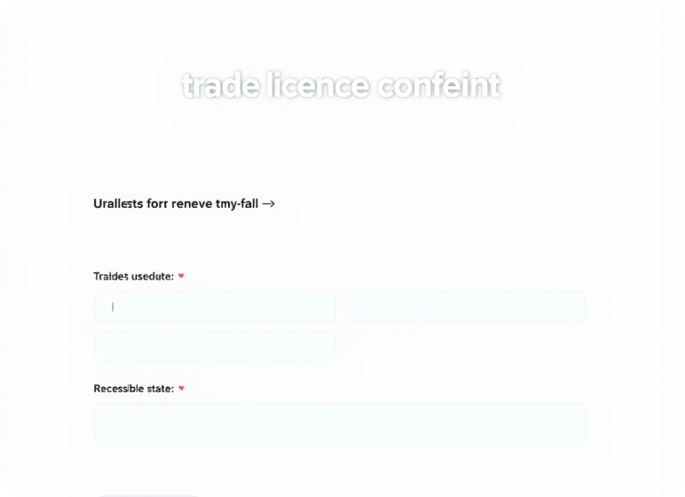
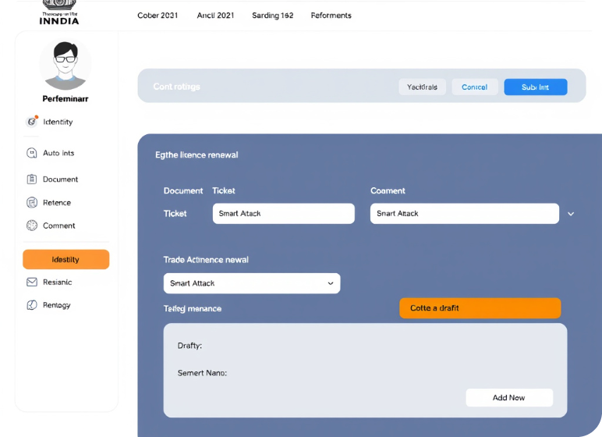





LIVE PROTOTYPE · TRADE LICENCE RENEWAL
From “I need a service” to a complete application journey.
A guided flow that keeps the citizen informed, in control, and moving forward.
The application, unfolding step by step
Citizen-led journey
The service does the heavy lifting.
Consent first
The citizen understands and authorises assistance.
Smart assistance
Information and documents move with less friction.
Control stays human
01 · Intent
02 · Assist
03 · Complete
Submit now—or keep the application as a draft.
Start with the service the citizen came for.
Consent, Smart Fill and Smart Attach reduce effort.
Verify identity, create a ticket, then choose.
A complete journey, not just a digital form.

Slide 7






TRUST BOUNDARY
Preparation starts only when the citizen says yes.
Consent is the gate. Intelligence prepares the application — it never takes control away.
Citizen consent
Prepared application
Consent gates Smart Fill.
Citizen stays in control.
Consent gates Smart Attach.
Application intelligence, not document storage.
The citizen decides when preparation begins.
Less repetition. Clearer ownership.
The system prepares only after permission — and the citizen remains the final authority.

Slide 8



PROTOTYPE CAPABILITY
Smart Fill + Smart Attach
Two guided steps that reduce citizen effort while keeping the officer in control.
Smart Fill
Smart Attach
Prepares form fields from the citizen’s stated intent, making the next step clearer and faster.
Matches the required documents to the service, so citizens know what to provide before submission.
Intent → ready-to-review fields
Requirement → matched documents
Prototype boundary: synthetic demo data only — no real registry retrieval or government data access.

Slide 9

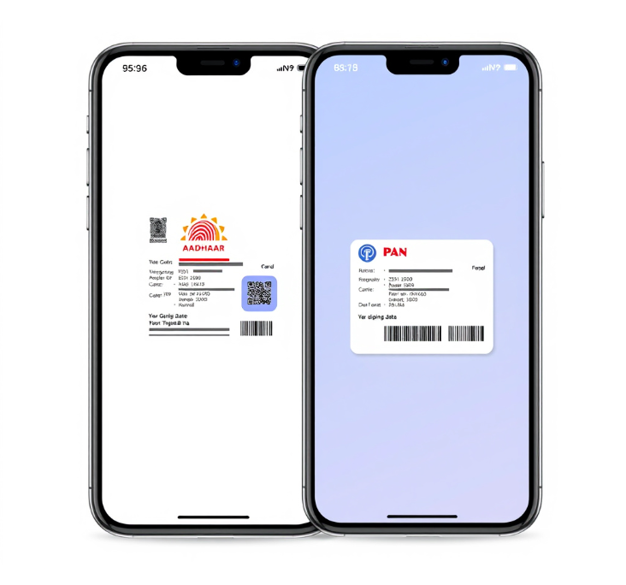
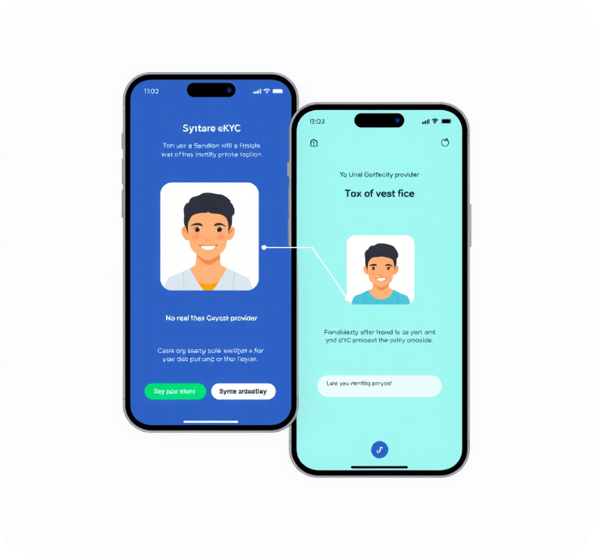
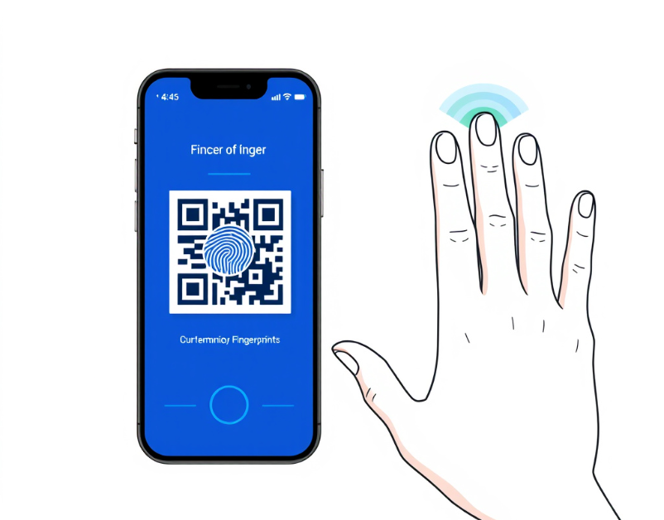




PROTOTYPE VERIFICATION STATE
Verification is visible, deterministic and clearly marked as a prototype.
A guided synthetic journey — from document capture to face and biometric demos.
Prototype sequence
Demo state
Synthetic-only by design.
The prototype makes its verification boundary impossible to miss.
Mock documents and demo biometrics only
No real government provider is contacted
03 QR fingerprint + five-finger scan
01 Mock Aadhaar + mock PAN
02 Mock e-KYC + face demo
Safe to present, inspect and repeat.
Every state is visible before the next step begins.

Slide 10




A BETTER STARTING POINT
A guided government application journey — from home.
Turn intent into progress, with the right support at every step.
Less effort. More confidence.
Less portal hunting
Find the right service from one clear starting point.
Less repetitive entry
Prepare information once, then move forward with ease.
Guided through verification
Know what is needed, where you stand, and what comes next.
Start where life happens.
A calmer path from application to completion.

Slide 11




HUMAN-OWNED REVIEW
AI assists the officer. The officer owns the final decision.
A guided workflow keeps advisory intelligence in service of accountable public decisions.
01
02
03
Submission enters the queue
Officer claims and reviews
AI advises. Officer decides.
The request is ready for accountable review.
The officer examines the submission with context.
Approve, correct, or reject remain officer decisions.
Approve Correct Reject
AI provides advisory support — accountability stays with the officer.

Slide 12



ONE CONNECTED JOURNEY
One application. Two experiences. One shared state.
The same lifecycle keeps citizen progress and officer action aligned from intent to completion.
Citizen
Officer
A clear path from intent to completion.
A focused path from queue to decision.
Intent becomes an application
Queue shows what needs attention
Consent and verification build confidence
Evidence arrives in context
Completion is visible and understandable
The officer owns the decision
Human-facing progress, without the black box.
Decision support, never decision replacement.
Shared lifecycle state links both sides.
AI connects — it does not decide.

Slide 13
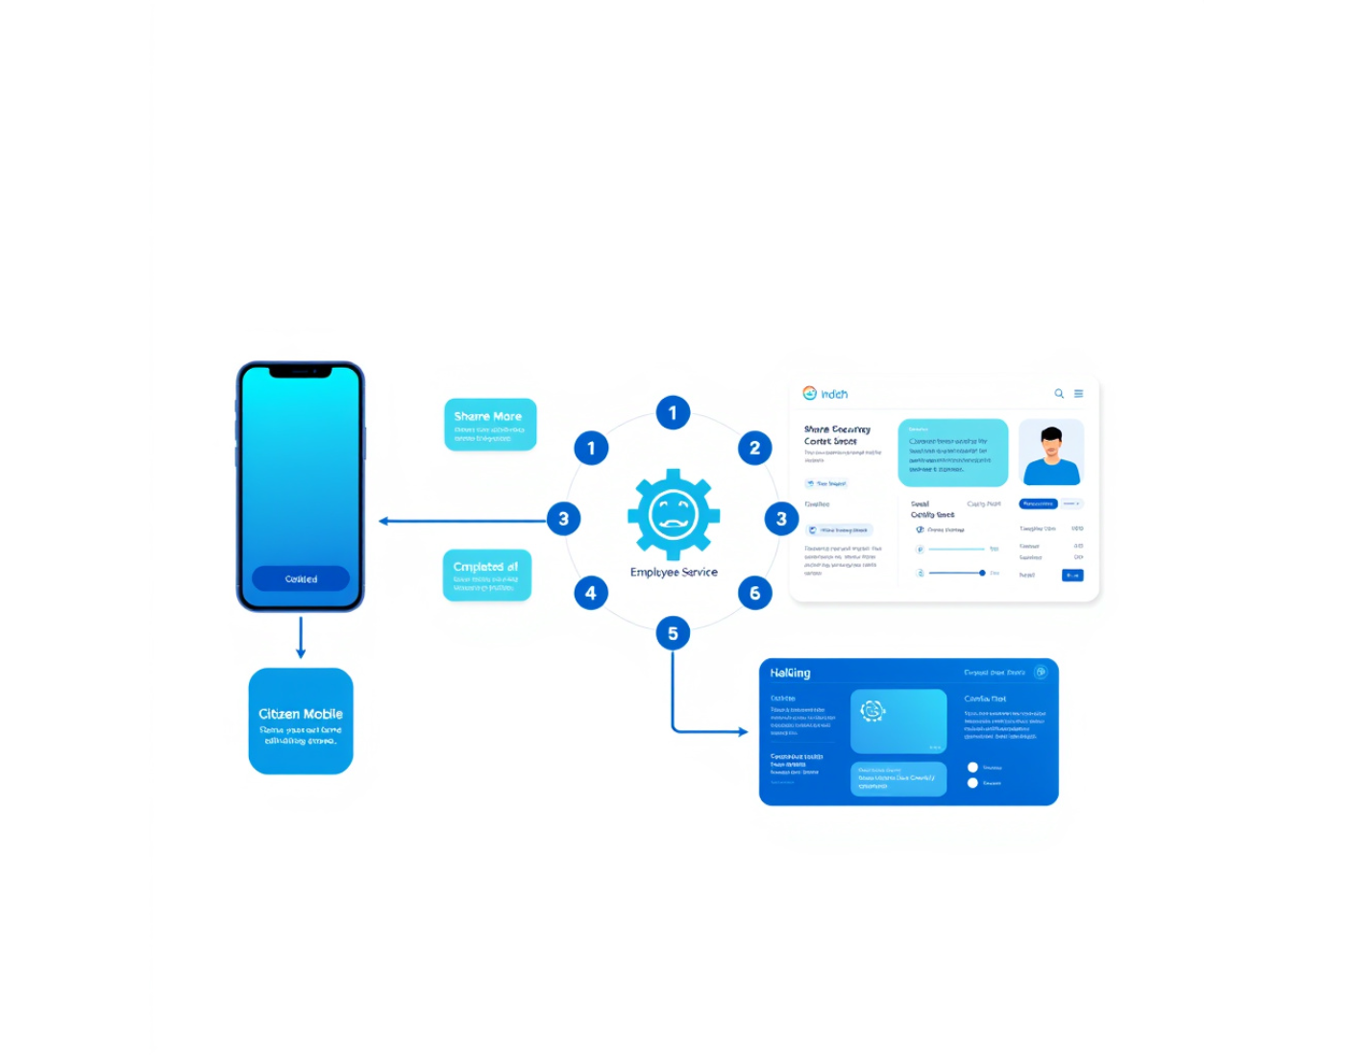



SYSTEM ARCHITECTURE
How it is built
Two service journeys, one shared foundation — designed for citizen trust and officer ownership.
One foundation, two experiences
The architecture keeps complexity behind the scenes.
Citizen frontend + backend
A guided public-service journey from intent to completion.
Shared state layer
PostgreSQL + Prisma keep every handoff consistent.
Employee frontend + backend
JANSEVA AI, mock verification, and PWA-ready workflows.
Trust moves with the case — from citizen consent to employee action.

Slide 14






TRUST & SECURITY
Built around consent, ownership and controlled lifecycle states.
Every request is checked at the point of access, action and transition.
Identity & authority
State & boundary controls
The right actor, with the right permission.
Safe transitions, isolated execution.
JWT authentication
Lifecycle validation
Reject unauthenticated requests and inactive accounts.
Allow only valid, controlled state transitions.
Idempotency + isolation
Role + ownership validation
Protect documents and isolate mock-provider behavior.
Confirm role authorization and resource ownership.
Control is explicit at every trust boundary.
Consent → verify → own → transition

Slide 15







IMPACT & SCALE
A reusable layer for clearer, more guided service journeys.
One service foundation that guides citizens today and expands across government workflows tomorrow.
01
02
03
For citizens
For government
Future roadmap
Less friction
Structured review
More services
Clearer status from intent through completion.
Advisory AI supports review while officers retain ownership.
A reusable layer designed to extend beyond one journey.
Current prototype
Synthetic and mocked — a foundation for validation, not a deployment claim.

Slide 16

JANSEVA-X
Government services should understand citizens.
Tell JANSEVA-X what you need. We will help you get it done.
A GUIDED APPLICATION JOURNEY
Hackathon prototype · Public service innovation

