Slide 1
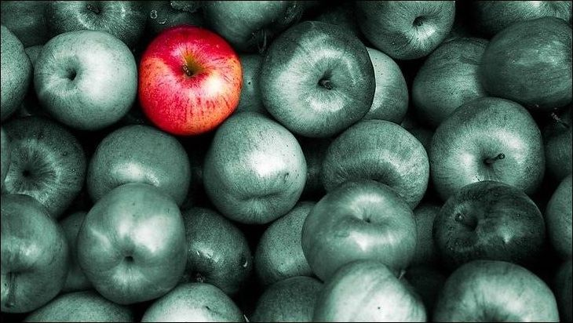
Lecture 9:
Differential Gene Expression

Slide 2
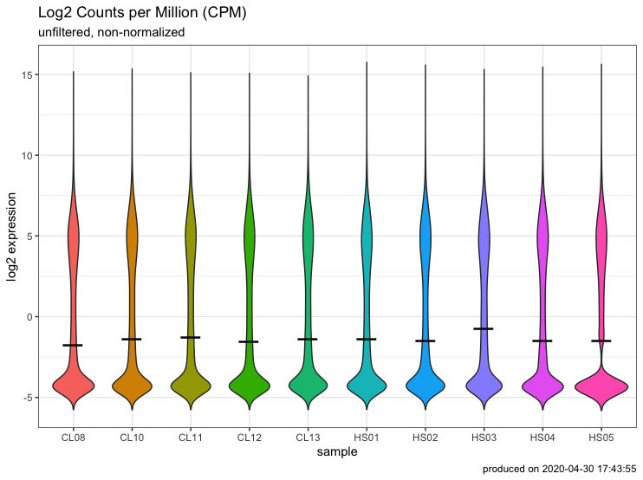
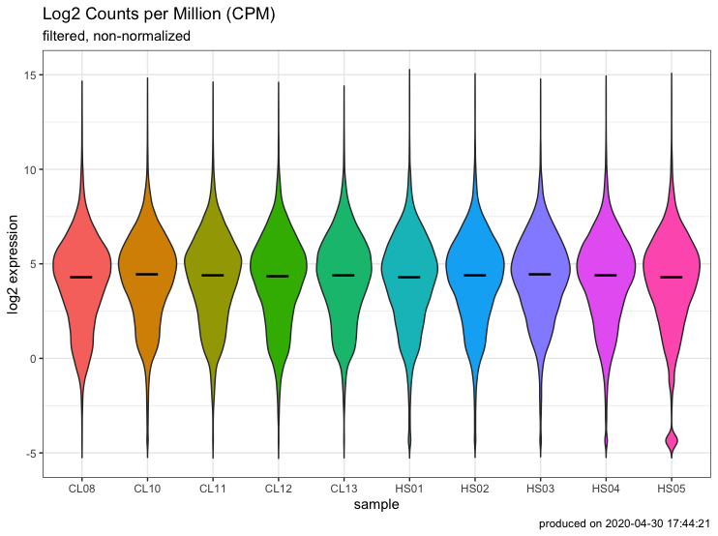
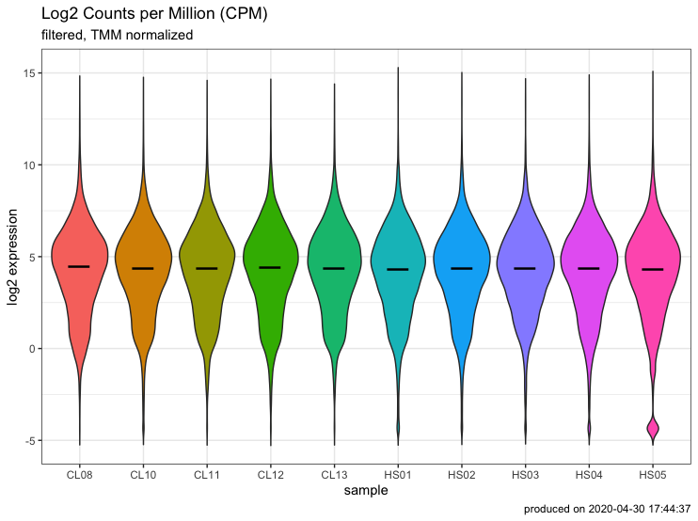
You’ve been preparing for DEG analysis all along
raw
filtered
normalized

Slide 3
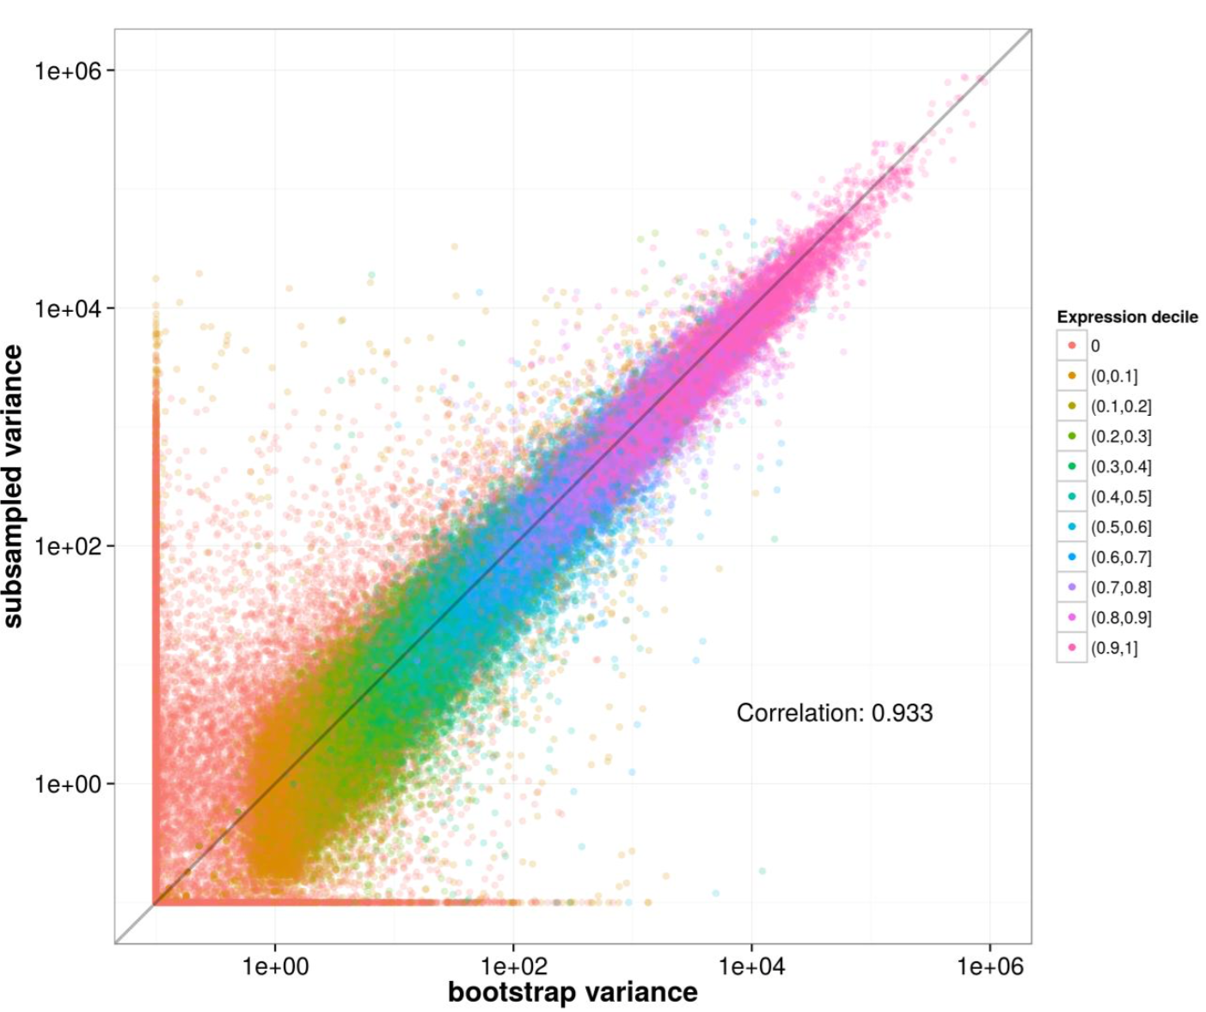
Uncertainty in RNAseq counts
Kallisto bootstraps ( -b)
single library of 216 million reads
30mil reads subsampled 40 times
variance for 40 subsamples of 30 million reads
variance for 40 bootstraps of 1 subsample
Bray et al., Nat. Biotech., 2016
Notes:
40 samples of 30 million reads subsampled from 275 million rat RNA-Seq reads

Slide 4
Some terminology
Gene A
DGE
Differential Gene Expression
DTE
Differential Transcript Expression
DTU
Differential Transcript Usage
Cond. 1
Cond. 2
Cond. 3

Slide 5
Some terminology
Transcript A
DGE
Differential Gene Expression
DTE
Differential Transcript Expression
DTU
Differential Transcript Usage
Cond. 1
Cond. 2
Cond. 3

Slide 6
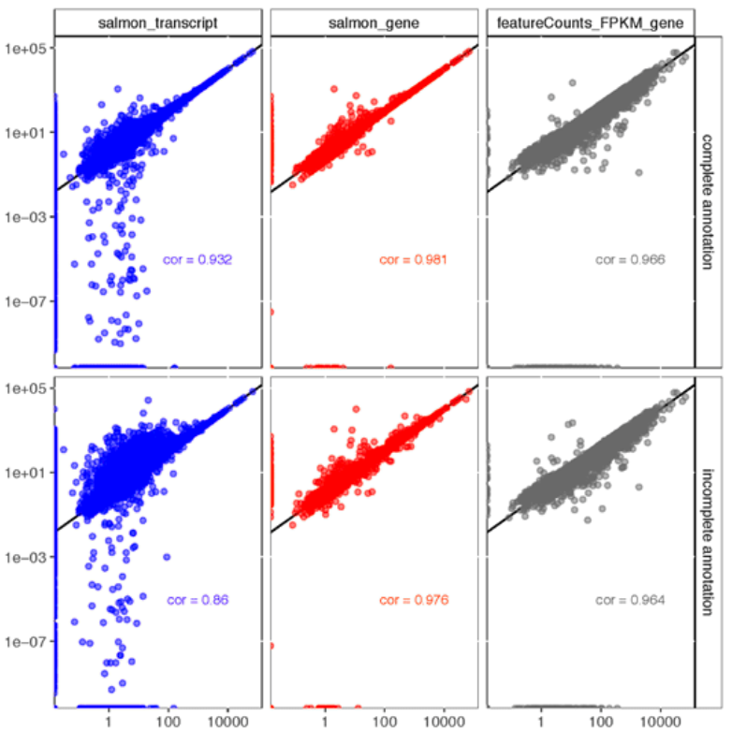
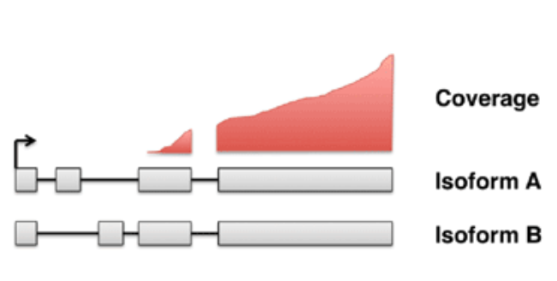
Genes can be more accurately measured than transcripts
transcript
gene
estimated TPM
actual TPM
Soneson et al., F1000Research., 2016

Slide 7
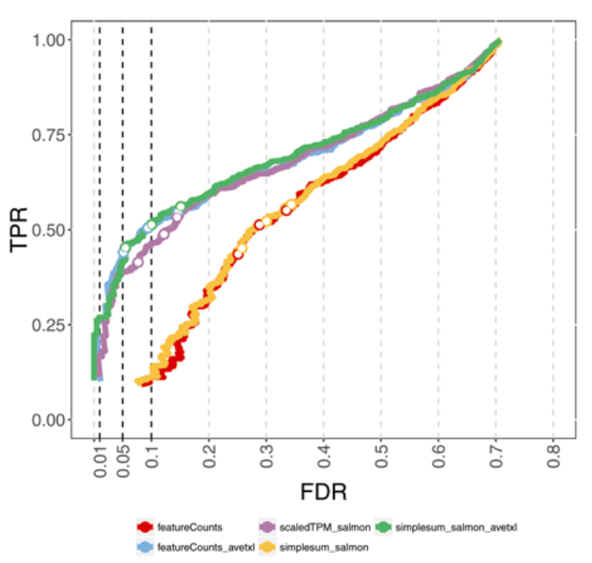
Aggregate transcript data to the gene level
Soneson et al., F1000Research., 2016

Slide 8
Some terminology
Gene A
DGE
Differential Gene Expression
Isoform A₁
DTE
Differential Transcript Expression
Not mutually exclusive
DTU
Differential Transcript Usage
“Isoform switching”
Isoform A₂
Cond. 1
Cond. 2
Cond. 3

Slide 9
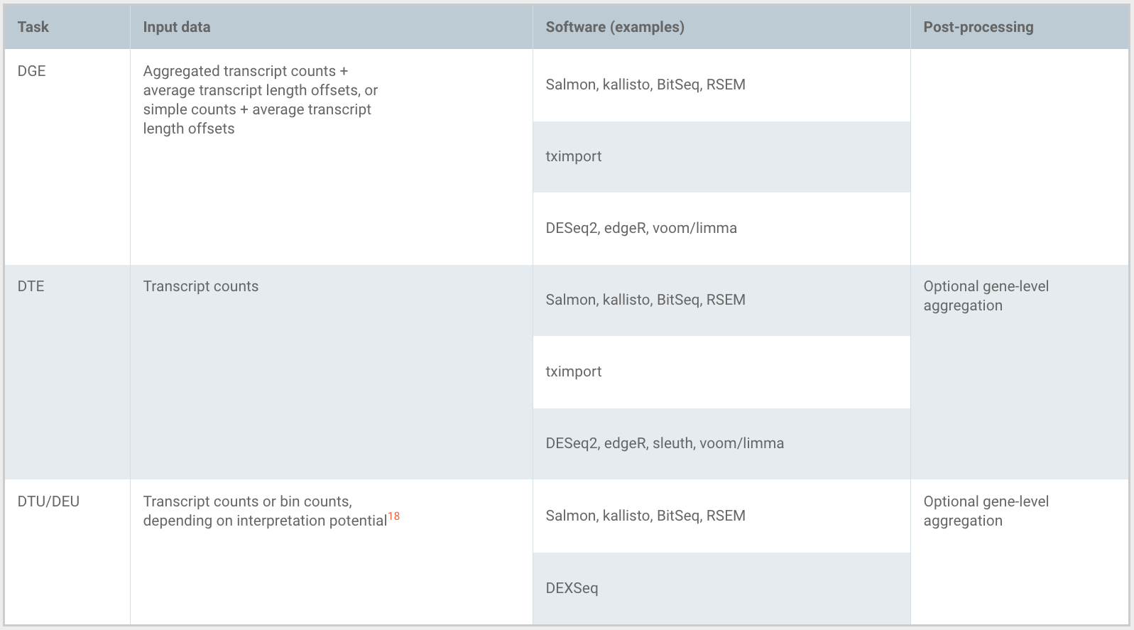
Choosing your path
Soneson et al., F1000Research., 2016

Slide 10
Start step 4 script

Slide 11
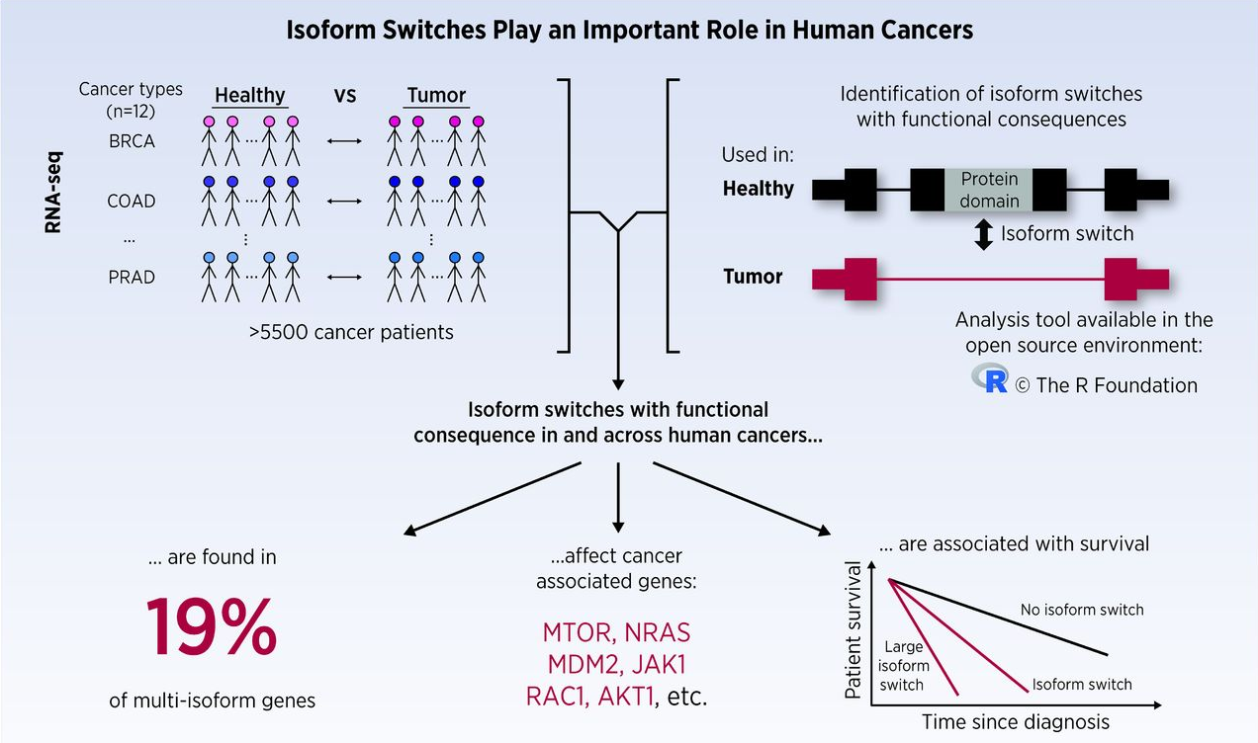
Isoform switching and cancer
Vitting-Seerup and Sandelin, Molecular Cancer Research. 2016

Slide 12
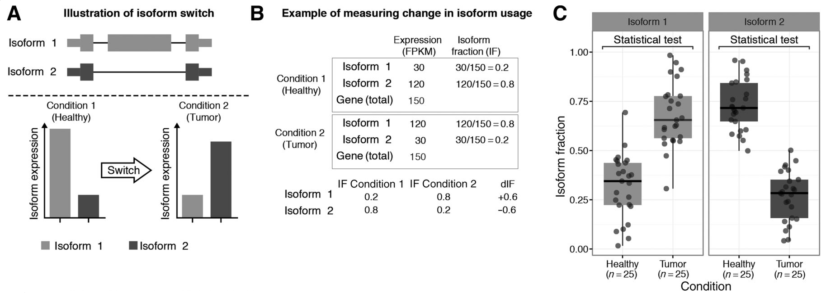
Defining and detecting an isoform switch
Vitting-Seerup and Sandelin, Molecular Cancer Research. 2016

Slide 13
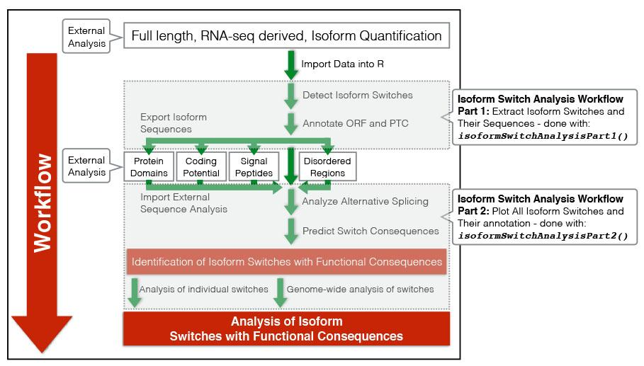
IsoformSwitchAnalyzeR
high-level functions for DTU analysis
isoformSwitchAnalysisCombined()
Vitting-Seerup and Sandelin, Bioinformatics. 2019

Slide 14
Warning!
DTU analysis with isoformSwitchAnalyzeR will not work unless you upgrade R and bioconductor
¯\_(ツ)_/¯

Slide 15
GTF files provide a map for all known genome features
Column | Description
Seqname | Name of chromosome, scaffold or contig
Source | Name of the datasource
Feature | Feature type (e.g. gene, exon, transcript, CDS, five_prime_UTR)
Start | Start position of the feature
End | End position of the feature
Empty | ‘.’
Strand | Defined as + (forward) or - (reverse)
Frame | Either ‘0’, ‘1’, or ‘2’ - indicating reading frame by base position
Attribute | A semicolon separated list of other info about the feature

Slide 16
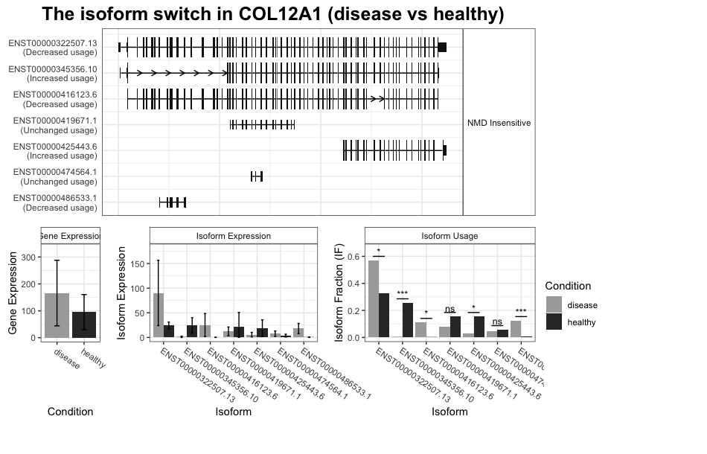
DTU example

Slide 17
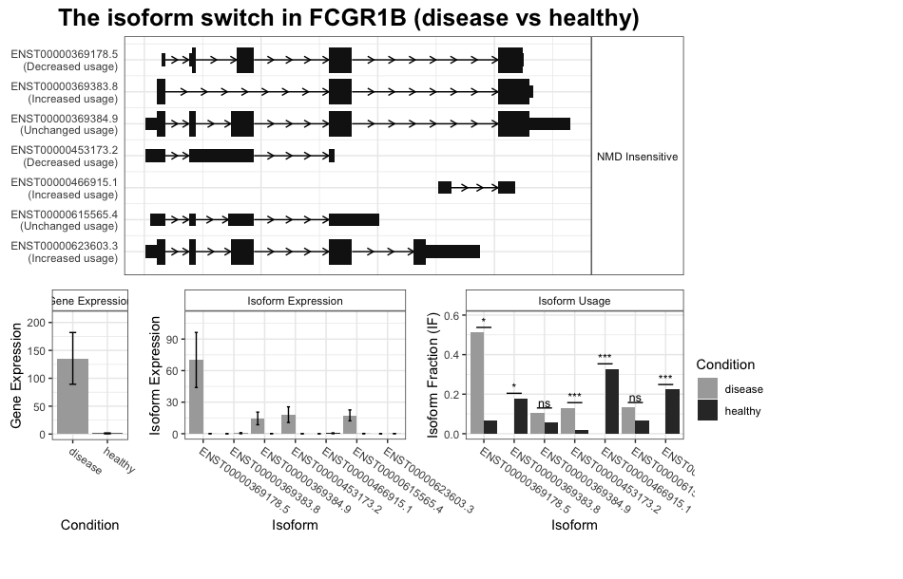
DGE + DTE + DTU example

