Slide 1
Jigsaw Solver
Lius@u6884783
Bowen@u6023330
Jiawen@u6227591

Slide 2
Outline
Problem description
Candidate approches
Our approach
Outcome/ demo
Review & some thoughts

Slide 3
Problem Description

Slide 4
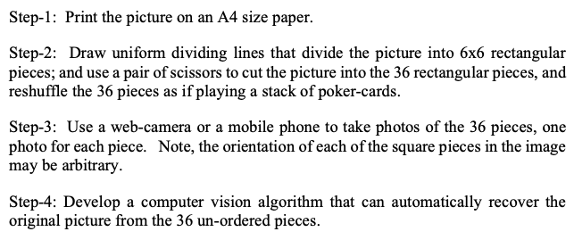
Problem Description

Slide 5

Problem Description
In one word, implement an algorithm that put 36 small (potentially noisy) pieces together.
Some properties: known dimension (6*6), half unknown orientation, imperfect rectangular puzzle pieces (cropped and resized -> noise)

Slide 6
Candidate approaches
General idea: some compatibility measure + reassembly technique
SIFT
Similarity + depth first search
Similarity + genetic algorithm
Reference paper: wMGC + minimum spanning tree
Our approach: wMGC + greedy search

Slide 7
Our approach
Weighted MGC + greedy algorithm
SSD
MGC
Weighted MGC
notes: FORMULA or EXPLANATION needed here!

Slide 8

Our approach
Weighted MGC + greedy algorithm
*36
For each small image,
Resize
Crop
x * y
*36

Slide 9
Randomly select one from 36 small pieces;
Calculate the wMGC between its vertical edges and all other vertical edges.
Perform a thresholding to rule out pairs with too big dissimilarities.
Match the pairs with smallest dissimilarities.
See the new concatenated matrix as a new small piece,
Keep on doing matching as before, until the length of this piece is 6 times of small length unit.
(check its left and right vertical edges and calculate similarities with the rest vertical edges)

Slide 10
Now that we have 6 small pieces sticking together,
do the same process until we have 6 long pieces
(Matching long pieces)
Randomly select one long piece,
calculate wMGC values between its top and bottom edges and the horizontal edges of others,
Do this process iteratively until the whole image is combined.

Slide 11



Outcome / demo
notes: need new screenshots after images are shuffled!

Slide 12
Review & some thoughts
Still some drawback
Genetic algorithm would be interesting to experiment on
Possibly add some domain knowledge, to act more like actual human

Slide 13
Thank you for watching :)

