Slide 1
Secure data hiding in images using steganography
CAPSTONE PROJECT
Presented By:
Student Name : Nandana Mahesh
College Name : Amrita Vishwa Vidyapeetham, Coimbatore Department : B. Tech. Computer Science Engineering with Cyber Security

Slide 2
OUTLINE
Problem Statement
Technology used
Wow factor
End users
Result
Conclusion
Git-hub Link
Future scope

Slide 3
Problem Statement
Modern digital communication requires secure ways to hide sensitive information. Traditional encryption techniques like AES, RSA etc. can protect data but they can also raise suspicion, making them a target for attackers. This project implements image steganography using Python, where messages are hidden in image pixels to ensure covert communication. The goal is to embed and retrieve secret messages within images without altering their visual appearance. Password protection is also implemented to ensure only authorized users can extract the hidden message.

Slide 4
Technology used
Programming Language: Python
Libraries Used:
OpenCV – Image processing and manipulation
OS – File handling for saving and retrieving encrypted images
Platform: Windows (Operating System)
Concepts Applied:
Least Significant Bit (LSB) Manipulation – Hiding data within the least significant bits of image pixels
ASCII Encoding – Mapping characters to numerical values for pixel embedding
Lossless Storage – Using PNG format to prevent image compression artifacts

Slide 5
Wow factors
Invisibility of Hidden Data
Unlike normal encryption, which results in unreadable ciphertext, steganography hides information within an image file that looks unchanged to the human eye.
Lossless Data Hiding
Using PNG format prevents compression artifacts, ensuring data integrity.
Lightweight & Efficient
The algorithm works with minimal computing power and can be executed on any standard system without requiring advanced hardware.
Future Expandability
This project can be extended to work with audio, video, and text-based steganography, making it scalable for advanced applications.

Slide 6
End users
Cybersecurity Experts & Ethical Hackers
Can use this technique for covert communication and secure information transfer.
Government & Military Personnel
Used for sending classified messages without attracting attention.
Journalists & Whistleblowers
Can send sensitive information without triggering surveillance alerts.
Privacy-Conscious Individuals
People who need secure personal messaging without detection.
Digital Forensics Teams
Can analyse steganographic data to detect hidden messages in suspicious files.

Slide 7
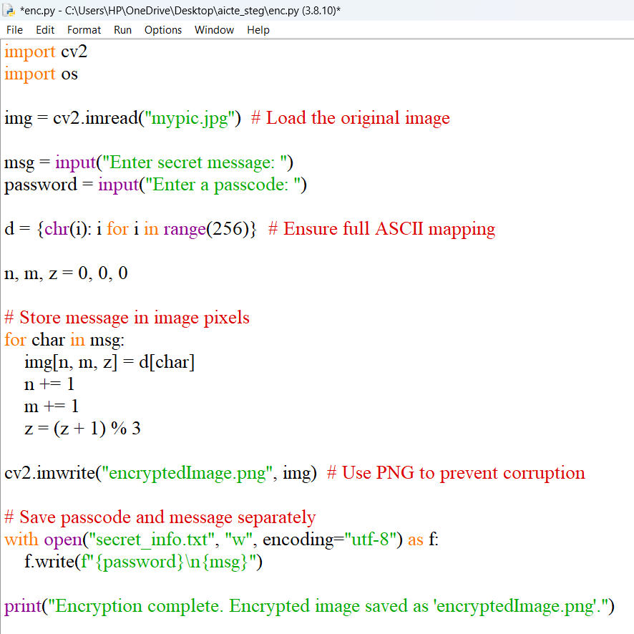
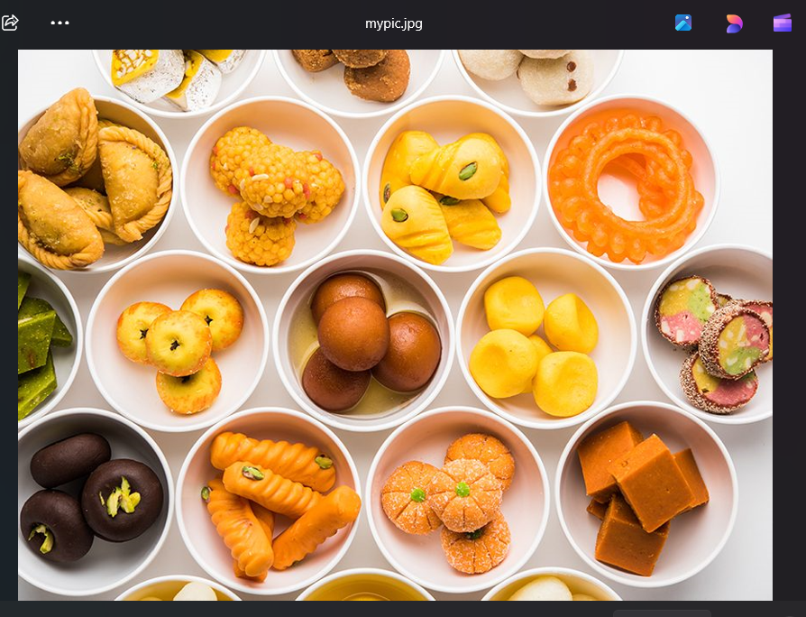
Results
Encryption Code:
Original Image:

Slide 8
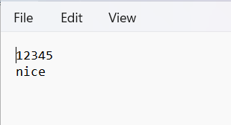
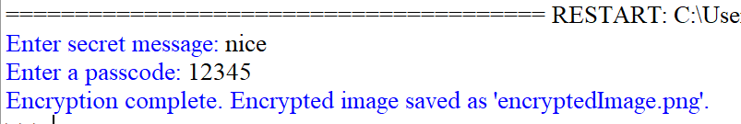
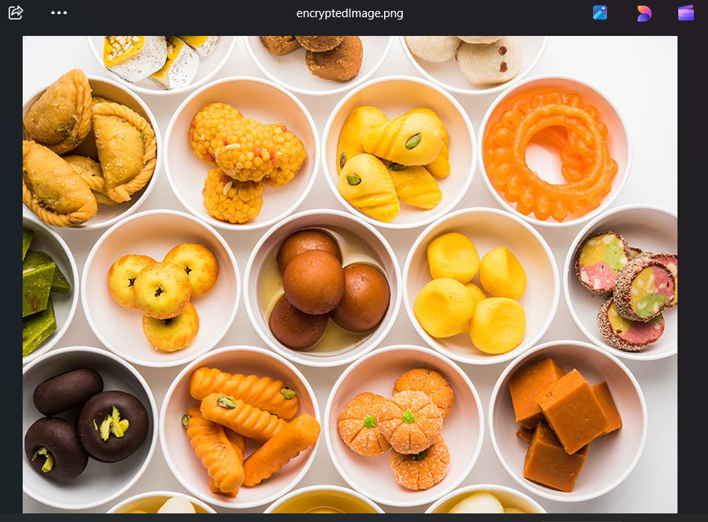
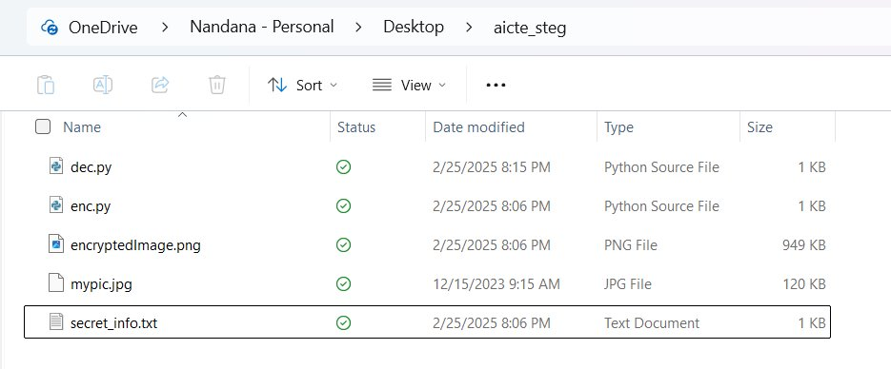
Results
Encryption Output:
secretinfo.txt :

Slide 9
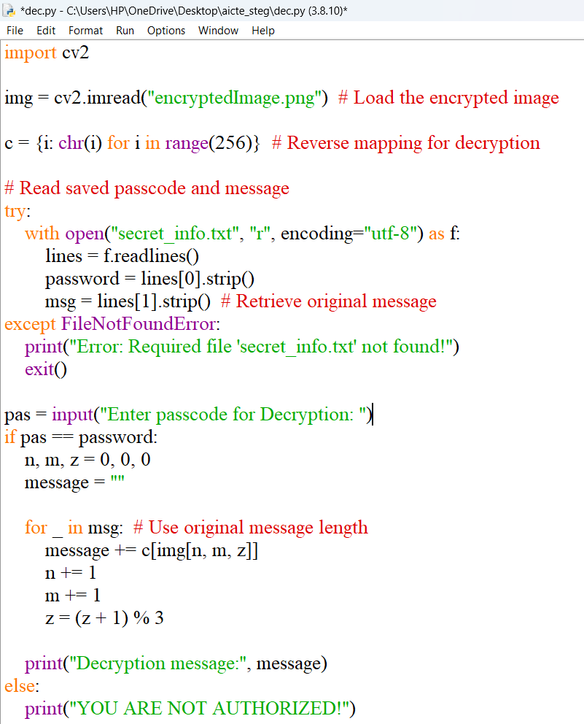

Results
Decryption Code -> (on the right)
Decryption Output:

Slide 10
Conclusion
This project successfully demonstrates how image-based steganography can provide a secure method of communication. By embedding text within an image at a pixel level, messages can be transmitted without raising suspicion. The approach ensures high confidentiality and data integrity while keeping the image visually unchanged. Password protection has been added to restrict unauthorized access. It also uses PNG format to maintain image integrity without compression losses. So, steganography offers an alternative to normal encryption by hiding data in images rather than protecting it via encryption keys.

Slide 11
GitHub Link
https://github.com/NANDANA-MAHESH/aicte_stego.git

Slide 12
Future scope
Advanced Security Features
Implement additional security layers like AES encryption combined with steganography.
Steganography for Other Media
Extend this project to audio & video files to hide messages in sound waves or video frames.
Machine Learning for Steganalysis
Develop AI-based steganalysis tools to detect hidden data in images.
Graphical User Interface (GUI) Support
Create a user-friendly GUI application for non-technical users to encode & decode messages easily.
Multi-Layer Encoding
Encrypt messages using multi-channel steganography to make detection even harder.

Slide 13
THANK YOU

