Slide 1
Data Communication
Department : Computer Science and Engineering
Course title : Data Communication | Course Code : 24CS430
Credits( L:T:P) : 4:0:0 | Core/Elective : Core
Type of Course : Lecture | Total Contact Hours : 60

Slide 2
Syllabus Introduction
Unit No. | Course Content | Hours
1 | Introduction: Data Communications, Networks, Network Types, Standards and Administration, Networks Models: Protocol Layering, TCP/IP Protocol suite, The OSI model. | 07
2 | Introduction to Physical Layer-1: Data and Signals, Digital Signals, Transmission Impairment, Data Rate Limits, Performance. Digital Transmission: Digital to Digital Conversion (Only Line coding: Polar, Bipolar and Manchester coding), Analog to Digital conversion (only PCM), Transmission Modes. | 08

Slide 3
Syllabus Introduction
3 | Bandwidth Utilization: Multiplexing, Transmission Media: Guided Media, Unguided Media, and Switching: Introduction, Circuit Switched Networks and Packet switching, Structure of a Switch. | 08
4 | Error Detection and Correction: Introduction, Block Coding, Cyclic Codes: Cyclic Redundancy Checksum, Forward Error Correction: Hamming distance, XOR. Network Layer: Network Layer Performance, IPV4-Addresses | 08
5 | Data link Layer: Introduction to Data-Link Layer: Introduction, Link-Layer Addressing, Data link Services: DLC services, Data link layer protocols, Point to Point protocol (Framing, Transition phases only). Media Access control: Random Access, Controlled Access. | 08

Slide 4
Course Outcomes
After completing this course, students should be able to:
CO1: | Understanding the importance of physical and data link layers of OSI model.
CO2: | Analyze and evaluate network topologies and protocols.
CO3: | Implementing different communication protocols.
CO4: | Exploring fundamental issues driving network design.

Slide 5
Text books
Prescribed Book:
Behrouz A. Forouzan, Data Communications and Networking 5E, 5th Edition, Tata McGraw-Hill, 2013.
Reference Text Book:
William Stallings: Data and Computer Communication, 10th Edition, Pearson Education, 2014.
Alberto Leon-Garcia and Indra Widjaja: Communication Networks - Fundamental Concepts and Key architectures, 2nd Edition Tata McGraw-Hill, Reprint 2017.
Larry L. Peterson and Bruce S. Davie: Computer Networks – A Systems Approach, 5th Edition, Elsevier, 2012.
Web Resources:
https://nptel.ac.in/downloads/106105080/
https://nptel.ac.in/courses/106105183/

Slide 6
Data Communication-Introduction
When we communicate, we are sharing information. This sharing can be local or remote.
Between individuals, local communication usually occurs face to face, while remote communication takes place over distance.
The term telecommunication, which includes telephony, telegraphy, and television, means communication at a distance (tele is Greek for "far").

Slide 7
Data Communication
The word data refers to information presented in whatever form is agreed upon by the parties creating and using the data.
Data communications are the exchange of data between two devices via some form of transmission medium such as a wire cable.
The communicating devices must be part of a communication system made up of a combination of hardware (physical equipment) and software (programs).
The effectiveness of a data communications system depends on four fundamental characteristics:

Slide 8
Fundamental Characteristic of DC
Delivery: The system must deliver data to the correct destination. Data must be received by the intended device or user and only by that device or user.
Accuracy: The system must deliver the data accurately. Data that have been altered in transmission and left uncorrected are unusable.
Timeliness: The system must deliver data in a timely manner.
Data delivered late are useless, In the case of video and audio.

Slide 9
Fundamental Characteristic of DC
Timely delivery means delivering data as they are produced, in the same order that they are produced.
This kind of delivery is called real-time transmission.
Jitter: Jitter refers to the variation in the packet arrival time.
It is the uneven delay in the delivery of audio or video packets.
let us assume that video packets are sent every 3D ms.
If some of the packets arrive with 3D-ms delay and others with 4D-ms delay, an uneven quality in the video is the result.

Slide 10
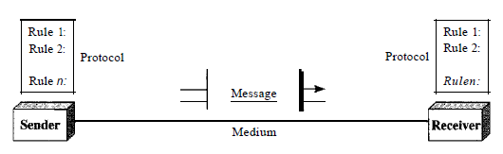
Components
A data communications system has five components.
Message: The message is the information (data) to be communicated. Popular forms of information include text, numbers, pictures, audio, and video.

Slide 11
Sender: The sender is the device that sends the data message. It can be a computer, workstation, telephone handset, video camera.
Receiver: The receiver is the device that receives the message. It can be a computer, workstation, telephone handset, television etc.
Transmission medium: The transmission medium is the physical path by which a message travels from sender to receiver. Twisted pair cable, coaxial cable, fiber optic or radio waves.
Protocol: A protocol is a set of rules that govern data communications. It represents an agreement between the communicating devices.

Slide 12
Data Representation
Information today comes in different forms such as text, numbers, images, audio, and video.
Text: Text is represented as a bit pattern, a sequence of bits. Each pattern is designed to represent the text symbols. Each set is called code. And the process of representing the symbol is called coding.
Numbers: Numbers are also represented by bit patterns. The number is directly converted to a binary number to simplify mathematical operations.
Images: Images are also represented by bit patterns. In its simplest form, an image is composed of a matrix of pixels.

Slide 13
Data Representation
Audio: Audio refers to the recording or broadcasting of sound or music. Audio is by nature different from text, numbers, or images. It is continuous, not discrete.
Video: Video refers to the recording or broadcasting of a picture or movie.
Video can either be produced as a continuous entity (e.g., by a TV camera), or it can be a combination of images, each a discrete entity, arranged to convey the idea of motion.

Slide 14
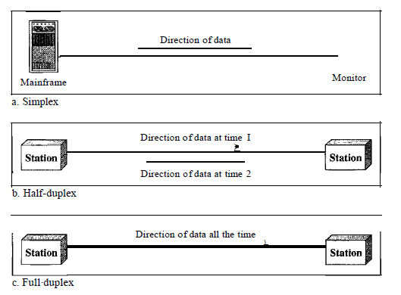
Data Flow
Communication between two devices can be simplex, half-duplex, or full-duplex.

Slide 15
Simplex
In simplex mode, the communication is unidirectional, as on a one-way street.
Only one of the two devices on a link can transmit; the other can only receive.
Keyboards and traditional monitors are examples of simplex devices.
The keyboard can only introduce input; the monitor can only accept output.
The simplex mode can use the entire capacity of the channel to send data in one direction.
Example: TV and radio station, were information transmitted from transmitter devices to multiple devices.

Slide 16
Half-Duplex
In half-duplex mode, each station can both transmit and receive, but not at the same time.
When one device is sending, the other can only receive, and vice versa.
The half-duplex mode is like a one-lane road with traffic allowed in both directions. When cars are traveling in one direction, cars going the other way must wait.
The entire capacity of a channel is taken over by whichever of the two devices is transmitting at the time.
the entire capacity of the channel can be utilized for each direction.
An example of a half-duplex device is a walkie-talkie, a two-way radio that has a push to-talk button.

Slide 17
Full-Duplex
In full-duplex mode (duplex), both stations can transmit and receive simultaneously.
The full-duplex mode is like a two-way street with traffic flowing in both directions at the same time.
In full-duplex mode, signals going in one direction share the capacity of the link: with signals going in the other direction.
This sharing can occur in two ways:
Either the link must contain two physically separate transmission paths, one for sending and the other for receiving. Or
The capacity of the channel is divided between signals traveling in both directions.
Example telephone communication, were both can talk and listen at the same time.

Slide 18
Networks
A network is a set of devices (often referred to as nodes) connected by communication links.
A node can be a computer, printer, or any other device capable of sending and/or receiving data generated by other nodes on the network.
Most networks use distributed processing, in which a task is divided among multiple computers.
Instead of one single large machine being responsible for all aspects of a process, multiple computer process and completes the task.

Slide 19
Network Criteria
A network must be able to meet a certain number of criteria.
The most important of these are performance, reliability, and security.
Performance: Performance can be measured in many ways, including transit time and response time.
Transit time is the amount of time required for a message to travel from one device to another.
Response time is the elapsed time between an inquiry and a response.

Slide 20
Performance
The performance of a network depends on a number of factors
Including the number of users, the type of transmission medium.
The capabilities of the connected hardware, and the efficiency of the software.
Performance is often evaluated by two networking metrics: throughput and delay.
The number of bits per second actually transmitted through a network is the network throughput.
Delay/ latency measures the time it takes for some data to get to its destination across the network.

Slide 21
Network criteria- Reliability and security
Reliability: Network reliability is measured by the frequency of failure.
The time it takes a link to recover from a failure, and the network's robustness in a catastrophe
Security: Network security issues include protecting data from unauthorized access, protecting data from damage and development.
Also implementing policies and procedures for recovery from breaches and data losses.

Slide 22
Physical Structure
Types of Networks: A network is two or more devices connected through links.
A link is a communications pathway that transfers data from one device to another.
Two devices must be connected in some way to the same link at the same time for communication to be happen.
There are two possible types of connections: point-to-point and multipoint.

Slide 23
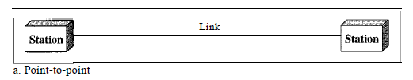
Point to point Connection
point-to-point connection provides a dedicated link between two devices.
The entire capacity of the link is reserved for transmission between those two devices.
When you change television channels by infrared remote control, you are establishing a point-to-point connection between the remote control and the television's control system.

Slide 24
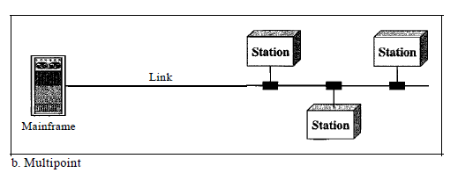
Multipoint Connection
A multipoint (Multidrop) connection is one in which more than two specific devices share a single link.
In a multipoint environment, the capacity of the channel is shared, either spatially or temporally.
If several devices can use the link simultaneously, it is a spatially shared connection .
If users must take turns, it is a timeshared connection.

Slide 25
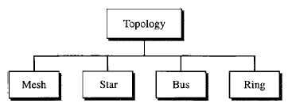
Physical Topology
The term physical topology refers to the way in which a network is laid out physically
Two or more devices connect to a link; two or more links form a topology.
Topology of a network is the geometric representation of the relationship of all the links and linking devices (usually called nodes) to one another.
There are four basic topologies possible: mesh, star, bus, and ring.

Slide 26
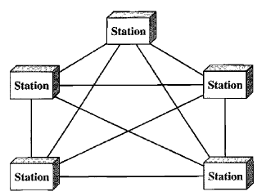
Mesh Topology
In a mesh topology, every device has a dedicated point-to-point link to every other device.
The term dedicated means that the link carries traffic only between the two devices it connects.

Slide 27
Mesh Topology
To find the number of physical links in a fully connected mesh network with n nodes, consider that each node must be connected to every other node.
Node 1 must be connected to n - I nodes, node 2 connected to n – 1 nodes, finally node n connected to n - 1 nodes.
We need n(n - 1) physical links. However, if each physical link allows communication in both directions (duplex mode).
we can divide the number of links by 2. Finally we need n(n-1)/2 links.

Slide 28
Advantages of Mesh Networks
The use of dedicated links guarantees that each connection can carry its own data load.
Eliminating the traffic problems that can occur when links must be shared by multiple devices.
A mesh topology is robust. If one link becomes unusable, it does not incapacitate the entire system.
Security and Privacy: When every message travels along a dedicated line, only the intended recipient sees it.
Point-to-point links make fault identification and fault isolation easy.

Slide 29
Disadvantages of Mesh Topology
The main disadvantages of a mesh are related to the amount of cabling and the number of I/O ports required.
Every device must be connected to every other device, installation and reconnection are difficult.
The hardware required to connect each link (I/O ports and cable) can be prohibitively expensive.
For these reasons a mesh topology is usually implemented in a limited fashion.
For example, as a backbone connecting the main computers of a hybrid network that can include several other topologies.

Slide 30
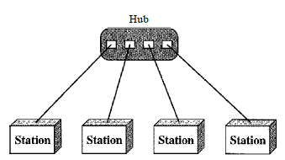
Star Topology
In a star topology, each device has a dedicated point-to-point link only to a central controller, usually called a hub.
The devices are not directly linked to one another.
Unlike a mesh topology, a star topology does not allow direct traffic between devices.
The controller acts as an exchange: If one device wants to send data to another, it sends the data to the controller, which then relays the data to the other connected device

Slide 31
Advantages: Star topology
A star topology is less expensive than a mesh topology.
In a star, each device needs only one link and one I/O port makes easy to install and reconfigure.
Far less cabling and additions, moves, and deletions involve only one connection: between that device and the hub.
Robustness: If one link fails, only that link is affected. All other links remain active.
Easy fault identification and fault isolation.

Slide 32
Disadvantage- Star Topology
One big disadvantage of a star topology is the dependency of the whole topology on one single point, the hub.
If the hub goes down, the whole system is dead.
The star topology is used in local-area networks (LANs), high speed LAN’s.
Although a star requires far less cable than a mesh, each node must be linked to a central hub.
For this reason, often more cabling is required in a star than in some other topologies (such as ring or bus).

Slide 33
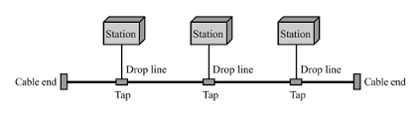
Bus Topology
The preceding topologies(star and mesh) are based on point to point connection.
A bus topology, on the other hand, is multipoint.
One long cable acts as a backbone to link all the devices in a network.
Nodes are connected to the bus cable by drop lines and taps.

Slide 34
Bus Topology
A drop line is a connection running between the device and the main cable.
A tap is a connector that either splices into the main cable or punctures the sheathing of a cable to create a contact with the metallic core.
Signals becomes weaker and weaker as it travels farther and farther.
For this reason there is a limit on the number of taps a bus can support and on the distance between those taps.

Slide 35
Bus Topology-Advantages
Advantages of a bus topology include ease of installation.
a bus uses less cabling than mesh or star topologies.
In a star, for example, four network devices in the same room require four lengths of cable.
In a bus, this redundancy is eliminated. Only the backbone cable stretches through the entire facility.
Each drop line has to reach only as far as the nearest point on the backbone.

Slide 36
Bus Topology- Disadvantages
Disadvantages include difficult reconnection and fault isolation.
A bus is usually designed to be optimally efficient at installation. It can therefore be difficult to add new devices.
Signal reflection at the taps can cause degradation in quality.
Adding new devices may therefore require modification or replacement of the backbone.
In addition, a fault or break in the bus cable stops all transmission.

Slide 37
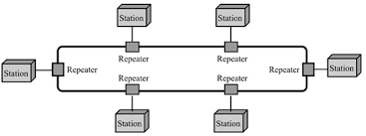
Ring Topology
In a ring topology, each device has a dedicated point-to-point connection with only the two devices on either side of it.
A signal is passed along the ring in one direction, from device to device, until it reaches its destination.
When a device receives a signal intended for another device, its repeater regenerates the bits and passes.

Slide 38
Advantages- Disadvantages
A ring is relatively easy to install and reconfigure.
To add or delete a device requires changing only two connections. Coz each device linked to its immediate neighbors.
The only constraints are media and traffic considerations (maximum ring length and number of devices).
Isolation is simplified.
In a simple ring, a break in the ring (such as a disabled station) can disable the entire network.

Slide 39
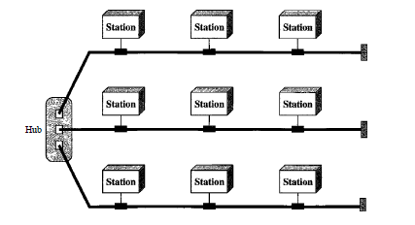
Hybrid Topology
A network can be hybrid. For example, a main star topology with each branch connecting several stations in a bus topology.

Slide 40
Categories of Network
Generally referring to two primary categories: local-area networks and wide-area networks.
The category into which a network falls is determined by its size.
A LAN normally covers an area less than 2 miles. A WAN can be worldwide.
Networks of a size in between are normally referred to as metropolitan area networks and span tens of miles.

Slide 41
Local Area Network : LAN
A local area network (LAN) is usually privately owned and links the devices in a single office, building, or campus.
Depending on the needs of an organization and the type of technology used, a LAN can be as simple as two PCs and a printer in someone's home office; or
it can extend throughout a company and include audio and video peripherals.
Currently, LAN size is limited to a few kilometers.

Slide 42
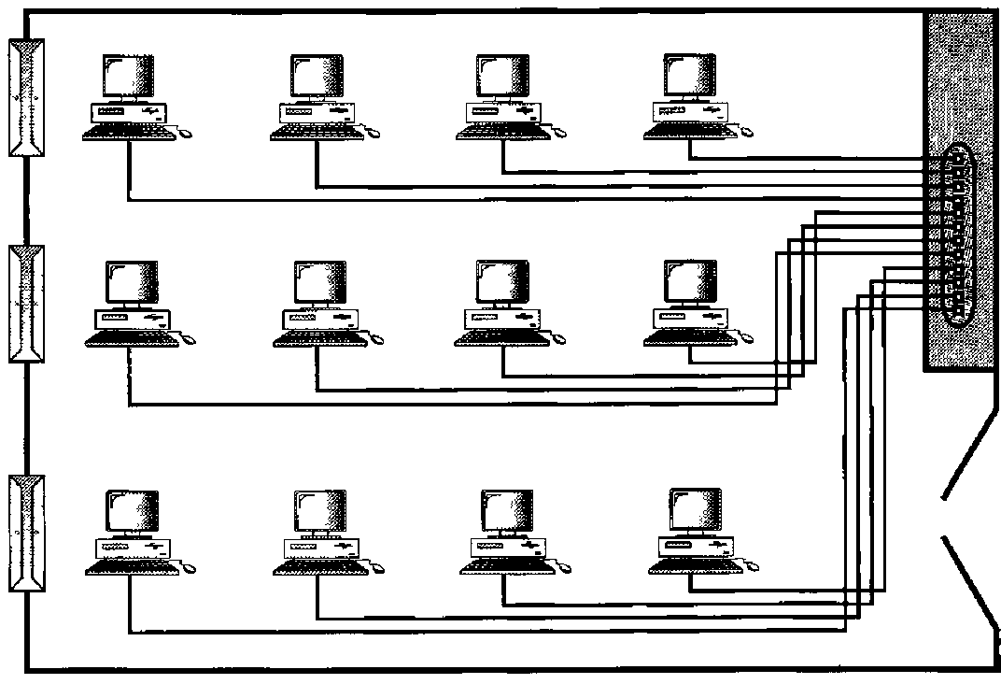
Local Area Network-LAN
LANs are designed to allow resources to be shared between personal computers or workstations.
The resources to be shared can include hardware (e.g., a printer), software (e.g., an application program), or data.
The most common LAN topologies are bus, ring, and star.

Slide 43
Local Area Network-LAN
Each host in the LAN has an identifier, an address, that uniquely defines the host in the LAN. The packet sent by a host to another host carries both the source host’s and destination host’s address.

Slide 44
Wide Area Network-WAN
WAN provides long-distance transmission of data information over large geographic areas (country, a continent, or even the whole world). Referred as switched WAN.
A WAN could be complex which connect the Internet or as simple as a dial-up line that connects a home computer to the Internet. Referred as P2P WAN.
The Switched WAN connect end system(Router) to another LAN or WAN.

Slide 45
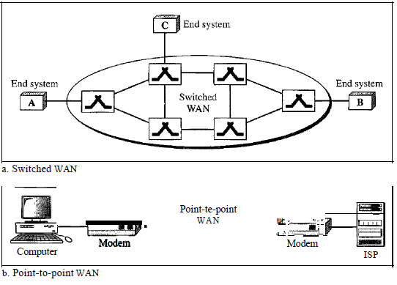
Switched WAN and P2P WAN

Slide 46
Metropolitan Area Networks
MAN is a network with a size between a LAN and a WAN.
It normally covers the area inside a town or a city.
It is designed for customers who need a high-speed connectivity, normally to the Internet.

Slide 47
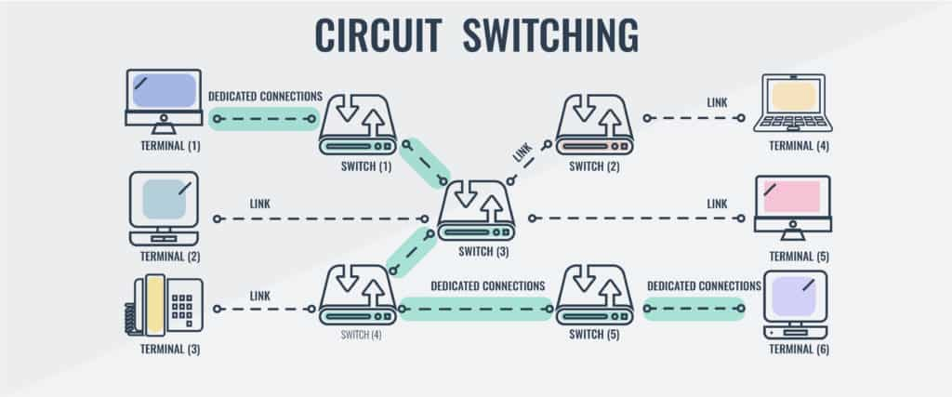
Switched Networks
2 Types
Circuit switched networks.
Packet switched Networks.
Circuit Switched Network:

Slide 48
Circuit Switching Network
A dedicated connection called circuit is always available between two end system.
CSN is very common in telephone networks.
The capacity of the link is shared between all the devices in the network.
The switches have forwarding task but no storing capacity.
Either all the devices can utilize the bandwidth of the link, means the bandwidth is fully utilized.
During the idle time, complete bandwidth is unutilized for the dedicated link.

Slide 49
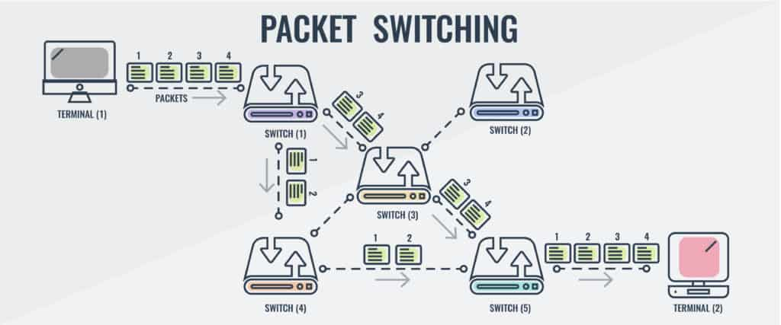
Packet Switched network

Slide 50
Packet Switching
Communication between the devices is done in blocks of data called packets.
We will exchange the packets with the help of switches/router. Switches support both storing and forwarding capacity.
The router has a queue that can store and forward the packets.
There is no dedicated path for packet to transfer. Hence packets may take different path.
Hence all the links can be effectively utilized.

Slide 51
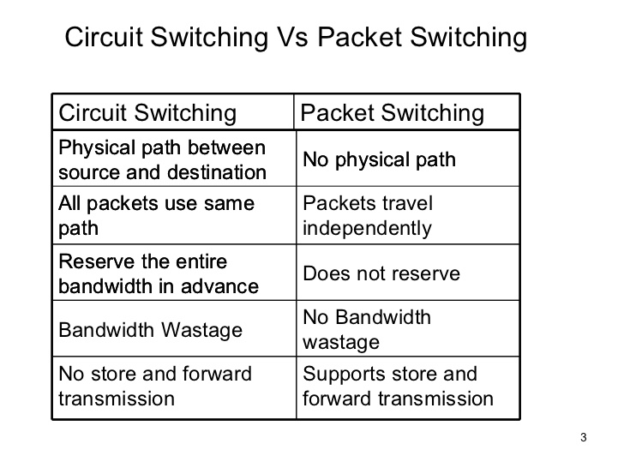
Differences

Slide 52
Protocols and Standards
Protocol which is synonymous with rule.
Standards, which are agreed-upon rules.
Protocols
In computer networks, communication occurs between entities in different systems.
An entity is anything capable of sending or receiving information. However, two entities cannot simply send bit streams to each other and expect to be understood.
For communication to occur, the entities must agree on a protocol.

Slide 53
Protocols
A protocol is a set of rules that govern data communications. A protocol defines what is communicated, how it is communicated, and when it is communicated. The key elements of a protocol are syntax, semantics, and timing.
Syntax: The term syntax refers to the structure or format of the data, meaning the order in which they are presented.
For example, a simple protocol might expect the first 8 bits of data to be the address of the sender, the second 8 bits to be the address of the receiver, and the rest of the stream to be the message itself.

Slide 54
Semantics. The word semantics refers to the meaning of each section of bits. How is a particular pattern to be interpreted, and what action is to be taken based on that interpretation?
For example, does an address identify the route to be taken or the final destination of the message?
Timing. The term timing refers to two characteristics: when data should be sent and how fast they can be sent.
For example, if a sender produces data at 100 Mbps but the receiver can process data at only 1Mbps, the transmission will overload the receiver and some data will be lost.

Slide 55
Standards
Standards are essential in creating and maintaining an open and competitive market for equipment manufacturers and in guaranteeing national and international interoperability of data and telecommunications technology and processes. Standards provide guidelines
Data communication standards fall into two categories: de facto (meaning "by fact" or "by convention") and de jure (meaning "by law" or "by regulation").

Slide 56
De facto meaning ("by fact" or "by convention") : Standards that have not been approved by an organized body but have been adopted as standards through widespread use are de facto standards. De facto standards are often established originally by manufacturers who seek to define the functionality of a new product or technology.
De jure (meaning "by law" or "by regulation"). Those standards that have been legislated by an officially recognized body are de jure standards.

Slide 57
Standards Organization
Standards are developed through the cooperation of standards creation committees, forums, and government regulatory agencies.
Standards Creation Committees
While many organizations are dedicated to the establishment of standards, data telecommunications in North America rely primarily on those published by the following:

Slide 58
International Organization for Standardization (ISO). The ISO is a multinational body whose membership is drawn mainly from the standards creation committees of various governments throughout the world. The ISO is active in developing cooperation in the realms of scientific, technological, and economic activity.
International Telecommunication Union-Telecommunication Standards Sector (ITU-T). By the early 1970s, a number of countries were defining national standards for telecommunications, but there was still little international compatibility.

Slide 59
The United Nations responded by forming, as part of its International Telecommunication Union (ITU), a committee, the Consultative Committee for International Telegraphy and Telephony (CCITT).
This committee was devoted to the research and establishment of standards for telecommunications in general and for phone and data systems in particular. On March 1, 1993, the name of this committee was changed to the International TelecommunicationUnionTelecommunication Standards Sector (ITU-T).

Slide 60
American National Standards Institute (ANSI). Despite its name, the American National Standards Institute is a completely private, nonprofit corporation not affiliated with the U.S. federal government. However, all ANSI activities are undertaken with the welfare of the United States and its citizens occupying primary importance
Institute of Electrical and Electronics Engineers (IEEE). The Institute of Electrical and Electronics Engineers is the largest professional engineering society in the world. International in scope, it aims to advance theory, creativity, and product quality in the fields of electrical engineering, electronics, and radio as well as in all related branches of engineering. As one of its goals, the IEEE oversees the development and adoption of international standards for computing and communications

Slide 61
Electronic Industries Association (EIA). Aligned with ANSI, the Electronic Industries Association is a nonprofit organization devoted to the promotion of electronics manufacturing concerns. Its activities include public awareness education and lobbying efforts in addition to standards development. In the field of information technology, the EIA has made significant contributions by defining physical connection interfaces and electronic signaling specifications for data communication

Slide 62
FORUMS
Telecommunications technology development is moving faster than the ability of standards committees to ratify standards. Standards committees are procedural bodies and by nature slow-moving.
To accommodate the need for working models and agreements and to facilitate the standardization process, many special-interest groups have developed forums made up of representatives from interested corporations.
The forums work with universities and users to test, evaluate, and standardize new technologies. By concentrating their efforts on a particular technology, the forums are able to speed acceptance and use of those technologies in the telecommunications community. The forums present their conclusions to the standards bodies

Slide 63
REGULATORY AGENCIES
All communications technology is subject to regulation by government agencies such as the Federal Communications Commission (FCC) in the United States.
The purpose of these agencies is to protect the public interest by regulating radio, television, and wire/cable communications. The FCC has authority over interstate and international commerce as it relates to communications

Slide 64
Networks Model
A network is a combination of hardware and software that sends data from one location to another.
The hardware consists of the physical equipment that carries signals from one point of the network to another.
The software consists of instruction sets that make possible the services that we expect from a network.

Slide 65
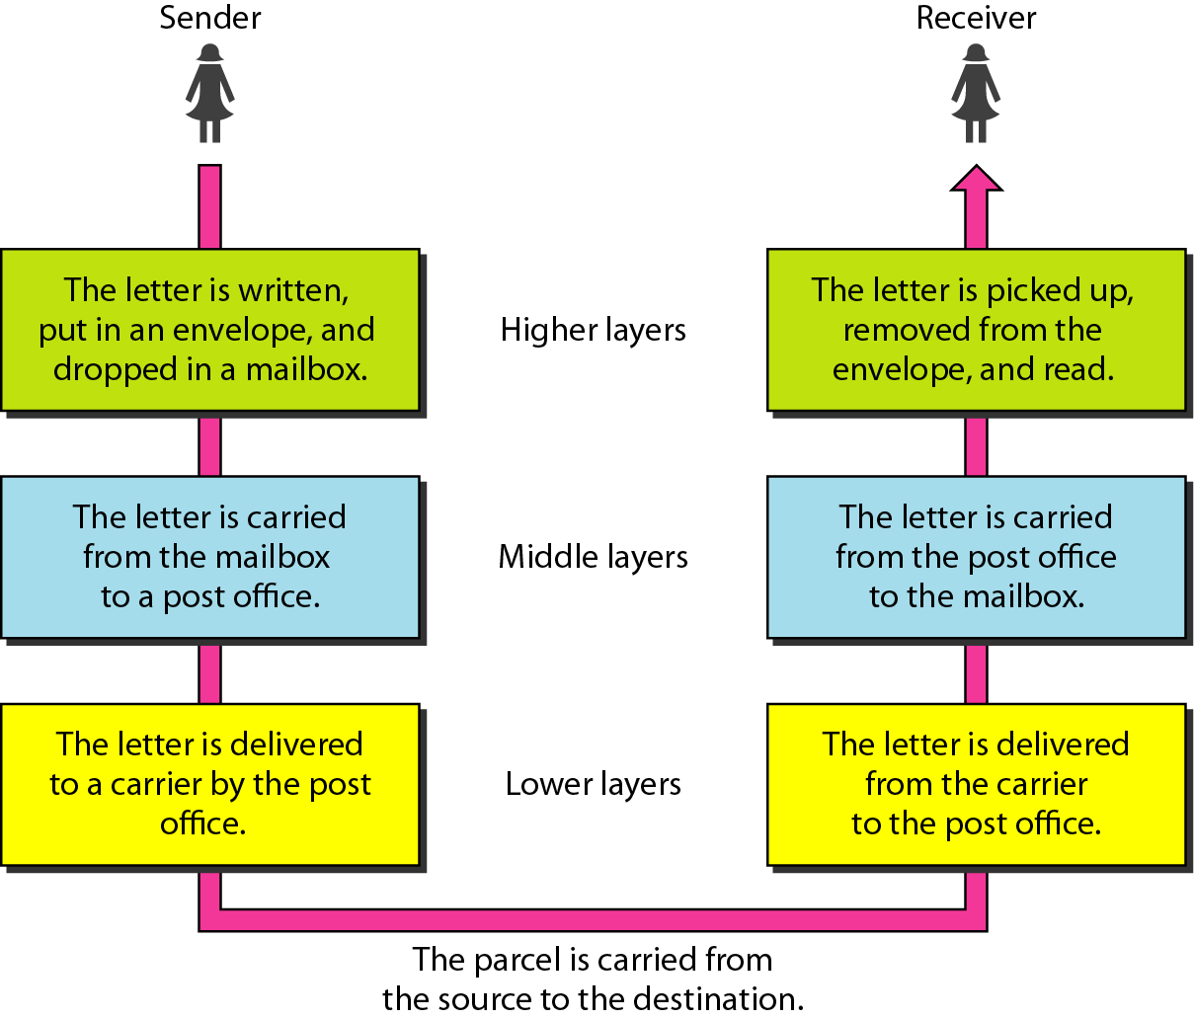
LAYERED TASKS
We use the concept of layers in our daily life.
let us consider two friends who communicate through postal mail.

Slide 66
Sender Side
The activities that take place at the sender site.
Higher layer. The sender writes the letter, inserts the letter in an envelope, writes the sender and receiver addresses, and drops the letter in a mailbox.
Middle layer. The letter is picked up by a letter carrier and delivered to the post office.
Lower layer. The letter is sorted at the post office; a carrier transports the letter.
On the Way: The letter is then on its way to the recipient. the letter may actually go through a central office. it may be transported by truck, train, airplane, boat.

Slide 67
Receiver Side
Lower layer. The carrier transports the letter to the post office.
Middle layer. The letter is sorted and delivered to the recipient's mailbox.
Higher layer. The receiver picks up the letter, opens the envelope, and reads it.
At sender side, Hierarchy goes from upper layer to lower layer.
Receiver side uses bottom to top approach.
Here at both side, Each layer uses upper or lower layer services.

Slide 68
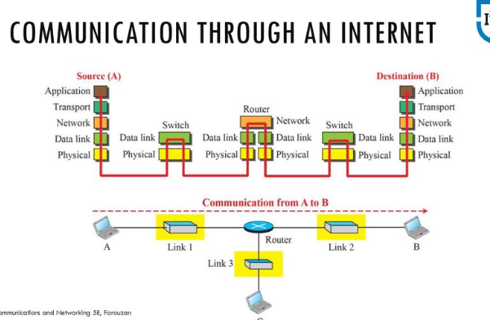

Slide 69
Assuming computer A wants to communicate with computer B. From fig, there are 5 communicating devices:
source host(computer-A)
Link layer switch in link-1
Router
Link layer switch in link-2
Destination host(computer-B)
Each device is involved in set of layers depending on the role of the devices in the internet

Slide 70
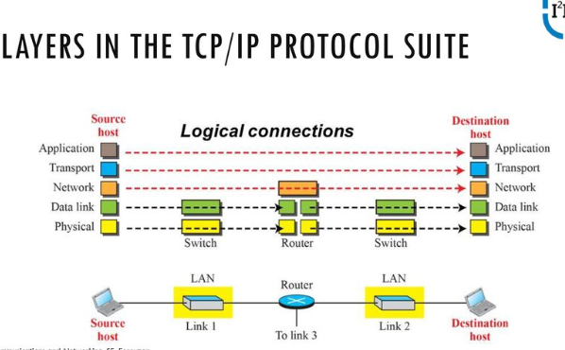

Slide 71
Using Logical connections it makes easier to think about the duty of each layer.
From fig, the duties of the application, transport and network layer is end to end .
However, duty of the data-link and physical layers is hop-hop, in which a hop is a host or router.
In other words, the domain of duty of the top three layers is the internet, and the next two layers is the link
Another way of thinking of the logical connection is in the top three layers,
data unit(packets) should not be changed by any router or links
Whereas, the next two layers , packet created by host is changed only by the routers not by link-layer switches.

Slide 72
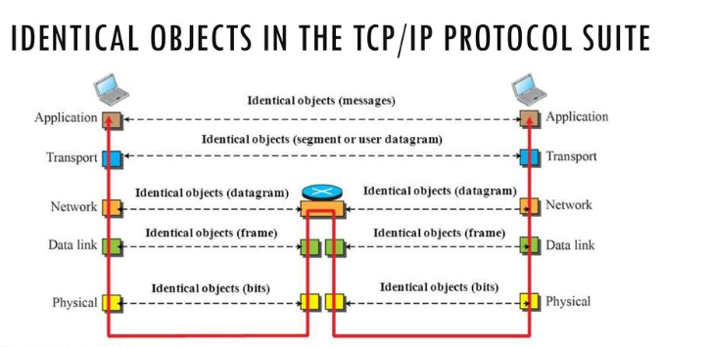

Slide 73
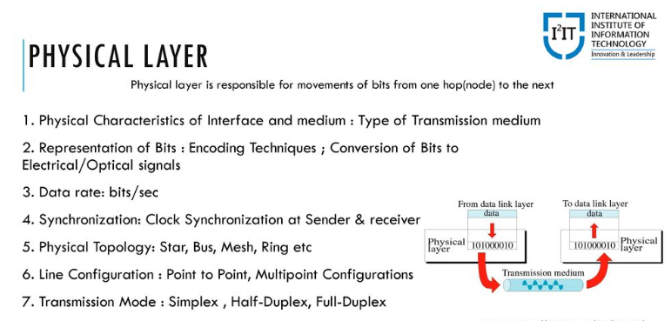
Description of Each Layer

Slide 74
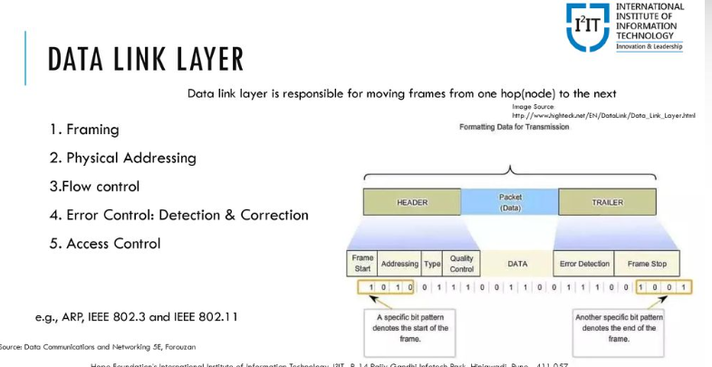

Slide 75
Internet is made up of several links connected by routers
It is responsible for choosing the best links
Data link is responsible for carrying datagram across the link
Link can be wired/wireless
It doesn’t have specific protocol , it suppors all standard and proprietary protocol
This layer takes the datagram ,encapsulates in a packet called frame

Slide 76
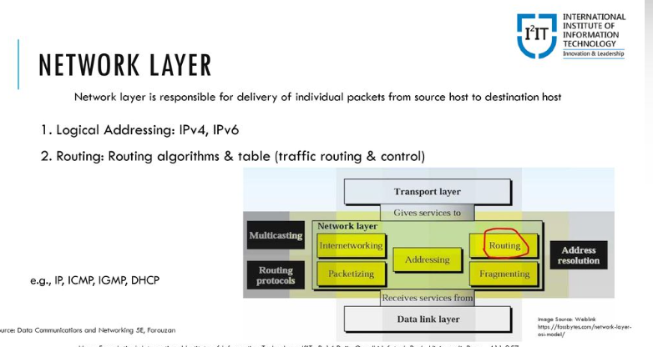

Slide 77
Responsible for creating the connection between the source and destination and the communication is Host to Host
Routers- Best route
Main protocol – IP
IP defines the format of packet called datagram
IP- connectionless protocol
It has no flow control, no error control , no congestion control services
Network Layer includes Unicast and Multicast Routing protocol

Slide 78
It has some of the Auxilary protocols
ICMP – The internet control message protocol responsible for reporting problems while routing
IGMP –The internet Group Management Protocol responsible for multitasking
DHCP - Helps IP to find the link layer address of a host or a router

Slide 79
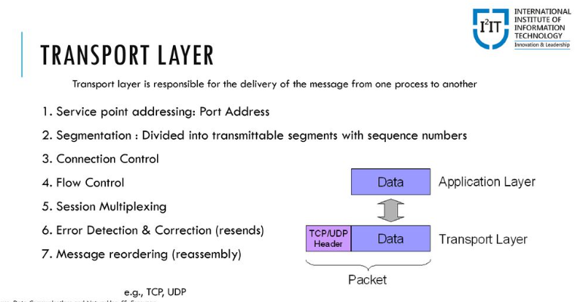

Slide 80
The transport layer at the source host gets the msg from the application layer, encapsulates it in a transport layer packet(segment/user datagram)and sends it to logical connection to T.Layer of destination host.
In other words T.Layers is responsible for giving services to the A.Layer
The main protocol of T.Layer is TCP
TCP- connection-oriented and establishes the logical connection between transport layer at two host before transfeering data

Slide 81
TCP provides - flow control,error control and congestion control.
The commonly used protocol is UDP- connectionless protocol that transmits user datagrams without first creating a logical connection.
It doesn’t provide flow control,error control and congestion control
A New protocol Stream Control Transimmision Protocol (SCTP) is designed to respond to new applications that are emerging in the multimedia.

Slide 82
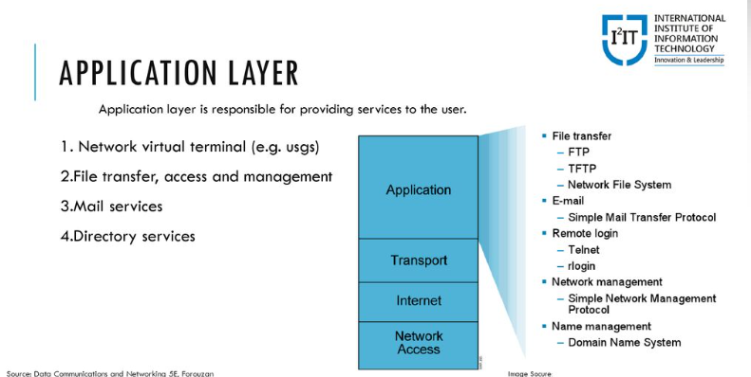

Slide 83
Logical connection between the two end system is end to end.
Communication at this layer is between two processes .
To communicate, a process sends a request to the other process and receive a response.
Process-process communication is the duty of this layer.
It has many predefined protocols but, a user can also create a pair of processes to run at the two hosts

Slide 84
Hypertext transfer protocol (HTTP) is a vehicle for accessing the (WWW).
SMTP is main protocol used in electronic mail .
FTP used for transferring files from one host to another.
TELNET ( Terminal N/w) and Secure Shell (SSH)used for accessing site remotely.
SNMP –used by an administrator to manage the internet at global and local levels
DNS – used to find network layer address of a computer
IGMP ( Internet group management protocol) used to collect membership in a group.

Slide 85
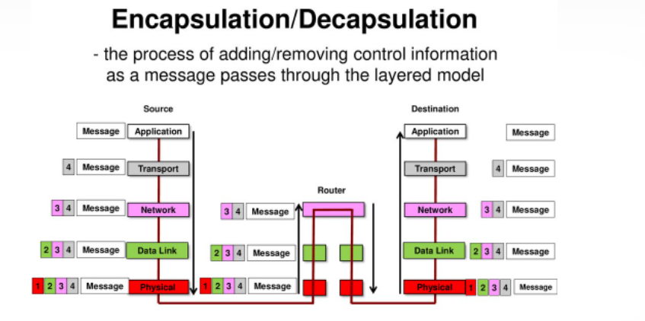

Slide 86
Encapsulation at source host
At the source , we have only encapsulation
At the application layer, the data to be exchanged is reffered as a message. Normally msg doesn’t contain any header or trailer if it does we refer to the whole as the message.
The transport layer takes the message as the payload, the load that the transport layer should take care of. It adds the header to the paylod, which contains the identifiers of the source and destination application programs that wants to communicate + some more info needed for end to end delivery of the msg. Such info is needed for flow,error and congestion control.
The result is the transport layer packet which is called the segment(in TCP) and the user datagram in UDP

Slide 87
c) The network layer takes the data/payload and adds its own header to the payload. The header contains the address of the source and destination hosts and some more info used for error checking of the header, fragmentation information and so on. The result is called a datagram.
d) The data link layer takes the datagram and adds its own header which contains the link-layer address of the host or the next hop. The result is called as a frame.

Slide 88
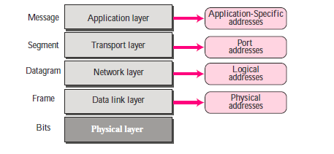
Addressing

Slide 89
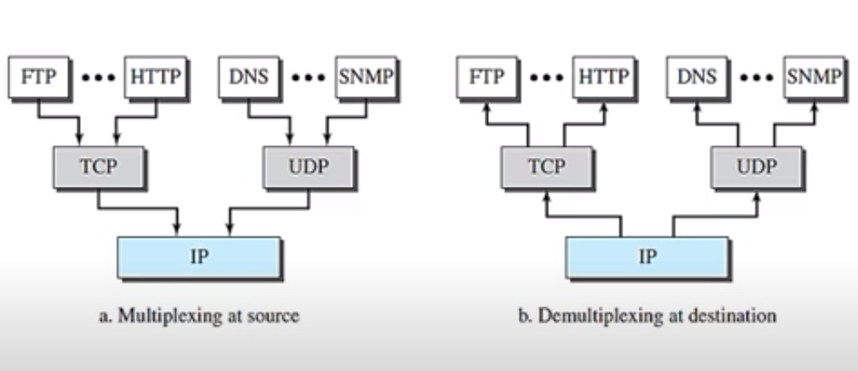
Multiplexing and Demultiplexing

Slide 90
THE OSI MODEL
International Standards Organization (ISO) established in 1947.
ISO is a multinational body dedicated to worldwide agreement on international standards.
An ISO standard that covers all aspects of network communications is the Open Systems Interconnection (OSI) model.
An open system is a set of protocols that allows any two different systems to communicate regardless of their underlying architecture.
ISO is the organization. OSI is the model.

Slide 91
OSI Layer
Purpose of the OSI model is to show how to facilitate communication between different system without requiring changes to the logic of the underlying hardware and software.
The OSI model is a layered framework for the design of network systems that allows communication between all types of computer systems.
It consists of seven separate but related layers.
Each layers defines a part of the process of moving information across a network.
An understanding of the fundamentals of the OSI model provides a solid basis for exploring data communications.

Slide 92
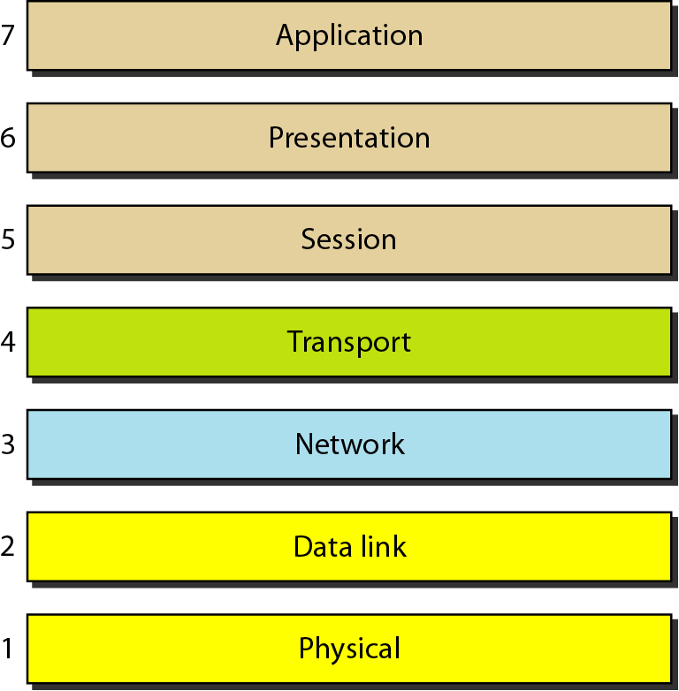
Layers of OSI model

Slide 93
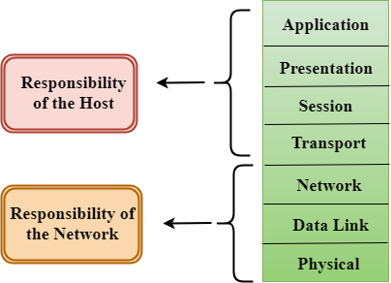
Organization of the layers
Upper layers deals with the application related issues, and they are implemented only in the software.
Lower layers deals with the data transport issues. The last two layers are implemented in hardware and software.

Slide 94
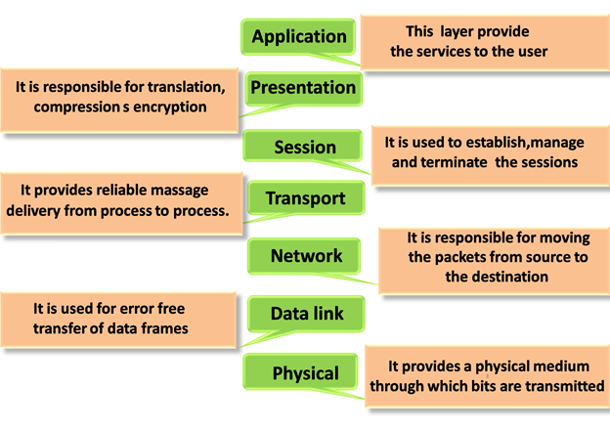
Functions of each layer-In Brief

Slide 95
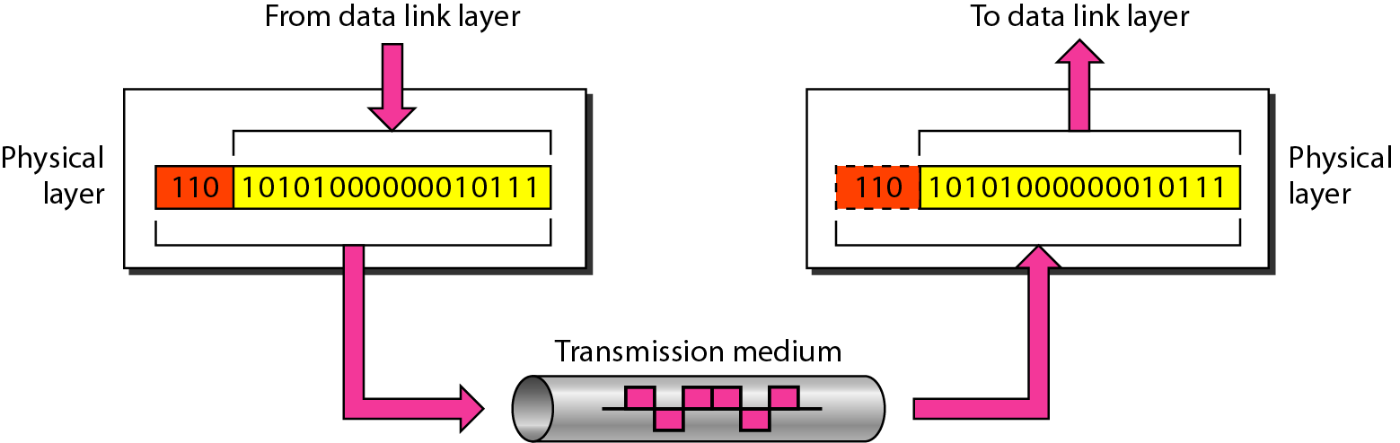
Layers in the OSI model(Specific)
Physical Layer: The layer is responsible for movements of individual bits from one hop (node) to the next.
Functions:
Line Configuration: Defines how two or more systems connected.
Data Transmission: Transfer of bits from sender to receiver.
Signals: Determines the type of signal used for transmission.

Slide 96
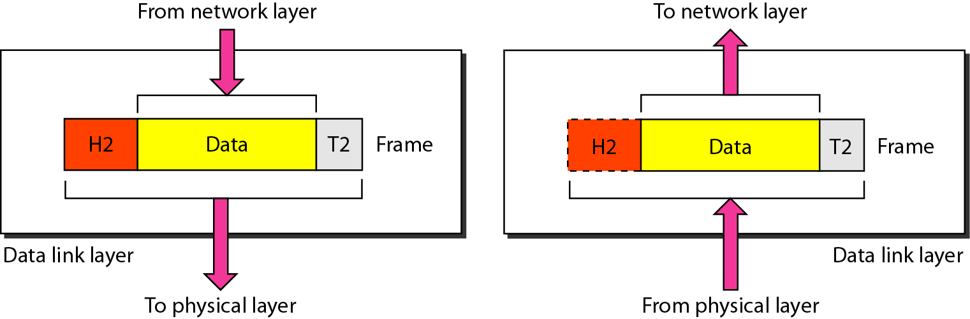
Data Link Layer
It is mainly responsible for the unique identification of each device that resides on a local network.
The data link layer is responsible for moving frames from one hop (node) to the next.
Framing- Adds header(S&D MAC address) and trailer(CRC)
Physical Addressing- Destination address
Flow Control- Constant data rate between sender and receiver.
Error Control- CRC added to the trailer.
Access Control- Defines which device has a control over the link if two or more devices connected to the same link.

Slide 97
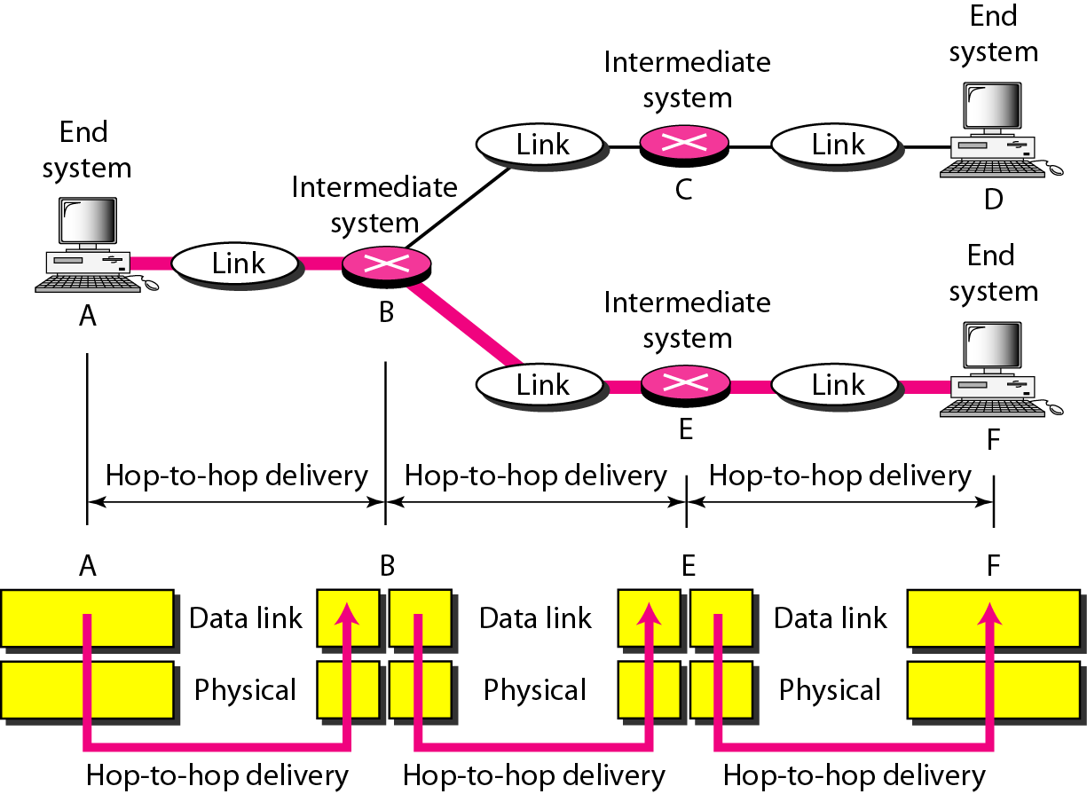
Hop-to-Hop Delivery

Slide 98
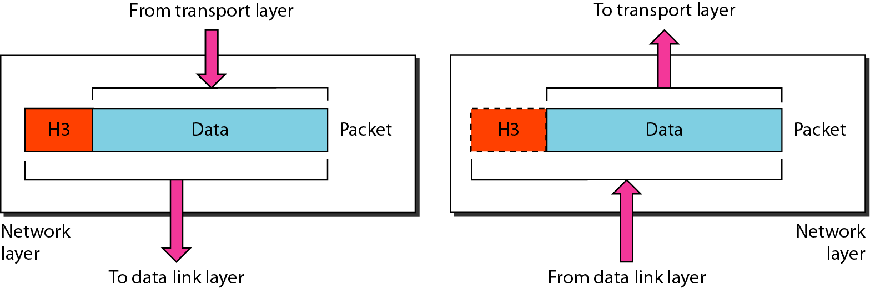
Network Layer
It determines the best path to move data from source to the destination.
The network layer is responsible for routing and addressing (IP) the packets.
Responsible for the delivery of individual packets from the source host to the destination host.

Slide 99
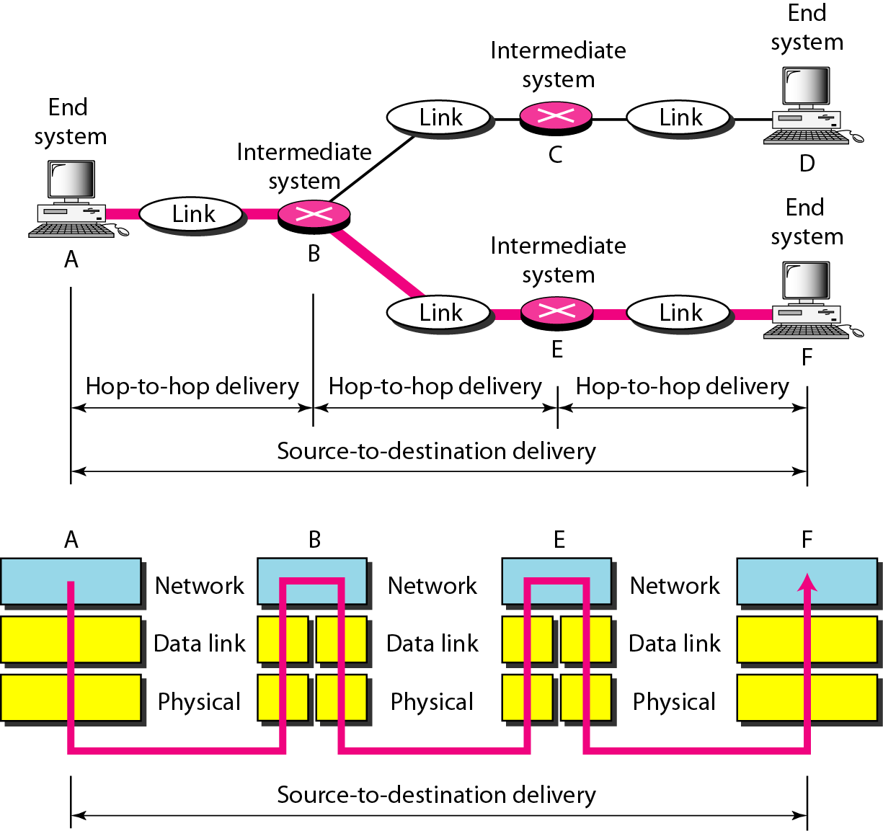
Network Layer- Source to destination delivery

Slide 100
Functions of Network layer
Addressing: adds the source and destination IP address to the header of the frame.
Addressing is used to identify the device on the internet.
Routing: It determines the best optimal path out of the multiple paths from source to the destination.
Packetizing: A Network Layer receives the packets from the upper layer and converts them into packets.

Slide 101
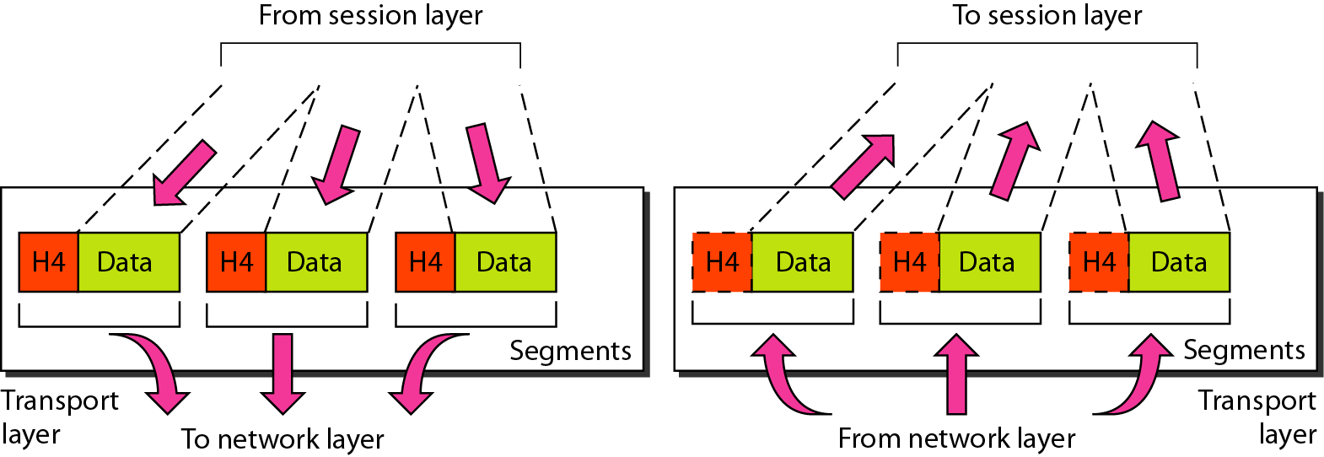
Transport Layer
The transport layer is responsible for the delivery of a message from one process to another.
Ensures that messages are transmitted in the order in which they are sent and there is no duplication of data.
It receives the data from the upper layer and converts them into smaller units known as segments.
Two protocols are used: TCP and UDP

Slide 102
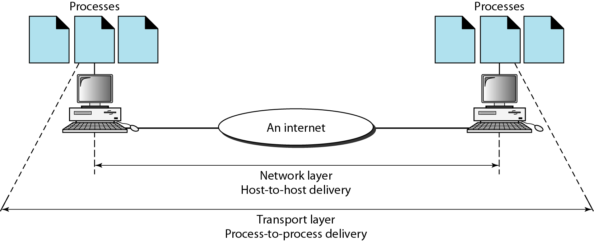
Functions of transport layer
Service-point addressing: Port address. i.e process to process delivery.
Segmentation and reassembly: Sequence Numbering.
Connection control: Single route or different route.
Flow control and Error control

Slide 103
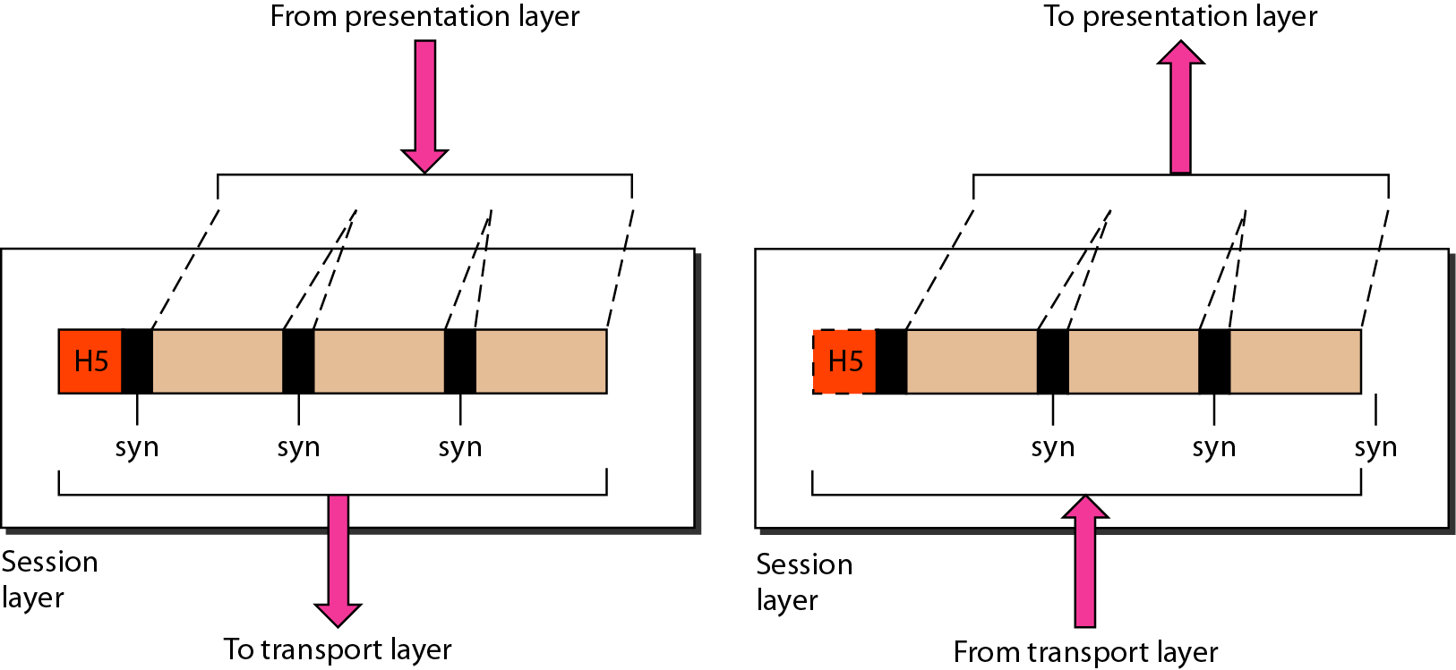
Session Layer
Session layer is used to establish, maintain and synchronizes the interaction between communicating devices.
Functions:
Dialog control: Half duplex or full duplex.
Synchronization: Adds some checkpoints when transmitting the data in a sequence. If error occurs, transmission take place again from the checkpoint.

Slide 104
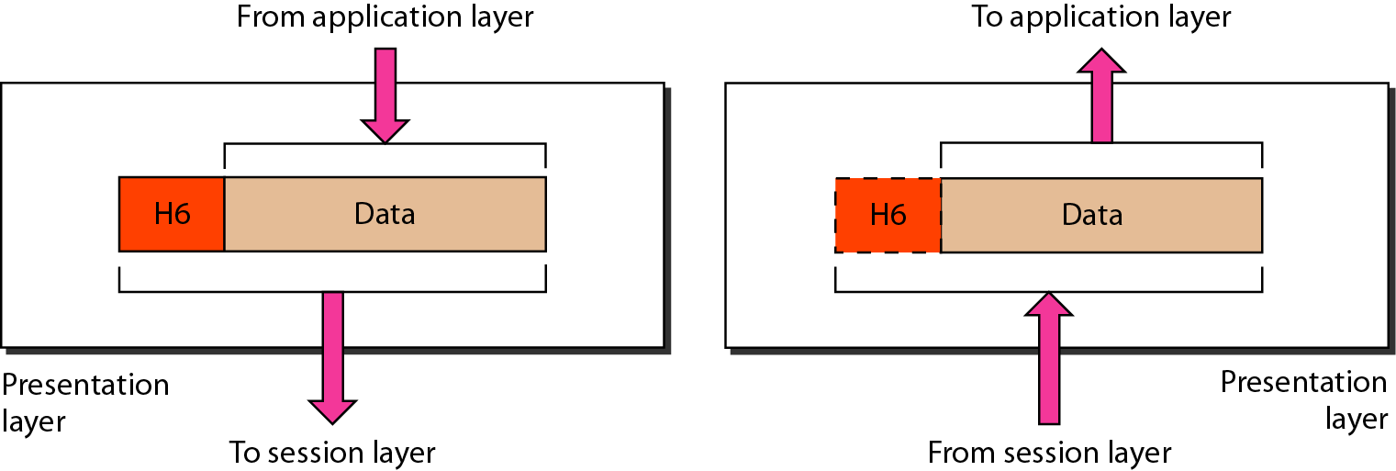
Presentation Layer
Mainly concerned with the syntax and semantics of the information exchanged between the two systems.
It acts as a data translator between network and OS.
Part of the operating system that converts the data from one presentation format to another format.
Functions: Translation, Encryption and Compression.

Slide 105
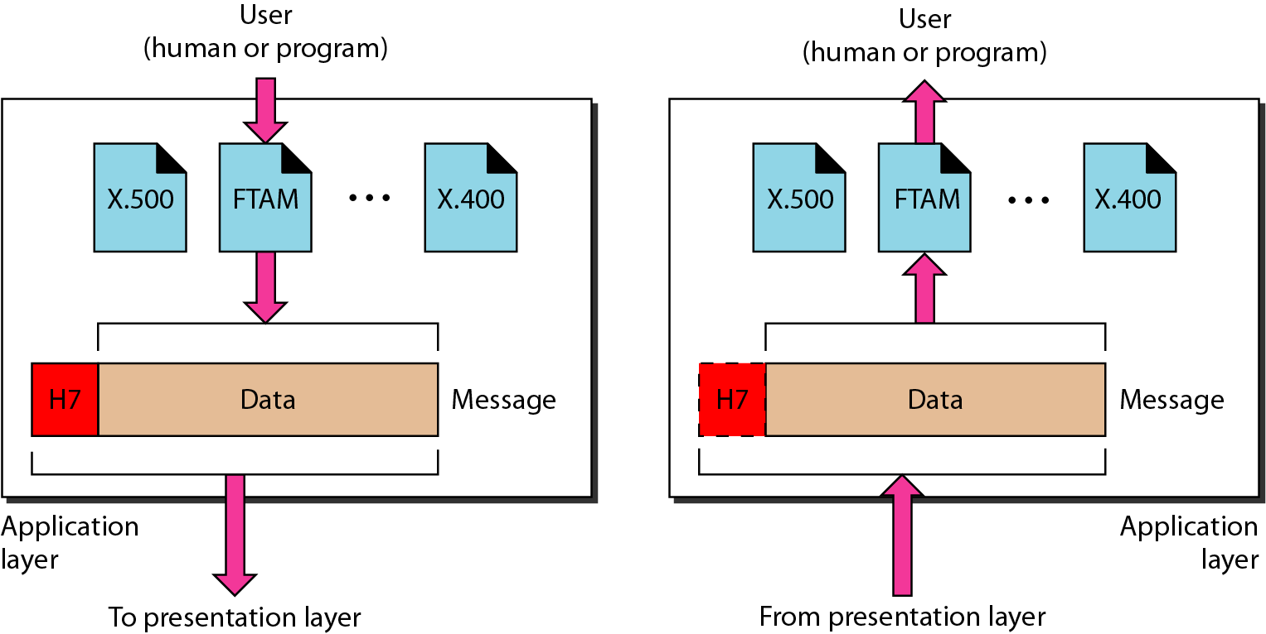
Application Layer
An application layer serves as a window for users and application processes to access network service.
This layer provides the network services to the end-users.
Functions-
File transfer, access, and management (FTAM)
Mail services

Slide 106
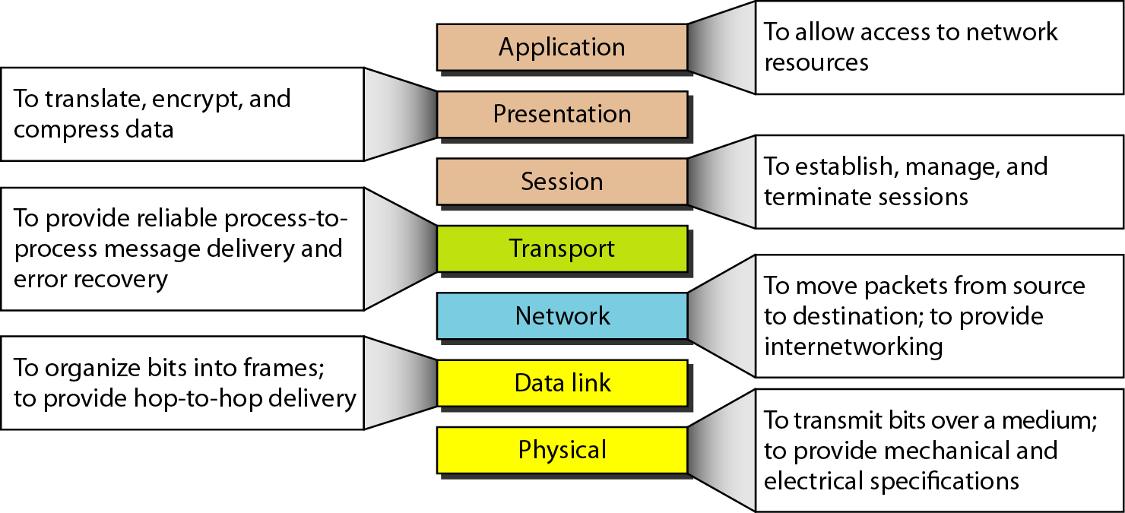
Summary of Layers

Slide 107
Lack of OSI Model’s Success
OSI model was completed when TCP/IP was fully in place and a lot of time and money had been spent on the suite, changing it would cost a lot.
Some layers in OSI model were never fully defined for example, although the service provided by the presentation and session layers were listed in the document, actual protocols for these two layers were not fully defined.
When OSI was implemented by an organization in a different application, it did not show a high enough level of performance to switch from TCP/IP protocol suite to OSI model.

