Slide 1


K.RAMAKRISHNAN COLLEGE OF TECHNOLOGY (AUTONOMOUS), TRICHY
Testing for Differences in Average Heights of Boys and Girls
PRESENTED BY
NANDHINI K-2303811724322075

Slide 2
PRESENTATION OVERVIEW
PROBLEM IDENTIFICATION AND ANALYSIS
OBJECTIVE
BLOCK DIAGRAM OF PROPOSED SYSTEM
R STRUCTURE USED
ADVANTAGES OF PROPOSED SYSTEM
MODULES OF THE SYSTEM
IMPLEMENTATION AND OUTPUT
CONCLUSION

Slide 3
PROBLEM IDENTIFICATION AND ANALYSIS
In many research fields, it is important to determine whether boys and girls have significant height differences.
This study helps in understanding growth patterns, nutrition requirements, and biological variations.
The comparison can be used in sports, education, and medical studies.
A statistical approach using R programming ensures accurate and data-driven results.
2/7/20

Slide 4
OBJECTIVE
To compare the average heights of boys and girls using statistical methods.
To test if there is a significant difference in their mean heights.
To use an independent t-test to validate the hypothesis.
To visualize the height distribution for better understanding.

Slide 5
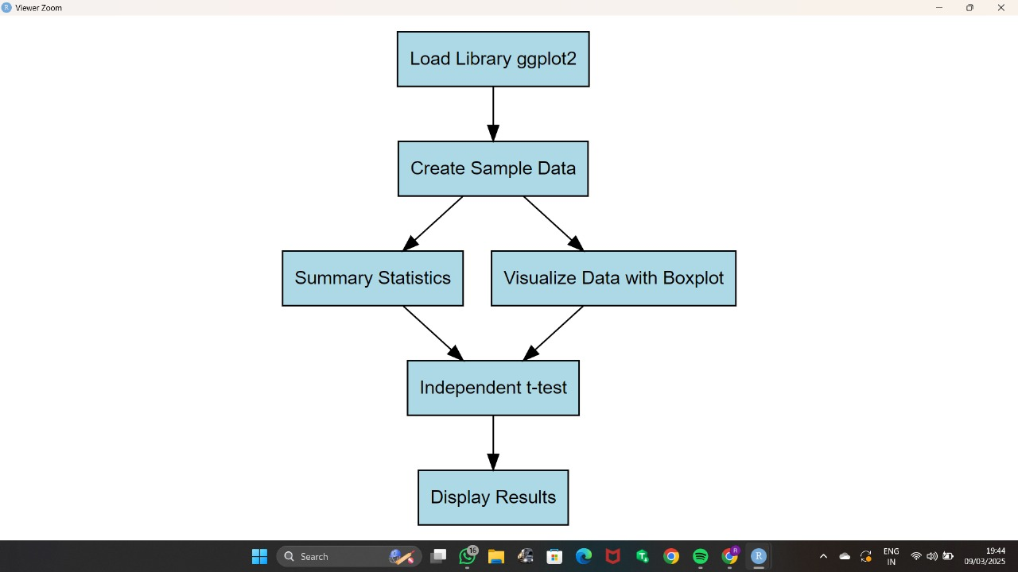
PROPOSED SYSTEM & ARCHITECTURE BLOCK DIAGRAM

Slide 6
R STRUCTURE USED
Data Frames (data.frame):
Used to store structured data in rows and columns (like tables in databases).
Tidyverse (tidyverse Package):
A collection of R packages for data manipulation, visualization, and statistical analysis.
Independent t-test (t.test):
A statistical test used to compare the means of two independent groups.
Visualization (ggplot2 Package):
Used for creating advanced graphs such as boxplots and histograms.

Slide 7
ADVANTAGES OF PROPOSED SYSTEM
Accuracy: Uses statistical methods to ensure reliable results.
Visualization: Provides clear graphical insights into the data.Data-Driven
Decision Making: Helps in making conclusions based on statistical evidence.
Applicability: Can be used in research, education, healthcare, and sports.

Slide 8
LIST OF MODULES
Data Collection Module
Data Preprocessing Module
Statistical Testing Module
Reporting and Interpretation Module
5.Data Visualization Module

Slide 9
MODULES OF THE SYSTEM
Data Collection Module
Collects height data for boys and girls from surveys, online datasets, or manually recorded sources.
Data Preprocessing Module
Removing missing or invalid entries.Converting data into structured format using data.frame
Statistical Testing Module
Applies a t-test to compare the means of the two groups.

Slide 10
MODULES OF THE SYSTEM
Reporting and Recommendation Module
Summarizes the test results and provides conclusions
Data Visualization Module
Helps communicate results effectively
Creates visual insights using ggplot2 with:
Boxplots – for comparing distribution
Histograms – for observing frequency of height ranges
Helps communicate results effectively

Slide 11
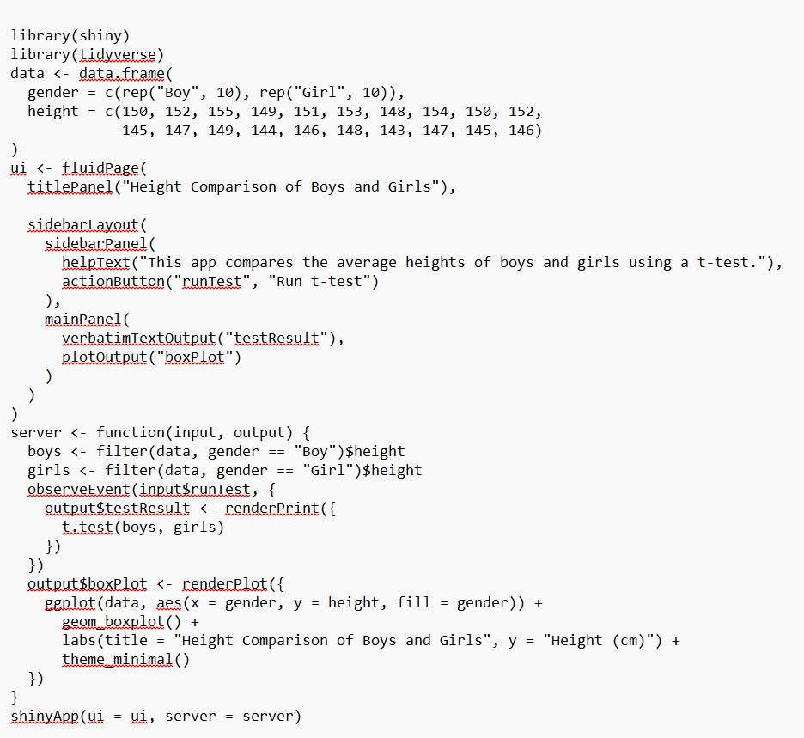
IMPLEMENTATION

Slide 12
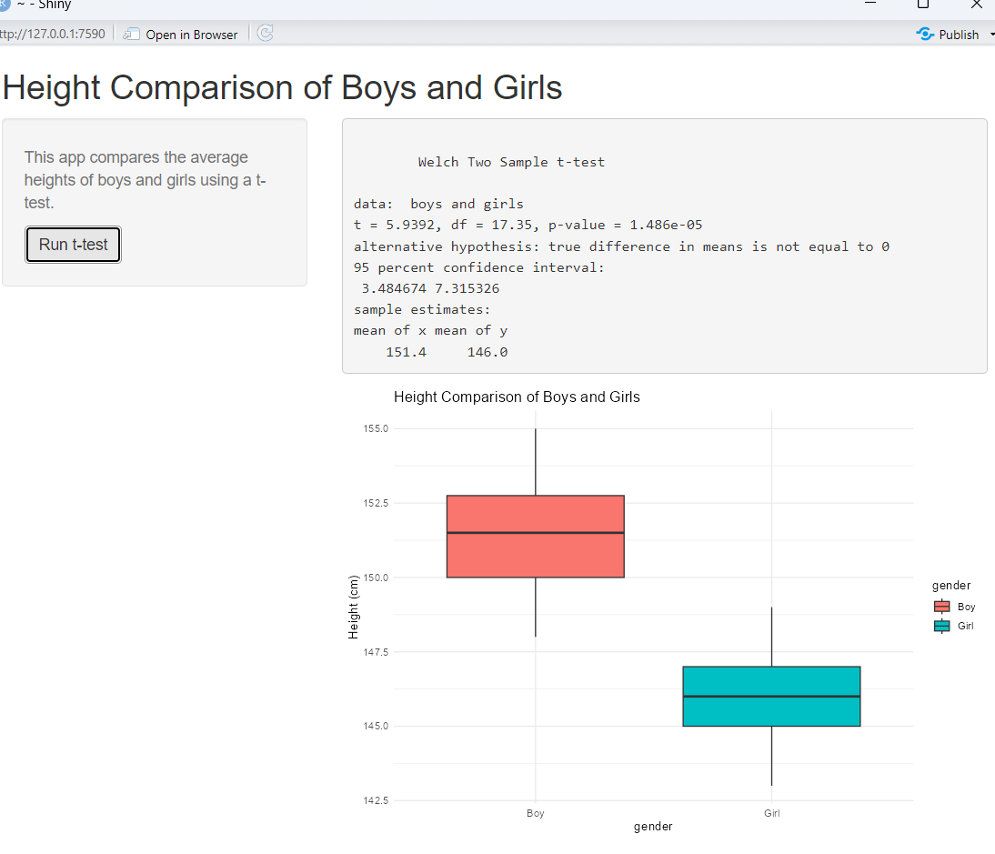
OUTPUT

Slide 13
CONCLUSION
The project successfully tested for differences in the average heights of boys and girls using R. The independent t-test provided statistical evidence to accept or reject the hypothesis. Visualizations helped enhance understanding of the data distribution.
Key takeaways:
The methodology is accurate and reliable.
Results are data-driven and easily interpreted.
Applicable in various fields like health, education, and sports science.

Slide 14


