Slide 1
CGB1201 – JAVA PROGRAMMING
Department of Artificial Intelligence and Data Science
Academic Year: 2024 – 2025 (Odd Semester)
Register Number : 2303811724322075
Name : K.NANDHINI
Year : II
Semester : III
Section : B
Date : 3.12.2024

Slide 2
Title of the Project
ALUMNI MANAGEMENT SYSTEM

Slide 3
Problem Identification
The Alumni Management System solves problems like disorganized communication, difficulty managing events, and storing alumni data. It helps keep alumni engaged with their institution and ensures their information is secure and easily accessible. This system makes it easier for institutions to connect with alumni and organize events efficiently.

Slide 4
Objective
The objective of the Alumni Management System is to provide a centralized platform for educational institutions to maintain and strengthen relationships with their alumni. It aims to facilitate communication, streamline event management, securely store alumni data, and encourage ongoing engagement and participation from alumni to support institutional growth and development.

Slide 5
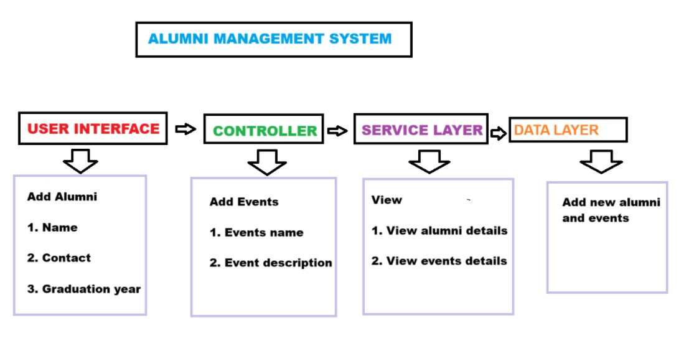
Proposed Architecture

Slide 6
Java Programming - Concepts Used
1. OOP Principles: Using classes and objects for structured and modular design
2. Exception Handling: Managing errors effectively during inputs or database operations.
3. File Handling: Storing and retrieving data for backups and reports.

Slide 7
List of Modules
1. Alumni Module
2. Event Module
3. Alumni Management Module
4. Event Management Module
5. User Interface Module

Slide 8
Module Description
1. Alumni Module:
This module manages alumni-related data, such as personal information, academic details, and contact information. It allows institutions to register, update, and search for alumni. It also facilitates alumni-specific actions like updating their profiles, sharing achievements, and interacting with fellow alumni.
2. Event Module:
The Event Module handles the creation, registration, and management of alumni-related events. It tracks event details such as dates, venues, guest lists, and schedules. Alumni can register for events, receive reminders, and provide feedback after attending. It helps institutions plan and execute events like reunions, webinars, and networking sessions.

Slide 9
Module Description (Cont..)
3. Alumni Management Module:
This module is responsible for managing the overall alumni network. It facilitates alumni communications, sending newsletters, updates, and invitations. It also handles data analytics to track alumni engagement, participation in events, and contributions. The module aims to strengthen the relationship between alumni and the institution.
4. Event Management Module:
The Event Management Module oversees the entire process of event planning, execution, and follow-up. It supports the creation of events, sending invitations to alumni, managing registrations, tracking attendance, and collecting feedback. It also integrates with the database to ensure all event details are accurately recorded and up-to-date.

Slide 10
Module Description
5. User Interface Module:
The User Interface (UI) Module provides an easy-to-navigate front-end experience for users (alumni, administrators, and event managers). It displays all functionalities like registration, login, event listings, alumni searches, and profile management. The UI ensures the system is user-friendly, accessible, and responsive across various devices.

Slide 11
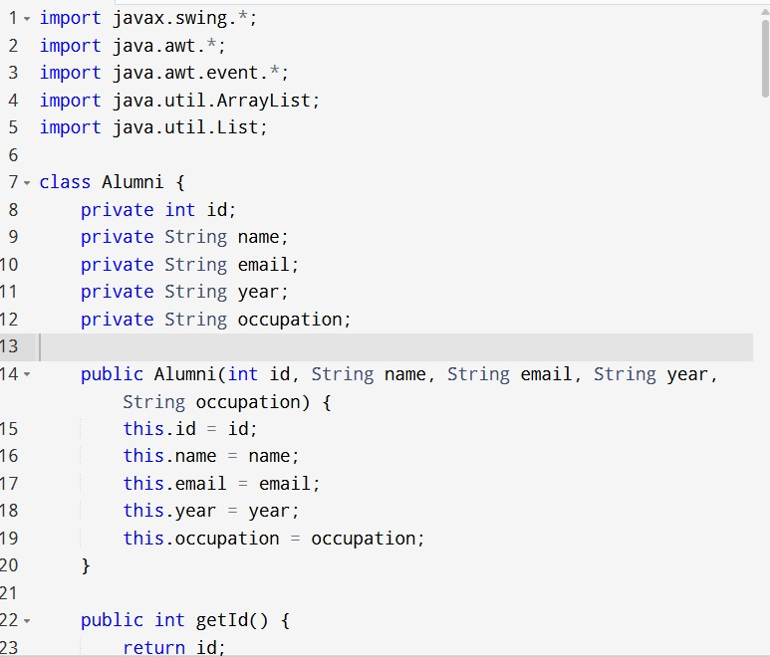
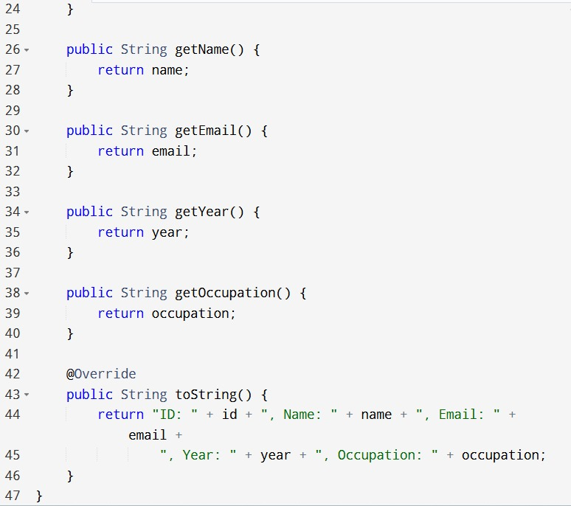
Source Code

Slide 12
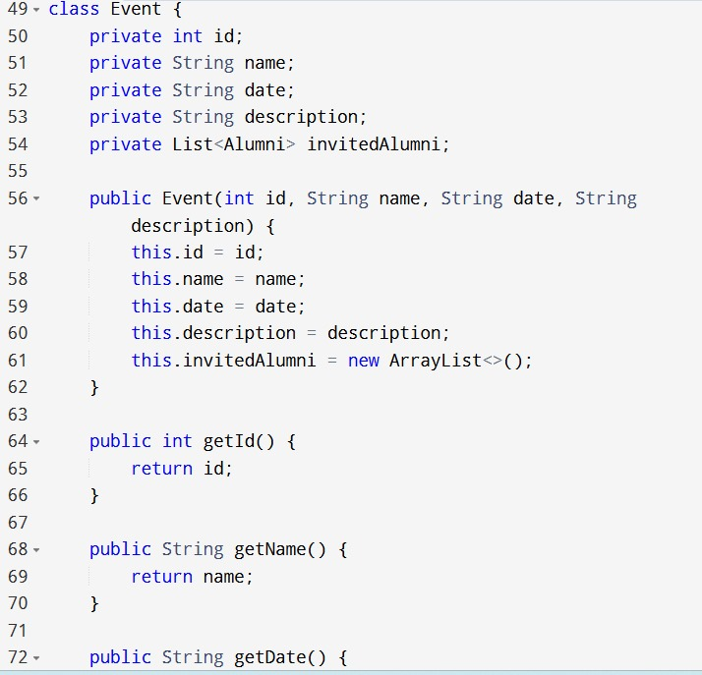
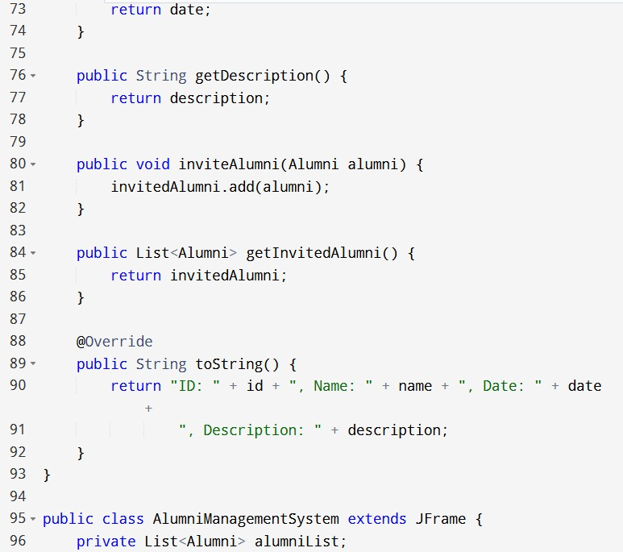
Source Code

Slide 13
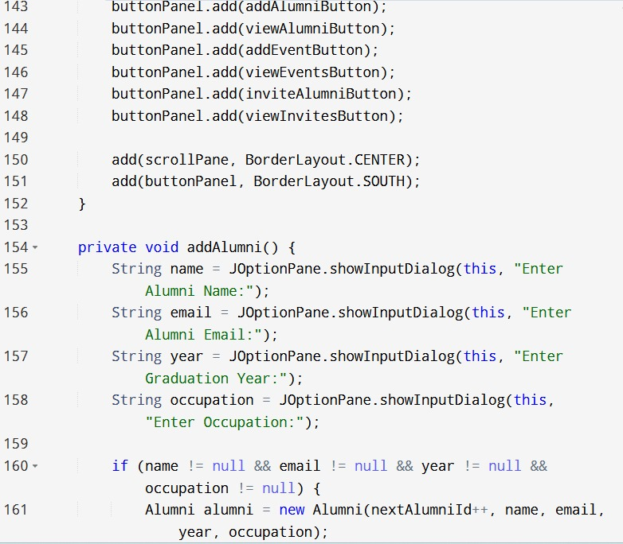
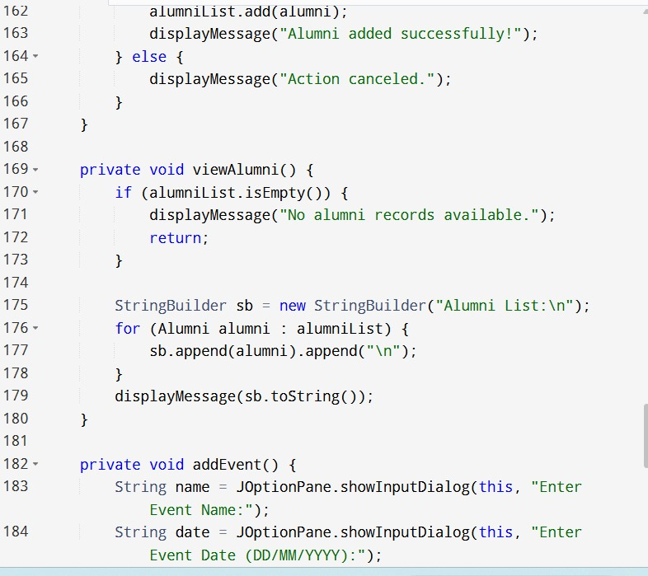
Source Code

Slide 14
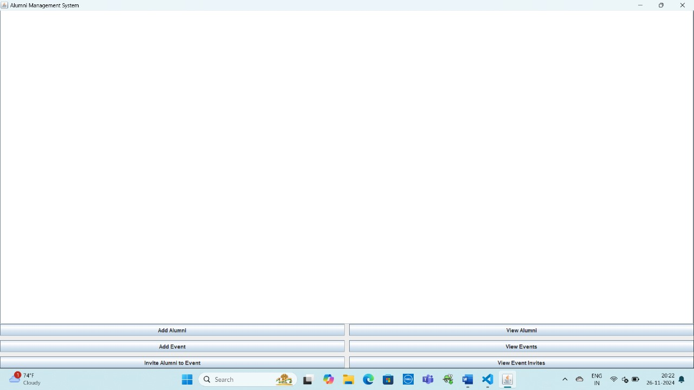
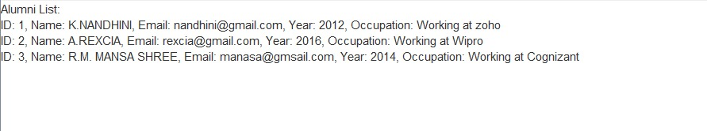
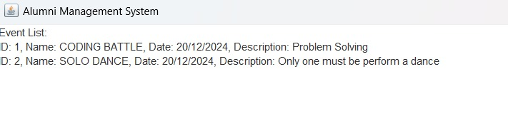
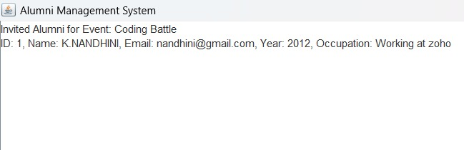
Results

Slide 15
Conclusion
In conclusion, the Alumni Management System is a comprehensive solution designed to foster strong and lasting connections between educational institutions and their alumni. By streamlining communication, event management, and data handling, it ensures that alumni remain engaged and active contributors to the institution’s growth. The system provides a centralized platform for managing alumni information, organizing events, and maintaining secure and efficient communication. Overall, it enhances the relationship between alumni and their alma mater, promoting mutual support and growth for both parties.

Slide 16
Thank You

