Slide 1
FISCAL DEVELOPMENT DASHBOARD
31
Government Expenditure, Fiscal Conditions and Economic Development in Indian States
states and UTs
11
fiscal years
A panel data analysis, 2011-12 to 2021-22
304
model observations
MSc Economics and Data Analytics | Python

Slide 2
Introduction
Why state fiscal behaviour matters for development
State governments carry much of India's public spending on health, education and infrastructure.
States differ widely in income: the richest average about 11 times the poorest.
Do states that spend more on social, capital or revenue items also have higher income?
We study 31 states and UTs over 2011-12 to 2021-22 using panel methods.
GOA VS BIHAR INCOME
11x
FISCAL YEARS STUDIED
11
FISCAL INDICATORS
5

Slide 3
Research question and objectives
For 28 Indian states and union territories over 2011–12 to 2021–22, how are the size and mix of state government spending, the fiscal deficit and outstanding debt (each relative to GSDP) associated with real per-capita income within states over time?
1
Describe income gaps and fiscal positions across states
2
Estimate within-state links between fiscal ratios and income (pooled OLS, FE, RE)
3
Test robustness to outliers, sample, timing and the COVID year
4
Identify whether any robust link reflects spending or GSDP growth
5
Assess convergence and COVID shock and recovery

Slide 4
Hypotheses
H1 and H2 are one-sided (positive); H3 to H5 are two-sided, at the 5% level
H1
Social spending raises income (+)
H2
Capital spending raises income (+)
H3
Revenue spending has a significant relationship
H4
Fiscal deficit has a significant relationship
H5
Outstanding liabilities have a significant relationship

Slide 5
01
Data and method
How the panel was built and checked before any model was run

Slide 6
Methodology
Three ways to estimate, and two tests to choose between them
Pooled OLS
Treats every state-year as one big sample
Ignores differences between states
Fixed effects
Compares each state only with itself over time
Removes fixed state traits
Random effects
Uses changes within states and differences between them
Our main model
HOW WE CHOSE
1
Do states differ from each other?
F-test and LM test: yes, p < 0.001. Pooled OLS is rejected.
2
Fixed or random effects?
Mundlak test: p = 0.055, so random effects is kept. Fixed effects gives almost the same answer.
In every model: year effects absorb shocks common to all states, such as COVID; errors are clustered by state.
Notes:
We estimate the model in three ways. Pooled OLS treats every state-year as one big sample, which ignores the fact that states differ. Fixed effects compares each state only with itself over time, so fixed traits such as geography drop out. Random effects uses both the changes within states and the differences between them; it is our main model.
To choose, we ask two questions. First, do states differ from each other? The F-test and the LM test both say yes, with p below 0.001, so pooled OLS is rejected. Second, fixed or random effects? The Mundlak test gives p = 0.055, so random effects is kept, and fixed effects gives almost the same coefficient anyway.
Every model also includes year effects, which absorb shocks common to all states such as COVID, and standard errors are clustered by state.
If asked why Mundlak and not Hausman: the classical Hausman test assumes random effects is fully efficient, which fails with clustered errors; Mundlak is the robust version. If asked about p-values: with 28 states we use a t-distribution with 27 degrees of freedom, which is more conservative.

Slide 7
Raw accounts to a stress-tested estimate
How we built the evidence: six steps from state accounts to a panel estimate
341
5
11
Clean the panel
Build fiscal ratios
Audit anomalies
31 states/UTs × 11 years of income, spending, deficit and debt
Spending, deficit and liabilities over current-price GSDP
Liability ratios >2× or <½ the state median flagged
5 × 3
6
3
Estimate
Try to break it
Extend
5 specifications × pooled OLS, fixed and random effects
Winsorise, drop states, lag, add split dummy, drop COVID year
Mechanism, convergence and COVID shock-recovery tests
OUTCOME
FISCAL PREDICTORS (% OF CURRENT-PRICE GSDP)
ln per-capita NSDP, constant 2011–12 prices (real income per person, logged)
Revenue · Capital · Social-sector · Deficit · Liabilities
Notes:
Walk the pipeline left to right. The key design choices: fiscal ratios use current-price GSDP so numerator and denominator are both nominal; the outcome is real (constant 2011–12) per-capita NSDP in logs. We audited liabilities before modelling, compared pooled OLS, fixed and random effects across five specifications, and then tried six ways to break the main result. Assam, Haryana and Nagaland lack a verified current-price GSDP denominator, so their fiscal ratios are left missing rather than imputed — that is why the model sample is 304 rows across 28 states.

Slide 8
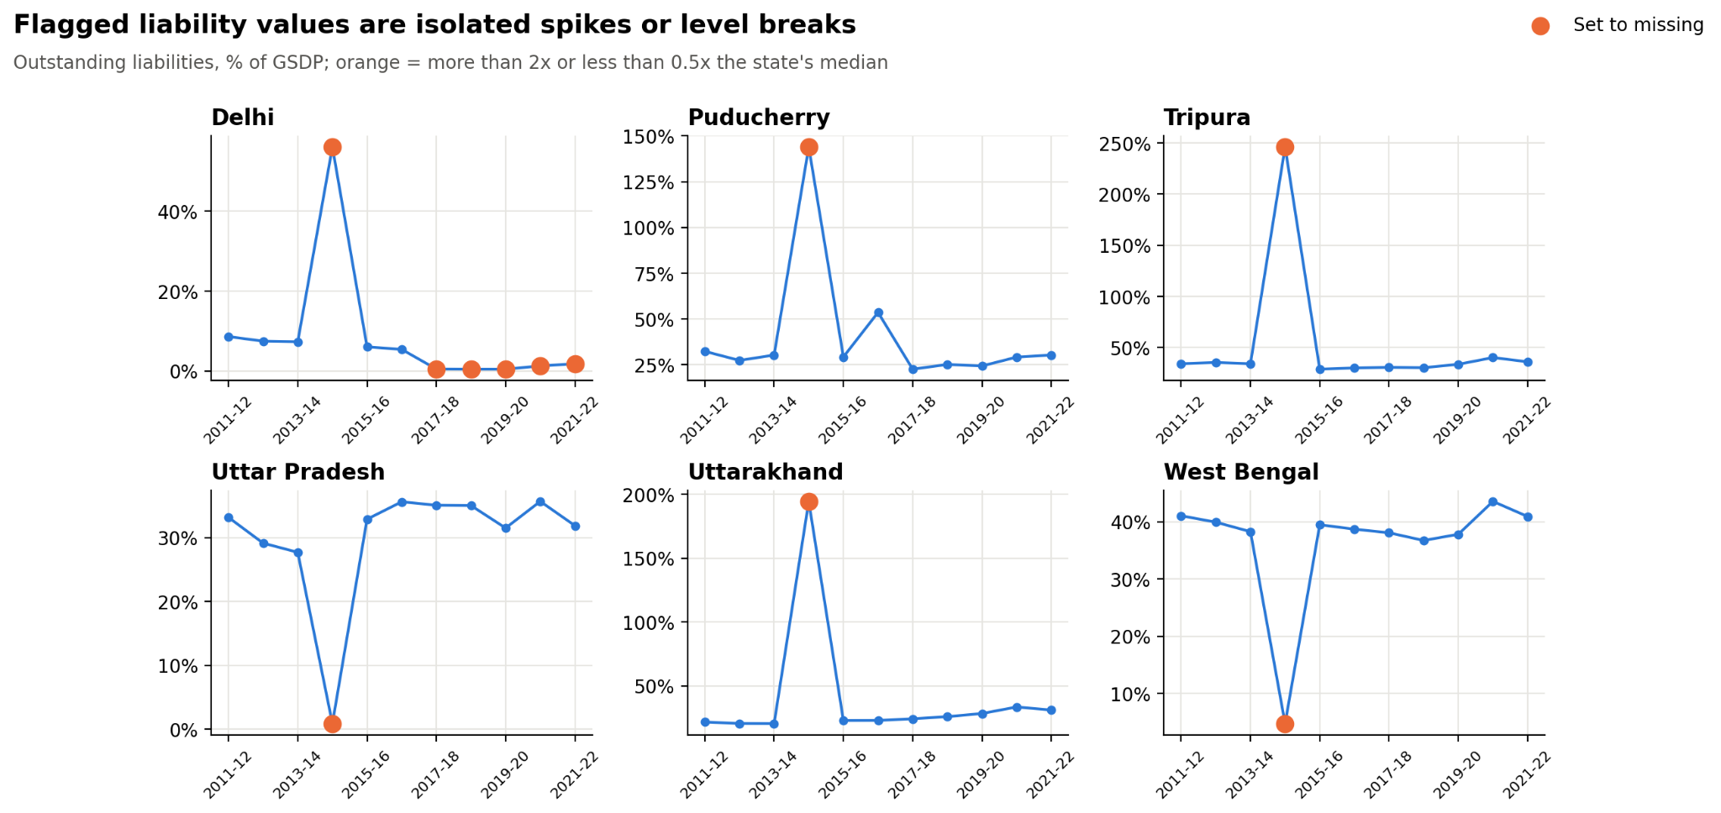
We audited first: 11 liability values flagged
Each panel is one state's liabilities-to-GSDP series; orange points are spikes or breaks
11
state-year liability values flagged as spikes or breaks
WHAT WE DID ABOUT IT
Flagged and documented every value
Winsorised 1%/99% as a robustness check
Logged ratios (Spec E) to tame skew
Left missing denominators missing
Notes:
Each panel shows one state's liabilities-to-GSDP series; orange points are more than twice or less than half the state's own median. Delhi, Puducherry, Tripura and Uttarakhand show one-year spikes in 2014–15 of up to 10× the median; Uttar Pradesh and West Bengal show one-year collapses in the same year; Delhi also has a level break from 2017–18. The 2014–15 clustering points to a reporting or unit issue rather than real fiscal events.

Slide 9
Variable construction
All fiscal variables are shares of current-price GSDP
Variable | Definition
ln per capita NSDP | Log of per capita NSDP, constant 2011-12 prices (outcome)
Social, capital, revenue | Nominal expenditure / current-price GSDP
Fiscal deficit | Fiscal deficit / current-price GSDP (can be negative)
Liabilities | Outstanding liabilities / current-price GSDP
Total, shares | Revenue + capital spending; social and capital shares of total
Logs and ln GSDP | Log ratios (Spec E); log constant-price GSDP (Spec A)
post_split | 1 for Andhra Pradesh and Telangana from 2014-15
A coefficient b on a fraction ratio means about b% change in income for +1 percentage point of GSDP.

Slide 10
Descriptive statistics
Per capita income is highly dispersed; spending ratios are right-skewed
Variable | N | Mean | Std. dev. | Min | Max
Per capita NSDP (Rs) | 341 | 101,644 | 58,428 | 21,750 | 313,973
Social sector / GSDP | 305 | 9.6% | 4.5% | 3.2% | 25.3%
Capital exp. / GSDP | 305 | 5.0% | 3.3% | 1.1% | 24.8%
Revenue exp. / GSDP | 305 | 19.2% | 9.5% | 4.8% | 53.9%
Fiscal deficit / GSDP | 305 | 2.9% | 2.1% | -4.2% | 12.4%
Liabilities / GSDP | 304 | 31.2% | 20.1% | 0.5% | 246%
Liabilities maximum (246%) is a flagged spike (Tripura, 2014-15).

Slide 11
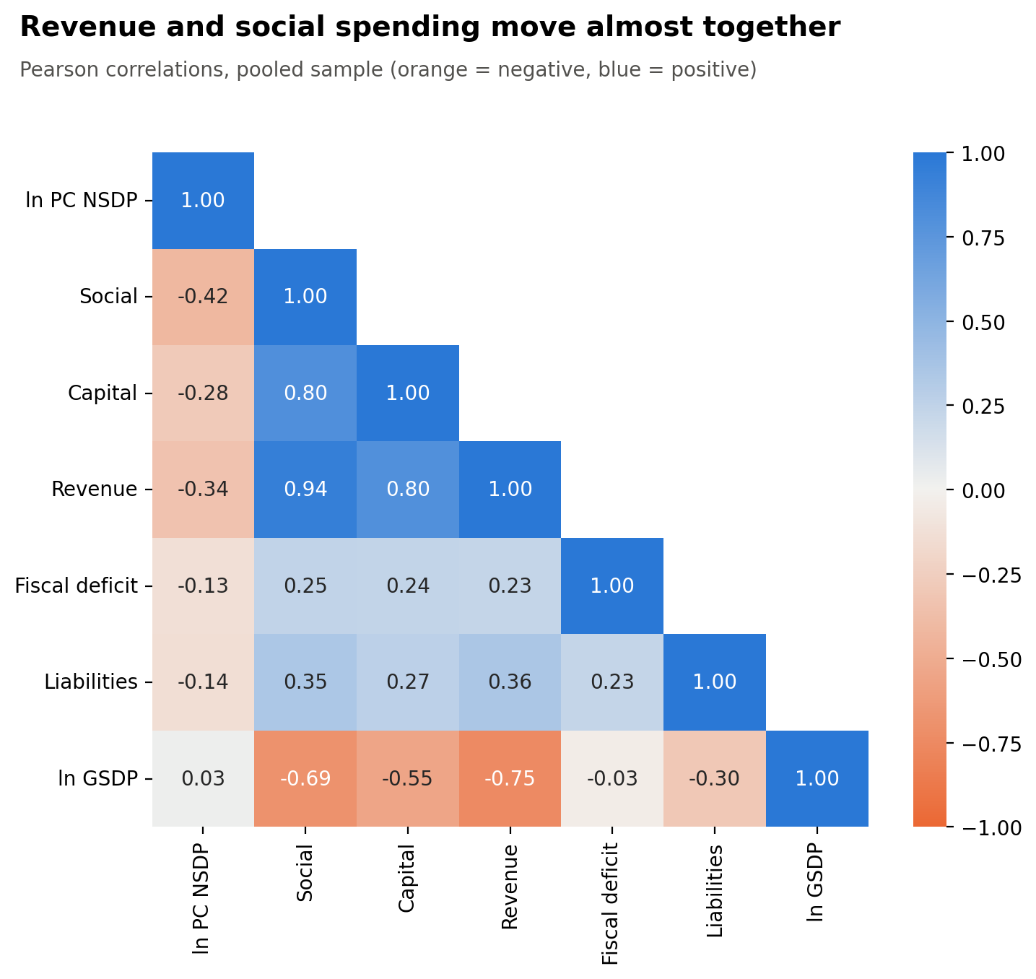
Revenue and social spending move in lockstep
Pooled correlations (r = 0.94) and variance inflation factors
0.94
−0.75
Revenue × social spending
Revenue spending × ln GSDP
VARIANCE INFLATION FACTORS (SPEC B)
Social sector exp.
9.9
Revenue exp.
9.7
Capital exp.
3.0
Fiscal deficit
1.1
Liabilities
1.2
SO WHAT
Separate effects of revenue and social spending are hard to pin down, so we run five specifications: C drops revenue spending, D uses total spending plus shares, E logs every ratio.
Notes:
Pooled Pearson correlations. Revenue and social spending ratios correlate at 0.94, capital and social at 0.80, giving variance inflation factors near 10 for revenue and social spending in the main specification. All spending ratios correlate negatively with ln GSDP — revenue at −0.75 — because bigger economies spend a smaller share of output. This is why we estimate five specifications, including one without revenue spending and one with total spending plus composition shares.

Slide 12
Research question and objectives
How do expenditure patterns and fiscal conditions relate to economic development across Indian states?
1
Describe income differences and trends across states
2
Estimate how spending, deficit and liabilities ratios relate to per capita income
3
Choose between pooled, fixed and random effects
4
Test five hypotheses and check robustness
5
Explore extensions: ratio mechanism, convergence, COVID-19

Slide 13
Model specifications A to E
Dependent variable: ln per capita NSDP
A
Spending ratios plus ln GSDP
B
Main: social, capital, revenue, deficit, liabilities
C
Spec B without revenue spending
D
Total spending plus composition shares
E
Log ratios (elasticities)

Slide 14
02
The landscape
Objective 1: describe income gaps and fiscal positions across states

Slide 15
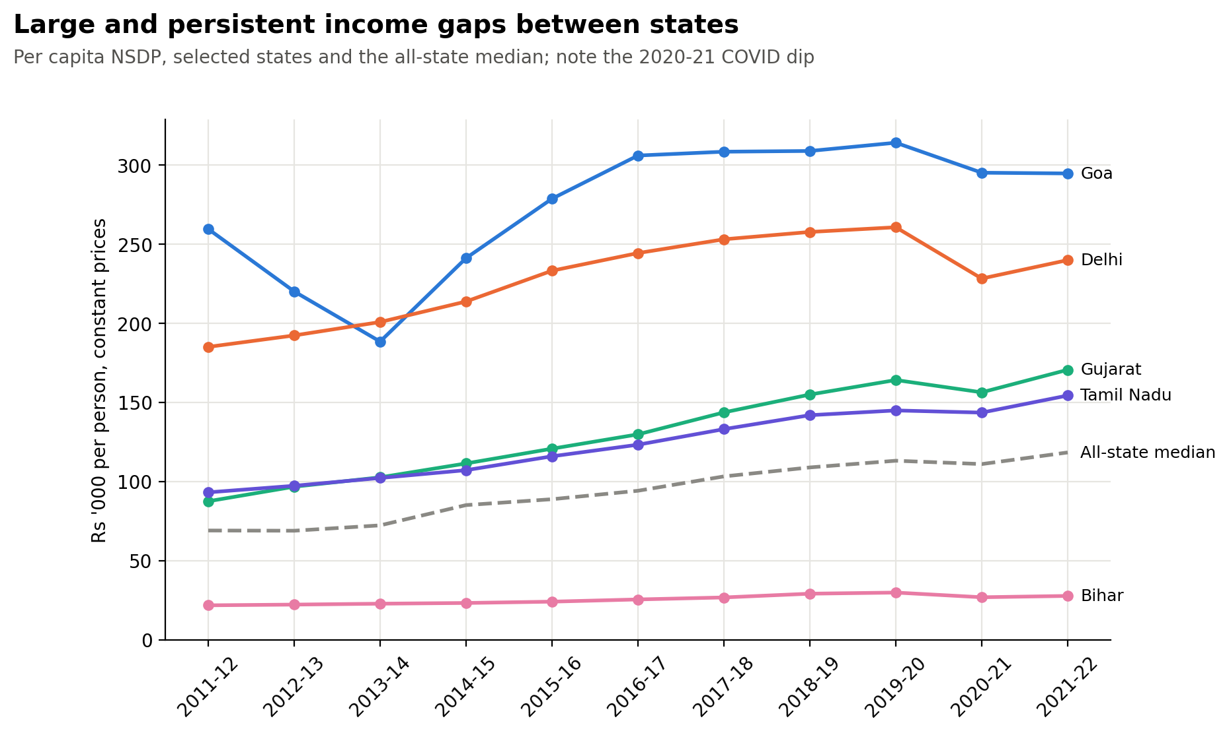
The richest state earns 10.6× the poorest
Real per-capita NSDP for selected states against the all-state median
10.6×
Goa vs Bihar, 2021–22
+71%
Real growth of the median state, 2011–12 to 2021–22
SO WHAT
Every state dipped in 2020–21, but the ranking barely moved. The gap is structural, not cyclical.
Notes:
Real per-capita NSDP for selected states against the all-state median. Goa and Delhi are far above everyone else; Gujarat and Tamil Nadu pull steadily away from the median; Bihar is flat near the bottom. The 2020–21 COVID dip is visible in every line. This is descriptive and unweighted by population.

Slide 16
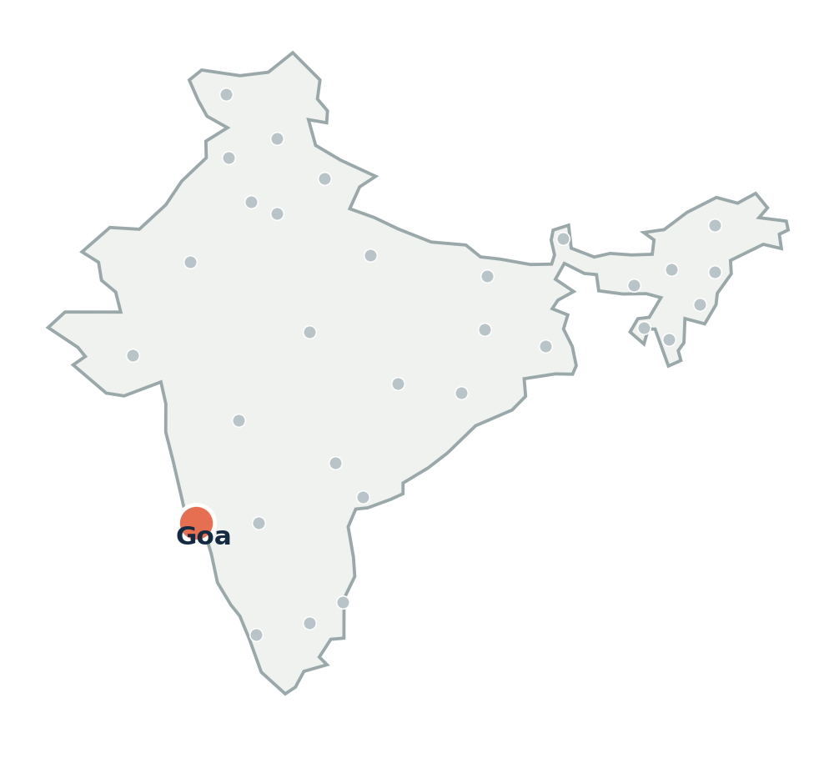
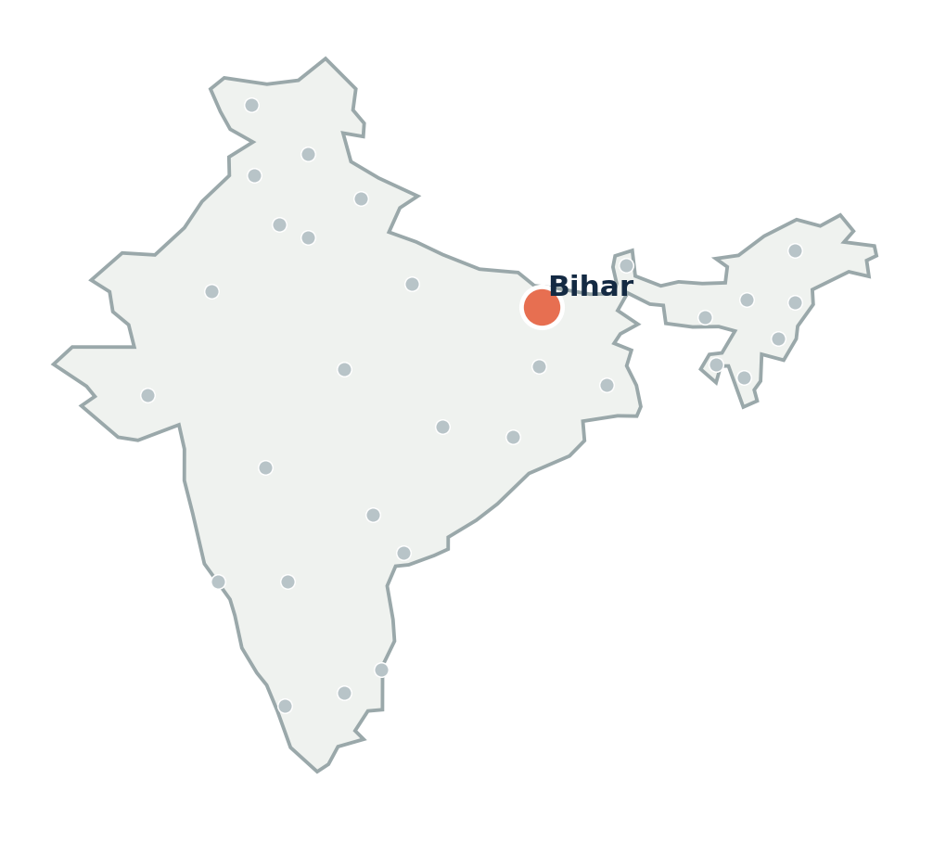
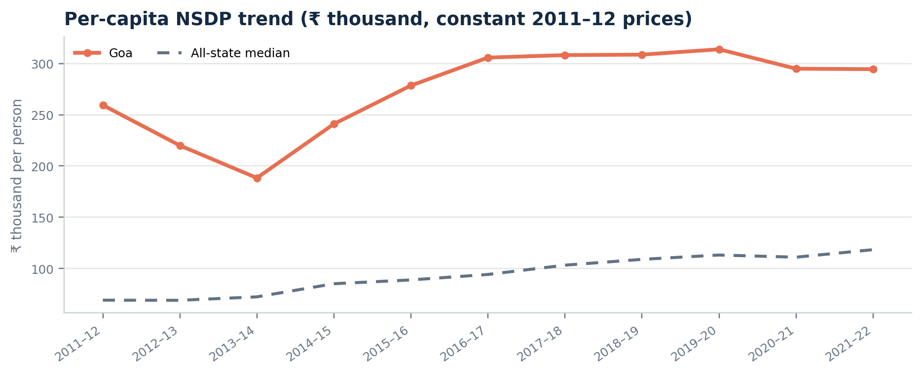
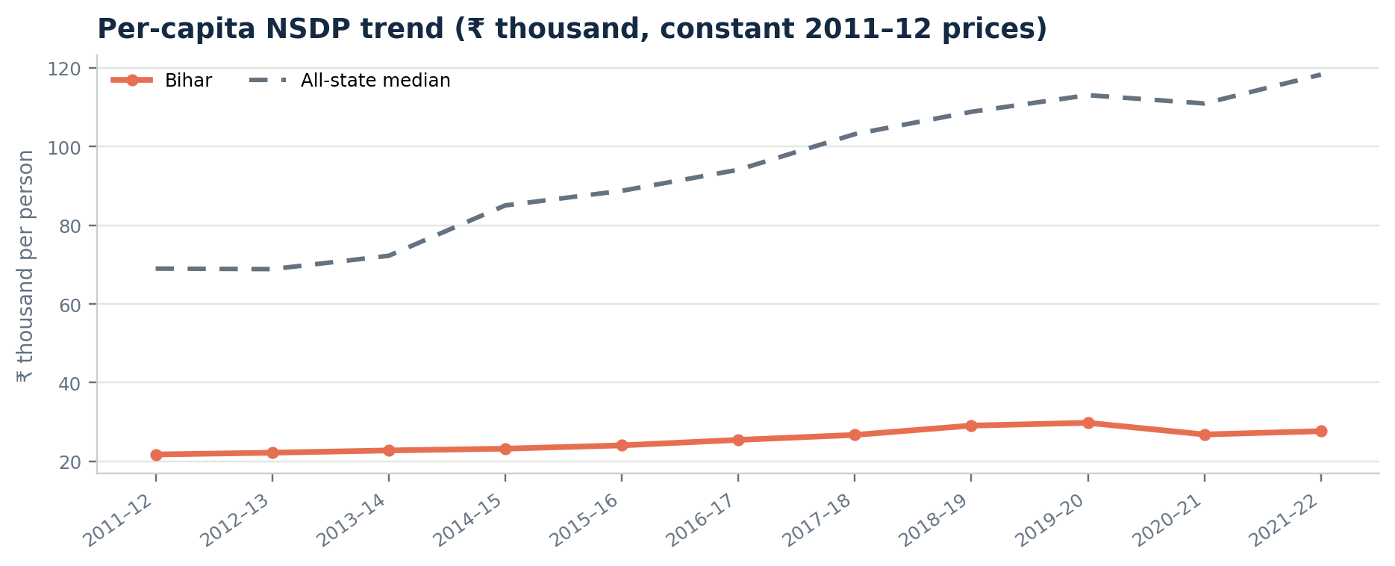
Two Indias: Goa earns 2.5× the median
Bihar earns under a quarter of the median; real per-capita NSDP trend vs all-state median
Goa
Bihar
₹2.95 lakh
₹27,674
2.5× the all-state median in 2021–22
+13.5% real growth over the decade
0.23× the all-state median in 2021–22
+27% real growth, from a very low base
Bihar grew, yet its rupee gap with the median nearly doubled: from ₹47,000 to ₹91,000 per person.
Notes:
Goa is the richest state, but its income was volatile early in the decade — it fell sharply in 2012–13 and 2013–14, the period of the iron-ore mining ban, then rebounded to above ₹3 lakh. Bihar grew steadily, 27% in real terms over the decade, but from such a low base that its gap with the median widened in rupee terms from about ₹47,000 to about ₹91,000 per person.

Slide 17
Spending ratios over time
Median share of current-price GSDP across 28 states/UTs (%)
REVENUE / GSDP
19.2%
SOCIAL / GSDP
9.6%
CAPITAL / GSDP
5.0%

Slide 18
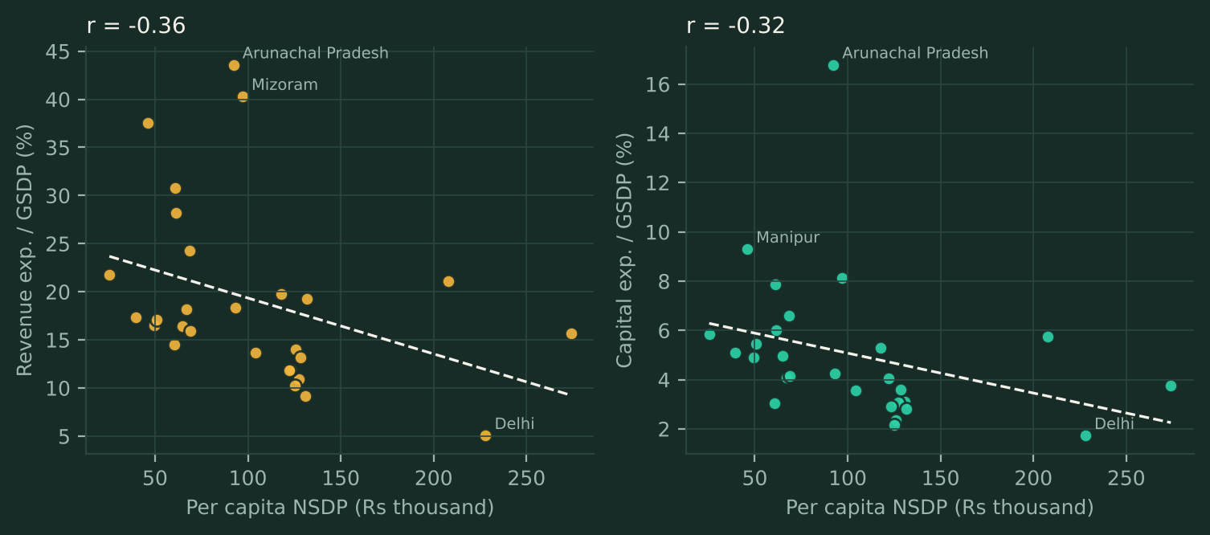
Spending and income across states
State averages: higher-income states spend a smaller share of GSDP
A small GSDP base mechanically raises a ratio, so read these as associations, not effects.

Slide 19
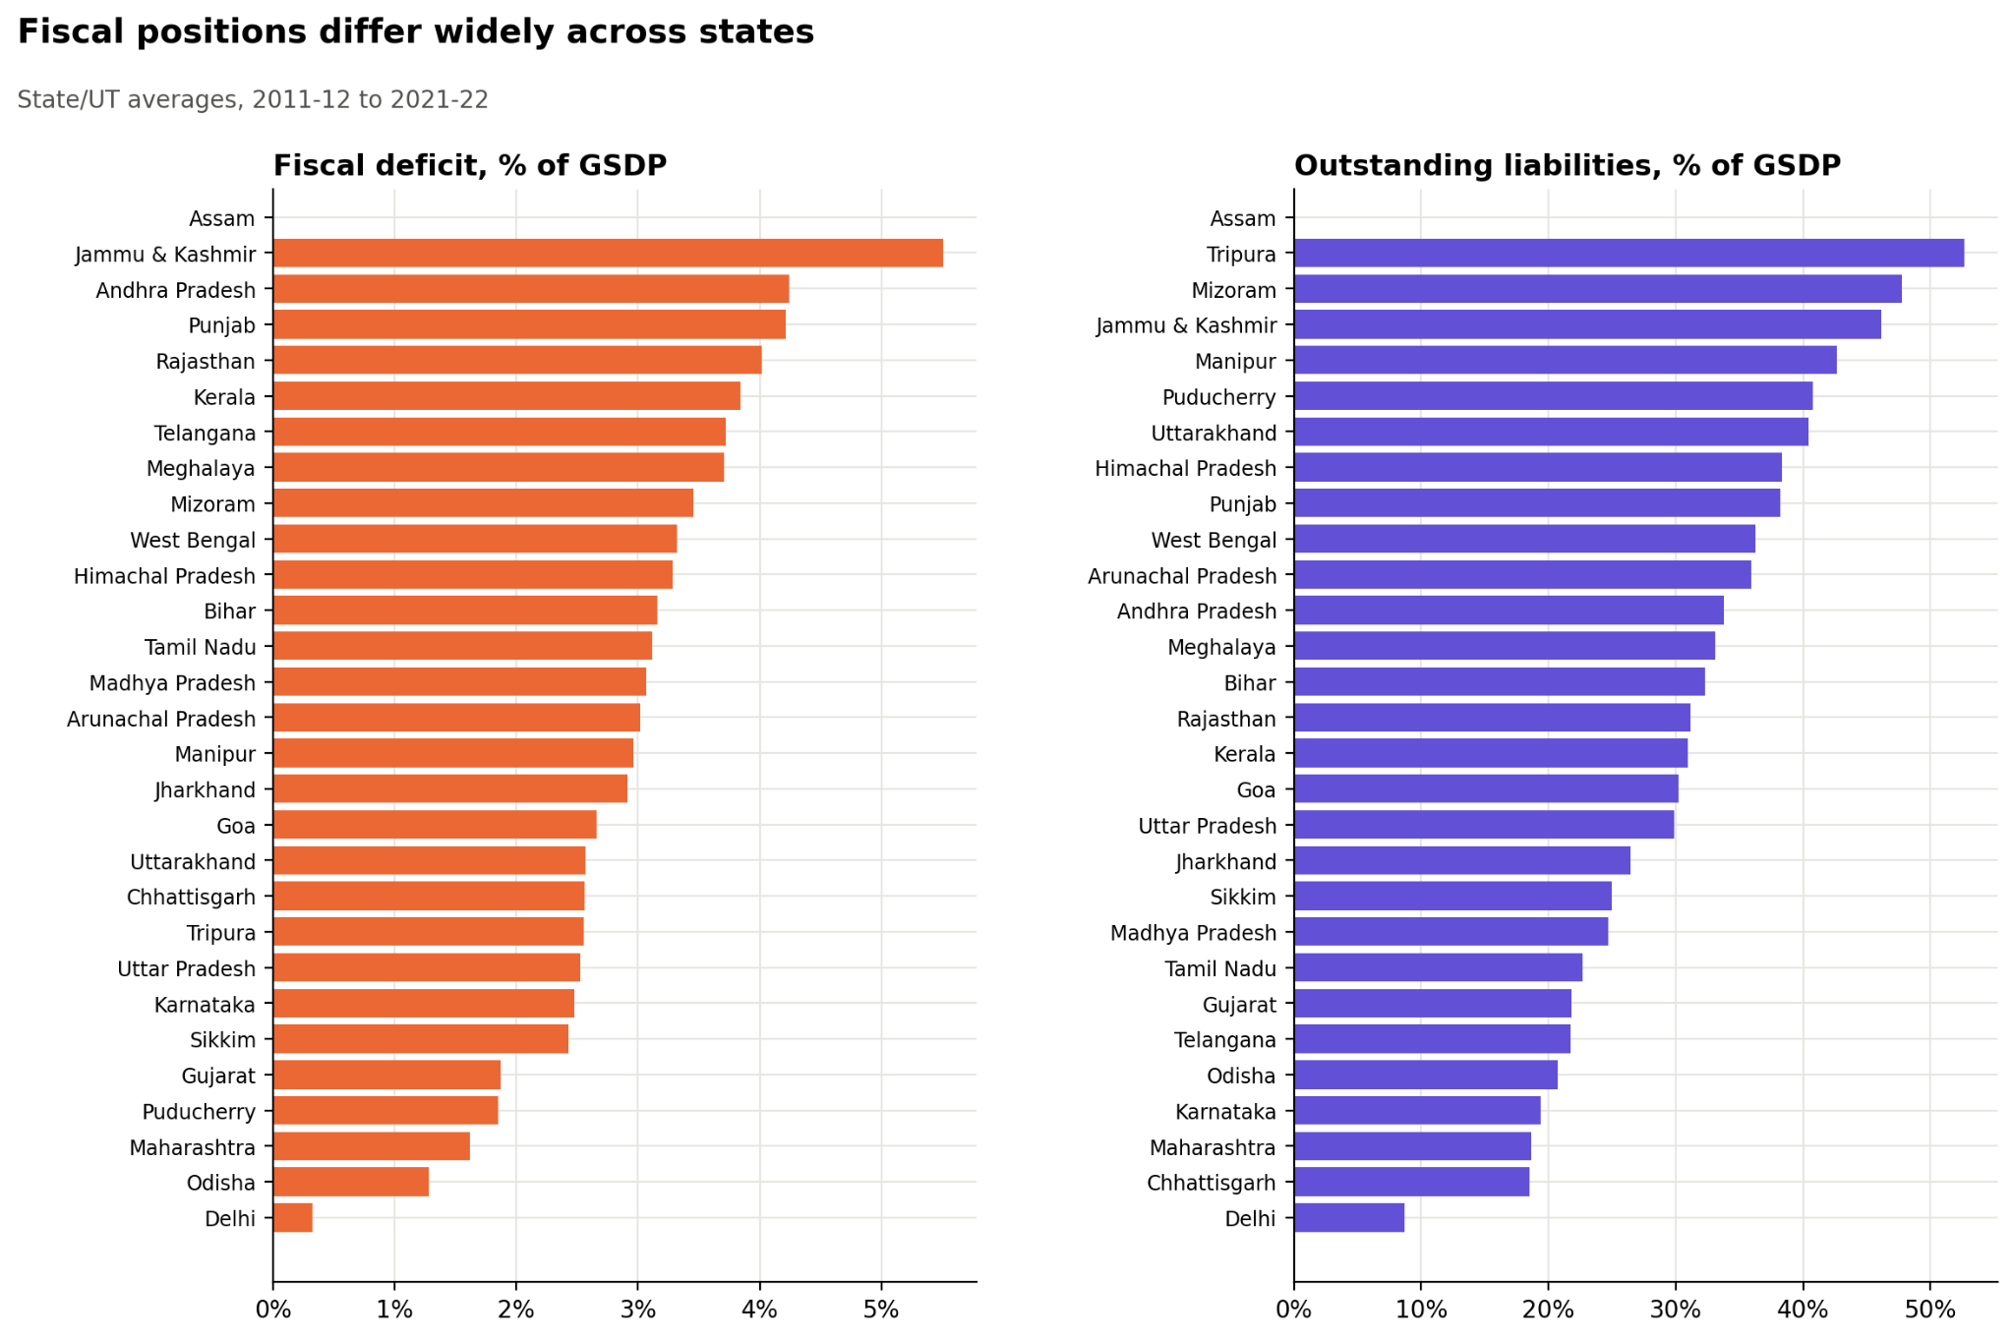
Deficits and debt vary five- to sixfold
State averages, % of GSDP, 2011–12 to 2021–22
5.5%
Jammu & Kashmir: highest average fiscal deficit
52.7%
Tripura: highest average liabilities / GSDP
SO WHAT
Hill and north-eastern states borrow and spend far more relative to output. We test whether results survive dropping them.
Notes:
State averages over 2011–12 to 2021–22. Jammu & Kashmir runs the largest average deficit at 5.5% of GSDP; Delhi the smallest at 0.3%. Tripura carries the most debt relative to output at 52.7%, including the flagged 2014–15 spike; Delhi the least at 8.7%. Assam appears empty because its current-price GSDP denominator is missing.

Slide 20
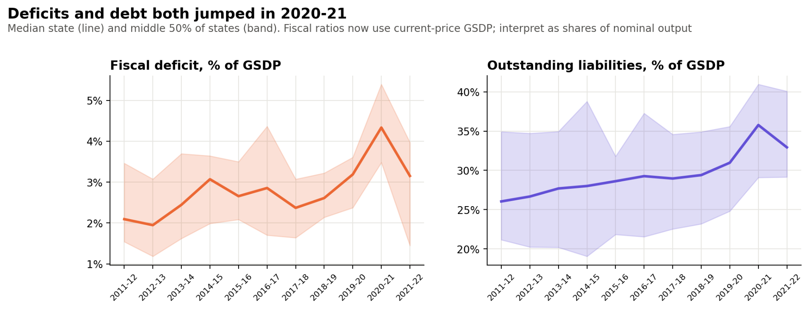
COVID lifted the median deficit to 4.3%
Median state (line) and middle 50% of states (band); debt rose to 36% of GSDP
2.1% → 4.3% median deficit, 2011–12 to the COVID year
26% → 36% median debt ratio, same period
Notes:
The line is the median state and the band the middle 50% of states. The deficit ratio roughly doubled from 2.1% in 2011–12 to 4.3% in 2020–21, then fell back to 3.2%. Liabilities rose slowly from 26% to 31% before COVID and jumped to about 36% in 2020–21. Part of the jump is the denominator: nominal GSDP shrank in the pandemic year. The chart does not identify a causal mechanism.

Slide 21
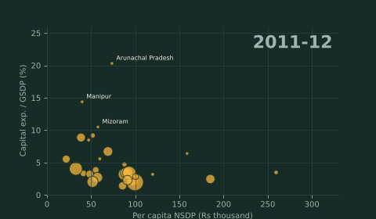
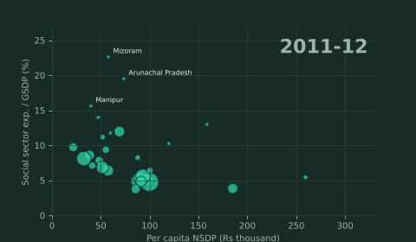
Animation: spending versus income
Each bubble is a state; bubble size is current-price GSDP
CAPITAL SPENDING VS INCOME
SOCIAL SPENDING VS INCOME
Notes:
Play in slideshow mode. Bubbles follow state-year changes.

Slide 22
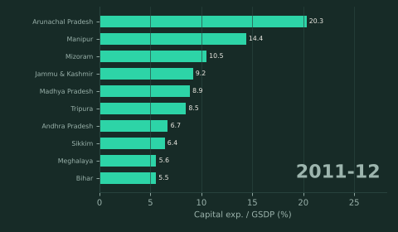
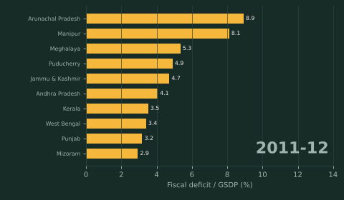
Animation: state rankings, 1
Top ten states by ratio to GSDP, year by year
CAPITAL EXPENDITURE RATIO
FISCAL DEFICIT RATIO
Notes:
Racing bars; values interpolated between years.

Slide 23
03
The evidence
Objectives 2–3: estimate within-state links and test their robustness

Slide 24
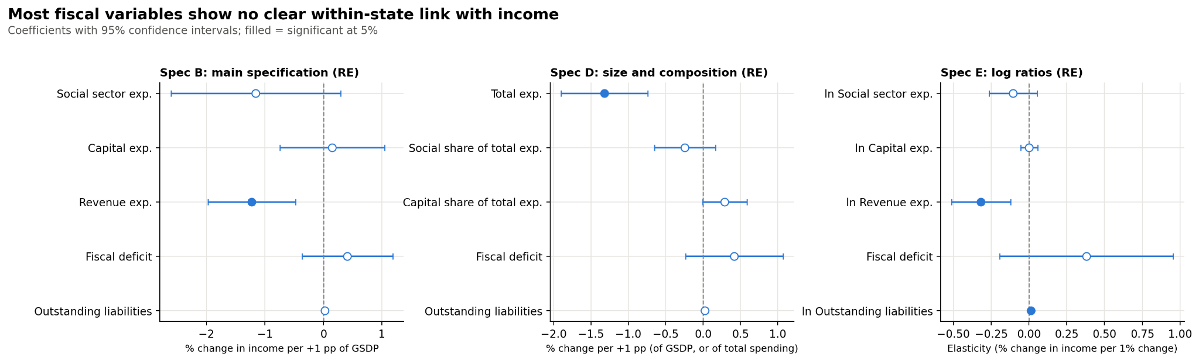
Only spending size carries a clear signal
Random-effects coefficients with 95% CI across Specs B, D and E; filled points significant at 5%
−1.223
SPEC B · MAIN
Revenue exp. / GSDP
−1.318
SPEC D · SIZE & MIX
Total exp. / GSDP
−0.318
SPEC E · LOG RATIOS
ln Revenue exp.
p = 0.002
p < 0.001
p = 0.002
Notes:
Coefficients with 95% confidence intervals from random-effects models; filled points are significant at 5%. In Spec B, only revenue expenditure/GSDP is significant (−1.223). In Spec D, total expenditure/GSDP is significant (−1.318) while composition shares are not at 5%. In Spec E, ln revenue expenditure is significant (−0.318) and ln liabilities small but significant (+0.014). Social and capital spending never reach 5% significance in these specs.

Slide 25
Results: pooled, fixed and random effects
Coefficient (cluster-robust SE); revenue spending stays negative once state effects are included
Spec B | Pooled OLS | Fixed effects | Random effects
Social sector | -13.747** (5.734) | -1.126 (0.694) | -1.154 (0.707)
Capital exp. | 2.638 (3.200) | 0.146 (0.425) | 0.153 (0.434)
Revenue exp. | 3.503 (2.568) | -1.229*** (0.362) | -1.223*** (0.364)
Fiscal deficit | -1.877 (1.803) | 0.410 (0.366) | 0.412 (0.377)
Liabilities | 0.023 (0.169) | 0.028* (0.016) | 0.028* (0.016)
Pooled OLS social-sector estimate is driven by between-state differences.
Spec E (logs) | Pooled OLS | Fixed effects | Random effects
ln Revenue exp. | 0.455 (0.487) | -0.317*** (0.094) | -0.318*** (0.095)
ln Liabilities | -0.079 (0.072) | 0.014*** (0.005) | 0.014*** (0.005)

Slide 26
Model selection
Specification tests, main model (Spec B)
HAUSMAN TEST
MUNDLAK (ROBUST)
FE VS POOLED
RE VS POOLED
p = .287
p = .055
p < .001
p < .001
Fails to reject: RE is consistent
Borderline evidence against RE
F(27,261) = 898.0
Breusch-Pagan LM = 1282
State effects matter: pooled OLS is rejected in every specification.
FE and RE give almost identical revenue estimates (-1.229 vs -1.223); average RE theta is 0.97.
Mundlak is the decision test because standard errors are clustered; random effects is reported as the main estimator.

Slide 27
Hypothesis tests
Spec B results and how many of six robustness variants agree
# | Hypothesis | Coef. | Result | Checks agree
H1 | Social spending raises income (+) | -1.154 | Not significant | 6 / 6
H2 | Capital spending raises income (+) | 0.153 | Not significant | 6 / 6
H3 | Revenue spending is significant | -1.223*** | Supported (-) | 6 / 6
H4 | Fiscal deficit is significant | 0.412 | Not significant | 5 / 6
H5 | Liabilities are significant | 0.028* | Not significant | 5 / 6
Other specifications: capital share of total spending is supported in Spec D (0.292, p = .027, 5 / 6) and ln liabilities in Spec E (0.014, p = .009, 5 / 6).

Slide 28
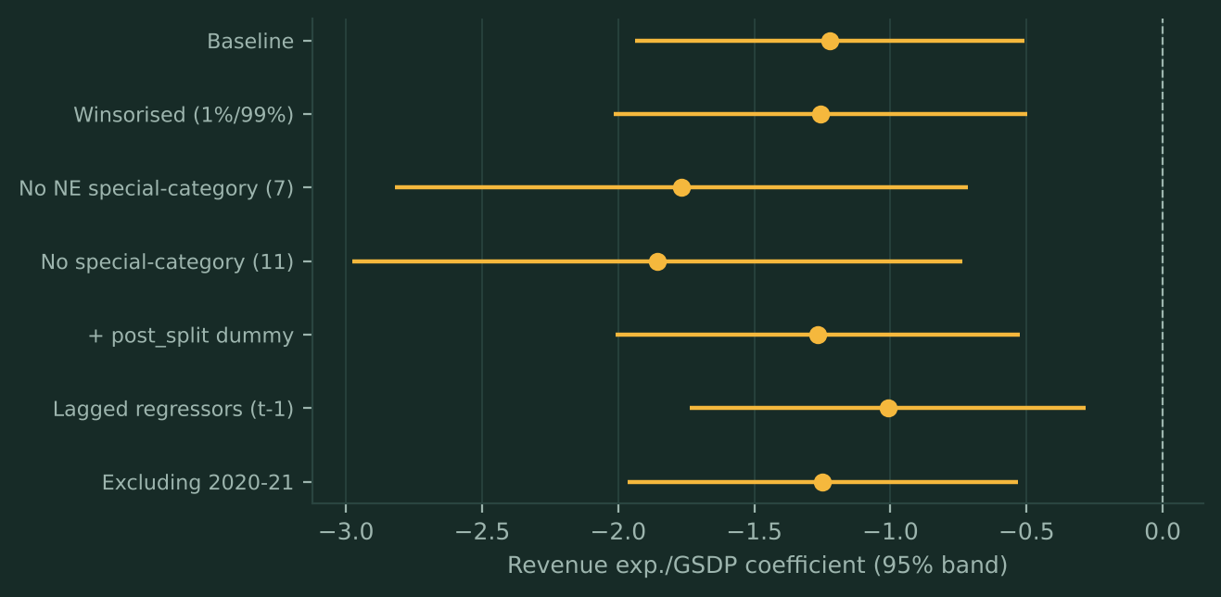
Robustness checks
The revenue coefficient stays negative and significant in all six variants
VARIANTS
Winsorised 1% / 99%
Drop 7 NE states
Drop 11 special-category
Post-split dummy
Lagged regressors
Exclude 2020-21

Slide 29
04
Why the sign is negative
Objective 4: is the link driven by spending, or by GSDP growth?

Slide 30
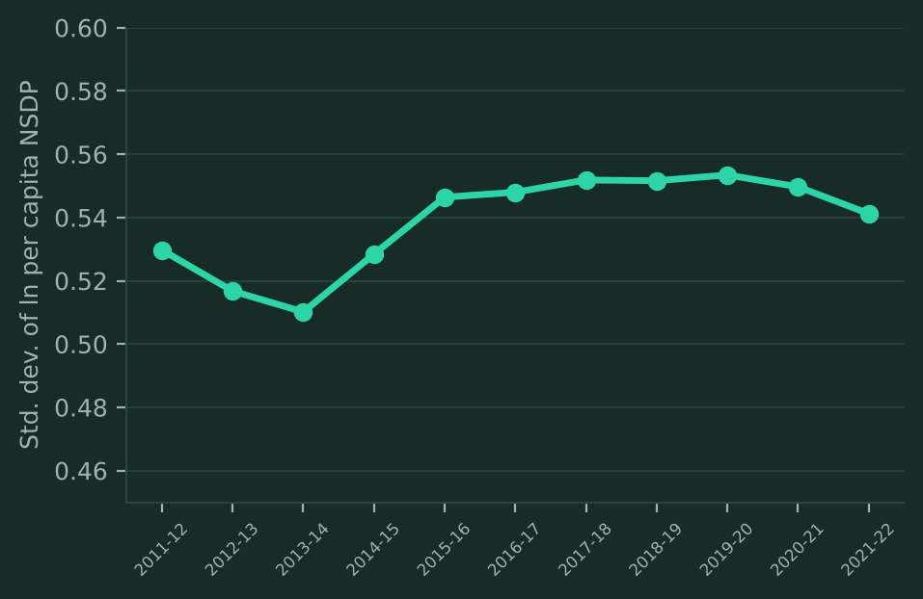
Extension: is the revenue result arithmetic?
Splitting the ratio into spending growth and GSDP growth
CHANGE IN LN REVENUE RATIO
REVENUE SPENDING GROWTH
GSDP GROWTH
-0.229
0.052
0.868
p = .007
p = .206, not significant
p < .001
With both parts, spending growth has no effect (0.002, p = .95).
The ratio result is consistent with a growing denominator.
SIGMA CONVERGENCE

Slide 31
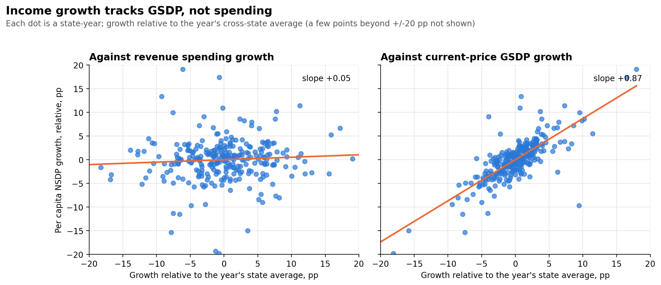
Why negative? Income tracks GSDP growth
Income growth against revenue-spending growth (left) and current-price GSDP growth (right)
+0.87
Slope on GSDP growth, p < 0.001
+0.002
Spending-growth slope once GSDP growth is controlled, p = 0.95
Revenue ratio = Revenue spending ÷ rising GSDP. Fast-growing states see the ratio shrink: growth drives the ratio, not the other way round.
Notes:
Each dot is a state-year, with growth measured relative to that year's cross-state average. Left: per-capita income growth against revenue spending growth — essentially flat (slope +0.05, p = 0.21). Right: against current-price GSDP growth — a tight positive relationship (slope +0.87, p < 0.001). In the joint regression, spending growth drops to +0.002 (p = 0.95). So the negative coefficient on the revenue ratio is a denominator effect: when GSDP grows faster than spending, the ratio falls while income rises. It is not evidence that revenue spending harms growth.

Slide 32
05
Catching up and COVID
Objective 5: assess convergence and COVID shock and recovery

Slide 33
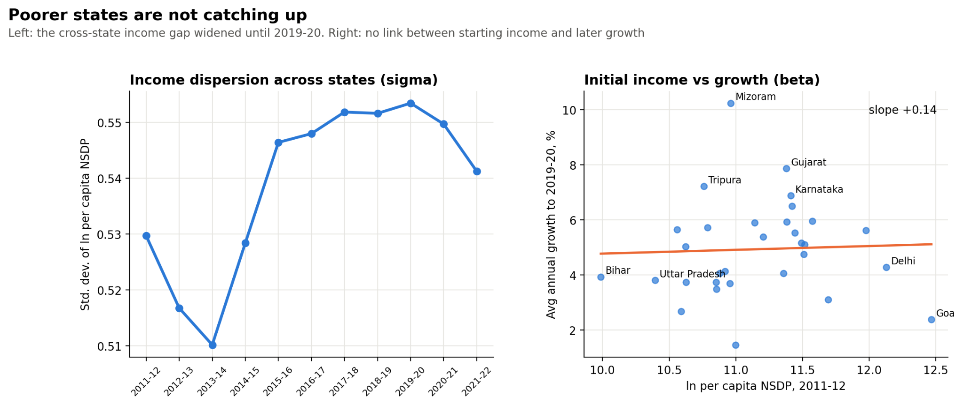
Poorer states are not catching up
Sigma dispersion over time (left) and starting income vs growth (right)
0.51 → 0.55
Sigma dispersion, 2013–14 to 2019–20: the gap widened
+0.137
Beta slope on starting income, p = 0.814: no catch-up
So what: growth alone is not closing the gap between states.
Notes:
Left: sigma dispersion, the standard deviation of log per-capita NSDP across states, falls to its low in 2013–14 and then rises through 2019–20. Right: average annual growth to 2019–20 plotted against starting income. The fitted slope is flat to slightly positive (+0.14, p = 0.81), so there is no beta convergence: poorer states did not grow faster. Mizoram, Gujarat, Tripura and Karnataka grew fastest; Goa slowest.

Slide 34
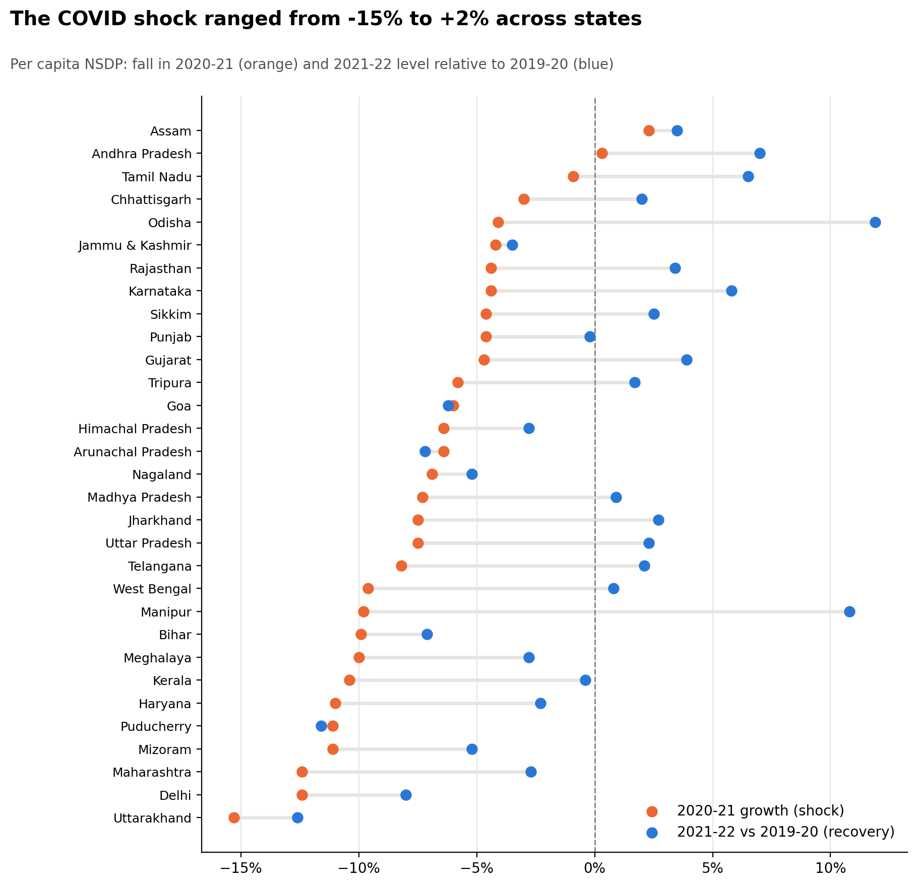
COVID shock ranged from −15% to +2%
Recovery split states in two; shock = 2020–21 growth, recovery = 2021–22 level vs 2019–20
−15.3%
+11.9%
Uttarakhand: deepest fall, still 12.6% below in 2021–22
Odisha: strongest rebound vs 2019–20 after a −4.1% shock
16 / 31
+20.6 pp
States back above their pre-COVID income by 2021–22
Manipur's swing from −9.8% shock to +10.8% recovery
SO WHAT
The size of the fall did not decide the outcome. Pre-COVID social and capital shares did not predict shock or recovery (Holm-adjusted p = 1 for every test).
Notes:
Orange is 2020–21 growth in real per-capita NSDP; blue is the 2021–22 level relative to 2019–20. Only Assam and Andhra Pradesh avoided a fall. Uttarakhand fell 15.3% and was still 12.6% below pre-COVID; Delhi and Maharashtra fell 12.4%. Manipur fell 9.8% yet ended 10.8% above its pre-COVID level; Odisha ended 11.9% above. Sixteen of thirty-one states were above their 2019–20 level by 2021–22.

Slide 35
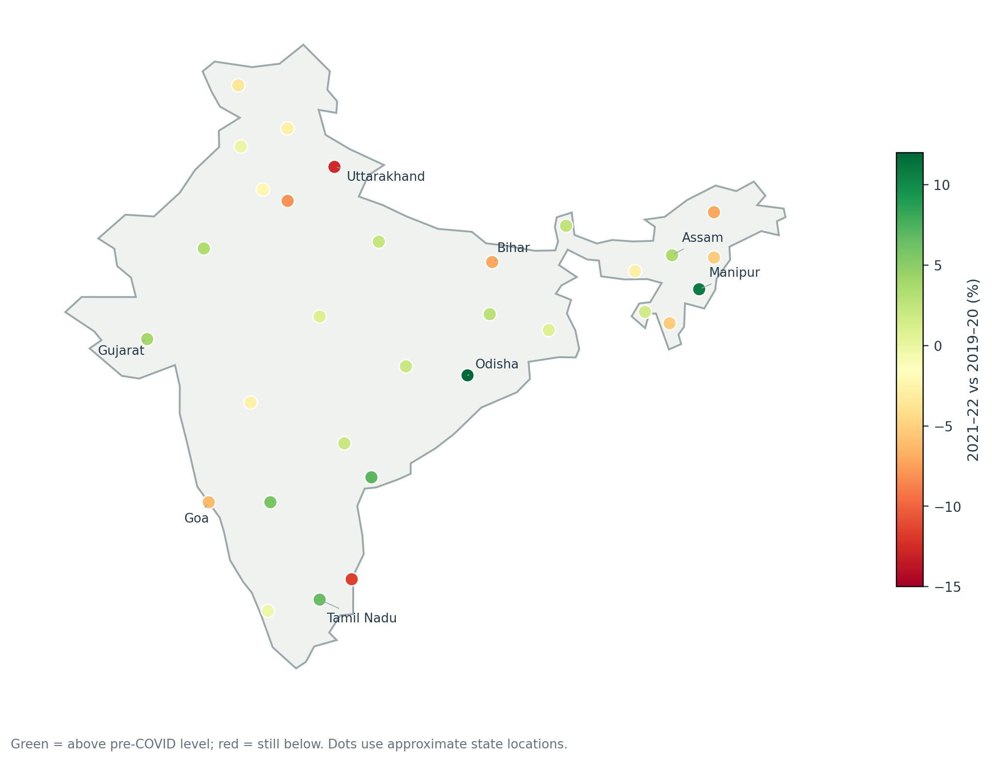
Recovery had no clear geography
2021–22 income relative to 2019–20: green above pre-COVID, red still below
ABOVE PRE-COVID
Odisha +11.9%, Manipur +10.8%, Andhra Pradesh +7.0%, Tamil Nadu +6.5%, Karnataka +5.8%
STILL BELOW
Uttarakhand −12.6%, Puducherry −11.6%, Delhi −8.0%, Arunachal −7.2%, Bihar −7.1%
SO WHAT
No fiscal predictor: pre-COVID social share, capital share and starting income do not predict who recovered (Holm-adjusted p = 1.0 for all).
Notes:
States coloured by their 2021–22 income relative to 2019–20: green is above pre-COVID, red still below. Strong recoveries appear in the east (Odisha), north-east (Manipur) and south (Tamil Nadu, Andhra Pradesh); laggards include Uttarakhand, Puducherry, Delhi and Bihar. We tested whether pre-COVID social share, capital share or initial income predicted the shock or recovery: none is significant after Holm correction (all adjusted p = 1.0).

Slide 36
Data quality and limitations
What to check before relying on the results
Flagged liabilities, 2014-15 | Ratio | vs median
Tripura | 2.46 | 7.2x
Uttarakhand | 1.95 | 8.1x
Puducherry | 1.44 | 4.9x
Delhi | 0.56 | 10.4x
Assam, Haryana, Nagaland: no verified denominator.
J&K series changes in 2019 (Ladakh separated).
Short 11-year observational panel.
Associations, not causal effects.
Delhi's ratio falls from 0.56 to 0.005 within three years: a level break, not a real change.

Slide 37
One fiscal signal survives every test
The answer in one slide
−1.223
01
Income gaps are wide, and not closing
Goa's per-capita income is 10.6× Bihar's in 2021–22. Dispersion rose after 2013–14; the beta-convergence test finds no catch-up (p = 0.81).
Revenue expenditure / GSDP → log per-capita NSDP
02
Higher revenue-spending ratios go with lower income
The link holds under every estimator and sample cut. The mechanism test shows it is driven by GSDP growth in the denominator, not by spending itself.
Main specification, random effects. SE 0.364 · p = 0.002 · n = 304, 28 states
03
COVID hit everyone, recovery split states
Significant in 7 of 7 robustness variants
Median fiscal deficit jumped to 4.3% of GSDP in 2020–21. Odisha ended 11.9% above its pre-COVID level; Uttarakhand 12.6% below.
Notes:
Lead with the headline. Revenue expenditure as a share of GSDP is the only spending ratio with a stable, significant relationship to income, and it is negative. It survives fixed vs random effects, logged ratios, winsorising, dropping special-category states, lagging regressors and dropping the COVID year. The mechanism analysis shows why: the ratio falls when GSDP grows faster than spending. Social and capital ratios are not significant in the main model.

Slide 38
CONCLUSION
Only spending size tracks income, and growth drives it
Answer to the research question: within states, only spending relative to GSDP is robustly associated with income, and negatively. The link reflects fast-growing economies outgrowing their budgets, not spending lowering income.
WHAT EACH OBJECTIVE FOUND
HYPOTHESES
1
Describe: Goa earns 10.6× Bihar; poorer states are not catching up (β = +0.137, p = 0.81)
H1
Social spending
Not supported
2
Estimate: Revenue exp./GSDP −1.223 (p = 0.002); fixed and random effects agree
H2
Capital spending
Partly: capital share, Spec D
3
Test: Holds in 7 of 7 variants, and is stronger without special-category states
H3
Revenue spending
Supported (negative)
4
Identify: Income tracks GSDP growth (+0.87), not spending growth (+0.002)
H4
Fiscal deficit
Not supported
5
Assess: COVID doubled the median deficit; no fiscal variable predicts recovery
H5
Liabilities
Not robust to flagged values
Policy reading: the negative coefficient is not a case for cutting spending; these are associations, not causal effects.
Notes:
So, to bring it all together. Our question was whether state spending, deficits and debt go with income within states over time. The answer is that only one thing does robustly: the size of spending relative to the economy, and the link is negative.
Going objective by objective: income gaps are large and poorer states aren't catching up. Revenue spending relative to GSDP has a coefficient of minus 1.2, and it holds in all seven of our robustness checks. But when we split that ratio apart, income tracks GSDP growth, not spending. So the negative sign comes from fast-growing economies outgrowing their budgets. And COVID doubled deficits, but no fiscal variable predicts which states recovered.
On the hypotheses: only H3 is supported. Social spending and the deficit show no clear link. Capital spending gets partial support through the share of the budget it takes. And the debt result disappears once we remove the suspicious values, so we don't rely on it.
The key message: this is not an argument for cutting spending. It tells us that, in ratio terms, growth drives the budget share, not the other way round.

Slide 39
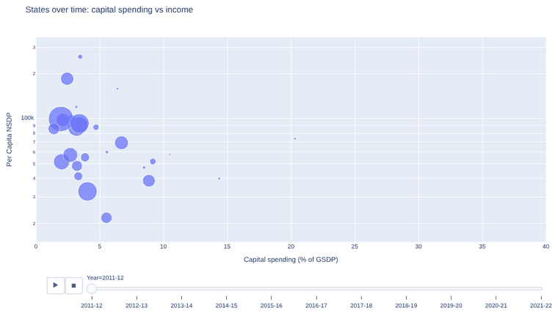
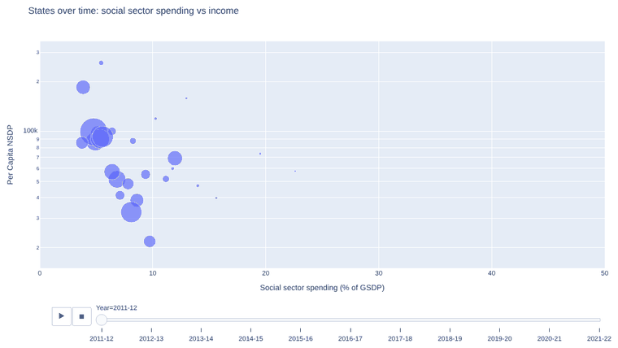
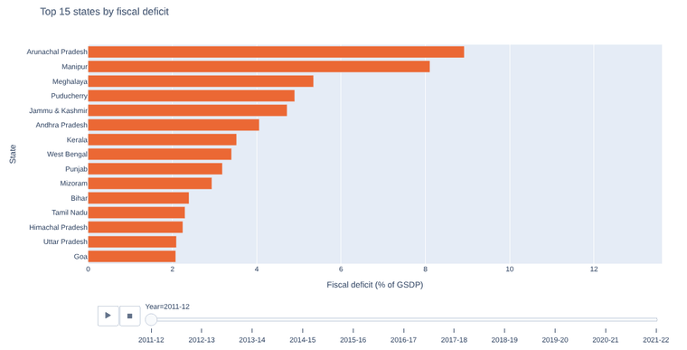
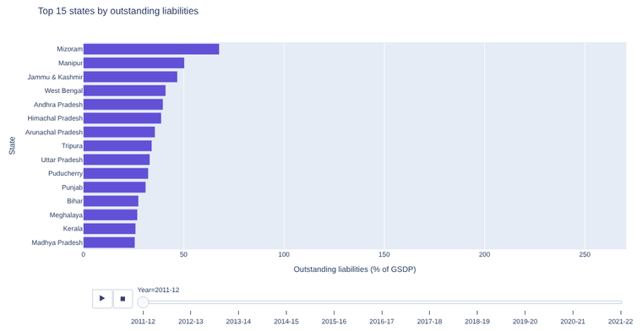
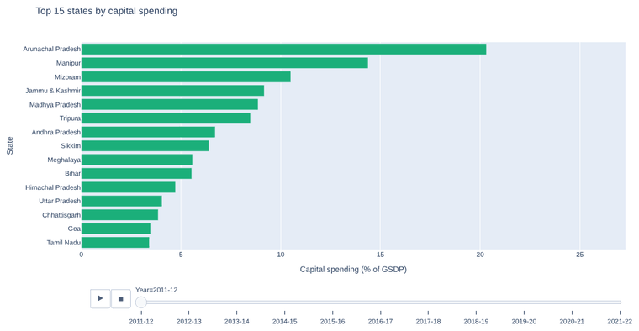
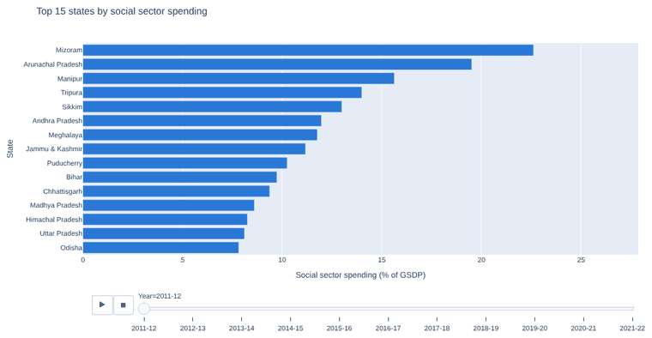
Six interactive animations
They play in slideshow mode; click any one to open the interactive Plotly version
Capital spending vs income
Social spending vs income
Fiscal deficit race
Bubbles sized by GSDP, 2011–12 → 2021–22
Bubbles sized by GSDP, 2011–12 → 2021–22
Top 15 states by deficit / GSDP, year by year
Liabilities race
Capital spending race
Social spending race
Top 15 states by debt / GSDP, year by year
Top 15 states by capital exp. / GSDP
Top 15 states by social exp. / GSDP
Notes:
Each card links to the original Plotly HTML export in the animations folder. Open the deck from the extracted package folder so the relative links resolve. The bubble charts plot spending against per-capita income, with bubble size showing GSDP, and animate across the 11 years. The racing bars show the top 15 states on each fiscal ratio year by year. Snapshots show the final 2021–22 frame.

Slide 40
EXPLORE IT YOURSELF
Every state has its own story
Open the State Explorer to animate the fiscal map across 11 years and click any state for its income trajectory, spending mix, deficit, debt and COVID recovery.
State_Explorer.html
animations/index.html
Results_Tables.xlsx
Animated map + clickable state profiles
All six Plotly animations in one place
All 5 specs, diagnostics and robustness runs
Thank you · Questions welcome
Notes:
Point the audience to the companion package. Open State_Explorer.html in a browser, press Play, and click a state of interest. Keep the animations folder beside the deck so the links work.

