Slide 1

Health alerts that learn the patient
PulseOS
Smart Health Monitoring System · B.Tech CSE Major Project
Self-learning, explainable alerts with patient and doctor feedback, powered by our AdaptAlert engine
~97%
100%
7
3
fewer false alarms
real events caught
stage explainable AI
apps: patient, doctor, nurse
Notes:
Good morning. Our project is PulseOS, a smart health monitoring system. The heart of it is AdaptAlert, an alert engine that learns what is normal for each patient, explains every alert, and learns from patient and doctor feedback. In our simulation it cut false alarms by about 97 percent while catching every real event.

Slide 2



The problem: too many false alarms
Health monitors alarm whenever a number crosses one fixed line, for example heart rate above 100.
At home that line is crossed all the time by harmless things. Most alarms are false, so people start ignoring them. This is alarm fatigue, a recognised patient-safety problem.
In our 30-day simulation of a fixed-threshold monitor
3.7
false alarms per patient, every day
A walk
Heart rate goes above 100 → fixed monitor alarms
3%
A strong coffee
Heart rate stays high for minutes → fixed monitor alarms
of its alerts were real
A loose band
Source: The Joint Commission, Sentinel Event Alert 50 (2013)
Readings jump all over the place → fixed monitor alarms
Notes:
The problem is alarm fatigue. Normal monitors use one fixed threshold for everyone. At home, a walk, a coffee or a loose strap crosses that line, so most alarms are false. In our simulation a fixed monitor gave 3.7 false alarms per patient per day, and only 3 percent of its alerts were real. When most alarms are false, people stop trusting them, and a real emergency can be missed.

Slide 3




Why existing monitoring systems fall short
One threshold for everyone
They never learn
A fit 24-year-old and a 70-year-old heart patient get the same alarm line.
The same harmless pattern alarms again and again, even after a doctor says it is fine.
Black-box alerts
Bad sensor data
An alert says “abnormal” but not why, so doctors and patients don’t trust it.
A loose band or movement looks like a medical problem.
Notes:
Existing systems have four main weaknesses. One threshold for everyone. No learning after deployment. Alerts that do not explain themselves. And no protection against bad sensor data. AdaptAlert addresses each of these.

Slide 4
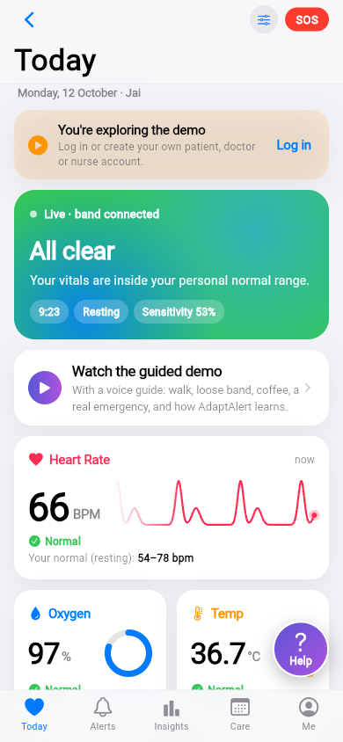
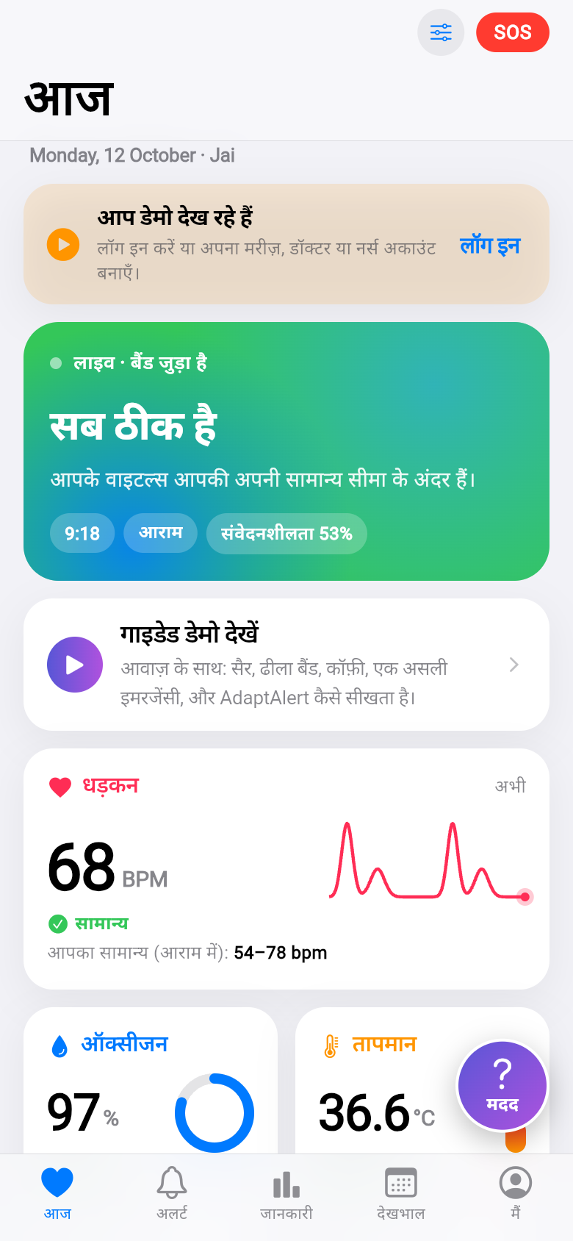

Our solution: PulseOS with AdaptAlert
Learns each patient’s normal
For each activity: resting, light activity, active, cooling down
Explains every alert
Plain-language reasons, how sure it is, and what would change the decision
Learns from feedback
“I was walking” from the patient, “false alarm” or “real” from the doctor
Never ignores danger
A safety floor and bounded learning keep critical readings alerting
Notes:
Our solution is PulseOS, a working website for phone and laptop, with AdaptAlert inside. It learns each patient’s normal per activity, explains every alert, learns from patient and doctor feedback, and never ignores danger because of a safety floor. On the right is the patient’s Today screen, in English and Hindi.

Slide 5
How AdaptAlert decides: a 7-stage pipeline
Every minute the wrist band sends heart rate, oxygen (SpO₂), temperature and movement. Each reading goes through:
A
B
C
D
E
F
G
Signal quality
Activity
Personal normal
Safety floor
Anomaly
Decide
Explain
Loose band or motion? The reading is ignored
Resting, light, active or cooling down
Average and spread for this person and activity
e.g. SpO₂ ≤ 90% → critical alert, no AI needed
Unusual for this person for 3+ minutes
Model + this person’s history vs threshold τ
Reasons, confidence, what would change it
Key idea: the safety floor (D) works without the AI, so learning can never switch off a critical alert.
Notes:
This is the core of the project. Stage A checks signal quality, so a loose band can never cause an alarm. Stage B detects activity. Stage C keeps a personal normal for each activity. Stage D is the safety floor: if oxygen drops to 90 percent or below, it alerts immediately without asking the model. Stage E looks for readings unusual for this person for at least three minutes. Stage F decides, and stage G explains the decision in plain words.

Slide 6
The learning rule
P(real) = (1−w)·P_model + w·P_you · w = n/(n+4) · alert if P(real) ≥ τ
P_model
P_you
τ (sensitivity)
Decision tree built from clinical reasoning: how many vitals are abnormal, how far from normal, activity, time of day.
How often this same pattern was really a problem for this patient, from their and the doctor’s answers. More answers (n) → more weight.
Personal threshold. “False alarm” from the doctor raises it a little; “real” lowers it more. Kept between 30% and 75%, moves at most 10 points a week.
Alerts that fall below τ are held back, not deleted: the patient and doctor can still see them, and anything worse alerts at once.
Notes:
The decision blends two estimates. P model is a decision tree based on clinical reasoning. P you is how often the same pattern was really a problem for this patient. At first the model decides; as the patient and doctor give answers, the personal history gets more weight. If the probability is above the personal threshold tau, an alert is sent. Tau changes slowly and only within safe limits, so the system cannot learn to ignore a real emergency.

Slide 7
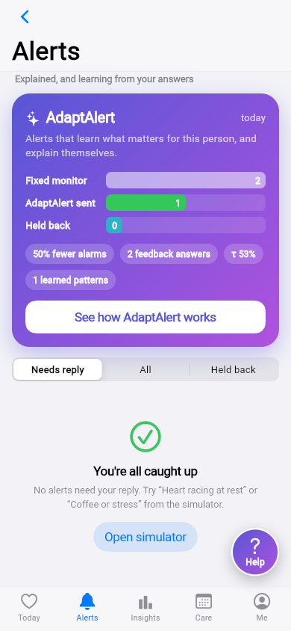
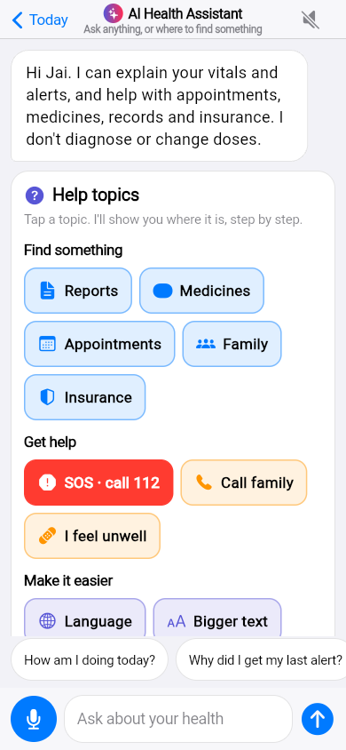
Every alert explains itself
Why
“Heart rate 118, which is 3.1 SD above your resting normal, while you were resting.”
How sure
A likelihood with a 90% range, shown as model vs your history.
What would change it
“No alert below 104 bpm.” “If only heart rate had changed, it would be rated lower.”
Who was told
A timeline: patient, caregiver, doctor, SOS.
Feedback
Patient: I was active / sensor loose / I feel unwell. Doctor: real or false alarm.
Notes:
Every alert has a page called “How AdaptAlert decided”. It shows why the alert fired, how sure the system is, what would have changed the decision, and who was told. The patient can answer what was happening, and the doctor marks it real or a false alarm. That feedback is what the system learns from.

Slide 8
Research gaps we address
G1
One threshold for all
G2
No learning after deployment
G3
Learning can hide emergencies
→ Personal normal per vital and activity
→ Learns from patient and doctor feedback
→ Safety floor + bounded, slow learning
G4
Black-box alerts
G5
Bad sensor data
G6
Cold start for new patients
→ Reasons, confidence, counterfactuals
→ Signal-quality check before anything else
→ Federated prior: shared label statistics, no raw data
G7
No uncertainty in results
G8
English-only apps
G9
Hard for elderly or disabled users
→ 5 systems, bootstrap CIs, ablation, fatigue sweep
→ Full English and Hindi, Hindi voice and assistant
→ Large text, easy home, flash and spoken alerts
Notes:
These are the research gaps our project fills. G1 to G7 are about the alert engine and are evaluated in our simulation: personal normals, learning from feedback, safe learning, explainability, signal quality, a federated cold start, and proper statistics. G8 and G9 are about inclusion: Hindi support and accessibility for older and disabled people. Those are built and tested in the app, and would need a user study for a paper.

Slide 9
How we tested it
40
30
159
5
virtual patients
days each
real deteriorations
systems compared
Every day each patient has exercise, a loose sensor, coffee or stress, night oxygen dips, and sometimes a real problem (fast heart with falling oxygen, fever, critical oxygen drop). All five systems see exactly the same events.
A
B
C
D
E
Fixed threshold
Personal normal
AdaptAlert
Unguarded learning
AdaptAlert + federated
today’s monitors
no learning
our system
ablation: no safeguards
shared prior for new patients
Notes:
We tested the engine in a simulation: 40 virtual patients for 30 days, with everyday events and 159 real deteriorations. We compared five systems on exactly the same events: a fixed threshold, a personal normal without learning, AdaptAlert, AdaptAlert without its safeguards as an ablation, and AdaptAlert with a federated prior. Results have 95 percent bootstrap confidence intervals. Anyone can rerun this in the Research Lab inside the app.

Slide 10
Results: about 97% fewer false alarms
96.9%
fewer false alarms than fixed thresholds
100%
real events and critical events caught
40% vs 3%
of alerts were real (precision)
0.47 → 0.06
week-1 false alarms with the federated prior
Notes:
Here are the results. Fixed thresholds gave 3.7 false alarms per patient per day. AdaptAlert gave 0.11, that is about 97 percent fewer, while still catching every real event and every critical event. About 40 percent of AdaptAlert’s alerts were real, compared with 3 percent for fixed thresholds. The federated prior also fixes the cold start: first-week false alarms dropped from 0.47 to 0.06.

Slide 11
Safe even when people dismiss real alerts
What if patients press “false alarm” on real alerts?
Even when half of the real alerts are dismissed, sensitivity stays near 94%.
Critical events stay at 100%, because the safety floor does not use the learned model.
Doctor labels outweigh patient answers, which limits the damage.
Notes:
A learning system can be taught the wrong thing. So we tested alarm fatigue: what if patients dismiss real alerts? Even at 50 percent dismissal, sensitivity stays around 94 percent, and critical events stay at 100 percent, because the safety floor never depends on the learned model.

Slide 12
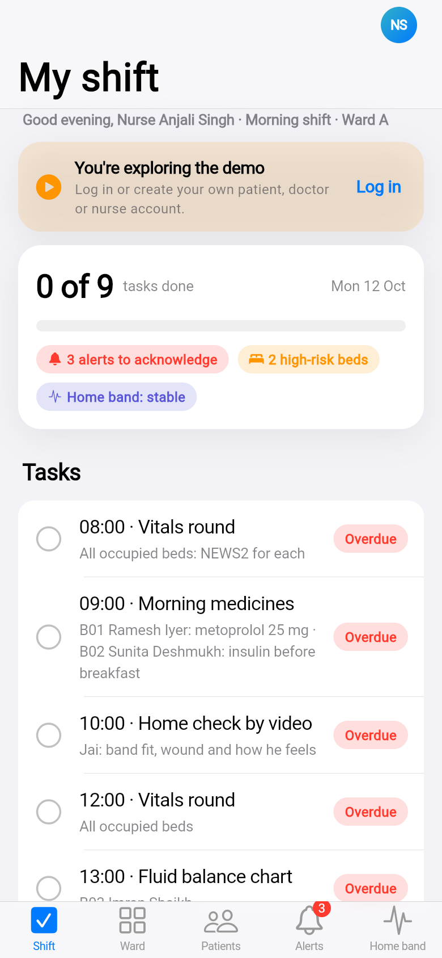



One website, three apps
Patient
Doctor
Nurse
Live vitals and status
Explained alerts and feedback
Appointments and doctors
Records, insurance, family
SOS and Medical ID
Today dashboard
Patients: notes, prescriptions
Schedule and follow-ups
Review AdaptAlert alerts
Ward with NEWS2 scores
Shift tasks with times
Handover notes
Ward alerts: acknowledge
Home patient band status
Patient notes
Notes:
PulseOS is one website with three apps. Patients see their vitals, explained alerts, appointments, records and SOS. Doctors get a dashboard, a patient list with notes and prescriptions, a schedule, and they review AdaptAlert alerts, which teaches the system. Nurses get timed shift tasks, handover notes and the ward. It works on phone and laptop.

Slide 13



Built for everyone
English and हिन्दी
Every screen, the alert explanations, the assistant and the demo voice-over.
Help assistant
“Report kahan hai?” → steps + a button that goes there. Speak questions; hear answers.
Accessibility
Large text, easy home for older users, flash alerts for hearing loss, spoken alerts for low vision.
Notes:
We also made it inclusive. The whole app works in English and Hindi. A help assistant answers questions like “where are my reports” in English, Hindi or Hinglish, and takes you there with one tap; you can also speak your question. The accessibility settings add large text, an easy home screen for older users, flashing alerts for people with hearing loss, and spoken alerts for people with low vision.

Slide 14





How it is built
Wrist band
AdaptAlert engine
PulseOS apps
Simulated now; ESP32 (MAX30102, MLX90614, MPU6050) or Apple Watch next
Pure Dart, runs on the device: 7 stages, learning, explanations
Flutter web, Android, iOS: patient, doctor, nurse
Research Lab
Data
Runs the 5-system experiment in the app; copy results for the paper
On-device accounts (salted SHA-256), optional Supabase for real multi-device use
Hosting
Quality
Vercel serves the built website; every push to GitHub redeploys
100 automated tests, incl. every screen in Hindi and at large text
Notes:
The band is simulated today; the same engine will take readings from an ESP32 band or an Apple Watch. The AdaptAlert engine is pure Dart and runs on the device. The apps are Flutter, so one code base gives us web, Android and iOS. The Research Lab runs the experiments, accounts are stored securely with salted hashes, the site is hosted on Vercel, and we have 100 automated tests.

Slide 15
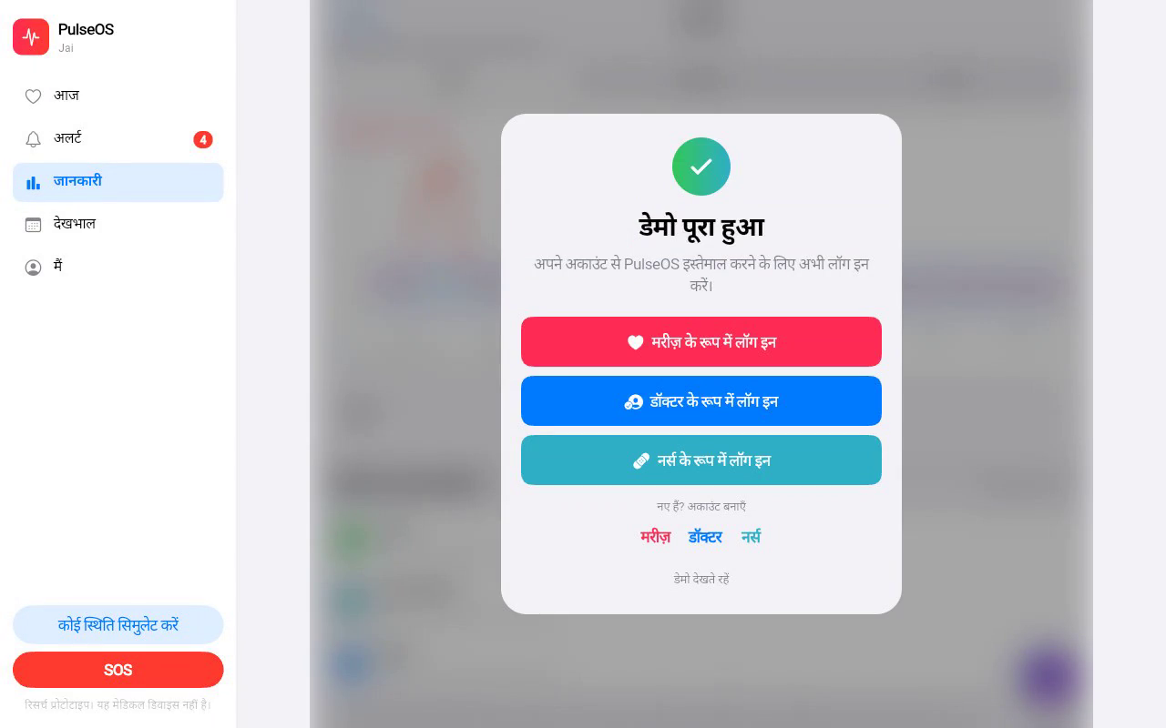
Live demo: 5 minutes
1
Guided demo with voice
Walk → no alert. Loose band → ignored. Coffee → explained alert. Doctor says false → held back next day. Real problem → urgent alert. Oxygen 89% → safety floor.
2
Doctor
Dashboard → Patients → Jai → note and prescription → Schedule
3
Nurse
Tick a shift task, write a handover, open the ward
4
Patient
The guided demo ends by asking you to log in as a patient, doctor or nurse.
Help: “report kahan hai?” · Me › Accessibility: easy home
5
Research Lab
Run the experiment, show the chart and table
Notes:
Now a short live demo. First the guided demo with voice: it shows the whole story in about two and a half minutes and ends with the log-in screen. Then I log in as a doctor, then as a nurse, then as a patient to show the help assistant and accessibility, and finally the Research Lab.

Slide 16
Limitations and next steps
Honest limitations
Real wrist band
ESP32 sensors or Apple Watch (HealthKit)
Results come from a simulation with assumed event rates, not real patients.
The band in the demo is simulated.
The decision tree is hand-built, not trained on data.
Hindi and accessibility need a user study with older and disabled people.
Real data
Replay PhysioNet / MIMIC recordings
Volunteer study
5–10 people for a week, before vs after
Shared backend
Supabase so patients and doctors use different devices
Notes:
We want to be honest about limitations. Our results are from a simulation, the band is simulated, and the decision tree is hand-built. Next we plan to connect a real ESP32 band or an Apple Watch, validate on real PhysioNet recordings, run a small volunteer study, and add a shared backend.

Slide 17

Alerts people can trust again
PulseOS learns each patient, explains every alert and never ignores danger. In simulation: ~97% fewer false alarms and every real event caught.
Try it: the PulseOS website · demo logins doctor@pulseos.app / doctor123
Code: github.com/NANDINISHARMA04/bt-39
Thank you · Questions?
Notes:
To conclude: PulseOS makes alerts trustworthy again. It learns each patient, explains every alert and keeps a safety floor so danger is never ignored. Thank you. We are happy to take questions.

