Slide 1
Summer Training/Internship Presentation
Data Structures and Algorithms in C++
ORGANIZATION NAME
Project: MOVIE RECOMMENDATION SYSTEM
Submitted By:
Name: Singamsetti Nanda Kishore
Registration Number: 12403083
Course: Data Structures and Algorithms using C++

Slide 2
Course Content
C++ Basics
Arrays
Linked Lists
Stacks
Queues
Trees
Graphs
Sorting
Searching
Recursion
Dynamic Programming

Slide 3
C++ Basics
Definition:
C++ is a general-purpose, object-oriented programming language developed by Bjarne Stroustrup.
It is widely used for system software, game development, competitive programming, and DSA.
Features
Object-Oriented Programming (OOP)
High Performance
Platform Independent
Rich Standard Template Library (STL)
Supports Dynamic Memory Allocation
Basic Structure of a C++ Program
#include <iostream>
using namespace std;
int main()
{
cout << "Hello World";
return 0;
}
Applications
Software Development
Game Development
Operating Systems
Data Structures & Algorithms
AI and Machine Learning

Slide 4
Arrays
Definition
An Array is a linear data structure that stores multiple elements of the same data type in contiguous memory locations.
Each element is accessed using an index, starting from 0.
Features
Stores multiple values under a single variable name.
Fast access to elements using index.
Fixed size once declared.
Easy to traverse using loops.
Advantages
Fast random access (O(1)).
Simple to implement.
Efficient memory usage.
Suitable for storing homogeneous data.
Disadvantages
Fixed size.
Insertion and deletion are time-consuming.
Can lead to memory wastage if the array is underutilized.
Applications
Storing student records.
Matrix operations.
Image processing.
Implementing other data structures like stacks and queues.
Example
int marks[5] = {80, 75, 90, 85, 95};
cout << marks[2]; // Output: 90

Slide 5
Linked Lists
Definition
A Linked List is a linear data structure consisting of nodes, where each node contains data and a pointer to the next node.
Unlike arrays, linked list elements are not stored in contiguous memory.
Features
Dynamic size.
Sequential access to elements.
Easy insertion and deletion.
Efficient memory utilization.
Advantages
Dynamic memory allocation.
Fast insertion and deletion without shifting elements.
No fixed size limitation.
Suitable for implementing stacks, queues, and graphs.
Disadvantages
Extra memory required for storing pointers.
Slower access compared to arrays (no direct indexing).
Sequential traversal is required to access elements.
Applications
Implementing Stacks and Queues.
Music Playlist Management.
Browser History Navigation.
Memory Management.
Polynomial Manipulation.

Slide 6
Stacks
Definition
A Stack is a linear data structure that follows the LIFO (Last In, First Out) principle.
The element inserted last is the first one to be removed.
Features
Follows LIFO order.
Insertion and deletion occur only at the top of the stack.
Simple and efficient data structure.
Supports operations like Push, Pop, Peek (Top), and isEmpty.
Advantages
Fast insertion and deletion (O(1)).
Easy to implement.
Efficient memory management.
Useful for recursive function calls and expression evaluation.
Disadvantages
No direct access to middle elements.
Limited access only through the top element.
Searching an element takes O(n) time.
Applications
Function Call Management (Recursion)
Undo/Redo Operations
Browser Back Button
Expression Evaluation
Parentheses Matching

Slide 7
Queues
Definition
A Queue is a linear data structure that follows the FIFO (First In, First Out) principle.
The element inserted first is removed first.
Features
Follows FIFO order.
Insertion is performed at the rear.
Deletion is performed from the front.
Efficient for processing tasks in sequence.
Advantages
Simple to implement.
Maintains the order of elements.
Efficient insertion and deletion (O(1)).
Suitable for scheduling and buffering tasks.
Disadvantages
No direct access to middle elements.
Fixed-size queues can become full (in array implementation).
Searching an element takes O(n) time.
Applications
CPU Scheduling
Printer Queue
Ticket Booking Systems
Call Center Management
Breadth-First Search (BFS) in Graphs

Slide 8
Trees
Definition
A Tree is a non-linear hierarchical data structure consisting of nodes connected by edges.
The topmost node is called the Root, and nodes without children are called Leaf Nodes.
Features
Hierarchical structure.
Consists of Parent and Child nodes.
No cycles are present.
Efficient for searching and organizing data.
Advantages
Fast searching, insertion, and deletion in balanced trees.
Represents hierarchical relationships effectively.
Efficient memory organization.
Supports recursive operations naturally.
Disadvantages
More complex to implement than linear data structures.
Unbalanced trees can reduce performance.
Requires additional memory for pointers.
Applications
File System Organization
Database Indexing (B-Trees, B+ Trees)
Decision Trees in Machine Learning
Expression Trees
XML/HTML Document Structure

Slide 9
Graphs
Definition
A Graph is a non-linear data structure consisting of vertices (nodes) and edges that connect them.
It is used to represent relationships between different objects.
Features
Consists of vertices and edges.
Can be Directed or Undirected.
Can be Weighted or Unweighted.
Represents complex relationships efficiently.
Advantages
Models real-world networks effectively.
Efficient for finding paths and connections.
Supports algorithms like BFS and DFS.
Flexible representation of interconnected data.
Disadvantages
More complex to implement than linear data structures.
Requires additional memory for storing edges.
Traversal algorithms can be complex for large graphs.
Applications
Social Networks (Facebook, Instagram)
Google Maps & GPS Navigation
Flight Route Planning
Computer Networks
Movie Recommendation Systems

Slide 10
Sorting
Definition
Sorting is the process of arranging data in a specific order, such as ascending or descending.
It helps in organizing data and improves the efficiency of searching and processing.
Features
Arranges data in a systematic order.
Improves search performance.
Makes data analysis easier.
Can be performed using various algorithms.
Advantages
Faster searching (especially with Binary Search).
Better data organization.
Simplifies data management.
Improves algorithm efficiency.
Disadvantages
Some sorting algorithms require extra memory.
Sorting large datasets can be time-consuming.
Algorithm performance depends on the chosen technique.
Applications
Student Result Management
Database Record Sorting
E-commerce Product Listings
Library Management Systems
Movie Recommendation Systems (sorting movies by ratings)

Slide 11
Searching
Definition
Searching is the process of finding a specific element in a collection of data.
It helps users quickly locate the required information from a dataset.
Features
Locates a specific element efficiently.
Can be performed on sorted or unsorted data.
Improves data retrieval speed.
Uses different algorithms based on the data structure.
Advantages
Quick access to required data.
Saves time in large datasets.
Improves application performance.
Essential for database and file management systems.
Disadvantages
Linear Search is slower for large datasets.
Binary Search works only on sorted data.
Efficiency depends on the search algorithm used.
Applications
Search Engines
Library Management Systems
Student Record Systems
E-commerce Product Search
Movie Recommendation Systems (search by ID, name, or genre)

Slide 12
Recursion
Definition
Recursion is a programming technique in which a function calls itself to solve a problem.
It breaks a complex problem into smaller, similar subproblems until a base case is reached.
Features
Function calls itself repeatedly.
Must have a base case to stop recursion.
Simplifies solutions for complex problems.
Uses the function call stack to manage recursive calls.
Advantages
Makes code shorter and easier to understand.
Ideal for tree and graph traversal.
Useful for divide-and-conquer algorithms.
Reduces code complexity for recursive problems.
Disadvantages
Higher memory usage due to recursive function calls.
Can cause stack overflow if the base case is missing.
Generally slower than iterative solutions because of function call overhead.
Applications
Factorial Calculation
Fibonacci Series
Tree Traversal (Preorder, Inorder, Postorder)
Binary Search
Merge Sort and Quick Sort
Tower of Hanoi

Slide 13
Dynamic Programming
Dynamic Programming (DP) is an algorithmic technique used to solve complex problems by breaking them into smaller overlapping subproblems.
It stores the results of solved subproblems to avoid repeated calculations, improving efficiency.
Features
Solves overlapping subproblems.
Uses Memoization (Top-Down) or Tabulation (Bottom-Up).
Optimizes recursive solutions.
Reduces execution time by storing intermediate results.
Advantages
Improves performance by avoiding repeated computations.
Provides optimal solutions for many optimization problems.
Efficient for large and complex problems.
Reduces time complexity compared to naive recursion.
Disadvantages
Requires additional memory to store intermediate results.
Can be difficult to identify DP problems.
Implementation is more complex than simple recursion.
Applications
Fibonacci Sequence
0/1 Knapsack Problem
Longest Common Subsequence (LCS)
Matrix Chain Multiplication
Coin Change Problem
Shortest Path Algorithms

Slide 14
Back Tracking
Backtracking is an algorithmic technique that solves problems by trying different possible solutions and backtracking whenever a solution does not satisfy the required conditions.
It is based on the trial-and-error approach.
Features
Explores all possible solutions systematically.
Eliminates invalid solutions early.
Uses recursion to build solutions step by step.
Suitable for constraint satisfaction problems.
Advantages
Finds all possible solutions.
Efficiently prunes unnecessary paths.
Easy to implement using recursion.
Useful for solving complex combinatorial problems.
Disadvantages
Can be slow for large problem sizes.
High time complexity in the worst case.
May require significant memory due to recursion.
Applications
N-Queens Problem
Sudoku Solver
Maze Solving
Rat in a Maze
Crossword Puzzle Solver
Graph Coloring Problem

Slide 15
Divide and Conquer
Divide and Conquer is an algorithm design technique that solves a complex problem by dividing it into smaller subproblems, solving each subproblem independently, and then combining their solutions to obtain the final result.
Features
Divides a large problem into smaller subproblems.
Solves each subproblem recursively.
Combines the solutions to form the final answer.
Improves efficiency for many algorithms.
Advantages
Simplifies complex problems.
Faster execution for large datasets.
Supports parallel processing.
Forms the basis of many efficient algorithms.
Disadvantages
Recursive calls increase memory usage.
Combining results may add overhead.
Not suitable for every problem.
Applications
Merge Sort
Quick Sort
Binary Search
Closest Pair of Points
Strassen's Matrix Multiplication

Slide 16
Greedy
A Greedy Algorithm is an algorithmic approach that makes the best possible choice at each step with the goal of finding an optimal solution.
It does not reconsider previous decisions once they are made.
Features
Makes locally optimal choices.
Simple and efficient approach.
Works well for optimization problems.
Decisions are irreversible.
Advantages
Easy to understand and implement.
Faster execution compared to many other algorithms.
Efficient for specific optimization problems.
Requires less memory.
Disadvantages
Does not always produce the optimal solution.
Cannot solve all optimization problems.
Depends on the problem satisfying the greedy-choice property.
Applications
Dijkstra's Shortest Path Algorithm
Prim's Minimum Spanning Tree
Kruskal's Minimum Spanning Tree
Huffman Coding
Job Scheduling
Fractional Knapsack Problem

Slide 17
List of Programs done
List of Programs Completed During Training
Hello World Program in C++
Basic Input/Output Programs
Conditional Statements (if-else, switch)
Looping Statements (for, while, do-while)
Functions and Recursion
Arrays (1D & 2D)
Linked List Operations
Stack Implementation
Queue Implementation
Tree Traversal (Preorder, Inorder, Postorder)
Graph Representation and Traversal (BFS & DFS)
Searching Algorithms (Linear Search & Binary Search)
Sorting Algorithms (Bubble, Selection, Insertion, Merge Sort, Quick Sort)
Dynamic Programming Problems
Backtracking Problems (N-Queens, Sudoku)
Greedy Algorithm Problems
Divide and Conquer Algorithms
Mini Project: Movie Recommendation System using C++ and DSA

Slide 18
Course Outcomes
Problem solving
Complexity analysis
Implementation skills
Coding practice

Slide 19
Project Details
Project Title : Movie Recommendation System using C++
Description
A console-based application developed using C++ that allows users to manage movies, search by ID, name, or genre, and receive movie recommendations.
DSA Concepts Used
Vector
Stack
Queue
Hash Map
Graph
Binary Search
Merge Sort
Key Features
Display & Search Movies
Add, Update & Delete Movies
Watch History
Recently Watched
Movie Recommendations

Slide 20
Technology Used
Technologies
C++
STL
VS Code
GCC Compiler

Slide 21
Algorithm
Start the program.
Load movie data into the system.
Display the main menu.
Accept the user's choice.
Perform the selected operation: Display Movies
Search Movie
Add/Update/Delete Movie
Watch Movie
Show Recommendations
Display the result. Repeat until the user chooses Exit. End the program.

Slide 22
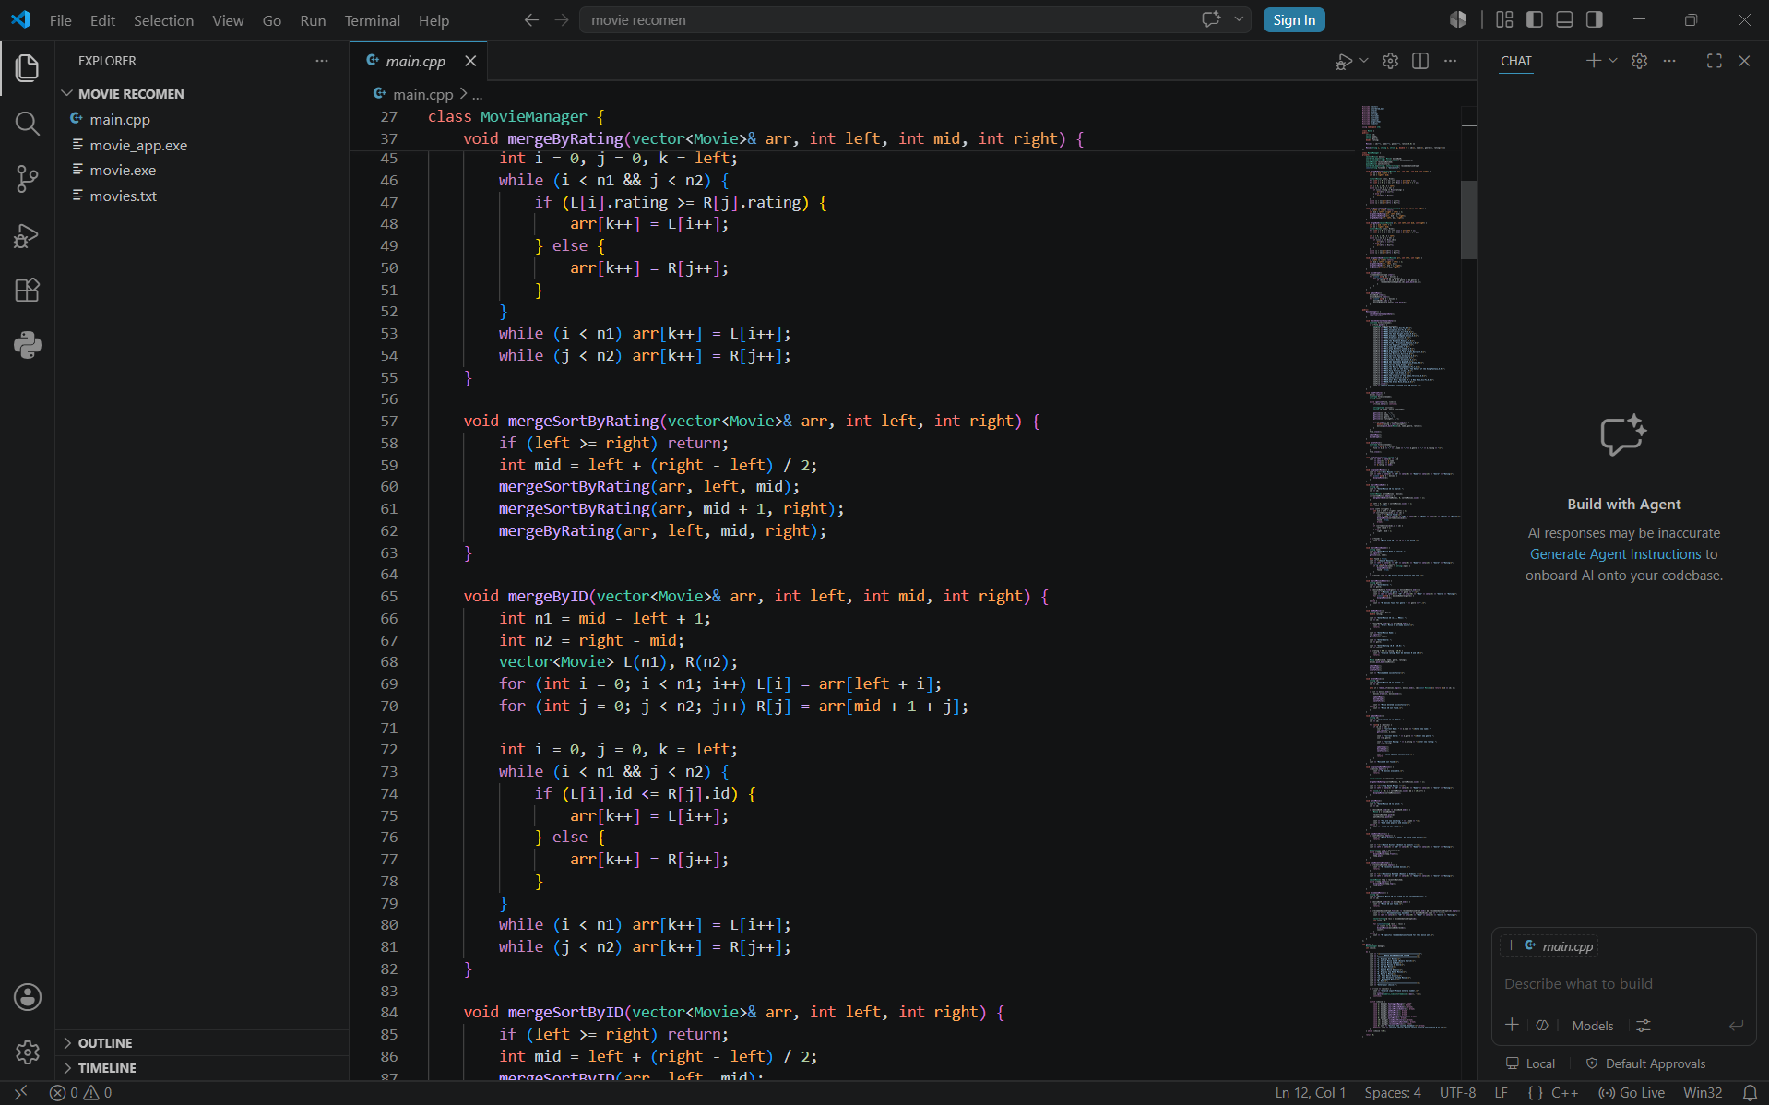
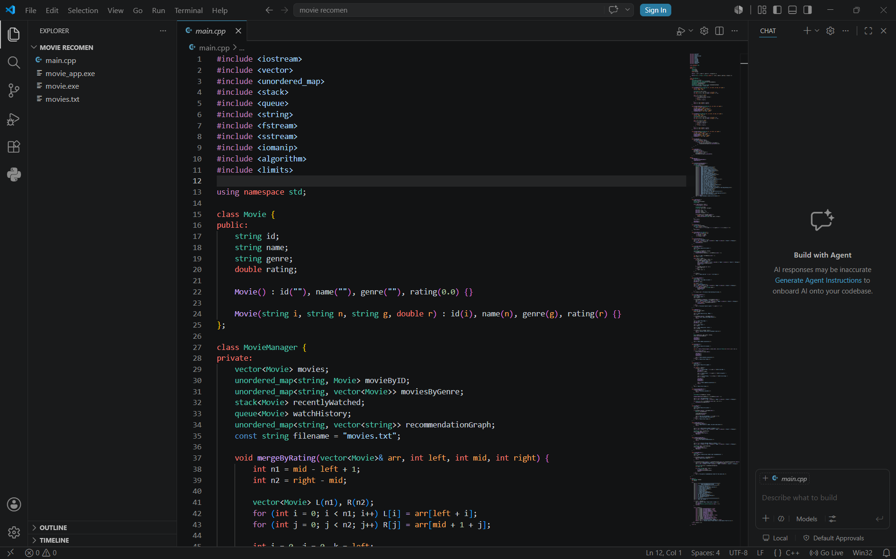
Project Code

Slide 23
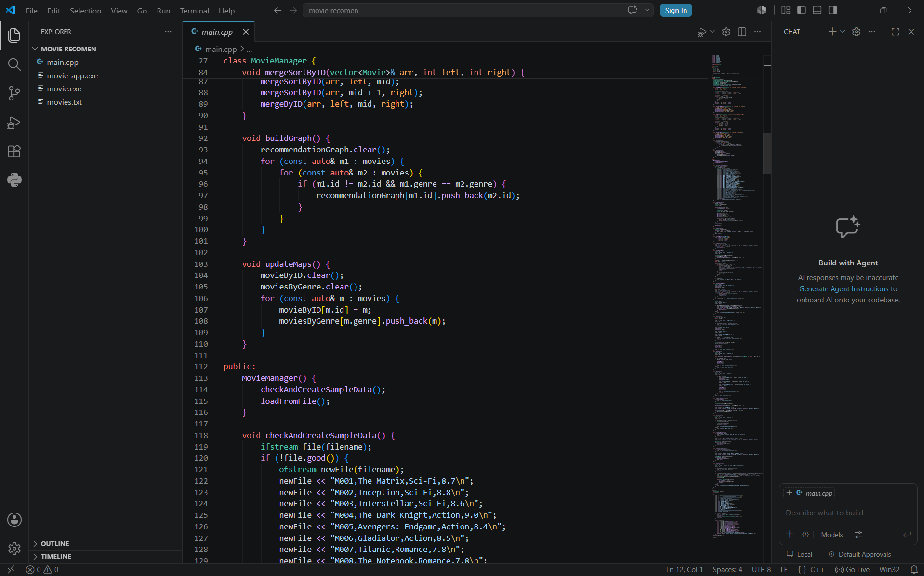
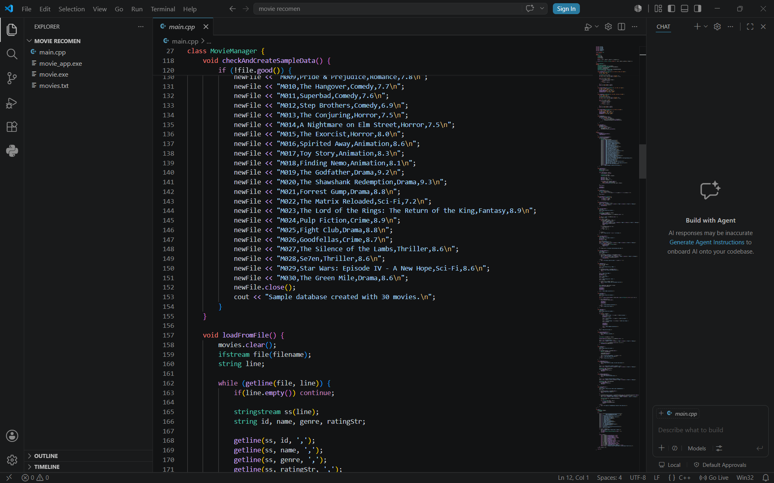

Slide 24
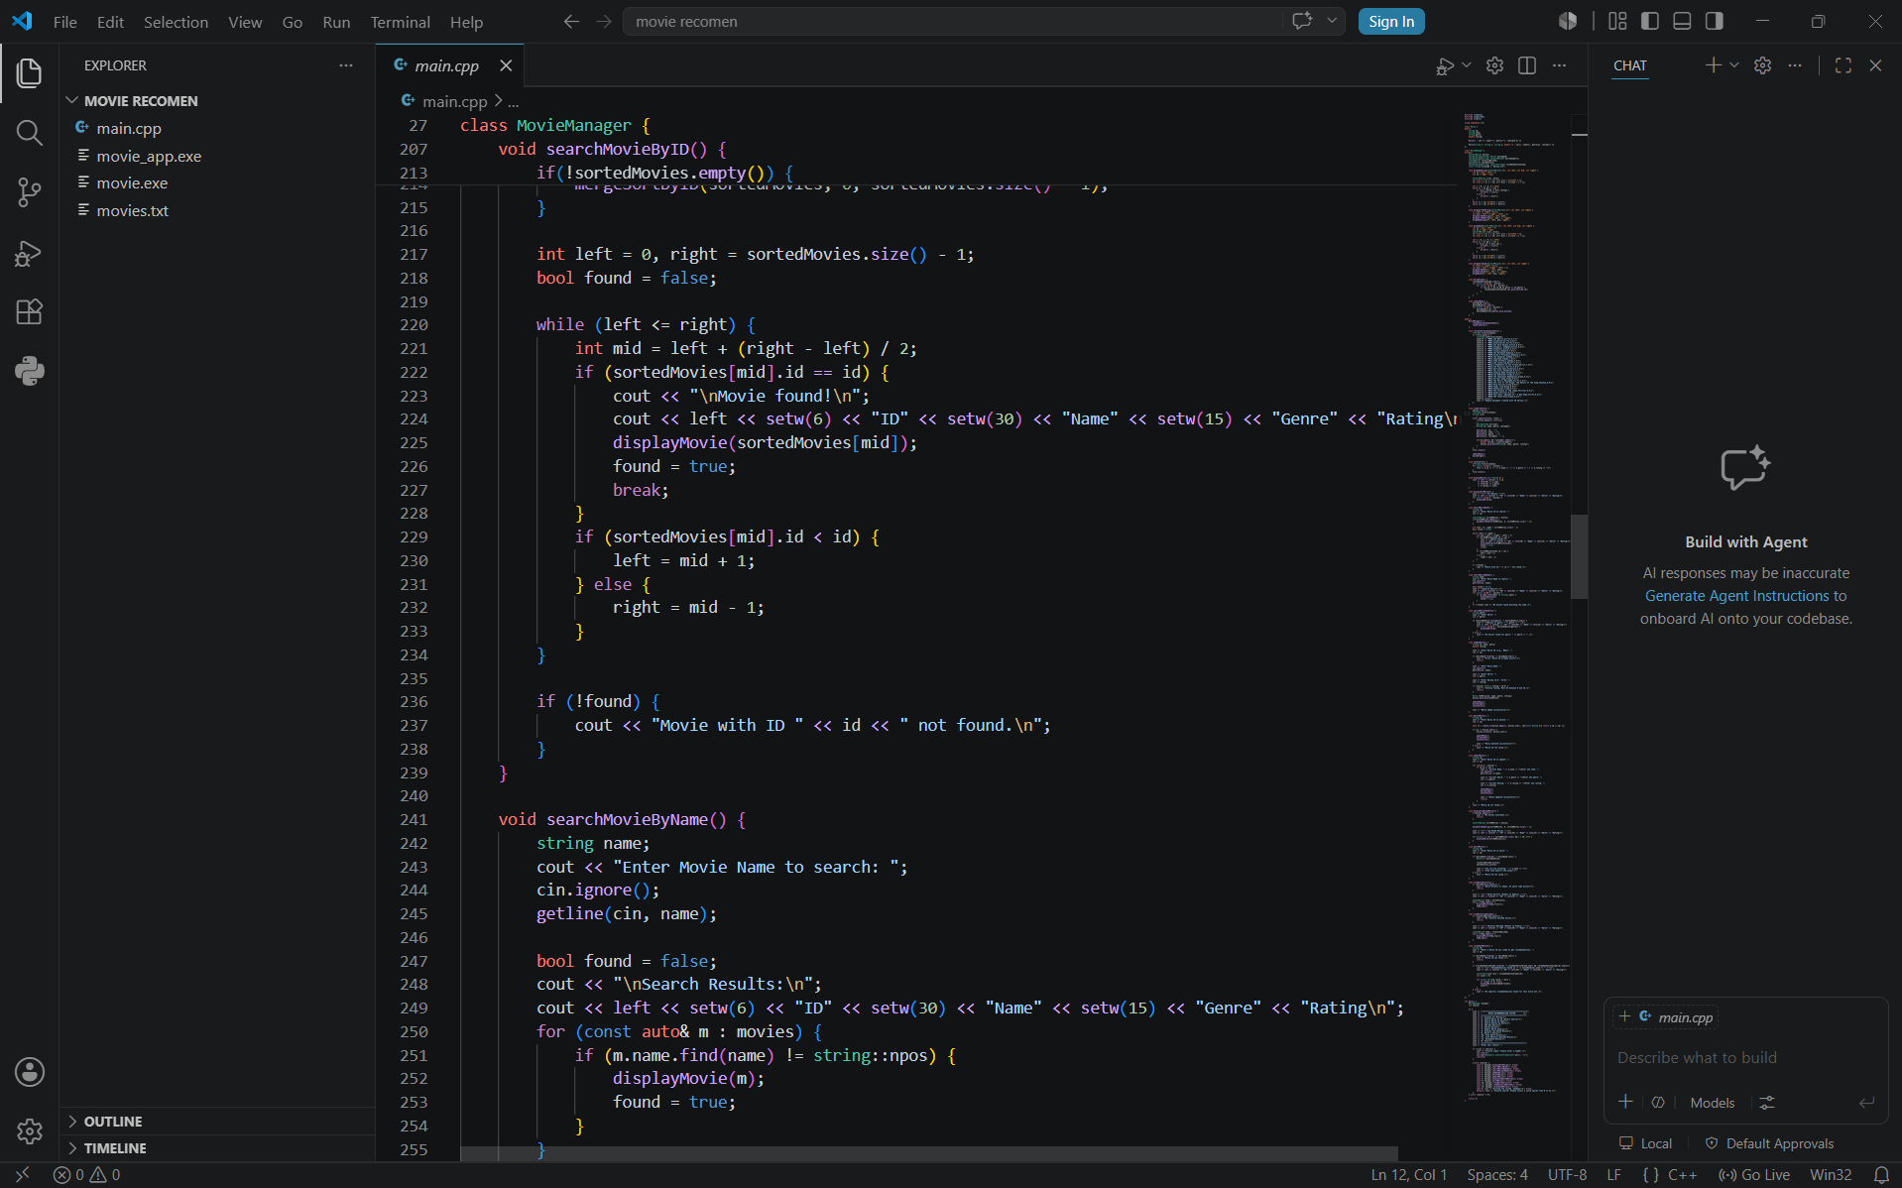
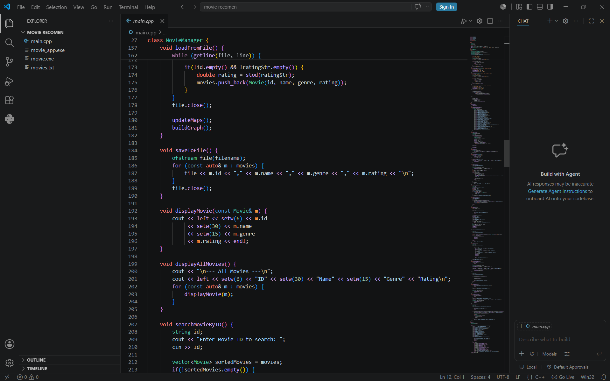
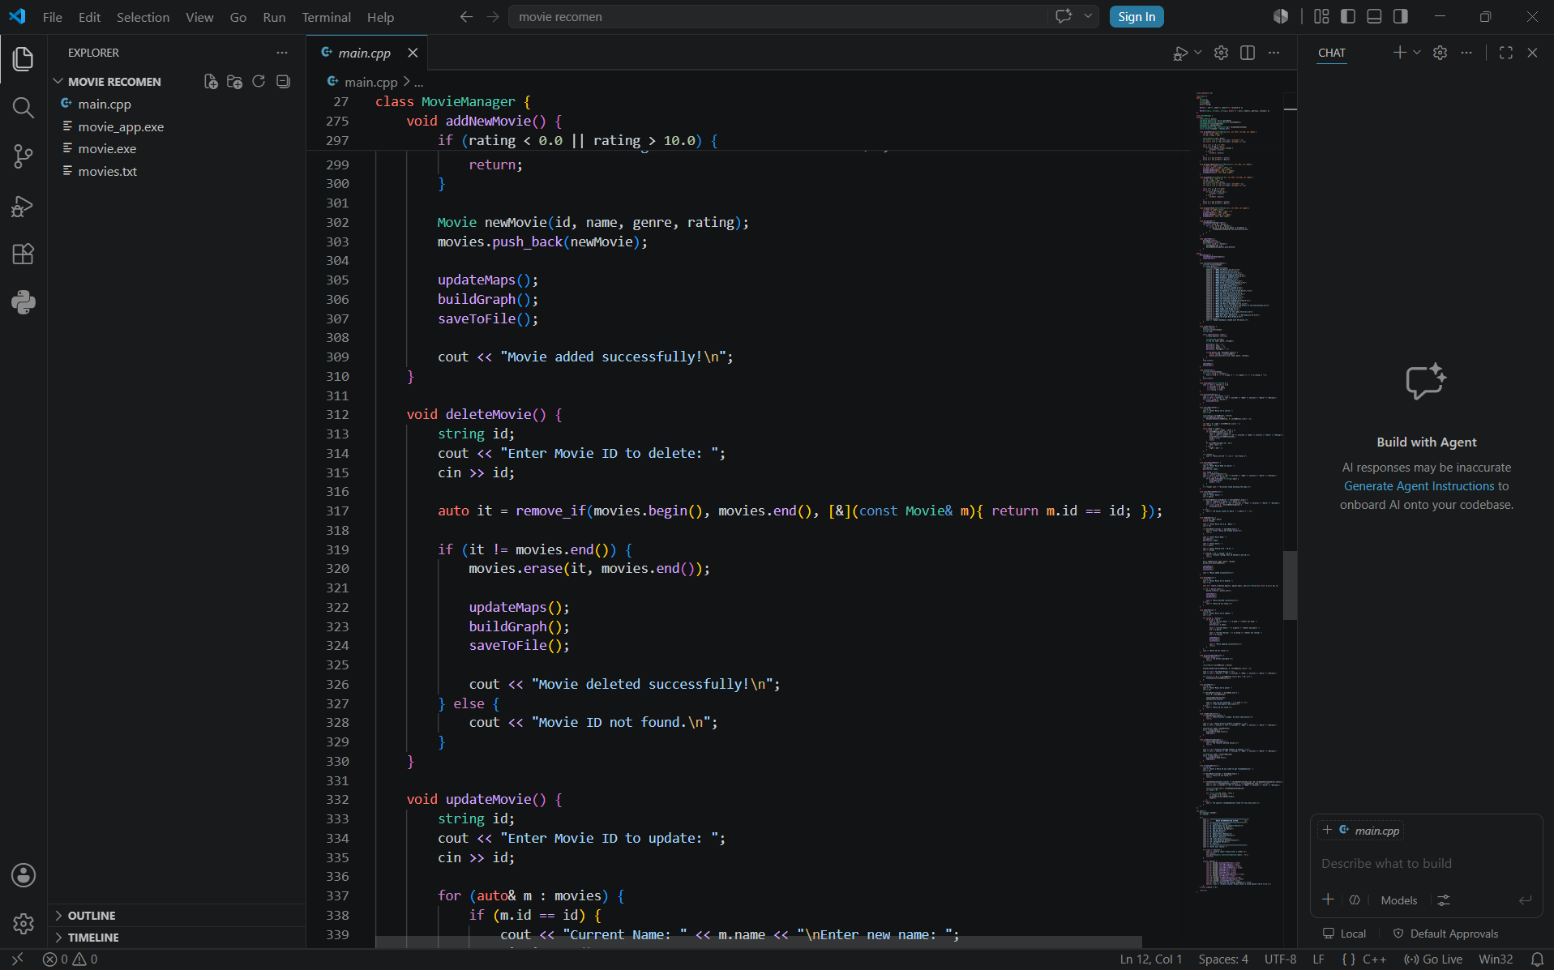
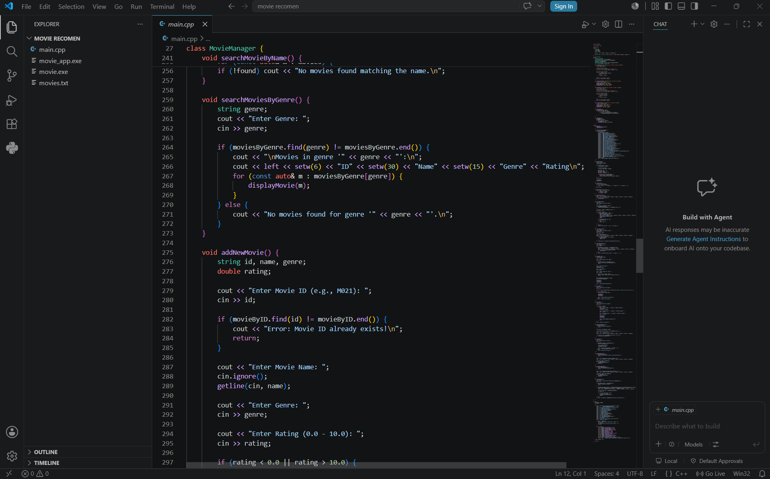

Slide 25
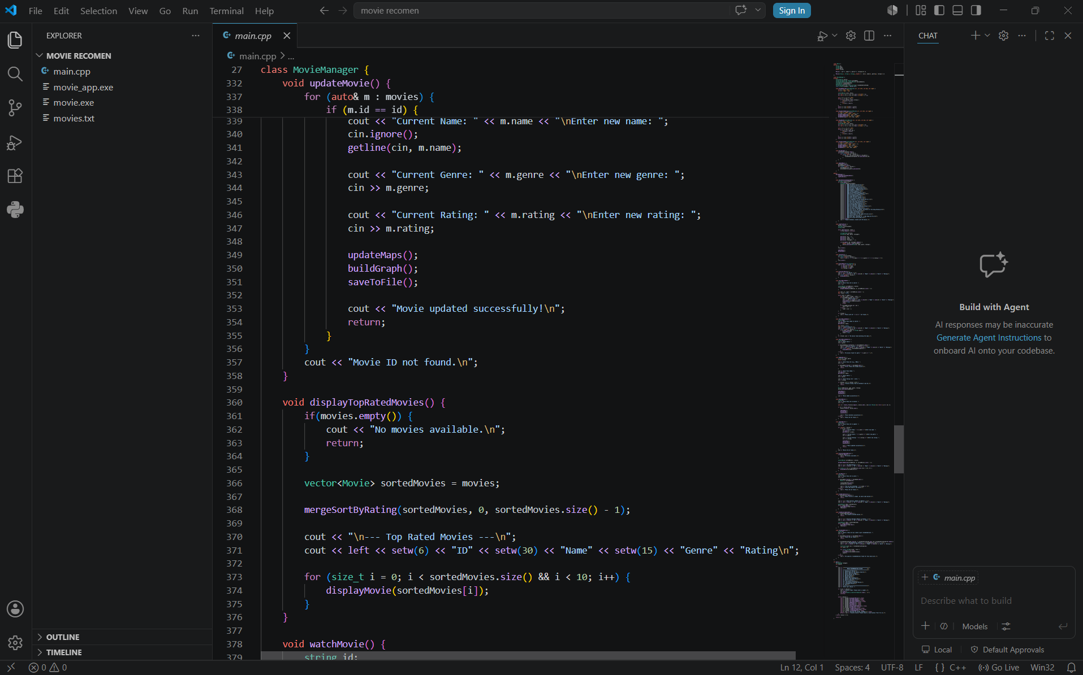
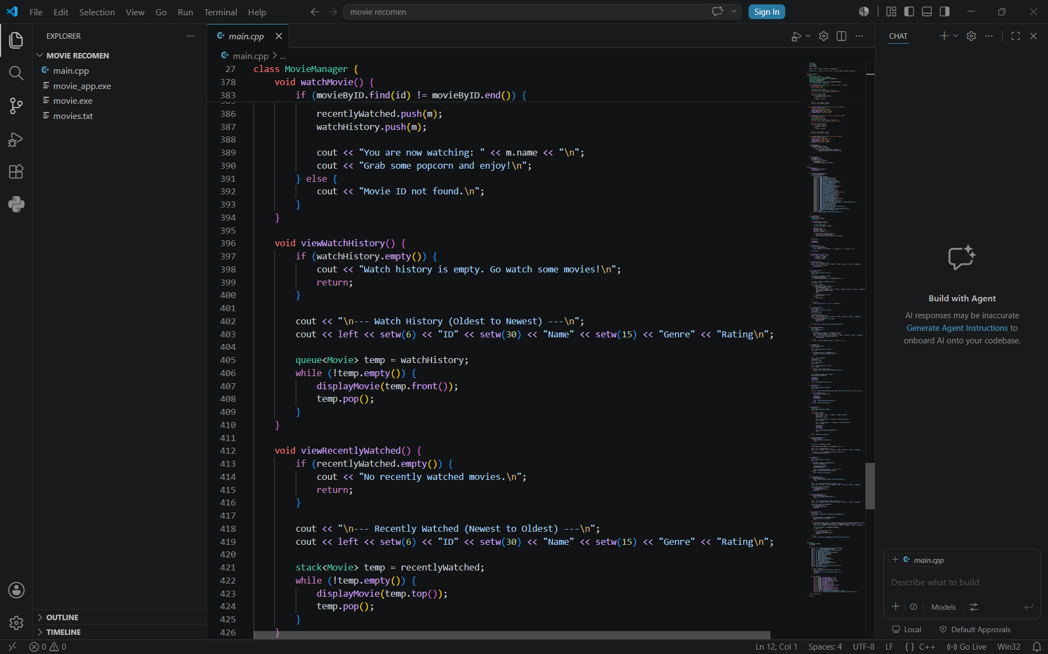
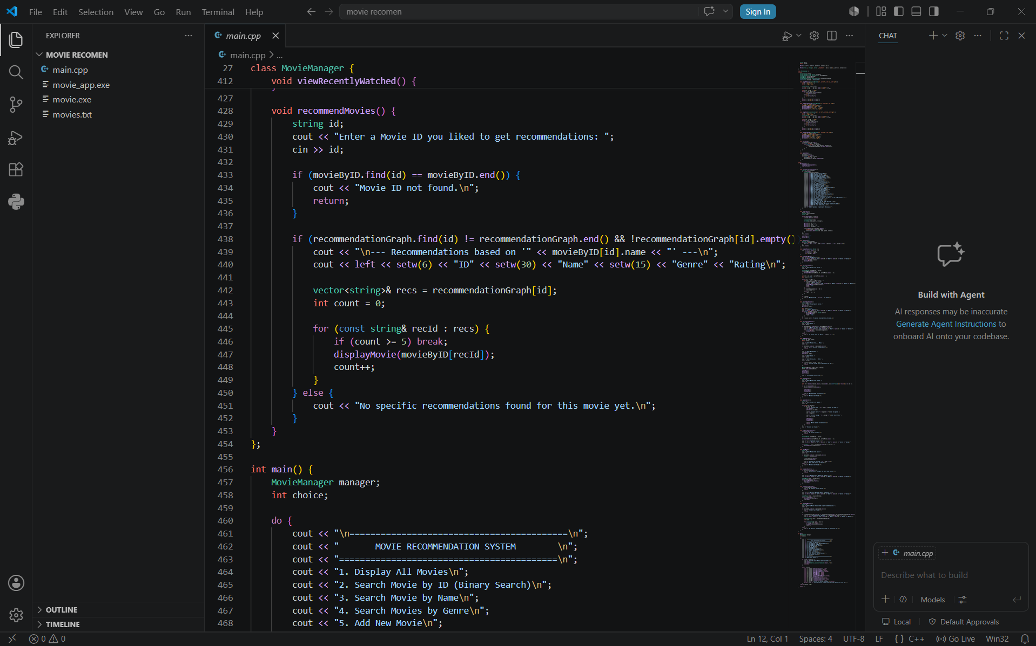
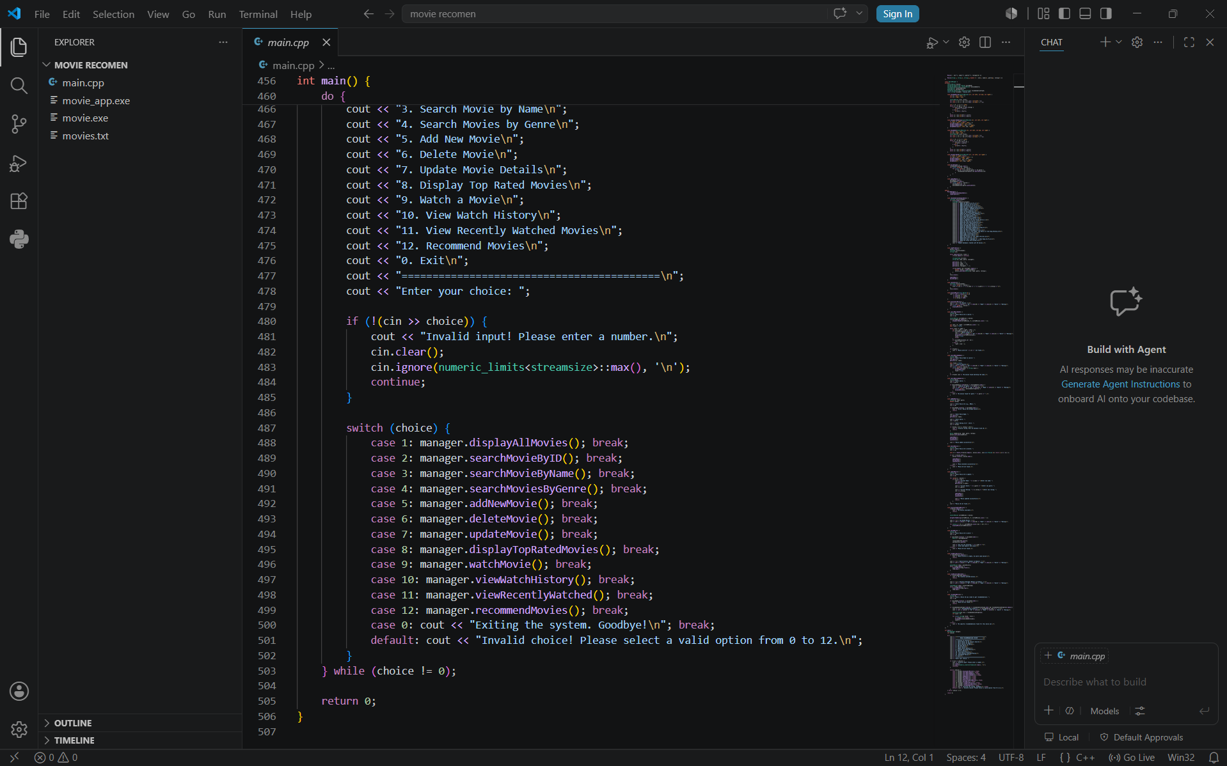

Slide 26
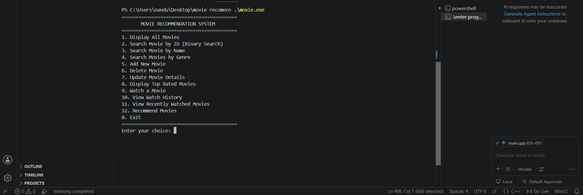
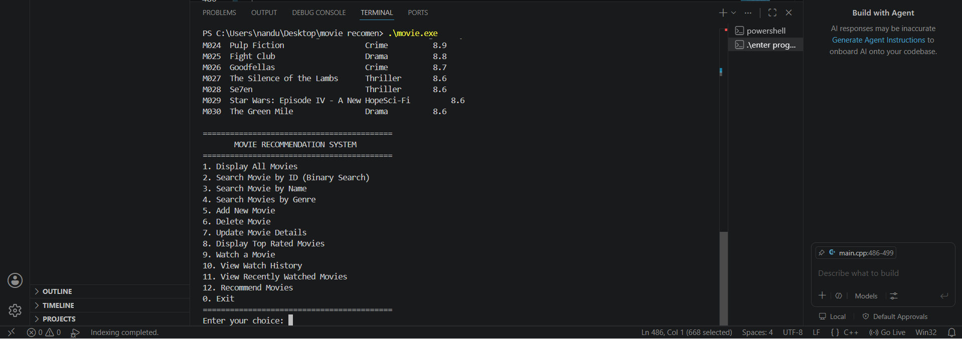
Project Screenshots

Slide 27
Project Outcomes
Successfully developed a Movie Recommendation System using C++.
Applied Data Structures and Algorithms to solve a real-world problem.
Implemented Vector, Stack, Queue, Hash Map, and Graph data structures.
Used Binary Search and Merge Sort to improve search and sorting efficiency.
Enhanced C++ programming, logical thinking, and problem-solving skills.
Gained practical experience in file handling and menu-driven application development.

Slide 28
Conclusion
The Movie Recommendation System was successfully developed using C++ and Data Structures & Algorithms.
The project demonstrates the practical use of Vector, Stack, Queue, Hash Map, Graph, Binary Search, and Merge Sort.
It provides an efficient and user-friendly way to manage, search, and recommend movies.
This project enhanced my C++ programming, DSA knowledge, and problem-solving skills, preparing me to build more advanced software applications in the future.

