Slide 1
Chapter 3: Processes

Slide 2
Chapter 3: Processes
Process Concept
Process Scheduling
Operations on Processes
Interprocess Communication
Examples of IPC Systems
Communication in Client-Server Systems

Slide 3
Objectives
To introduce the notion of a process -- a program in execution, which forms the basis of all computation
To describe the various features of processes, including scheduling, creation and termination, and communication
To explore interprocess communication using shared memory and message passing
To describe communication in client-server systems

Slide 4
Process Concept
An operating system executes a variety of programs:
  Batch system – jobs（作业）
  Time-shared systems – user programs or tasks（用户程序，任务）
Textbook uses the terms job and process almost interchangeably
Process – a program in execution; process execution must progress in sequential fashion
Multiple parts
  The program code, also called text section（代码段）
  Current activity including program counter, processor registers
  Stack containing temporary data
    Function parameters, return addresses, local variables
  Data section（数据段） containing global variables
  Heap（堆） containing memory dynamically allocated during run time（需要手动进行动态分配）

Slide 5
Process Concept (Cont.)
Program is passive entity stored on disk (executable file), process is active
  Program becomes process when executable file loaded into memory
Execution of program started via GUI mouse clicks, command line entry of its name, etc
One program can be several processes
  Consider multiple users executing the same program

Slide 6

Process in Memory

Slide 7
Process State
As a process executes, it changes state
  New（创建态）: The process is being created
  Running（运行态）: Instructions are being executed
  waiting（阻塞态）: The process is waiting for some event to occur
  Ready（就绪态）: The process is waiting to be assigned to a processor
  Terminated（终止态）: The process has finished execution

Slide 8

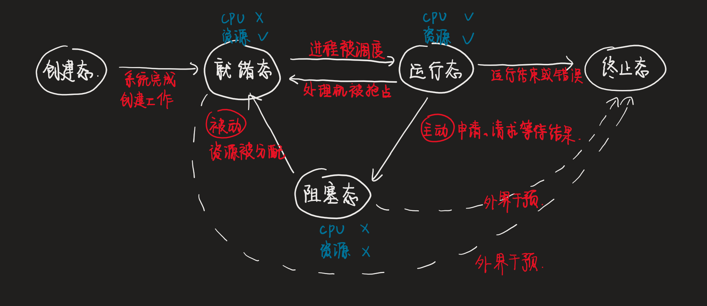
Diagram of Process State

Slide 9

Process Control Block (PCB)
Information associated with each process
(also called task control block)
Process state – running, waiting, etc
Program counter – location of instruction to next execute
CPU registers – contents of all process-centric registers
CPU scheduling information- priorities, scheduling queue pointers
Memory-management information – memory allocated to the process
Accounting information – CPU used, clock time elapsed since start, time limits
I/O status information – I/O devices allocated to process, list of open files

Slide 10

CPU Switch From Process to Process

Slide 11
Threads
So far, process has a single thread of execution
Consider having multiple program counters per process
  Multiple locations can execute at once
    Multiple threads of control -> threads
Must then have storage for thread details, multiple program counters in PCB
See next chapter

Slide 12

Process Representation in Linux
Represented by the C structure
struct task_struct
pid t_pid; /* process identifier */
long state; /* state of the process */
unsigned int time_slice /* scheduling information */
struct task_struct *parent; /* this process’s parent */
struct list_head children; /* this process’s children */
struct files_struct *files; /* list of open files */
struct mm_struct *mm; /* address space of this process */

Slide 13
Process Scheduling
Maximize CPU use, quickly switch processes onto CPU for time sharing
Process scheduler（进程调度器） selects among available processes for next execution on CPU
Maintains scheduling queues of processes
  Job queue（作业队列） – set of all processes in the system
  Ready queue（就绪队列） – set of all processes residing in main memory, ready and waiting to execute
  Device queues（设备队列） – set of processes waiting for an I/O device
  Processes migrate among the various queues（进程不断改变队列）

Slide 14

Ready Queue And Various I/O Device Queues

Slide 15

Representation of Process Scheduling
Queueing diagram represents queues, resources, flows

Slide 16
Schedulers
Short-term scheduler (or CPU scheduler) – selects which process should be executed next and allocates CPU
  Sometimes the only scheduler in a system
  Short-term scheduler is invoked frequently（经常使用） (milliseconds) ⇒ (must be fast)
Long-term scheduler (or job scheduler) – selects which processes should be brought into the ready queue
  Long-term scheduler is invoked infrequently（不经常使用） (seconds, minutes) ⇒ (may be slow)
  The long-term scheduler controls the degree of multiprogramming
Processes can be described as either:
  I/O-bound process – spends more time doing I/O than computations, many short CPU bursts
  CPU-bound process – spends more time doing computations; few very long CPU bursts
Long-term scheduler strives for good process mix

Slide 17

Addition of Medium Term Scheduling
Medium-term scheduler can be added if degree of multiple programming needs to decrease
  Remove process from memory, store on disk, bring back in from disk to continue execution: swapping（交换）

Slide 18
Multitasking in Mobile Systems
Some mobile systems (e.g., early version of iOS) allow only one process to run, others suspended
Due to screen real estate, user interface limits iOS provides for a
  Single foreground process- controlled via user interface
  Multiple background processes– in memory, running, but not on the display, and with limits
  Limits include single, short task, receiving notification of events, specific long-running tasks like audio playback
Android runs foreground and background, with fewer limits
  Background process uses a service to perform tasks
  Service can keep running even if background process is suspended
  Service has no user interface, small memory use

Slide 19
Context Switch
When CPU switches to another process, the system must save the state of the old process and load the saved state for the new process via a context switch（上下文切换）
Context of a process represented in the PCB
Context-switch time is overhead（开销）; the system does no useful work while switching
  The more complex the OS and the PCB ➔ the longer the context switch（系统越复杂，转换时间越长）
Time dependent on hardware support
  Some hardware provides multiple sets of registers per CPU ➔ multiple contexts loaded at once

Slide 20
Operations on Processes
System must provide mechanisms for:
  process creation,
  process termination,
  and so on as detailed next

Slide 21

Process Creation
Parent process create children processes, which, in turn create other processes, forming a tree of processes
Generally, process identified and managed via a process identifier (pid)（进程标识符）
Resource sharing options
  Parent and children share all resources
  Children share subset of parent’s resources
  Parent and child share no resources
Execution options
  Parent and children execute concurrently
  Parent waits until children terminate

Slide 22
PID
进程标识符
系统给每个进程定义了一个唯一标识该进程的非负正数，称作进程标识符。进程标识符可以简单的表示为主进程表中的一个索引。当某一进程终止后，其标识符可以重新用作另一进程的标识符。不过，在任何时刻，一个标识符所代表的进程是唯一的。系统把标识符 0 和 1 保留给系统的两个重要进程。进程 0 是调度进程，它按一定的原则把处理机分配给进程使用。进程 1 是初始化进程，它是程序/sbin/init 的执行。进程 1 是 UNIX 系统那其它进程的祖先，并且是进程结构的最终控制者。
进程属性
标识符每个进程都有6个重要的ID：进程ID、父进程ID、有效用户ID、有效组ID、实际用户ID和实际组ID。这6个标识符保存在进程的PCB中。

Slide 23

A Tree of Processes in Linux
初始化进程

Slide 24

Process Creation (Cont.)
Address space
  Child duplicate of parent
  Child has a program loaded into it
UNIX examples
  fork() system call creates new process
  exec() system call used after a fork() to replace the process’ memory space with a new program

Slide 25

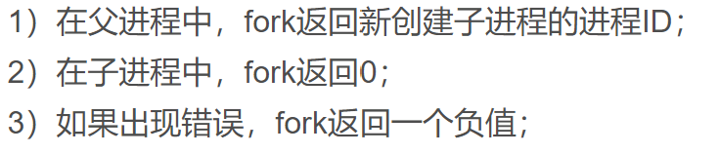
C Program Forking Separate Process
在pid=fork()语句前，是一个进程
在pid=fork()语句后，是两个进程
两个进程没有固定的执行顺序

Slide 26

Creating a Separate Process via Windows API

Slide 27
Process Termination
Process executes last statement and then asks the operating system to delete it using the exit() system call.
  Returns status data from child to parent (via wait())
  Process’ resources are deallocated by operating system
Parent may terminate the execution of children processes using the abort() system call（父进程通过abort（）结束子进程）. Some reasons for doing so:
  Child has exceeded allocated resources（子进程使用资源超过）
  Task assigned to child is no longer required（子进程的任务完成）
  The parent is exiting and the operating systems does not allow a child to continue if its parent terminates

Slide 28
Process Termination
Some operating systems do not allow child to exists if its parent has terminated. If a process terminates, then all its children must also be terminated.
  cascading termination（级联终止）. All children, grandchildren, etc. are terminated.
  The termination is initiated by the operating system.
The parent process may wait for termination of a child process by using the wait()system call. The call returns status information and the pid of the terminated process
pid = wait(&status);
If no parent waiting (did not invoke wait()) process is a zombie
If parent terminated without invoking wait , process is an orphan
A process that has terminated, but whose parent has not yet called wait(), is known as a zombie process.
A parent did not invoke wait() and instead terminated, thereby leaving its child processes as orphans

Slide 29
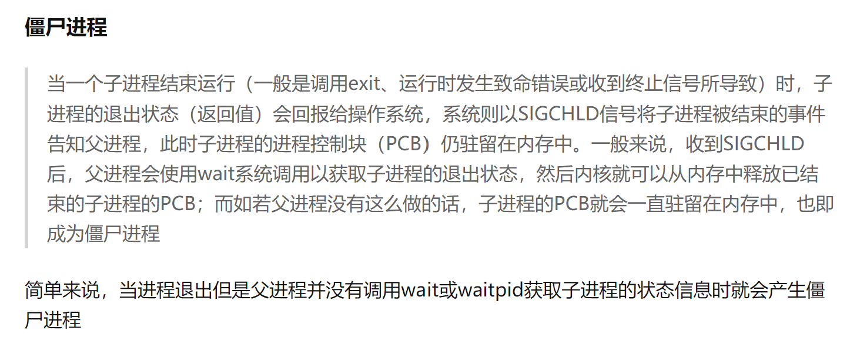
当一个进程完成它的工作终止之后，它的父进程需要调用wait()或者waitpid()系统调用取得子进程的终止状态

Slide 30
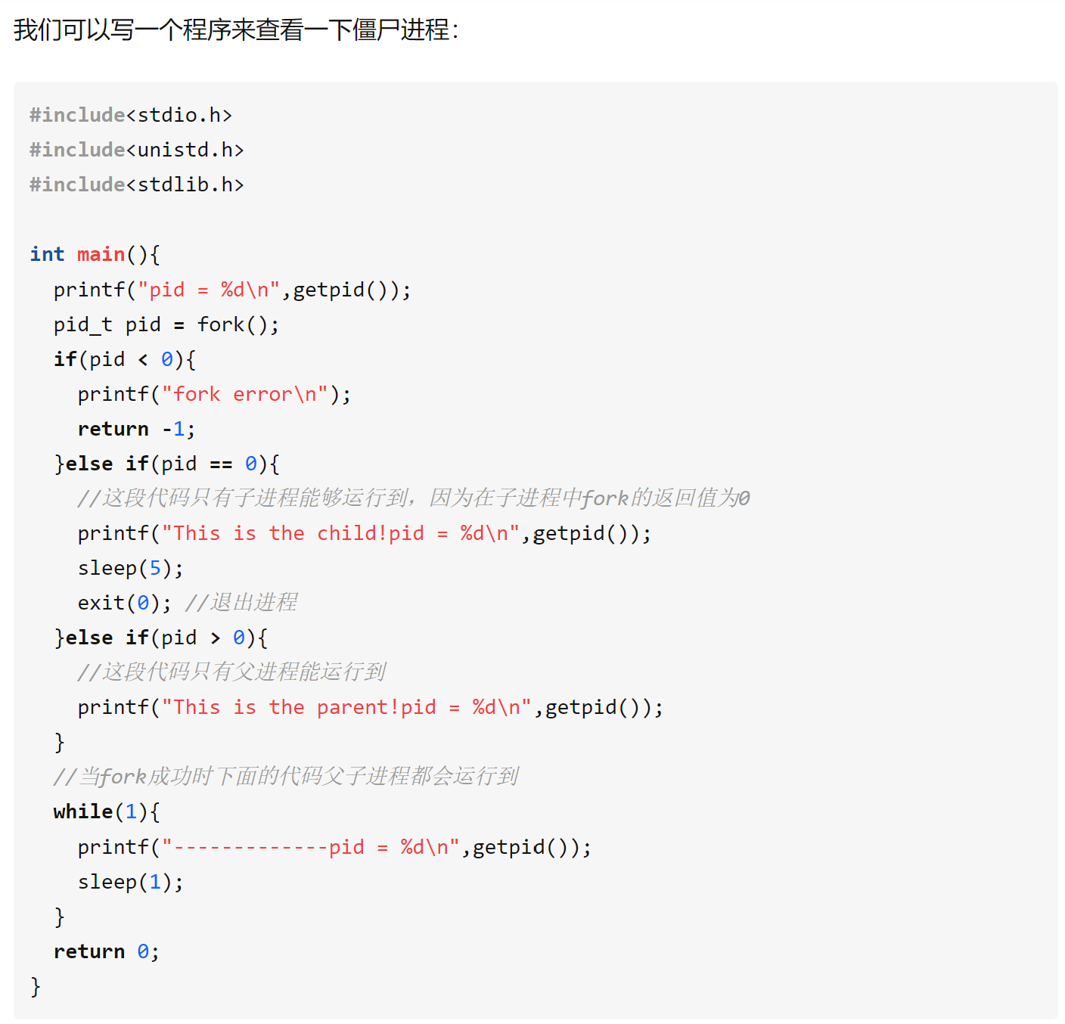

Slide 31

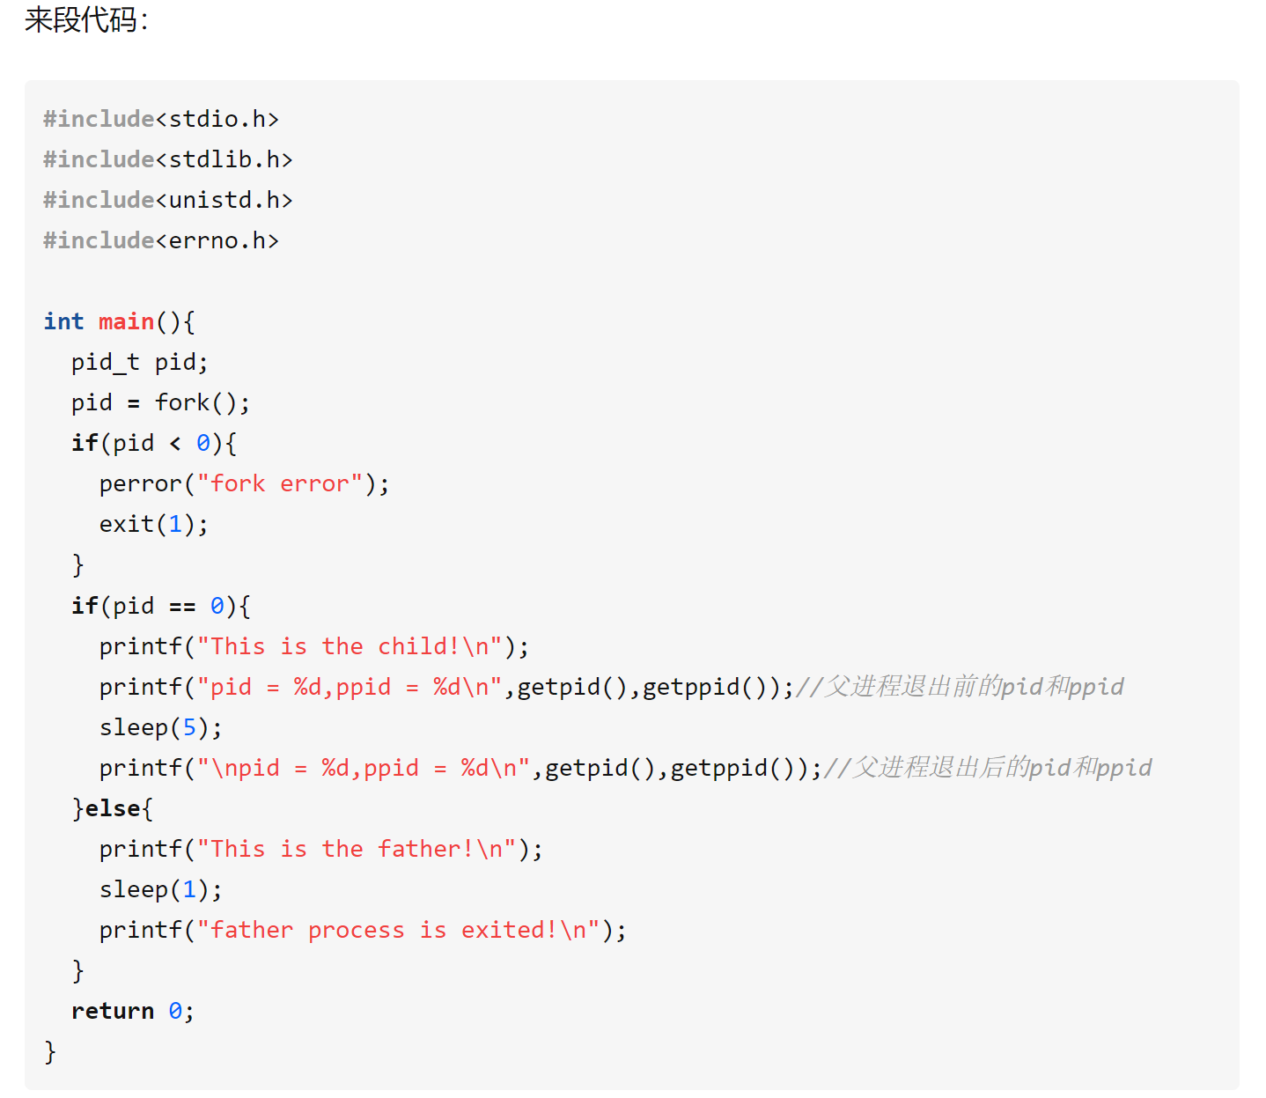

Slide 32
Questions？
What is a process?
Describe the five states of a process and their transitions.
What is a PCB? What types of information it has?
Describe the process creation in Linux.

Slide 33
Questions？
What is a process?
  进程是执行中的程序，进程不只是程序代码，程序代码有时称为文本段，进程还包括当前活动，通过程序计数器的值和处理器寄存器的内容来表示。另外进程通常还包括堆栈段、数据段、堆。
Describe the five states of a process and their transitions.
What is a PCB? What types of information it has?
  进程控制块：进程状态、程序计数器、CPU寄存器、CPU调度信息、内存管理信息、记账信息、I/O状态信息
Describe the process creation in Linux.

Slide 34

Multiprocess Architecture – Chrome Browser
Many web browsers ran as single process (some still do)
  If one web site causes trouble, entire browser can hang or crash
Google Chrome Browser is multiprocess with 3 different types of processes:
  Browser process manages user interface, disk and network I/O
  Renderer process（渲染器进程） renders web pages, deals with HTML, Javascript. A new renderer created for each website opened
    Runs in sandbox restricting disk and network I/O, minimizing effect of security exploits
  Plug-in process for each type of plug-in

Slide 35
Interprocess Communication（进程通信）
Processes within a system may be independent or cooperating
Cooperating process can affect or be affected by other processes, including sharing data
Reasons for cooperating processes:
  Information sharing
  Computation speedup
  Modularity
  Convenience
Cooperating processes need interprocess communication (IPC)
Two models of IPC
  Shared memory（内存共享）
  Message passing（消息传递）（消息队列）

Slide 36

Communications Models
(a) Message passing. (b) shared memory.

Slide 37
Producer-Consumer Problem
Paradigm for cooperating processes, producer process produces information that is consumed by a consumer process
  unbounded-buffer（无界缓冲区） places no practical limit on the size of the buffer
  bounded-buffer（有界缓冲区） assumes that there is a fixed buffer size

Slide 38
Bounded-Buffer – Shared-Memory Solution
Shared data
      #define BUFFER_SIZE 10
      typedef struct {
      . . .
      } item;
      item buffer[BUFFER_SIZE];
      int in = 0;
      int out = 0;
Solution is correct, but can only use BUFFER_SIZE-1 elements

Slide 39
Bounded-Buffer – Producer
item next_produced;
while (true) {
/* produce an item in next produced */
while (((in + 1) % BUFFER_SIZE) == out)
; /* do nothing */
buffer[in] = next_produced;
in = (in + 1) % BUFFER_SIZE;
}

Slide 40
Bounded Buffer – Consumer
item next_consumed;
while (true) {
while (in == out)
; /* do nothing */
next_consumed = buffer[out];
out = (out + 1) % BUFFER_SIZE;
/* consume the item in next consumed */
}

Slide 41
Interprocess Communication – Shared Memory
An area of memory shared among the processes that wish to communicate
The communication is under the control of the users’ processes not the operating system.
Major issues is to provide mechanism that will allow the user processes to synchronize their actions when they access shared memory. （主要问题是提供一种机制，允许用户进程在访问共享内存时同步其操作。）
Synchronization is discussed in great details in Chapter 5.

Slide 42
Interprocess Communication – Message Passing
Mechanism for processes to communicate and to synchronize their actions
Message system – processes communicate with each other without resorting to shared variables
IPC facility provides two operations:
  send(message)
  receive(message)
The message size is either fixed or variable

Slide 43
Message Passing (Cont.)
If processes P and Q wish to communicate, they need to:
  Establish a communication link between them
  Exchange messages via send/receive
Implementation issues:
  How are links established?
  Can a link be associated with more than two processes?
  How many links can there be between every pair of communicating processes?
  What is the capacity of a link?
  Is the size of a message that the link can accommodate fixed or variable?
  Is a link unidirectional or bi-directional?

Slide 44
Message Passing (Cont.)
Implementation of communication link
  Physical:
    Shared memory（共享存储）
    Hardware bus（桥）
    Network（网络）
  Logical:
    Direct or indirect
    Synchronous or asynchronous（同步，异步）
    Automatic or explicit buffering（显式缓冲）

Slide 45
Direct Communication（直接通信）
Processes must name each other explicitly:
  send (P, message) – send a message to process P
  receive(Q, message) – receive a message from process Q
Properties of communication link
  Links are established automatically
  A link is associated with exactly one pair of communicating processes （一条link连接一对进程）
  Between each pair there exists exactly one link（一对进程只有一个link）
  The link may be unidirectional, but is usually bi-directional

Slide 46
Indirect Communication（间接通信，信箱）
Messages are directed and received from mailboxes (also referred to as ports)
  Each mailbox has a unique id（每个信箱有个唯一的id）
  Processes can communicate only if they share a mailbox
Properties of communication link
  Link established only if processes share a common mailbox
  A link may be associated with many processes
  Each pair of processes may share several communication links
  Link may be unidirectional or bi-directional

Slide 47
Indirect Communication
Operations
  create a new mailbox (port)
  send and receive messages through mailbox
  destroy a mailbox
Primitives are defined as:
send(A, message) – send a message to mailbox A
receive(A, message) – receive a message from mailbox A

Slide 48
Indirect Communication
Mailbox sharing
  P₁, P₂, and P₃ share mailbox A
  P₁, sends; P₂ and P₃ receive
  Who gets the message?
Solutions
  Allow a link to be associated with at most two processes
  Allow only one process at a time to execute a receive operation
  Allow the system to select arbitrarily the receiver. Sender is notified who the receiver was.（指定接收者）

Slide 49
Synchronization
Message passing may be either blocking or non-blocking
Blocking is considered synchronous（阻塞———同步）
  Blocking send -- the sender is blocked until the message is received
  Blocking receive -- the receiver is blocked until a message is available
Non-blocking is considered asynchronous（非阻塞——非同步）
  Non-blocking send -- the sender sends the message and continue
  Non-blocking receive -- the receiver receives:
    A valid message, or
    Null message
Different combinations possible
  If both send and receive are blocking, we have a rendezvous

Slide 50
Synchronization (Cont.)
Producer-consumer becomes trivial
message next_produced;
while (true) {
/* produce an item in next produced */
send(next_produced);
}
message next_consumed;
while (true) {
receive(next_consumed);
/* consume the item in next consumed */
}

Slide 51
Buffering
Queue of messages attached to the link.
implemented in one of three ways
  1. Zero capacity – no messages are queued on a link.
  Sender must wait for receiver (rendezvous)
  2. Bounded capacity – finite length of n messages
  Sender must wait if link full
  3. Unbounded capacity – infinite length
  Sender never waits

Slide 52
Examples of IPC Systems - POSIX
POSIX Shared Memory
  Process first creates shared memory segment
  shm_fd = shm_open(name, O CREAT | O RDWR, 0666);
  Also used to open an existing segment to share it
  Set the size of the object
ftruncate(shm fd, 4096);
  Now the process could write to the shared memory
  sprintf(shared memory, "Writing to shared memory");

Slide 53

IPC POSIX Producer

Slide 54

IPC POSIX Consumer

Slide 55
Examples of IPC Systems - Mach
Mach communication is message based
  Even system calls are messages
  Each task gets two mailboxes at creation- Kernel and Notify
  Only three system calls needed for message transfer
  msg_send(), msg_receive(), msg_rpc()
  Mailboxes needed for commuication, created via
  port_allocate()
  Send and receive are flexible, for example four options if mailbox full:
    Wait indefinitely
    Wait at most n milliseconds
    Return immediately
    Temporarily cache a message

Slide 56
Examples of IPC Systems – Windows
Message-passing centric via advanced local procedure call (LPC) facility（高级本地程序调用工具）
  Only works between processes on the same system
  Uses ports (like mailboxes) to establish and maintain communication channels
  Communication works as follows:
    The client opens a handle （句柄） to the subsystem’s connection port object.
    The client sends a connection request.
    The server creates two private communication ports and returns the handle to one of them to the client.
    The client and server use the corresponding port handle to send messages or callbacks and to listen for replies.

Slide 57

Local Procedure Calls in Windows

Slide 58
Communications in Client-Server Systems
Sockets
Remote Procedure Calls
Pipes

Slide 59
Sockets
A socket（套接字） is defined as an endpoint for communication
Concatenation of IP address and port – a number included at start of message packet to differentiate network services on a host
The socket 161.25.19.8:1625 refers to port 1625（接口） on host 161.25.19.8（主机地址）
Communication consists of a pair of sockets（通信由一对套接字组成）
All ports below 1024 are well known, used for standard services（用于标准服务）
Special IP address 127.0.0.1 (loopback) to refer to system on which process is running（正在运行进程的系统）

Slide 60

Socket Communication

Slide 61

Sockets in Java
Three types of sockets
  Connection-oriented (TCP)
  Connectionless (UDP)
  MulticastSocket （多播） class– data can be sent to multiple recipients
Consider this “Date” server:

Slide 62
Remote Procedure Calls
Remote procedure call (RPC，远程过程调用) abstracts procedure calls between processes on networked systems
  Again uses ports for service differentiation
Stubs – client-side proxy for the actual procedure on the server（Stubs，存根–服务器上实际过程的客户端代理）
The client-side stub locates the server and marshalls the parameters（客户端存根定位服务器并封送参数）
The server-side stub receives this message, unpacks the marshalled parameters, and performs the procedure on the server（服务器端存根接收此消息，解压缩封送的参数，并在服务器上执行该过程）
On Windows, stub code compile from specification written in Microsoft Interface Definition Language (MIDL)

Slide 63
Remote Procedure Calls (Cont.)
Data representation handled via External Data Representation (XDL) format to account for different architectures（通过外部数据表示（XDL）格式处理数据表示，以考虑不同的体系结构）
  Big-endian and little-endian
Remote communication has more failure scenarios than local（有更多故障场景）
  Messages can be delivered exactly once rather than at most once（消息只能传递一次，而不是最多一次）
OS typically provides a rendezvous (or matchmaker，配对) service to connect client and server

Slide 64

Execution of RPC
Matchmaker and
Port P are in server

Slide 65
Pipes
Acts as a conduit allowing two processes to communicate
Issues:
  Is communication unidirectional or bidirectional?
  In the case of two-way communication, is it half or full-duplex?
  Must there exist a relationship (i.e., parent-child) between the communicating processes?
  Can the pipes be used over a network?
Ordinary pipes – cannot be accessed from outside the process that created it. Typically, a parent process creates a pipe and uses it to communicate with a child process that it created. （不允许外部访问）
Named pipes – can be accessed without a parent-child relationship.（可以在没有父子关系下进行访问）

Slide 66

Ordinary Pipes
Ordinary Pipes allow communication in standard producer-consumer style
Producer writes to one end (the write-end of the pipe)
Consumer reads from the other end (the read-end of the pipe)
Ordinary pipes are therefore unidirectional（普通管道单向）
Require parent-child relationship between communicating processes
Windows calls these anonymous pipes
See Unix and Windows code samples in textbook

Slide 67
Named Pipes
Named Pipes are more powerful than ordinary pipes
Communication is bidirectional（命名管道双向）
No parent-child relationship is necessary between the communicating processes
Several processes can use the named pipe for communication
Provided on both UNIX and Windows systems

Slide 68
Homework
P149： 3.1、3.2、3.5、3.6、3.14
12月7日（周一）交

Slide 69
End of Chapter 3
Slides are created based on http://codex.cs.yale.edu/avi/os-book/OS9/slide-dir/index.html

