Slide 1
Chapter 10: Mass-Storage Systems

Slide 2
Chapter 10: Mass-Storage Systems
Overview of Mass Storage Structure
Disk Structure
Disk Attachment
Disk Scheduling
Disk Management
Swap-Space Management
RAID Structure
Stable-Storage Implementation

Slide 3
Objectives
To describe the physical structure of secondary storage devices and its effects on the uses of the devices
To explain the performance characteristics of mass-storage devices
To evaluate disk scheduling algorithms
To discuss operating-system services provided for mass storage, including RAID

Slide 4

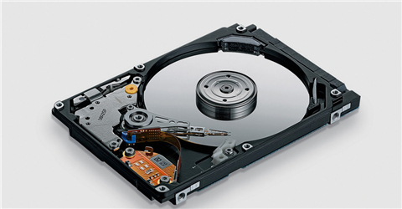

Slide 5
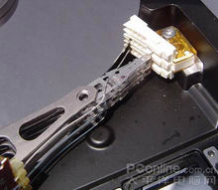

Slide 6

Moving-head Disk Mechanism
磁道
转轴
机械臂杆
扇区
柱面
读写磁头
磁盘面
磁臂
旋转
Disk drive
磁盘驱动器

Slide 7
Overview of Mass Storage Structure
Magnetic disks provide bulk of secondary storage of modern computers
  Drives rotate at 60 to 250 times per second
  Transfer rate is rate at which data flow between drive and computer
  Positioning time (random-access time) is time to move disk arm to desired cylinder (seek time) and time for desired sector to rotate under the disk head (rotational latency)
  Head crash results from disk head making contact with the disk surface -- That’s bad
Disks can be removable
Drive attached to computer via I/O bus
  Busses vary, including EIDE, ATA, SATA, USB, Fibre Channel, SCSI, SAS, Firewire
  Host controller in computer uses bus to talk to disk controller built into drive or storage array
  控制器（controller） 是一个特殊处理器，用于执行总线上的数据传输。其中， 主机（host） 控制器是计算机上位于总线末端的控制器，而 磁盘（disk） 控制器位于磁盘驱动器内。

Slide 8
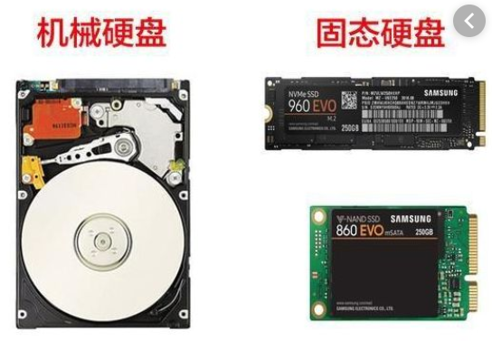
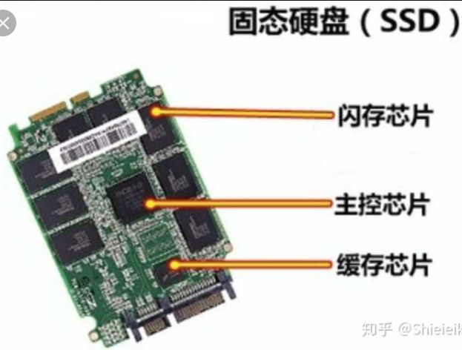
Solid-State Disks
Nonvolatile memory used like a hard drive
  Many technology variations
Can be more reliable than HDDs
More expensive per MB
Maybe have shorter life span
Less capacity
But much faster
Buses can be too slow -> connect directly to PCI for example
No moving parts, so no seek time or rotational latency

Slide 9
Magnetic Tape
Was early secondary-storage medium
  Evolved from open spools to cartridges
Relatively permanent and holds large quantities of data
Access time slow
Random access ~1000 times slower than disk
Mainly used for backup, storage of infrequently-used data, transfer medium between systems
Kept in spool and wound or rewound past read-write head
Once data under head, transfer rates comparable to disk
  140MB/sec and greater
200GB to 1.5TB typical storage
Common technologies are LTO-{3,4,5} and T10000

Slide 10
Disk Structure
Disk drives are addressed as large 1-dimensional arrays of logical blocks, where the logical block is the smallest unit of transfer 磁盘驱动器被寻址为逻辑块的大型一维阵列，其中逻辑块是最小的传输单元
  Low-level formatting creates logical blocks on physical media低级格式化在物理介质上创建逻辑块
The 1-dimensional array of logical blocks is mapped into the sectors of the disk sequentially
  Sector 0 is the first sector of the first track on the outermost cylinder
  Mapping proceeds in order through that track, then the rest of the tracks in that cylinder, and then through the rest of the cylinders from outermost to innermost
  Logical to physical address should be easy
    Except for bad sectors
    Non-constant # of sectors per track via constant angular velocity

Slide 11
Disk Attachment（磁盘连接）
Host-attached storage accessed through I/O ports talking to I/O busses
SCSI itself is a bus, up to 16 devices on one cable, SCSI initiator requests operation and SCSI targets(x15) perform tasks
  Each target can have up to 8 logical units (disks attached to device controller)
  SCSI的英文全称为“Small Computer System Interface”（小型计算机系统接口），是同IDE（ATA）完全不同的接口，IDE接口是普通PC的标准接口，而SCSI并不是专门为硬盘设计的接口，是一种广泛应用于小型机上的高速数据传输技术。SCSI接口具有应用范围广、多任务、带宽大、CPU占用率低，以及热插拔等优点，但较高的价格使得它很难如IDE硬盘般普及，因此SCSI硬盘主要应用于中、高端服务器和高档工作站中。

Slide 12
Host-attached storage
FC （ Fibre Channel ）is high-speed serial architecture
  Large switched fabric with a 24-bit address space – the basis of storage area networks (SANs) in which many hosts attach to many storage units
  光纤通道的英文拼写是Fibre Channel，和SCSI接口一样光纤通道最初也不是为硬盘设计开发的接口技术，是专门为网络系统设计的，但随着存储系统对速度的需求，才逐渐应用到硬盘系统中。光纤通道硬盘是为提高多硬盘存储系统的速度和灵活性才开发的，它的出现大大提高了多硬盘系统的通信速度。光纤通道的主要特性有：热插拔性、高速带宽、远程连接、连接设备数量大等。
  光纤通道是为在像服务器这样的多硬盘系统环境而设计的，能满足高端工作站、服务器、海量存储子网络、外设间通过集线器、交换机和点对点连接进行双向、串行数据通讯等系统对高数据传输率的要求。

Slide 13

Network-Attached Storage
Network-attached storage (NAS) is storage made available over a network rather than over a local connection (such as a bus) 网络连接存储（NAS）是通过网络而不是通过本地连接（如总线）提供的存储
  Remotely attaching to file systems
NFS（Network File System,网络文件系统） and CIFS (Common Internet File System,通用网络文件系统) are common protocols
  CIFS 是一个新提出的协议，它使程序可以访问远程Internet计算机上的文件并要求此计算机提供服务。CIFS 使用客户/服务器模式。
Implemented via remote procedure calls (RPCs) between host and storage over typically TCP or UDP on IP network
iSCSI（Internet small computer system interface） protocol uses IP network to carry the SCSI protocol
  Remotely attaching to devices (blocks)

Slide 14
Storage Array (存储阵列)
Can just attach disks, or arrays of disks
  A disk array is a disk storage system which contains multiple disk drives. 磁盘阵列是包含多个磁盘驱动器的磁盘存储系统。
Storage Array has controller(s), provides features to attached host(s)
  Ports to connect hosts to array
  Memory, controlling software (sometimes NVRAM, etc)
  A few to thousands of disks
  RAID, hot spares, hot swap (discussed later)
  Hot Spare：热备用: 当一个正在使用的磁盘发生故障后，一个空闲、加电并待机的磁盘将马上代替此故障盘。
  Hot Swap: 热插拔 :即带电插拔，指的是在不关闭系统电源的情况下，将模块、板卡插入或拔出系统而不影响系统的正常工作，从而提高了系统的可靠性、快速维修性、冗余性和对灾难的及时恢复能力等
  Shared storage -> more efficiency
  Features found in some file systems
    Snapshots, clones, thin provisioning, replication, deduplication, etc

Slide 15
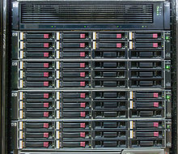
HP EVA4400 storage array, consisting of 2U controller enclosure (top) and 4 2U disk shelves
“U”在服务器领域中特指机架式服务器厚度，是一种表示服务器外部尺寸的单位，是unit的缩略语，详细的尺寸由作为业界团体的美国电子工业协会（EIA）所决定。 厚度以.cm为基本单位。
1U就是4.45cm，2U则是1U的2倍为8.9cm。

Slide 16

Storage Area Network
Network-attached storage consume bandwidth on the data network, increasing network communication latency 网络连接存储会消耗数据网络上的带宽，从而增加网络通信延迟
Storage Area Network (SAN) is a private network, common in large storage environments 存储区域网络（SAN）是一种专用网络，在大型存储环境中很常见
Multiple hosts attached to multiple storage arrays – flexible
  主机是指计算机除去输入输出设备以外的主要机体部分。也是用于放置主板及其他主要部件的控制箱体（容器Mainframe）。通常包括 CPU、内存、硬盘、光驱、电源、以及其他输入输出控制器和接口。
  在网络技术中是关于发送与接收信息的终端设备。

Slide 17
Storage Area Network (Cont.)
SAN can connect one or more storage arrays
  Connected to one or more Fibre Channel switches
Hosts also attach to the switches
Storage made available via LUN Masking （逻辑单元数掩码 ）from specific arrays to specific servers
Easy to add or remove storage, add new host and allocate it storage
  Over low-latency Fibre Channel fabric
Why have separate storage networks and communications networks?
  Consider iSCSI, FCOE

Slide 18
LUN Masking
SAN结构中存储设备是被当作本地设备访问的，文件系统和数据的维护在主机端完成。所以，SAN中一般情况下，需要基于主机的数据隔离，即所谓的LUN Masking技术。这种技术主要保证多种操作系统平台不会互相破坏文件系统。
每块磁盘都在一个队列里，磁盘分区也能被分配成LUN。当多台计算机在同一时间访问同一磁盘时将会导致磁盘数据的混乱，克服这个问题的最简单的办法就是使用LUN masking。LUN masking能使磁盘通过SAN分配给一台计算机，而其它计算机在此时则无法看到该磁盘。如果你应用LUN masking，那么一个单独的RAID将被分到多个逻辑磁盘上，这些磁盘都分配给了指定的计算机。
逻辑单元数掩码(LUN masking)是以独立磁盘冗余阵列(RAID)为中心的，在一个端口掩码多个LUN的加强型方法。通过使用服务器HBA的全球端口名 (WWPN)，在RAID-array级配置LUN masking。LUN masking也允许磁盘存储资源在多个独立服务器之间共享。单个的大容量RAID设备可以划分子模块，之后通过带LUN masking功能的SAN光纤通道连到RAID上的不同主机上，提供服务。所以，只有一个或者有限的服务器可以看到LUN (例如，磁盘薄片，部分，单元)， 可对RAID设备中的每个LUN进行限制。
LUN masking既可以在RAID设备中进行设置 (位于RAID端口后)，也可以在服务器HBA中进行设置。 RAID在设备中进行设置更为安全，但并不是所有的RAID设备具有LUN masking能力，这样，为了设置LUN masking， 一些HBA厂商允许在驱动器级进行持久绑定（persistent binding）。

Slide 19
Disk Scheduling
The operating system is responsible for using hardware efficiently — for the disk drives, this means having a fast access time and disk bandwidth
Minimize seek time（寻道时间）
  The seek time is the time for the disk arm to move the heads to the cylinder containing the desired sector扇区. 寻道时间 是磁盘臂将磁头移动到包含所需扇区的气缸的时间。
Seek time ≈ seek distance
Disk bandwidth带宽 is the total number of bytes transferred, divided by the total time between the first request for service and the completion of the last transfer 传输的总字节数除以第一次服务请求与最后一次传输完成之间的总时间

Slide 20
Disk Scheduling (Cont.)
There are many sources of disk I/O request
  OS
  System processes
  Users processes
I/O request includes input or output mode, disk address for the transfer, memory address for the transfer, number of sectors to be transferred
OS maintains queue of requests, per disk or device
  磁盘驱动器（Disk Driver）又称“磁盘机”，是以磁盘作为记录信息媒体的存储装置。磁盘驱动器读取磁盘中的数据，传递给处理器。
  硬盘是电脑主要的存储媒介之一，由一个或者多个铝制或者玻璃制的碟片组成。碟片外覆盖有铁磁性材料。
Idle disk can immediately work on I/O request, busy disk means work must queue
  Optimization algorithms only make sense when a queue exists

Slide 21
Disk Scheduling (Cont.)
Note that drive controllers have small buffers and can manage a queue of I/O requests (of varying “depth”)
Several algorithms exist to schedule the servicing of disk I/O requests
The analysis is true for one or many platters
We illustrate scheduling algorithms with a request queue (0-199)
98, 183, 37, 122, 14, 124, 65, 67
Head pointer 53

Slide 22

FCFS先来先服务
Illustration shows total head movement of 640 cylinders

Slide 23

SSTF
Shortest Seek Time First最短寻道时间优先 selects the request with the minimum seek time from the current head position
SSTF scheduling is a form of SJF scheduling; may cause starvation of some requests
Illustration shows total head movement of 236 cylinders

Slide 24
SCAN
The disk arm starts at one end of the disk, and moves toward the other end, servicing requests until it gets to the other end of the disk, where the head movement is reversed and servicing continues. 磁盘臂从磁盘的一端开始，向另一端移动，为请求提供服务，直到到达磁盘的另一端，磁头的移动方向相反，服务继续
SCAN algorithm Sometimes called the elevator algorithm
But note that if requests are uniformly dense, largest density at other end of disk and those wait the longest
Total number of cylinders? 236

Slide 25

SCAN (Cont.)顺序移动，将queue先排列，然后按顺序进行调度

Slide 26
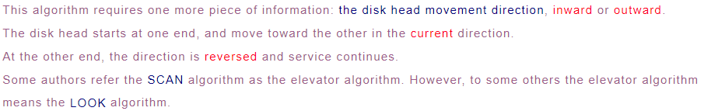
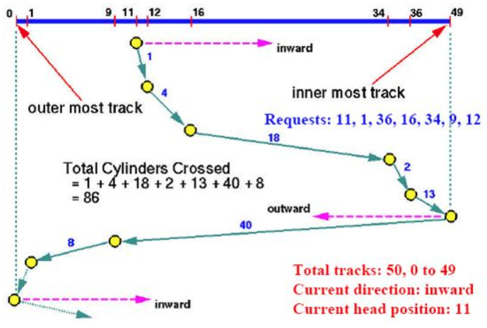

Slide 27
C-SCAN
Provides a more uniform wait time than SCAN
The head moves from one end of the disk to the other, servicing requests as it goes
  When it reaches the other end, however, it immediately returns to the beginning of the disk, without servicing any requests on the return trip
Treats the cylinders as a circular list that wraps around from the last cylinder to the first one

Slide 28

C-SCAN (Cont.)
（199-53）+（199-0）[不处理数据]+（37-0）

Slide 29

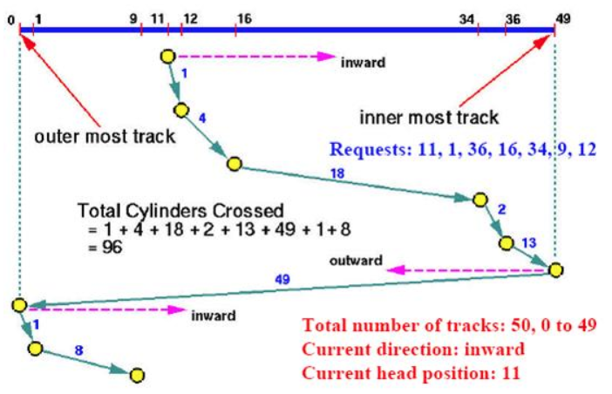

Slide 30
C-LOOK
LOOK a version of SCAN, C-LOOK a version of C-SCAN
Arm only goes as far as the last request in each direction, then reverses direction immediately, without first going all the way to the end of the disk

Slide 31

C-LOOK (Cont.)

Slide 32
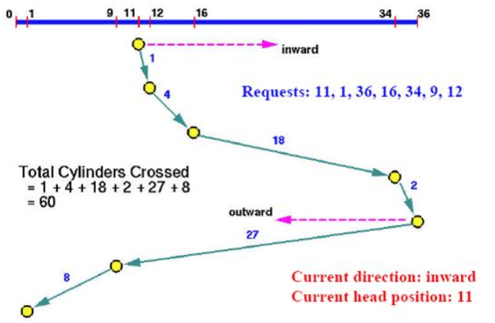
Look Scheduling

Slide 33
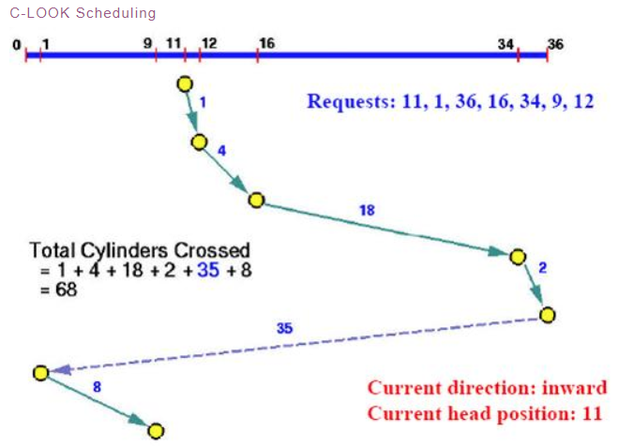
C-Look Scheduling

Slide 34
Selecting a Disk-Scheduling Algorithm
SSTF is common and has a natural appeal
SCAN and C-SCAN perform better for systems that place a heavy load on the disk SCAN和C-SCAN对于磁盘负载较大的系统性能更好
  Less starvation
Performance depends on the number and types of requests
Requests for disk service can be influenced by the file-allocation method
  And metadata layout
The disk-scheduling algorithm should be written as a separate module of the operating system, allowing it to be replaced with a different algorithm if necessary
Either SSTF or LOOK is a reasonable choice for the default algorithm
What about rotational latency 旋转延迟?
  Difficult for OS to calculate
  Modern disks do not disclose the physical location of logical blocks

Slide 35
Disk Management
Disk initialization
Booting from disk
Bad-block recovery

Slide 36
Disk Management
Low-level formatting, or physical formatting — Dividing a disk into sectors that the disk controller can read and write
  Each sector can hold header information, plus data, plus error correction code (ECC) 纠错代码
  Usually 512 bytes of data but can be selectable
To use a disk to hold files, the operating system still needs to record its own data structures on the disk. Two steps:
  Partition the disk into one or more groups of cylinders, each treated as a logical disk
    One partition can hold a copy of the OS’s executable code, while another holds user files
  Logical formatting or “creation of a file system”
    Maps of free and allocated space and an initial empty directory
  To increase efficiency most file systems group blocks into clusters簇为了提高效率，大多数文件系统将块分组到簇
    Disk I/O done in blocks
    File I/O done in clusters
    Assuring that I/O has more sequential-access and fewer random-access characteristics

Slide 37
Disk Management (Cont.)
Boot block initializes system
  The bootstrap（自举程序） is stored in ROM（只读存储器）
  Bootstrap loader program （引导加载程序） stored in boot blocks（启动块） of boot partition (a fixed location on the disk) 引导加载程序在启动块中在启动分区中
Methods such as sector sparing 扇区备用 used to handle bad blocks

Slide 38

Booting from a Disk in Windows
主引导记录（MBR）：包含了启动代码和分区表信息

Slide 39
Bootstrap（自举）
自举只有两个功能：加电自检和磁盘引导
  加电自检：当我们按下计算机电源开关时，头几秒钟机器似乎什么反应也没有，其实，这时的计算机正在进行加电自检，以断定它的所有元件都在正确地工作。如果某个元件有故障，显示器上就会出现报警提示信息（如果显示器也不能正常工作，则以一串嘟嘟声来报警）。由于大多数计算机工作非常可靠，加电自检报警非常罕见。

Slide 40
自举只有两个功能：加电自检和磁盘引导
  磁盘引导：查找装有操作系统的磁盘驱动器。
  从磁盘加载操作系统的原因有二：
    一是操作系统升级简单容易，
    二是使用户拥有选择操作系统的自由。当以上功能完成时，自举操作就启动一个读写操作系统文件和将它们复制到随机存储器中的过程，此时的机器才是真正意义上的计算机。
    计算机的启动可以有冷启动和热启动两种方式 ，它们之间的差别是热启动不进行机器的自检（机器本事配置的检查与测试），当计算机在使用过程中由于某些原因造成死机时，可以对计算机进行热启动处理。

Slide 41
Swap-Space Management
Swap-space — Virtual memory uses disk space as an extension of main memory
  Less common now due to memory capacity increases
Swap-space can be carved out of the normal file system, or, more commonly, it can be in a separate disk partition (raw)
Swap-space management
  4.3BSD allocates swap space when process starts; holds text segment (the program) and data segment
  Kernel uses swap maps to track swap-space use
  Solaris 2 allocates swap space only when a dirty page is forced out of physical memory, not when the virtual memory page is first created
    File data written to swap space until write to file system requested
    Other dirty pages go to swap space due to no other home
    Text segment pages thrown out and reread from the file system as needed
What if a system runs out of swap space?
Some systems allow multiple swap spaces

Slide 42
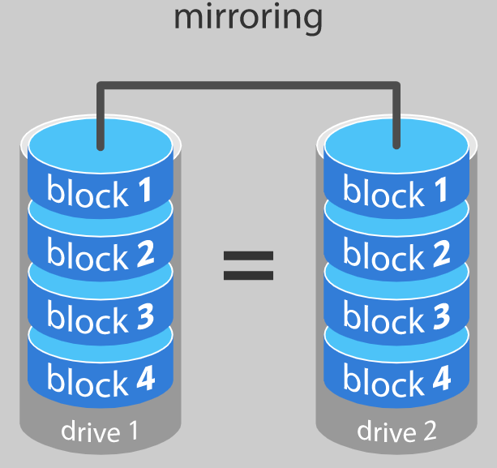
RAID Structure
RAID – redundant array of independent disks 磁盘冗余阵列
  multiple disk drives provides reliability via redundancy
Disk mirroring、mirrored volume （镜像卷）
Increases the mean time to failure 增加平均故障时间
Mean time to repair – exposure time when another failure could cause data loss 平均修复时间–另一个故障可能导致数据丢失时的暴露时间
Mean time to data loss based on above factors
If mirrored disks fail independently, consider disk with 100,000 mean time to failure and 10 hour mean time to repair
  Mean time to data loss is 100, 000² / (2 ∗ 10) = 500 ∗ 10⁶ hours, or 57,000 years!
Frequently combined with NVRAM to improve write performance
Several improvements in disk-use techniques involve the use of multiple disks working cooperatively

Slide 43
RAID (Cont.)
Disk striping (磁盘分条） uses a group of disks as one storage unit----increase data transfer rate, not improve reliability
RAID is arranged into six different levels
RAID schemes improve performance and improve the reliability of the storage system by storing redundant data
  Mirroring or shadowing (RAID 1) keeps duplicate of each disk
  Striped mirrors (RAID 1+0) or mirrored stripes (RAID 0+1) provides high performance and high reliability
  Block interleaved parity (RAID 4, 5, 6) uses much less redundancy
RAID within a storage array can still fail if the array fails, so automatic replication of the data between arrays is common如果阵列出现故障，存储阵列中的RAID仍可能出现故障，因此阵列之间的数据自动复制很常见
Frequently, a small number of hot-spare disks are left unallocated, automatically replacing a failed disk and having data rebuilt onto them

Slide 44

RAID Levels

Slide 45

RAID (0 + 1) and (1 + 0)

Slide 46
RAID Structure
RAID – redundant array of independent disks 独立磁盘冗余阵列
  是把相同的数据存储在多个硬盘的不同的地方的方法。
  基本思想就是把多个相对便宜的小磁盘组合起来，成为一个磁盘组， 使性能达到甚至超过一个价格昂贵、容量巨大的磁盘
  因此，操作系统仅把它们看作一个单一的逻辑存储单元或磁盘。
  RAID常被用在服务器计算机上，并且常使用完全相同的硬盘作为组合。由于硬盘价格的不断下降与和RAID功能更加有效地与主板整合，它也成为了高级最终用户的一个选择，特别是需要大量存储的工作，如：视频与音频制作。
  利用如磁盘条纹化 (RAID 0) 和 磁盘镜像 (RAID 1) 的技巧，把数据分布到各个磁盘上,来达到冗余性、低延迟、读写的高带宽、硬盘毁坏后的最大可恢复性。
  加上非冗余阵列（RAID-0）至少有九种类型的RAID：

Slide 47
RAID Structure
RAID-0：这一技术有条带但是没有数据冗余。它提供了最好的性能但是不能容错。
RAID-1：这一个类型也称为磁盘镜像，至少由二个复制数据存储的驱动器组成。没有条带。因为任一驱动器能同时被读，读取性能被改良。输写性能和单一磁盘存储相同。在多用户系统中，RAID-1 提供最好的性能和最好的容错。
RAID-2：这一个类型使用条带，一些磁盘储存错误检查和纠正（ECC）信息。与RAID-3相比没有优势。
RAID-3：这一个类型使用条带而且用一个驱动器专门储存奇偶信息。内含的错误检查（ECC）用来探测错误。通过计算存储在另一个驱动器上信息的异或逻辑运算（XOR）来完成数据恢复。因为一个输入输出操作同时访问所有驱动器，所以RAID-3 不能交叠输入输出。由于这个原因，RAID-3 对有长纪录应用软件的单一用户系统来说是最好的。
RAID-4：这一个类型使用大的条带，意味着你能读取单一驱动器的记录。它允许你利用交叠输入输出。因为所有输写操作必须更新奇偶驱动器，不可能有输入输出交叠处理。相对于RAID-5，RAID-4没有提供优势。
RAID-5：这一个类型包括一个旋转奇偶阵列，因此解决了RAID-4 的输写限制。因此，所有读和写操作能被交叠。RAID-5存储奇偶信息但是没有冗余数据（但是奇偶信息能用来重建数据）。RAID-5的阵列需要至少三个通常是五个磁盘。对于性能不是关键或者很少进行写操作的多用户系统，RAID-5是最好的选择。

Slide 48
RAID Structure
RAID-6：这一个类型与RAID-5 类似但是包括另一个驱动器奇偶配置，这个配置分布于不同的驱动器，因此提供了极高容错能力。
RAID-7：这一个类型包括一个实时内含操作系统作为控制器，经由一个高速总线和计算机的其他特性来隐藏。有一个厂商提供这个系统。
RAID-10：这一个类型结合了RAID-0和RAID-1，称为RAID-10，它提供比RAID-1更高的性能，但成本比较高。它有两个子类型：在RAID-0 +1中，数据在条带穿过多个磁盘的时候被组织，然后被条带化的磁盘集被镜像。在RAID-1 +0中，数据被镜像，镜像被条带化。
RAID-50（或RAID-5+0）：这种类型包括一个RAID-5系列组，并在RAID-0中条带化来改善RAID-5的性能（在没有降低数据保护的情况下）。
RAID-53（或RAID-5+3）：这一个类型提供一个条带阵列，其中每条条带是一个驱动器的RAID-3阵列。它提供比RAID-3更高的性能，但是费用比较高。
RAID-S（也称为奇偶RAID）：这是EMC Symmetrix的条带化奇偶RAID阵列专有和备用的方法，不再在现有设备中使用。它类似于RAID-5。具有一些增强性能，以及在磁盘阵列上高速磁盘缓存的增强性能。

Slide 49
RAID Structure
采用 RAID 的主要原因是:
  增强了速度
  扩容了存储能力(以及更多的便利)
  可高效恢复磁盘

Slide 50
Other Features
Regardless of where RAID implemented, other useful features can be added
Snapshot is a view of file system before a set of changes take place (i.e. at a point in time)
  More in Ch 12
Replication is automatic duplication of writes between separate sites
  For redundancy and disaster recovery
  Can be synchronous or asynchronous
Hot spare disk is unused, automatically used by RAID production if a disk fails to replace the failed disk and rebuild the RAID set if possible
  Decreases mean time to repair

Slide 51
End of Chapter 10

