Slide 1
Chapter 11:
File-System Interface

Slide 2
Objectives
To explain the function of file systems
To describe the interfaces to file systems
To discuss file-system design tradeoffs, including access methods, file sharing, file locking, and directory structures
To explore file-system protection

Slide 3
Chapter 10: File-System Interface
File Concept
Access Methods
Disk and Directory Structure
File-System Mounting
File Sharing
Protection

Slide 4
File Concept
Contiguous logical address space
Types:
  Data
    numeric
    character
    binary
  Program
Contents defined by file’s creator
  Many types
    Consider text file, source file, executable file

Slide 5
File Attributes
Name – only information kept in human-readable form
Identifier – unique tag (number) identifies file within file system
Type – needed for systems that support different types
Location – pointer to file location on device
Size – current file size
Protection – controls who can do reading, writing, executing
Time, date, and user identification – data for protection, security, and usage monitoring
Information about files are kept in the directory structure, which is maintained on the disk
Many variations, including extended file attributes such as file checksum
Information kept in the directory structure

Slide 6

File info Window on Mac OS X

Slide 7
File Operations
File is an abstract data type
Create
Write – at write pointer location
Read – at read pointer location
Reposition within file - seek
Delete
Truncate截断：用户可能想要删除文件的内容，但保留文件属性。
Open(F_{i}) – search the directory structure on disk for entry F_{i}, and move the content of entry to memory
Close (F_{i}) – move the content of entry F_{i} in memory to directory structure on disk

Slide 8
Open Files
Several pieces of data are needed in OS to manage open files:
  Open-file table: tracks open files
  File pointer: pointer to last read/write location, per process that has the file open
  File-open count: counter of number of times a file is open – to allow removal of data from open-file table when last processes closes it
  Disk location of the file: cache of data access information
  Access rights: per-process access mode information

Slide 9
Open File Locking
Provided by some operating systems and file systems
  Similar to reader-writer locks
  Shared lock similar to reader lock – several processes can acquire concurrently （共享锁）
  Exclusive lock similar to writer lock （独占锁）
Mediates access to a file
Mandatory or advisory:
  Mandatory – access is denied depending on locks held and requested 强制–根据持有和请求的锁拒绝访问
  Advisory – processes can find status of locks and decide what to do 咨询–流程可以找到锁的状态并决定要执行的操作

Slide 10

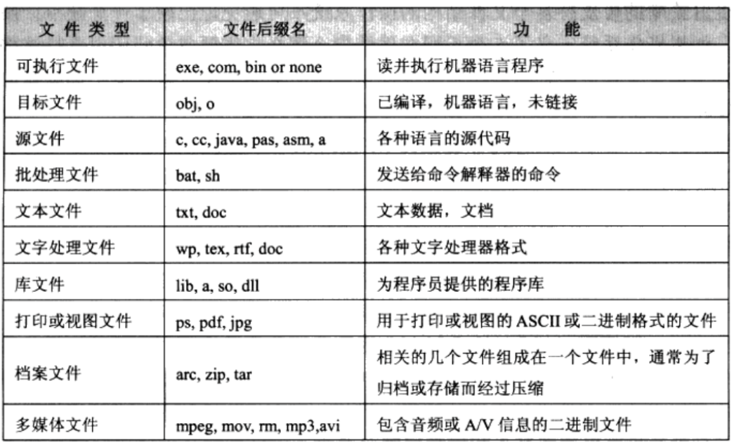
File Types – Name, Extension

Slide 11
File Structure
None - sequence of words, bytes
Simple record structure
  Lines
  Fixed length
  Variable length
Complex Structures
  Formatted document
  Relocatable load file
Can simulate last two with first method by inserting appropriate control characters
Who decides:
  Operating system
  Program

Slide 12
Chapter 10: File-System Interface
File Concept
Access Methods
Disk and Directory Structure
File-System Mounting
File Sharing
Protection

Slide 13

Access Methods
Sequential Access
read next
write next
reset
no read after last write
(rewrite)

Slide 14
Access Methods
Direct Access – file is fixed length logical records
read n
write n
position to n
read next
write next
rewrite n
n = relative block number
Relative block numbers allow OS to decide where file should be placed
  See allocation problem in Ch 12

Slide 15
Chapter 10: File-System Interface
File Concept
Access Methods
Disk and Directory Structure
File-System Mounting
File Sharing
Protection

Slide 16
Directory Structure
A collection of nodes containing information about all files
Directory
Files
F 1
F 2
F 3
F 4
F n
Both the directory structure and the files reside on disk

Slide 17
Disk Structure
Disk can be subdivided into partitions
Disks or partitions can be RAID protected against failure
Disk or partition can be used raw – without a file system, or formatted with a file system
Partitions also known as minidisks, slices 分区也称为小型磁盘、片
Entity containing file system known as a volume
Each volume containing file system also tracks that file system’s info in device directory or volume table of contents
As well as general-purpose file systems there are many special-purpose file systems, frequently all within the same operating system or computer

Slide 18

A Typical File-system Organization

Slide 19
Types of File Systems
We mostly talk of general-purpose file systems
But systems frequently have may file systems, some general- and some special- purpose
Consider Solaris has
  tmpfs – memory-based volatile FS for fast, temporary I/O
  objfs – interface into kernel memory to get kernel symbols for debugging
  ctfs – contract file system for managing daemons
  lofs – loopback file system allows one FS to be accessed in place of another
  procfs – kernel interface to process structures
  ufs, zfs – general purpose file systems

Slide 20
Operations Performed on Directory
Search for a file
Create a file
Delete a file
List a directory
Rename a file
Traverse the file system

Slide 21
Directory Organization
The directory is organized logically to obtain
Efficiency – locating a file quickly
Naming – convenient to users
  Two users can have same name for different files
  The same file can have several different names
Grouping – logical grouping of files by properties, (e.g., all Java programs, all games, …)

Slide 22

Single-Level Directory
A single directory for all users
Naming problem
Grouping problem

Slide 23

Two-Level Directory
Separate directory for each user
Path name
Can have the same file name for different user
Efficient searching
No grouping capability

Slide 24

Tree-Structured Directories

Slide 25
Tree-Structured Directories (Cont.)
Efficient searching
Grouping Capability
Current directory (working directory)
  cd /spell/mail/prog
  type list

Slide 26

Tree-Structured Directories (Cont)
Absolute or relative path name
Creating a new file is done in current directory
Delete a file
rm <file-name>
Creating a new subdirectory is done in current directory
  mkdir <dir-name>
  Example: if in current directory /mail
  mkdir count
Deleting “mail” ⇒ deleting the entire subtree rooted by “mail”

Slide 27

Acyclic-Graph Directories
Have shared subdirectories and files

Slide 28
Acyclic-Graph Directories (Cont.)
Two different names (aliasing)
If dict deletes list ⇒ dangling pointer
New directory entry type
  Link – another name (pointer) to an existing file
  Resolve the link – follow pointer to locate the file

Slide 29

General Graph Directory

Slide 30
General Graph Directory (Cont.)
How do we guarantee no cycles?
  Allow only links to file not subdirectories 只能连接到文件
  Garbage collection
  Every time a new link is added use a cycle detection algorithm to determine whether it is OK 每次添加新链接时，使用循环检测算法确定其是否正常

Slide 31
Chapter 10: File-System Interface
File Concept
Access Methods
Disk and Directory Structure
File-System Mounting 文件系统装载
File Sharing
Protection

Slide 32


File System Mounting
A file system must be mounted before it can be accessed 在访问前需要装载
A unmounted file system (i.e., Fig. 11-11(b)) is mounted at a mount point

Slide 33
Chapter 10: File-System Interface
File Concept
Access Methods
Disk and Directory Structure
File-System Mounting
File Sharing
Protection

Slide 34
File Sharing
Sharing of files on multi-user systems is desirable
Sharing may be done through a protection scheme 共享可以通过保护方案完成
On distributed systems, files may be shared across a network
Network File System (NFS) is a common distributed file-sharing method
If multi-user system
  User IDs identify users, allowing permissions and protections to be per-user
  Group IDs allow users to be in groups, permitting group access rights
  Owner of a file / directory
  Group of a file / directory

Slide 35
File Sharing – Remote File Systems
Uses networking to allow file system access between systems
  Manually via programs like FTP
  Automatically, seamlessly using distributed file systems 分布式文件系统
  Semi automatically via the world wide web
Client-server model allows clients to mount remote file systems from servers
  Server can serve multiple clients
  Client and user-on-client identification is insecure or complicated 客户端和用户对客户端的标识不安全或复杂
  NFS is standard UNIX client-server file sharing protocol
  CIFS is standard Windows protocol
  Standard operating system file calls are translated into remote calls
Distributed Information Systems (distributed naming services) such as LDAP, DNS, NIS, Active Directory implement unified access to information needed for remote computing

Slide 36
File Sharing – Failure Modes
All file systems have failure modes
  For example corruption of directory structures or other non-user data, called metadata 保存文件的属性的信息的数据（size，name，address）
Remote file systems add new failure modes, due to network failure, server failure
Recovery from failure can involve state information about status of each remote request 故障恢复可能涉及每个远程请求状态的状态信息
Stateless protocols such as NFS v3 include all information in each request, allowing easy recovery but less security 无状态协议（如NFS v3）在每个请求中包含所有信息，允许轻松恢复，但安全性较低

Slide 37
File Sharing – Consistency Semantics
文件共享 一致性语义
Specify how multiple users are to access a shared file simultaneously
  Similar to Ch 5 process synchronization algorithms
    Tend to be less complex due to disk I/O and network latency (for remote file systems
  Andrew File System (AFS) implemented complex remote file sharing semantics
  Unix file system (UFS) implements:
    Writes to an open file visible immediately to other users of the same open file
    Sharing file pointer to allow multiple users to read and write concurrently
  AFS has session semantics
    Writes only visible to sessions starting after the file is closed

Slide 38
Chapter 10: File-System Interface
File Concept
Access Methods
Disk and Directory Structure
File-System Mounting
File Sharing
Protection

Slide 39
Protection
File owner/creator should be able to control:
  what can be done
  by whom
Types of access
  Read R
  Write W
  Execute X 文件装入内存，并执行
  Append 附加，在文末添加新的信息
  Delete
  List 列出文件名和文件属性

Slide 40

Access Lists and Groups
Mode of access: read, write, execute
Three classes of users on Unix / Linux
RWX
a) owner access 7 ⇒ 1 1 1
RWX
b) group access 6 ⇒ 1 1 0
RWX
c) public access 1 ⇒ 0 0 1
Ask manager to create a group (unique name), say G, and add some users to the group.
For a particular file (say game) or subdirectory, define an appropriate access.
Attach a group to a file
chgrp G game

Slide 41

Windows 7 Access-Control List Management

Slide 42

A Sample UNIX Directory Listing
_ _ _ _ _ _ _ _ _ _
_ 指的是文件的类型，- 文件，d 文件夹
_ _ _ 指的是文件的拥有者拥有的权限
_ _ _ 指的是group对该文件的权限
_ _ _ 指的是user对该文件的权限

Slide 43
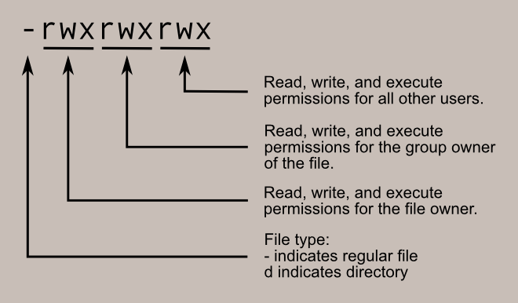
Typical file permissions

Slide 44
End of Chapter 11
Slides are created based on http://codex.cs.yale.edu/avi/os-book/OS9/slide-dir/index.html

