Slide 1
Chapter 4: Threads

Slide 2

Review of Process, IPC, and etc
As a process executes, it changes state
  new: The process is being created
  running: Instructions are being executed
  waiting: The process is waiting for some event to occur
  ready: The process is waiting to be assigned to a processor
  terminated: The process has finished execution

Slide 3

Review of Process, IPC, and etc

Slide 4

Review of Process, IPC, and etc
Information associated with each process
(also called task control block)
Process state – running, waiting, etc
Program counter – location of instruction to next execute
CPU registers – contents of all process-centric registers
CPU scheduling information- priorities, scheduling queue pointers
Memory-management information – memory allocated to the process
Accounting information – CPU used, clock time elapsed since start, time limits
I/O status information – I/O devices allocated to process, list of open files

Slide 5
Review of Process, IPC, and etc
When to do Context Switch?
Multitasking – When the CPU needs to switch processes in and out of memory, so that more than one process can be running.
Kernel/User Switch – When switching between user mode to kernel mode, it may be used (but isn’t always necessary).
Interrupts – When the CPU is interrupted to return data from a disk read.

Slide 6

Review of Process, IPC, and etc
Context Switch:
Step1: Save the context of the processor, including program counter and other registers.
Step2: Update the process control block of the process that is currently in the Running state. This includes changing the state of the process to one of the other states (Ready; Blocked; Ready/Suspend; or Exit).

Slide 7
Review of Process, IPC, and etc
Context Switch:
Step3: Move the process control block of this process to the appropriate queue(Ready; Blocked on Event i ; Ready/Suspend).

Slide 8
Review of Process, IPC, and etc
Context Switch:
Step4: Select another process for execution.
Step5: Update the process control block of the process selected. This includes changing the state of this process to Running.

Slide 9
Review of Process, IPC, and etc
Context Switch:
Step6: Update memory management data structures. This may be required, depending on how address translation is managed.
Step7: Restore the context of the processor to that which existed at the time the selected process was last switched out of the Running state, by loading in the previous values of the program counter and other registers.

Slide 10
Review of Process, IPC, and etc
Long term schedulers
  adjust the level of multiprogramming through admission control
Medium term schedulers
  adjust the level of multiprogramming by suspending processes （通过暂停进程来调整多道程序设计的级别）
Short term schedulers
  determine which process should execute next

Slide 11

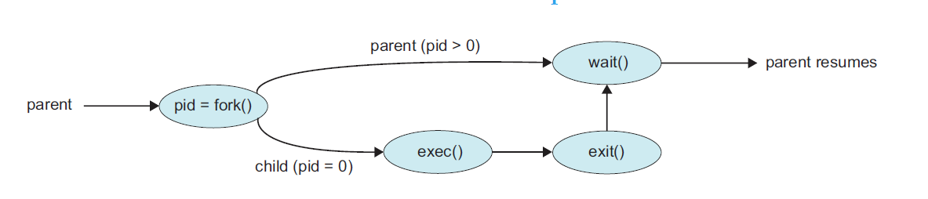
Review of Process, IPC, and etc

Slide 12
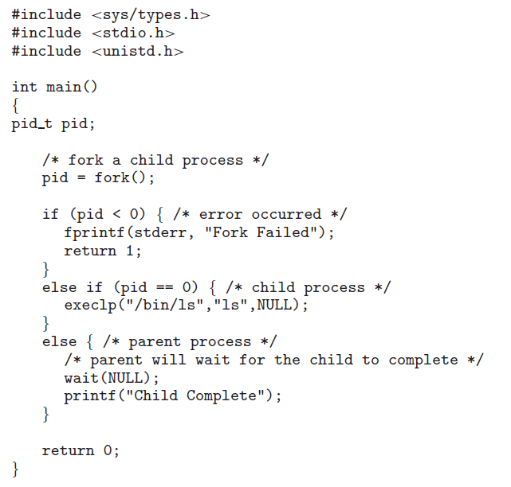
Review of Process, IPC, and etc

Slide 13
Review of Process, IPC, and etc
Reasons of providing IPC:
  Information sharing. Since several users may be interested in the same piece of information (for instance, a shared file), we must provide an environment to allow concurrent access to such information.
  Computation speedup. If we want a particular task to run faster, we must break it into subtasks, each of which will be executing in parallel with the others. Notice that such a speedup can be achieved only if the computer has multiple processing cores.
  Modularity. We may want to construct the system in a modular fashion, dividing the system functions into separate processes or threads.
  Convenience. Even an individual user may work on many tasks at the same time. For instance, a user may be editing, listening to music, and compiling in parallel.

Slide 14
Review of Process, IPC, and etc
IPC:
Shared Memory
  An area of memory shared among the processes that wish to communicate
  Synchronization
Message Passing
  Direct communication
    One link is associated to exactly one pair of processes
  Indirect communication
    Mailbox
Communications in Client-Server Systems: Sockets, remote procedure calls, pipes

Slide 15
Chapter 4: Threads
Overview
Multicore Programming
Multithreading Models
Thread Libraries
Implicit Threading
Threading Issues
Operating System Examples

Slide 16
Objectives
To introduce the notion of a thread—a fundamental unit of CPU utilization that forms the basis of multithreaded computer systems
To discuss the APIs for the Pthreads, Windows, and Java thread libraries
To explore several strategies that provide implicit threading
To examine issues related to multithreaded programming
To cover operating system support for threads in Windows and Linux

Slide 17

Single and Multithreaded Processes

Slide 18
Motivation
Most modern applications are multithreaded
Threads run within application
Multiple tasks with the application can be implemented by separate threads
  Update display
  Fetch data
  Spell checking
  Answer a network request
Process creation is heavy-weight while thread creation is light-weight
Can simplify code, increase efficiency
Kernels are generally multithreaded（内核通常是多线程）

Slide 19

Multithreaded Server Architecture

Slide 20
Benefits
Responsiveness – may allow continued execution if part of process is blocked, especially important for user interfaces （部分停止，部分继续执行）
Resource Sharing – threads share resources of process, easier than shared memory or message passing（资源分配的单位——进程，调度的单位——线程，线程共享进程的资源）
Economy – cheaper than process creation, thread switching lower overhead than context switching（开销比进程低）
Scalability – process can take advantage of multiprocessor architectures（可扩展性）

Slide 21
Multicore Programming
Multicore or multiprocessor systems putting pressure on programmers, challenges include:
  Dividing activities: This involves examining applications to find areas that can be divided into separate, concurrent tasks. Ideally, tasks are independent of one another and thus can run in parallel on individual cores.
  Balance: While identifying tasks that can run in parallel, programmers must also ensure that the tasks perform equal work of equal value. In some instances, a certain task may not contribute as much value to the overall process as other tasks. Using a separate execution core to run that task may not be worth the cost.

Slide 22
Multicore Programming
Multicore or multiprocessor systems putting pressure on programmers, challenges include:
  Data splitting: Just as applications are divided into separate tasks, the data accessed and manipulated by the tasks must be divided to run on separate cores.
  Data dependency: The data accessed by the tasks must be examined for dependencies between two or more tasks. When one task depends on data from another, programmers must ensure that the execution of the tasks is synchronized to accommodate the data dependency.

Slide 23
Multicore Programming
Multicore or multiprocessor systems putting pressure on programmers, challenges include:
  Testing and debugging: When a program is running in parallel on multiple cores, many different execution paths are possible. Testing and debugging such concurrent programs is inherently more difficult than testing and debugging single-threaded applications
  调试多线程比调试单线程更难

Slide 24
Multicore Programming
Parallelism（并行，多个CPU） implies a system can perform more than one task simultaneously
Concurrency（并发，单个CPU） supports more than one task making progress
  Single processor / core, scheduler providing concurrency

Slide 25
Multicore Programming (Cont.)
Types of parallelism
  Data parallelism – distributes subsets of the same data across multiple cores, same operation on each（数据并行性–将相同数据的子集分布在多个核上，每个核上的操作相同）
  Task parallelism – distributing threads across cores, each thread performing unique operation（任务并行性–跨内核分布线程，每个线程执行唯一的操作）
As of threads grows, so does architectural support for threading
  CPUs have cores as well as hardware threads(CPU有核和线程）
  Consider Oracle SPARC T4 with 8 cores, and 8 hardware threads per core

Slide 26


Concurrency vs. Parallelism
Concurrent execution on single-core system:
Parallelism on a multi-core system:

Slide 27

Amdahl’s Law
Identifies performance gains from adding additional cores to an application that has both serial and parallel components
S is serial portion
N processing cores
That is, if application is 75% parallel / 25% serial, moving from 1 to 2 cores results in speedup of 1.6 times
As N approaches infinity, speedup approaches 1 / S
Serial portion of an application has disproportionate effect on performance gained by adding additional cores
But does the law take into account contemporary multicore systems?

Slide 28
User Threads and Kernel Threads
User threads - management done by user-level threads library
用户线程-由用户级线程库完成的管理
Three primary thread libraries:
  POSIX Pthreads
  Windows threads
  Java threads
Kernel threads - Supported by the Kernel
内核线程-由内核支持
Examples – virtually all general purpose operating systems, including:
  Windows
  Solaris
  Linux
  Tru64 UNIX
  Mac OS X

Slide 29
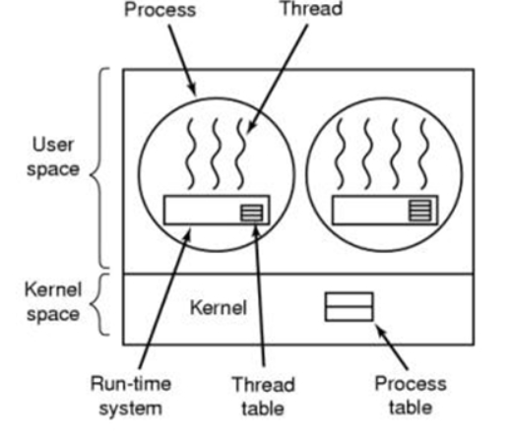
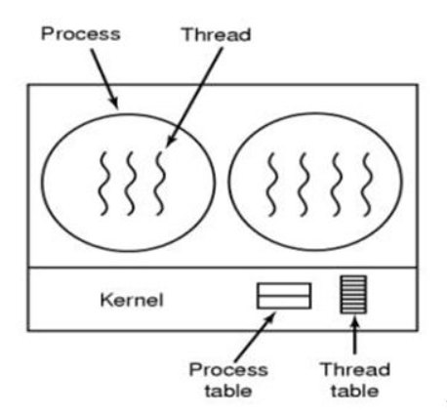
处理机分配的单位是：内核线程
用户线程 内核线程

Slide 30
Multithreading Models
Many-to-One
One-to-One
Many-to-Many

Slide 31

Many-to-One
Many user-level threads mapped to single kernel thread
One thread blocking causes all to block
Multiple threads may not run in parallel on multicore system because only one may be in kernel at a time
Few systems currently use this model
Examples:
  Solaris Green Threads
  GNU Portable Threads

Slide 32

One-to-One
Each user-level thread maps to kernel thread
Creating a user-level thread creates a kernel thread
More concurrency than many-to-one
Number of threads per process sometimes restricted due to overhead
Examples
  Windows
  Linux
  Solaris 9 and later
The one-to-one model allows greater concurrency, but the developer has to be careful not to create too many threads within an application

Slide 33

Many-to-Many Model
Allows many user level threads to be mapped to many kernel threads
Allows the operating system to create a sufficient number of kernel threads
Solaris prior to version 9
Windows with the ThreadFiber package

Slide 34

Two-level Model（两层模型）
Similar to M:M, except that it allows a user thread to be bound to kernel thread
Examples
  IRIX
  HP-UX
  Tru64 UNIX
  Solaris 8 and earlier

Slide 35
Thread Libraries
Thread library provides programmer with API for creating and managing threads（线程库为程序员提供了创建和管理线程的API）
Two primary ways of implementing
  Library entirely in user space（用户空间的库）
  Kernel-level library（内核库） supported by the OS
Three primary thread libraries:
  POSIX Pthreads
  Windows threads
  Java threads

Slide 36
Pthreads
May be provided either as user-level or kernel-level
A POSIX standard (IEEE 1003.1c) API for thread creation and synchronization
Specification, not implementation
API specifies behavior of the thread library, implementation is up to development of the library
Common in UNIX operating systems (Solaris, Linux, Mac OS X)

Slide 37

Pthreads Example

Slide 38
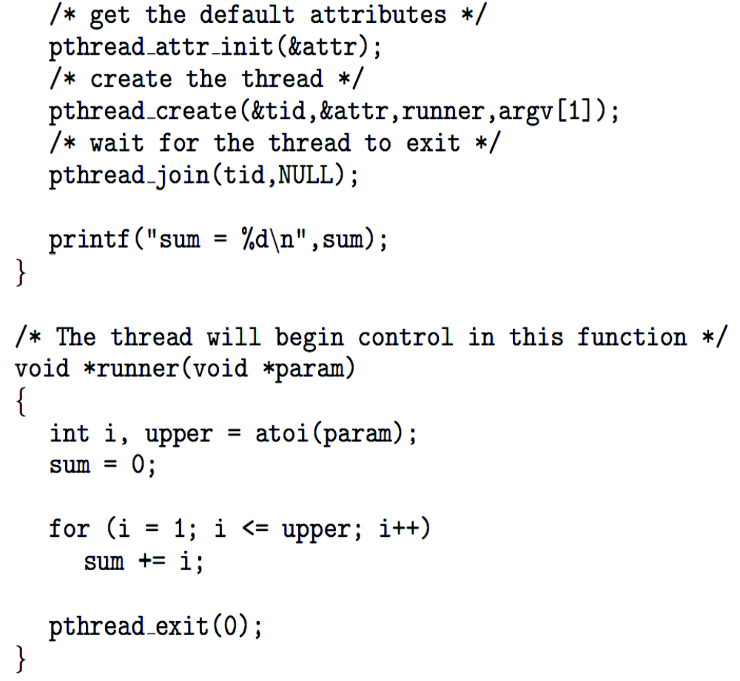
Pthreads Example (Cont.)

Slide 39
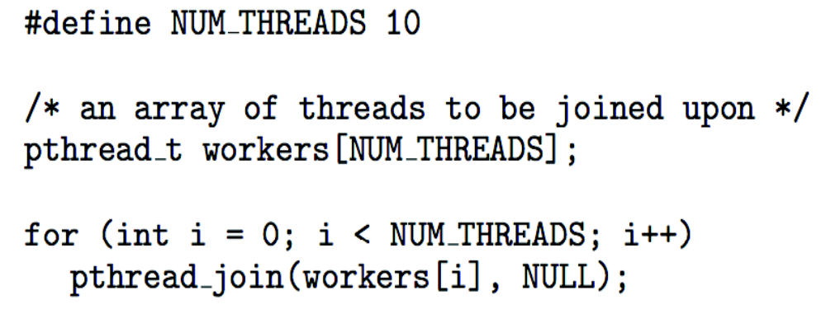
Pthreads Code for Joining 10 Threads

Slide 40
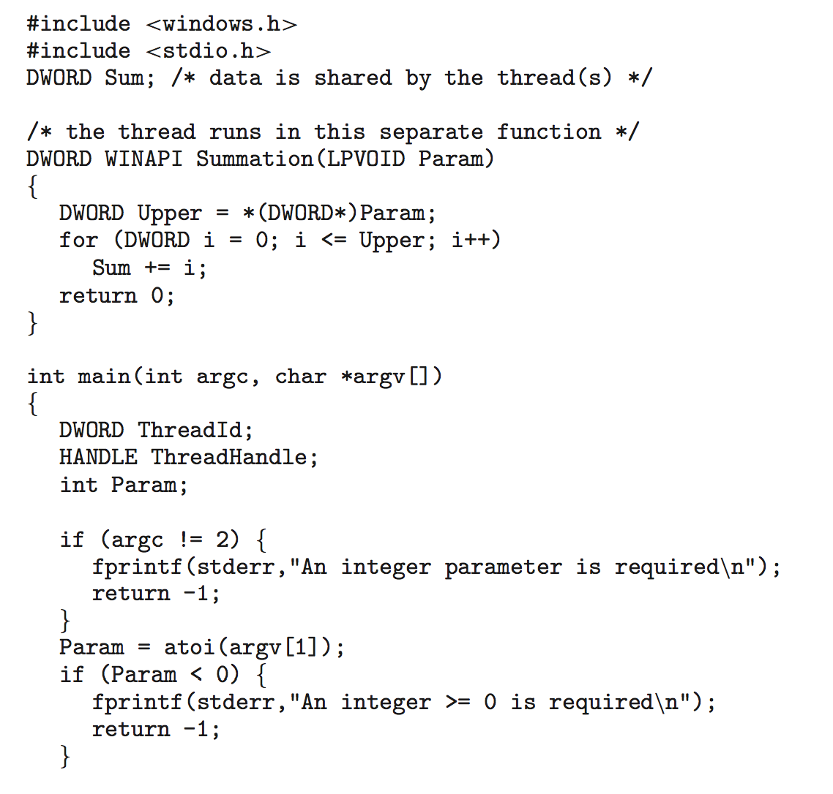
Windows Multithreaded C Program

Slide 41
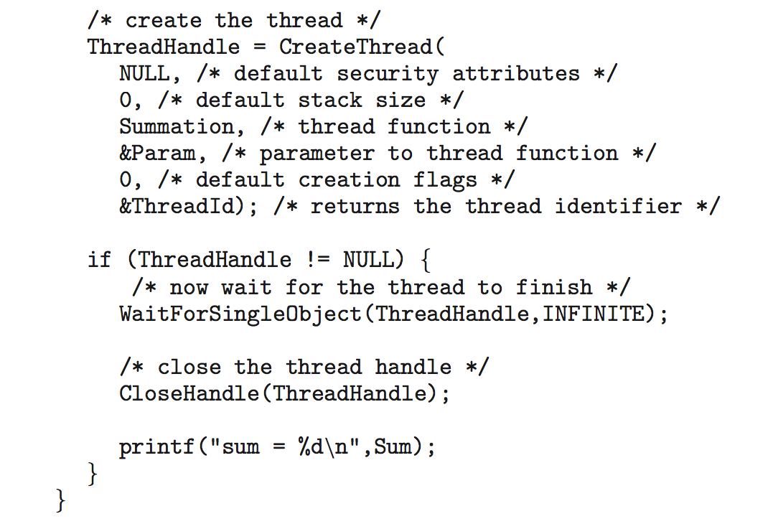
Windows Multithreaded C Program (Cont.)

Slide 42

Java Threads
Java threads are managed by the JVM
Typically implemented using the threads model provided by underlying OS
Java threads may be created by:
  Extending Thread class
  Implementing the Runnable interface

Slide 43

Java Multithreaded Program

Slide 44

Java Multithreaded Program (Cont.)

Slide 45
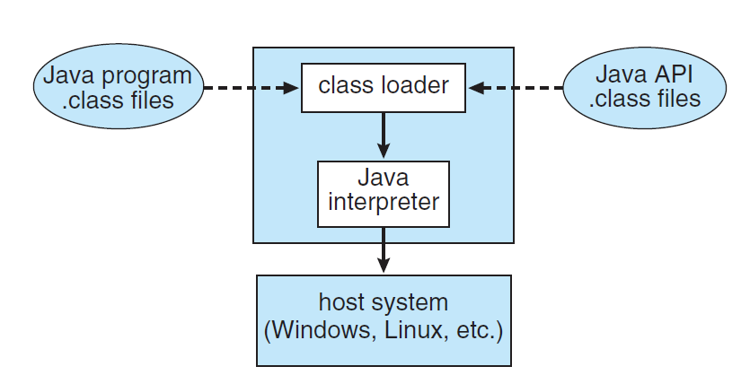
Java Multithreaded Program (Cont.)

Slide 46
Implicit Threading（隐式线程）
Growing in popularity as numbers of threads increase, program correctness more difficult with explicit threads
Creation and management of threads done by compilers and run-time libraries rather than programmers（由编译器和运行时库，而不是程序员创建和管理线程）
Three methods explored
  Thread Pools（线程池）
  OpenMP
  Grand Central Dispatch（多线程优化技术）
Other methods include Microsoft Threading Building Blocks (TBB), java.util.concurrent package

Slide 47

Thread Pools
Create a number of threads in a pool where they await work （刚开始就创建一定数量的线程）
Advantages:
  Usually slightly faster to service a request with an existing thread than create a new thread
  Allows the number of threads in the application(s) to be bound to the size of the pool（允许将应用程序中的线程数绑定到池的大小）
  Separating task to be performed from mechanics of creating task allows different strategies for running task （将要执行的任务和创建任务的机制分离，可以使用不同的策略来运行任务）
    i.e. Tasks could be scheduled to run periodically（定期）
Windows API supports thread pools:

Slide 48

OpenMP
Set of compiler directives and an API for C, C++, FORTRAN
Provides support for parallel programming in shared-memory environments（并行）
Identifies parallel regions – blocks of code that can run in parallel（标识并行区域–可以并行运行的代码块）
#pragma omp parallel
Create as many threads as there are cores（创建和core数一样多的线程）
#pragma omp parallel for for(i=0;i<N;i++) {
c[i] = a[i] + b[i];
}
Run for loop in parallel

Slide 49
Grand Central Dispatch
Apple technology for Mac OS X and iOS operating systems
Extensions to C, C++ languages, API, and run-time library
Allows identification of parallel sections
Manages most of the details of threading
Block is in “^{ }” - ˆ{ printf("I am a block"); }
Blocks placed in dispatch queue
  Assigned to available thread in thread pool when removed from queue

Slide 50

Grand Central Dispatch
Two types of dispatch queues:
  serial – blocks removed in FIFO order, queue is per process, called main queue（串行–按FIFO顺序删除块，队列为每个进程，称为主队列）
    Programmers can create additional serial queues within program（程序员可以在程序中创建额外的串行队列）
  concurrent – removed in FIFO order but several may be removed at a time（并发–按FIFO顺序删除，但一次可以删除多个）
    Three system wide queues with priorities low, default, high

Slide 51
Threading Issues
Semantics of fork() and exec() system calls
Signal handling
  Synchronous and asynchronous
Thread cancellation of target thread
  Asynchronous or deferred
Thread-local storage
Scheduler Activations

Slide 52
Semantics of fork() and exec()
Does fork()duplicate only the calling thread or all threads?（既可以复制所有线程，也可以只复制调用线程）
  Some UNIXes have two versions of fork
exec() usually works as normal – replace the running process including all threads

Slide 53
Signal Handling
Signals are used in UNIX systems to notify a process that a particular event has occurred.
A signal handler is used to process signals
  Signal is generated by particular event
  Signal is delivered to a process
  Signal is handled by one of two signal handlers:
    Default（默认）
    user-defined（用户定义）
Every signal has default handler that kernel runs when handling signal
  User-defined signal handler can override（重写） default
  For single-threaded, signal delivered to process

Slide 54
Signal Handling (Cont.)
Where should a signal be delivered for multi-threaded?
  Deliver the signal to the thread to which the signal applies
  Deliver the signal to every thread in the process
  Deliver the signal to certain threads in the process
  Assign a specific thread to receive all signals for the process

Slide 55

Thread Cancellation
Terminating a thread before it has finished
Thread to be canceled is target thread（目标线程——要取消的线程）
Two general approaches:
  Asynchronous cancellation（异步取消） terminates the target thread immediately
  Deferred cancellation（延迟取消） allows the target thread to periodically check（定期检查） if it should be cancelled
Pthread code to create and cancel a thread:

Slide 56

Thread Cancellation (Cont.)
Invoking thread cancellation requests cancellation, but actual cancellation depends on thread state
If thread has cancellation disabled, cancellation remains pending until thread enables it
Default type is deferred（默认是延迟取消）
  Cancellation only occurs when thread reaches cancellation point（取消仅在线程到达取消点时发生）
    I.e. pthread_testcancel()
    Then cleanup handler is invoked
On Linux systems, thread cancellation is handled through signals

Slide 57
Thread-Local Storage
Thread-local storage (TLS) allows each thread to have its own copy of data（线程本地存储允许每个线程拥有自己的数据副本）
  For example, in a transaction-processing system, we might service each transaction in a separate thread
Useful when you do not have control over the thread creation process (i.e., when using a thread pool)
Different from local variables
  Local variables visible only during single function invocation
  TLS visible across function invocations
Similar to static data
  TLS is unique to each thread（TLS对每个线程唯一）

Slide 58

Scheduler Activations
Both M:M and Two-level models require communication to maintain the appropriate number of kernel threads allocated to the application
Typically use an intermediate data structure between user and kernel threads – lightweight process (LWP，通常在用户线程和内核线程之间使用中间数据结构–轻量级进程)
  Appears to be a virtual processor on which process can schedule user thread to run
  Each LWP attached to kernel thread
  How many LWPs to create?
Scheduler activations provide upcalls - a communication mechanism from the kernel to the upcall handler in the thread library（从内核到线程库，回调）
This communication allows an application to maintain the correct number kernel threads（这种通信允许应用程序保持正确的内核线程数）

Slide 59
Operating System Examples
Windows Threads
Linux Threads

Slide 60
Windows Threads
Windows implements the Windows API – primary API for Win 98, Win NT, Win 2000, Win XP, and Win 7
Implements the one-to-one mapping, kernel-level
Each thread contains
  A thread id
  Register set representing state of processor
  Separate user and kernel stacks for when thread runs in user mode or kernel mode（分开用户和内核的堆栈）
  Private data storage area used by run-time libraries and dynamic link libraries (DLLs) （运行时库和动态链接库（DLL）使用的专用数据存储区域）
  The register set, stacks, and private storage area are known as the context of the thread（寄存器集、堆栈和专用存储区域称为线程的上下文）

Slide 61
Windows Threads (Cont.)
The primary data structures of a thread include:
  ETHREAD (executive thread block) – includes pointer to process to which thread belongs and to KTHREAD, in kernel space（ETHREAD（执行线程块）–在内核空间中包含指向线程所属进程和KTHREAD的指针）
  KTHREAD (kernel thread block) – scheduling and synchronization info, kernel-mode stack, pointer to TEB, in kernel space（KTHREAD（内核线程块）–调度和同步信息，内核模式堆栈，指向TEB的指针，在内核空间中）
  TEB (thread environment block) – thread id, user-mode stack, thread-local storage, in user space（TEB（线程环境块）–用户空间中的线程id、用户模式堆栈、线程本地存储）

Slide 62

Windows Threads Data Structures

Slide 63

Linux Threads
Linux refers to them as tasks rather than processes or threads
Thread creation is done through clone() system call
clone() allows a child task to share the address space of the parent task (process)
  Flags control behavior
struct task_struct points to process data structures (shared or unique)

Slide 64
作业
P191： 4.8，4.15，4.17
本周三交

Slide 65
End of Chapter 4
Slides are created based on http://codex.cs.yale.edu/avi/os-book/OS9/slide-dir/index.html

