Slide 1
Chapter 6: Process Synchronization

Slide 2
Chapter 5: Process Synchronization
Background
The Critical-Section Problem
Peterson’s Solution
Synchronization Hardware
Mutex Locks
Semaphores
Classic Problems of Synchronization
Monitors
Synchronization Examples
Alternative Approaches

Slide 3
Objectives
To present the concept of process synchronization.
To introduce the critical-section problem, whose solutions can be used to ensure the consistency of shared data
To present both software and hardware solutions of the critical-section problem
To examine several classical process-synchronization problems
To explore several tools that are used to solve process synchronization problems

Slide 4
Background
Processes can execute concurrently
  May be interrupted at any time, partially completing execution
Concurrent access to shared data may result in data inconsistency
Maintaining data consistency requires mechanisms to ensure the orderly execution of cooperating processes
Illustration of the problem:
Suppose that we wanted to provide a solution to the consumer-producer problem that fills all the buffers. We can do so by having an integer counter that keeps track of the number of full buffers. Initially, counter is set to 0. It is incremented by the producer after it produces a new buffer and is decremented by the consumer after it consumes a buffer.

Slide 5

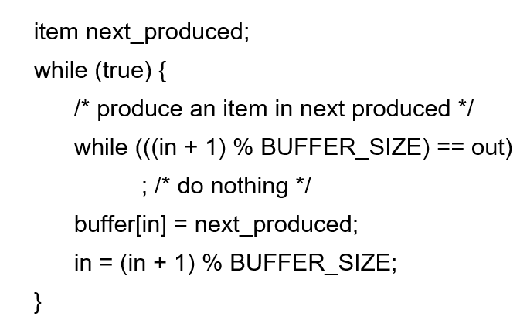
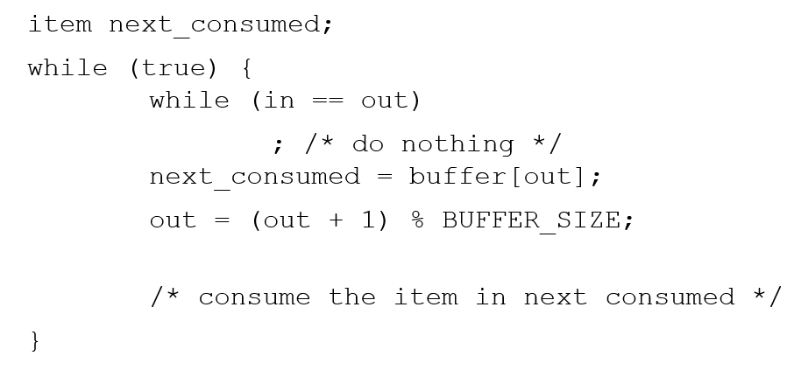
Bounded-Buffer – Shared-Memory Solution
Shared data
      #define BUFFER_SIZE 10
      typedef struct {
      . . .
      } item;
      item buffer[BUFFER_SIZE];
      int in = 0;
      int out = 0;
      _______________________________________
      Producer Consumer
In: 缓冲区进产品（写）下标
Out: 缓冲区出产品（读）下标

Slide 6
Producer
while (true) {
/* produce an item in next produced */
while (counter == BUFFER_SIZE) ;
/* do nothing */
buffer[in] = next_produced;
in = (in + 1) % BUFFER_SIZE;
counter++;
}
Consumer
while (true) {
while (counter == 0)
; /* do nothing */
next_consumed = buffer[out];
out = (out + 1) % BUFFER_SIZE;
counter--;
/* consume the item in next consumed */
}

Slide 7
Race Condition 竞争条件
counter++ could be implemented as
register1 = counter
register1 = register1 + 1
counter = register1
counter-- could be implemented as
register2 = counter
register2 = register2 - 1
counter = register2
Consider this execution interleaving with “counter = 5” initially:
  S0: producer execute register1 = counter {register1 = 5}
  S1: producer execute register1 = register1 + 1 {register1 = 6}
  S2: consumer execute register2 = counter {register2 = 5}
  S3: consumer execute register2 = register2 – 1 {register2 = 4}
  S4: producer execute counter = register1 {counter = 6 }
  S5: consumer execute counter = register2 {counter = 4}

Slide 8
Critical Section Problem
Consider system of n processes {p₀, p₁, … p_{n-1}}
Each process has critical section segment of code每个进程都有关键的代码段
  Process may be changing common variables, updating table, writing file, etc
  When one process in critical section, no other may be in its critical section
Critical section problem is to design protocol to solve this
Each process must ask permission to enter critical section in entry section, may follow critical section with exit section, then remainder section每个流程必须在入口段请求进入关键段的许可，可以在关键段后加出口段，然后是剩余段
每个进程中访问临界资源的那段程序称为临界区（临界资源是一次仅允许一个进程使用的共享资源）。每次只准许一个进程进入临界区，进入后不允许其他进程进入。

Slide 9

Critical Section
General structure of process P_{i}

Slide 10
Algorithm for Process P_{i}
do {
while (turn == j);
critical section
turn = j;
remainder section
} while (true);

Slide 11
Solution to Critical-Section Problem
1. Mutual Exclusion 进程互斥- If process P_{i} is executing in its critical section, then no other processes can be executing in their critical sections
2. Progress - If no process is executing in its critical section and there exist some processes that wish to enter their critical section, then the selection of the processes that will enter the critical section next cannot be postponed indefinitely
3. Bounded Waiting 循环等待 A bound must exist on the number of times that other processes are allowed to enter their critical sections after a process has made a request to enter its critical section and before that request is granted
  Assume that each process executes at a nonzero speed
  No assumption concerning relative speed of the n processes

Slide 12
Critical-Section Handling in OS
Two approaches depending on if kernel is preemptive or non- preemptive
  Preemptive – allows preemption of process when running in kernel mode
  Non-preemptive – runs until exits kernel mode, blocks, or voluntarily yields CPU
    Essentially free of race conditions in kernel mode

Slide 13
Peterson’s Solution
Good algorithmic description of solving the problem
Two process solution
Assume that the load and store machine-language instructions are atomic; that is, cannot be interrupted
The two processes share two variables:
  int turn;
  Boolean flag[2]
The variable turn indicates whose turn it is to enter the critical section
The flag array is used to indicate if a process is ready to enter the critical section. flag[i] = true implies that process P_{i} is ready!

Slide 14
Algorithm for Process P_{i}
do {
flag[i] = true;
turn = j;
while (flag[j] && turn = = j);
critical section
flag[i] = false;
remainder section
} while (true);

Slide 15
Algorithm for Process P_{j}
do {
flag[j] = true;
turn = i;
while (flag[i] && turn = = i);
critical section
flag[j] = false;
remainder section
} while (true);

Slide 16
Algorithm for Processes P_{i} and P_{j}
do {
flag[i] = true;
turn = j;
while (flag[j] && turn = = j);
critical section
flag[i] = false;
remainder section
} while (true);
do {
flag[j] = true;
turn = i;
while (flag[i] && turn = = i);
critical section
flag[j] = false;
remainder section
} while (true);

Slide 17
Peterson’s Solution (Cont.)
Provable that the three CS requirement are met:
1. Mutual exclusion is preserved
P_{i} enters CS only if:
either flag[j] = false or turn = i
2. Progress requirement is satisfied
3. Bounded-waiting requirement is met

Slide 18
Synchronization Hardware
Many systems provide hardware support for implementing the critical section code.
All solutions below based on idea of locking
  Protecting critical regions via locks
Uniprocessors – could disable interrupts
  Currently running code would execute without preemption
  Generally too inefficient on multiprocessor systems
    Operating systems using this not broadly scalable
Modern machines provide special atomic hardware instructions
    Atomic = non-interruptible
  Either test memory word and set value
  Or swap contents of two memory words

Slide 19
Solution to Critical-section Problem Using Locks
do {
acquire lock
critical section
release lock
remainder section
} while (TRUE);

Slide 20
test_and_set Instruction
Definition:
boolean test_and_set (boolean *target)
{
boolean rv = *target;
*target = TRUE;
return rv:
}
Executed atomically
Returns the original value of passed parameter
Set the new value of passed parameter to “TRUE”.

Slide 21
Solution using test_and_set()
Shared Boolean variable lock, initialized to FALSE
Solution:
do {
while (test_and_set(&lock))
; /* do nothing */
/* critical section */
lock = false;
/* remainder section */
} while (true);

Slide 22
compare_and_swap Instruction
Definition:
int compare _and_swap(int *value, int expected, int new_value) {
int temp = *value;
if (*value == expected)
*value = new_value;
return temp;
}
Executed atomically
Returns the original value of passed parameter “value”
Set the variable “value” the value of the passed parameter “new_value” but only if “value” ==“expected”. That is, the swap takes place only under this condition.

Slide 23
Solution using compare_and_swap
Shared integer “lock” initialized to 0;
Solution:
do {
while (compare_and_swap(&lock, 0, 1) != 0)
; /* do nothing */
/* critical section */
lock = 0;
/* remainder section */
} while (true);

Slide 24
Mutex Locks互斥锁
Previous solutions are complicated and generally inaccessible to application programmers
OS designers build software tools to solve critical section problem
Simplest is mutex lock
Protect a critical section by first acquire() a lock then release() the lock
  Boolean variable indicating if lock is available or not
Calls to acquire() and release() must be atomic
  Usually implemented via hardware atomic instructions
But this solution requires busy waiting 忙等待
  This lock therefore called a spinlock

Slide 25
acquire() and release()
acquire() {
while (!available)
; /* busy wait */
available = false;
}
release() {
available = true;
}
do {
acquire lock
critical section
release lock
remainder section
} while (true);

Slide 26
Semaphore
Synchronization tool that provides more sophisticated ways (than Mutex locks) for process to synchronize their activities.
Semaphore S – integer variable
Can only be accessed via two indivisible (atomic) operations
  wait() and signal()
    Originally called P() and V()
Definition of the wait() operation
  wait(S) {
  while (S <= 0)
  ; // busy wait
  S--;
  }
Definition of the signal() operation
  signal(S) {
  S++;
  }

Slide 27
Semaphore Usage
Counting semaphore – integer value can range over an unrestricted domain
Binary semaphore – integer value can range only between 0 and 1
  Same as a mutex lock
Can solve various synchronization problems
Consider P₁ and P₂ that require S₁ to happen before S₂
Create a semaphore “synch” initialized to 0
  P1:
  S₁;
  signal(synch);
  P2:
  wait(synch);
  S₂;
Can implement a counting semaphore S as a binary semaphore

Slide 28
Semaphore Implementation
Must guarantee that no two processes can execute the wait() and signal() on the same semaphore at the same time不能同时执行
Thus, the implementation becomes the critical section problem where the wait and signal code are placed in the critical section
  Could now have busy waiting in critical section implementation
    But implementation code is short
    Little busy waiting if critical section rarely occupied
Note that applications may spend lots of time in critical sections and therefore this is not a good solution

Slide 29
Semaphore Implementation with no Busy waiting
With each semaphore there is an associated waiting queue
Each entry in a waiting queue has two data items:
  value (of type integer)
  pointer to next record in the list
Two operations:
  block – place the process invoking the operation on the appropriate waiting queue
  wakeup – remove one of processes in the waiting queue and place it in the ready queue
typedef struct{
int value;
struct process *list;
} semaphore;

Slide 30
Implementation with no Busy waiting (Cont.)
wait(semaphore *S) {
S->value--;
if (S->value < 0) {
add this process to S->list;
block();
}
}
signal(semaphore *S) {
S->value++;
if (S->value <= 0) {
remove a process P from S->list;
wakeup(P);
}
}

Slide 31
Deadlock and Starvation
Deadlock – two or more processes are waiting indefinitely for an event that can be caused by only one of the waiting processes
Let S and Q be two semaphores initialized to 1
P₀ P₁
wait(S); wait(Q);
wait(Q); wait(S);
... ...
signal(S); signal(Q);
signal(Q); signal(S);
Starvation – indefinite blocking
  A process may never be removed from the semaphore queue in which it is suspended
Priority Inversion – Scheduling problem when lower-priority process holds a lock needed by higher-priority process 低优先级进程持有高优先级进程所需锁时的调度问题
  Solved via priority-inheritance protocol 先提升C优先级，释放资源后恢复

Slide 32
Classical Problems of Synchronization
Classical problems used to test newly-proposed synchronization schemes
  Bounded-Buffer Problem
  Readers and Writers Problem
  Dining-Philosophers Problem

Slide 33
Bounded-Buffer Problem
n buffers, each can hold one item
Semaphore mutex initialized to the value 1
Semaphore full initialized to the value 0
Semaphore empty initialized to the value n

Slide 34
Bounded Buffer Problem (Cont.)
The structure of the producer process
do {
...
/* produce an item in next_produced */
...
wait(empty);
wait(mutex);
...
/* add next produced to the buffer */
...
signal(mutex);
signal(full);
} while (true);

Slide 35
Bounded Buffer Problem (Cont.)
The structure of the consumer process
Do {
wait(full);
wait(mutex);
...
/* remove an item from buffer to next_consumed */
...
signal(mutex);
signal(empty);
...
/* consume the item in next consumed */
...
} while (true);

Slide 36
Readers-Writers Problem
A data set is shared among a number of concurrent processes
  Readers – only read the data set; they do not perform any updates
  Writers – can both read and write
Problem – allow multiple readers to read at the same time
  Only one single writer can access the shared data at the same time
Several variations of how readers and writers are considered – all involve some form of priorities
Shared Data
  Data set
  Semaphore rw_mutex initialized to 1
  Semaphore mutex initialized to 1
  Integer read_count initialized to 0

Slide 37
Readers-Writers Problem (Cont.)
The structure of a writer process
do {
wait(rw_mutex);
...
/* writing is performed */
...
signal(rw_mutex);
} while (true);
  Semaphore rw_mutex initialized to 1
  Semaphore mutex initialized to 1
  Integer read_count initialized to 0

Slide 38
Readers-Writers Problem (Cont.)
The structure of a reader process
do {
wait(mutex);
read_count++;
if (read_count == 1)
wait(rw_mutex);
signal(mutex);
...
/* reading is performed */
...
wait(mutex);
read count--;
if (read_count == 0)
signal(rw_mutex);
signal(mutex);
} while (true);
  Semaphore rw_mutex initialized to 1
  Semaphore mutex initialized to 1
  Integer read_count initialized to 0

Slide 39
Readers-Writers Problem Variations
First variation – no reader kept waiting unless writer has permission to use shared object
Second variation – once writer is ready, it performs the write ASAP
Both may have starvation leading to even more variations
Problem is solved on some systems by kernel providing reader-writer locks

Slide 40

Dining-Philosophers Problem
Philosophers spend their lives alternating thinking and eating
Don’t interact with their neighbors, occasionally try to pick up 2 chopsticks (one at a time) to eat from bowl
  Need both to eat, then release both when done
In the case of 5 philosophers
  Shared data
    Bowl of rice (data set)
    Semaphore chopstick [5] initialized to 1

Slide 41
Dining-Philosophers Problem Algorithm
The structure of Philosopher i:
    do {
    wait (chopstick[i] );
    wait (chopStick[ (i + 1) % 5] );
    // eat
    signal (chopstick[i] );
    signal (chopstick[ (i + 1) % 5] );
    // think
    } while (TRUE);
What is the problem with this algorithm?

Slide 42
Dining-Philosophers Problem Algorithm (Cont.)
Deadlock handling
  Allow at most 4 philosophers to be sitting simultaneously at the table.
  Allow a philosopher to pick up the forks only if both are available (picking must be done in a critical section.
  Use an asymmetric solution -- an odd-numbered philosopher picks up first the left chopstick and then the right chopstick. Even-numbered philosopher picks up first the right chopstick and then the left chopstick.

Slide 43
Problems with Semaphores
Incorrect use of semaphore operations:
  signal (mutex) …. wait (mutex)两个P操作
  wait (mutex) … wait (mutex)两个V操作
  Omitting of wait (mutex) or signal (mutex) (or both)省略某个操作
Deadlock and starvation are possible.

Slide 44
Monitors
A high-level abstraction that provides a convenient and effective mechanism for process synchronization
Abstract data type, internal variables only accessible by code within the procedure
Only one process may be active within the monitor at a time
But not powerful enough to model some synchronization schemes
    monitor monitor-name
    {
    // shared variable declarations
    procedure P1 (…) { …. }
    procedure Pn (…) {……}
    Initialization code (…) { … }
    }
    }

Slide 45

Schematic view of a Monitor

Slide 46
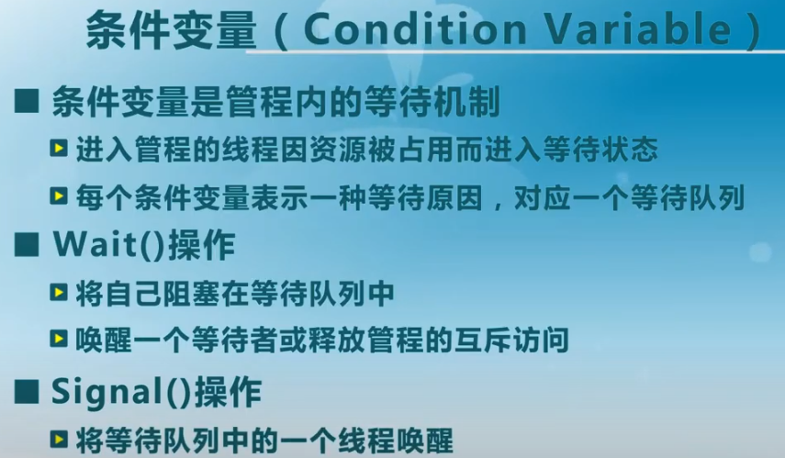
Condition Variables
condition x, y;
Two operations are allowed on a condition variable:
  x.wait() – a process that invokes the operation is suspended until x.signal()
  x.signal() – resumes one of processes (if any) that invoked x.wait()
    If no x.wait() on the variable, then it has no effect on the variable

Slide 47

Monitor with Condition Variables

Slide 48
Condition Variables Choices
If process P invokes x.signal(), and process Q is suspended in x.wait(), what should happen next?
  Both Q and P cannot execute in paralel. If Q is resumed, then P must wait
Options include
  Signal and wait – P waits until Q either leaves the monitor or it waits for another condition
  Signal and continue – Q waits until P either leaves the monitor or it waits for another condition
  Both have pros and cons – language implementer can decide
  Monitors implemented in Concurrent Pascal compromise
    P executing signal immediately leaves the monitor, Q is resumed
  Implemented in other languages including Mesa, C#, Java

Slide 49
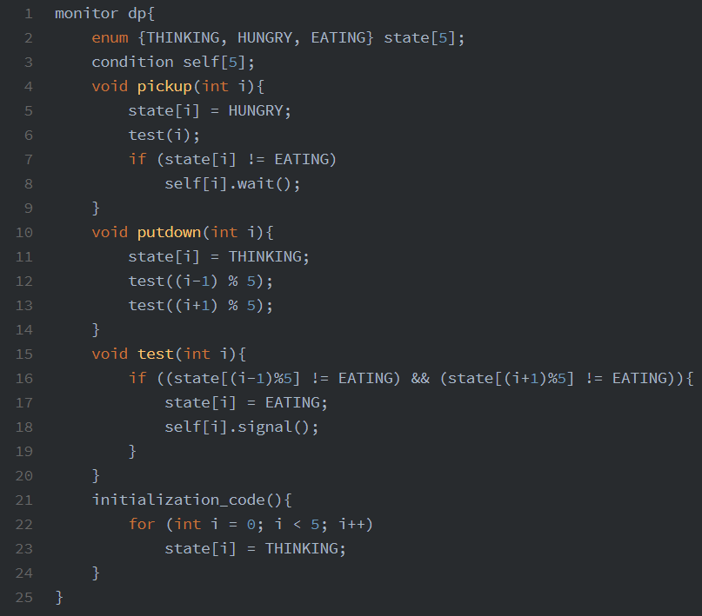
Monitor Solution to Dining Philosophers

Slide 50
Solution to Dining Philosophers (Cont.)
Each philosopher i invokes the operations pickup() and putdown() in the following sequence:
DiningPhilosophers.pickup(i);
EAT
DiningPhilosophers.putdown(i);
No deadlock, but starvation is possible

Slide 51
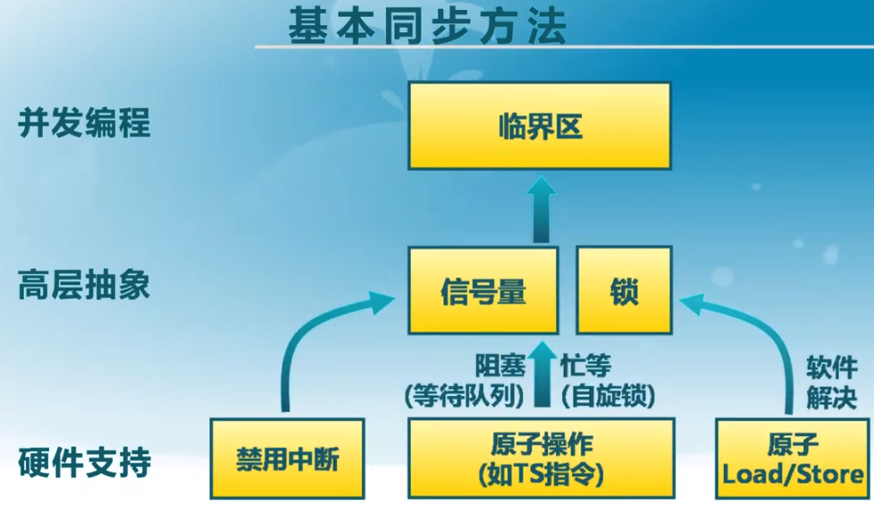
管程

Slide 52

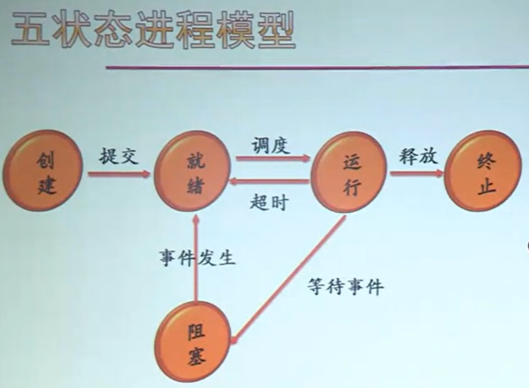

Slide 53
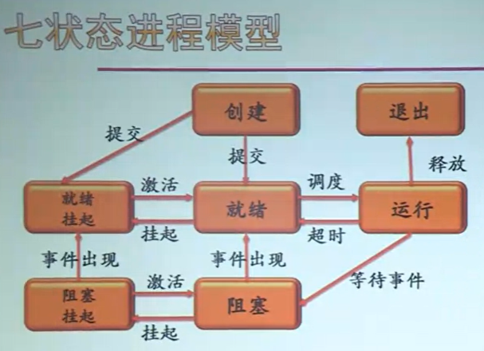

Slide 54
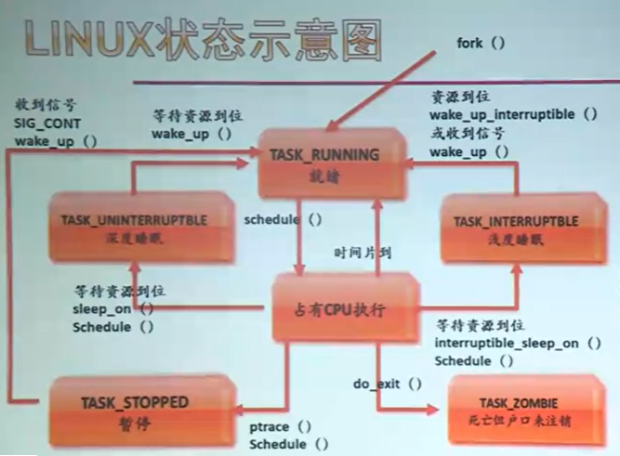

Slide 55
挂起(suspend)：
  用于调节负载
  进程不占用内存空间，其进程映像交到到磁盘上
  是指CPU告诉线程你先去休息，有资源我告诉你。它会释放CPU
激活（active）：当激活事件发生，系统利用激活原语将指定进程激活。进程从外存换入到内存，状态改变
睡眠(sleep)：是指CPU告诉线程，你先去休息，过规定时间，你自己回来
忙等待 (busy waiting)：是指线程找不到资源就一直等，并且将CPU占据
阻塞 (block)：是线程自己发现没资源，获取不到资源，它自己先去休息了，有资源它会自己回来，而且不占用CPU
  进程需要请求系统服务的时候；
  启动某种操作：如 I/O；
  新数据尚未到达
  无新工作可做（如定期清理垃圾的进程）
唤醒（wakeup）：当阻塞进程期待的事件发生，有关进程调用唤醒原语，将等待该事件的进程唤醒。状态变为Ready，插入就绪队列
  从相关等待队列中移出
  修改PCB内容，->就绪态
  将其加入就绪队列

Slide 56

互斥

Slide 57

同步

Slide 58

12月6日17:30截止
https://ks.wjx.top/vj/h4l3HJp.aspx

Slide 59
End of Chapter 5
Slides are created based on http://codex.cs.yale.edu/avi/os-book/OS9/slide-dir/index.html

