Slide 1
Chapter 9: Virtual Memory

Slide 2
Chapter 9: Virtual Memory
Background
Demand Paging
Copy-on-Write
Page Replacement
Allocation of Frames
Thrashing
Memory-Mapped Files
Allocating Kernel Memory内核内存的分配
Other Considerations
Operating-System Examples

Slide 3
Objectives
To describe the benefits of a virtual memory system
To explain the concepts of demand paging, page-replacement algorithms, and allocation of page frames
To discuss the principle of the working-set model
To examine the relationship between shared memory and memory-mapped files
To explore how kernel memory is managed

Slide 4
Content
Background
Demand Paging
Copy-on-Write
Page Replacement
Allocation of Frames
Thrashing
Memory-Mapped Files
Allocating Kernel Memory
Other Considerations
Operating-System Examples

Slide 5
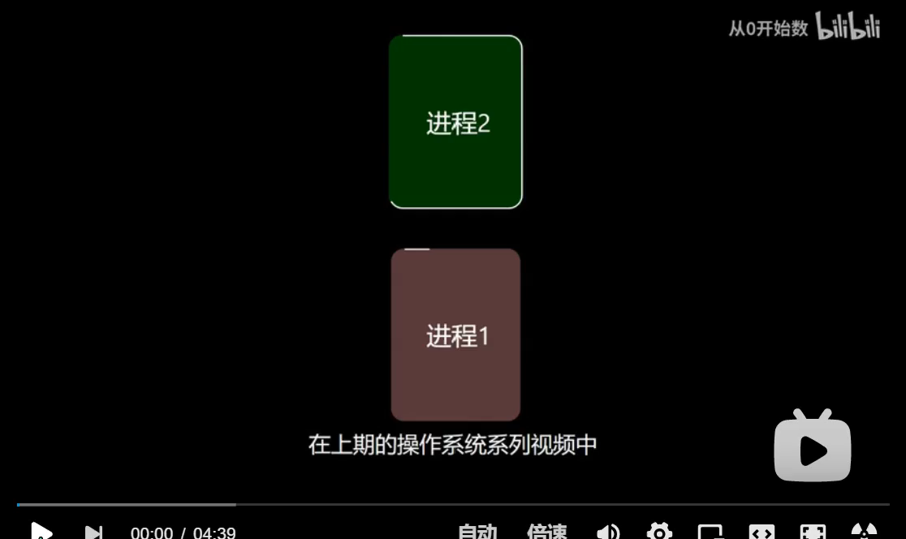
内存管理-虚拟内存

Slide 6
Background
Code needs to be in memory to execute, but entire program rarely used
  Error code, unusual routines, large data structures
Entire program code not needed at same time
Consider ability to execute partially-loaded program
  Program no longer constrained by limits of physical memory
  Each program takes less memory while running -> more programs run at the same time
    Increased CPU utilization and throughput with no increase in response time or turnaround time
  Less I/O needed to load or swap programs into memory -> each user program runs faster

Slide 7
Background (Cont.)
Virtual memory – separation of user logical memory from physical memory 用户逻辑内存与物理内存的分离
  Only part of the program needs to be in memory for execution
  Logical address space can therefore be much larger than physical address space
  Allows address spaces to be shared by several processes 允许多个进程共享地址空间
  Allows for more efficient process creation
  More programs running concurrently
  Less I/O needed to load or swap processes 加载或交换进程所需的I/O更少

Slide 8
Background (Cont.)
Virtual address space – logical view of how process is stored in memory
  Usually start at address 0, contiguous addresses until end of space
  Meanwhile, physical memory organized in page frames
  MMU must map logical to physical
Virtual memory can be implemented via:
  Demand paging
  Demand segmentation

Slide 9

Virtual Memory That is Larger Than Physical Memory

Slide 10

Virtual-address Space
Usually design logical address space for stack to start at Max logical address and grow “down” while heap grows “up”
  Maximizes address space use
  Unused address space between the two is hole
    No physical memory needed until heap or stack grows to a given new page
Enables sparse address spaces with holes left for growth, dynamically linked libraries, etc
System libraries shared via mapping into virtual address space
Shared memory by mapping pages read-write into virtual address space
Pages can be shared during fork(), speeding process creation

Slide 11

Shared Library Using Virtual Memory

Slide 12
Content
Background
Demand Paging
Copy-on-Write
Page Replacement
Allocation of Frames
Thrashing
Memory-Mapped Files
Allocating Kernel Memory
Other Considerations
Operating-System Examples

Slide 13

Demand Paging（请求调页）
Could bring entire process into memory at load time
Or bring a page into memory only when it is needed
  Less I/O needed, no unnecessary I/O
  Less memory needed
  Faster response
  More users
Similar to paging system with swapping (diagram on right)
Lazy swapper – never swaps a page into memory unless page will be needed
  Swapper that deals with pages is a pager（调页程序）
Transfer of a paged memory to contiguous disk space

Slide 14
Basic Concepts
With swapping, pager guesses which pages will be used before swapping out again
Instead, pager brings in only those pages into memory
Hardware support to distinguish between the pages that are in memory and the pages that are on the disk 硬件支持区分内存中的页面和磁盘上的页面
  Valid bit—page is both legal and in memory
  Invalid bit—the page either is not valid (not in the logical address space) or is valid but is currently on the disk

Slide 15

Page Table When Some Pages Are Not in Main Memory

Slide 16
Basic Concepts
If pages needed are already memory resident
  No difference from non demand-paging
If page needed and not memory resident
  Need to detect and load the page into memory from storage
    Without changing program behavior
    Without programmer needing to change code

Slide 17

Valid-Invalid Bit
With each page table entry a valid–invalid bit is associated
(v ⇒ in-memory – memory resident, i ⇒ not-in-memory or illegal )
Initially valid–invalid bit is set to i on all entries
Example of a page table snapshot:
During MMU address translation, if valid–invalid bit in page table entry is i ⇒ page fault

Slide 18
Page Fault
What happens if the process tries to access a page that was not brought into memory?
  Access to a page marked invalid causes a page fault 缺页.
The procedure for handling page fault :
Operating system looks at another table to decide:
  Invalid reference ⇒ abort
  Just not in memory, page it in
Find free frame
Swap page into frame via scheduled disk operation
Reset tables to indicate page now in memory
Set validation bit = v
Restart the instruction that was caused the page fault

Slide 19

Steps in Handling a Page Fault

Slide 20
Aspects of Demand Paging
Extreme case – start process with no pages in memory
  OS sets instruction pointer to first instruction of process, non-memory-resident -> page fault
  Faulting until every page that it needs is in memory
  Pure demand paging纯粹按需调页：是只有出现中断的时候才开始调页，这样一开始所有的页都不在内存中，这样进程执行过程中会不断出现页错误直到所有需要的页都在内存中。
Theoretically, a given instruction could access multiple pages -> multiple page faults
  Result in unacceptable system performance
  Analysis of running processes show that this behavior is exceedingly unlikely.
  Programs tend to have locality of reference 访问局部性/局部引用, which results in reasonable performance from demand paging.

Slide 21
Aspects of Demand Paging
locality of reference
  时间局部性是指，被引用一次的储存器位置，在接下来的时间会经常被引用，这样我们就说他有良好的时间局部性
  空间局部性是指，被引用一次的储存器位置，在接下来的时间，他旁边的储存器位置也会被引用，这样我们就说他有良好的空间局部性
Hardware support needed for demand paging
  Page table with valid / invalid bit
  Secondary memory (swap device with swap space)
  Instruction restart

Slide 22
Performance of Demand Paging
Stages in Demand Paging (worse case)
Trap to the operating system
Save the user registers and process state
Determine that the interrupt was a page fault
Check that the page reference was legal and determine the location of the page on the disk
Issue a read from the disk to a free frame:
  Wait in a queue for this device until the read request is serviced
  Wait for the device seek and/or latency time
  Begin the transfer of the page to a free frame
While waiting, allocate the CPU to some other user
Receive an interrupt from the disk I/O subsystem (I/O completed)
Save the registers and process state for the other user
Determine that the interrupt was from the disk
Correct the page table and other tables to show page is now in memory
Wait for the CPU to be allocated to this process again
Restore the user registers, process state, and new page table, and then resume the interrupted instruction

Slide 23
Performance of Demand Paging (Cont.)
Three major activities
  Service the interrupt 处理硬件中断 – careful coding means just several hundred instructions needed
  Read the page读取页面 – lots of time
  Restart the process 重启进程– again just a small amount of time
Page Fault Rate 0 ≤ p ≤ 1
  if p = 0 no page faults
  if p = 1, every reference is a fault
Effective Access Time (EAT) for a demand paged memory
EAT = (1 – p) x memory access（在内存中的页面的访问时间）
+ p x (page fault overhead处理中断
+ swap page out调出
+ swap page in调入 )

Slide 24
Demand Paging Example
Memory access time = 200 nanoseconds毫微秒、纳秒
Average page-fault service time = 8 milliseconds毫秒
1 millisecond = 1,000 microsecond=1,000,000 nanoseconds
EAT = (1 – p) x 200 + p x (8 milliseconds)
= (1 – p ) x 200 + p x 8,000,000
= 200 + p x 7,999,800
If one access out of 1,000 causes a page fault, then
EAT = 8.2 microseconds = 8,200 nanoseconds.
This is a slowdown by a factor of 40!!性能下降40倍
If want performance degradation < 10 percent
  220 > 200 + 7,999,800 x p
  20 > 7,999,800 x p
  p < .0000025
  < one page fault in every 400,000 memory accesses

Slide 25
Demand Paging Optimizations
An additional aspect of demand paging is the handling and overall use of swap space.
Swap space I/O faster than file system I/O even if on the same device交换空间的I/O操作比文件系统的I/O操作更快
  Swap allocated in larger chunks, less management needed than file system
Copy entire process image to swap space at process load time
  Then page in and out of swap space
  Used in older BSD Unix
Demand page can be read in from program binary on disk, but discard rather than paging out when freeing frame
  Used in Solaris and current BSD
  Still need to write to swap space
    A page of memory that is not associated with a file (like stack and heap) - anonymous memory 匿名内存
    Pages modified in memoty but not yet written back to the file system

Slide 26
Mobile systems
  Typically don’t support swapping: 磁盘的读写寿命远远大于闪存(flash)的寿命，闪存（flash）的读写次数一般为十万次
  Instead, these systems demand page from file system and reclaim read-only pages (such as code) from applications if memory becomes constrained.

Slide 27
Content
Background
Demand Paging
Copy-on-Write
Page Replacement
Allocation of Frames
Thrashing
Memory-Mapped Files
Allocating Kernel Memory
Other Considerations
Operating-System Examples

Slide 28
Copy-on-Write
Copy-on-Write (COW) 写时复制 allows both parent and child processes to initially share the same pages in memory 允许父进程和子进程最初共享内存中的相同页面
  If either process modifies a shared page, only then is the page copied
COW allows more efficient process creation as only modified pages are copied

Slide 29

Before Process 1 Modifies Page C

Slide 30

After Process 1 Modifies Page C

Slide 31
Copy-on-Write
In general, free pages are allocated from a pool of zero-fill-on-demand（按需填零） pages
  Pool should always have free frames for fast demand page execution
    Don’t want to have to free a frame as well as other processing on page fault
  Why zero-out a page before allocating it?
vfork()（virtual memoty fork） variation on fork() system call has parent suspend and child using copy-on-write address space of parent
父进程会挂起，子进程会访问父进程的地址空间（共享），相对fork()更高效
  Designed to have child call exec()
  Very efficient

Slide 32
fork() and vfork()
Fork() 一个现有进程可以调用fork函数创建一个新进程。由fork创建的新进程被称为子进程。fork函数被调用一次但返回两次。两次返回的唯一区别是子进程中返回0值而父进程中返回子进程ID。
子进程是父进程的副本，它将获得父进程数据空间、堆、栈等资源的副本。注意，子进程持有的是上述存储空间的“副本”，这意味着父子进程间不共享这些存储空间。
UNIX将复制父进程的地址空间内容给子进程，因此，子进程有了独立的地址空间。在不同的UNIX (Like)系统下，我们无法确定fork之后是子进程先运行还是父进程先运行，这依赖于系统的实现。所以在移植代码的时候我们不应该对此作出任何的假设。
由于在复制时复制了父进程的堆栈段，所以两个进程都停留在fork函数中，等待返回
Vfork() 会产生一个新的子进程.但是vfork创建的子进程与父进程共享数据段,而且由vfork创建的
子进程将先于父进程运行.fork()的使用详见百度词条fork().
vfork()用法与fork()相似.但是也有区别,具体区别归结为以下3点:
1. fork():子进程拷贝父进程的数据段，代码段. vfork():子进程与父进程共享数据段.
2. fork():父子进程的执行次序不确定.
vfork():保证子进程先运行，在调用exec或exit之前与父进程数据是共享的,在它调用exec
或exit之后父进程才可能被调度运行。如果在调用这两个函数之前子进程依赖于父进程的进一步动作，则会导致死锁。
3.当需要改变共享数据段中变量的值，则拷贝父进程。

Slide 33
What Happens if There is no Free Frame?
Used up by process pages
Also in demand from the kernel, I/O buffers, etc
How much to allocate to each?
Page replacement – find some page in memory, but not really in use, page it out
  Algorithm – terminate? swap out? replace the page?
  Performance – want an algorithm which will result in minimum number of page faults
Same page may be brought into memory several times

Slide 34
Content
Background
Demand Paging
Copy-on-Write
Page Replacement
Allocation of Frames
Thrashing
Memory-Mapped Files
Allocating Kernel Memory
Other Considerations
Operating-System Examples

Slide 35
Page Replacement
Prevent over-allocation of memory by modifying page-fault service routine to include page replacement 通过修改页面错误服务例程以包括页面替换，防止内存过度分配
Use modify (dirty) bit to reduce overhead of page transfers – only modified pages are written to disk 使用修改（脏）位减少页面传输的开销–只有修改过的页面才会写入磁盘
Page replacement completes separation between logical memory and physical memory – large virtual memory can be provided on a smaller physical memory 页面替换完成了逻辑内存和物理内存之间的分离–可以在较小的物理内存上提供较大的虚拟内存

Slide 36

Need For Page Replacement

Slide 37
Basic Page Replacement
Find the location of the desired page on disk
Find a free frame:
- If there is a free frame, use it
- If there is no free frame, use a page replacement algorithm to select a victim frame
- Write victim frame to disk if dirty
Bring the desired page into the (newly) free frame; update the page and frame tables
Continue the process by restarting the instruction that caused the trap
Note now potentially 2 page transfers for page fault – increasing EAT

Slide 38

Page Replacement

Slide 39
Page and Frame Replacement Algorithms
Frame-allocation algorithm determines
  How many frames to give each process
  Which frames to replace
Page-replacement algorithm
  Want lowest page-fault rate on both first access and re-access
Evaluate algorithm by running it on a particular string of memory references (reference string) and computing the number of page faults on that string
  String is just page numbers, not full addresses
  Repeated access to the same page does not cause a page fault
  Results depend on number of frames available
In all our examples, the reference string of referenced page numbers is
7,0,1,2,0,3,0,4,2,3,0,3,0,3,2,1,2,0,1,7,0,1

Slide 40

Graph of Page Faults Versus The Number of Frames

Slide 41

First-In-First-Out (FIFO) Algorithm
Reference string: 7,0,1,2,0,3,0,4,2,3,0,3, 2,1,2,0,1,7,0,1
3 frames (3 pages can be in memory at a time per process)
15 page faults

Slide 42
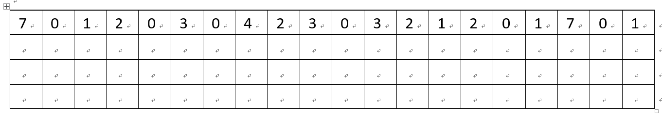
First-In-First-Out (FIFO) Algorithm
Reference string: 7,0,1,2,0,3,0,4,2,3,0,3, 2,1,2,0,1,7,0,1
3 frames (3 pages can be in memory at a time per process)
15 page faults

Slide 43
First-In-First-Out (FIFO) Algorithm
Reference string: 7,0,1,2,0,3,0,4,2,3,0,3, 2,1,2,0,1,7,0,1
3 frames (3 pages can be in memory at a time per process)
Can vary by reference string: consider 1,2,3,4,1,2,5,1,2,3,4,5
  Adding more frames can cause more page faults!
    Belady’s Anomaly
How to track ages of pages?
  Just use a FIFO queue
15 page faults

Slide 44

FIFO Illustrating Belady’s Anomaly

Slide 45

Optimal Algorithm
Replace page that will not be used for longest period of time
  9 is optimal for the example
How do you know this?
  Can’t read the future
Used for measuring how well your algorithm performs

Slide 46

Least Recently Used (LRU) Algorithm
Use past knowledge rather than future
Replace page that has not been used in the most amount of time
Associate time of last use with each page
12 faults – better than FIFO but worse than OPT
Generally good algorithm and frequently used
But how to implement?

Slide 47
Least Recently Used (LRU) Algorithm
Use past knowledge rather than future
Replace page that has not been used in the most amount of time
Associate time of last use with each page
12 faults – better than FIFO but worse than OPT
Generally good algorithm and frequently used
But how to implement?

Slide 48
LRU Approximation Algorithms
LRU needs special hardware and still slow
Reference bit 访问位
  With each page associate a bit, initially = 0
  When page is referenced bit set to 1
  Replace any with reference bit = 0 (if one exists)
    We do not know the order, however
Second-chance algorithm
  Generally FIFO, plus hardware-provided reference bit 访问位硬件支持
  Clock replacement
  If page to be replaced has
    Reference bit = 0 -> replace it
    reference bit = 1 then:
      set reference bit 0, leave page in memory
      replace next page, subject to same rules

Slide 49

Second-Chance (clock) Page-Replacement Algorithm

Slide 50
Enhanced Second-Chance Algorithm
Improve algorithm by using reference bit and modify bit (if available) in concert
Take ordered pair (reference, modify)
(0, 0) neither recently used not modified – best page to replace
(0, 1) not recently used but modified – not quite as good, must write out before replacement
(1, 0) recently used but clean – probably will be used again soon
(1, 1) recently used and modified – probably will be used again soon and need to write out before replacement. the worst page to replace.
When page replacement called for, use the clock scheme but use the four classes replace page in lowest non-empty class
  Might need to search circular queue several times

Slide 51
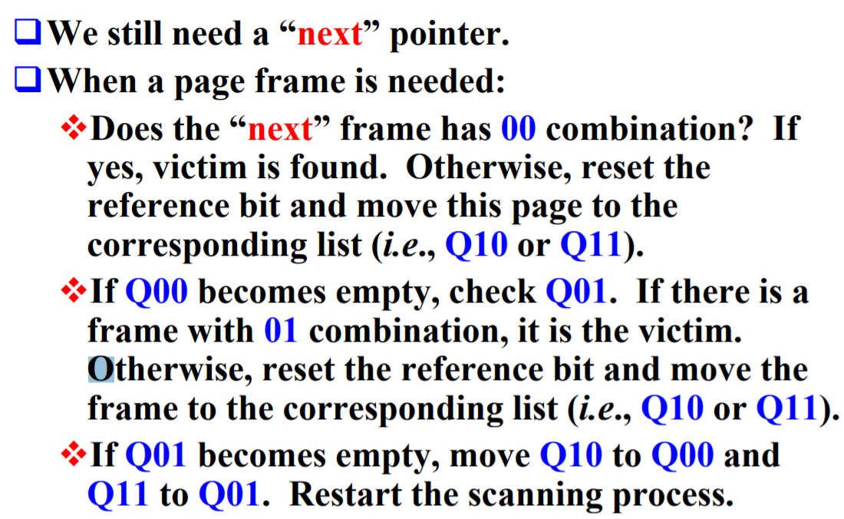
Enhanced Second-Chance Algorithm

Slide 52
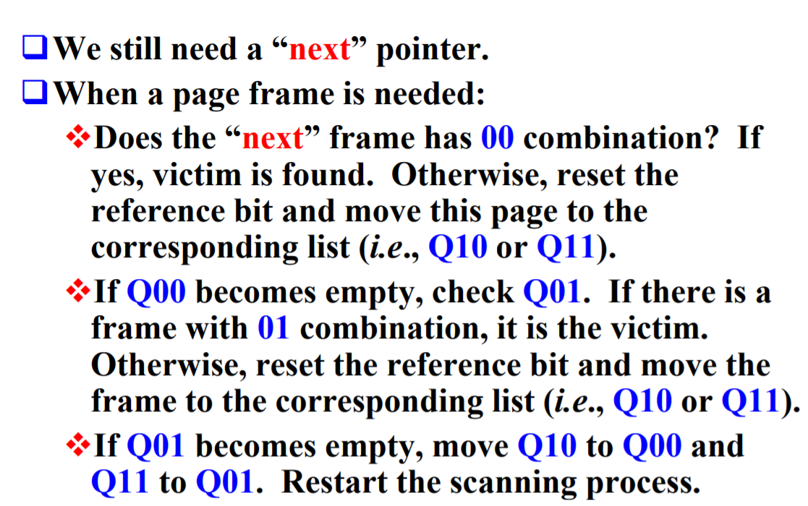
http://pages.mtu.edu/~shene/FORUM/Taiwan-Forum/ComputerScience/003-OS/SLIDES/chap09.pdf

Slide 53
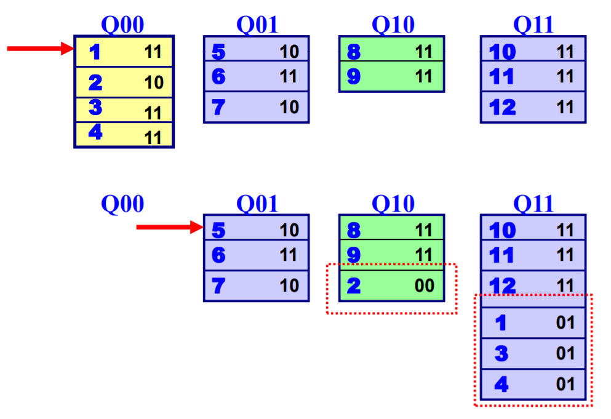

Slide 54
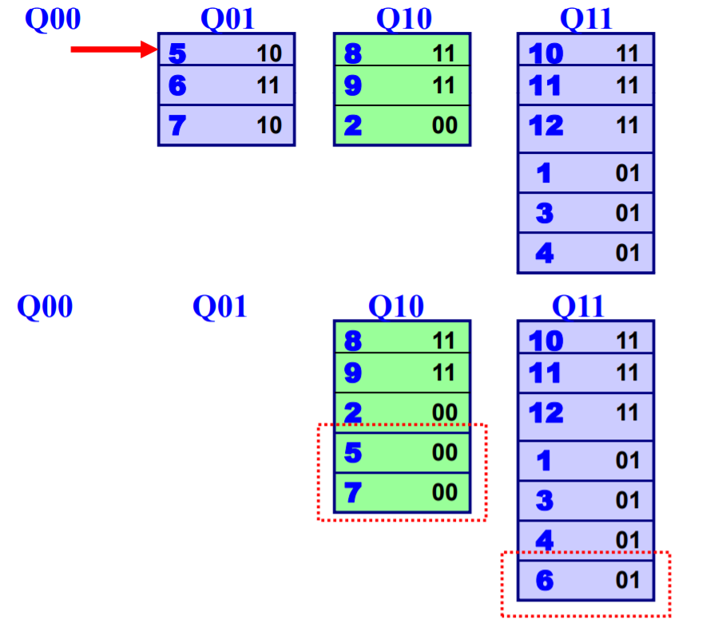

Slide 55
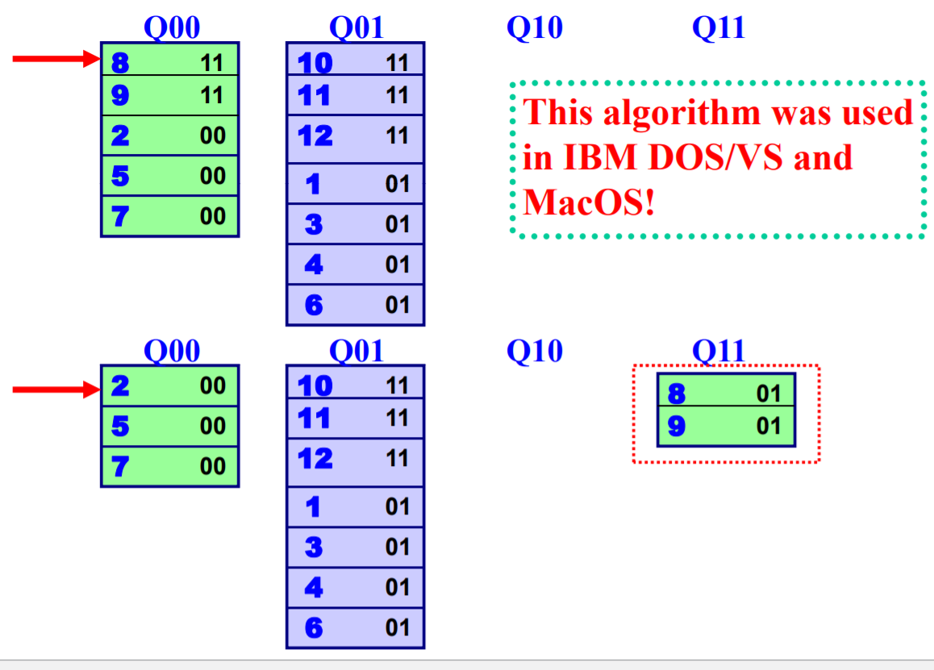

Slide 56
Counting Algorithms
Keep a counter of the number of references that have been made to each page
  Not common
Lease Frequently Used (LFU) Algorithm: 最不常使用页置换算法 replaces page with smallest count
Most Frequently Used (MFU) Algorithm: 最常使用页置换算法based on the argument that the page with the smallest count was probably just brought in and has yet to be used

Slide 57
Page-Buffering Algorithms页面缓冲算法
Keep a pool of free frames, always
  Then frame available when needed, not found at fault time
  Read page into free frame and select victim to evict and add to free pool
  When convenient, evict victim
Possibly, keep list of modified pages
  When backing store otherwise idle, write pages there and set to non-dirty
Possibly, keep free frame contents intact and note what is in them
  If referenced again before reused, no need to load contents again from disk
  Generally useful to reduce penalty if wrong victim frame selected

Slide 58
Content
Background
Demand Paging
Copy-on-Write
Page Replacement
Allocation of Frames 页面分配策略
Thrashing
Memory-Mapped Files
Allocating Kernel Memory
Other Considerations
Operating-System Examples

Slide 59
Allocation of Frames
Each process needs minimum number of frames
The minimum number of frames is defined by the computer architecture.
Example: IBM 370 MVC instruction – 6 pages to handle SS MOVE instruction: storage location to storage location
  instruction is 6 bytes, might span 2 pages
  2 pages to handle ‘from’
  2 pages to handle ‘to’
Maximum of course is total frames in the system
Two major allocation schemes
  fixed allocation
  priority allocation
Many variations

Slide 60
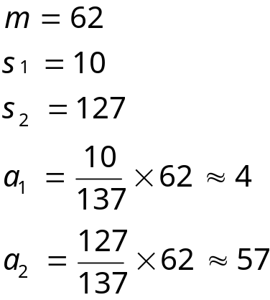

Fixed Allocation
Equal allocation – For example, if there are 100 frames (after allocating frames for the OS) and 5 processes, give each process 20 frames
  Keep some as free frame buffer pool
Proportional allocation – Allocate according to the size of process
  Dynamic as degree of multiprogramming, process sizes change

Slide 61
Priority Allocation
Use a proportional allocation scheme using priorities rather than size
If process P_{i} generates a page fault,
  select for replacement one of its frames
  select for replacement a frame from a process with lower priority number

Slide 62
Global vs. Local Allocation
Global replacement 全部置换– process selects a replacement frame from the set of all frames; one process can take a frame from another
  But then process execution time can vary greatly
  But greater throughput so more common
Local replacement 局部置换– each process selects from only its own set of allocated frames
  More consistent per-process performance
  But possibly underutilized memory

Slide 63
Non-Uniform Memory Access非均匀内存访问
不同的CPU的板之间的内存的访问速度不一样。相同板的内存访问速度比不同板访问内存速度快
So far all memory accessed equally
Many systems are NUMA – speed of access to memory varies
  Consider system boards containing CPUs and memory, interconnected over a system bus
Optimal performance comes from allocating memory “close to” the CPU on which the thread is scheduled
  And modifying the scheduler to schedule the thread on the same system board when possible
  Solved by Solaris by creating lgroups
    Structure to track CPU / Memory low latency groups
    Used my schedule and pager
    When possible schedule all threads of a process and allocate all memory for that process within the lgroup

Slide 64
Content
Background
Demand Paging
Copy-on-Write
Page Replacement
Allocation of Frames
Thrashing
Memory-Mapped Files
Allocating Kernel Memory
Other Considerations
Operating-System Examples

Slide 65
Thrashing
If a process does not have “enough” pages, the page-fault rate is very high
  Page fault to get page
  Replace existing frame
  But quickly need replaced frame back
  This leads to:
    Low CPU utilization
    Operating system thinking that it needs to increase the degree of multiprogramming
    Another process added to the system
Thrashing ≡ a process is busy swapping pages in and out
页面频繁换进换出的现象

Slide 66

Thrashing (Cont.)

Slide 67
Demand Paging and Thrashing
Why does demand paging work?
Locality model 局部模型
  A locality is a set of pages that are actively used together
  Process migrates from one locality to another
  Localities may overlap
Why does thrashing occur?
Σ size of locality > total memory size
  Limit effects by using local or priority page replacement

Slide 68

Locality In A Memory-Reference Pattern

Slide 69

Working-Set Model
Δ ≡ working-set window ≡ a fixed number of page references Δ 窗口尺寸
Example: 10,000 instructions
WSS_{i} (working set of Process P_{i}) =
total number of pages referenced in the most recent Δ (varies in time)
  if Δ too small will not encompass entire locality
  if Δ too large will encompass several localities
  if Δ = ∞ ⇒ will encompass entire program
D = Σ WSS_{i} ≡ total demand for frames D 工作集
  Approximation of locality
if D > m ⇒ Thrashing, m: the total # of available frames m 驻留集
Policy if D > m, then suspend or swap out one of the processes

Slide 70
Keeping Track of the Working Set
Approximate with interval timer + a reference bit 使用间隔计时器+参考位的近似值
Example: Δ = 10,000
  Timer interrupts after every 5,000 time units
  Keep in memory 2 bits for each page
  Whenever a timer interrupts, copy and sets the values of all reference bits to 0
  If one of the bits in memory = 1 ⇒ page in working set
Why is this not completely accurate?
Improvement = 10 bits and interrupt every 1,000 time units

Slide 71
工作集算法
基本思路
  找出一个不在工作集中的页面并置换它
思路：
  每个页表项中有一个字段：记录该页面最后一次被访问的时间
  设置一个时间值T
  判断：
    根据一个页面的访问时间，判断是否落在“当前时间-T”之前或之中，决定其在工作集之外还是之内
因为只有那些在内存中的页面才可以作为候选者被淘汰，所以该算法忽略了那些不在内存中的页面。
每个表项至少包含两条信息：上次使用该页面的近似时间和R（访问）位。空白的矩形表示该算法不需要的其他域，如页框号、保护位、M（修改）位。

Slide 72
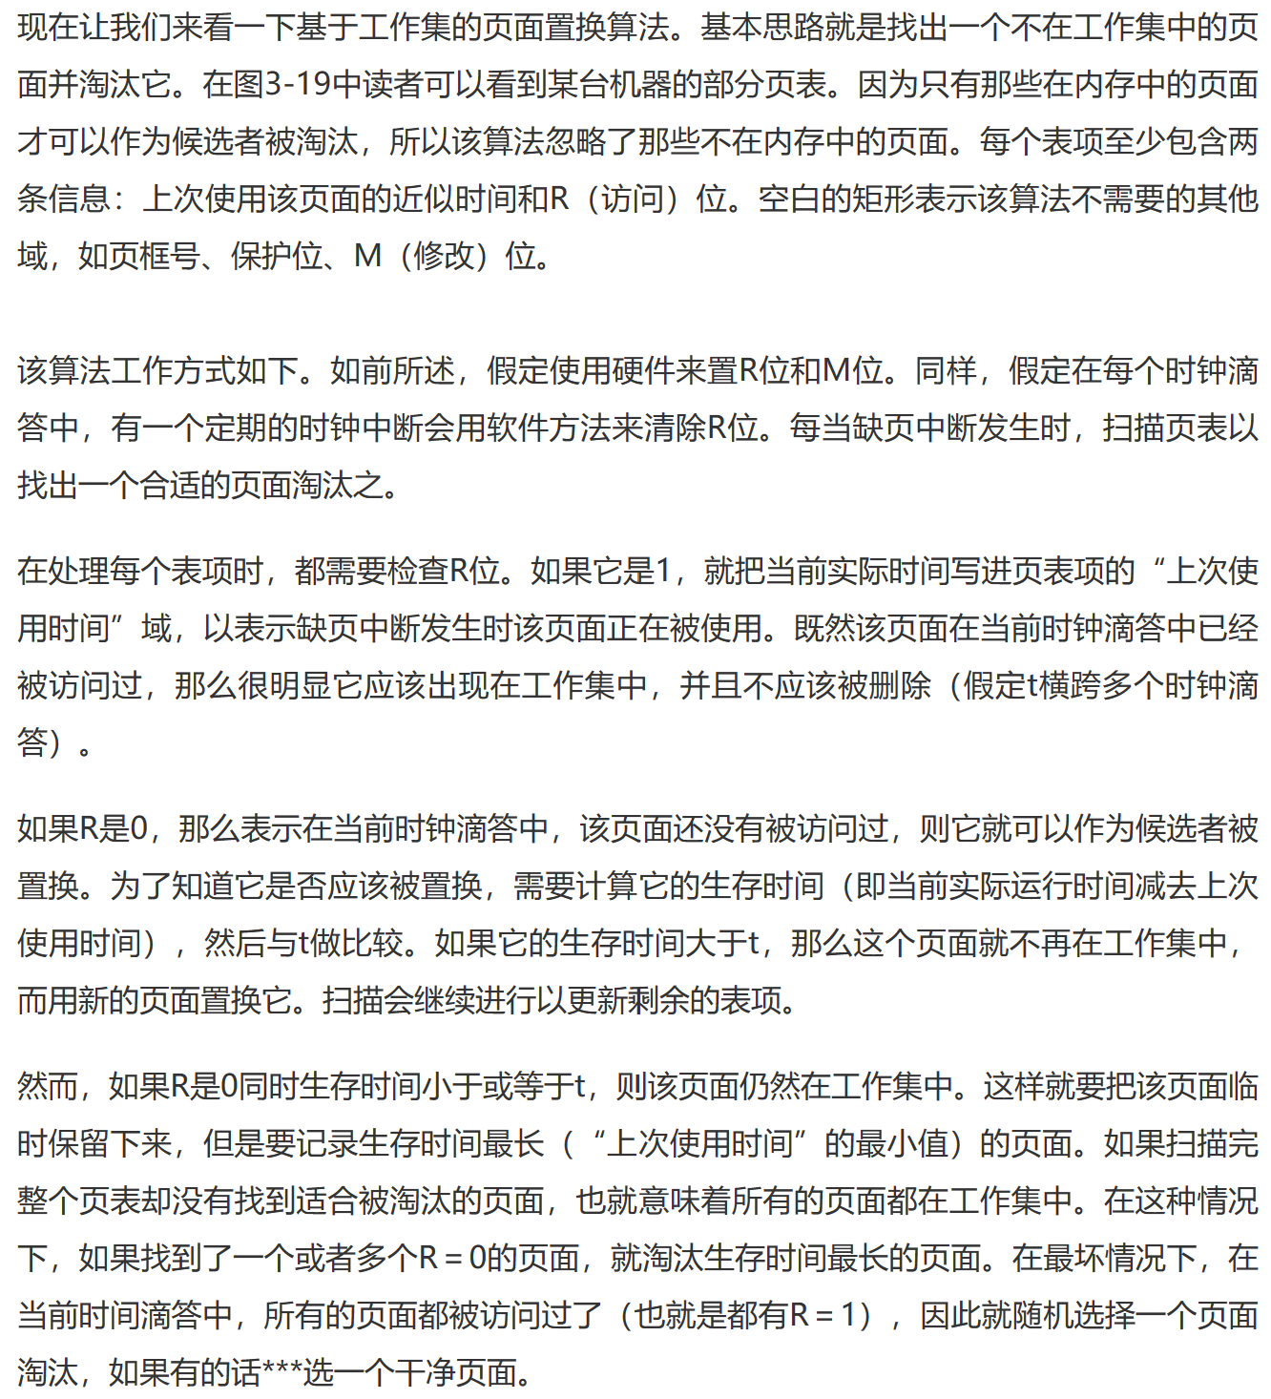
工作集算法

Slide 73

Page-Fault Frequency
More direct approach than WSS
Establish “acceptable” page-fault frequency (PFF) rate and use local replacement policy
  If actual rate too low, process loses frame
  If actual rate too high, process gains frame

Slide 74

Working Sets and Page Fault Rates
Direct relationship between working set of a process and its page-fault rate
Working set changes over time
Peaks and valleys over time

Slide 75
Content
Background
Demand Paging
Copy-on-Write
Page Replacement
Allocation of Frames
Thrashing
Memory-Mapped Files
Allocating Kernel Memory
Other Considerations
Operating-System Examples

Slide 76
Memory-Mapped Files
Memory-mapped file I/O allows file I/O to be treated as routine memory access by mapping a disk block to a page in memory
A file is initially read using demand paging
  A page-sized portion of the file is read from the file system into a physical page
  Subsequent reads/writes to/from the file are treated as ordinary memory accesses
Simplifies and speeds file access by driving file I/O through memory rather than read() and write() system calls 通过在内存中驱动文件I/O而不是read（）和write（）来简化和加快文件访问
Also allows several processes to map the same file allowing the pages in memory to be shared 还允许多个进程映射同一文件，从而允许共享内存中的页面
But when does written data make it to disk?
  Periodically and / or at file close() time
  For example, when the pager scans for dirty pages

Slide 77
Memory-Mapped File Technique for all I/O
Some OSes provide memory mapping only through a specific system call and use the standard system calls to perform all other file I/O.
Process can explicitly request memory mapping a file via mmap() system call
  Now file mapped into process address space
For standard I/O (open(), read(), write(), close()), mmap anyway
  But map file into kernel address space
  Process still does read() and write()
    Copies data to and from kernel space and user space
  Uses efficient memory management subsystem
    Avoids needing separate subsystem
COW can be used for read/write non-shared pages
Memory mapped files can be used for shared memory (although again via separate system calls)

Slide 78

Memory Mapped Files

Slide 79

Shared Memory via Memory-Mapped I/O

Slide 80
Content
Background
Demand Paging
Copy-on-Write
Page Replacement
Allocation of Frames
Thrashing
Memory-Mapped Files
Allocating Kernel Memory
Other Considerations
Operating-System Examples

Slide 81
Allocating Kernel Memory
Treated differently from user memory
Often allocated from a free-memory pool
  Kernel requests memory for structures of varying sizes
  Some kernel memory needs to be contiguous
    I.e. for device I/O

Slide 82
Buddy System--伙伴系统算法
Allocates memory from fixed-size segment consisting of physically-contiguous pages
Memory allocated using power-of-2 allocator
  Satisfies requests in units sized as power of 2
  Request rounded up to next highest power of 2
  When smaller allocation needed than is available, current chunk split into two buddies of next-lower power of 2
    Continue until appropriate sized chunk available
For example, assume 256KB chunk available, kernel requests 21KB
  Split into A_{L} _{and} A_{R} of 128KB each
    One further divided into B_{L} and B_{R} of 64KB
      One further into C_{L} and C_{R} of 32KB each – one used to satisfy request
Advantage – quickly coalesce合并unused chunks into larger chunk
Disadvantage - fragmentation

Slide 83

Buddy System Allocator

Slide 84
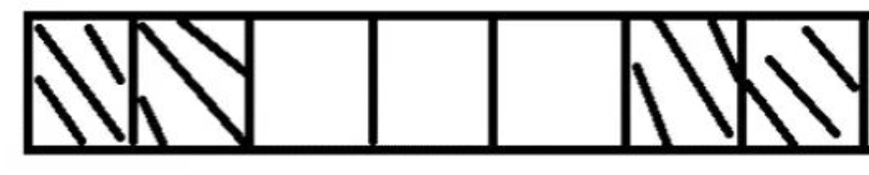
假设这是一段连续的页框，阴影部分表示已经被使用的页框，现在需要申请一个连续的5个页框。这个时候，在这段内存上不能找到连续的5个空闲的页框，就会去另一段内存上去寻找5个连续的页框，这样子，久而久之就形成了页框的浪费。为了避免出现这种情况，Linux内核中引入了伙伴系统算法(Buddy system)。把所有的空闲页框分组为11个块链表，每个块链表分别包含大小为1，2，4，8，16，32，64，128，256，512和1024个连续页框的页框块。最大可以申请1024个连续页框，对应4MB大小的连续内存。每个页框块的第一个页框的物理地址是该块大小的整数倍，如图
Ref: https://zhuanlan.zhihu.com/p/36140017

Slide 85
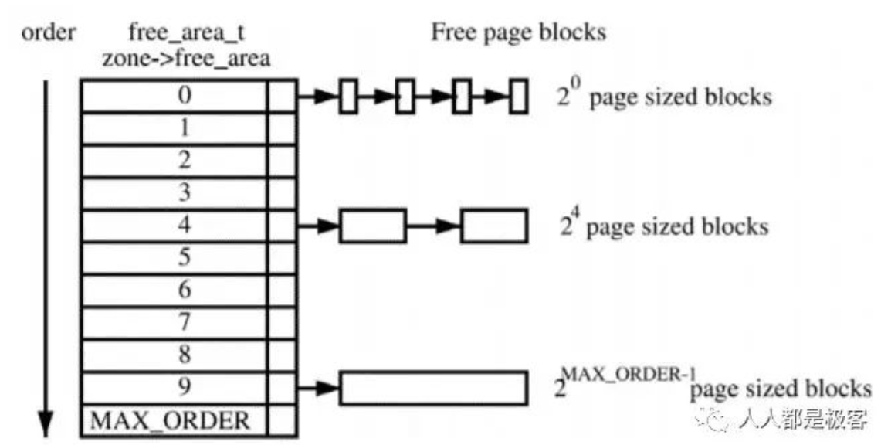

Slide 86
假设要申请一个256个页框的块，先从256个页框的链表中查找空闲块，如果没有，就去512个页框的链表中找，找到了则将页框块分为2个256个页框的块，一个分配给应用，另外一个移到256个页框的链表中。如果512个页框的链表中仍没有空闲块，继续向1024个页框的链表查找，如果仍然没有，则返回错误。页框块在释放时，会主动将两个连续的页框块合并为一个较大的页框块。
从上面可以知道Buddy算法一直在对页框做拆开合并拆开合并的动作。Buddy算法运用了世界上任何正整数都可以由2^n的和组成。这也是Buddy算法管理空闲页表的本质。

Slide 87
Slab Allocator Slab分配器
Alternate strategy
Slab is one or more physically contiguous pages Slab是一个或多个物理上连续的页面
Cache consists of one or more slabs 缓存由一个或多个slab组成
Single cache for each unique kernel data structure
  Each cache filled with objects – instantiations of the data structure 每个缓存都充满了对象–数据结构的实例化
When cache created, filled with objects marked as free
When structures stored, objects marked as used
If slab is full of used objects, next object allocated from empty slab
  If no empty slabs, new slab allocated

Slide 88

Slab Allocation

Slide 89
The slab-allocation algorithm uses caches to store kernel objects. When a
cache is created, a number of objects—which are initially marked as free—are
allocated to the cache.
The number of objects in the cache depends on the size of the associated slab.
  For example, a 12-KB slab (made up of three continguous 4-KB pages) could store six 2-KB objects.
  Initially, all objects in the cache are marked as free. When a new object for a kernel data structure is needed, the allocator can assign any free object from the cache to satisfy the request.
  The object assigned from the cache is marked as used.
Benefits include no fragmentation, fast memory request satisfaction

Slide 90
用户应用程序对内存的需求是频繁的和任意的，而伙伴算法作为一个基础内存管理算法，并不具备提供这种任意性的条件，因此还需要以伙伴算法为基础，实现另外的内存管理机制，为用户提供申请任意大小内存的可能，这里就介绍 slab 分配器。
通俗的讲，slab 就是专门为某一模块预先一次性申请一定数量的内存备用，当这个模块想要使用内存的时候，就不再需要从系统中分配内存了（因为从系统中申请内存的时间开销相对来说比较大），而是直接从预申请的内存中拿出一部分来使用，这样就提高了这个模块的内存申请速度。

Slide 91
slab 要在合适的场合下使用才能发挥作用。
使用 slab 通常需要满足以下两个条件：
  第一条件是，当某一子系统需要频繁地申请和释放内存时，使用 slab 才会合理一些。如果某段程序中申请和释放内存的频率不高，就没必要预先申请一块很大的内存备用，然后再从这段私有空间中分配内存了。因为这样就意味着系统将会一次性损失过多内存，而由于内存请求的频率不高，也不会对系统性能有多大的提升。所以，对于频繁使用内存的程序来说，使用 slab 才有意义。
  使用 slab 的另一个条件是，利用 slab 申请的内存必须是大小固定的。只有固定内存大小才有可能实现内存的高速申请和释放。

Slide 92
分配和释放数据结构时所有内核中最普遍的操作之一。Linux 内核提供了 slab 层（slab 分配器），其扮演了通用数据结构缓存层的角色。slab 层把不同的对象划分为所谓高速缓存组，其中每个高速缓存组都存放不同类型的对象，每种对象类型对应一个高速缓存。例如，一个高速缓存用于存放进程描述符，而另一个高速缓存存放索引节点对象，然后这些高速缓存又被划分为 slab。slab 由一个或多个物理上连续的页组成。一般情况下，slab 也就是仅仅由一页组成，每个高速缓存可以由多个 slab 组成。

Slide 93
slab 分配器把每一个请求的内存称之为对象。每个 slab 都包含一些对象成员，这里的对象指的是被缓存的数据结构。每个 slab 处于三种状态之一：满、部分满或空。一个满的 slab 没有空闲的对象（slab 中的对象都已被分配）。一个空的 slab 没有分配出任何对象（slab 中所有对象都是空闲的）。一个部分满的 slab 有一些对象已分配出去，有些对象还空闲着。当内核的某一部分需要一个新的对象时，先从部分满的 slab 中进行分配，如果没有部分满的 slab，就从空的 slab 中进行分配。如果没有空的 slab，就要创建一个 slab 了

Slide 94
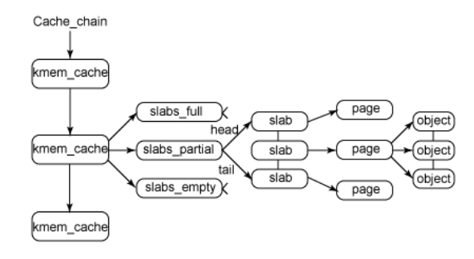
高速缓存、slab、对象之间的关系
每个高速缓存都使用 kmem_cache 结构来表示。这个结构包含3个链表：slabs_full，slabs_partial 和 slabs_empty，均存放在 kmem_list3 结构内（定义于 mm/slab.c），这些链表包含高速缓存中的所有slab。

Slide 95
The end of Chapter 9

