Slide 1
Chap 3: Control flow
Lecture 1: Decision making and branching

Slide 2
Introduction
Two-way branching —— The simplest decision making
if (bank balance is zero) borrow money
if (room is dark) turn on lights
if (age is more than 60)
person is retired
C language possesses such decision-making capabilities by supporting the following statements
if statement
switch statement
Conditional operator statement
goto statement
Entry
test expression?
False
True

Slide 3
Simple if statement
Relational and/or logical expressions
Non-zero stands for true, otherwise false
General form
Flow chart
if (test expression)
{
statement-block;
}
statement-x;
Entry
True
test expression?
statement-block
False
statement-x

Slide 4
Test expressions
Relational or logical operators that having Boolean values
Leap year
Arithmetic expressions of which the value stand for true
Examples:
Assignment expressions can also be tested
The operators = and == (!!)
if ( a - b ) printf("%d != %d", a, b );
if( num% 2) printf("% odd number");
if (sum = a + b) printf("Summation is non-zero");
if ( disc==0 ) if ( disc=0 )
printf(“Two equal roots”);

Slide 5
Exercise 3. 1
A program reads 4 values a, b, c, d from the keyboard and evaluates the ratio of (a+b) to (c-d) and prints the result, if (c-d) is no equal to zero.

Slide 6
Program
main()
{
int a, b, c, d;
float ratio;
// Read four integer values
printf(“Enter four integer values\n”);
scanf(“%d%d%d%d”, &a, &b, &c, &d);
// Evaluate the ratio
if(c-d !=0) // Is this test correct?
{
ratio=(float)(a+b)/(float)(c-d); //Is type casting necessary?
printf(“Ratio =%f\n”, ratio);
}
}

Slide 7
De Morgan’s Rule
Remove the parentheses by applying the NOT operator to every relation expression component, while complementing the logical operators.
Examples:
!(x&&y||!z)
Apply NOT operators: !x, !y, z
Complement relational operators: !x || !y && z
!(x<=0||!condition)
Leap year: exactly divisible by four is a leap year, except for years that are exactly divisible by 100, but these centurial years are leap years if they are divisible by 400.
(year％4==0 && year％100!=0) || year％400==0
Common year
! (year％4==0 && year％100!=0 || year％400==0)
year%4 != 0 || year%100 == 0 && year %400 != 0
x>0&&condition

Slide 8
If-else statement
General form
if (test expression)
{
True-block statement(s)
}
else
{
False-block statement(s)
}
statement-x
Flow chart
Entry
test
expression
True
False
True-block statement
False-block
statement
statement-x

Slide 9
If-else and multiple Ifs
Count the number of boys and girls in a class. We use code1 for a boy and 2 for a girl.
...............
...............
if (code==1)
boy=boy+1;
if (code==2)
girl=girl+1;
...............
...............
...............
...............
if (code==1)
boy=boy+1;
else
girl=girl+1;
...............
...............

Slide 10
Nesting of if-else statement
General form
if(test condition-2)
{
statement-1;
}
if(test condition-1)
{
if(test condition-2)
{
statement-1;
}
else
{
statement-2;
}
}
else
{
statement-3;
}
statement-x;
if(test condition-3)
{
statement-4;
}
else
{
statement-5;
}

Slide 11
Nesting of if-else statement
Flow chart
Entry
test condition 1
True
False
test condition 2
False
True
statement-3
statement-2
statement-1
statement-x
Next Statement

Slide 12
Dangling else problem
else is always paired with the most recent unpaired if.
if( )
{ if( ) statement1
else
{ if( )statement2
else statement3
}
}
if( )
if( ) statment1
else
if( ) statement2
else statement3
int x=20;
if(x>=0)
{ if(x<50)
printf( " okey! \n" );
else
printf( " not ok! \n" );
}
int x=20;
if(x>=0)
if(x<50)
printf( " okey! \n" );
else
printf( " not ok! \n" );

Slide 13
Exercise
Refine your program to solve a quadratic equation
Conditions:
a equals 0 → a linear equation
discriminant equals 0 → Two equal real roots
discriminant is greater than 0 → Two distinct real roots
discriminant is less than 0 → Two conjugate roots
ax² + bx + c = 0

Slide 14
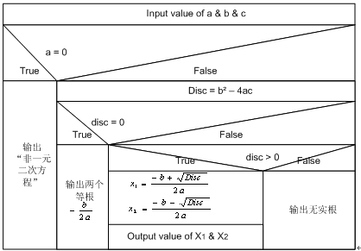
Flow chart

Slide 15
Program
#include<stdio.h>
#include<math.h>
int main()
{
int a,b,c ,disc; /*Declare variables */
double x1,x2;
printf("Input coefficients of the equation:\n");
scanf("a=%d,b=%d,c=%d",&a,&b,&c);
if(a==0) /*Linear equation*/
printf("Not a quadratic");
else
{
disc=b*b-4*a*c; /*Discriminant*/
….
}

Slide 16
Program_Contd
else /*Quadratic equation*/
{
disc=b*b-4*a*c;
if(disc==0) /* Two equal roots*/
printf("Two equal roots:%8.4f\n",-b/(2*a));
else
{
if(disc>0) /*Two distinct roots*/
{
x1=(-b+sqrt(disc))/(2*a);
x2=(-b-sqrt(disc))/(2*a);
printf("Distinct real roots:%8.4f and %8.4f\n”, x1,x2);
}
else /*Complex roots/
printf("No real roots\n");
}
}
return 0;
}

Slide 17
Else-if ladder
if (condition 1)
statement-1;
else if (condition 2)
statement-2;
else if (condition 3)
statement-3;
else if (condition n)
statement-n;
else
default-statement;
statement-x;

Slide 18
Flow Chart of else-if ladder
Entry
True
test condition 1
?
False
test condition 2
?
False
statement-1
True
test condition 3
?
False
statement-2
True
statement-3
True
test condition n
?
False
statement-n
default statement
statement-x
The else-if ladder runs more efficient than a set of nesting if-else(s).

Slide 19
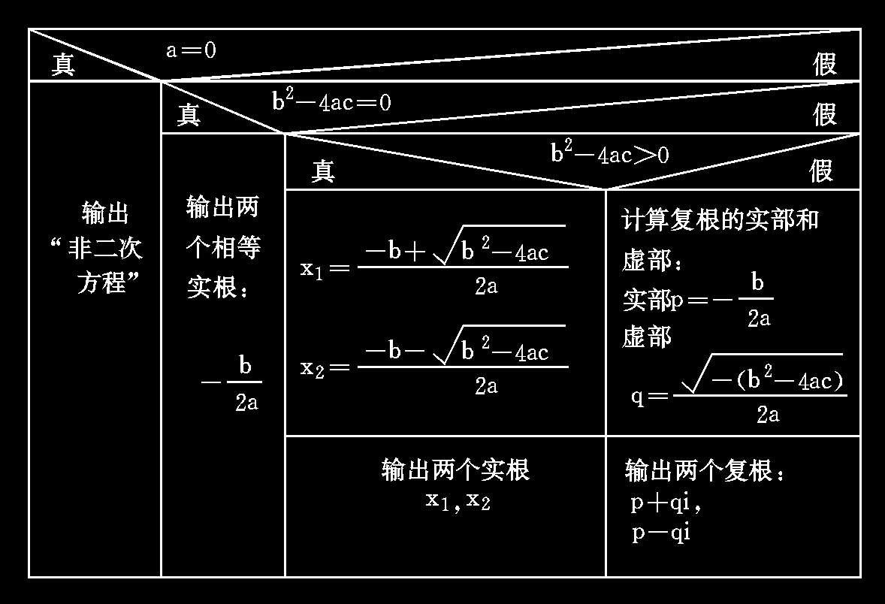
Exercise
Refine the program for quadratic equations by else-if ladder.

Slide 20
A classical example
Binary search for sorted arrays：
find x in v[0] <= v[1] <=v[2] <= … <= v[n-1]
M
x
A
B
E
F
G
K
M
P
v

Slide 21
Algorithm
int binsearch(int x, int v[], int n)
{
int mid;
int low = 0, high = n – 1;
{
}
return -1;
}

Slide 22
Flow chart
mid=(low+high)/2
True
x < v[mid]
?
False
x > v[mid]
?
False
high = mid-1
True
x == v[mid]
?
False
low = mid +1
True
return mid
return -1

Slide 23
Algorithm
int binsearch(int x, int v[], int n)
{
int mid;
int low = 0, high = n – 1;
{
mid = (low + high) / 2;
if (x < v[mid])
high = mid – 1;
else if (x > v[mid])
low = mid + 1;
else return mid;
}
return -1;
}

Slide 24
Algorithm
int binsearch(int x, int v[], int n)
{
int mid;
int low = 0, high = n – 1;
while (low <= high)
{
mid = (low + high) / 2;
if (x < v[mid])
high = mid – 1;
else if (x > v[mid])
low = mid + 1;
else return mid;
}
return -1;
}

Slide 25
Switch statement
General form
switch (expression)
{
case value_1:
block_1；
break;
case value_2:
block_1；
break;
......
......
default:
default_block；
break;
}
statement_x;
Entry
switch expression
Expression==value_1
block1
Expression==value_2
block2
...
...
(no match) default
default block
statement-x

Slide 26
Rules for switch statement
The switch expression must be an integral type including int, char and enum.
Case labels must be constants or constant expressions.
Case labels must be unique and end with semicolon.
The break statement transfers the control out of the switch statement. Set break upon demand.

Slide 27
Exercise-1
What is the numerical value of each of the following expressions?
5 > 2
3+4 > 2 && 3 < 2
x >= y || y > x
d = 5 + (6 > 2)
‘X’ > ‘T’? 10 : 5
x > y ? y > x : x > y

Slide 28
Exercise-2
What’s wrong with the program
#include <stdio.h>
int main(void)
{
char ch;
int lc = 0;/*lowercase char count*/
int uc = 0;/*uppercase char count*/
int oc = 0;/*other char count*/
while ((char = getchar()) != ‘#’)
{
if (‘a’ <= ch >= ‘z’)
lc++;
else if (!(‘a’ <= ch >= ‘z’))
uc++;
oc++;
}
return 0;
}

Slide 29
Homework
Read Chapter 3.
Write a function to remove consecutively repeating characters in a string s.
Using if else statements, write a program that reads input up to #, replaces each period with an exclamation mark, replaces each exclamation mark initially present with two exclamation marks, and reports at the end the number of substitutions it has made.
Exercise 3-1 (Analyze not measure the time difference).

