Slide 1
Chap 4: Functions and Program Structure
Lecture 1: Functions

Slide 2
Introduction
Divide and conquer
Divide a large and complex task into a set of smaller and easier sub-tasks.
Modulus programming
Organize a large program into small, independent program segments → Modules
Modules are separately named and individually callable program units.
C Functions
Each module refers to a function that is responsible for a single task.
A C program must have one and only one main, and main can call several user-defined functions.
A user-defined function can be called by main or other functions multiple times (re-use). Main cannot be called by other functions.

Slide 3
Introduction
An example: print each line of its input that contains a particular ‘pattern’ or string of characters.
This task can be divided into three segments
The program looks neat and is easy for testing and debugging
1. Ah Love! could you and I with fate
2. To grasp this sorry Scheme of Things
3. Would not we shatter it to bits
Ah Love! could you and I with fate
3. Would not we shatter it to bits
“ould”
int getline(char s[], int lim)
/*get line into s, return length*/
while ( there’s another line)
if (the line contains the pattern)
print it
int strindex(char s[], char t[])
/*return index of t in s, -1 if none*/
printf()…

Slide 4
A quick exercise
Write a user defined function to calculate the GCD of two integers and finish the main function to read two integers from keyboard and print their GCD and LCM.
int gcd (int m, int n)
{
}
int main()
{
int a, b, d;
scanf(“%d%d”, &a, &b);
d = gcd(a,b);
printf(“The GCD of %d and %d is %d”, gcd);
printf(“The LCM of %d and %d is %d”, a*b/d);
return 0;
}

Slide 5
Another example for exhausted search
Output the greatest common divisor (GCD) of two positive integers m and n.
Find the maximum integer i between [2, min(m,n)) that satisfies (m%i == 0 && n%i == 0)
Euclid's algorithm
We observe that the gcd of two numbers also divides their difference.
The gcd of two numbers does not change if the smaller number is subtracted from the larger number.
We may have a larger step to search.
Difference ?
Remainder!
Algorithm
gcd(m,n) = gcd(n, m mod n)
gcd(n,0) = n
Notes:
the greatest common divisor of two numbers does not change if the smaller number is subtracted from the larger number. For if k, m, and n are integers, and k is a common factor of two integers A and B, then A = nk and B = mk implies A − B = (n − m)k, therefore k is also a common factor of the difference. That k may also represent the greatest common divisor is proven below. For example, 21 is the GCD of 252 and 105 (252 = 12 × 21; 105 = 5 × 21); since 252 − 105 = (12 − 5) × 21 = 147, the GCD of 147 and 105 is also 21.

Slide 6
Flow demo
a = m , b = n , r = m%n ;
while ( r != 0 )
{
a b
b r
r a%b
}
b is the gcd
m（a）
n（b）
a % b
a
b
r
24
9
6
a
b
r
9
6
3
a
b
r
6
3
0
3 is the gcd of 24 and 9.

Slide 7
A quick exercise
Write a user defined function to calculate the GCD of two integers and finish the main function to read two integers from keyboard and print their GCD and LCM.
int gcd (int m, int n)
{
int r;
if (m < n)
{
r = n; n = m; m = r;
}
r = n;
while (r != 0)
{
r = m%n; m = n; n = r;
}
return m;
}
int main()
{
int a, b, d;
scanf(“%d%d”, &a, &b);
d = gcd(a,b);
printf(“The GCD of %d and %d is %d”, gcd);
printf(“The LCM of %d and %d is %d”, a*b/d);
return 0;
}

Slide 8
Introduction
Elements of functions
Function definition
Function call
Function declaration
Function communications (*)
Parameter passing → From the caller to the called
Returning values → From the called to the caller
No communication can take place directly between functions that do not have calling-called relationship.
Variables and functions
Names are identifier → Accessible by names
Have a type
Have to be declared before being used

Slide 9
Function definition
General form
Function header
function_type function_name(param list)
{
local variable declaration;
executable statement1;
executable statement2;
... ...
return statement;
}
Function body
No semicolon

Slide 10
Function header
Function type (returning type)
Type of return value
Assume to be int if not specified
void – return nothing
Code explicitly the return type, even when it is an integer.
function name
Letters (underscore) and digits
Starts with a letter
Formal parameter list
No value at the time declaration
Obtained values when being called.
function_type function_name(param list)

Slide 11
Examples for headers
/*Examples:*/
float quadratic(int a,int b,int c){…}
double power(double x, int n){…}
float mul(float x,float y){…}
int sum(int a,int b){…}
void printline(void){…}
void printline(){…}

Slide 12
Function body
Local variables declarations
Function statements
Return statement (Can be omitted if the function returns nothing.)
float mul (float x, float y)
{
float result;/*local variable*/
/*compute the product*/
result = x * y;
/*return the result*/
return result;
}

Slide 13
Notes for function definition
A local variable is a variable that is defined and used inside a function
When a function reaches its return statement, the control is immediately transferred back to the calling program.
In the absence of a return statement, the closing brace acts as a void return.

Slide 14
Function declarations
All functions in a C program must be declared before they are called.
fun1() {…}
fun2() {…}
…
main ()
{
…
/*Function call*/
y = fun1();
fun2();
…
}

Slide 15
Function declaration
General form (known as function prototype)
Four parts
Function type
Function name
Parameter list
Semicolon
fun_type fun_name(param list);
/*fun is short for function*/
/*param is short for parameter*/
Elements in a function header
/*function prototype*/
int mul(int m, int n);
int mul(int, int);
mul(int, int);

Slide 16
Notes for function declarations
The parameter list must be separated by commas.
The parameter names do not need to be the same in the prototype declaration and the function definition.
The types must match the types of parameters in the function definition, in number and order. Otherwise, a compiler may produce an error.
Use of parameter names in the declaration is optional.
If the function has no parameters, the list is written as (void).
The return type is optional when the function returns int type data.
The retype must be void if no value is returned.

Slide 17
Declaration placement
A prototype declaration may be placed in two places in a program:
Above all the functions (including main) as what we do by ‘#include’
-- as a global prototype: the function is available to all in this file.
Inside a function definition.
-- as a local prototype: the function is only visible to where the declaration locates.
Scope: the part of a program within which the name can be used.
int fun1(int, int);
main ()
{
int a, b, c;
void fun2(int, int);
fun2(a,b);
c = fun1(a, b);
}
int fun1(int m, int n){fun2(m,n);}
void fun2(int m, int n){}
fun2 is not available in the definition of fun1()

Slide 18
Necessarility of prototype declaration
Prototype declaration are not essential.
If a function has not been declared before it is used, C will assume that its definition available at the time of linking.
C will assume that the return type is an integer and that the types of parameters match the formal definitions.
If these assumptions are wrong, the compiler or linker will fail.
The moral is that we must always include prototype declarations, preferably in global declaration section.

Slide 19
Function Calls
Function name followed by a list of actual parameters (or arguments).
int mul (int x, int y)
{
int p;
p = x * y;
return (p);
}
main ()
{
int y;
/*Function call*/
y = mul(10,5);
printf (“%d\n”,y);
}

Slide 20
Function Calls
main()
{ int y;
y = mul (10,5);/*call*/
......
}
int mul (int x, int y)
{ int p;
p = x * y;
return (p); }

Slide 21
Actual paramters
Actual parameters can be any expressions having a definite value (e.g., constants, variables, function calls with a returning value, and arithmetic expressions)
mul(10,5)
mul(m,5)
mul(10,n)
mul(m,n)
mul(m+5,10)
mul(10,mul(m,n))
mul(expression1,expression2)

Slide 22
Actual parameters
The actual parameters must match the function’s formal parameters in type, order and number. Multiple actual parameters must be separated by commas.
If the actual parameters are more than the formal parameters, the extra actual arguments will be discarded. On the contrary, less actual parameters give garbage values.
If types do not match, type conversion occurs ( convert the type of actual parameters to that of formal parameters).
Function calls can not act as l-value.
mul(a,b) = 15;/*Invalid*/

Slide 23
Communication between functions
Arguments
Assign the values of actual arguments to formal arguments when calling a function.
Returning values
External variables
main(){
......
function1(a1,a2,a3,...,am);
......
}
function1(f1,f2,f3,...,fm){
......
}
Function call
actual arguments
Called
function
formal arguments

Slide 24
Notes for argument passing
Passing values
When a function call is made, only a copy of the values of actual arguments is passed into the called function.
What occurs inside the function has no effect on the variables used in the actual argument list.
Make sure that the function call has matching arguments. Type conversion may occur in the case of type mismatch
Actual type → formal type
The formal arguments must be valid variable names. The actual arguments may be variable names, expressions, or constants.
The variable used in actual arguments must be assigned values before the function call is made.

Slide 25
Swap the values of two variables
void main()
{
int iA=3,iB=4;
/function declaration*/
void swap(int iA1,int iB1);
/*function call*/
swap( iA, iB );
printf("iA=%d,iB=%d\n",iA,iB);
}
void swap( int iA1,int iB1 )
/*function definition*/
{ int iC1;
iC1=iA1;
iA1=iB1;
iB1=iC1;
}
Memory space
for main
Memory space for swap
iA1
4
3
iA
3
3
iC1
iB1
4
iB
4
3

Slide 26
Passing by address
Actual arguments pass the address of a memory
Pointers to variables (& and *, detailed in the next chapter)
Use the name of an array as the actual parameter.
void reverse(char s[]);
void main()
{
char arr[] = “Hello”;
reverse(arr);
printf(“%s”, arr);
}
void reverse (char s[])
{
for (…) { s[i] = c;…}
}
Take arr as a constant with the value of the address of the first cell.
Memory space
for main
Memory space for reverse
arr
o
l
l
e
H
0
s
 |  | l
H
e
l
o
0
0x00123456
0x00123456
Notes:
Just like asking a student to move the furniture in a room. Tell him the address→ do it → check the address

Slide 27
Return value
The communication from the called to the caller.
A function may send back any value to the calling function through the return statement.
return (expression); or return ;
The called function can only return one value per call, at the most.
The type of function determines the type of returned value.
If the type of the returning expression does not match the function type, type conversion may occur.
Expression type → function type
The function call with returning values can be used in any expressions except for an l-value.

Slide 28
Returning processing
main()
{ int y;
y = mul (10,5);/*call*/
......
}
Memory space
for main
y
0X….
50
Temporary space
int mul(int x,int y)
{
return (x*y);
}
int type
50
Memory space for mul
x
10
What conversion(s) may occur if change to “float mul(int, int)”?
y
5

Slide 29
Functions that Return Multiple Values
What if we want to get more information from a function?
One C function can contain only one return statement which returns only one value.
We can achieve this in C using the arguments not only to receive information but also send back information (output parameters) to the calling function.
The mechanism of sending back information through arguments is achieved using what are known as the address operator (&) and indirection operation (*). (detailed in the next chapter)

Slide 30
A quick example
void mathoperation(int x,int y,
int *s,int *d)
{ *s = x+y;
*d = x-y;
}
main()
{ int x=20,y=10,s,d;
mathoperation(x,y,&s,&d);
printf(“s=%d\n d=%d\n”,s,d);
}

Slide 31
Nesting of functions
C permits nesting of functions freely.
main can call function1, which calls function2, which call fucntion3
The main function cannot be called by any other functions including itself.
Nesting calls are permitted, but no nesting definitions!
void fa( );
int fb( );
int fc( );
void main( )
{
fa( )；
fc( );
}
main( )
fa( )
fb( )
call fa( )
call fb( )
fc( )
call fc( )

Slide 32
Exercise
Verify Goldbach’s conjecture:
Every even integer greater than 2 can be expressed as the sum of two primes.
Write two functions, Goldbach(int m) to verify a specified even integer m and Prime(int n) to test whether an integer is prime or not.

Slide 33
Recursion
Recursion can be regarded as a special case of nesting process, where a function calls itself.
Two key issues to design a recursion
Divide action (convert to a smaller self-similar problem)
End condition (jump out from recursion)
void fa( );
{ fa( ) }
void main( )
{
fa( )
}
main( )
fa()
fa( )
call fa()
call fa()
End

Slide 34
A classical example
The factorial number n is expressed as a series of repetitive multiplications as shown below:
factorial of n = n(n-1)(n-2)……1.
New formula (formulation)
Convert to pseudo-codes
Divide：
if (n > 0) n!=n*(n-1)!
End of recursion ：
if (n equals 0) n!=1

Slide 35
Program
int Fact(int n)
{
if(n>0)
/*call face recursively*/
return (fact(n-1)*n);
else
return 1;
}
Divide
Exit of recursion

Slide 36
Recursion process inside
int Fact ( int n )
{ if ( n = = 0 ) return 1 ;
else
return n * Factorial ( n - 1 ) ;
}
Fact (3) = 3!
n
3
n
3
n
2
n
1
n
0
F (n)
F (3)
3* F (2)
F(2)
2* F(1)
F(1)
1* F(0)
Output 3! = ?
F (0)
1

Slide 37
Recursion process inside
int Fact ( int n )
{ if ( n = = 0 ) return 1 ;
else
return n * Factorial ( n - 1 ) ;
}
Fact (3) = 3!
k
3
n
3
n
2
n
1
n
0
F (k)
F (3)
3* F (2)
F(2)
2* F(1)
F(1)
1* F(0)
Output 3! = ?
F (1) = 1
F (0)
1

Slide 38
Recursion process inside
int Fact ( int n )
{ if ( n = = 0 ) return 1 ;
else
return n * Factorial ( n - 1 ) ;
}
Fact (3) = 3!
k
3
n
3
n
2
F (k)
F (3)
3* F (2)
F(2)
Output 3! = ?
F(3) = 6
F(2) = 2
3! = 6

Slide 39
A quick example
Write a recursion version of summation of items in an array
A = {a₁, a₂, …, a_{n}}
Rewrite the equation
sum(n-1)

Slide 40
Main function
#define ARR_SIZE 10
/*function declaration*/
int sum(int a[], int n);
int main()
{
int array[ARR_SIZE],m,i;
/*Input numbers*/
for(i=0;i<ARR_SIZE;i++)
scanf("%d",&array[i]);
/*function call*/
m=sum(array,ARR_SIZE);
printf("%d\n",m);
return 0;
}

Slide 41
function implementation
int sum(int a[], int n)
{
if (n > 1)
return (a[n-1] + sum(a, n-1));
else
return (a[n-1]);
}

Slide 42
A classical example
Quick sort: sort an array in the order of O(nlogn)
History:
The quicksort algorithm was developed in 1960 by Tony Hoare while in the Soviet Union, as a visiting student at Moscow State University.
Sir Charles Antony Richard Hoare (born 11 January 1934), he received his Bachelor's degree in Classics from the University of Oxford in 1956. He remained an extra year at Oxford studying graduate-level statistics, and following his National Service in the Royal Navy (1956–1958). While he studied Russian, he also studied computer translation of human languages at the Moscow State University in the Soviet Union in the school of Kolmogorov.

Slide 43
Bubble sort
The simplest algorithm with the time expense O(n²).
n passes, each of which find (pop out) the greatest one.
b[0]
49
b[0]
38
b[1]
38
b[1]
49
b[2]
65
The first pass
b[2]
65
b[3]
97
b[3]
76
b[4]
76
b[4]
13
b[5]
13
b[5]
27
b[6]
27
b[6]
52
b[7]
52
b[7]
97
Original
After one pass

Slide 44
Bubble sort
The simplest algorithm with the time expense O(n²).
n passes, each of which find (pop out) the greatest one.
b [ 0 ]
49
b[0]
49
38
b [ 0 ] > b [ 1 ]
b[1]
38
b[2]
65
b [ 1 ]
b[3]
97
b[4]
76
b[5]
13
b[6]
27
b[7]
52

Slide 45
Bubble sort
The simplest algorithm with the time expense O(n²).
n passes, each of which find (pop out) the greatest one.
b [ 0 ]
49
b[0]
38
49
b [ 0 ] > b [ 1 ]
b[1]
38
b[2]
65
b [ 1 ]
b[3]
97
b[4]
76
b[5]
13
b[6]
27
b[7]
52

Slide 46
Bubble sort
The simplest algorithm with the time expense O(n²).
n passes, each of which find (pop out) the greatest one.
b[0]
38
49
b[1]
49
b [ 1 ] < b [ 2 ]
65
b[2]
65
b[3]
97
b[4]
76
b[5]
13
b[6]
27
b[7]
52

Slide 47
Bubble sort
The simplest algorithm with the time expense O(n²).
n passes, each of which find (pop out) the greatest one.
b[0]
38
b[1]
49
65
b[2]
65
b [ 2 ] < b [ 3 ]
97
b[3]
97
b[4]
76
b[5]
13
b[6]
27
b[7]
52

Slide 48
Bubble sort
The simplest algorithm with the time expense O(n²).
n passes, each of which find (pop out) the greatest one.
b[0]
38
b[1]
49
b[2]
65
b [ 3 ]
76
97
b[3]
97
b [ 3 ] > b [ 4 ]
97
76
b[4]
76
b[5]
13
b [ 4 ]
b[6]
27
b[7]
52

Slide 49
Bubble sort
The simplest algorithm with the time expense O(n²).
n passes, each of which find (pop out) the greatest one.
b[0]
38
b[1]
49
b[2]
65
b[3]
76
b [ 4 ]
97
13
b[4]
97
13
b [ 4 ] > b [ 5 ]
97
b[5]
13
b[6]
27
b [ 5 ]
b[7]
52

Slide 50
Bubble sort
The simplest algorithm with the time expense O(n²).
n passes, each of which find (pop out) the greatest one.
b[0]
38
b[1]
49
b[2]
65
b[3]
76
b[4]
13
b [ 5 ]
27
97
b[5]
97
b [ 5 ] > b [ 6 ]
97
27
b[6]
27
b[7]
52
b [ 6 ]

Slide 51
Bubble sort
The simplest algorithm with the time expense O(n²).
n passes, each of which find (pop out) the greatest one.
b[0]
38
b[1]
49
b[2]
65
b[3]
76
b[4]
13
b[5]
27
b [ 6 ]
52
97
b[6]
97
b [ 6 ] > b [ 7 ]
97
52
b[7]
52
b [ 7 ]

Slide 52
Bubble sort
The simplest algorithm with the time expense O(n²).
n passes, each of which find (pop out) the greatest one.
b[0]
49
b[0]
38
b[1]
38
b[1]
49
for( int j=0; j<N-1;j++ )
{
if(b[j]>b[j+1])
b[j] b[j+1]
}
b[2]
65
b[2]
65
b[3]
97
b[3]
76
b[4]
76
b[4]
13
b[5]
13
b[5]
27
b[6]
27
b[6]
52
b[7]
52
b[7]
97

Slide 53
Bubble sort
The simplest algorithm with the time expense O(n²).
n passes, each of which find (pop out) the greatest one.
b[0]
38
38
b[1]
49
49
for( int j=0; j<N-2; j++ )
{
if(b[j]>b[j+1])
b[j] b[j+1])
}
b[2]
65
65
b[3]
76
13
b[4]
13
27
b[5]
27
52
b[6]
52
76
b[7]
97
97
The first pass
The second pass

Slide 54
Bubble sort
The simplest algorithm with the time expense O(n²).
n passes, each of which find (pop out) the greatest one.
for( int i =0; i<N-1; i++)
{
for( int j=0;j < N-1-i ; j++ )
{
if(b[j]>b[j+1])
b[j] b[j+1]
}
}
49
38
38
38
38
13
13
13
b[0]
38
49
49
49
13
27
27
27
b[1]
65
65
65
13
27
38
38
38
b[2]
97
76
13
27
49
49
49
49
b[3]
76
13
27
52
52
52
52
52
b[4]
13
27
52
65
65
65
65
65
b[5]
27
52
76
76
76
76
76
76
b[6]
52
97
97
97
97
97
97
97
b[7]
1st
2nd
3rd
4th
5th
6th
7th
8th

Slide 55
Bubble sort
The simplest algorithm with the time expense O(n²).
n passes, each of which find (pop out) the greatest one.

Slide 56
Quick sort
General philosophy: divide and conquer
Pick an element, called a pivot, typically the middle one, from the array.
Partition operation: Reorder the list so that all elements with values less than the pivot come before the pivot, while all elements with values greater than the pivot come after it (equal values can go either way).
Recursively sort the sub-array of lesser elements and the sub-array of greater elements.
Base case (exit of recursion) is that the array contains 1 or 0 element.

Slide 57
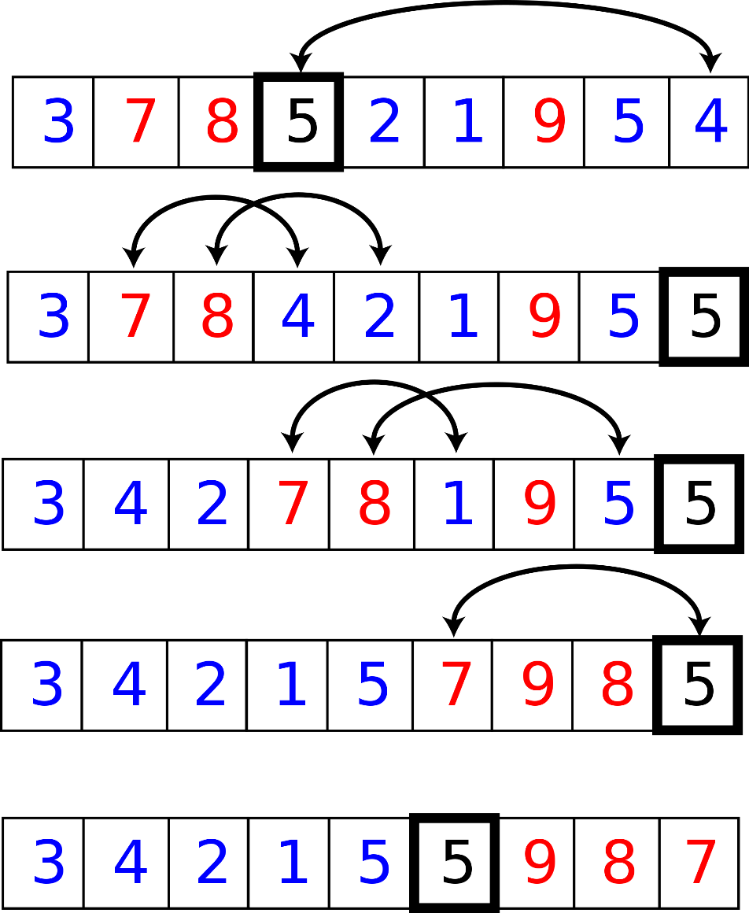
Quick sort
In-place partition operation (Page 87): Move all elements less than the pivot before the pivot those greater than (or equal) after the the pivot, and find the index (position) for the pivot.
Move the pivot to a ‘safe’ place
Search from the beginning of the sub-array and move forward those less than the pivot.
The correct index locates where the last movement occurs
Move the pivot to the correct position

Slide 58
Program
void qsort(int v[], int left, int right)
{
int i, sort_index; //less than 2 elements
if (left >= right) return;
swap(v, right, (left + right) /2); //pick the pivot and move to the last
//Partition process
sort_index = left;
for (i = left; i < right; i++)
{
if (v[i] < v[right])
{
swap(v, sort_index++, i);
}
}
swap(v, sort_index, right);
qsort(v, left, sort_index - 1);
qsort(v, sort_index + 1, right);
}

Slide 59
Recursion summary
Follows the principle of ‘divide and conquer”
Recursive functions can be effectively used to solve problems where solution is expressed in terms of successively applying the same solution to subsets of the problem.
we must have an if statement somewhere to force the function to return without the recursive calling being executed.
Effective to solve the problem and has concise implementation but may not be efficient (in terms of space or time).

Slide 60
Homework
Read Chap 3 through 4
Complete the verification of Goldbach’s conjecture
Exercise 4-1 and 4-2.
Write recursive versions of binary search and GCD.
Generate an array with 50000 or more random integers. Implement bubble, shell, insertion, selection, two versions (recursive and non-recursive) of quick sorting programs, and compare their performance on the array.

