Slide 1
Chap 5: Pointers and Arrays
Lecture3: Pointers and 2D array

Slide 2
Two-dimensional array
Declaration
type array_name [row_size][column_size];
Storage:
int arr[2][3]={{310,275,365},
{10,190,325}};
arr [2 ][ 3 ]
Column 0
[0][0]
Column 1
[0][1]
Column 2
[0][2]
a [ 0 ] [ 0 ]
a [ 0 ] [ 1 ]
Row 0
a [ 0 ] [ 2 ]
310 | 275 | 365
a [ 1 ] [ 0 ]
[1][0] [1][1] [1][2]
a [ 1 ] [ 1 ]
Row 1
10 | 190 | 325
a [ 1 ] [ 2 ]

Slide 3
Initialization
Initialize rows by rows literally
int arr[2][3]={{310,275,365},
{10,190,325}};
Initialize by a 1D sequence
int arr[2][3]={310,275,365,10,190,325};
Default initialization
int k [ ] [ 3 ] = { {1, 2, 3},{ 4, 5, 6},{ 7, 8, 9} } ;
/The first column to 1 and others zeros*/
int n [ ] [ 4 ] = { { 1 }, { 1 }, { 1 } } ;
/*Wrong, the column number is necessary*/
int m [ 3 ] [ ] = { 1, 2, 3, 4, 5, 6 };

Slide 4
Using 2D array
Access elements of a 2D array
array_name [row_ind][column_ind]
Example: arr[0][1], arr[i][j]
The values of row and column indices should be within the bound[0,M-1]and [0,N-1] for a M*N array, respectively.
Can be used in any context where a variable could.
Access the values one by one.
Access operations for arr[i][j]
Obtain the initial row address from initial address of the array
arr[i] ←→*(arr+i)
Obtain the address offset to the initial row address
Access the memory block given by the address.
arr[i][j] ←→
*(
*(arr+i)
+ j
)

Slide 5
Using 2D array
int a[3][4]，i , j ;
for ( i = 0 ; i < 3 ; i ++ )
{ for ( j = 0 ; j < 4 ; j ++ )
scanf(" %d", a[i]+j) ; //&a [ i ] [ j ]
}
for ( j = 0 ; j < 4 ; j ++ )
{ for ( i = 0 ; i < 3 ; i ++ )
printf(“%5d”, a [ i ] [ j ]) ;
// *( *( a +i) +j)
printf(‘\n’) ;
}
a [ 3 ] [ 4 ]
a [ 0 ] [ 0 ]
a [ 0 ] [ 1 ]
a [ 0 ] [ 2 ]
a [ 0 ] [ 3 ]
a [ 1 ] [ 0 ]
a [ 1 ] [ 1 ]
a [ 1 ] [ 2 ]
a [ 1 ] [ 3 ]
a [ 2 ] [ 0 ]
a [ 2 ] [ 1 ]
a [ 2 ] [ 2 ]
a [ 2 ] [ 3 ]

Slide 6
1. 求矩阵的转置
将一个二维数组a行和列元素互换，
存到另一个二维数组b中。exersise4.c
例如：a= 1 2 3 1 4 7
4 5 6 b= 2 5 8
7 8 9 3 6 9

Slide 7
Example for using 2D arrays
Calculate the average points of every courses for a group of students.
赵 钱 孙 李 张
Math 80 61 59 85 76
C 75 65 63 87 77
English 92 71 70 90 85
char name[ ? ][10], courseName[ ][10] ?
int score[3][5];
float avg[3];

Slide 8
Program
int main()
{ int i,j; float sum, float score[3][5]; /*Scores*/
float courseAverage[3]; /*average scores*/
/*Read scores one by one from the keyboard
for(i=0;i<3;i++)
for(j=0;j<5;j++)
scanf("%f",&score[i][j]);
/*Calculate every course*/
for(i=0;i<3;i++)
{
sum=0; /*Initialization for each course*/
for(j=0;j<5;j++) /*Count in all students*/
sum+=score[i][j];
courseAverage[i]=sum/5;
}
}

Slide 9
Exercise
Write a program to multiply two matrices. The column number of a equals the row number of b.
A= [1 2 3 B= [1 2 3 4
4 5 6] 5 6 7 8
9 10 11 12]
C[i,j]+=A[i][k]*B[k][j];

Slide 10
Why do we need 2D arrays
Many data are organized as rows by columns such as matrices, digital images, and Excel worksheets (data table in a relational database).
The data structure for these data can be naturally chosen as 2D arrays.
Easily and naturally access elements by indices, and more importantly 2D arrays have direct access to rows.
arr[i] or *(arr + i)

Slide 11
Pointers and 2D Arrays
Pointer/address and 1D array
Array name iArr_1D is the address of the first element (initial address)
iArr_1D can be assigned to a pointer with the type of element.
iArr_1D + i means offset i element ahead of the initial.
*(iArr_1D +i) access the element
a
......
int a[5]={1,2,3,4,5};
int *pi = a;
pi+3;
*(pi+3)
*(pi+3) ←→ pi[3]
0x0012F78
1
a [ 0 ]
a [ 1 ]
a [ 2 ]
a [ 3 ]
a [ 4 ]
0x0012F7C
2
0x0012F80
3
0x0012F84
4
0x0012F88
5
......
0x0012F74
0x0012F78
pi

Slide 12
Address and 2D Arrays
Address and 1D array
Array name iArr_1D is the address of the first element (initial address)
iArr_1D can be assigned to a pointer with the type of element.
iArr_1D + i means offset i element ahead of the initial.
*(iArr_1D +i) access the element at the address
Address and 2D array
A 2D array can be regarded as one 1D array whose elements are 1D arrays.
Array name iArr_2D is the address of the first element (1D array).
iArr_2D can be assigned to a pointer with the type of element (1D array).
iArr_2D + i means offset i 1D array ahead of the initial (the ith row).
*(iArr_2D+i) obtain the element at the address
←→ the initial address of the ith row
[0][0]
[0][1]
[0][2]
[1][0] [1][1] [1][2]

Slide 13
Pointer to array
arr
Address to a 1D array
int arr[2][3], *p;
p = &arr[0][1] ;
p = arr[1]+2;
int* p = arr + i; ??
Declare a pointer to a 2D array
type_name (*pointer_name)[column_size]
Examples:
int arr[2][3]; int (*pRow)[3] = arr;
arr[0]
arr[0][0]
arr[0][1]
arr[0][2]
arr[1][0] arr[1][1] arr[1][2]
arr[1]
arr+1

Slide 14
Pointer to a 2D array
Declare a pointer to a 1D array
type_name (*pointer_name)[column_size]
Examples:
int arr[2][3];
int (*pRow)[3] = arr;
pRow +1(What’s the type?)
pRow[1] (What’s the type?)
*pRow[1]
*pRow + 1 (What’s the type?)
(*pRow)[1] (What’s the value?)
pRow
arr[0]
arr[0][0]
arr[0][1]
arr[0][2]
arr[1][0] arr[1][1] arr[1][2]
arr[1]
pRow+1

Slide 15
Rewrite the example for average score
int main()
{ int i,j; float sum, float score[3][5]; /*Scores*/
float courseAverage[3]; /*average scores*/
float row_average(float (*p)[5]);/*function declaration*/
/*Read scores one by one from the keyboard
for(i=0;i<3;i++)
for(j=0;j<5;j++)
scanf("%f",&score[i][j]);
/*Call function to Calculate every course (row)*/
for(i=0;i<3;i++)
{
courseAverage[i]=row_average(score+i);
}
}

Slide 16
Sub function
float average(float (*p)[5])
{
int i;
float sum=0;
for(i=0;i<5;i++)
sum+=*(*p+i); /* sum += *p[i]; ??*/
return sum/5;
}

Slide 17
Array of pointers
An array with arr_size elements
Type of elements
Declare a 1D array whose elements are pointers (variables storing addresses)
type_name *array_name[array_size]
Example:
int i = 1, j, k = 10, a[k]={4,5,6,7};
int *ptarr[5]={&i, &k, a, a+i};
Comparing with a pointer to a 1D array
ptarr
......
0x0012F48
0x0012F40
0x0012F00
0x0012F04
0x0000000
......
type_name (*pointer_name)[column_size]
0x0012F00
4
a
int (*pRow)[3] = arr_2d;
......
0x0012F40
10
k
type of the pointer
1
A pointer
0x0012F48
1
i

Slide 18
Array of pointers & 2D array
int main()
{
int iArr[3][4]={1,2,3,4,5,6,7,8,9,10,11,12};
int *pa[3] = {NULL};/*Array of pointers to integers*/
int iRow;
for (iRow = 0; iRow < 3; iRow++)
pa[iRow] = iArr[iRow];
//iArr[0] ←→ *(iArr+0) the address to the first element of the row
for(iRow=0;iRow<3;iRow++)
printf("%d,%d,%d,%d\n",*pa[iRow],*(pa[iRow]+1), *(pa[iRow]+2),*(pa[iRow]+3));
return 0;
}
pa[iRow] = iArr +iRow; ?

Slide 19
Exercise
Find the max string among three C-strings
char str1[20], str2[20], str3[20];
char string[20], *pStr = NULL;
strcpy(str , str1);
if( strcmp(str,str2) < 0)
strcpy(str , str2);
if( strcmp(str, str3) < 0 )
strcpy(str , str3);
puts(str);
pStr = str1;
if( strcmp(str2,pStr)>0 )
pStr = str2;
if( strcmp(str3, pStr)>0 )
pStr = str3;
puts(str);

Slide 20
Exercise
Find the max string among N C-strings
char str1[20], str2[20], str3[20];(?)
char str[20], *pStr = NULL;
char string[N][20];
gets( string[i]);
strcpy(str , string[0]);
for(i=1; i<N;i++ )
if( strcmp(str,string[i])<0 )
strcpy(str , string[i]);
puts(str);
gets( string[i]);
pStr = string[0];
for(i=1; i<N;i++ )
if( strcmp(pStr,string[i])<0 )
pStr = string[i];
strcpy(str, pStr);

Slide 21
Exercise
Find the max string among N C-strings
char* pStr[3]
= {“Shijiazhuang”,“Shenzhen”, “Daqing”;}
pStr[i] = str[i]; //char str[3][N]
char* pMax ＝ pStr[0]; // 指向最大字符串
pStr [ 0 ]
S | h | i | j | i | a | z | h | u | a | n | g
pStr
pStr [ 1 ]
S | h | e | z | h | e | n
pStr[ 2 ]
D | a | q | i | n | g

Slide 22
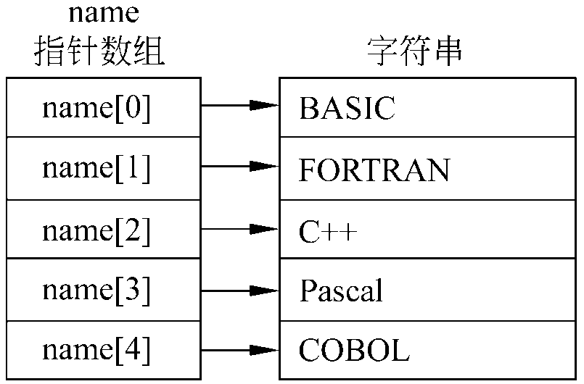
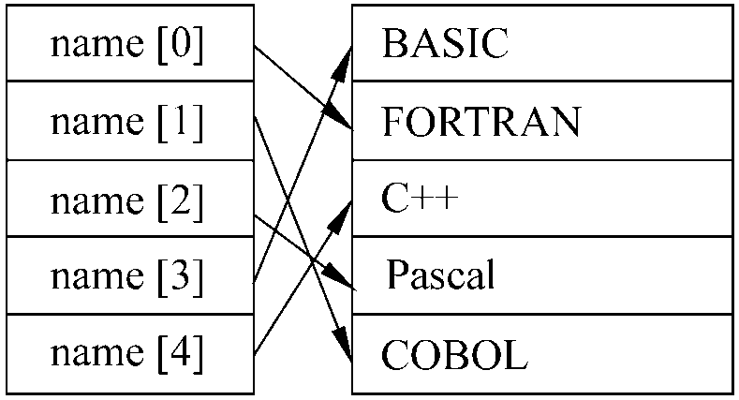
Exercise-sort
Sort five C-strings
″BASIC″,″FORTRAN″,
″C++″,″Pascal″,″COBOL″};
char str[5][ 10] ;
void sort1(char (*p)[10], int n);
char * name[ 5] ;
void sort2(char *p[], int n);

Slide 23
Typical usage of array of pointers
Work as a 2D array with columns of varying length.
An example for an array with fixed column
char name[3][N]= {“China”, “Japan”,“United States”};
Array of pointers
Declare an array of pointers, each pointer pointing to the first element of an array.
These pointed arrays do NOT need to have identical length.
Examples :char *Name[3]= { “China”,“Japan”,“United States”};
This declaration allocate 26 bytes not including the memory for pointers (12 bytes)
Name[0]－>China
Name[1]－>Japan
Name[0]－>United States

Slide 24
Access the elements
Access rows by elements of the array (i.e., pointer to the first element).
Access any single element on the ith row and jth column in the 2D array by name[i][j]
*(name[i] + j)
*(*(name +i) + j)
for( i = 0; i <= m; i++)
{ scanf(“Ns%”, name[i]);
printf(“%s\n”, name[i]); }

Slide 25
Example: arguments of main function
Complete declaration of main function
argc: count of arguments including the program name
argv: an array of pointers to the argument strings separated by white spaces.
Example: project (program) name is myprint, type on the console window (black window)
myprint hello world
argc: passed the value of 3
argv
int main (int argc, const char * argv[])
“myprint”
“hello”
argv
0x0012345
0x0012ABC
0x0012DEF
“world”

Slide 26
Pointer to a pointer
Array name is a constant address of the first element.
Array name of an array of pointers is a constant address of the first pointer (address)
Declaration of a pointer of a pointer
The name of of an array of pointer can be assigned to a pointer to pointer.
type_name **pointer_name;
The pointer points to a pointer
This variable is a pointer

Slide 27
Exercise
What is the value of *ptr and of *(ptr+2) in each case
a. int torf[2][2]={12,14,16};
int *ptr=torf[0];
b. int fort[2][2]={{12},{14,16} };
int *ptr = fort[0];
What is the value of **ptr and of **(ptr+1) in each case
a. int torf[2][2]={12,14,16};
int (*ptr)[2]=torf;
b. int fort[2][2]={{12},{14,16} };
int (*ptr)[2] = fort;

Slide 28
Homework
Write a program to allocate memory for a 2D array with M rows and N columns, where M and N are variables.
We can access the array by a[i][j]

Slide 29
Homework
Write a function that returns the difference between the largest and smallest elements of an array-of-double.
Test the function in a simple program.

Slide 30
Homework
Write a program that prompts the user to enter three sets of five double numbers each.
Store the information in a 3by5 array.
Compute the average of each set of five values.
Compute the average of all the values.
Determine the largest value of the 15 values.
Report the results.
Each major task (b-d) should be handled by a separate function. Accomplish task b by using a function that computes and returns the average of a one-dimensional array; use a loop to call this function three times. The other tasks should take the entire array as an argument, and the functions performing tasks c and d should return the answer to the caller.

