Slide 1
第三次上机

Slide 2
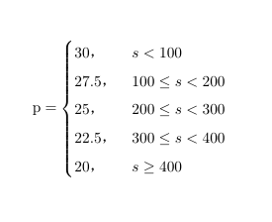
1. Write a program to calculate the freight of the goods, and implement the program with three different choice statements. The freight per ton of unit price p (US dollar) and the distance s (km) have the following relationship: the weight of the goods is w tons, the distance is s km, and calculate the total freight for output. t = p x w x s

Slide 3
2. Enter three integers from the keyboard and output them in ascending order

Slide 4
3. Enter a positive number less than 10,000 and convert it to an uppercase number.

Slide 5
4. Character data can be simply divided into four categories: numbers, uppercase letters, lowercase letters, and other characters. Enter a character from the keyboard and output its type.
（注 ：本题若课堂上未及时完成留作课后作业）

