Slide 1
第五次上机

Slide 2
1. Remove repetitive elements from an array. For example, if a[]={1,1,2,7,3,2,3,4,5,8,7,4}, then the corresponding output is 1,2,7,3,4,5,8.

Slide 3
2. Copy the 20 elements of the 1-d integer array into the 2-d array of 20x2, and store the even and odd numbers in the column 0 and column 1 respectively.

Slide 4
3. There are 5 students in a study group, each student has the exam scores of 3 courses. Calculate the average score of each course and output in ascending order, calculate the average score of each student and output in descending order.

Slide 5
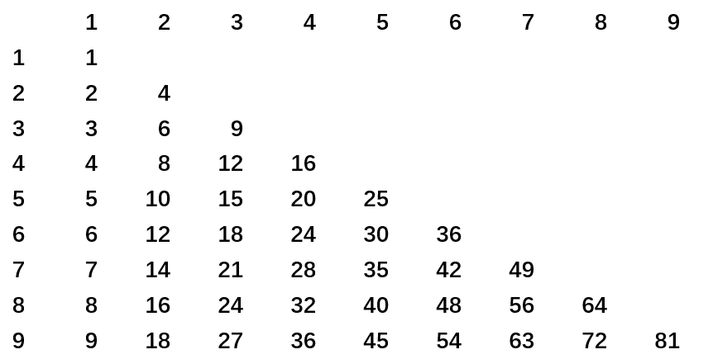
4. Calculate multiplication table and store in an array, then output in following format:

Slide 6
附加题（课后）

Slide 7
1. Combine two ascending order integer arrays a and b into one ascending order integer array c.

Slide 8
2. Matrix multiplication
Precondition: The number of columns of A is equal to the number of lines of B
Then C[i][j]+=A[i][k]*B[k][j]; k=0,1,…,M-1

