Slide 1

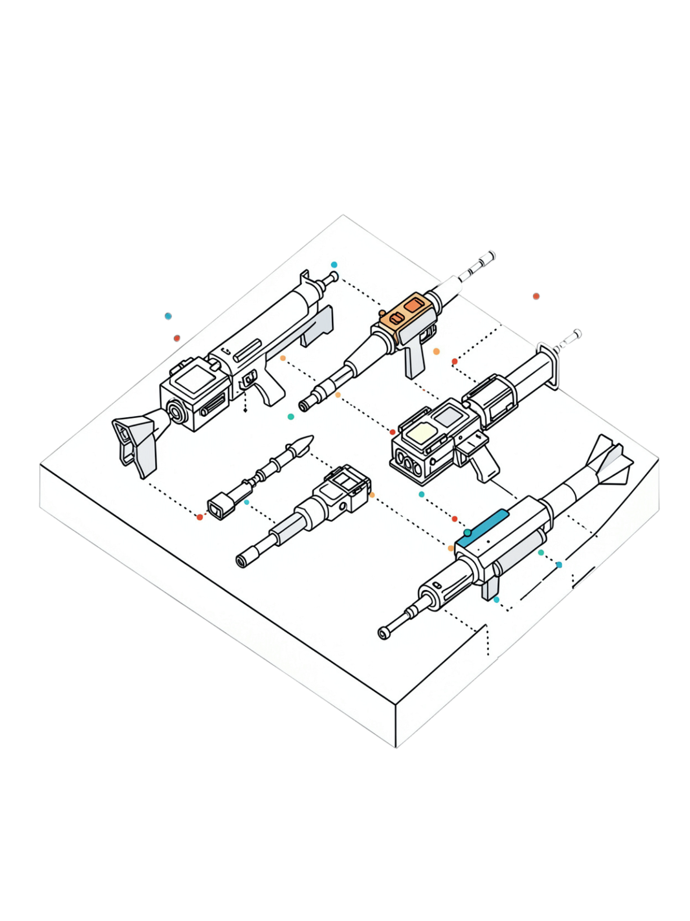

Cold War Armory
NATO vs Warsaw Pact — Final Python Project
Aura Narendra .M

Slide 2

About the Developer
Aura Narendra .M
Beginner Python Developer focused on programming fundamentals and problem-solving
Dual Interests
Passionate about Cold War history and military-themed game design
This Project
Combines both interests into a focused, functional armory subsystem

Slide 3
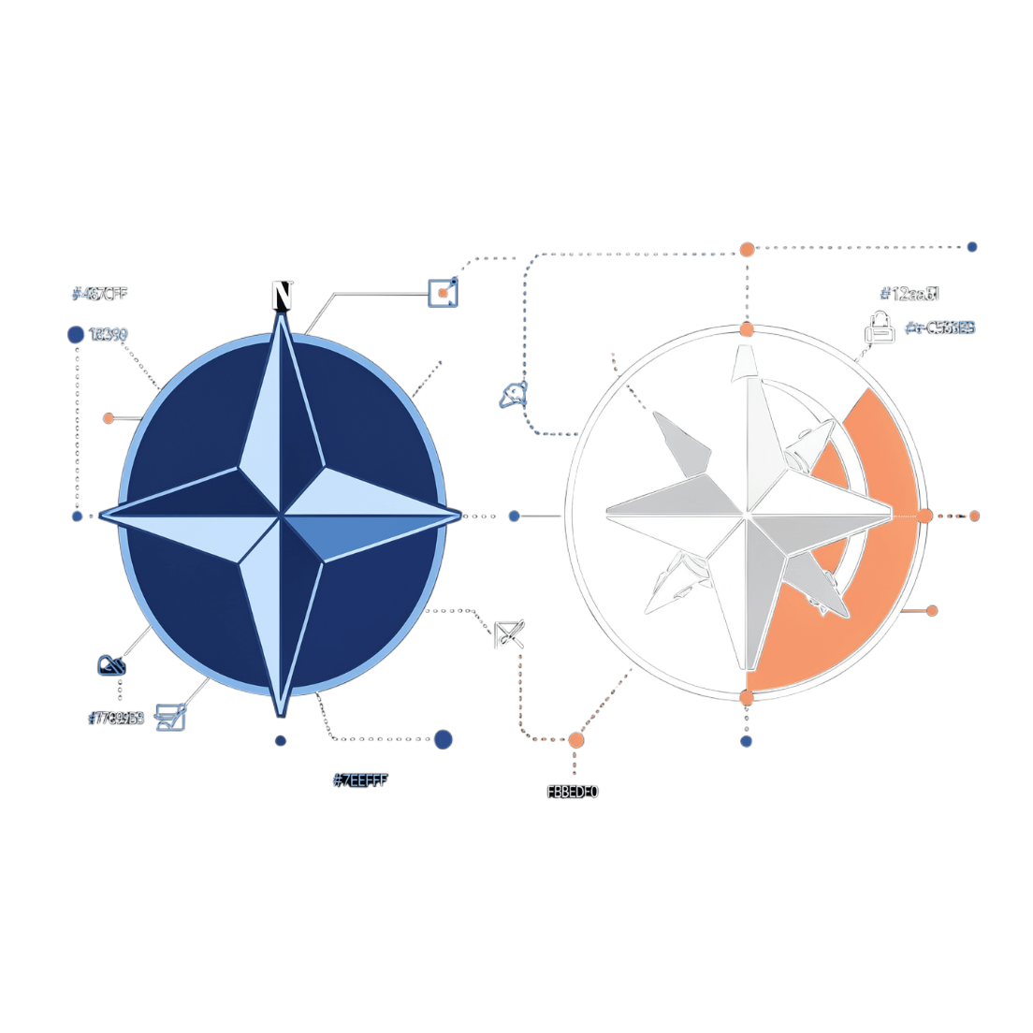
Why "Cold War Armory"?
Applies Python programming concepts to a focused weapon-armory system
Inspired by NATO and Warsaw Pact equipment from the Cold War era
Project scope: armory subsystem only — not a full game
Demonstrates how core Python concepts build a functional, interactive system

Slide 4

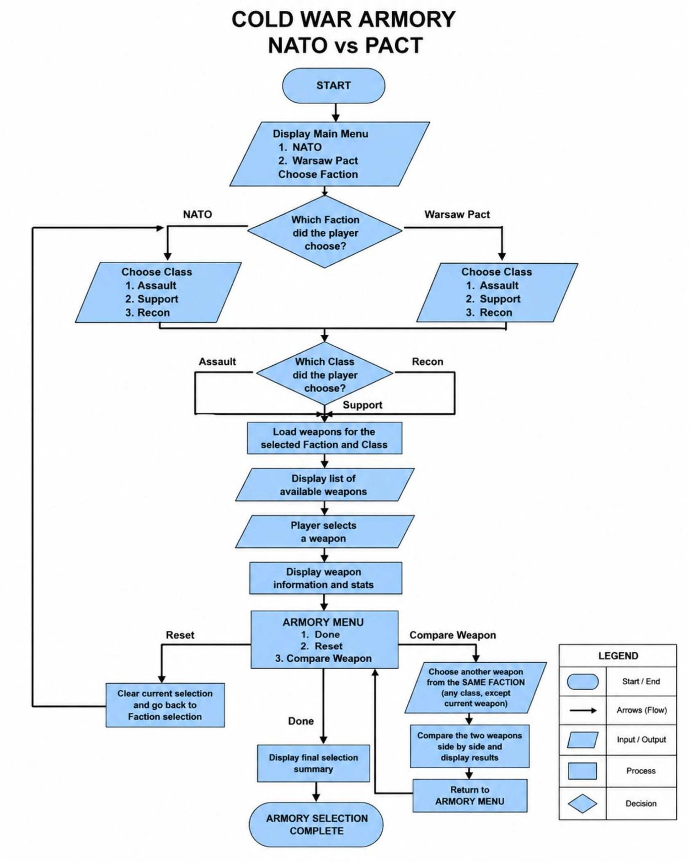
Application Flowchart
The flowchart shows the complete logic of the Cold War Armory system, from selecting a faction to finalizing a weapon. The user first chooses between NATO and the Warsaw Pact, then selects a weapon class: Assault, Support, or Recon. The system loads and displays the weapons available for that faction and class, allowing the user to select a weapon and view its detailed information and statistics.
After viewing the selected weapon, the user enters the Armory Menu, which provides three options: Done, Reset, or Compare Weapon.
Done displays a final summary of the selected nation, class, and weapon, then ends the program.
Reset clears the current selection and returns the user to faction selection.
Compare Weapon allows the user to choose another weapon from the same faction, regardless of its class. The two weapons are then compared side by side, after which the user returns to the Armory Menu with the original selection preserved.

Slide 5

How the Program Started
Original Data Structure
Example Structure
Weapon data was initially stored as nested dictionaries in Python, organized by Faction → Class → Weapons → Weapon information.
weapons = {
"NATO": {
"Assault": [
{
"name": "M16A1",
"year_design": 1957,
"caliber": "5.56x45mm",
...
}
]
}
}
This approach kept all data and logic in a single file — a natural beginner starting point before file processing was introduced.

Slide 6



File Processing: Data Separation
External File
Parse & Convert
Create Objects
weapons.txt stores all weapon records, one per line
Python reads each line, separates fields using |, and converts numeric values
Parsed weapon data is passed into the Weapon class to create a weapon object.
weapons.txt line
load_weapons() function
NATO|Assault|M16A1|1957|5.56x45mm|Semi / Burst|72|88|80|75|20|2.4|35|3.6|A lightweight service rifle...
for line in file:
data = line.strip().split("|")
weapon = Weapon(
data[2],
int(data[3]),
data[4],
data[5],
...
)

Slide 7
OOP: Class and Object
The Weapon Class
Weapon Class
M16A1 Object
class Weapon:
def __init__(self,
name,
year_design,
caliber,
firing_mode,
damage,
accuracy,
range,
rate_of_fire,
magazine_capacity,
reload_time,
recoil,
weight,
description):
self.name = name
self.damage = damage
self.caliber = caliber
Blueprint defining shared structure
NATO · Assault · damage 72
FN FAL Object
AKM Object
NATO · Assault · damage 80
Warsaw Pact · Assault · damage 75
SVD Object
Warsaw Pact · Recon · damage 88
A class is the blueprint for creating objects. An object is an individual weapon instance created from that blueprint.

Slide 8
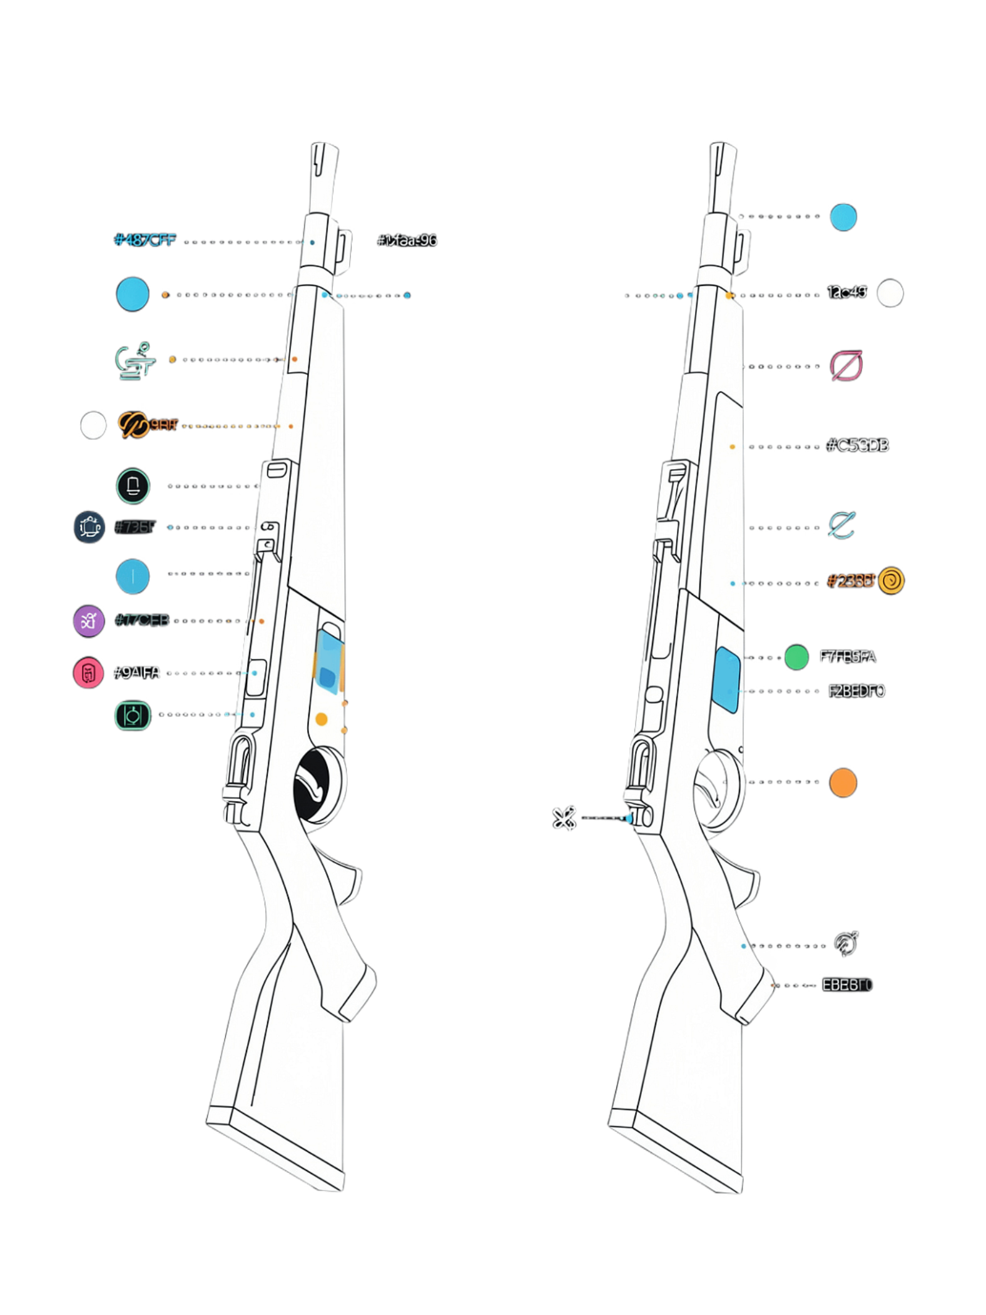
OOP: Behavior and Methods
show_info()
Displays the weapon's own information — name, caliber, damage, accuracy, and other attributes.
compare(other_weapon)
Compares two Weapon objects side by side and displays their statistics for easy comparison.
Encapsulation
Encapsulation was studied and experimentally tested, but it was not forced into the final implementation because the current Armory did not require additional access control for its weapon statistics.

Slide 9
Final Result
1
2
External Weapon Database
OOP Implementation
Weapon records are loaded from weapons.txt using file processing.
The Weapon class creates weapon objects and provides show_info() and compare() methods.
3
4
Armory Menu
Focused Scope
Done, Reset, Compare Weapon — supports same-faction weapon comparisons across any class.
The final project remains a focused Cold War Armory subsystem rather than a full game.
The project demonstrates how Python concepts combine into a focused and functional Cold War Armory system.

