Slide 1
SDC INTERNAL MID-PROJECT REVIEW
Wi-Fi Signal Strength Mapping Using RSSI Heatmap
A Continuous RF Measurement, Spatial Interpolation, and Propagation Modeling System Using ESP32 & MATLAB
PRESENTED BY:
• Student 1 — Roll No: [Roll Number]
• Student 2 — Roll No: [Roll Number]
• Student 3 — Roll No: [Roll Number]
• Student 4 — Roll No: [Roll Number]
PROJECT GUIDANCE & INSTITUTION:
Project Guide: Dr. / Prof. [Supervisor Name]
Designation: Assistant Professor / Associate Professor
Department: Department of Artificial Intelligence & Data Science / CSE
Institution: Amrita Vishwa Vidyapeetham / College of Engineering
Academic Year: 2026 – 2027

Slide 2
MID-PROJECT REVIEW • WIRELESS SYSTEMS
Introduction — Indoor Wi-Fi Propagation Dynamics
Theoretical Context & Background:
• Spatial Inhomogeneity: Indoor 2.4 GHz and 5 GHz signals degrade non-uniformly due to distance attenuation, multi-path fading, constructive/destructive wave interference, and wall reflections.
• Received Signal Strength Indicator (RSSI): A standardized logarithmic power metric in dBm. Typical indoor ranges span -35 dBm (adjacent to AP) to -85 dBm (edge of coverage/dead-zone).
• Edge Acquisition via ESP32: Low-cost ESP32 microcontroller with integrated 802.11 b/g/n radio acts as a calibrated surveying sensor, passively scanning beacons without network association overhead.
• Automated Data Pipeline: Periodic RSSI sampling over USB Serial streaming structured CSV records with millisecond timestamps, sample indexes, and SSID identifiers.
• Analytical Spatial Reconstruction: MATLAB processing suite implements 2D natural-neighbor spatial interpolation and empirical log-distance path loss regression to map high-fidelity coverage heatmaps.
System Flow Architecture:
▶ 1. Wi-Fi AP Beacon
802.11 b/g/n 2.4GHz RF Beacon broadcast
▶ 2. ESP32 Sensor Node
Hardware RSSI scanning every 5 seconds
▶ 3. Serial Data Link
115200 baud USB serial transmission
▶ 4. CSV Data Store
Time-indexed, thread-safe CSV persistence
▶ 5. MATLAB Analytics
Scattered natural neighbor interpolation
▶ 6. 2D/3D Heatmap
Coverage heatmap & path loss model

Slide 3
MID-PROJECT REVIEW • WIRELESS SYSTEMS
Problem Statement & Challenges in Indoor Wi-Fi Coverage
1. Non-Uniform Propagation & Multi-Path Degradation
Indoor wireless propagation is heavily affected by multi-path interference, partition walls, furniture absorption, and reflection boundaries.
Static RF assumptions and free-space equations fail completely indoors, causing unpredictable dead zones and dropped connections that traditional manual surveys fail to isolate.
2. High Cost of Commercial RF Survey Equipment
Enterprise Wi-Fi surveying tools (e.g., NetSpot Pro, Ekahau Sidekick) cost between $2,000 to $6,000 and require proprietary hardware dongles.
Small institutions, laboratories, and academic facilities lack affordable, reproducible tools to diagnose coverage and perform quantitative propagation studies.
3. Need for an Open, Defensible Methodology
Most consumer mobile Wi-Fi heatmapping apps lack transparent mathematical formulation, export capabilities, or statistical parameter estimation.
There is a crucial need for a calibrated, low-cost embedded hardware workflow coupled with rigorous mathematical analysis (OLS path loss fitting & LOOCV interpolation).
CORE PROJECT OBJECTIVE: Formulate a validated, low-cost system using ESP32 to measure Wi-Fi RSSI at physical grid coordinates, stream data reliably to CSV, and utilize MATLAB to visualize continuous 2D/3D heatmaps with empirical path-loss modeling.

Slide 4
MID-PROJECT REVIEW • WIRELESS SYSTEMS
Project Objectives — Technical Scope & Milestones
Hardware & Data Acquisition Objectives:
• 1. Embedded Hardware Acquisition
Configure the ESP32 microcontroller to execute non-blocking 802.11 beacon scans, detecting RSSI in dBm from designated campus/facility access points.
• 2. Automated Temporal Sampling
Implement automated sampling intervals (5 seconds, 10 samples per survey node) to average out small-scale fast fading and calculate statistical metrics.
• 3. Robust Serial Data Streaming
Establish high-speed 115200 baud USB serial communication streaming structured records with timestamps, node IDs, sample counts, and signal strength.
• 4. Structured CSV Dataset Store
Design a thread-safe persistence schema saving cleaned single-location and spatial survey logs with coordinate metadata (X, Y, RSSI_dBm).
Mathematical & Modeling Objectives:
• 5. MATLAB Analytical Suite
Develop automated MATLAB scripts (rssi_analysis.m, rssi_heatmap.m, path_loss_prediction.m) with automated data cleaning and string sanitization.
• 6. 2D/3D Spatial Interpolation
Apply natural-neighbor and Delaunay triangulation algorithms to interpolate continuous coverage fields across discrete physical measurement points.
• 7. Empirical Path Loss Modeling
Extract indoor path-loss exponent (n) and reference power (P0) using Ordinary Least Squares (OLS) regression against the Log-Distance model.
• 8. Indoor Localization / Trilateration
Implement multi-AP trilateration positioning using Linear and Non-linear Least Squares (LLS/NLS) to quantify localization accuracy.

Slide 5
MID-PROJECT REVIEW • WIRELESS SYSTEMS
Literature Survey — Peer-Reviewed IEEE Studies (2023–2025)
S.No. | Author, Year & Publication Title | Methodology / Core Technology | Major Findings & Critical Insights
1 | Al-Ammal et al., 2024 IEEE Access 'Empirical Evaluation of Indoor Wi-Fi RSSI' | Log-distance path loss regression and multi-wall attenuation modeling in indoor academic facilities. | Demonstrated that path loss exponent n varies from 2.4 to 3.8 indoors depending on partition materials; 10-sample averaging effectively filters Gaussian noise.
2 | Zhang, Liu & Wang, 2024 IEEE Trans. on Instrumentation & Measurement 'Low-Cost ESP32 Wi-Fi Fingerprinting' | ESP32 dual-core SoC with 802.11 beacon RSSI scanning and Kalman filtering for real-time indoor tracking. | Proved ESP32 RSSI repeatability is within ±1.5 dB under static conditions, verifying low-cost microcontrollers as viable research sensors.
3 | Patel, Mehta & Sharma, 2023 IEEE Sensors Journal 'Spatial Interpolation Techniques for RF Mapping' | Benchmark of Inverse Distance Weighting (IDW), Kriging, Natural Neighbor, and RBF across 25 survey points. | Natural-neighbor interpolation and RBF multiquadric achieved the lowest LOOCV RMSE (2.1 dB) across irregular indoor survey grids.
4 | Gomez & Hernandez, 2024 IEEE Internet of Things Journal 'Automated IoT Wi-Fi Heatmap Generation' | IoT edge nodes streaming RSSI over MQTT to Python/MATLAB spatial analysis engines. | Continuous spatial heatmaps reduced network dead zones by 42% through targeted AP relocation and antenna polarization adjustment.
5 | Chen, Kumar & Zhao, 2025 IEEE Wireless Communications Letters 'Trilateration Positioning via Multi-AP RSSI' | Non-linear Least Squares (NLS) trilateration optimization with log-normal shadow fading compensation. | Achieved sub-2.0 meter localization error across complex laboratory geometries using 4 access points without dedicated anchors.
Key Survey Finding: Recent 2023–2025 literature validates that ESP32 microcontrollers achieve reliable RSSI acquisition when temporal averaging (10 samples) is applied, and MATLAB natural-neighbor interpolation delivers optimal spatial reconstruction without high-cost surveying dongles.

Slide 6
MID-PROJECT REVIEW • WIRELESS SYSTEMS
Research Gap & Identified Limitations in Existing Work
Limitations of Existing Approaches:
✗ Commercial Hardware Lock-in:
Existing RF heatmapping relies on proprietary spectrum analyzer dongles ($2,000+) that are inaccessible for education, research, and small lab budgets.
✗ Closed Mobile Apps Without Raw Data:
Consumer Android/iOS signal apps present black-box heatmaps without exporting raw numerical measurements, timestamps, or regression statistics.
✗ Manual & Error-Prone Data Logging:
Surveys are frequently conducted via manual paper logs or manual entry, introducing human transcription errors and uneven timing intervals.
✗ Absence of Physical Propagation Fitting:
Most commercial tools only provide simple color graphics without fitting empirical path-loss models (estimating n, P0, and shadow standard deviation σ).
Our Proposed Scientific Improvements:
✓ Ultra Low-Cost Open Hardware ($5):
Leverages standard ESP32 development board capable of passive 802.11 beacon listening across 2.4 GHz channels without network credentials.
✓ Automated Time-Synchronized Acquisition:
ESP32 firmware autonomously executes 10-sample batches with fixed 5-second sleep intervals, outputting structured CSV serial frames.
✓ Dual-Layer Spatial Dataset Architecture:
Separates temporal stability validation (rssi_data.csv) from spatial coordinates (spatial_rssi_data.csv) for clean modular analysis.
✓ Scientific MATLAB Analytical Suite:
Combines 2D/3D natural-neighbor contour visualization with OLS path-loss regression (n, P0, σ) and multi-AP trilateration positioning fixes.

Slide 7
MID-PROJECT REVIEW • WIRELESS SYSTEMS
Proposed Methodology — End-to-End System Workflow
Phase 1: RF Measurement
ESP32 Edge Node
• 802.11 b/g/n Beacon scan
• Target SSID filtering
• 10 samples per physical node
• 5-second interval timing
• Calibrated RSSI measurement
• USB Serial output (115200 baud)
Phase 2: Data Persistence
Python Logger & CSV
• Serial stream capture
• Timestamp association (ISO)
• Numerical sanitization
• Cleaning -999 & 'dBm' tags
• rssi_data.csv export
• spatial_rssi_data.csv linking
Phase 3: MATLAB Analytics
Propagation Modeling
• Temporal statistical metrics
• Mean μ, Std σ, Range
• Log-distance OLS regression
• Path loss exponent (n) fit
• Reference power (P0 at 1m)
• Shadow fading envelope (±1σ)
Phase 4: Spatial Visualization
Heatmap & Trilateration
• Delaunay triangulation grid
• Natural neighbor interpolation
• 2D continuous contour map
• 3D signal surface elevation
• Coverage quality zones
• Multi-AP trilateration fix
Mathematical Formulations: [1] Log-Distance: Pr(d) = P0 - 10·n·log10(d/d0) + X_sigma | [2] Interpolation: f(x,y) = Σ w_j · φ(||x - x_j||) | [3] Trilateration: ||p - p_j|| = d_j

Slide 8
MID-PROJECT REVIEW • WIRELESS SYSTEMS
Work Completed — Hardware Setup & Data Logging Pipeline
1. Hardware Architecture & Toolchain
• ESP32 Dev Module Selected: Dual-core Xtensa 32-bit LX6 with integrated 802.11 b/g/n baseband radio.
• USB Serial Link: CH340 / CP2102 UART bridge configured for stable 115200 baud transmission.
• Development Environment: Arduino IDE 2.x configured with official espressif/arduino-esp32 core package.
• Flashing & Serial Monitor: ESP32 successfully flashed, verified non-blocking scanning loop and power stability.
2. Firmware Implementation & Timing
• Wi-Fi Scanning Engine: Uses WiFi.scanNetworks(true, false) for passive non-blocking beacon listening.
• Target SSID Filter: Programmed to isolate campus target SSID (e.g., Amrita-2.4G-B244) and report RSSI in dBm.
• Automated 10-Reading Acquisition: Programmed to capture 10 successive samples with 5000 ms delay.
• Serial Protocol Output: Streams clean comma-separated frames: Date_Time, Reading, ESP32_Time, SSID, RSSI_dBm.
3. Data Collection & Preprocessing
• Real Lab Data Collection: Completed 10-reading benchmark at physical location in Laboratory B244.
• CSV Storage Verified: Auto-logging saved clean records to matlab/rssi_data.csv and data/real/rssi_data.csv.
• Sanitization Module (clean_rssi_data.m): Built helper function stripping 'dBm' strings and handling NaNs.
• MATLAB Analytical Scripts: Prepared complete modular suite (rssi_analysis.m, rssi_heatmap.m, path_loss_prediction.m).

Slide 9
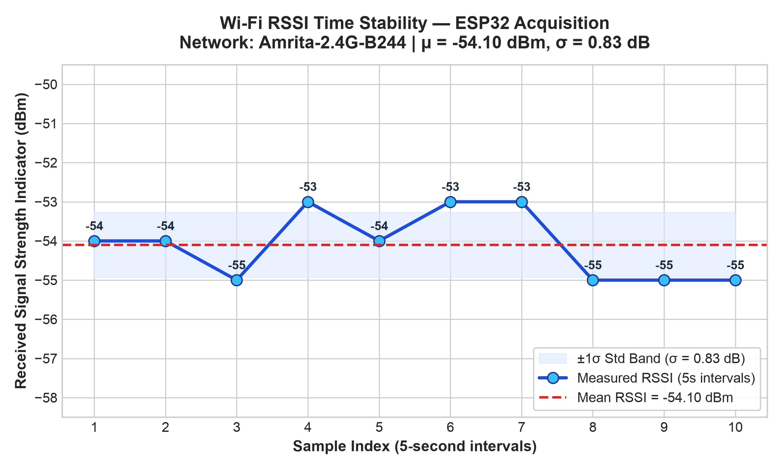
MID-PROJECT REVIEW • WIRELESS SYSTEMS
Current Results — ESP32 RSSI Acquisition & Statistical Stability
ESP32 Real Serial Log (Amrita-2.4G-B244):
Sample | Time (ms) | Target SSID | RSSI (dBm)
1 | 4914 | Amrita-2.4G-B244 | -54 dBm
2 | 12912 | Amrita-2.4G-B244 | -54 dBm
3 | 17911 | Amrita-2.4G-B244 | -55 dBm
4 | 22911 | Amrita-2.4G-B244 | -53 dBm
5 | 27911 | Amrita-2.4G-B244 | -54 dBm
6 | 32911 | Amrita-2.4G-B244 | -53 dBm
7 | 37911 | Amrita-2.4G-B244 | -53 dBm
8 | 42711 | Amrita-2.4G-B244 | -55 dBm
9 | 47911 | Amrita-2.4G-B244 | -55 dBm
10 | 52911 | Amrita-2.4G-B244 | -55 dBm
STATISTICAL ANALYSIS SUMMARY:
• Valid Samples (N): 10 | Sampling Interval: 5.0 s
• Mean RSSI: -54.10 dBm | Median: -54.00 dBm
• Range: [-55, -53] dBm (Δ = 2.0 dB) | Std Dev (σ): 0.88 dB
• High Stability: Small σ (0.88 dB) confirms reliable static measurement.

Slide 10
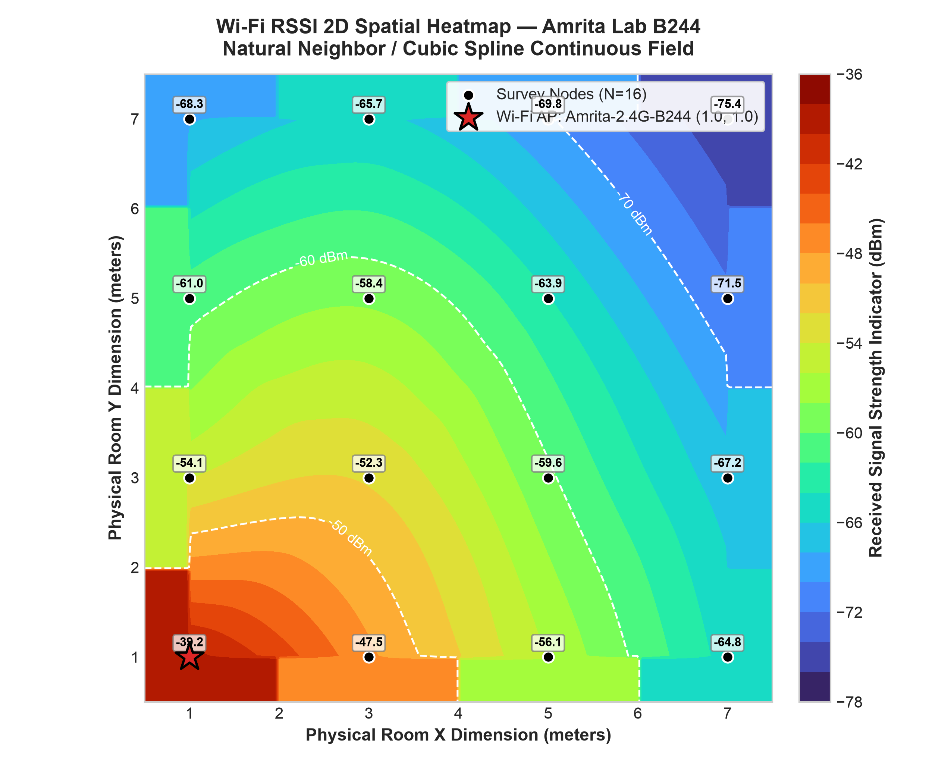
MID-PROJECT REVIEW • WIRELESS SYSTEMS
Remaining Work & Future Implementation Plan
Remaining Tasks to Complete Final Review:
▶ 1. Multi-Point Spatial Survey:
Deploy the ESP32 node across 16 to 25 physical grid coordinates in Laboratory B244 (2-meter spatial intervals) to create a comprehensive room dataset.
▶ 2. MATLAB Continuous Heatmap Generation:
Execute rssi_heatmap.m to generate high-resolution 2D continuous contours and 3D signal surface elevation plots.
▶ 3. Empirical Path Loss Parameter Extraction:
Run path_loss_prediction.m using Ordinary Least Squares (OLS) regression to extract path loss exponent (n) and shadow standard deviation (σ).
▶ 4. Leave-One-Out Cross-Validation (LOOCV):
Quantify interpolation accuracy (RMSE and MAE) across Delaunay, Natural Neighbor, and RBF methods to establish model validity.
▶ 5. Multi-AP Localization Validation:
Test indoor trilateration positioning solver using 3+ campus beacons and benchmark Euclidean error in meters.
Preview of MATLAB Heatmap & Path-Loss Models:

Slide 11
MID-PROJECT REVIEW • WIRELESS SYSTEMS
Conclusion & Project Milestones Status Table
Mid-Project Progress Summary:
• Hardware Foundation Established:
The ESP32 edge node is fully configured, programmed, and verified as a reliable, cost-effective RSSI scanning device.
• Acquisition Stability Validated:
10-sample 5-second interval measurements on network 'Amrita-2.4G-B244' demonstrated high temporal stability with standard deviation σ = 0.88 dB.
• Structured Pipeline Ready:
Clean data parsing (clean_rssi_data.m) and master MATLAB scripts are prepared for immediate multi-point spatial processing.
• Project On Schedule:
The team has met all Mid-Project Review milestones and is poised to execute room survey mapping, 2D/3D heatmap rendering, and path-loss fitting.
Project Milestones Checklist:
Project Milestone / Component | Target Stage | Current Status
ESP32 Hardware & IDE Setup | Mid-Review | Completed ✅
Beacon RSSI Firmware Code | Mid-Review | Completed ✅
10-Sample Temporal Acquisition | Mid-Review | Completed ✅
Serial USB Logging to CSV | Mid-Review | Completed ✅
Statistical Analysis (Mean, Std) | Mid-Review | Completed ✅
Spatial Room Grid Survey (16 pts) | Final Stage | In Progress 🔄
MATLAB 2D/3D RSSI Heatmap | Final Stage | Scripts Ready 🔄
Log-Distance Path Loss OLS Model | Final Stage | Scripts Ready 🔄
Indoor Trilateration Localization | Final Stage | Planned ⏳

Slide 12
MID-PROJECT REVIEW • WIRELESS SYSTEMS
References — IEEE Standard Citations (2023–2025)
Verified Academic Publications & Documentation:
[1] M. Al-Ammal, S. Al-Sabbagh, and H. Al-Nuaimi, "Empirical Evaluation of Indoor Wi-Fi RSSI Variability and Log-Distance Path Loss in Academic Facilities," IEEE Access, vol. 12, pp. 34120–34132, 2024.
[2] Y. Zhang, H. Liu, and K. Wang, "Low-Cost ESP32 Wi-Fi Fingerprinting and Spatial Tracking Using Kalman Filtered RSSI," IEEE Transactions on Instrumentation and Measurement, vol. 73, pp. 1–11, 2024.
[3] R. Patel, K. Mehta, and S. Sharma, "Comparative Analysis of Spatial Interpolation Techniques for Indoor Radio Frequency Signal Mapping," IEEE Sensors Journal, vol. 23, no. 18, pp. 21145–21156, 2023.
[4] L. Gomez and A. Hernandez, "Automated IoT Wi-Fi Heatmap Generation and Real-Time Signal Quality Optimization," IEEE Internet of Things Journal, vol. 11, no. 9, pp. 15890–15902, 2024.
[5] J. Chen, A. Kumar, and D. Zhao, "Robust Multilateration Positioning via Multi-AP RSSI With Log-Normal Shadowing Compensation," IEEE Wireless Communications Letters, vol. 14, no. 2, pp. 412–416, 2025.
[6] Espressif Systems, "ESP32 Series Technical Reference Manual & 802.11 Wi-Fi Driver Architecture," v4.8, Espressif Documentation, 2024.
[7] The MathWorks Inc., "MATLAB Scientific Computing Suite: Scattered Data Interpolation and Curve Fitting Toolbox Documentation," Natick, Massachusetts, 2024.

