Slide 1


DAYANANDA SAGAR COLLEGE OF ENGINEERING
An Autonomous Institute affiliated to VTU, Belagavi – 590018, Approved by AICTE & ISO 9001:2008 Certified
Accredited by National Assessment & Accreditation Council (NAAC) with 'A' grade & NBA
DEPARTMENT OF ELECTRICAL & ELECTRONICS ENGINEERING
ANTI-SUICIDAL CEILING FAN
Under Bachelor of Engineering in Electrical & Electronics
Presented by
Names:
Basavaraj S Sajjan
Kavana P
Meghana N Rao
Narana Gowda A
USN:
1DS19EE016
1DS19EE039
1DS19EE049
1DS19EE051
Under the guidance of
Rachana M Hullamani
Assistant Professor
Department of EEE

Slide 2
Abstract
Introduction
Problem identified
Need for solution
Literature survey
Design constraints
Block Diagram
Components used
Working principle
Advantages
Contents

Slide 3

Abstract
Suicide is a critical issue in the modern society. While the link between suicide and mental disorders (in particular depression), is well established in high income countries. Many suicides happen impulsively in moment of crisis with a breakdown in ability to deal with the life stresses.
The main idea of the project is to prevent suicide by hanging from ceiling fan. The early detection and prevention of this issue should be addressed to save one's life. The theme of the project comes under the health care domain of work.
So we demonstrate this concept by building an anti-suicidal fan which prevents death by hanging.

Slide 4
Introduction
The intersection of health care and engineering helps in improving the lives of many people all over the world. Electrical engineers are responsible for providing industries throughout the world involved with the medical, industrial, military etc., with the solutions they need in order to continue the engineering advancements.
Rapidly advancing technology has put electronic devices at the centre of modern health care. Although electrical engineering in the medical field has come a long way, looking to further advancements.

Slide 5

Problem Identified
Suicide rates in India have been rising over the past five decades. In 2016, suicide was the most common cause of death in both the age groups of 15-29 years and 15-39 years.
India has registered nearly 2% of rise in committing suicide by hanging from 2018-2019.
According to the latest report and national crime records bureau (NCRB) 2019, 53.6% of total cases of suicide in 2019 were committed by resorting to the mean of hanging.
In 2019, 74,629 persons committed suicide by hanging themselves to roofs or other support system.

Slide 6

Need for Solution
Our project helps in saving people from dying by hanging from ceiling fan. Our main idea is – The spring which we attach between the motor and the down rod, should expand, making the person hanging, land on ground safely.
This prevents the person from dying. Besides this, a message will be sent to the hostel warden or the concerned persons.
Students not living under the supervision of their parents, who live in hostels and who are facing depression might get suicidal thoughts, when staying alone. They might choose to hang themselves from the ceiling fan.
They can be saved from dying, with the installation of this device through a spring and automatic message delivery technique.

Slide 7
Literature Survey
Raghavendra S Narsapura, Basavaraj P Hiremath and Dr. B M Jayadevappa presented a paper - "A Novel Approach On Ceiling Fan Based System To Avoid Suicide By Hanging". This paper provides insight on the prototype model which can be designed using structured modelling in Real Time Systems.
Kishan Kariippanon, Coralie J. Wilson, Timothy J. McCarthy and Kairi Kolves, presented a paper - "A Call For Preventing Suicide By Hanging From Ceiling Fans: An Interdisciplinary Research Agenda". This paper provides insight on the modification of ceiling fan to primarily focus on global mental health.

Slide 8
Design Constraints
This project needs a load sensor to sense the weight, applied on the fan. The load sensor used in this project is a 5 Kg load sensor.
The project must have a spring to land the person safely on the ground. So, a spring is used in between the down rod and the rotor of the fan.
A relay model is used to generate signal, based on the sensed weight. This signal is sent to the Arduino NANO.
An Arduino NANO in conjunction with a GSM, is required to send a message to the concerned persons.

Slide 9
Block Diagram
Bulk weight on fan
Sensing and signal generation
Signal from sensor to relay model
Sending message to the concerned person
Expansion of spring

Slide 10
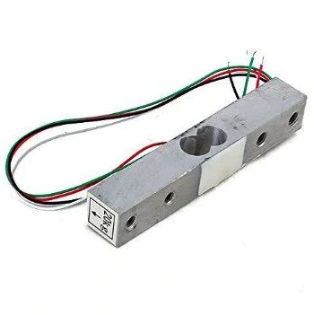
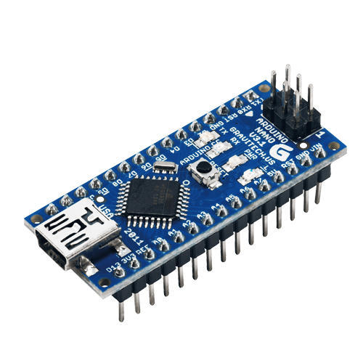
Prototype
Load Sensor
Arduino NANO
Spring
Fan (model)
Load

Slide 11

Working Principle
A spring will be connected between the down rod and the rotor of the fan.
A load sensor will be used to sense the load on the fan.
When a bulk weight is subjected on the ceiling fan, the tension on the ceiling fan increases and the load sensor senses the bulk weight.
If the load on the ceiling fan is greater than the maximum weight, the spring expands.
The expanded spring ensures that the person lands to the ground safely.
At the same time, a message will be sent to the concerned person with the help of GSM.

Slide 12
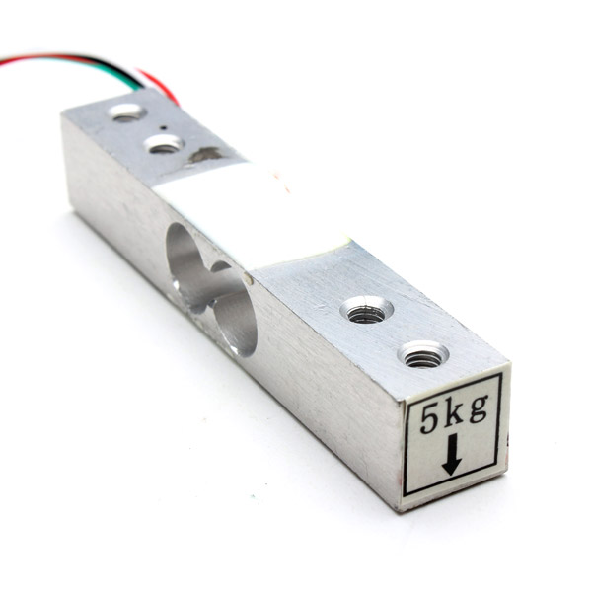
Components used
Load Sensor: A load sensor (more commonly referred to as a "load cell"), is an electronic device that converts tension and compression forces into a corresponding electrical signal. In our project, we will be using a 5Kg load sensor.
Arduino NANO: The Arduino Nano is a small, complete, and breadboard-friendly board based on the ATmega328 (Arduino Nano 3.x).It's a perfect micro controller to learn hobby electronics and programming on, and its size makes it excellent for building into projects which require a small form factor.

Slide 13
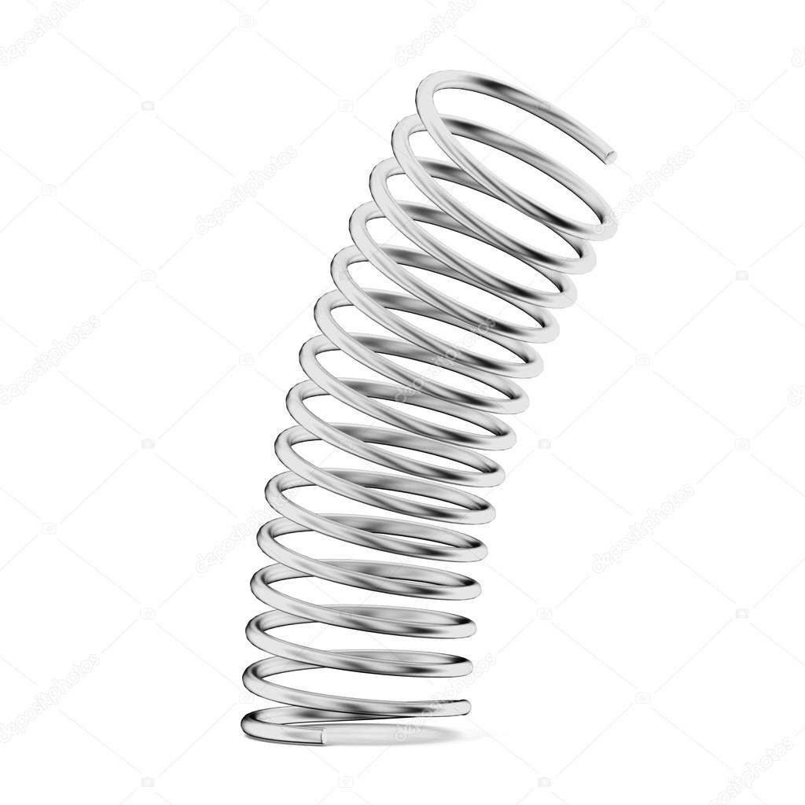
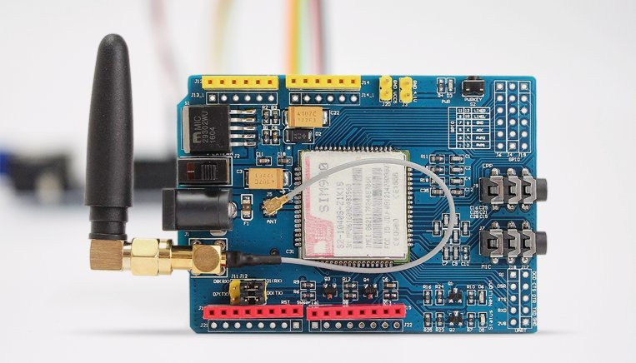
Components used
Spring: A spring is used to ensure the safe landing of the person trying to hang, land safely on the ground.
GSM: Global system for mobile communication is an international standard for digital cellular communication. In our project, GSM will be used to send message to the concerned persons.

Slide 14

Work completed as of now
As of now, the load sensor has been tested. The load sensor senses the weight of the load and this measured value is displayed on the LCD.
Load Sensor
LCD
Load

Slide 15

Advantages
Our project will be helpful for the public with respect to healthcare.
With installation of our innovation, death by hanging can be reduced at least by a few numbers.
Colleges can ensure safe hostels to their students and give assurance to their parents as well.
The automatic message delivery technique can be useful for the hostel wardens to save the victim.
Besides being obligatory for public healthcare, this innovation is economic.

Slide 16
Conclusion
Our project will be helpful for the public with respect to healthcare.
Parents who send their teenage kids to other cities or states, for education purpose or any other reasons, can stay relieved by knowing that the death prevention innovation is installed in the fans of the respective hostels, where their kids are accommodated.

Slide 17

References
"A Novel Approach On Ceiling Fan Based System To Avoid Suicide By Hanging". Raghavendra S Narsapura, Basavaraj P Hiremath and Dr. B M Jayadevappa presented a paper - This paper provides insight on the prototype model which can be designed using structured modelling in Real Time Systems.
Kishan Kariippanon, Coralie J. Wilson, Timothy J. McCarthy and Kairi Kolves, presented a paper - "A Call For Preventing Suicide By Hanging From Ceiling Fans: An Interdisciplinary Research Agenda". This paper provides insight on the modification of ceiling fan to primarily focus on global mental health.

Slide 18
Thank You!

