Slide 1
Dsce productathon
Abhishek kumar Tiwari
Mukul mayur
Narana gowda
Basavaraj sajjan

Slide 2



contents
PROBLEM!
SOLUTION
Product Info.

Slide 3

PROBLEM
COVID-19
SOCIAL DISTANCING NORMS
AUTOMOBILE PROXIMITY SENSORS

Slide 4
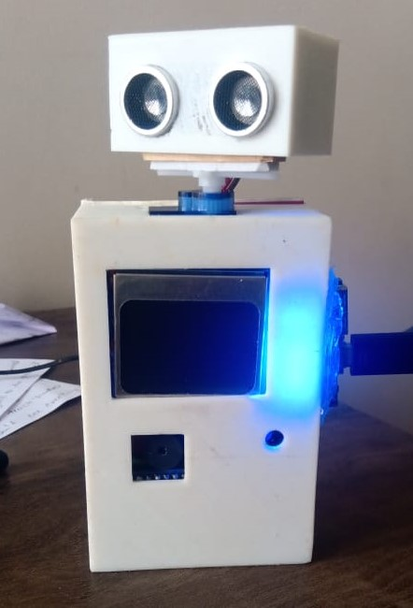


Solution
istiNo

Slide 5
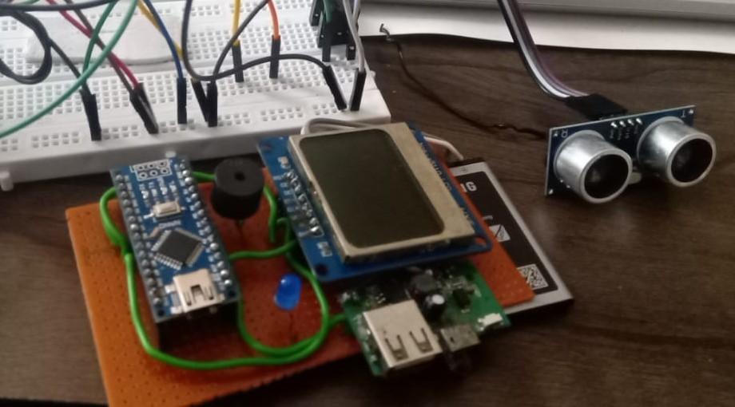
DISTINO` - It’s components
Arduino NANO
Ultra sonic sensor(HC-SR04)
Micro-Servo
Display(Nokia-5100)
Li-on battery
Buzzer & LED

Slide 6
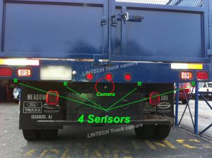
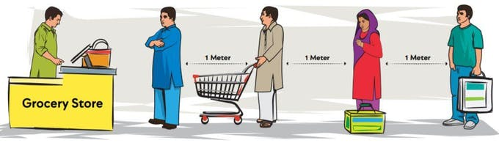
DISTINO` applications its Future
Social-Distance monitoring
Parking sensors for trucks

Slide 7
DISTINO` uniqueness
Compact & Portable
Rechargeable
Wireless
Accurate(distance)
Affordable

Slide 8

marketing
Demand Pull inflation
Promotion
Resources
Affordable

Slide 9


