Slide 1
Stock Price Prediction App
A Streamlit-based web app for predicting stock prices using Machine Learning models.

Slide 2
Objective
To build an interactive application that fetches stock data and predicts future prices using ML models.

Slide 3
Technologies Used
• Streamlit
• Pandas
• yFinance
• Scikit-learn
• XGBoost

Slide 4
Key Features
• Fetch real-time stock data
• Data visualization
• Multiple ML models
• Future price prediction

Slide 5
Data Collection
Stock data is fetched using yFinance API based on user input (symbol, date range).

Slide 6
Data Preprocessing
• Select 'Close' price
• Create target using shift
• Remove missing values
• Feature scaling using StandardScaler

Slide 7
Models Used
• Linear Regression
• Random Forest Regressor
• XGBoost Regressor

Slide 8
Model Training
• Train-test split (80-20)
• Fit model on training data
• Evaluate using R2 score

Slide 9
Prediction Logic
• Use last N days data
• Scale data
• Predict future stock prices

Slide 10
User Interface
• Sidebar for inputs
• Display recent data
• Button to run prediction

Slide 11
Performance Metrics
• R2 Score
• Mean Absolute Error (optional)

Slide 12
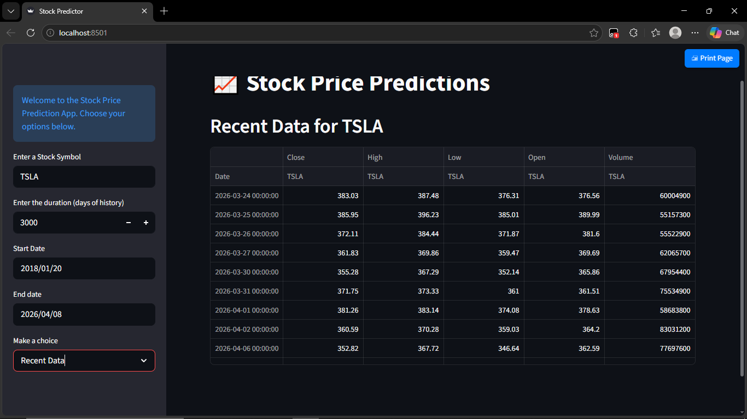
OUTPUT

Slide 13
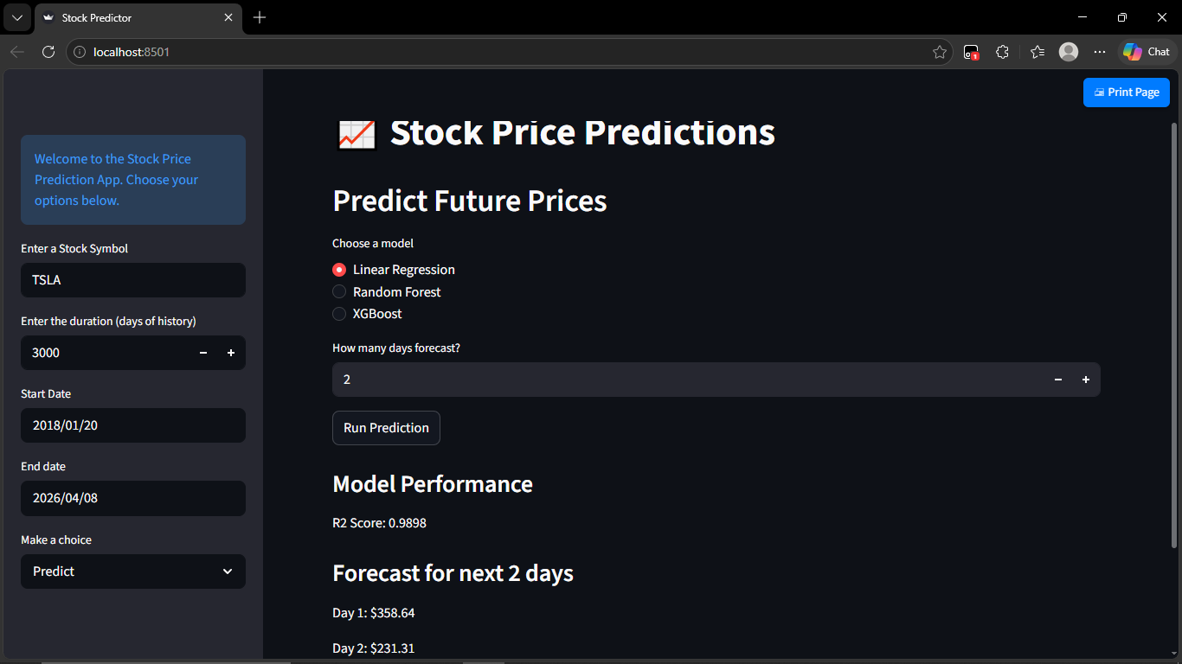

Slide 14
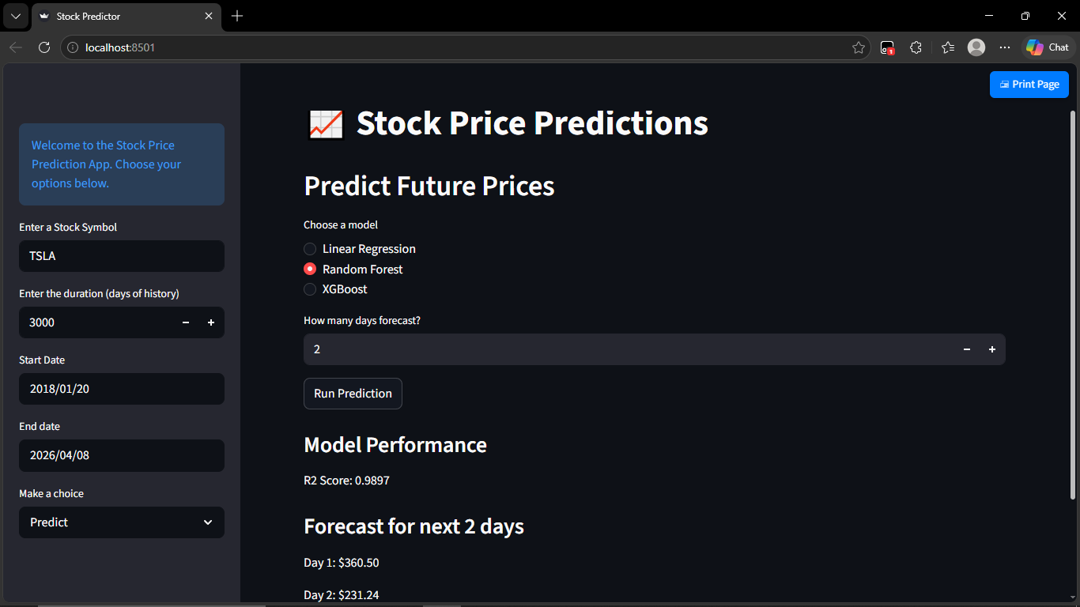

Slide 15


Slide 16
Conclusion
This app helps users understand stock trends and make basic predictions using machine learning.

Slide 17
THANK YOU

