Slide 1
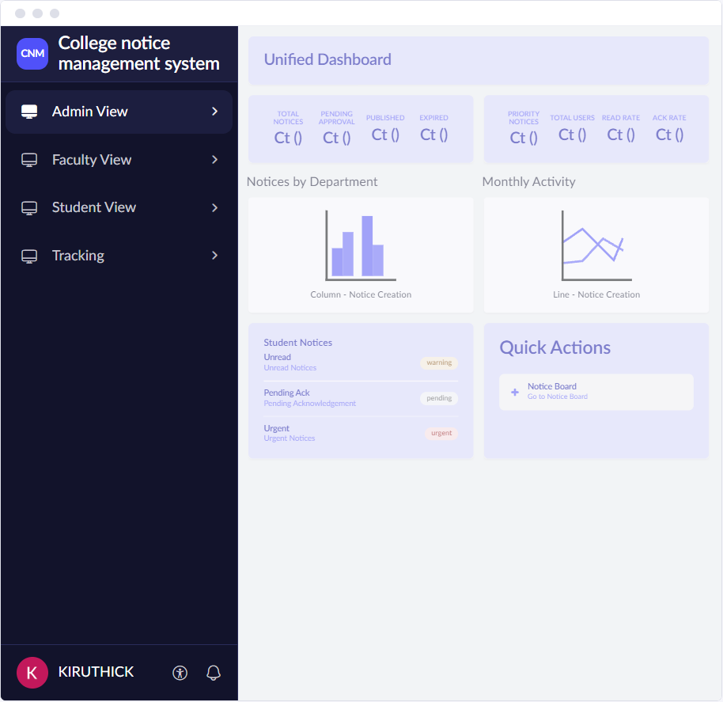
CB23F35 · LOW-CODE APPLICATION DEVELOPMENT USING ZOHO CREATOR
College Notice Management
Notice creation, approval, targeted publishing and read tracking on Zoho Creator
Narendaran K · 240701624
B.E. Computer Science and Engineering
Rajalakshmi Engineering College

Slide 2
THE PROBLEM
Notices reach people unevenly today
Scattered channels
Notice boards, e-mail and messaging groups each carry part of the news, so students miss updates.
Faculty / office prepares notice
▼
Printed or forwarded to groups
Outdated and unprioritised notices
Expired announcements stay visible and urgent notices do not stand out.
▼
Shared on board or messaging apps
▼
No approval or targeting
Anyone can post, and notices go to everyone instead of the intended department, year or section.
Students may miss it
▼
Expired notice removed by hand
No read tracking
Nobody can tell who has seen or acknowledged an important notice.
▼
No record of reading
2

Slide 3
THE SOLUTION
Forms, reports and one dashboard
8 Linked forms
WHAT IT CONTAINS
User Registration, Notice Creation, Notice Approval, Department Details, Notice Category, Audience Target Group, Notice Acknowledgement and User Feedback.
WHAT IT RESOLVES
Scattered notices. Every notice has one record with its category, audience, dates, approval and read status.
8 Reports
WHAT IT CONTAINS
All Notices, Pending Approvals, Published Notices, Acknowledgement Status, User Feedback, Department-wise Notices, Notice Activity Log and Target Groups.
WHAT IT RESOLVES
Missed and outdated notices. Status, priority and activity are visible without opening each record.
1 Unified Dashboard
WHAT IT CONTAINS
A page with Admin, Faculty and Student views, eight KPI tiles and charts for notices by department and monthly activity.
WHAT IT RESOLVES
No single view. Staff see counts and rates in one place; students see their unread and urgent notices.
3

Slide 4
THE SOLUTION
Automation, access and notifications
3 Form workflows
WHAT IT CONTAINS
Workflows on Notice Creation, Notice Approval and Notice Acknowledgement, with schedules for publishing and expiry and a lifecycle Blueprint design.
WHAT IT RESOLVES
Manual follow-up. Submitted notices route to the Admin, decisions reach the creator and expired notices are archived.
3 Role profiles
WHAT IT CONTAINS
Administrator, Faculty/Staff and Student, each with its own menu, reports and dashboard view.
WHAT IT RESOLVES
Uncontrolled access. Faculty see their own notices and students only notices delivered to them.
E-mail and Zia
WHAT IT CONTAINS
E-mail notifications on submission, decision and publishing, and the Zia Build Agent used to generate and refine the app.
WHAT IT RESOLVES
Slow communication and build effort. Target users are notified automatically, and AI output is reviewed by hand.
4

Slide 5
OBJECTIVES
What the project set out to do
01
02
03
Design structured forms for users, notices, approvals, audiences, acknowledgements and feedback
Automate approval routing, publishing, notification and expiry archiving
Target notices by department, category, year, section or selected users
04
05
06
Track read status and acknowledgement for every targeted user
Give each role its own access, reports and dashboard view
Validate, test and prepare the app for secure deployment
5

Slide 6
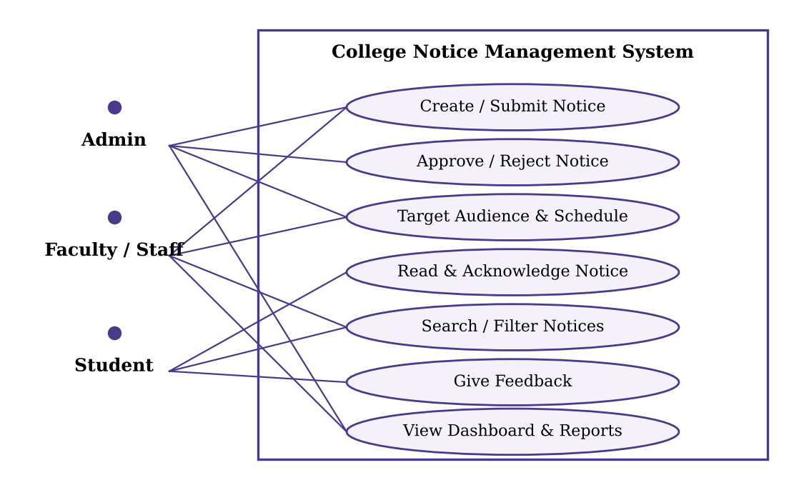
USERS AND ROLES
Three kinds of users, one shared record
Administrator
Manages users, departments and categories, approves or rejects notices and monitors dashboards.
Faculty / Staff
Creates notices, sets the audience and dates, submits for approval and tracks status.
Student
Reads targeted notices, acknowledges when required, searches and filters, and gives feedback.
6

Slide 7
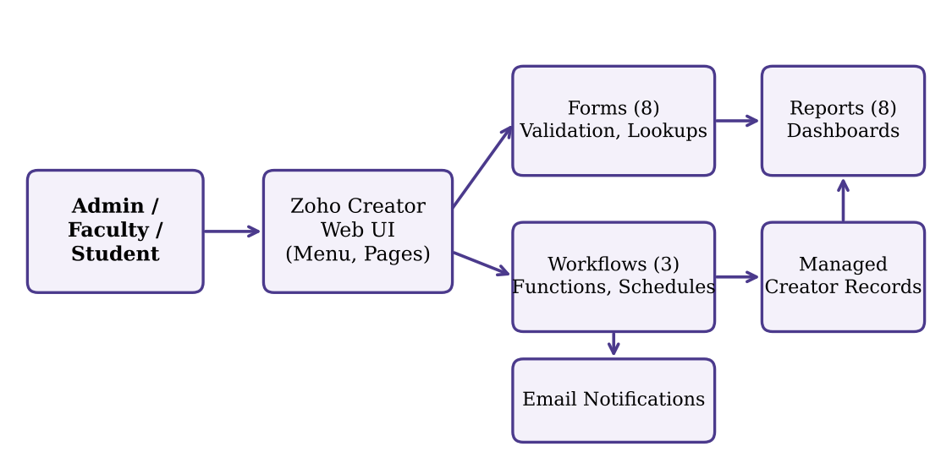
SYSTEM ARCHITECTURE
Four layers on Zoho Creator
Users and channels
Web and mobile browsers for the three roles.
Notice application
8 forms, 8 reports, Unified Dashboard and 3 form workflows.
Data layer
Creator data store for form records and uploaded attachments.
Automation and e-mail
Schedules, Deluge functions and e-mail notifications.
7

Slide 8
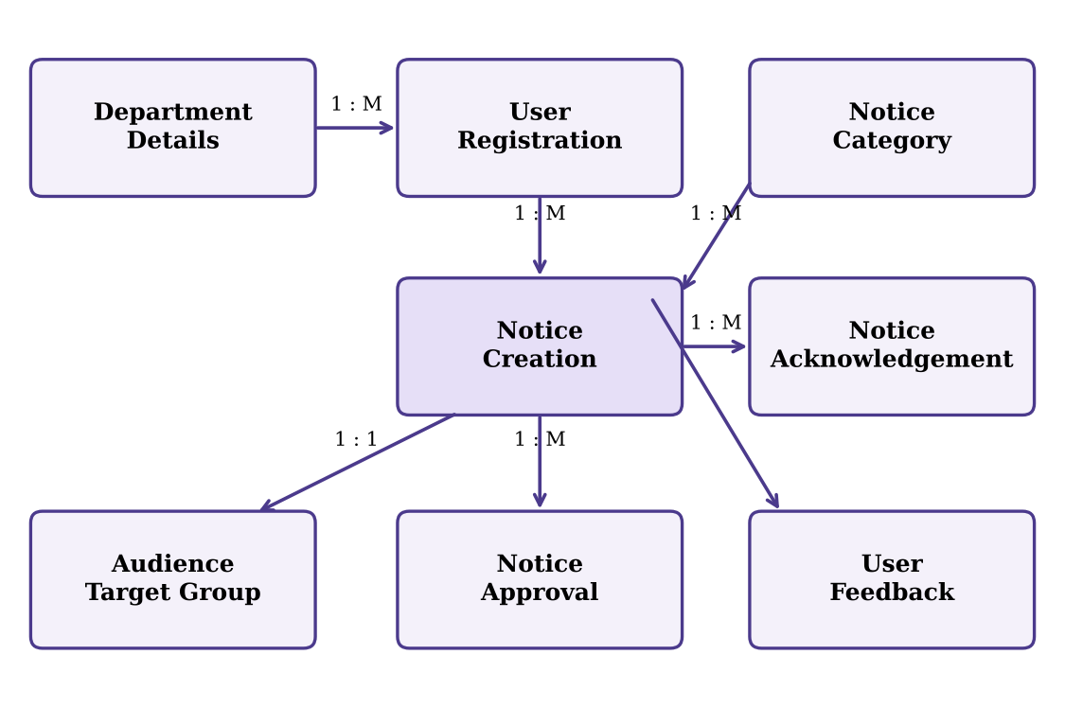
DATA MODEL
Eight forms linked by lookups
Notices own their audience
Notice Creation links to one Audience Target Group.
Notices have a history
Approvals, acknowledgements and feedback point back to the notice.
Master data stays central
Departments, categories and users are looked up, not retyped.
Delivery is tracked
One Notice Acknowledgement row per target user.
8

Slide 9
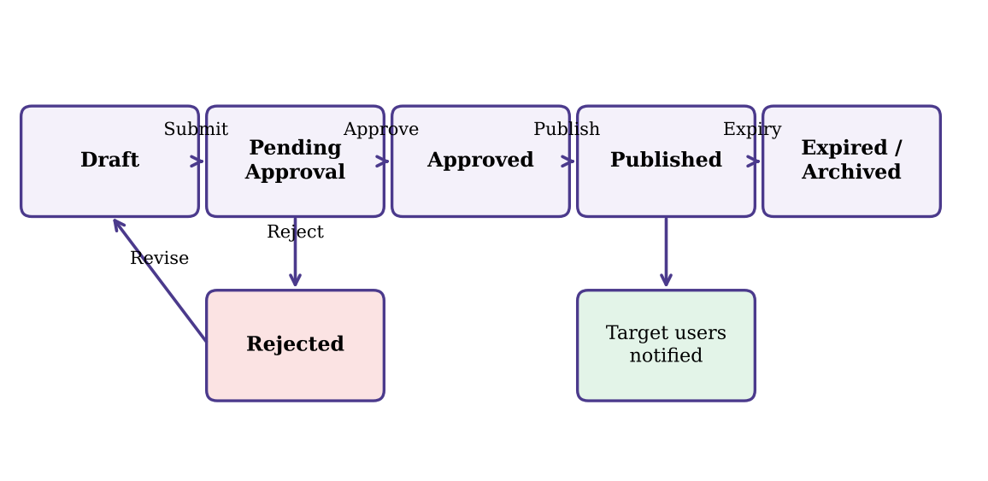
PROCESS DESIGN
The notice lifecycle
1 · Draft and submit
Faculty saves a draft, then submits it for approval.
2 · Review
Admin approves or rejects with remarks; rejected notices return for revision.
3 · Publish and notify
Approved notices publish on time and notify the target users.
4 · Read, acknowledge, expire
Read status is recorded; expired notices move to the archive.
9

Slide 10
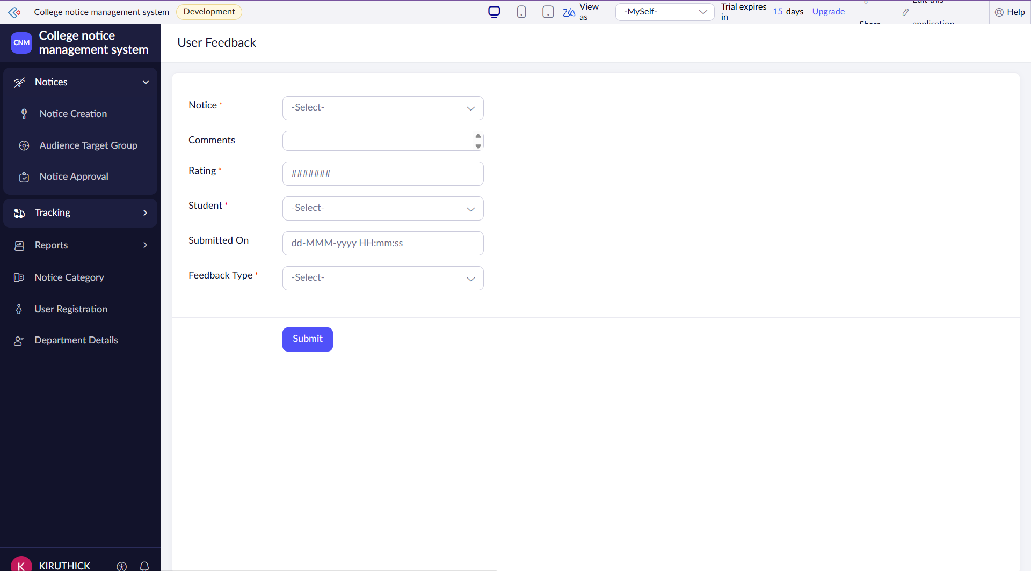
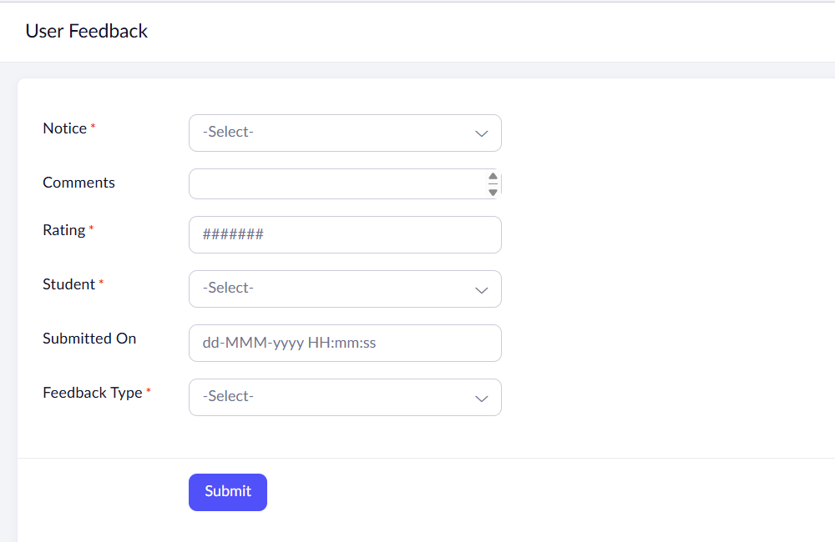
IMPLEMENTATION · FORMS
Forms capture every step
Application navigation: Notices, Tracking, Reports and setup forms
User Feedback form with notice lookup and rating
Auto Number IDs
Lookups between forms
Attachments and date validation
10

Slide 11
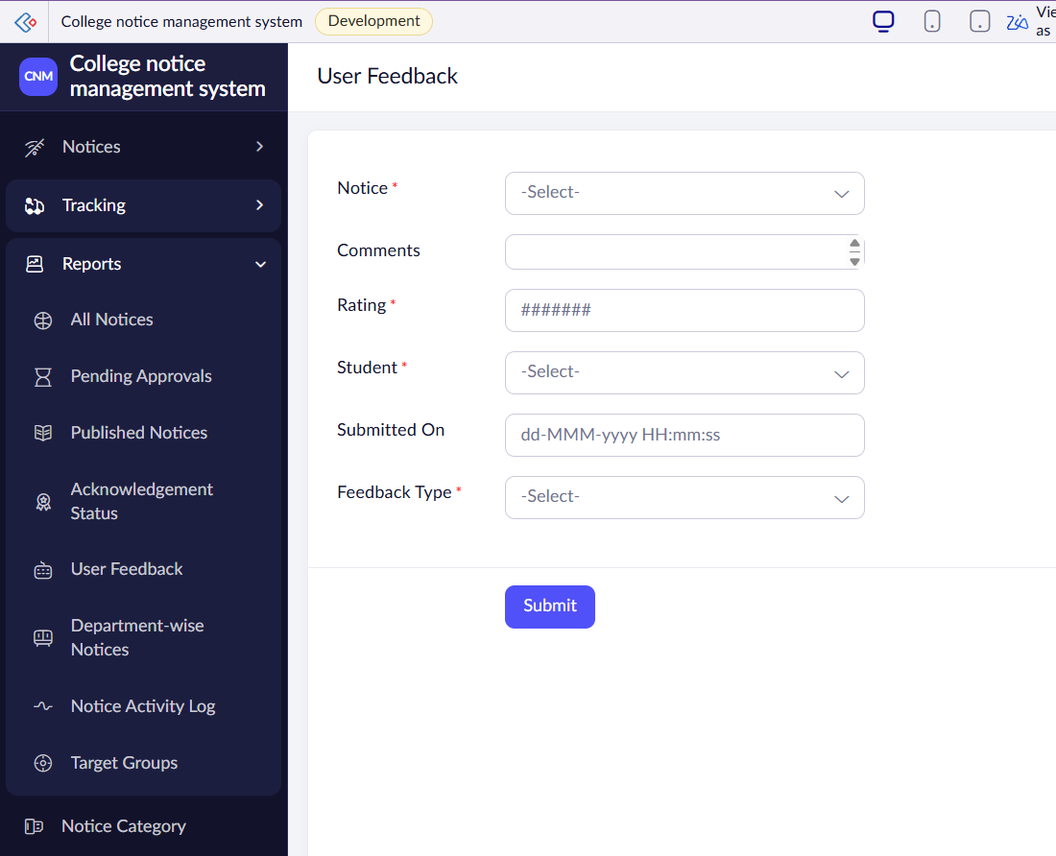
IMPLEMENTATION · REPORTS
Eight reports for every role
8 reports
Search and filters
Role-based views
All Notices
Pending Approvals
Published Notices
Acknowledgement Status
User Feedback
Department-wise Notices
Notice Activity Log
Target Groups
11

Slide 12
IMPLEMENTATION · DASHBOARD
The Unified Dashboard
Eight KPI tiles
Total Notices, Pending Approval, Published, Expired, Priority Notices, Total Users, Read Rate and Acknowledgement Rate.
Charts and role views
Notices by Department, Monthly Activity, and separate Admin, Faculty and Student views with quick actions.
12

Slide 13
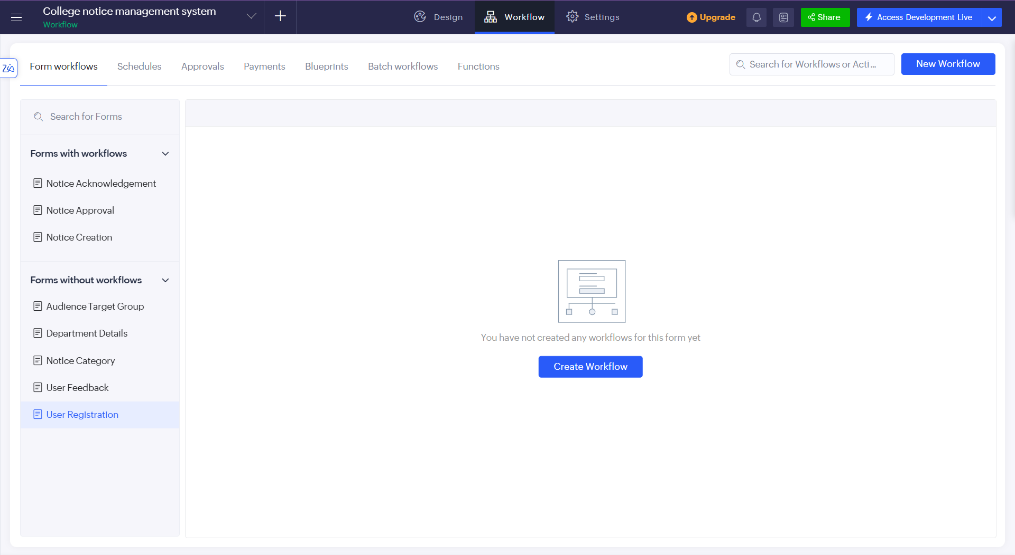
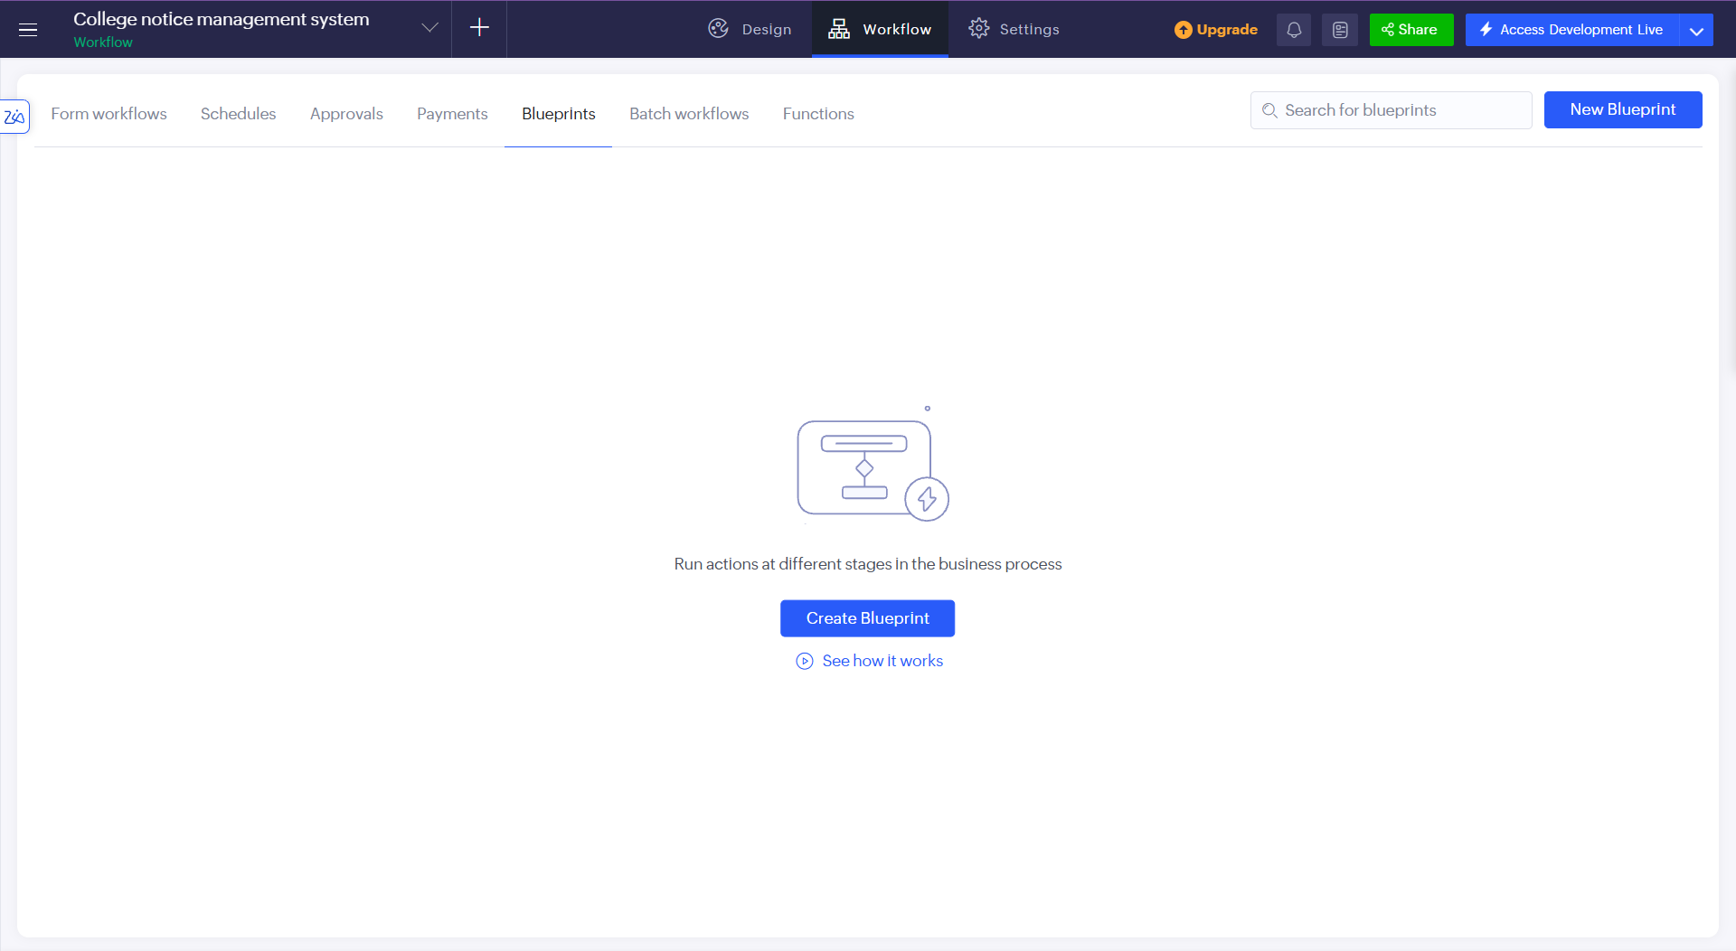
IMPLEMENTATION · AUTOMATION
Workflows do the routine work
Form workflows
Posting, approval and seen-tracking on three forms.
Schedules
Publish approved notices on time; archive expired ones.
Approval
Admin approves or rejects with remarks; creator is notified.
Blueprint
Notice_Lifecycle stages from Draft to Archived (designed).
Form workflows list in the builder
Blueprints tab for Notice_Lifecycle
13

Slide 14
IMPLEMENTATION · NOTIFICATIONS AND AI
E-mail, schedules and Zia
E-mail notifications
Sent on submission, decision and publishing using sendmail.
Scheduled publishing
A schedule publishes approved notices at their publish time.
Zia Build Agent
Generated forms, workflows and pages; all reviewed by hand.
Notification flow
Faculty submits
E-mail to Admin
Admin decides
E-mail to creator
Notice published
E-mail to targets
14

Slide 15
IMPLEMENTATION · SECURITY
Access control and safeguards
Role profiles: Administrator, Faculty/Staff and Student
Faculty see only their own notices; students see only notices delivered to them
Approval before a notice is published
Status changes made only by workflows, not typed by users
Decision, reviewer and time stored in Notice Approval
Attachment type and size limits; unique e-mail and ID numbers
15

Slide 16
TESTING AND DEPLOYMENT
Tested, then prepared for production
Test plan
Forms, workflows, reports and role access mapped to functional requirements.
Empty category list
Notice Category had no records; five default categories (Academic, Examination, Events, Sports, General) are added.
3 defects found
Found during build and addressed or scheduled for correction.
Dashboard criteria error
Status was used on Notice Acknowledgement; criteria corrected to use Notice Creation status.
Dev → Stage → Production
Built in Development; publish to Stage and Production before the final demo.
Feedback field types
Comments and Rating fields corrected to multi-line text and a 1–5 rating.
16

Slide 17
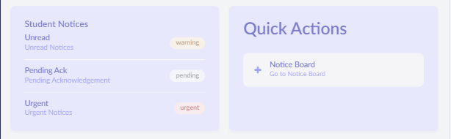
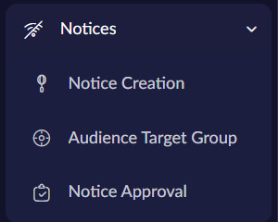
RESULTS · DEMO SCENARIO
One notice, end to end
Faculty creates an exam notice for CSE Year 2, Section A
Faculty sets the audience, priority, attachment and dates, then submits
Admin reviews the notice in Pending Approvals and approves it
Notice publishes at the scheduled time and target students are notified
Student opens it (read recorded) and acknowledges
Dashboard read and acknowledgement rates update; expiry archives the notice
Student view on the dashboard
Notices section of the menu
17

Slide 18
CONCLUSION
What was achieved and what comes next
Achieved
One approved, targeted and trackable record per notice
Automatic notifications and expiry archiving
Role-based access with Admin approval
Read and acknowledgement tracking
Built by one developer in one semester on a low-code platform
Future enhancements
SMS and WhatsApp notifications
Mobile push alerts and a customer portal
AI-drafted notices and smart audience suggestions
Calendar sync for event and exam notices
Multilingual notices
18

Slide 19
COLLEGE NOTICE MANAGEMENT
Thank you
Narendaran K
240701624
B.E. CSE, Rajalakshmi Engineering College

