Slide 1
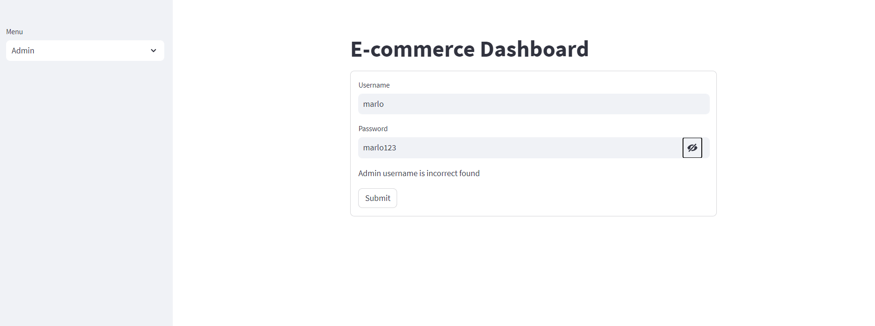
Ecommerce Dashboard
Login on to the website by giving the Admin credentials Username – “marlo” and
Password as “marlo123”.

Slide 2
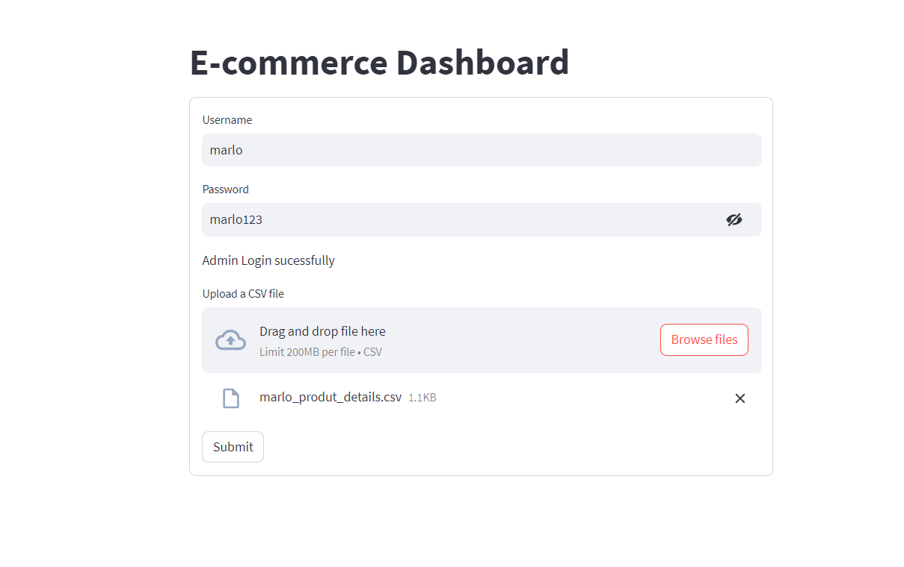
Upload the CSV file into drop down box.
Click the Submit Button.

Slide 3
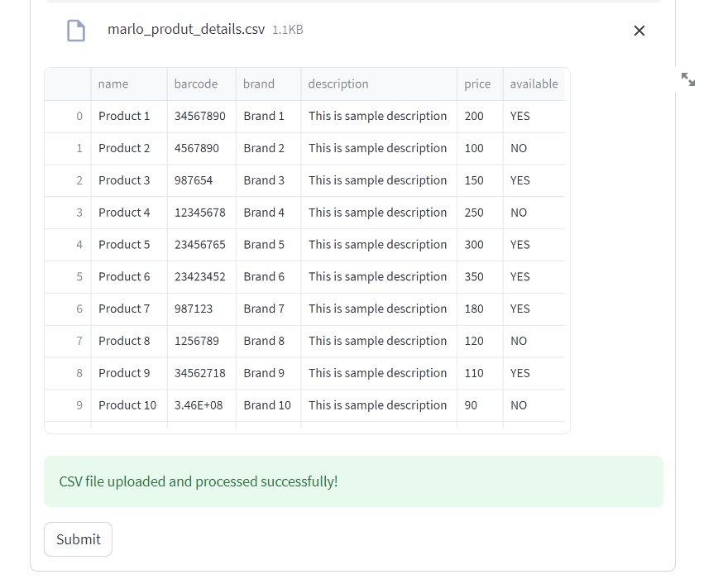
Uploaded the file in the Database successfully.

Slide 4
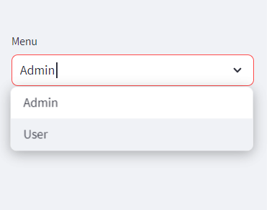
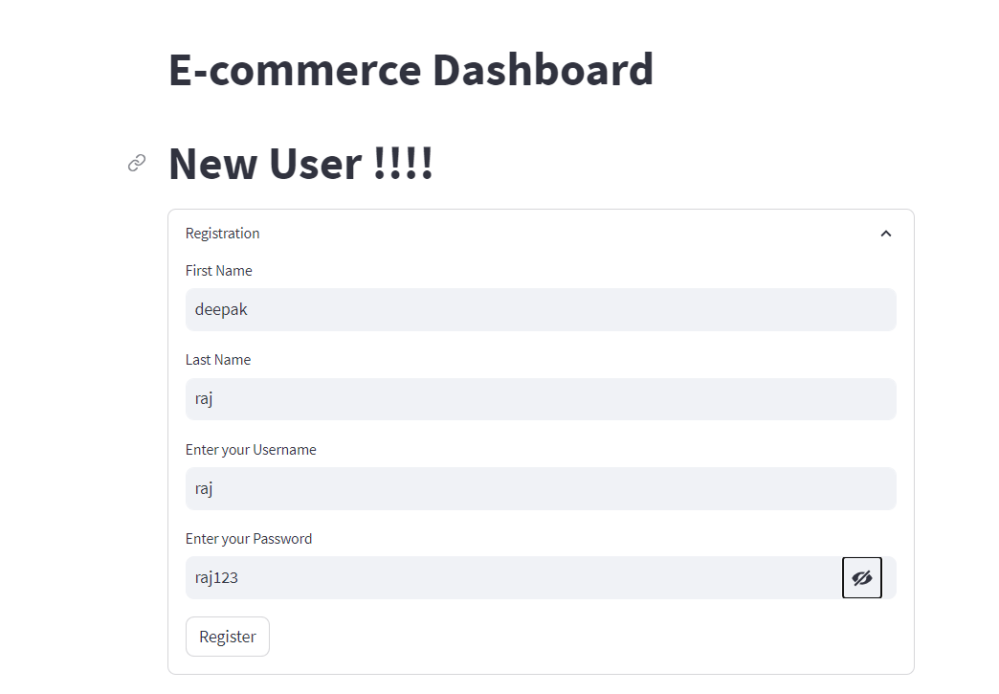
We have Two options Admin and User column.
Switch to User menu , Login into User by clicking it.
If New User!
Enter all basic details in the given form
and click Register.
After Registration process is complete,
Details are stored in the Database.

Slide 5
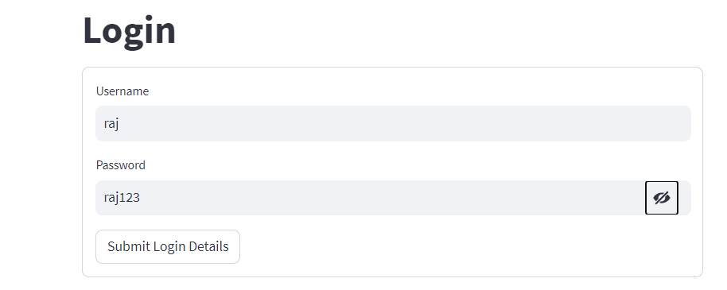
Once the Registration process is Successful,
Login by giving Username and Password correctly,
And click Submit Login Details.
Once the Registration and Login
details are matched appropriately,
it takes into our Account .
The Product Details are Listed There.

Slide 6
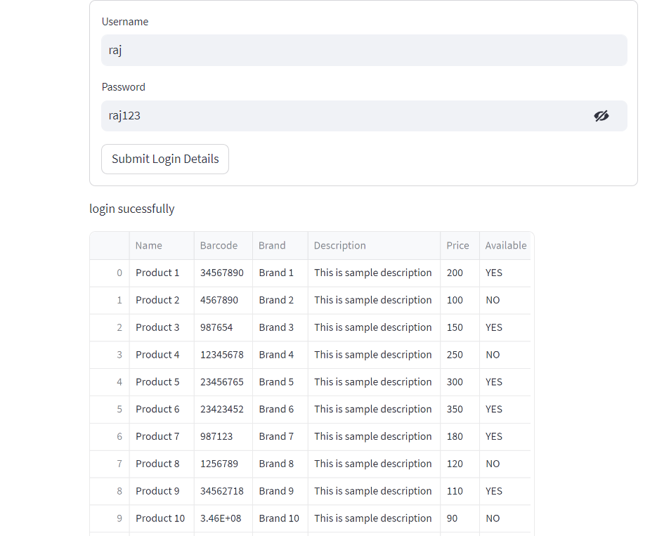
List of Products are shown here.

Slide 7
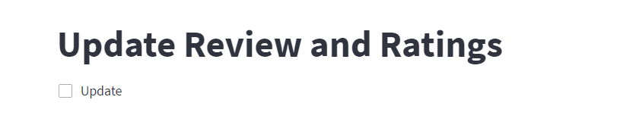
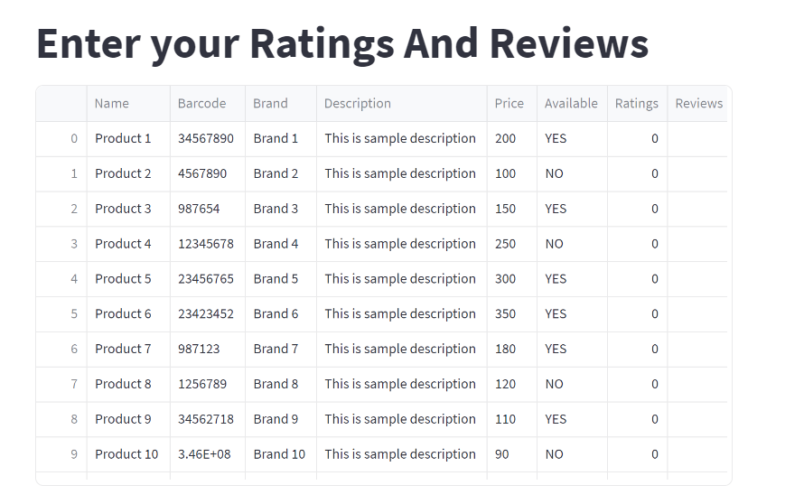
The Update Button will Update the database by providing Review and Rating Options to the user.
Review and Rating Options are
Added in the table.

Slide 8
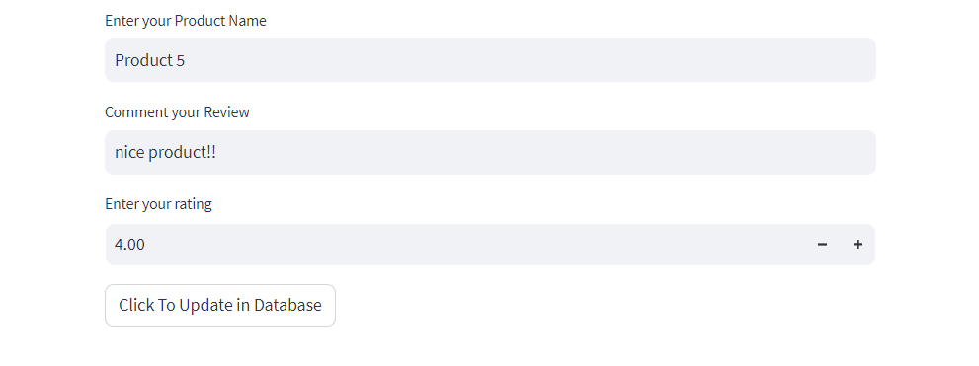
We can give the Product’s ,Review and Rating to add into the product.
“Click the Update in Database” button to update the review and rating in database.

Slide 9
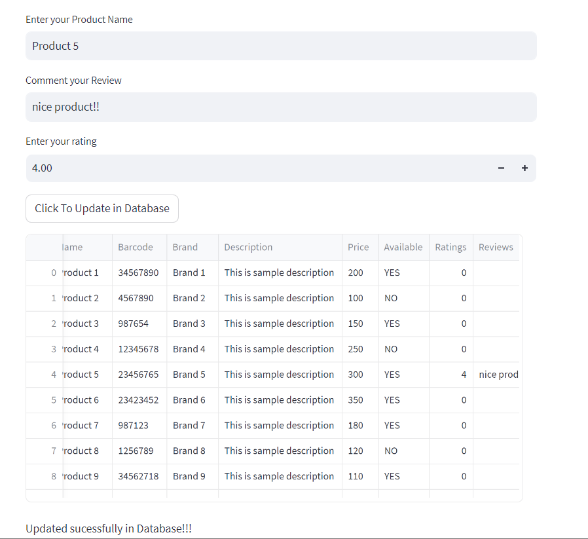
Once the update button is clicked,
Automatically it update the review and
rating to the particular Product.

Slide 10
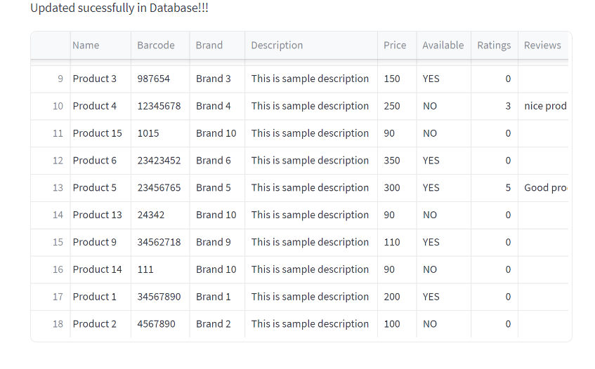
Database saves the all actions of
different users with their Reviews
and Ratings accordingly.

Slide 11
Python file are github for the reference.
Github link - https://github.com/NARESH-VNK/marlo

