Slide 1
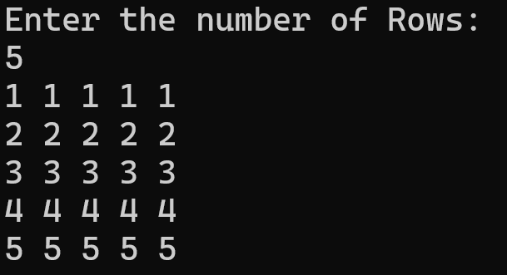
QSpiders|JSpiders|PySpiders, NOIDA
B-4, Block-B, Sector-3, Noida
Pattern Programming Questions by Shambhu Sir
Monday, 11 August 2025
@javac_java
@kumarsam07
SHAMBHU KUMAR QSpiders |JSpiders, NOIDA
LEVEL-I

Slide 2
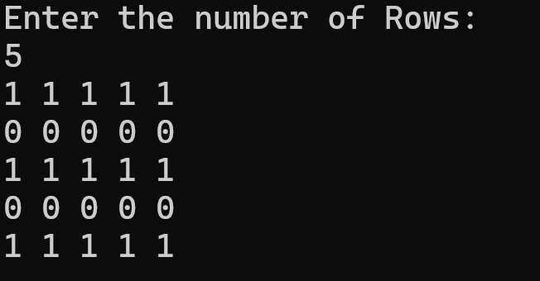
Pattern Programming
SHAMBHU KUMAR QSpiders |JSpiders, NOIDA
LEVEL-I

Slide 3
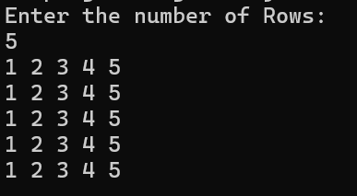
Pattern Programming
SHAMBHU KUMAR QSpiders |JSpiders | PySpiders, NOIDA
LEVEL-I

Slide 4
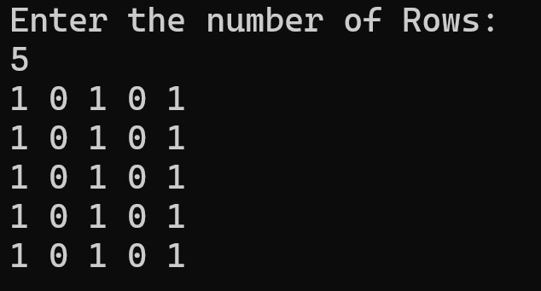
Pattern Programming
SHAMBHU KUMAR QSpiders |JSpiders, NOIDA
LEVEL-I

Slide 5
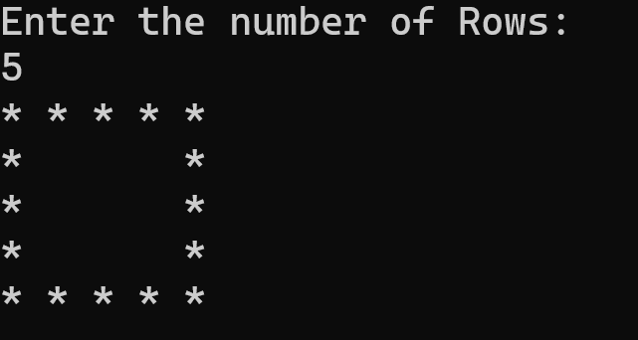
Pattern Programming
SHAMBHU KUMAR QSpiders |JSpiders, NOIDA
LEVEL-I

Slide 6
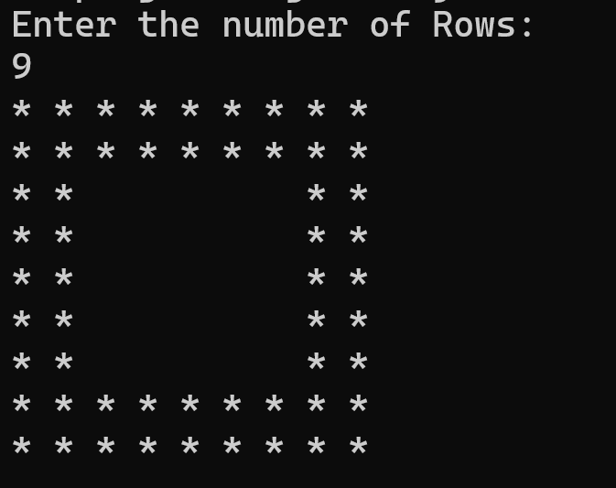
Pattern Programming
SHAMBHU KUMAR QSpiders |JSpiders, NOIDA
LEVEL-I

Slide 7
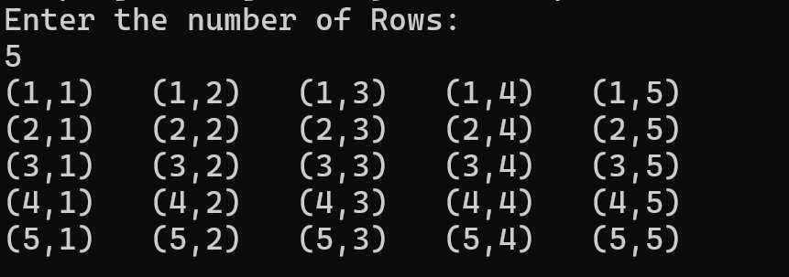
Pattern Programming
SHAMBHU KUMAR QSpiders |JSpiders, NOIDA
LEVEL-I
Important
Don’t leave it..!!

Slide 8
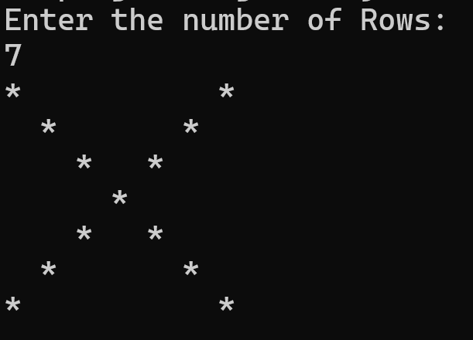
Pattern Programming
SHAMBHU KUMAR QSpiders |JSpiders, NOIDA
LEVEL-I

Slide 9
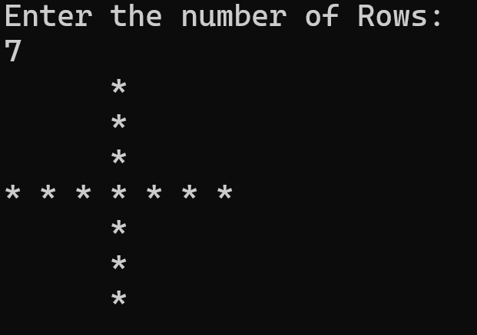
Pattern Programming
SHAMBHU KUMAR QSpiders |JSpiders, NOIDA
LEVEL-I
Important
Don’t leave it..!!

Slide 10
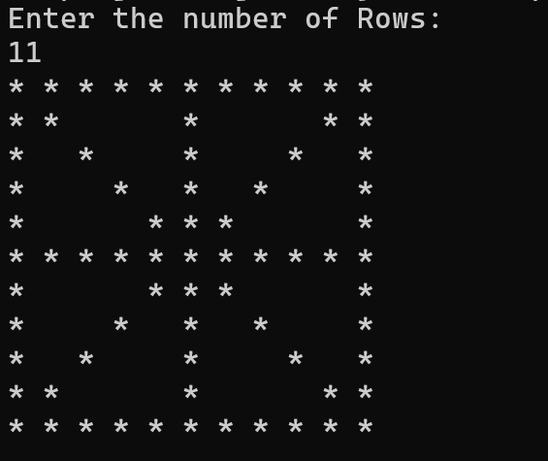
Pattern Programming
SHAMBHU KUMAR QSpiders |JSpiders, NOIDA
LEVEL-I

Slide 11
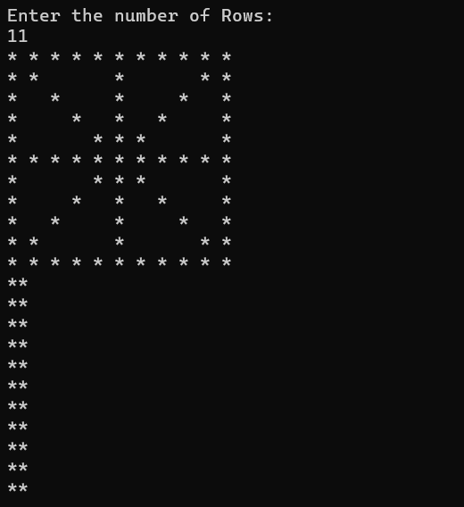
Pattern Programming
SHAMBHU KUMAR QSpiders |JSpiders, NOIDA
LEVEL-I

Slide 12
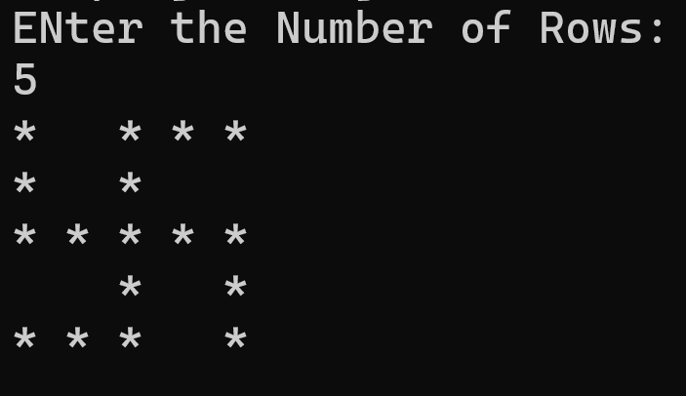
Pattern Programming
SHAMBHU KUMAR QSpiders |JSpiders, NOIDA
LEVEL-I
Important
Don’t leave it..!!

Slide 13
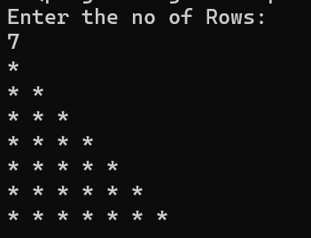
Pattern Programming
SHAMBHU KUMAR QSpiders |JSpiders, NOIDA
LEVEL-II
Important
Don’t leave it..!!

Slide 14
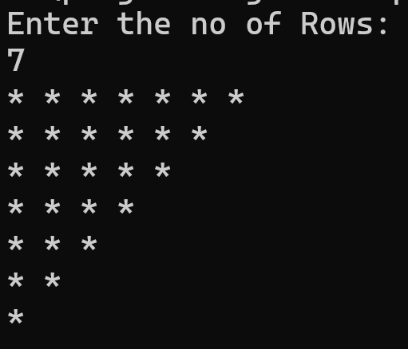
Pattern Programming
SHAMBHU KUMAR QSpiders |JSpiders, NOIDA
LEVEL-II

Slide 15
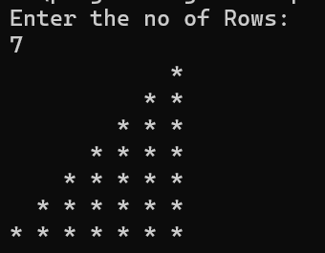
Pattern Programming
SHAMBHU KUMAR QSpiders |JSpiders, NOIDA
LEVEL-II
Important
Don’t leave it..!!

Slide 16
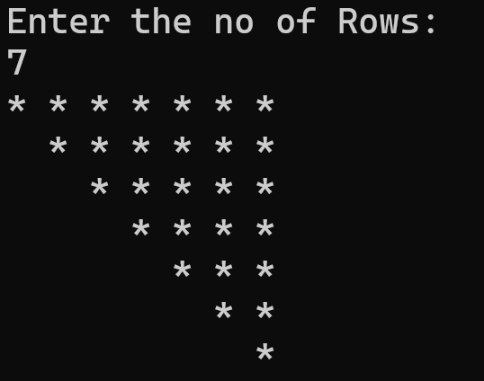
Pattern Programming
SHAMBHU KUMAR QSpiders |JSpiders, NOIDA
LEVEL-II

Slide 17
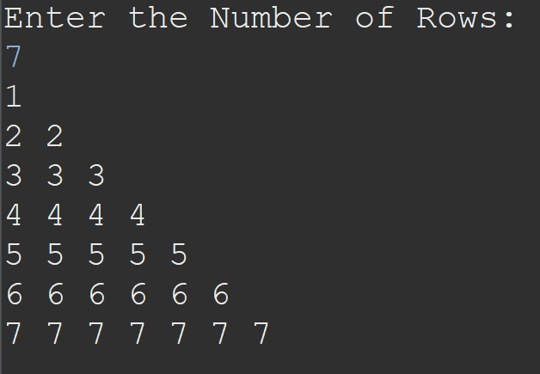
Pattern Programming
SHAMBHU KUMAR QSpiders |JSpiders, NOIDA
LEVEL-II

Slide 18
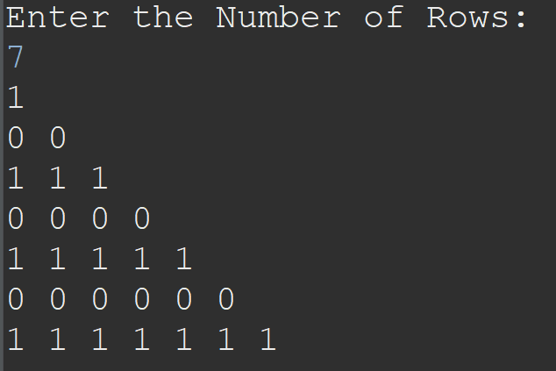
Pattern Programming
SHAMBHU KUMAR QSpiders |JSpiders, NOIDA
LEVEL-II

Slide 19
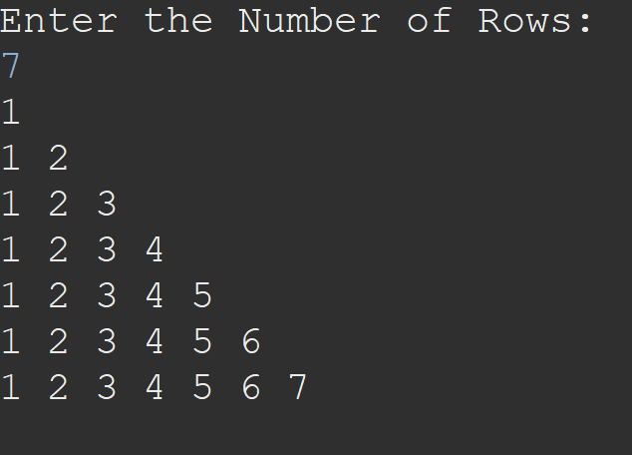
Pattern Programming
SHAMBHU KUMAR QSpiders |JSpiders, NOIDA
LEVEL-II

Slide 20
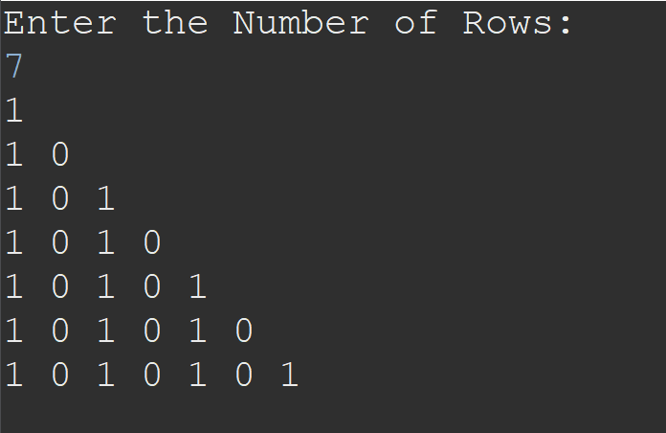
Pattern Programming
SHAMBHU KUMAR QSpiders |JSpiders, NOIDA
LEVEL-II
Important
Don’t leave it..!!

Slide 21
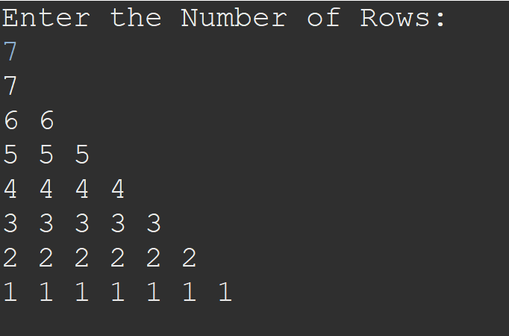
Pattern Programming
SHAMBHU KUMAR QSpiders |JSpiders, NOIDA
LEVEL-II

Slide 22
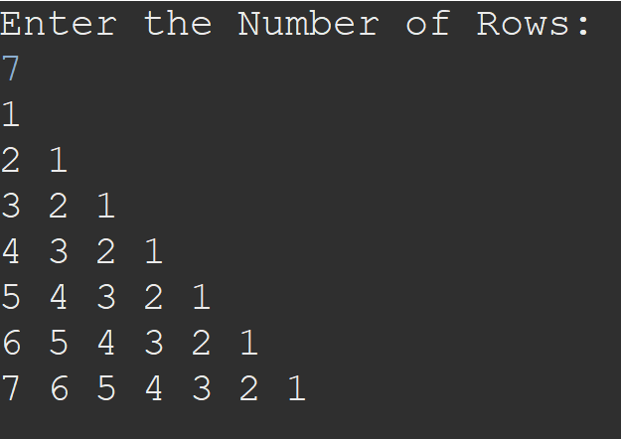
Pattern Programming
SHAMBHU KUMAR QSpiders |JSpiders, NOIDA
LEVEL-II

Slide 23
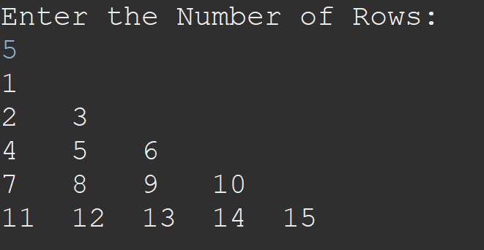
Pattern Programming
SHAMBHU KUMAR QSpiders |JSpiders, NOIDA
LEVEL-II

Slide 24
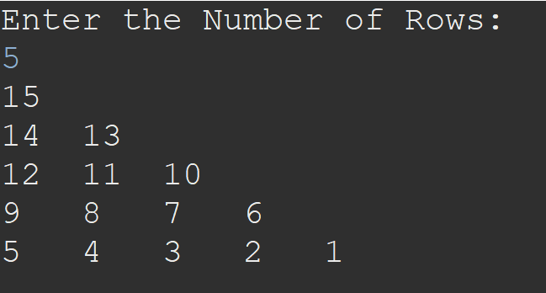
Pattern Programming
SHAMBHU KUMAR QSpiders |JSpiders, NOIDA
LEVEL-II

Slide 25
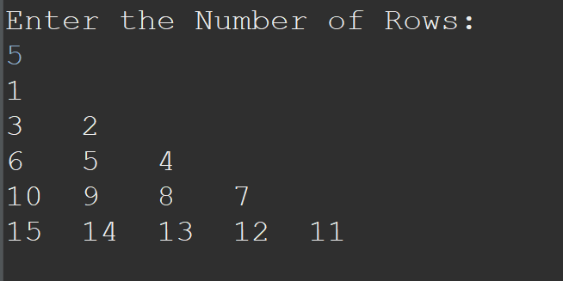
Pattern Programming
SHAMBHU KUMAR QSpiders |JSpiders, NOIDA
LEVEL-II

Slide 26
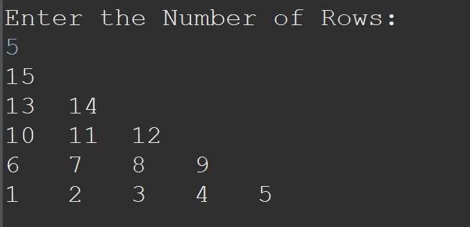
Pattern Programming
SHAMBHU KUMAR QSpiders |JSpiders, NOIDA
LEVEL-II

Slide 27
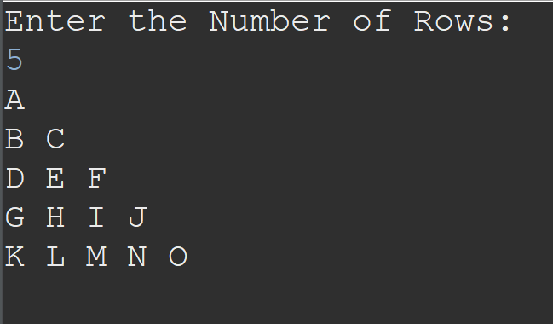
Pattern Programming
SHAMBHU KUMAR QSpiders |JSpiders, NOIDA
LEVEL-II

Slide 28
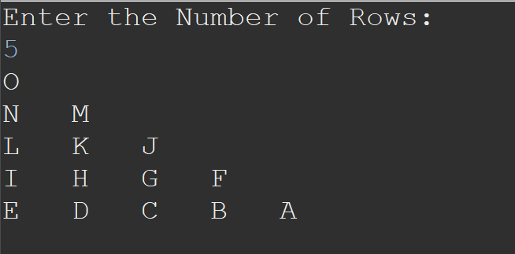
Pattern Programming
SHAMBHU KUMAR QSpiders |JSpiders, NOIDA
LEVEL-II

Slide 29
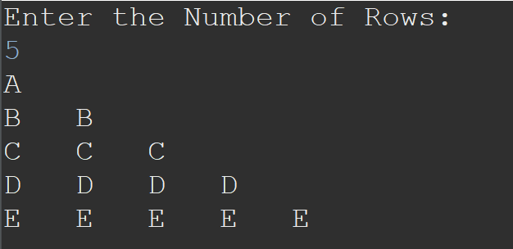
Pattern Programming
SHAMBHU KUMAR QSpiders |JSpiders, NOIDA
LEVEL-II

Slide 30
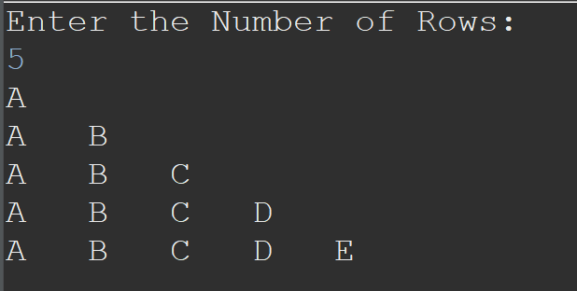
Pattern Programming
SHAMBHU KUMAR QSpiders |JSpiders, NOIDA
LEVEL-II

Slide 31
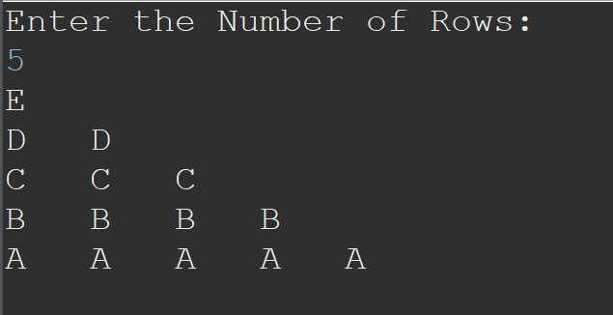
Pattern Programming
SHAMBHU KUMAR QSpiders |JSpiders, NOIDA
LEVEL-II

Slide 32
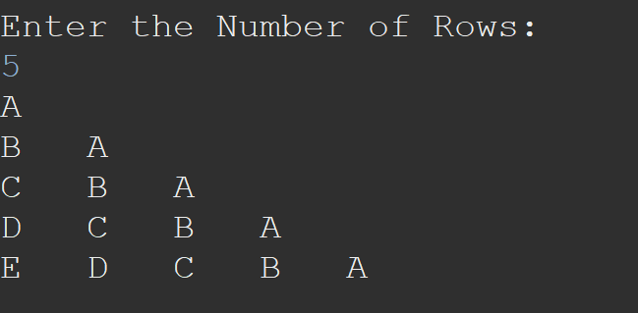
Pattern Programming
SHAMBHU KUMAR QSpiders |JSpiders, NOIDA
LEVEL-II

Slide 33
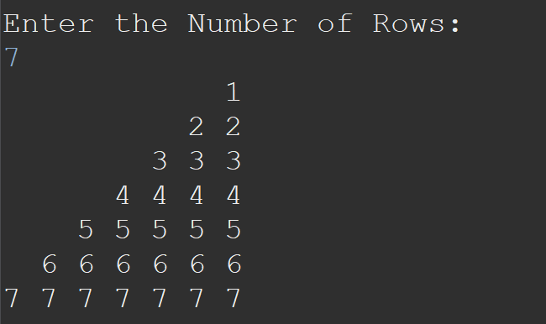
Pattern Programming
SHAMBHU KUMAR QSpiders |JSpiders, NOIDA
LEVEL-II

Slide 34
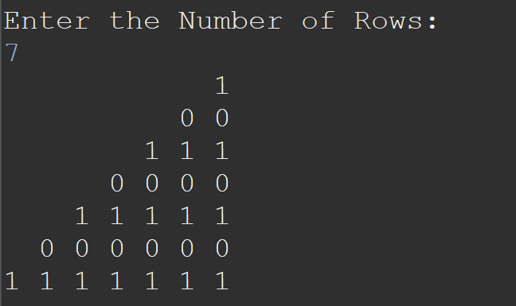
Pattern Programming
SHAMBHU KUMAR QSpiders |JSpiders, NOIDA
LEVEL-II

Slide 35
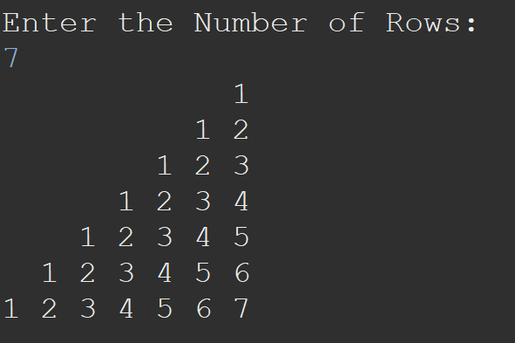
Pattern Programming
SHAMBHU KUMAR QSpiders |JSpiders, NOIDA
LEVEL-II

Slide 36
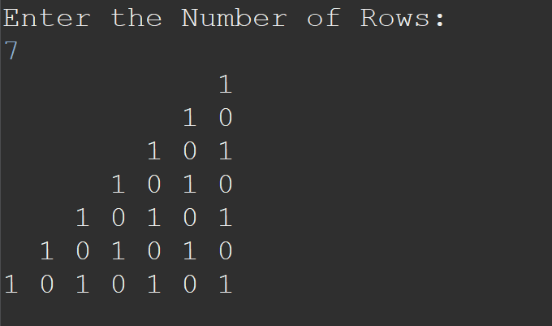
Pattern Programming
SHAMBHU KUMAR QSpiders |JSpiders, NOIDA
LEVEL-II
Important
Don’t leave it..!!

Slide 37
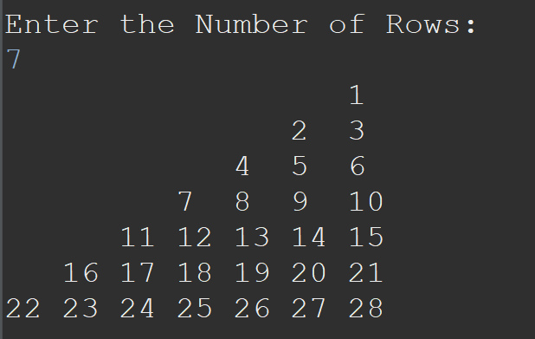
Pattern Programming
SHAMBHU KUMAR QSpiders |JSpiders, NOIDA
LEVEL-II

Slide 38
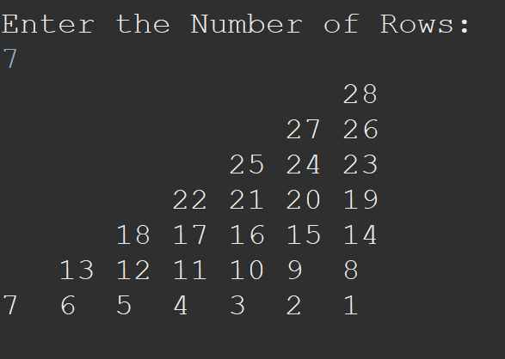
Pattern Programming
SHAMBHU KUMAR QSpiders |JSpiders, NOIDA
LEVEL-II

Slide 39
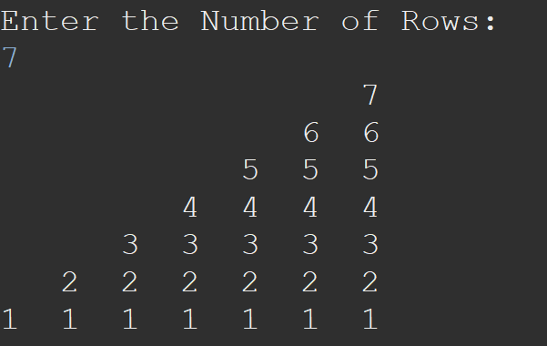
Pattern Programming
SHAMBHU KUMAR QSpiders |JSpiders, NOIDA
LEVEL-II

Slide 40
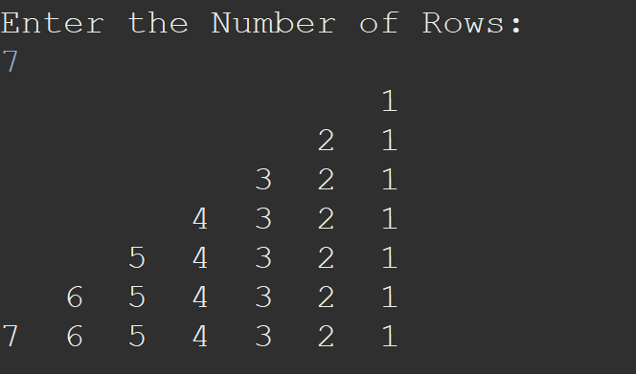
Pattern Programming
SHAMBHU KUMAR QSpiders |JSpiders, NOIDA
LEVEL-II

Slide 41
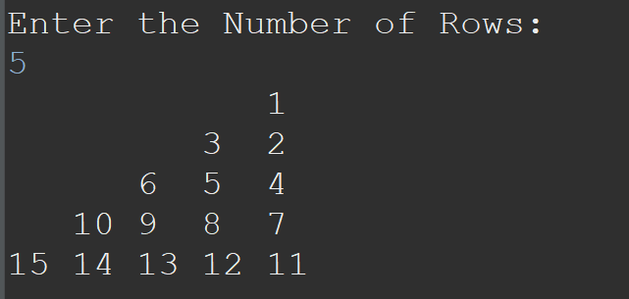
Pattern Programming
SHAMBHU KUMAR QSpiders |JSpiders, NOIDA
LEVEL-II

Slide 42
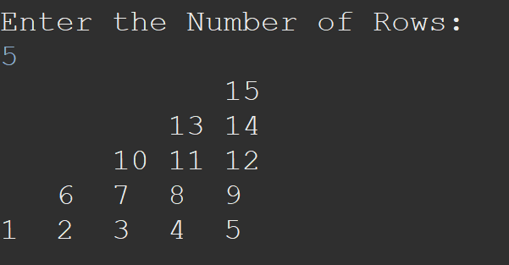
Pattern Programming
SHAMBHU KUMAR QSpiders |JSpiders, NOIDA
LEVEL-II

Slide 43
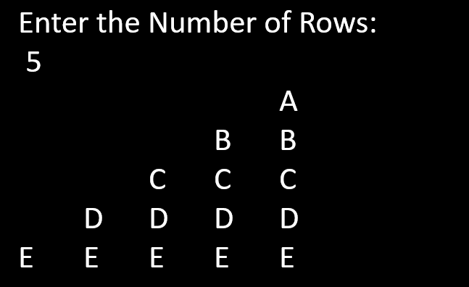
Pattern Programming
SHAMBHU KUMAR QSpiders |JSpiders, NOIDA
LEVEL-II

Slide 44
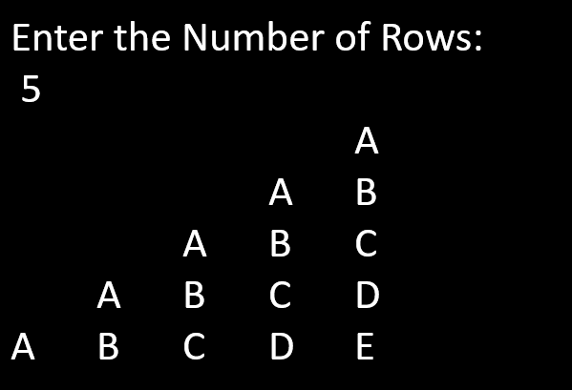
Pattern Programming
SHAMBHU KUMAR QSpiders |JSpiders, NOIDA
LEVEL-II

Slide 45
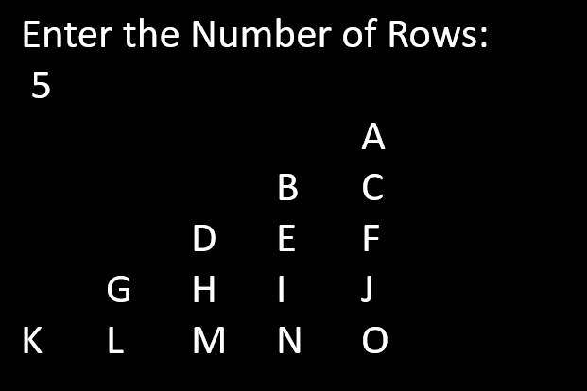
Pattern Programming
SHAMBHU KUMAR QSpiders |JSpiders, NOIDA
LEVEL-II

Slide 46
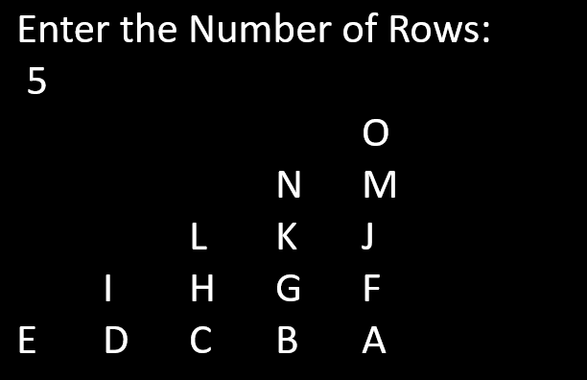
Pattern Programming
SHAMBHU KUMAR QSpiders |JSpiders, NOIDA
LEVEL-II

Slide 47
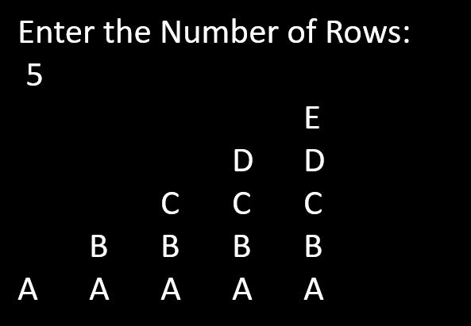
Pattern Programming
SHAMBHU KUMAR QSpiders |JSpiders, NOIDA
LEVEL-II

Slide 48
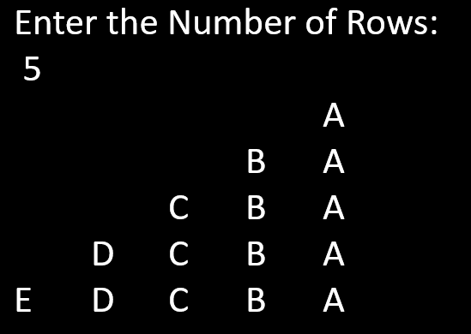
Pattern Programming
SHAMBHU KUMAR QSpiders |JSpiders, NOIDA
LEVEL-II

Slide 49
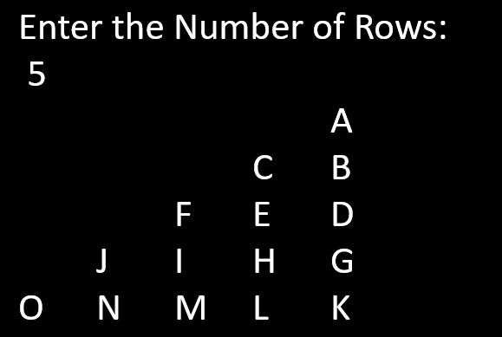
Pattern Programming
SHAMBHU KUMAR QSpiders |JSpiders, NOIDA
LEVEL-II

Slide 50
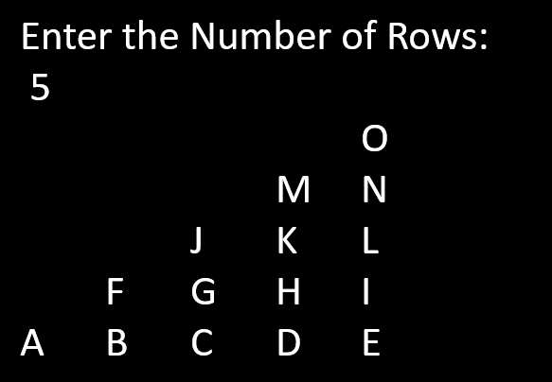
Pattern Programming
SHAMBHU KUMAR QSpiders |JSpiders, NOIDA
LEVEL-II

Slide 51

Pattern Programming
SHAMBHU KUMAR QSpiders |JSpiders, NOIDA
LEVEL-II
Important
Don’t leave it..!!

Slide 52

Pattern Programming
SHAMBHU KUMAR QSpiders |JSpiders, NOIDA
LEVEL-II
Important
Don’t leave it..!!

Slide 53

Pattern Programming
SHAMBHU KUMAR QSpiders |JSpiders, NOIDA
LEVEL-II
Important
Don’t leave it..!!

Slide 54

Pattern Programming
SHAMBHU KUMAR QSpiders |JSpiders, NOIDA
LEVEL-II
Important
Don’t leave it..!!

Slide 55

Pattern Programming
SHAMBHU KUMAR QSpiders |JSpiders, NOIDA
LEVEL-II
Important
Don’t leave it..!!

Slide 56

Pattern Programming
SHAMBHU KUMAR QSpiders |JSpiders, NOIDA
LEVEL-II

Slide 57

Pattern Programming
SHAMBHU KUMAR QSpiders |JSpiders, NOIDA
LEVEL-II

Slide 58

Pattern Programming
SHAMBHU KUMAR QSpiders |JSpiders, NOIDA
LEVEL-II

Slide 59

Pattern Programming
SHAMBHU KUMAR QSpiders |JSpiders, NOIDA
LEVEL-II

Slide 60

Pattern Programming
SHAMBHU KUMAR QSpiders |JSpiders, NOIDA
LEVEL-II

Slide 61

Pattern Programming
SHAMBHU KUMAR QSpiders |JSpiders, NOIDA
LEVEL-II

Slide 62

Pattern Programming
SHAMBHU KUMAR QSpiders |JSpiders, NOIDA
LEVEL-II
Important
Don’t leave it..!!

Slide 63

Pattern Programming
SHAMBHU KUMAR QSpiders |JSpiders, NOIDA
LEVEL-II

Slide 64

Pattern Programming
SHAMBHU KUMAR QSpiders |JSpiders, NOIDA
LEVEL-II

Slide 65

Pattern Programming
SHAMBHU KUMAR QSpiders |JSpiders, NOIDA
LEVEL-II

Slide 66

Pattern Programming
SHAMBHU KUMAR QSpiders |JSpiders, NOIDA
LEVEL-II

Slide 67

Pattern Programming
SHAMBHU KUMAR QSpiders |JSpiders, NOIDA
LEVEL-II
Important
Don’t leave it..!!

Slide 68

Pattern Programming
SHAMBHU KUMAR QSpiders |JSpiders, NOIDA
LEVEL-II
Important
Don’t leave it..!!

Slide 69

Pattern Programming
SHAMBHU KUMAR QSpiders |JSpiders, NOIDA
LEVEL-II
Important
Don’t leave it..!!

Slide 70

Pattern Programming
SHAMBHU KUMAR QSpiders |JSpiders, NOIDA
LEVEL-II

Slide 71

Pattern Programming
SHAMBHU KUMAR QSpiders |JSpiders, NOIDA
LEVEL-II
Important
Don’t leave it..!!

Slide 72

Pattern Programming
SHAMBHU KUMAR QSpiders |JSpiders, NOIDA
LEVEL-II
Important
Don’t leave it..!!

Slide 73

Pattern Programming
SHAMBHU KUMAR QSpiders |JSpiders, NOIDA
LEVEL-II

Slide 74

Pattern Programming
SHAMBHU KUMAR QSpiders |JSpiders, NOIDA
LEVEL-II
Important
Don’t leave it..!!

Slide 75

Pattern Programming
SHAMBHU KUMAR QSpiders |JSpiders, NOIDA
LEVEL-II

Slide 76

Pattern Programming
SHAMBHU KUMAR QSpiders |JSpiders, NOIDA
LEVEL-II
Important
Don’t leave it..!!

Slide 77

Pattern Programming
SHAMBHU KUMAR QSpiders |JSpiders, NOIDA
LEVEL-II

Slide 78

Pattern Programming
SHAMBHU KUMAR QSpiders |JSpiders, NOIDA
LEVEL-II

Slide 79

Pattern Programming
SHAMBHU KUMAR QSpiders |JSpiders, NOIDA
LEVEL-II
Important
Don’t leave it..!!

Slide 80

Pattern Programming
SHAMBHU KUMAR QSpiders |JSpiders, NOIDA
LEVEL-II
Important
Don’t leave it..!!

Slide 81

Pattern Programming
SHAMBHU KUMAR QSpiders |JSpiders, NOIDA
LEVEL-II

Slide 82

Pattern Programming
SHAMBHU KUMAR QSpiders |JSpiders, NOIDA
LEVEL-II

Slide 83

Pattern Programming
SHAMBHU KUMAR QSpiders |JSpiders, NOIDA
LEVEL-II

Slide 84

Pattern Programming
SHAMBHU KUMAR QSpiders |JSpiders, NOIDA
LEVEL-II
Important
Don’t leave it..!!

Slide 85

Pattern Programming
SHAMBHU KUMAR QSpiders |JSpiders, NOIDA
LEVEL-II

Slide 86

Pattern Programming
SHAMBHU KUMAR QSpiders |JSpiders, NOIDA
LEVEL-II

Slide 87

Pattern Programming
SHAMBHU KUMAR QSpiders |JSpiders, NOIDA
LEVEL-II

Slide 88

Pattern Programming
SHAMBHU KUMAR QSpiders |JSpiders, NOIDA
LEVEL-II

Slide 89

Pattern Programming
SHAMBHU KUMAR QSpiders |JSpiders, NOIDA
LEVEL-II

Slide 90

Pattern Programming
SHAMBHU KUMAR QSpiders |JSpiders, NOIDA
LEVEL-II

Slide 91

Pattern Programming
SHAMBHU KUMAR QSpiders |JSpiders, NOIDA
LEVEL-II
Important
Don’t leave it..!!

Slide 92

Pattern Programming
SHAMBHU KUMAR QSpiders |JSpiders, NOIDA
LEVEL-II

Slide 93

Pattern Programming
SHAMBHU KUMAR QSpiders |JSpiders, NOIDA
LEVEL-II
Important
Don’t leave it..!!

Slide 94

Pattern Programming
SHAMBHU KUMAR QSpiders |JSpiders, NOIDA
LEVEL-II
Important
Don’t leave it..!!

Slide 95

Pattern Programming
SHAMBHU KUMAR QSpiders |JSpiders, NOIDA
LEVEL-II
Important
Don’t leave it..!!

Slide 96

Pattern Programming
SHAMBHU KUMAR QSpiders |JSpiders, NOIDA
LEVEL-II
Important
Don’t leave it..!!

Slide 97

Pattern Programming
SHAMBHU KUMAR QSpiders |JSpiders, NOIDA
LEVEL-II

Slide 98

Pattern Programming
SHAMBHU KUMAR QSpiders |JSpiders, NOIDA
LEVEL-II
Important
Don’t leave it..!!

Slide 99

Pattern Programming
SHAMBHU KUMAR QSpiders |JSpiders, NOIDA
LEVEL-II

Slide 100

Pattern Programming
SHAMBHU KUMAR QSpiders |JSpiders, NOIDA
LEVEL-II

Slide 101

Pattern Programming
SHAMBHU KUMAR QSpiders |JSpiders, NOIDA
LEVEL-II

Slide 102

Pattern Programming
SHAMBHU KUMAR QSpiders |JSpiders, NOIDA
LEVEL-II

Slide 103

Pattern Programming
SHAMBHU KUMAR QSpiders |JSpiders, NOIDA
LEVEL-II

Slide 104

Pattern Programming
SHAMBHU KUMAR QSpiders |JSpiders, NOIDA
LEVEL-II

Slide 105

Pattern Programming
SHAMBHU KUMAR QSpiders |JSpiders, NOIDA
LEVEL-II

Slide 106

Pattern Programming
SHAMBHU KUMAR QSpiders |JSpiders, NOIDA
LEVEL-II

Slide 107

Pattern Programming
SHAMBHU KUMAR QSpiders |JSpiders, NOIDA
LEVEL-II
Important
Don’t leave it..!!

Slide 108

Pattern Programming
SHAMBHU KUMAR QSpiders |JSpiders, NOIDA
LEVEL-II
Important
Don’t leave it..!!

Slide 109

Pattern Programming
SHAMBHU KUMAR QSpiders |JSpiders, NOIDA
LEVEL-II

Slide 110

Pattern Programming
SHAMBHU KUMAR QSpiders |JSpiders, NOIDA
LEVEL-II

Slide 111

Pattern Programming
SHAMBHU KUMAR QSpiders |JSpiders, NOIDA
LEVEL-II
Important
Don’t leave it..!!

Slide 112

Pattern Programming
SHAMBHU KUMAR QSpiders |JSpiders, NOIDA
LEVEL-II

Slide 113

Pattern Programming
SHAMBHU KUMAR QSpiders |JSpiders, NOIDA
LEVEL-II

Slide 114

Pattern Programming
SHAMBHU KUMAR QSpiders |JSpiders, NOIDA
LEVEL-II

Slide 115

Pattern Programming
SHAMBHU KUMAR QSpiders |JSpiders, NOIDA
LEVEL-II

Slide 116

Pattern Programming
SHAMBHU KUMAR QSpiders |JSpiders, NOIDA
LEVEL-II
Important
Don’t leave it..!!

Slide 117

Pattern Programming
SHAMBHU KUMAR QSpiders |JSpiders, NOIDA
LEVEL-II
Important
Don’t leave it..!!

Slide 118

Pattern Programming
SHAMBHU KUMAR QSpiders |JSpiders, NOIDA
LEVEL-II
Important
Don’t leave it..!!

Slide 119

Pattern Programming
SHAMBHU KUMAR QSpiders |JSpiders, NOIDA
LEVEL-II
Important
Don’t leave it..!!

Slide 120

Pattern Programming
SHAMBHU KUMAR QSpiders |JSpiders, NOIDA
LEVEL-II

Slide 121

Pattern Programming
SHAMBHU KUMAR QSpiders |JSpiders, NOIDA
LEVEL-II

Slide 122

Pattern Programming
SHAMBHU KUMAR QSpiders |JSpiders, NOIDA
LEVEL-II

Slide 123

Pattern Programming
SHAMBHU KUMAR QSpiders |JSpiders, NOIDA
LEVEL-II

Slide 124

Pattern Programming
SHAMBHU KUMAR QSpiders |JSpiders, NOIDA
LEVEL-II

Slide 125

Pattern Programming
SHAMBHU KUMAR QSpiders |JSpiders, NOIDA
LEVEL-II

Slide 126

Pattern Programming
SHAMBHU KUMAR QSpiders |JSpiders, NOIDA
LEVEL-II

Slide 127

Pattern Programming
SHAMBHU KUMAR QSpiders |JSpiders, NOIDA
LEVEL-II

Slide 128

Pattern Programming
SHAMBHU KUMAR QSpiders |JSpiders, NOIDA
LEVEL-II

Slide 129

Pattern Programming
SHAMBHU KUMAR QSpiders |JSpiders, NOIDA
LEVEL-II

Slide 130

Pattern Programming
SHAMBHU KUMAR QSpiders |JSpiders, NOIDA
LEVEL-II
Important
Don’t leave it..!!

Slide 131

Pattern Programming
SHAMBHU KUMAR QSpiders |JSpiders, NOIDA
LEVEL-II
Important
Don’t leave it..!!

Slide 132

Pattern Programming
SHAMBHU KUMAR QSpiders |JSpiders, NOIDA
LEVEL-II
Important
Don’t leave it..!!

Slide 133

Pattern Programming
SHAMBHU KUMAR QSpiders |JSpiders, NOIDA
LEVEL-II
Important
Don’t leave it..!!

Slide 134

Pattern Programming
SHAMBHU KUMAR QSpiders |JSpiders, NOIDA
LEVEL-II
Important
Don’t leave it..!!

Slide 135

Pattern Programming
SHAMBHU KUMAR QSpiders |JSpiders, NOIDA
LEVEL-II

Slide 136

Pattern Programming
SHAMBHU KUMAR QSpiders |JSpiders, NOIDA
LEVEL-II

Slide 137

Pattern Programming
SHAMBHU KUMAR QSpiders |JSpiders, NOIDA
LEVEL-II
Important
Don’t leave it..!!

Slide 138

Pattern Programming
SHAMBHU KUMAR QSpiders |JSpiders, NOIDA
LEVEL-II

Slide 139

Pattern Programming
SHAMBHU KUMAR QSpiders |JSpiders, NOIDA
LEVEL-II

Slide 140

Pattern Programming
SHAMBHU KUMAR QSpiders |JSpiders, NOIDA
LEVEL-II

Slide 141

Pattern Programming
SHAMBHU KUMAR QSpiders |JSpiders, NOIDA
LEVEL-II

Slide 142

Pattern Programming
SHAMBHU KUMAR QSpiders |JSpiders, NOIDA
LEVEL-II

Slide 143

Pattern Programming
SHAMBHU KUMAR QSpiders |JSpiders, NOIDA
LEVEL-II

Slide 144

Pattern Programming
SHAMBHU KUMAR QSpiders |JSpiders, NOIDA
LEVEL-II

Slide 145

Pattern Programming
SHAMBHU KUMAR QSpiders |JSpiders, NOIDA
LEVEL-II

Slide 146

Pattern Programming
SHAMBHU KUMAR QSpiders |JSpiders, NOIDA
LEVEL-II

Slide 147

Pattern Programming
SHAMBHU KUMAR QSpiders |JSpiders, NOIDA
LEVEL-II
Important
Don’t leave it..!!

Slide 148

Pattern Programming
SHAMBHU KUMAR QSpiders |JSpiders, NOIDA
LEVEL-II
Important
Don’t leave it..!!

Slide 149

Pattern Programming
SHAMBHU KUMAR QSpiders |JSpiders, NOIDA
LEVEL-II

Slide 150

Pattern Programming
SHAMBHU KUMAR QSpiders |JSpiders, NOIDA
LEVEL-II

Slide 151

Pattern Programming
SHAMBHU KUMAR QSpiders |JSpiders, NOIDA
LEVEL-II
Important
Don’t leave it..!!

Slide 152

Pattern Programming
SHAMBHU KUMAR QSpiders |JSpiders, NOIDA
LEVEL-II

Slide 153

Pattern Programming
SHAMBHU KUMAR QSpiders |JSpiders, NOIDA
LEVEL-II

Slide 154

Pattern Programming
SHAMBHU KUMAR QSpiders |JSpiders, NOIDA
LEVEL-II

Slide 155

Pattern Programming
SHAMBHU KUMAR QSpiders |JSpiders, NOIDA
LEVEL-II

Slide 156

Pattern Programming
SHAMBHU KUMAR QSpiders |JSpiders, NOIDA
LEVEL-II

Slide 157

Pattern Programming
SHAMBHU KUMAR QSpiders |JSpiders, NOIDA
LEVEL-II

Slide 158

Pattern Programming
SHAMBHU KUMAR QSpiders |JSpiders, NOIDA
LEVEL-II
Important
Don’t leave it..!!

Slide 159

Pattern Programming
SHAMBHU KUMAR QSpiders |JSpiders, NOIDA
LEVEL-II
Important
Don’t leave it..!!

Slide 160

Pattern Programming
SHAMBHU KUMAR QSpiders |JSpiders, NOIDA
LEVEL-II

Slide 161

Pattern Programming
SHAMBHU KUMAR QSpiders |JSpiders, NOIDA
LEVEL-II
Important
Don’t leave it..!!

Slide 162

Pattern Programming
SHAMBHU KUMAR QSpiders |JSpiders, NOIDA
LEVEL-II
Important
Don’t leave it..!!

Slide 163

Pattern Programming
SHAMBHU KUMAR QSpiders |JSpiders, NOIDA
LEVEL-II

Slide 164

Pattern Programming
SHAMBHU KUMAR QSpiders |JSpiders, NOIDA
LEVEL-II
Important
Don’t leave it..!!

Slide 165

Pattern Programming
SHAMBHU KUMAR QSpiders |JSpiders, NOIDA
LEVEL-II

Slide 166

Pattern Programming
SHAMBHU KUMAR QSpiders |JSpiders, NOIDA
LEVEL-II

Slide 167

Pattern Programming
SHAMBHU KUMAR QSpiders |JSpiders, NOIDA
LEVEL-II
Important
Don’t leave it..!!

Slide 168

Pattern Programming
SHAMBHU KUMAR QSpiders |JSpiders, NOIDA
LEVEL-II

Slide 169

Pattern Programming
SHAMBHU KUMAR QSpiders |JSpiders, NOIDA
LEVEL-II

Slide 170

Pattern Programming
SHAMBHU KUMAR QSpiders |JSpiders, NOIDA
LEVEL-II

Slide 171

Pattern Programming
SHAMBHU KUMAR QSpiders |JSpiders, NOIDA
LEVEL-II
Important
Don’t leave it..!!

Slide 172

Pattern Programming
SHAMBHU KUMAR QSpiders |JSpiders, NOIDA
LEVEL-II

Slide 173

Pattern Programming
SHAMBHU KUMAR QSpiders |JSpiders, NOIDA
LEVEL-II
Important
Don’t leave it..!!

Slide 174

Pattern Programming
SHAMBHU KUMAR QSpiders |JSpiders, NOIDA
LEVEL-II
Important
Don’t leave it..!!

Slide 175

Pattern Programming
SHAMBHU KUMAR QSpiders |JSpiders, NOIDA
LEVEL-II

Slide 176

Pattern Programming
SHAMBHU KUMAR QSpiders |JSpiders, NOIDA
LEVEL-II

Slide 177

Pattern Programming
SHAMBHU KUMAR QSpiders |JSpiders, NOIDA
LEVEL-II

Slide 178

Pattern Programming
SHAMBHU KUMAR QSpiders |JSpiders, NOIDA
LEVEL-II

Slide 179

Pattern Programming
SHAMBHU KUMAR QSpiders |JSpiders, NOIDA
LEVEL-II
Important
Don’t leave it..!!

Slide 180

Pattern Programming
SHAMBHU KUMAR QSpiders |JSpiders, NOIDA
LEVEL-II
Important
Don’t leave it..!!

Slide 181

Pattern Programming
SHAMBHU KUMAR QSpiders |JSpiders, NOIDA
LEVEL-II
Important
Don’t leave it..!!

Slide 182

Pattern Programming
SHAMBHU KUMAR QSpiders |JSpiders, NOIDA
LEVEL-II
Important
Don’t leave it..!!

Slide 183

Pattern Programming
SHAMBHU KUMAR QSpiders |JSpiders, NOIDA
LEVEL-II

Slide 184

Pattern Programming
SHAMBHU KUMAR QSpiders |JSpiders, NOIDA
LEVEL-II
Important
Don’t leave it..!!

Slide 185

Pattern Programming
SHAMBHU KUMAR QSpiders |JSpiders, NOIDA
LEVEL-II
Important
Don’t leave it..!!

Slide 186

Pattern Programming
SHAMBHU KUMAR QSpiders |JSpiders, NOIDA
LEVEL-II

Slide 187

Pattern Programming
SHAMBHU KUMAR QSpiders |JSpiders, NOIDA
LEVEL-II

Slide 188

Pattern Programming
SHAMBHU KUMAR QSpiders |JSpiders, NOIDA
LEVEL-II
Important
Don’t leave it..!!

Slide 189

Pattern Programming
SHAMBHU KUMAR QSpiders |JSpiders, NOIDA
LEVEL-II
Important
Don’t leave it..!!

Slide 190

Pattern Programming
SHAMBHU KUMAR QSpiders |JSpiders, NOIDA
LEVEL-II
Important
Don’t leave it..!!

Slide 191

Pattern Programming
SHAMBHU KUMAR QSpiders |JSpiders, NOIDA
LEVEL-II

Slide 192

Pattern Programming
SHAMBHU KUMAR QSpiders |JSpiders, NOIDA
LEVEL-II

Slide 193

Pattern Programming
SHAMBHU KUMAR QSpiders |JSpiders, NOIDA
LEVEL-II

Slide 194

Pattern Programming
SHAMBHU KUMAR QSpiders |JSpiders, NOIDA
LEVEL-II

Slide 195

Pattern Programming
SHAMBHU KUMAR QSpiders |JSpiders, NOIDA
LEVEL-II

Slide 196

Pattern Programming
SHAMBHU KUMAR QSpiders |JSpiders, NOIDA
LEVEL-II

Slide 197

Pattern Programming
SHAMBHU KUMAR QSpiders |JSpiders, NOIDA
LEVEL-II

Slide 198

Pattern Programming
SHAMBHU KUMAR QSpiders |JSpiders, NOIDA
LEVEL-II

Slide 199

Pattern Programming
SHAMBHU KUMAR QSpiders |JSpiders, NOIDA
LEVEL-II
Important
Don’t leave it..!!

Slide 200

Pattern Programming
SHAMBHU KUMAR QSpiders |JSpiders, NOIDA
LEVEL-II
Important
Don’t leave it..!!

Slide 201

Pattern Programming
SHAMBHU KUMAR QSpiders |JSpiders, NOIDA
LEVEL-II

Slide 202

Pattern Programming
SHAMBHU KUMAR QSpiders |JSpiders, NOIDA
LEVEL-II

Slide 203

Pattern Programming
SHAMBHU KUMAR QSpiders |JSpiders, NOIDA
LEVEL-II

Slide 204

Pattern Programming
SHAMBHU KUMAR QSpiders |JSpiders, NOIDA
LEVEL-II

Slide 205

Pattern Programming
SHAMBHU KUMAR QSpiders |JSpiders, NOIDA
LEVEL-II
Important
Don’t leave it..!!

Slide 206

Pattern Programming
SHAMBHU KUMAR QSpiders |JSpiders, NOIDA
LEVEL-II

Slide 207

Pattern Programming
SHAMBHU KUMAR QSpiders |JSpiders, NOIDA
LEVEL-II

Slide 208

Pattern Programming
SHAMBHU KUMAR QSpiders |JSpiders, NOIDA
LEVEL-II

Slide 209

Pattern Programming
SHAMBHU KUMAR QSpiders |JSpiders, NOIDA
LEVEL-II
Important
Don’t leave it..!!

Slide 210

Pattern Programming
SHAMBHU KUMAR QSpiders |JSpiders, NOIDA
LEVEL-II

Slide 211

Pattern Programming
SHAMBHU KUMAR QSpiders |JSpiders, NOIDA
LEVEL-II

Slide 212

Pattern Programming
SHAMBHU KUMAR QSpiders |JSpiders, NOIDA
LEVEL-II

Slide 213

Pattern Programming
SHAMBHU KUMAR QSpiders |JSpiders, NOIDA
LEVEL-II
Important
Don’t leave it..!!

Slide 214

Pattern Programming
SHAMBHU KUMAR QSpiders |JSpiders, NOIDA
LEVEL-II
Important
Don’t leave it..!!

Slide 215
Pattern Programming
SHAMBHU KUMAR QSpiders |JSpiders, NOIDA
LEVEL-II
Print the below Series:
2, 6, 12, 20, 30, 42, ...

Slide 216

Pattern Programming
SHAMBHU KUMAR QSpiders |JSpiders, NOIDA
LEVEL-II

Slide 217

Pattern Programming
SHAMBHU KUMAR QSpiders |JSpiders, NOIDA
LEVEL-II

Slide 218

Pattern Programming
SHAMBHU KUMAR QSpiders |JSpiders, NOIDA
LEVEL-II

Slide 219

Pattern Programming
SHAMBHU KUMAR QSpiders |JSpiders, NOIDA
LEVEL-II

Slide 220
Pattern Programming
SHAMBHU KUMAR QSpiders |JSpiders, NOIDA
LEVEL-II
Print the below series:
2 5 11 23 47 95 191 383 767 1535
Important
Don’t leave it..!!

Slide 221
Pattern Programming
SHAMBHU KUMAR QSpiders |JSpiders, NOIDA
LEVEL-II
Print the below series:
3, 5, 9, 17, 33, ...

Slide 222
Pattern Programming
SHAMBHU KUMAR QSpiders |JSpiders, NOIDA
LEVEL-II
Print the below series:
1, 2, 5, 26, 677, ...

Slide 223
Pattern Programming
SHAMBHU KUMAR QSpiders |JSpiders, NOIDA
LEVEL-II
Print the below series:
1, 2, 6, 7, 21, 22, 66, ...

Slide 224
Pattern Programming
SHAMBHU KUMAR QSpiders |JSpiders, NOIDA
LEVEL-II
Print the below Fibonacci Series
0, 1, 1, 2, 3, 5, 8, 13, 21, ...
Important
Don’t leave it..!!

Slide 225
Pattern Programming
SHAMBHU KUMAR QSpiders |JSpiders, NOIDA
LEVEL-II
Print the below Tribonacci Series:
0, 0, 1, 1, 2, 4, 7, 13, 24, ...
Important
Don’t leave it..!!

Slide 226
Pattern Programming
SHAMBHU KUMAR QSpiders |JSpiders, NOIDA
LEVEL-II
Print the below Series:
1, 3, 7, 15, 31, 63, ...

Slide 227
Pattern Programming
SHAMBHU KUMAR QSpiders |JSpiders, NOIDA
LEVEL-II
Print the below Series:
1, 3, 7, 13, 21, ...

Slide 228

Pattern Programming
SHAMBHU KUMAR QSpiders |JSpiders, NOIDA
LEVEL-II

Slide 229

Pattern Programming
SHAMBHU KUMAR QSpiders |JSpiders, NOIDA
LEVEL-II

Slide 230

Pattern Programming
SHAMBHU KUMAR QSpiders |JSpiders, NOIDA
LEVEL-II

Slide 231

Pattern Programming
SHAMBHU KUMAR QSpiders |JSpiders, NOIDA
LEVEL-II

Slide 232

Pattern Programming
SHAMBHU KUMAR QSpiders |JSpiders, NOIDA
LEVEL-II

Slide 233

Pattern Programming
SHAMBHU KUMAR QSpiders |JSpiders, NOIDA
LEVEL-II

Slide 234

Pattern Programming
SHAMBHU KUMAR QSpiders |JSpiders, NOIDA
LEVEL-II
Important
Don’t leave it..!!

Slide 235

Pattern Programming
SHAMBHU KUMAR QSpiders |JSpiders, NOIDA
LEVEL-II
Important
Don’t leave it..!!

Slide 236

Pattern Programming
SHAMBHU KUMAR QSpiders |JSpiders, NOIDA
LEVEL-II
Important
Don’t leave it..!!

Slide 237

Pattern Programming
SHAMBHU KUMAR QSpiders |JSpiders, NOIDA
LEVEL-II
Important
Don’t leave it..!!

Slide 238

Pattern Programming
SHAMBHU KUMAR QSpiders |JSpiders, NOIDA
LEVEL-II
Important
Don’t leave it..!!

Slide 239

Pattern Programming
SHAMBHU KUMAR QSpiders |JSpiders, NOIDA
LEVEL-II
Important
Don’t leave it..!!

Slide 240

Pattern Programming
SHAMBHU KUMAR QSpiders |JSpiders, NOIDA
LEVEL-II

Slide 241

Pattern Programming
SHAMBHU KUMAR QSpiders |JSpiders, NOIDA
LEVEL-II

Slide 242

Pattern Programming
SHAMBHU KUMAR QSpiders |JSpiders, NOIDA
LEVEL-III

Slide 243

Pattern Programming
SHAMBHU KUMAR QSpiders |JSpiders, NOIDA
LEVEL-III

Slide 244

Pattern Programming
SHAMBHU KUMAR QSpiders |JSpiders, NOIDA
LEVEL-III

Slide 245

Pattern Programming
SHAMBHU KUMAR QSpiders |JSpiders, NOIDA
LEVEL-III

Slide 246

Pattern Programming
SHAMBHU KUMAR QSpiders |JSpiders, NOIDA
LEVEL-III

Slide 247

Pattern Programming
SHAMBHU KUMAR QSpiders |JSpiders, NOIDA
LEVEL-III

Slide 248

Pattern Programming
SHAMBHU KUMAR QSpiders |JSpiders, NOIDA
LEVEL-III

Slide 249

Pattern Programming
SHAMBHU KUMAR QSpiders |JSpiders, NOIDA
LEVEL-III

Slide 250

Pattern Programming
SHAMBHU KUMAR QSpiders |JSpiders, NOIDA
LEVEL-III

Slide 251

Pattern Programming
SHAMBHU KUMAR QSpiders |JSpiders, NOIDA
LEVEL-III

Slide 252

Pattern Programming
SHAMBHU KUMAR QSpiders |JSpiders, NOIDA
LEVEL-III

Slide 253

Pattern Programming
SHAMBHU KUMAR QSpiders |JSpiders, NOIDA
LEVEL-III

Slide 254

Pattern Programming
SHAMBHU KUMAR QSpiders |JSpiders, NOIDA
LEVEL-III

Slide 255

Pattern Programming
SHAMBHU KUMAR QSpiders |JSpiders, NOIDA
LEVEL-III

Slide 256

Pattern Programming
SHAMBHU KUMAR QSpiders |JSpiders, NOIDA
LEVEL-III

Slide 257

Pattern Programming
SHAMBHU KUMAR QSpiders |JSpiders, NOIDA
LEVEL-III

Slide 258

Pattern Programming
SHAMBHU KUMAR QSpiders |JSpiders, NOIDA
LEVEL-III

Slide 259

Pattern Programming
SHAMBHU KUMAR QSpiders |JSpiders, NOIDA
LEVEL-III

Slide 260

Pattern Programming
SHAMBHU KUMAR QSpiders |JSpiders, NOIDA
LEVEL-III

Slide 261

Pattern Programming
SHAMBHU KUMAR QSpiders |JSpiders, NOIDA
LEVEL-III

Slide 262

Pattern Programming
SHAMBHU KUMAR QSpiders |JSpiders, NOIDA
LEVEL-III

Slide 263

Pattern Programming
SHAMBHU KUMAR QSpiders |JSpiders, NOIDA
LEVEL-III

Slide 264

Pattern Programming
SHAMBHU KUMAR QSpiders |JSpiders, NOIDA
LEVEL-III

Slide 265

Pattern Programming
SHAMBHU KUMAR QSpiders |JSpiders, NOIDA
LEVEL-III

Slide 266

Pattern Programming
SHAMBHU KUMAR QSpiders |JSpiders, NOIDA
LEVEL-III

Slide 267

Pattern Programming
SHAMBHU KUMAR QSpiders |JSpiders, NOIDA
LEVEL-III

Slide 268

Pattern Programming
SHAMBHU KUMAR QSpiders |JSpiders, NOIDA
LEVEL-III
Pascal Triangle:
Important
Don’t leave it..!!

Slide 269

Pattern Programming
SHAMBHU KUMAR QSpiders |JSpiders, NOIDA
LEVEL-III

Slide 270

Pattern Programming
SHAMBHU KUMAR QSpiders |JSpiders, NOIDA
LEVEL-III

Slide 271

Pattern Programming
SHAMBHU KUMAR QSpiders |JSpiders, NOIDA
LEVEL-III

Slide 272

Pattern Programming
SHAMBHU KUMAR QSpiders |JSpiders, NOIDA
LEVEL-III

Slide 273

Pattern Programming
SHAMBHU KUMAR QSpiders |JSpiders, NOIDA
LEVEL-III

Slide 274

Pattern Programming
SHAMBHU KUMAR QSpiders |JSpiders, NOIDA
LEVEL-III

Slide 275

Pattern Programming
SHAMBHU KUMAR QSpiders |JSpiders, NOIDA
LEVEL-III

Slide 276

Pattern Programming
SHAMBHU KUMAR QSpiders |JSpiders, NOIDA
LEVEL-III

Slide 277

Pattern Programming
SHAMBHU KUMAR QSpiders |JSpiders, NOIDA
LEVEL-III

Slide 278

Pattern Programming
SHAMBHU KUMAR QSpiders |JSpiders, NOIDA
LEVEL-III

Slide 279

Pattern Programming
SHAMBHU KUMAR QSpiders |JSpiders, NOIDA
LEVEL-III

Slide 280

Pattern Programming
SHAMBHU KUMAR QSpiders |JSpiders, NOIDA
LEVEL-III

Slide 281

Pattern Programming
SHAMBHU KUMAR QSpiders |JSpiders, NOIDA
LEVEL-III
Important
Don’t leave it..!!

Slide 282

Pattern Programming
SHAMBHU KUMAR QSpiders |JSpiders, NOIDA
LEVEL-III
Important
Don’t leave it..!!

