Slide 1
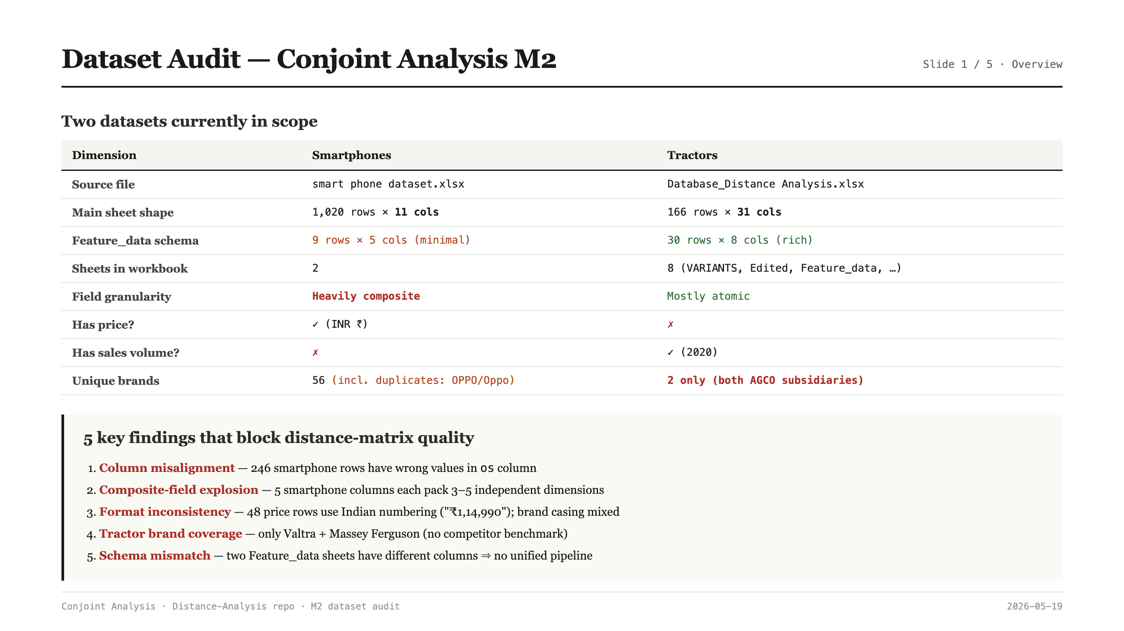
Notes:
Dataset Audit — Overview
Two datasets in scope: smartphones (1020 x 11) and tractors (166 x 31). Their Feature_data schemas differ (5 cols vs 8 cols), which already blocks a unified pipeline. Five core issues will drive the rest of the deck: column misalignment, composite-field explosion, format inconsistency, tractor brand coverage, and schema mismatch.

Slide 2
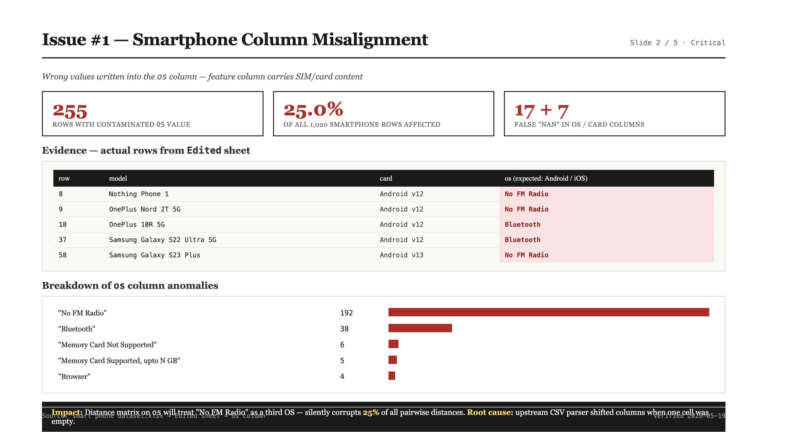
Notes:
Issue #1 — Smartphone Column Misalignment (P0)
255 rows (25% of the smartphone dataset) have the wrong value written into the `os` column — values like 'No FM Radio' (192 rows), 'Bluetooth' (38), and 'Memory Card Not Supported' (6) leaked in from neighbouring columns. Root cause is an upstream CSV parser that shifted columns when a cell was empty. Impact: the distance matrix on `os` silently treats 'No FM Radio' as a third operating system, corrupting 25% of all pairwise distances.

Slide 3
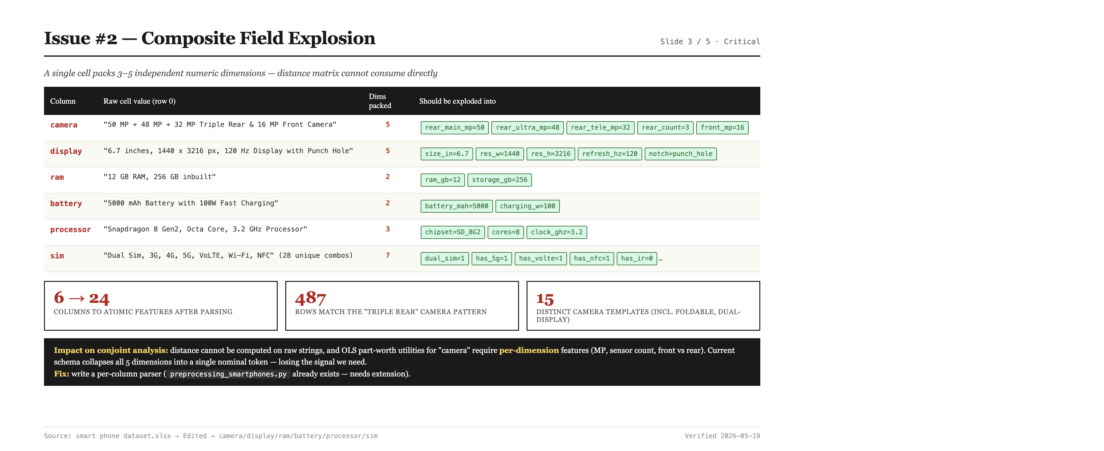
Notes:
Issue #2 — Composite-Field Explosion (P0)
Six smartphone columns each pack 3-5 independent dimensions into a single cell. Camera holds five numbers (3 rear MPs + lens count + front MP), display holds size + resolution + refresh rate + notch type, and so on. Distance cannot be computed on these raw strings, and conjoint OLS needs per-dimension features to estimate part-worth utilities. Fix is a regex parser per field — preprocessing_smartphones.py already exists, just needs extension. Estimated 1-2 days of work.

Slide 4
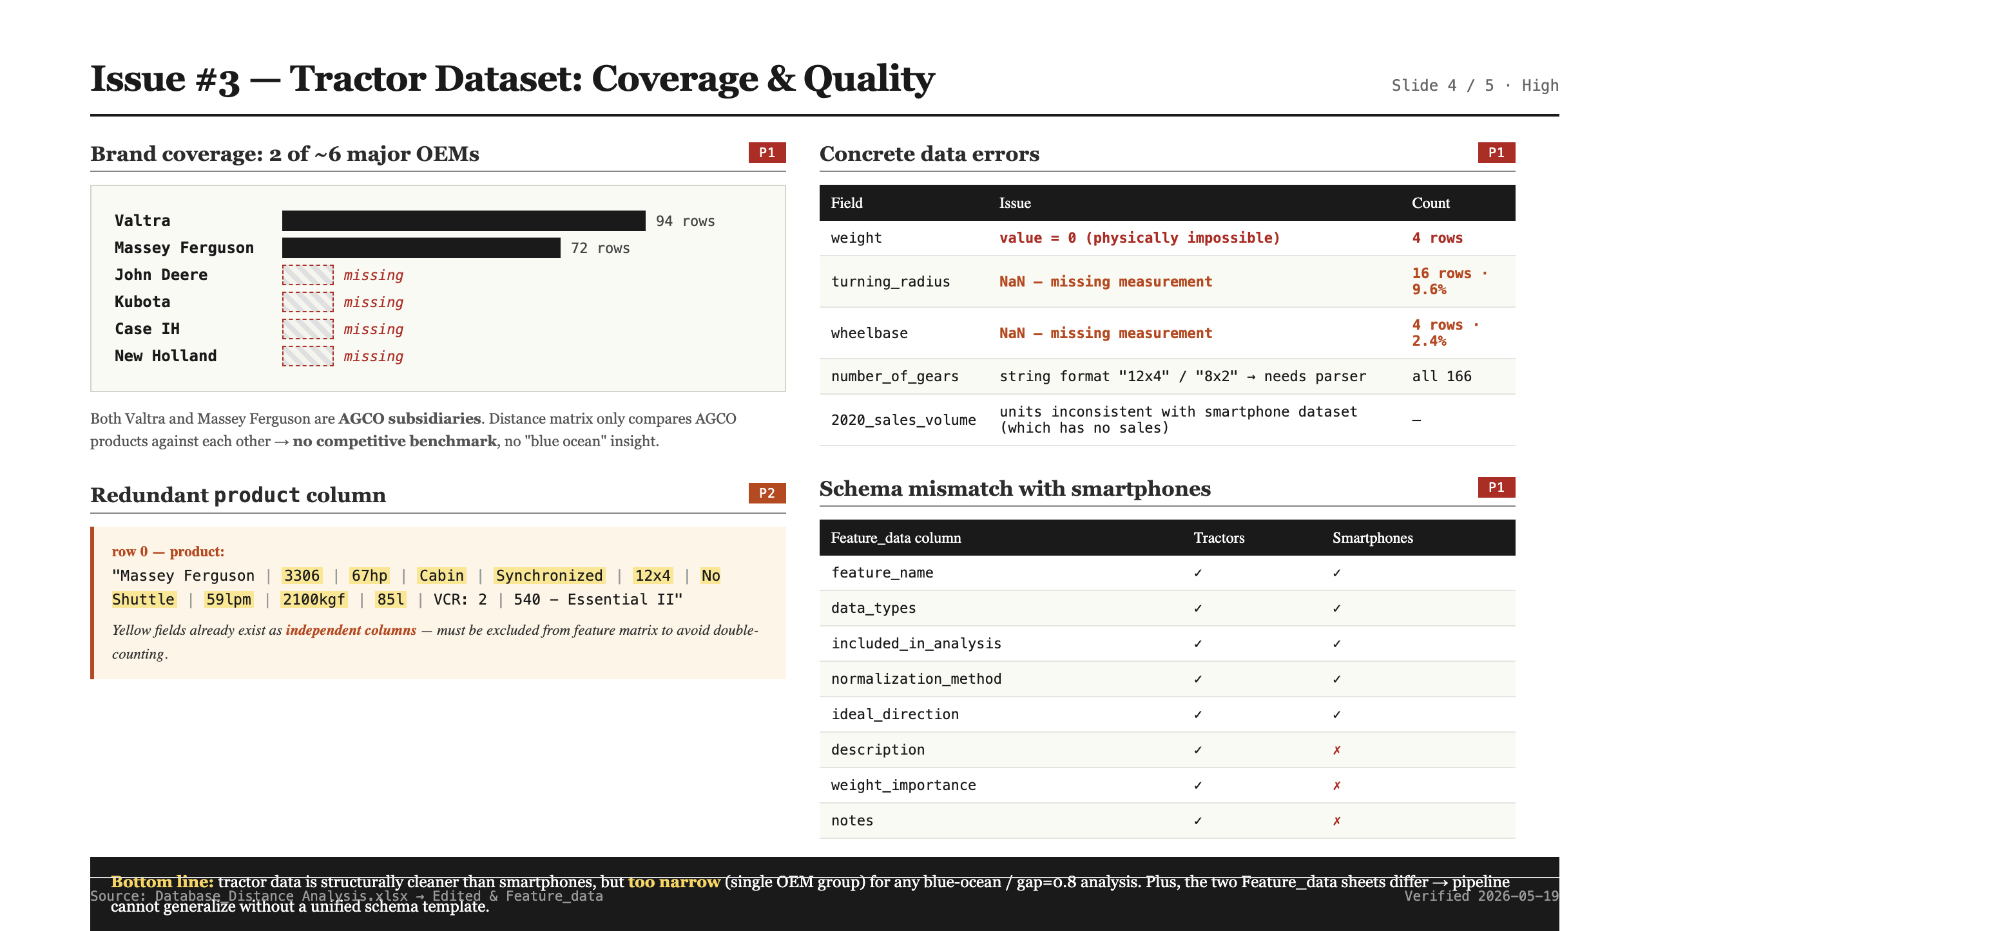
Notes:
Issue #3 — Tractor Coverage & Quality (P1)
Tractor data is structurally cleaner (31 atomic columns) but suffers from two issues. First, brand coverage: only Valtra and Massey Ferguson, both AGCO subsidiaries — no competitor benchmark for John Deere, Kubota, Case IH, or New Holland. Distance results are intra-AGCO only, not useful for blue-ocean analysis. Second, concrete errors: weight=0 in 4 rows, turning_radius missing in 9.6%, and the `product` column is a redundant pipe-concat of fields that already exist as independent columns.

Slide 5
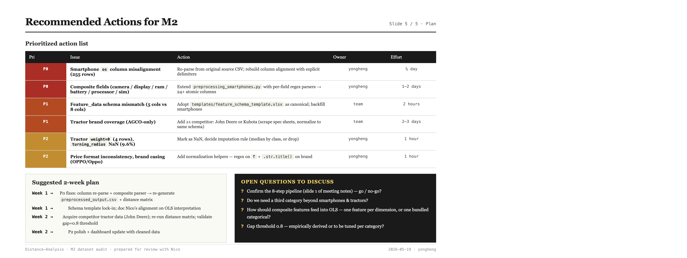
Notes:
Recommended Actions for M2
Six prioritized actions: two P0 (column re-parse + composite parser, owner yongheng), two P1 (schema template + tractor competitor data, team), two P2 (numeric error handling + format normalization). Suggested 2-week plan: Week 1 = P0 + schema lock-in + Nico alignment; Week 2 = competitor data + P2 polish + dashboard update. Four open questions for the team: 8-step pipeline confirmation, third product category, composite features in OLS, gap=0.8 threshold tuning.

