Slide 1
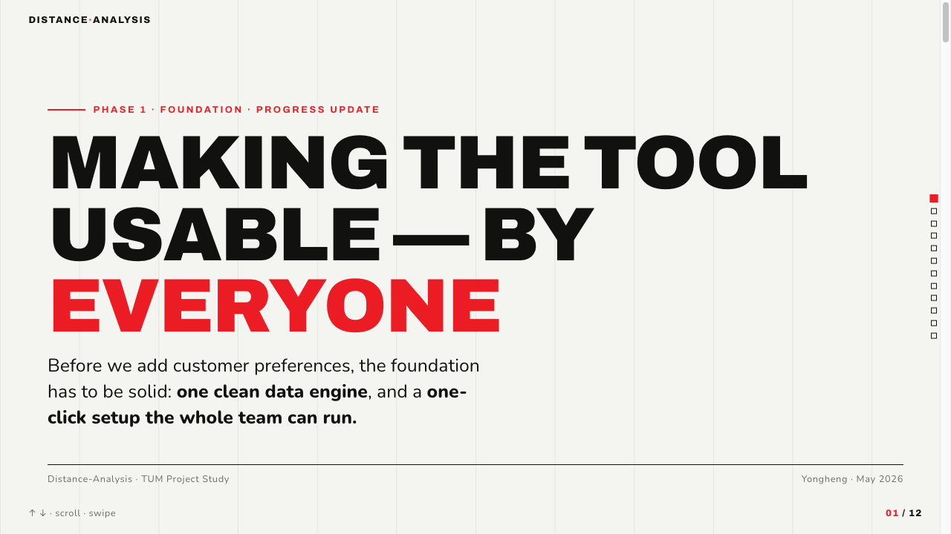
Notes:
1 · Title — Making the tool usable, by everyone
This is a Phase 1 progress update. Before we layer customer preferences onto the tool, the foundation has to be solid. Two things this update delivers: one clean data engine, and a one-click setup the whole team can run.

Slide 2
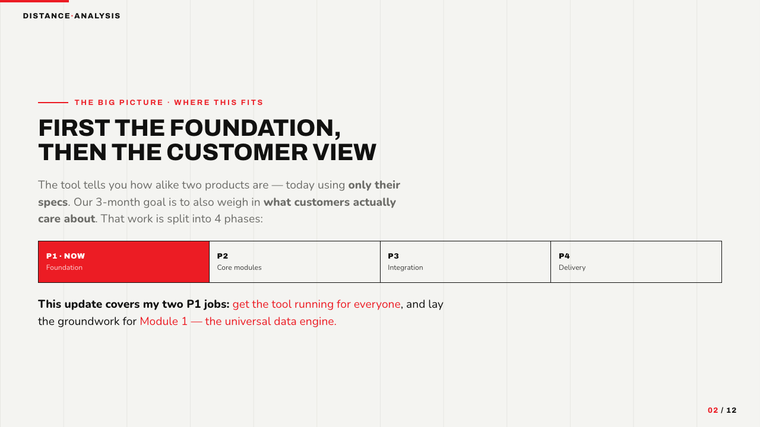
Notes:
2 · Where this fits
Quick map of the project. The tool today tells you how alike two products are using only their technical specs. Our 3-month goal is to also weigh in what customers care about. The work is split into four phases; we are in P1, the foundation. This update covers my two P1 jobs: get the tool running for everyone, and lay the groundwork for Module 1, the universal data engine.

Slide 3
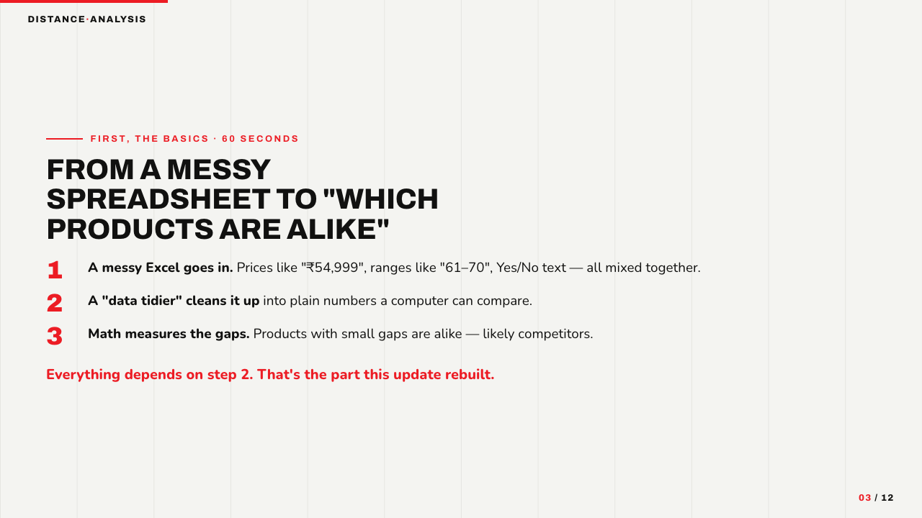
Notes:
3 · How the tool works (60-second primer)
Primer for anyone non-technical. A messy Excel goes in - prices with currency symbols, ranges like 61-70, Yes/No text. A 'data tidier' cleans it into plain numbers. Then math measures the gaps; small gaps mean similar products, likely competitors. Everything depends on that middle step - and that is the part we rebuilt.

Slide 4
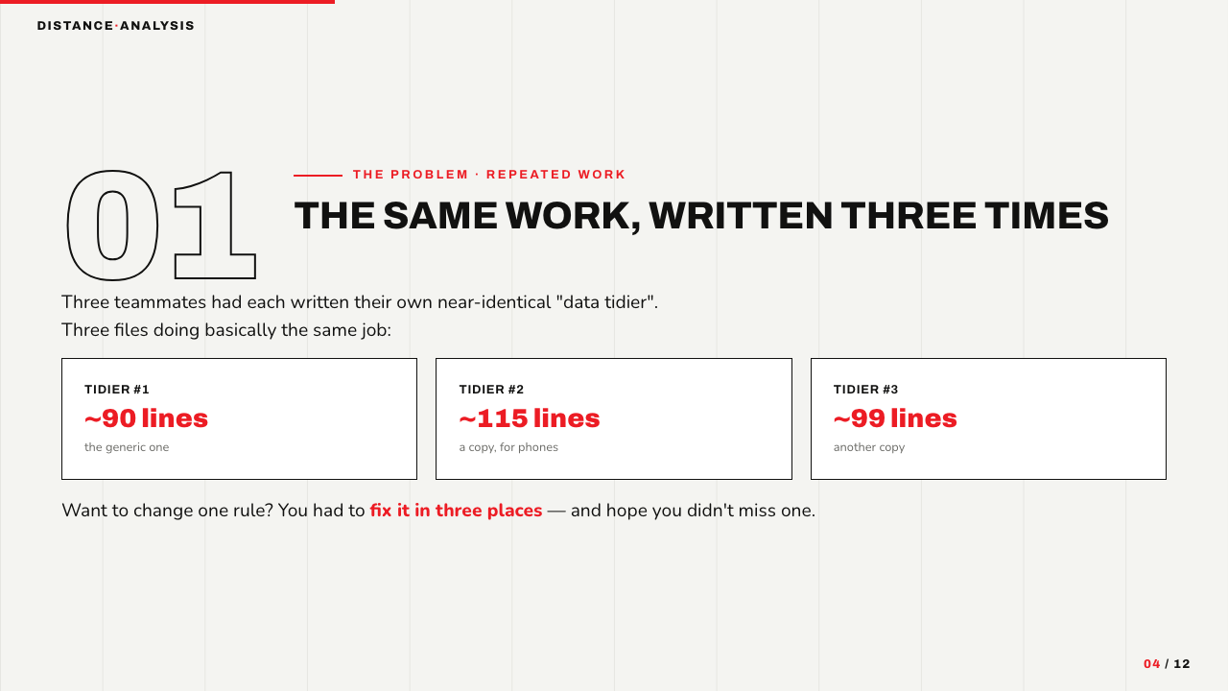
Notes:
4 · Problem 1 — the same work, written three times
The first problem was duplication. Three teammates had each written their own near-identical data tidier - about 90, 115 and 99 lines, all doing basically the same job. Changing one rule meant editing three files and hoping you did not miss one. A bug fixed in one copy stayed alive in the others.

Slide 5
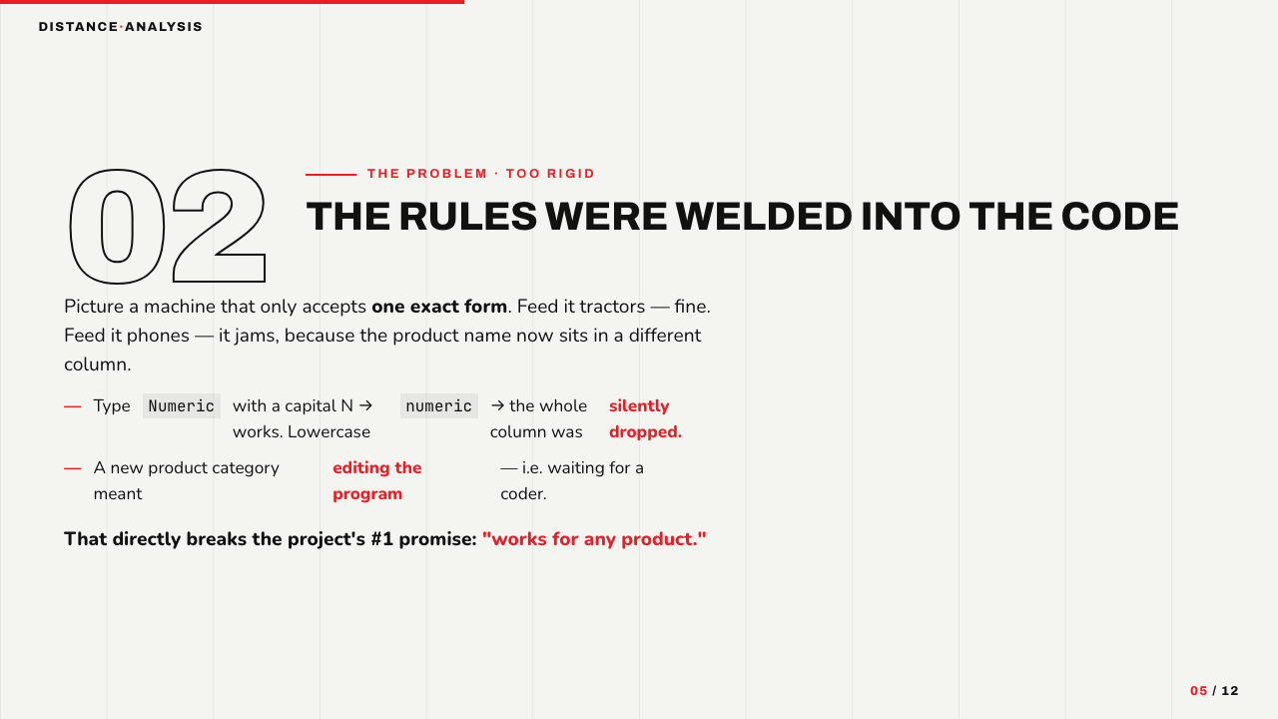
Notes:
5 · Problem 2 — the rules were welded into the code
The second problem was rigidity. The code only accepted one exact format. The product name was hardcoded to one column, so the phone data - which uses a different column - jammed it. It also only matched exact spellings: 'Numeric' worked, lowercase 'numeric' silently dropped the whole column. A new product category meant editing source code, which breaks the project's core promise of working for any product.

Slide 6
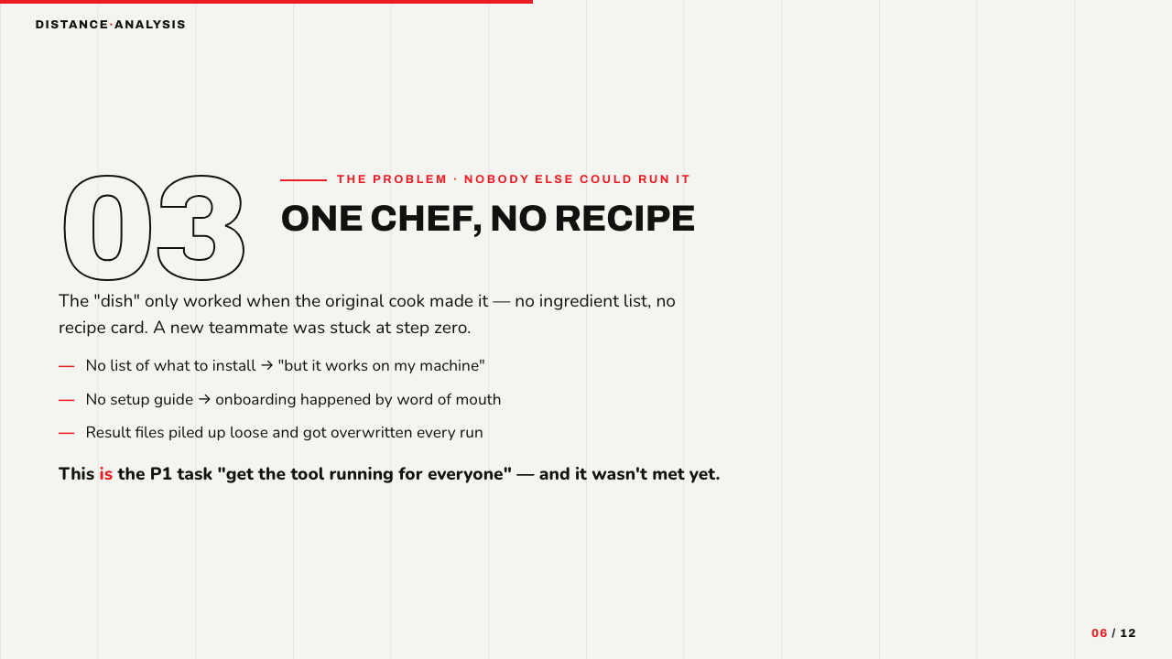
Notes:
6 · Problem 3 — one chef, no recipe
The third problem: only the original author could run it. No list of what to install, no setup guide, results piled up loose and got overwritten. A new teammate was stuck at step zero. This is exactly the P1 task 'get the tool running for everyone' - and it was not met yet.

Slide 7
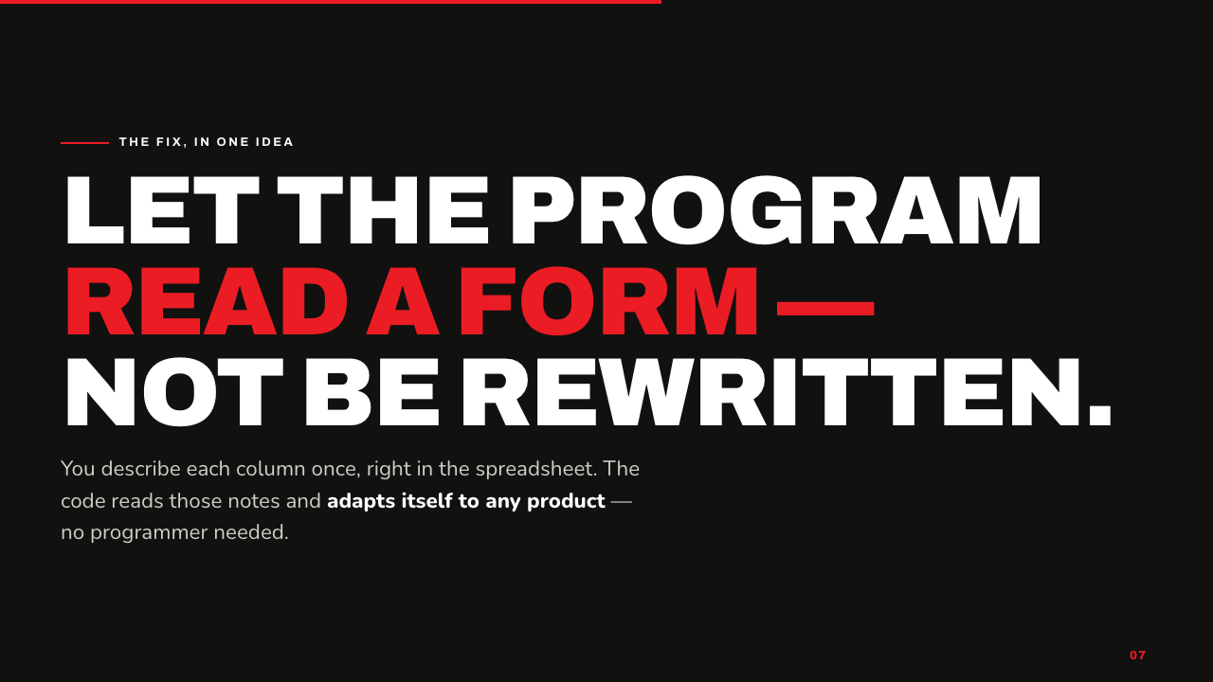
Notes:
7 · The fix, in one idea
The fix in one idea: let the program read a form instead of being rewritten. You describe each column once, right in the spreadsheet, and the code adapts itself to any product - no programmer needed.

Slide 8
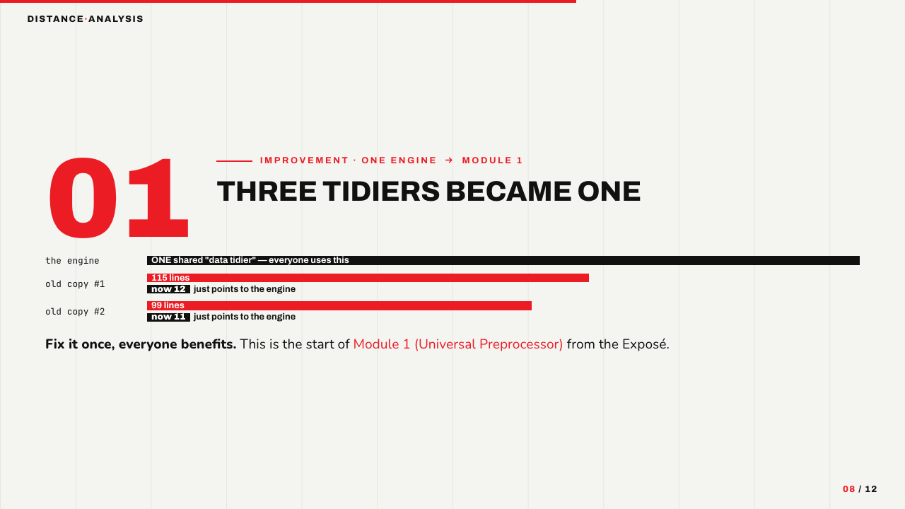
Notes:
8 · Improvement 1 — three tidiers became one (Module 1)
First improvement: the three tidiers became one shared engine. The two old files shrank to about a dozen lines each - they now just point at the engine. Fix it once, everyone benefits. This is the start of Module 1, the Universal Preprocessor from the Exposé.

Slide 9
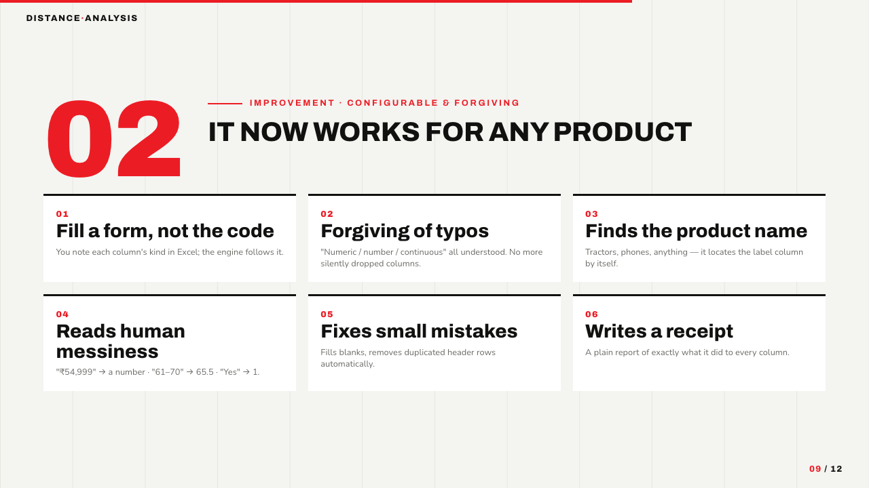
Notes:
9 · Improvement 2 — it now works for any product
Second improvement: configurable and forgiving. You fill in a form, not the code. It tolerates spelling variants, finds the product-name column by itself, reads human messiness like 54,999 or 61-70, fixes small mistakes like blanks and duplicate headers, and writes a plain 'receipt' of what it did to every column. This backs the P1 task of defining one unified data schema.

Slide 10
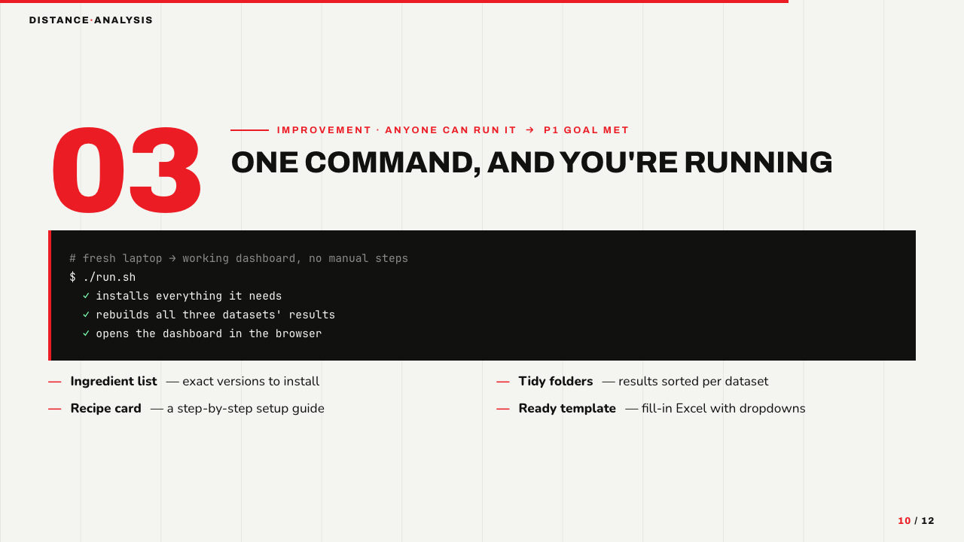
Notes:
10 · Improvement 3 — one command, and you're running
Third improvement: anyone can run it. A single command - ./run.sh - installs everything, rebuilds all three datasets, and opens the dashboard. It ships with an ingredient list (exact versions), a recipe card (setup guide), tidy per-dataset folders, and a fill-in template with dropdowns. This delivers the P1 task 'get the tool running for everyone.'

Slide 11
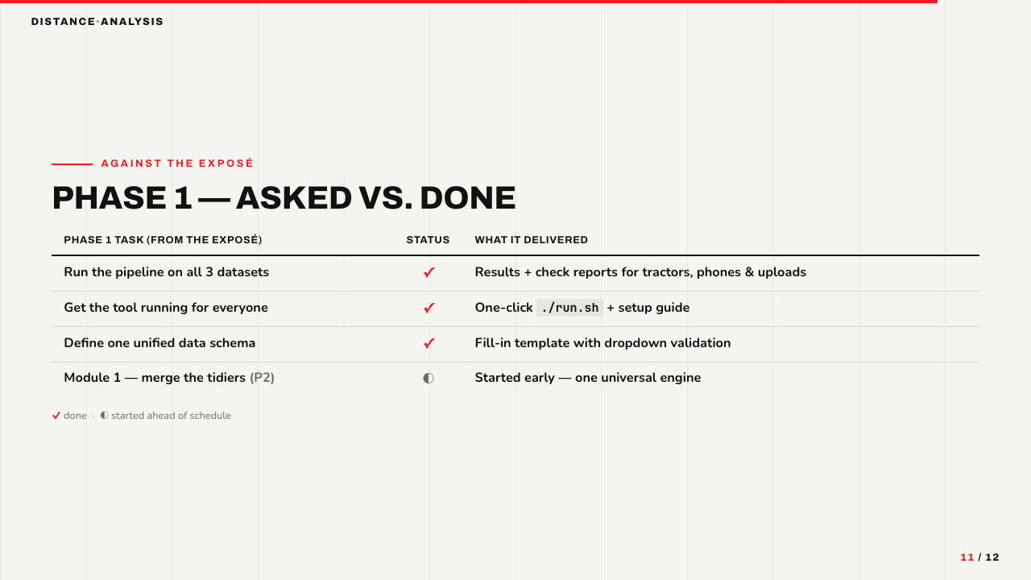
Notes:
11 · Phase 1 scorecard — asked vs. done
Scored against the Exposé's Phase 1 task list. Three tasks done: the pipeline runs on all three datasets with check reports; the tool runs for everyone via one command; a unified data schema template exists. One bonus: Module 1, officially a Phase 2 task, was started early as the universal engine.

Slide 12
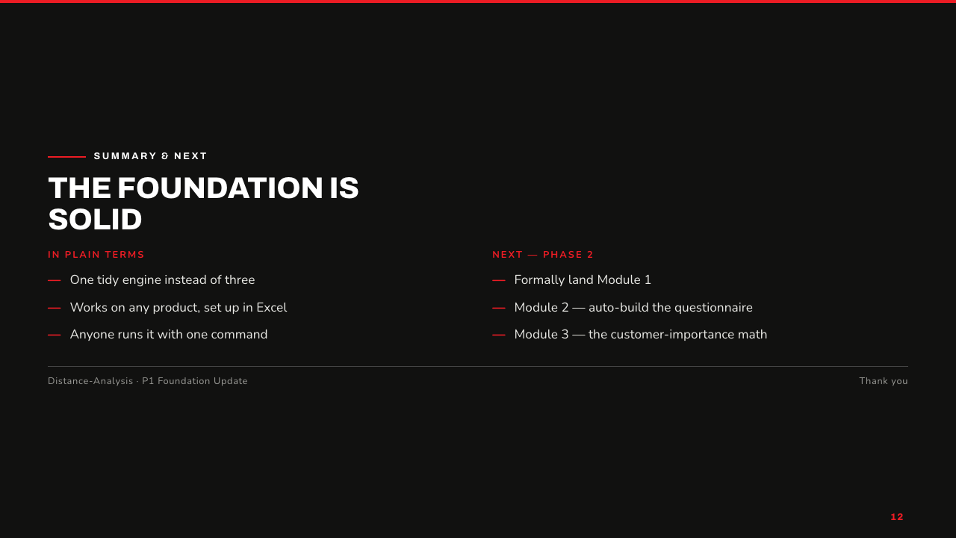
Notes:
12 · Summary & next
To summarize in plain terms: one tidy engine instead of three, works on any product set up in Excel, and anyone can run it with one command. Next, in Phase 2: formally land Module 1, then build Module 2 (auto-generate the questionnaire) and Module 3 (the customer-importance math) on top of this foundation. Thank you.

