Slide 1

Instrument Data Processing
MMR March 2020
AMMOS Technology
Jack Lightholder

Slide 2
Instrument Data Processing (CODEX)
Schedule
ID | WBS | CAM | Task Name | % Complete | Duration | Planned Start | Actual Start | Finished
375 | 05.01.13 | JLightholder | CODEX - Complex Data Explorer | 37% | 224 d | Tue 10/1/19 | Tue 10/1/19 | Fri 9/25/20
376 | 05.01.13 | JLightholder | Design and Implement "Data Quality Scan" User Interface | 7100% | 62 d | Tue 10/1/19 | Tue 10/1/19 | Tue 12/31/19
377 | 05.01.13 | JLightholder | Feature Bar Extension to Support Multiple Interaction Windows | 100% | 40 d | Thu 1/2/20 | 1/2/20 | Fri 2/28/20
378 | 05.01.13 | JLightholder | Extend Server Data Reader Capabilities to for Additional Data Types | 20% | 33 d | Mon 3/2/20 | 3/1/20 | Wed 4/15/20
379 | 05.01.13 | JLightholder | Extend Runtime Prediction Model to Support Features/Samples in Calculation | 0% | 22 d | Thu 4/16/20 | NA | Fri 5/15/20
380 | 05.01.13 | JLightholder | Design and Implement "Model Training" User Interface | 0% | 20 d | Mon 5/18/20 | NA | Mon 6/15/20
381 | 05.01.13 | JLightholder | Enable Session Saving / Loading | 0% | 33 d | Tue 6/16/20 | NA | Fri 7/31/20
382 | 05.01.13 | JLightholder | Enable Data / Code / Selection / Feature Export | 0% | 17 d | Mon 8/3/20 | NA | Tue 8/25/20
383 | 05.01.13 | JLightholder | Advanced User Guidance Through Dynamic Error Reporting | 0% | 22 d | Wed 8/26/20 | NA | Fri 9/25/20

Slide 3
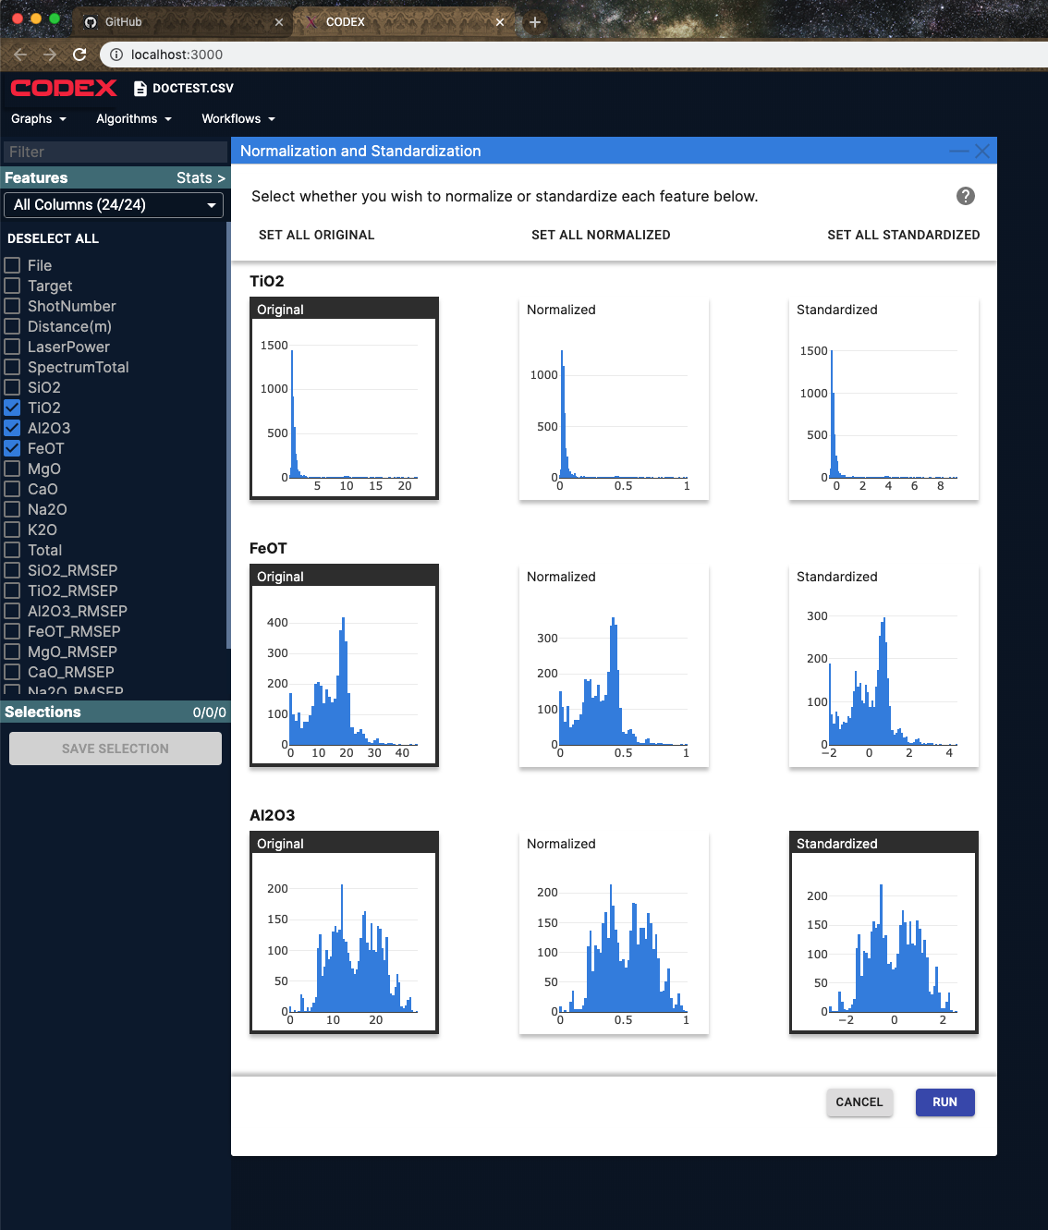
CODEX
Data Normalization / Standardization Implemented
Interactive page allowing users to explore normalization and standardization on a per-feature basis.
Allows for all features to be normalized, standardized, or a per-feature mixture.
Histograms provide intuitive user guidance to how the distribution of their data will be adjusted with each action.
Generates new features for use on other pages and in downstream workflows.

Slide 4
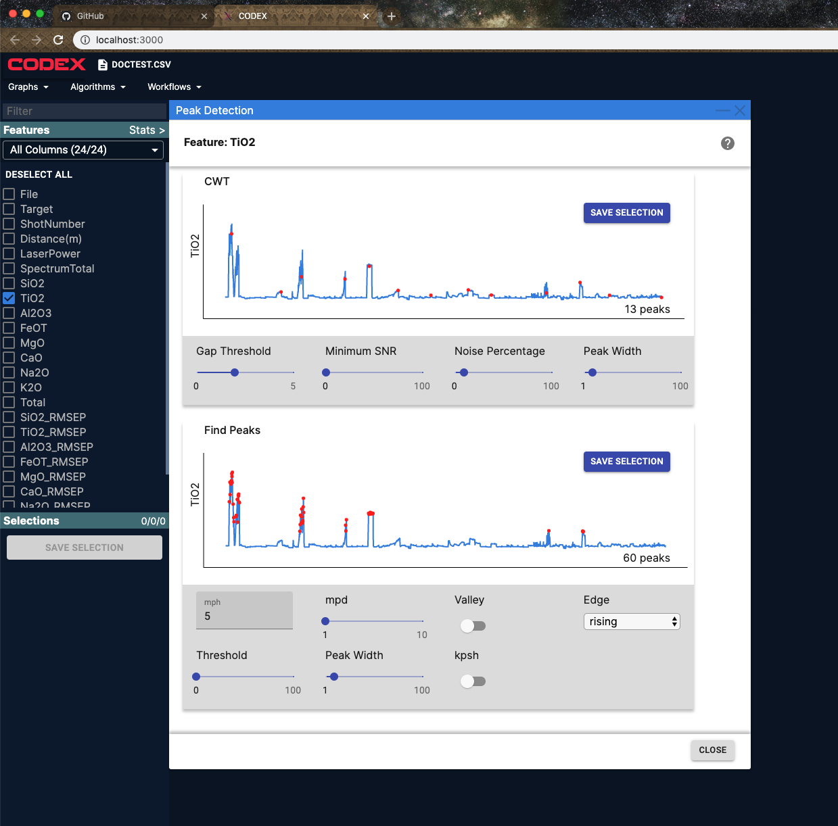
CODEX
Peak Detection Page Implemented
Allows users to load in a feature and explore different algorithms for detecting peaks.
Peak locations can be saved for downstream analysis.
Pre-computation allows for rapid exploration with the hyperparameters to determine the correct peak detection strategy for the users needs.
Hover-over guidance helps users understand how each hyperparameter impacts their data.

Slide 5
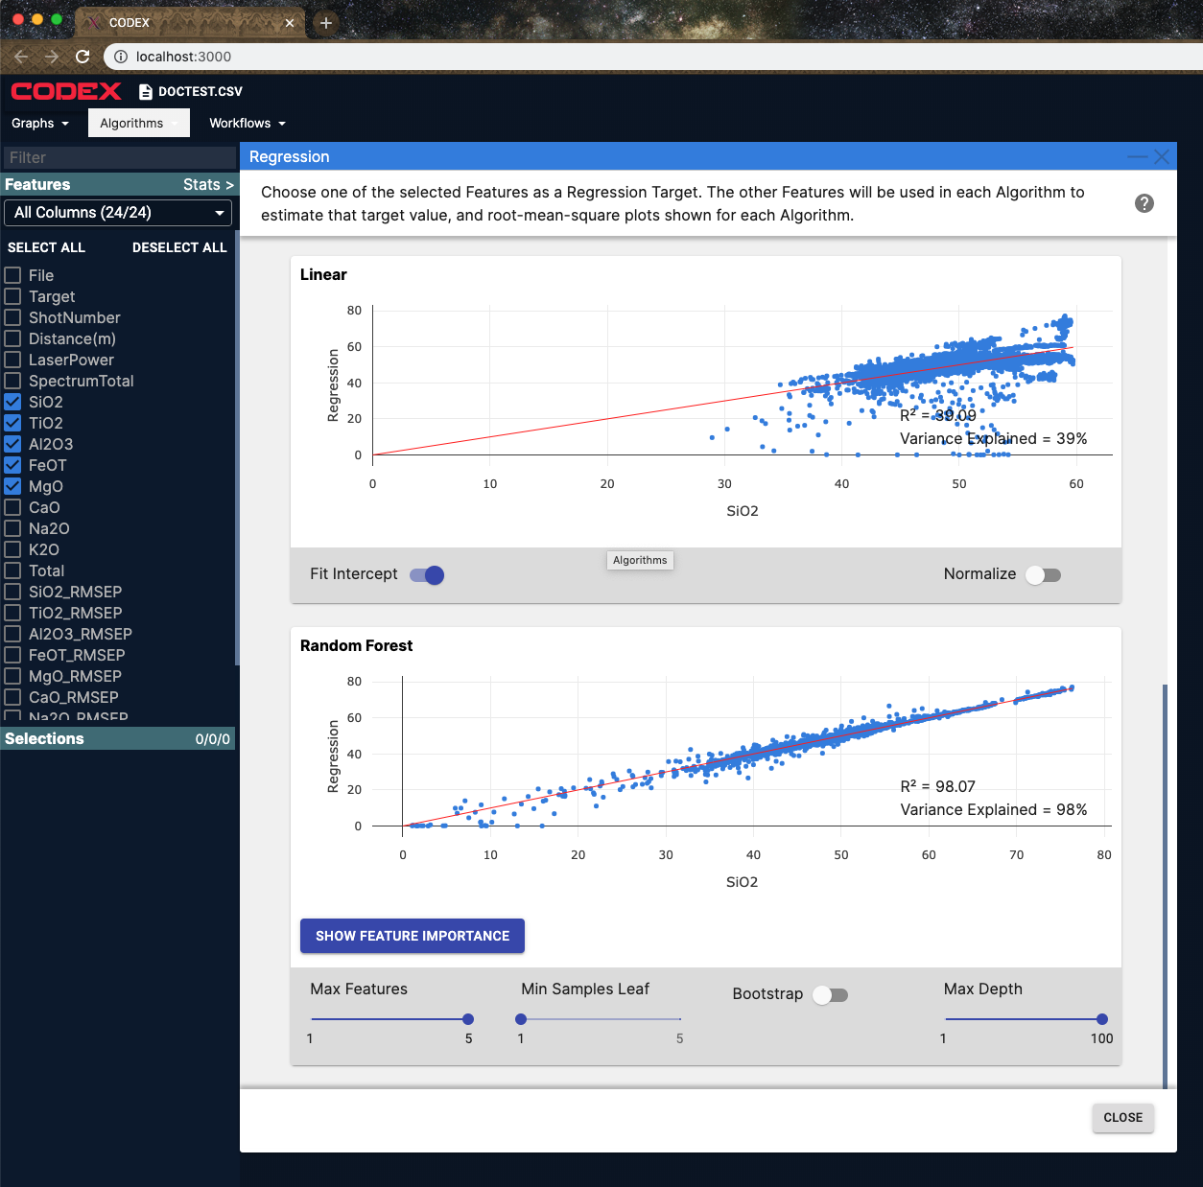
CODEX
Regression Algorithm Page Implemented
Allows users to select a set of features and hold one out as a regression target.
Multiple regression models can be explored to determine the correct algorithm and hyperparameters for the users application.
Feature importance dropdowns allow the user to gain further insight into which features are most important for predicting their regression target.
Hyperparameters can be quickly modified to explore sensitivity and tuning relevance for the users application.

Slide 6
CODEX
Infusion Status
MAIA Mission Integration Conversations
Initial meeting with science data systems and instrument data systems team leads.
Provided access to CODEX for the team to explore
Planning another demonstration of the tool for the larger team
Planning demonstration day with section 398 science data system and instrument data system groups to get user feedback.
Workshop where users bring their own data to use in CODEX
Design feedback for team on how users use the tool and features they desire.
Presented at GSAW 2020
Multiple people interested in utilizing CODEX outside of JPL.
Open sourced to leverage this growing user community.

Slide 7
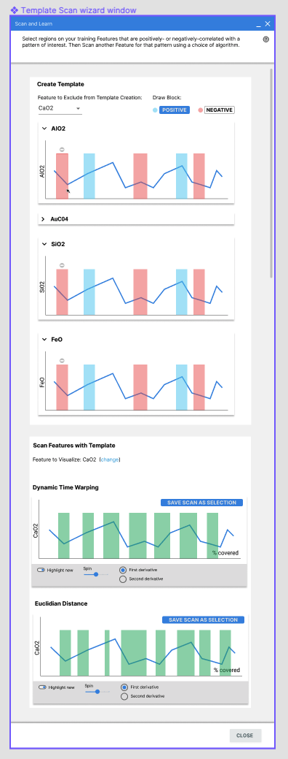
CODEX
Plans for Next Month
Implement template scan algorithm page
Spark-line driven guidance for hyperparameter tuning
Multiple model pre-calculation to provide optimal user guidance for determining the sensitivity of a hyperparameter
Design data/code/model export capabilities
Add hot key support and documentation for common actions
Design correlation exploration algorithm page
Template scan page design to be implemented

Slide 8
CODEX
Financial Status
Complex Data Explorer
Actual YTD costs are $48K versus plan of $73K
Workforce temporarily needed by Mars 2020.
Now available and burning hot to adjust
Additionally looking at brining on additional developers to support. In process with line management.

