Slide 1
CODEX Redux Integration
Patrick Kage
Notes:
Title slide

Slide 2
Current CODEX State
State is difficult to manage across application
Individual components manage a lot of their own state
Several separate controllers
model, controller, manager
Unclear which direction data flows
Difficult to test
Singleton model creates dependency loops
Exacerbates run-on-import code issues
Extremely difficult to mock state
Component state depends on singleton config

Slide 3
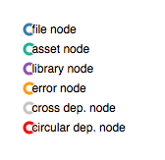
Notes:
Dependency hierarchy

Slide 4
Notes:
Dependency hierarchy with strictly circular deps

Slide 5
Notes:
Dependency hierarchy with all cross deps

Slide 6
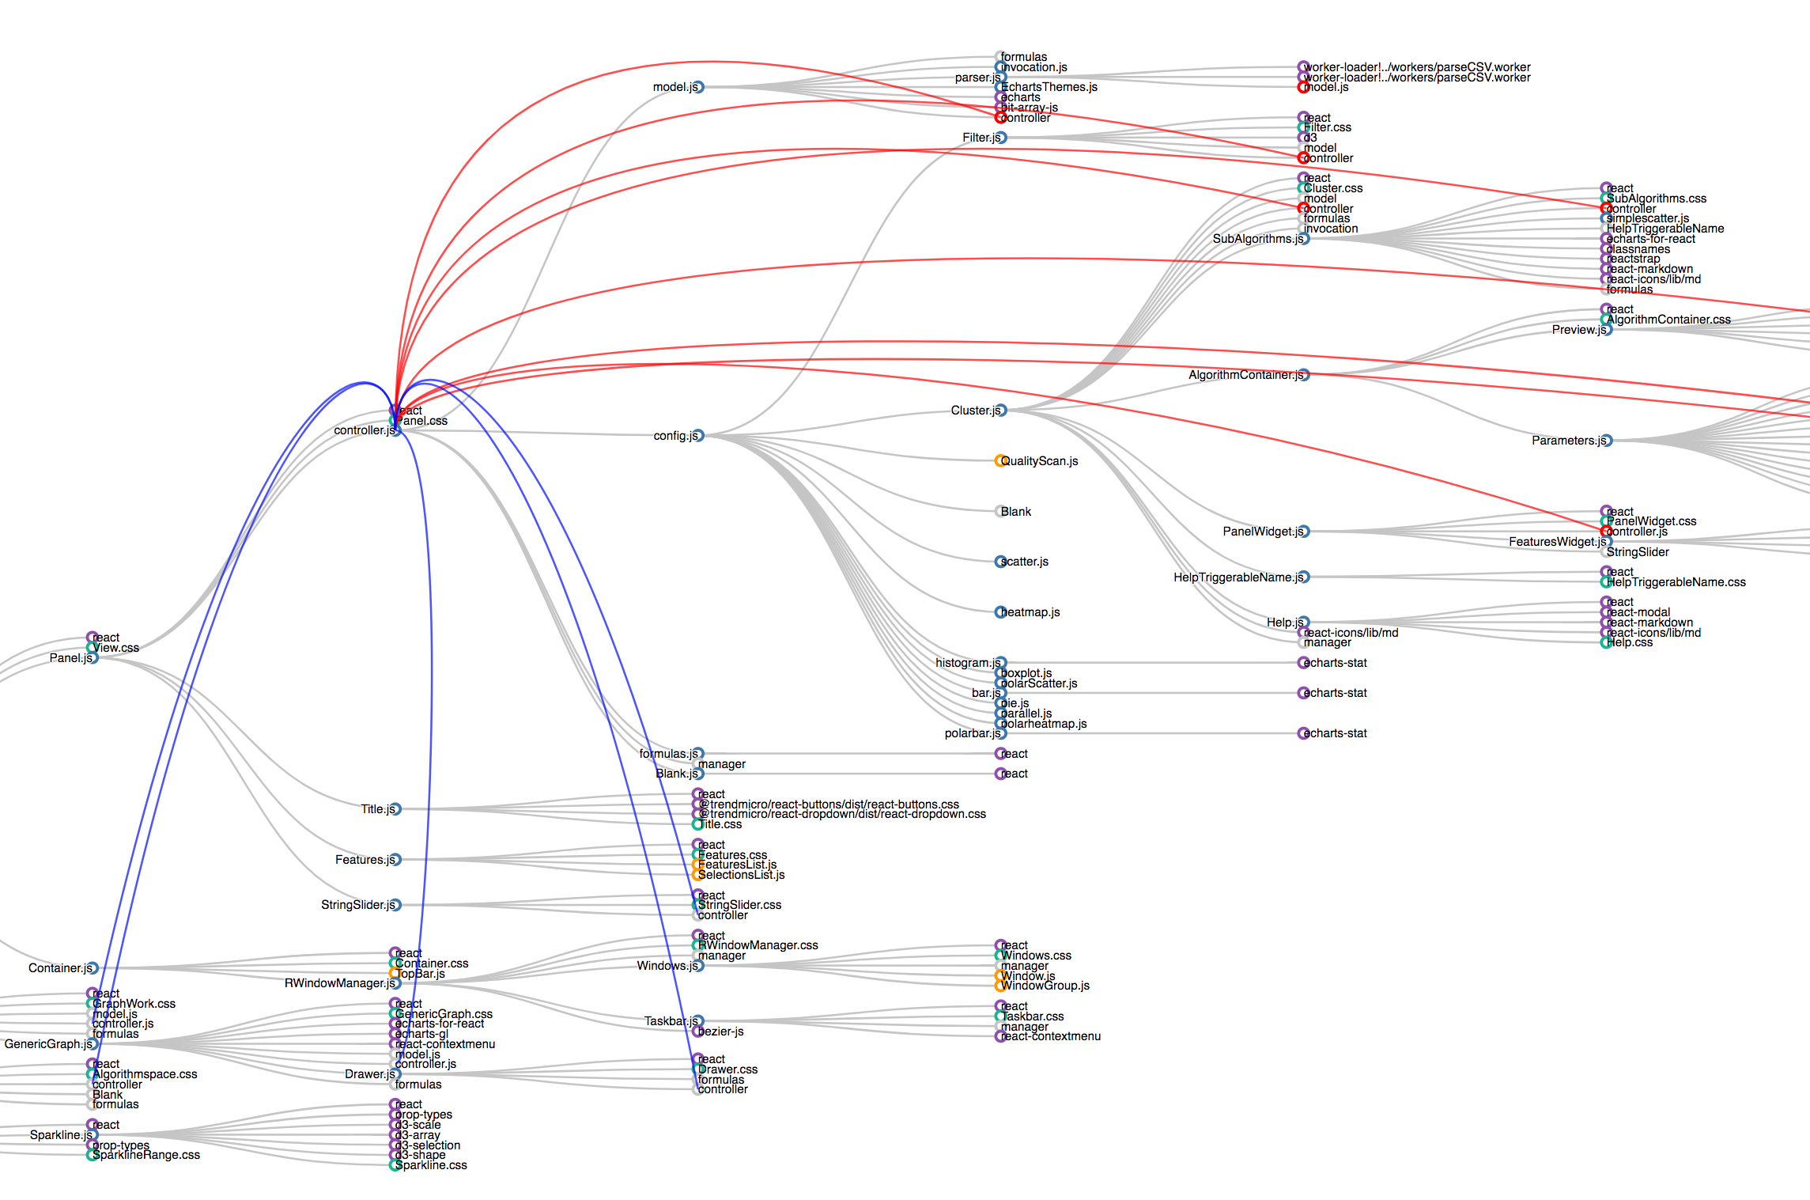
Notes:
Dependency hierarchy zoomed in on controller.js

Slide 7


Flux/Redux Recap
Flux
Developed at Facebook to address large application state mgmt.
Not a library (zero code)
Centralizes state, application is a function of central state
Central state is immutable
Modified by actions emitted by view
Redux / React-Redux
React implementation of Flux
Helper library to implement Flux in React
Notes:
Basic overview of Flux

Slide 8
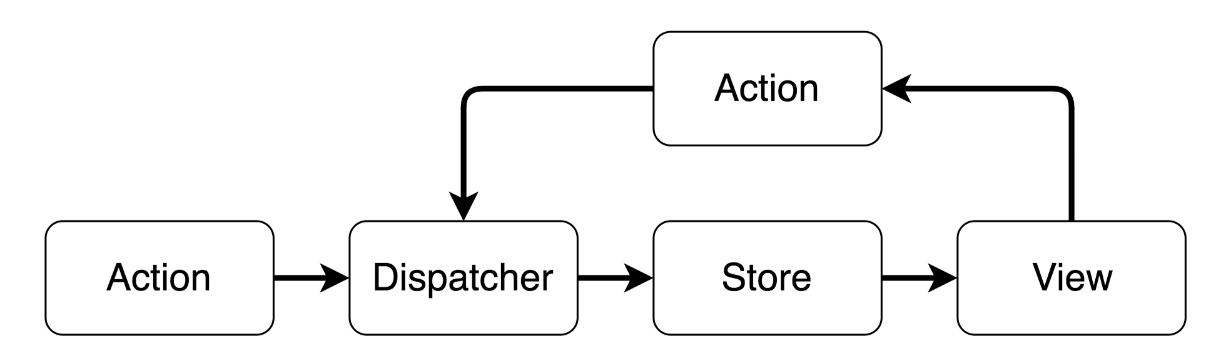
Flux/Redux Recap
Notes:
Flux data flow diagram

Slide 9
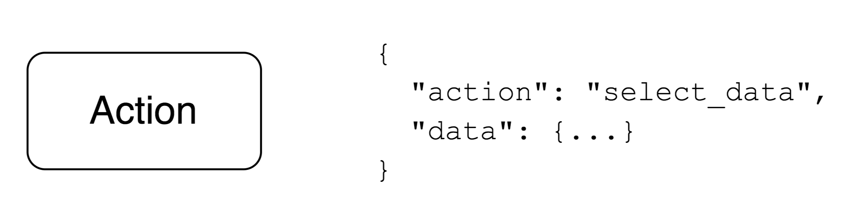
Flux/Redux Recap
Notes:
Flux action

Slide 10
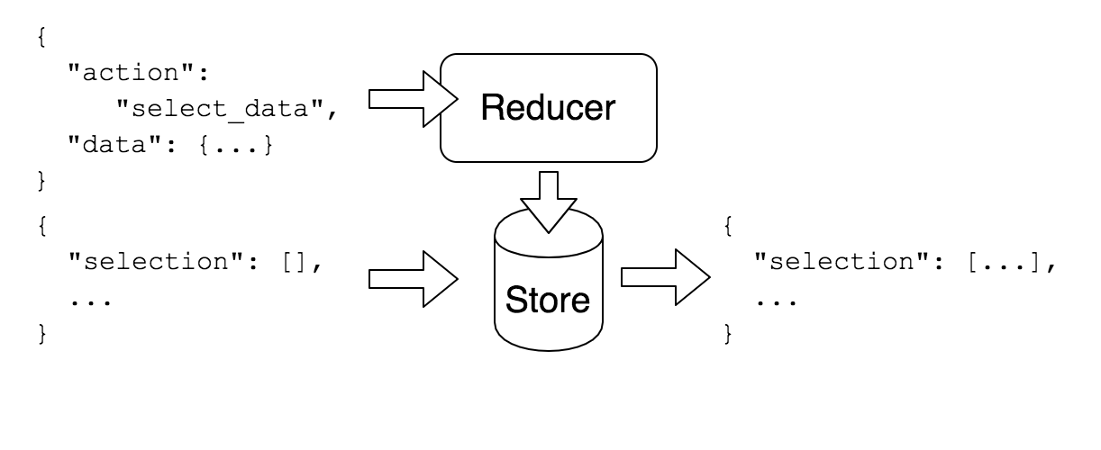
Flux/Redux Recap
Notes:
Flux reducer structure

Slide 11
Is Redux the Solution?
Pros
Cons
Central state
Clear, unidirectional state flow
Testable actions
Cleaner codebase
Piecewise upgrade
Existing code needs to be ported
Spin-up time
Singleton mgrs. already exist

Slide 12
Is Redux the Solution?
Cons
… weighed by
Existing code needs to be ported
Spin-up time
Singleton mgrs. already exist
Cost of not porting
Spin-up time of new developers
Singletons are easy to port to reducers/stores

Slide 13
Lowest-Friction Integration Path
Focus on data controllers
Start with controller.js
Redux-based data operations
Keeps development fast
Local state allowed for presentational components
Allows for easier management of data
Centralized state
State restoration
Testable reducers

Slide 14
Integration Steps
Add Redux boilerplate
Example Redux-enabled component (Filter)
Port controller.js
Port model.js
Don’t port manager.js (RWindowManager)

