Slide 1




A Web Based Data Explorer
Presentation by Alec Helbling
Jet Propulsion Laboratory, California Institute of Technology
CL#19-4964

Slide 2
What is CODEX?

Slide 3

CODEX Description
COmplex Data EXplorer
A web based data exploration tool for generating insight from data
Breaks high dimensional data down into understandable parts
Allows a non-data scientist to harness the power of statistics and machine learning
Data
Visuals
Insight

Slide 4



Non-data scientist
Python, Statistics,
Math, etc.
Insight
CODEX

Slide 5
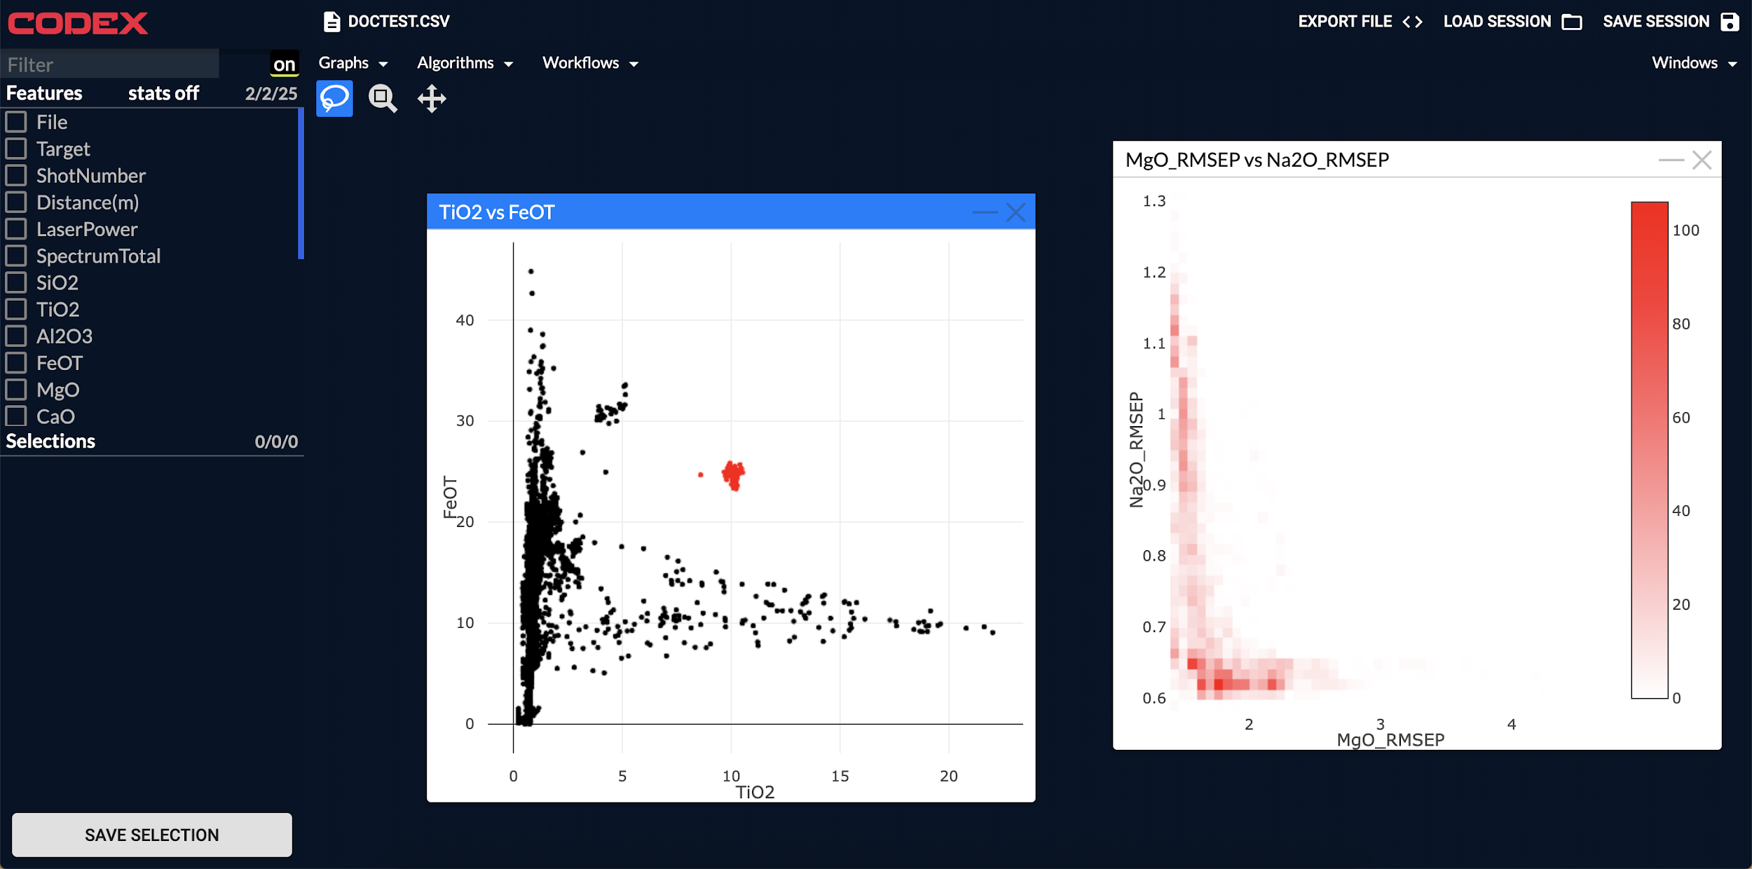

Slide 6
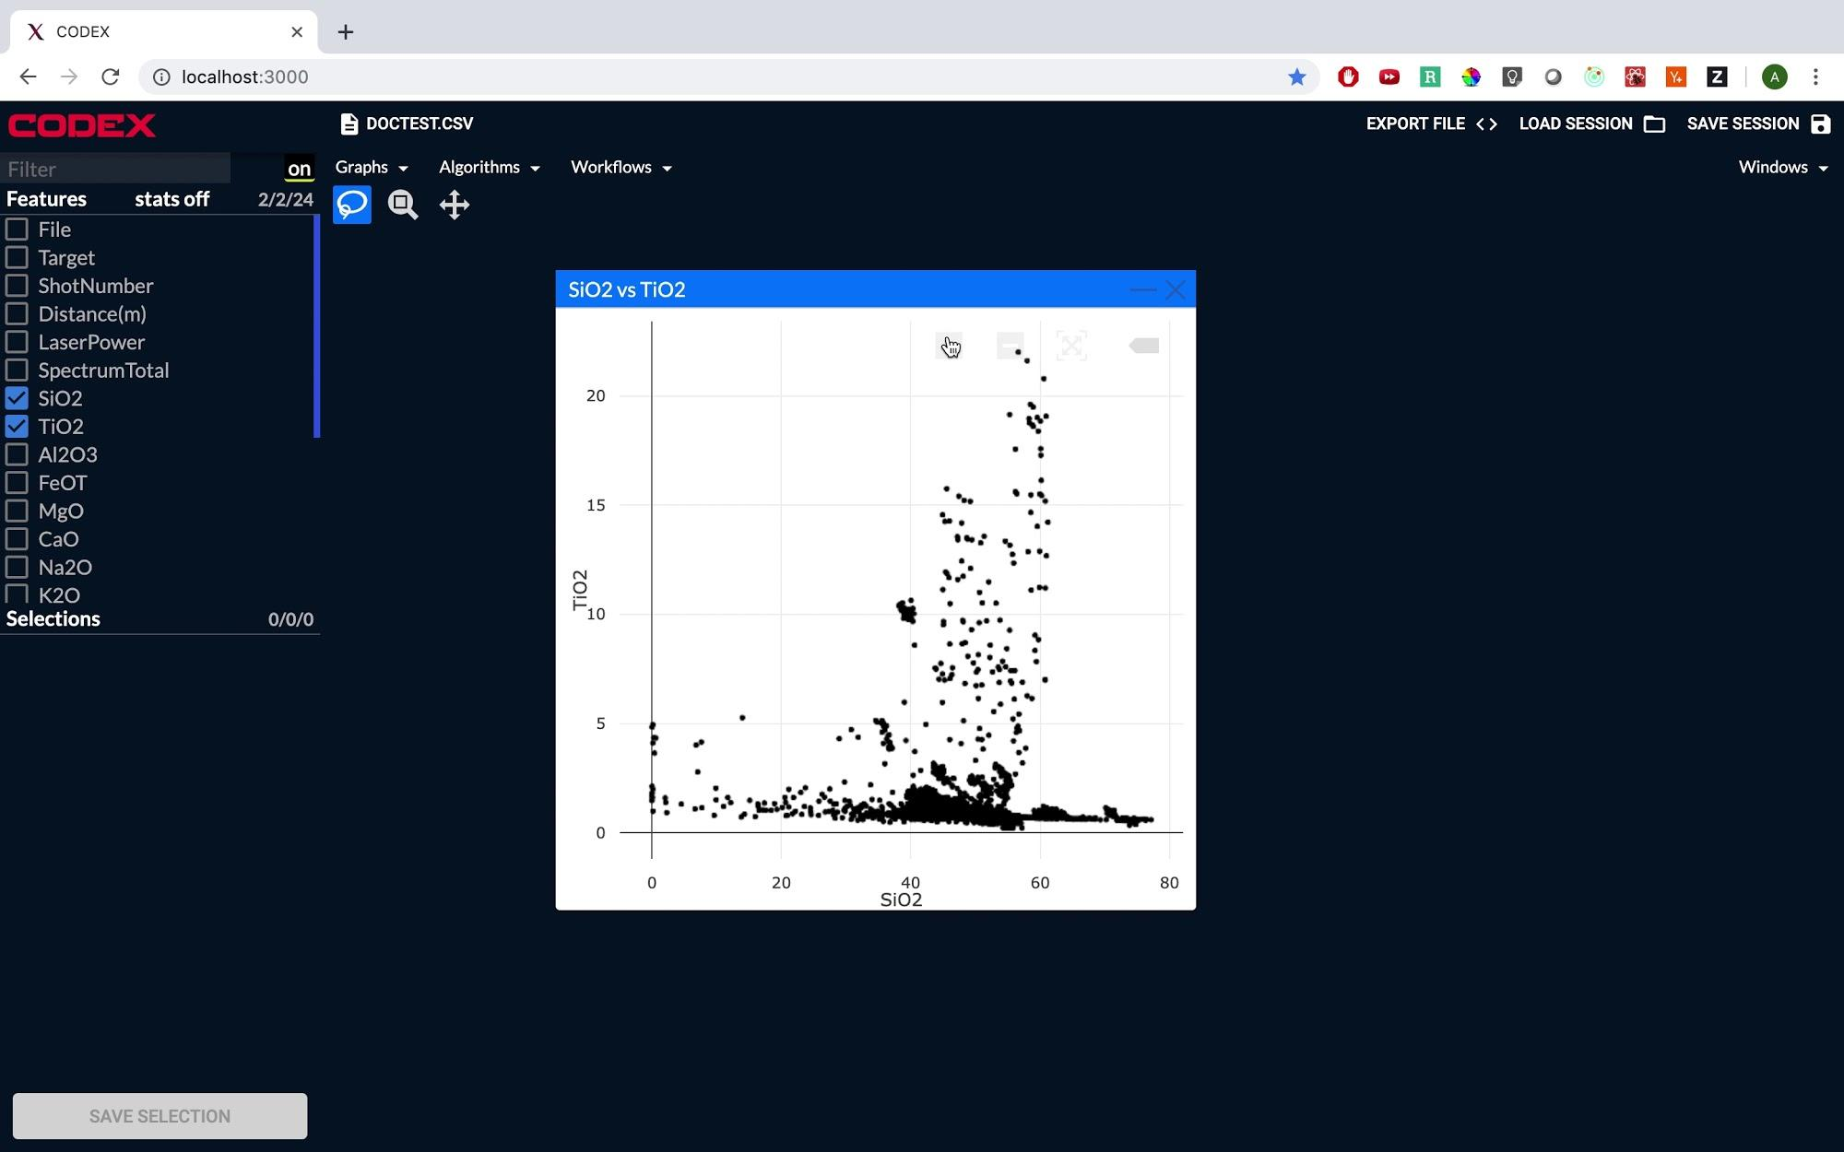

Slide 7
Presentation Outline
Tools
New Plot Types
Cross Plot Selections
General Interface Development
Find More Like This Workflow
Explain This Workflow

Slide 8
Tools

Slide 9



React.js
Redux
Tornado
Web Frameworks

Slide 10



Plotly.js
D3.js
Sklearn
Plotting and ML

Slide 11
What I did?

Slide 12
Newly Introduced Plot Types (part 1)
Histogram
Heatmap
Time Series Plot
Violin Plot
Box Plot

Slide 13
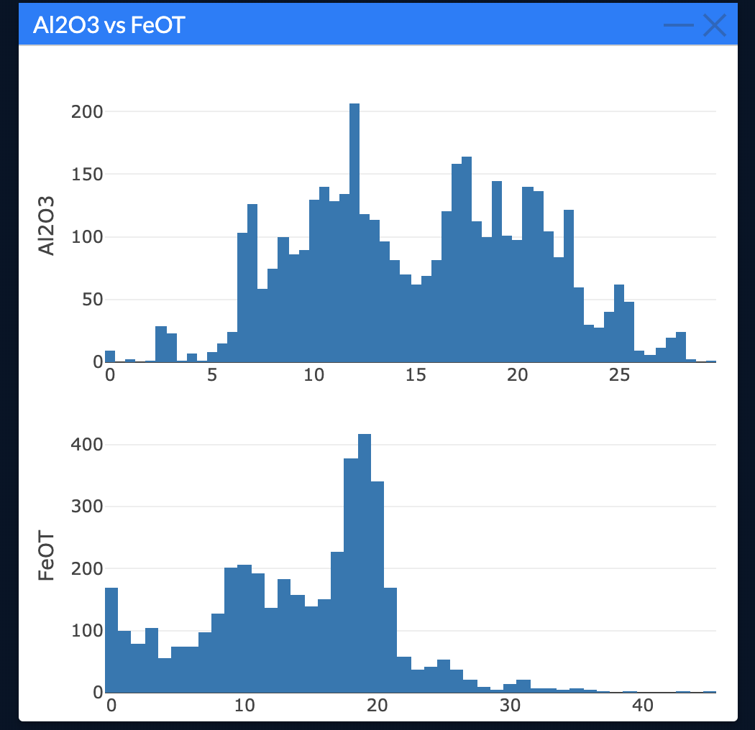
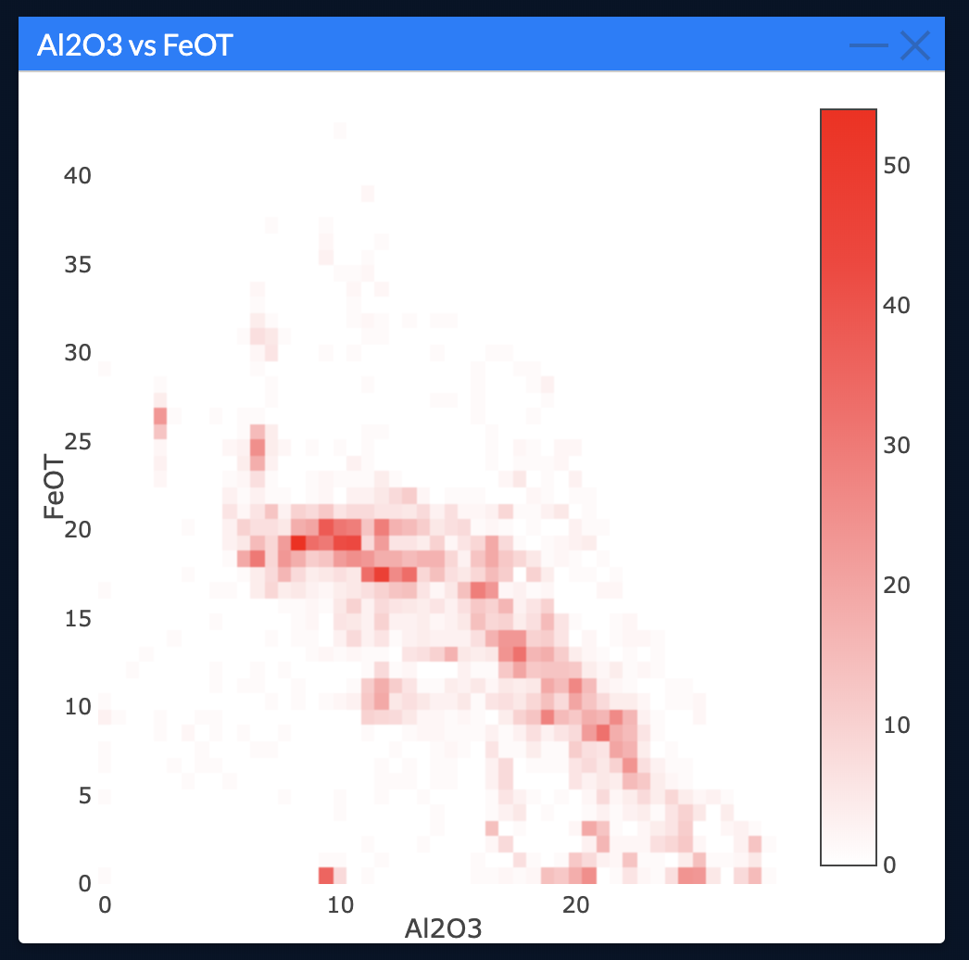
Newly Introduced Plot Types (part 2)

Slide 14
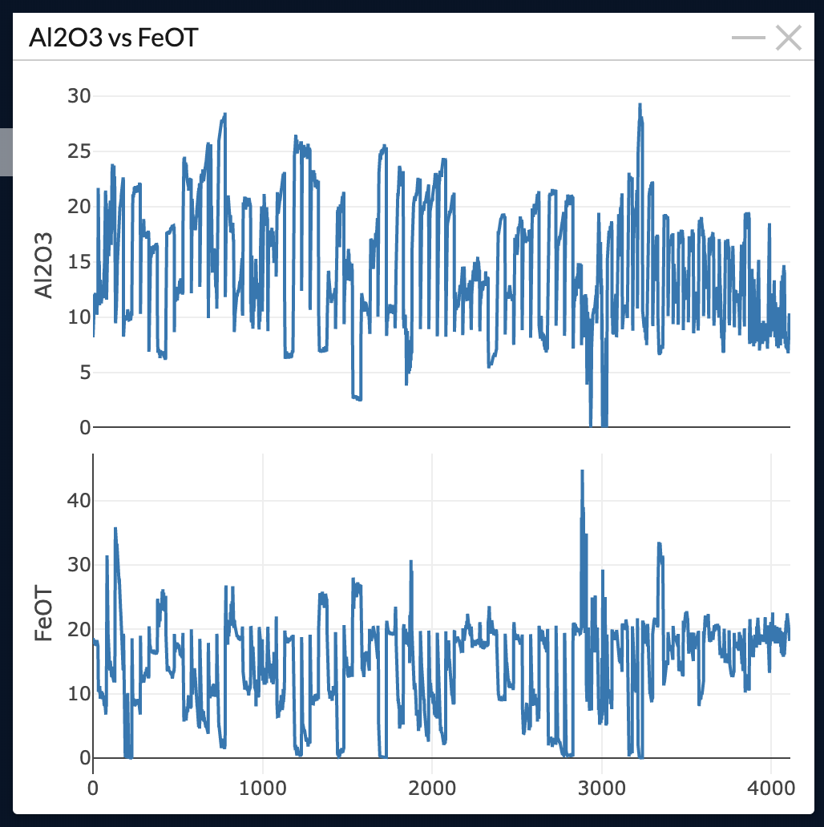
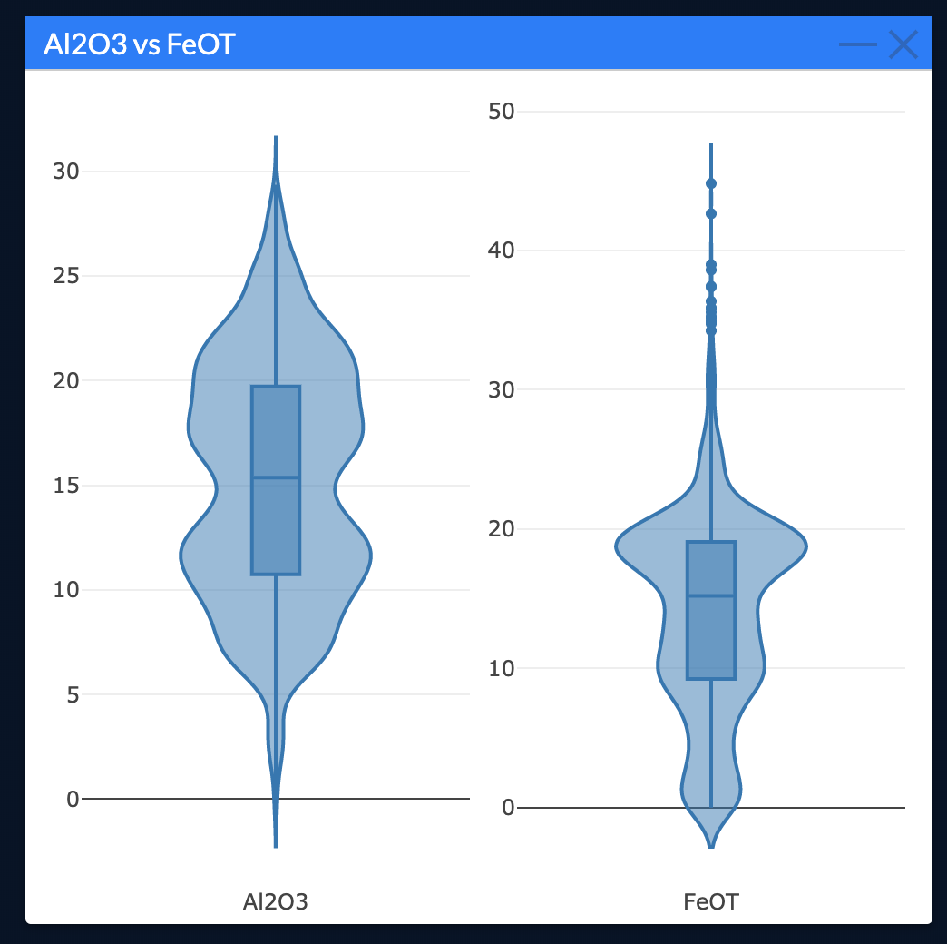
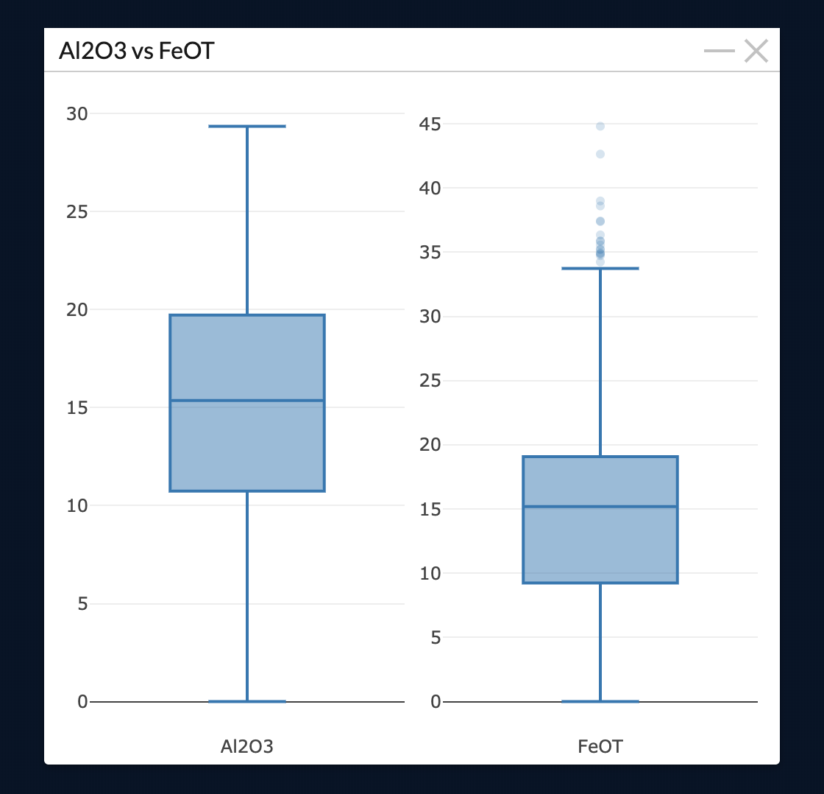
Newly Introduced Plot Types (part 3)

Slide 15
Linking Data Across Dimensions(part 1)
CODEX supports the ability to make selections of data in one plot and see it in another plot
This allows you to visually see possible correlations in data and the higher dimensional shape of the data using only 2D representations

Slide 16
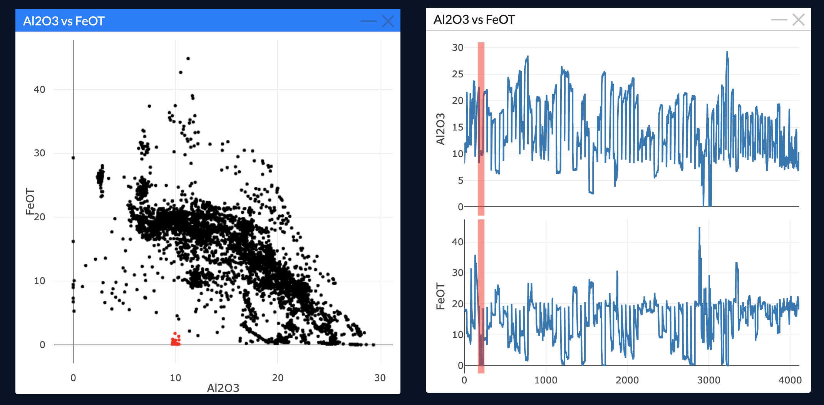
Linking Data Across Dimensions(part 2)

Slide 17
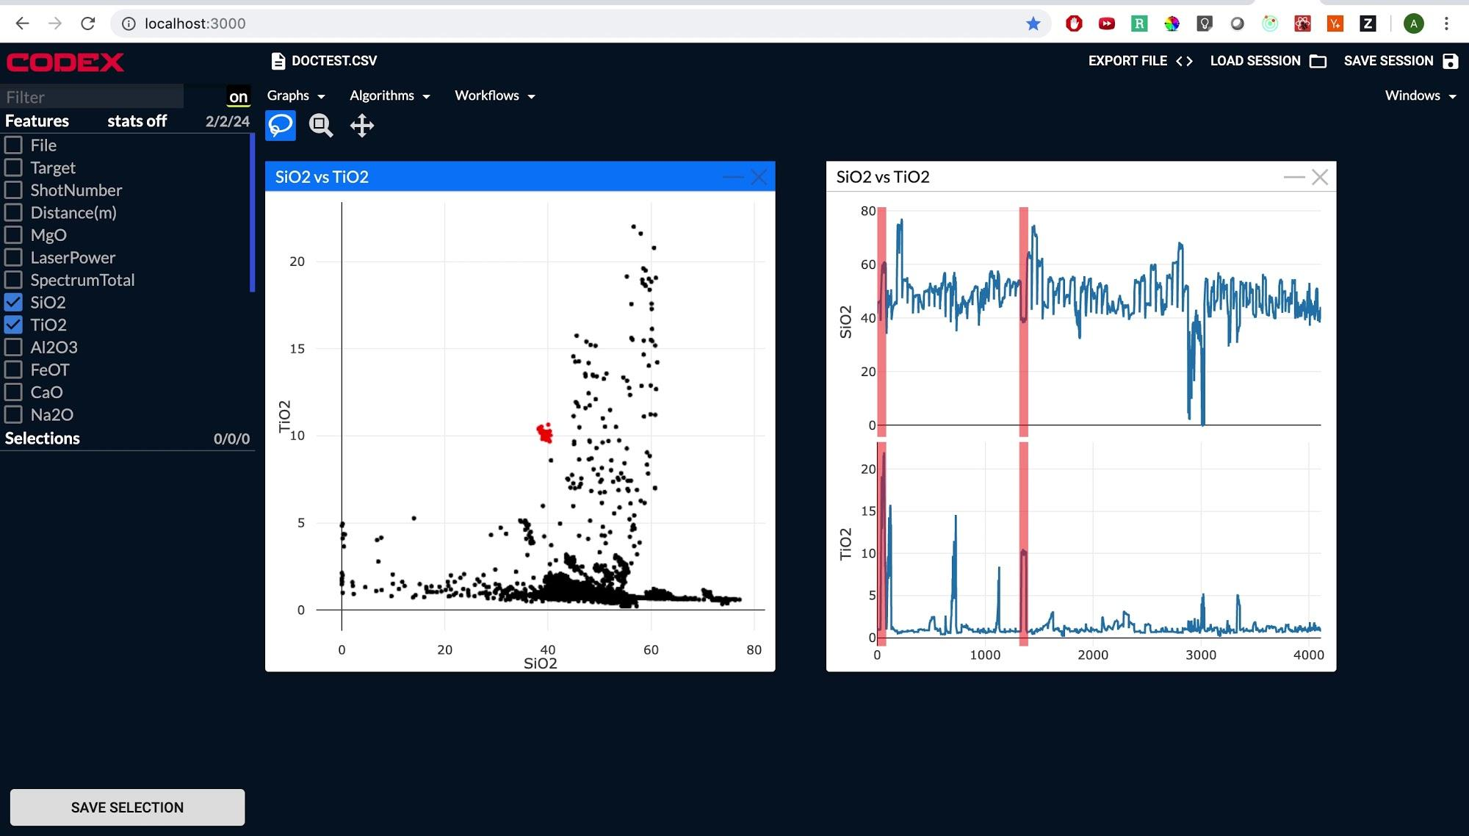

Slide 18
General Interface Development

Slide 19
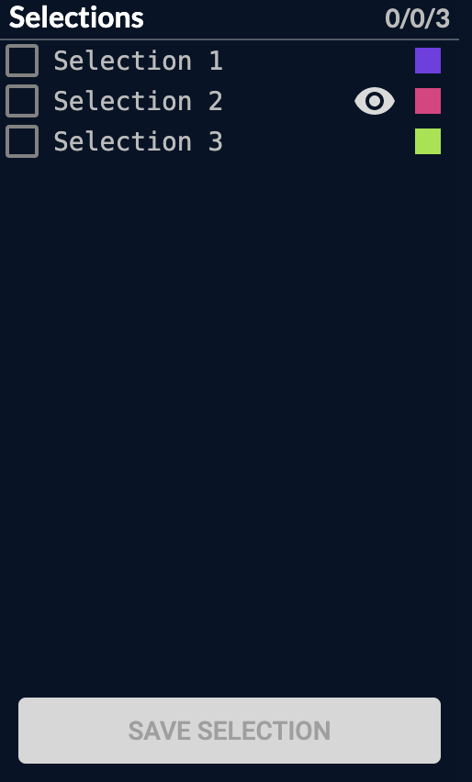
Selections Panel
Allows users to make selections of subsets of the data
Allows users to manipulate these selections and change various options about them

Slide 20
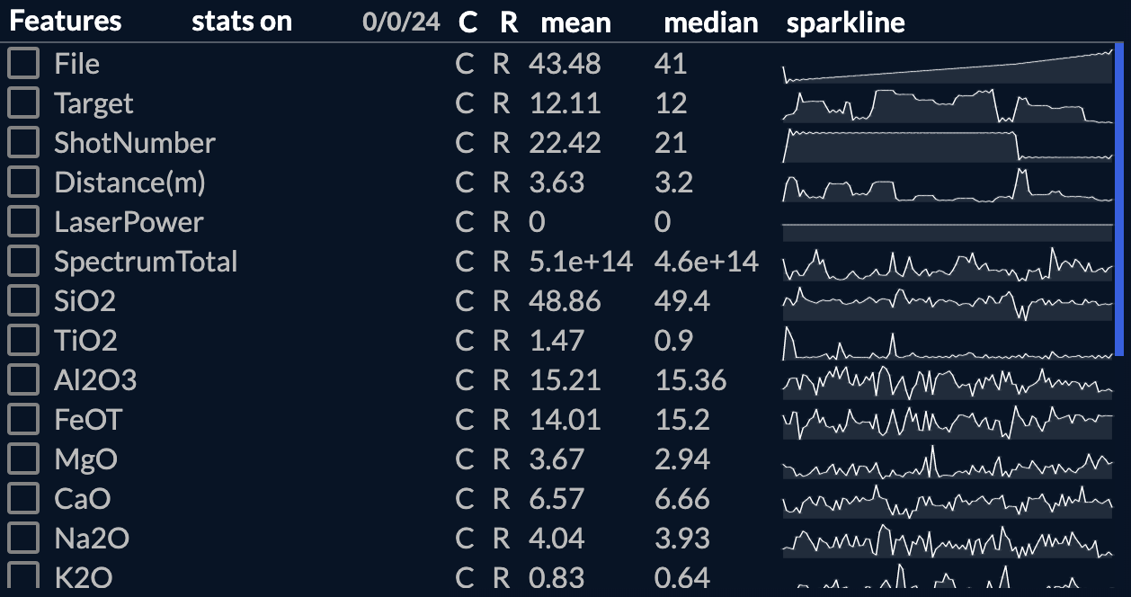
Feature Statistics Panel
Side panel that a user can expand to show various statistics about the loaded features

Slide 21
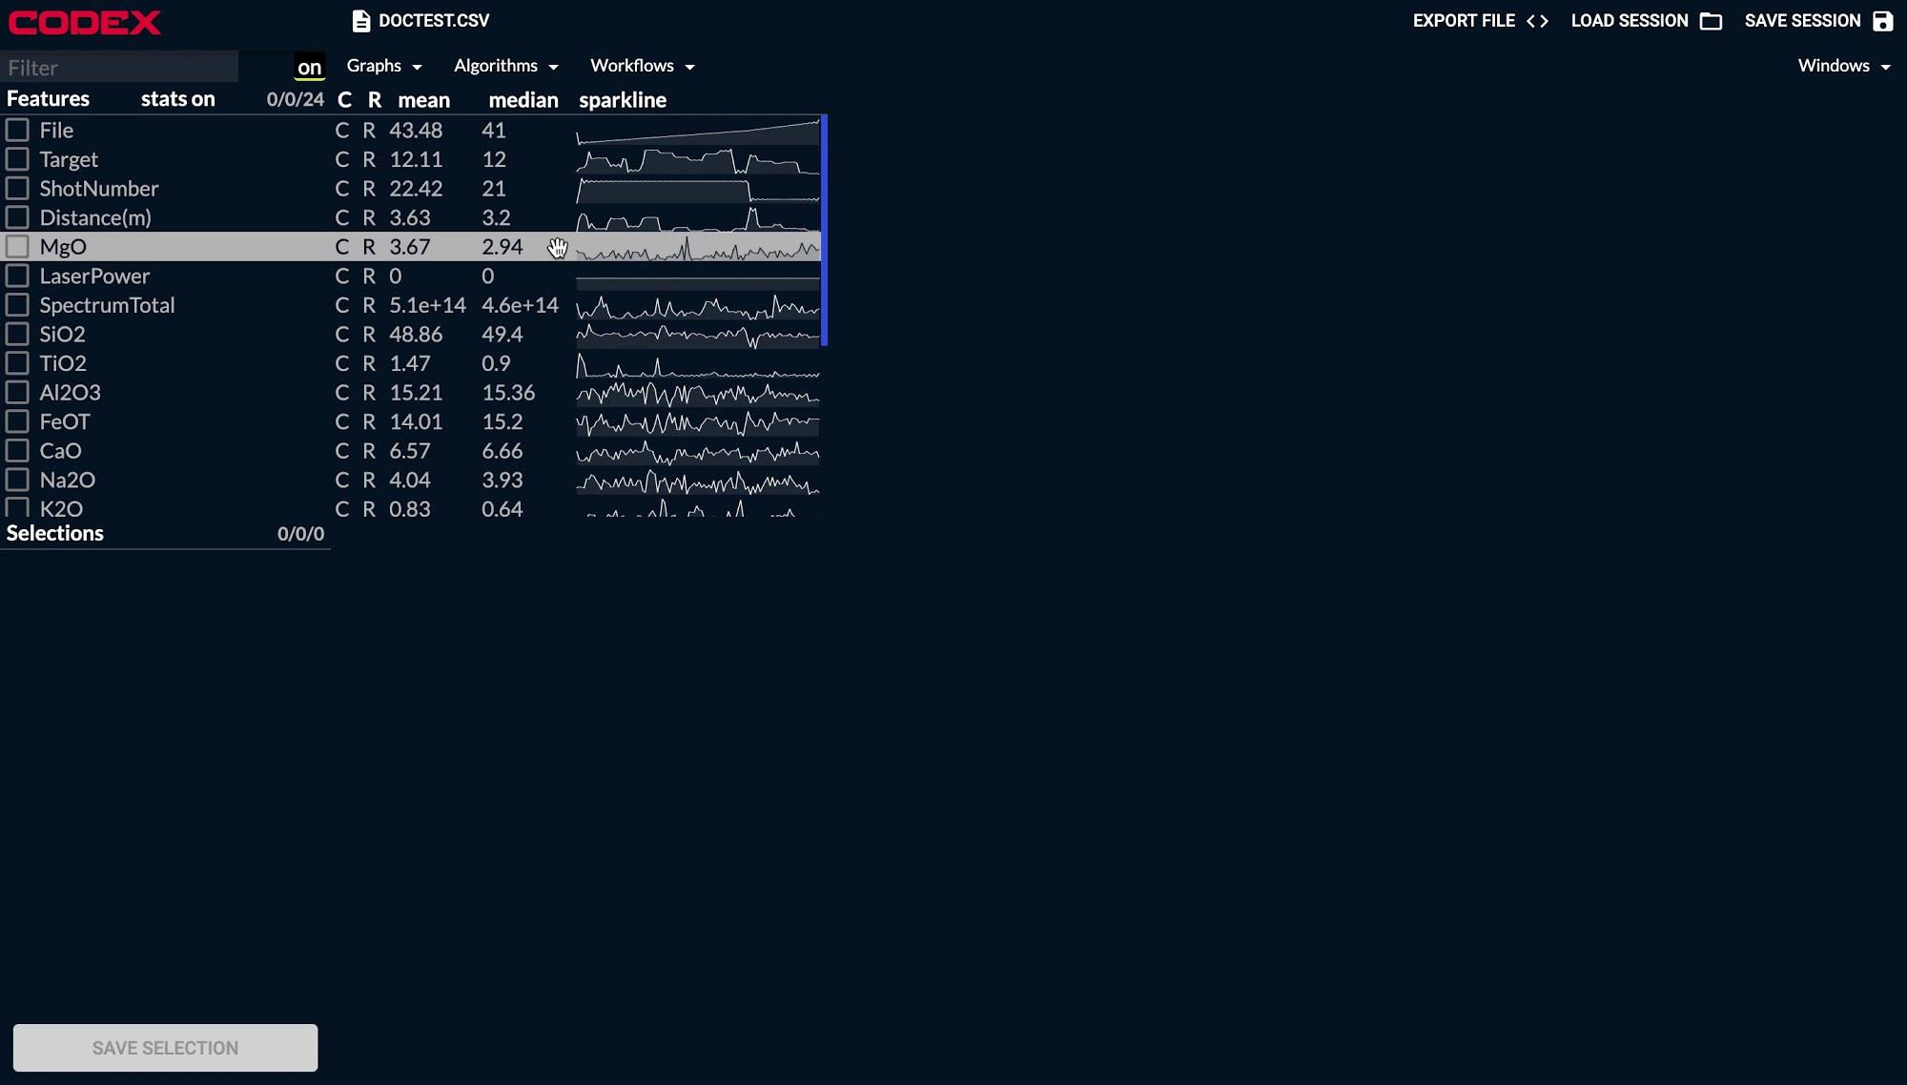

Slide 22
Find More Like This Workflow

Slide 23
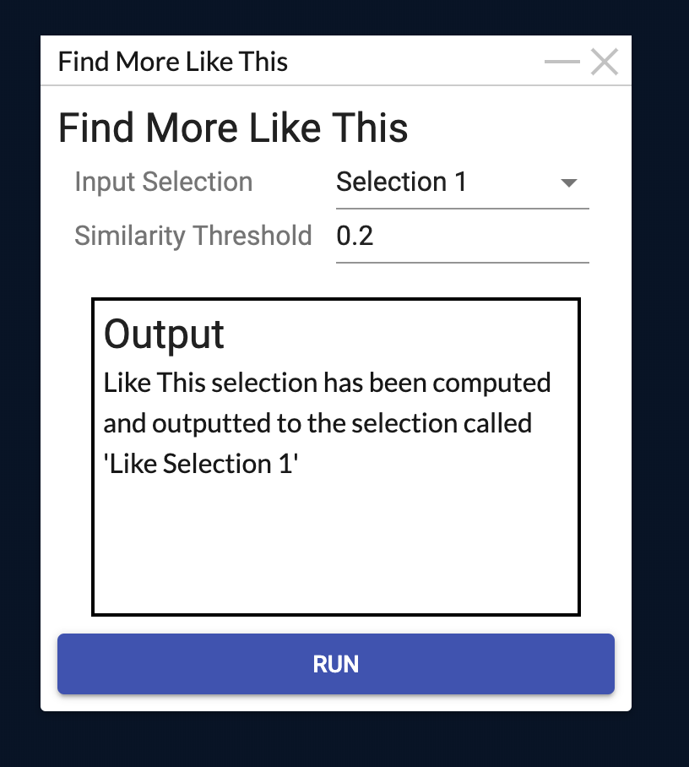
Find More Like This
A workflow that allows a user to construct a model of data from a single selection
This model is then queried for more samples that are similar to that selection
Little to no statistical knowledge needed to understand

Slide 24
Find More Like This Training
Random forest with a random parameter sweep using cross validation
Positive-unlabeled learning
Needed because there are only positive labels
A semi supervised learning method that utilizes a random subset of unlabeled points as negative examples
This is done with several random samples and ensambled at the end
Random forests are fast and easy to train, but the PU framework is model agnostic

Slide 25
Explain This Workflow

Slide 26


Explain This
What is the difference between these two selections of points?
A user makes two selections in their data
These selections are then used to train a decision tree classifier, which is then visualized

Slide 27
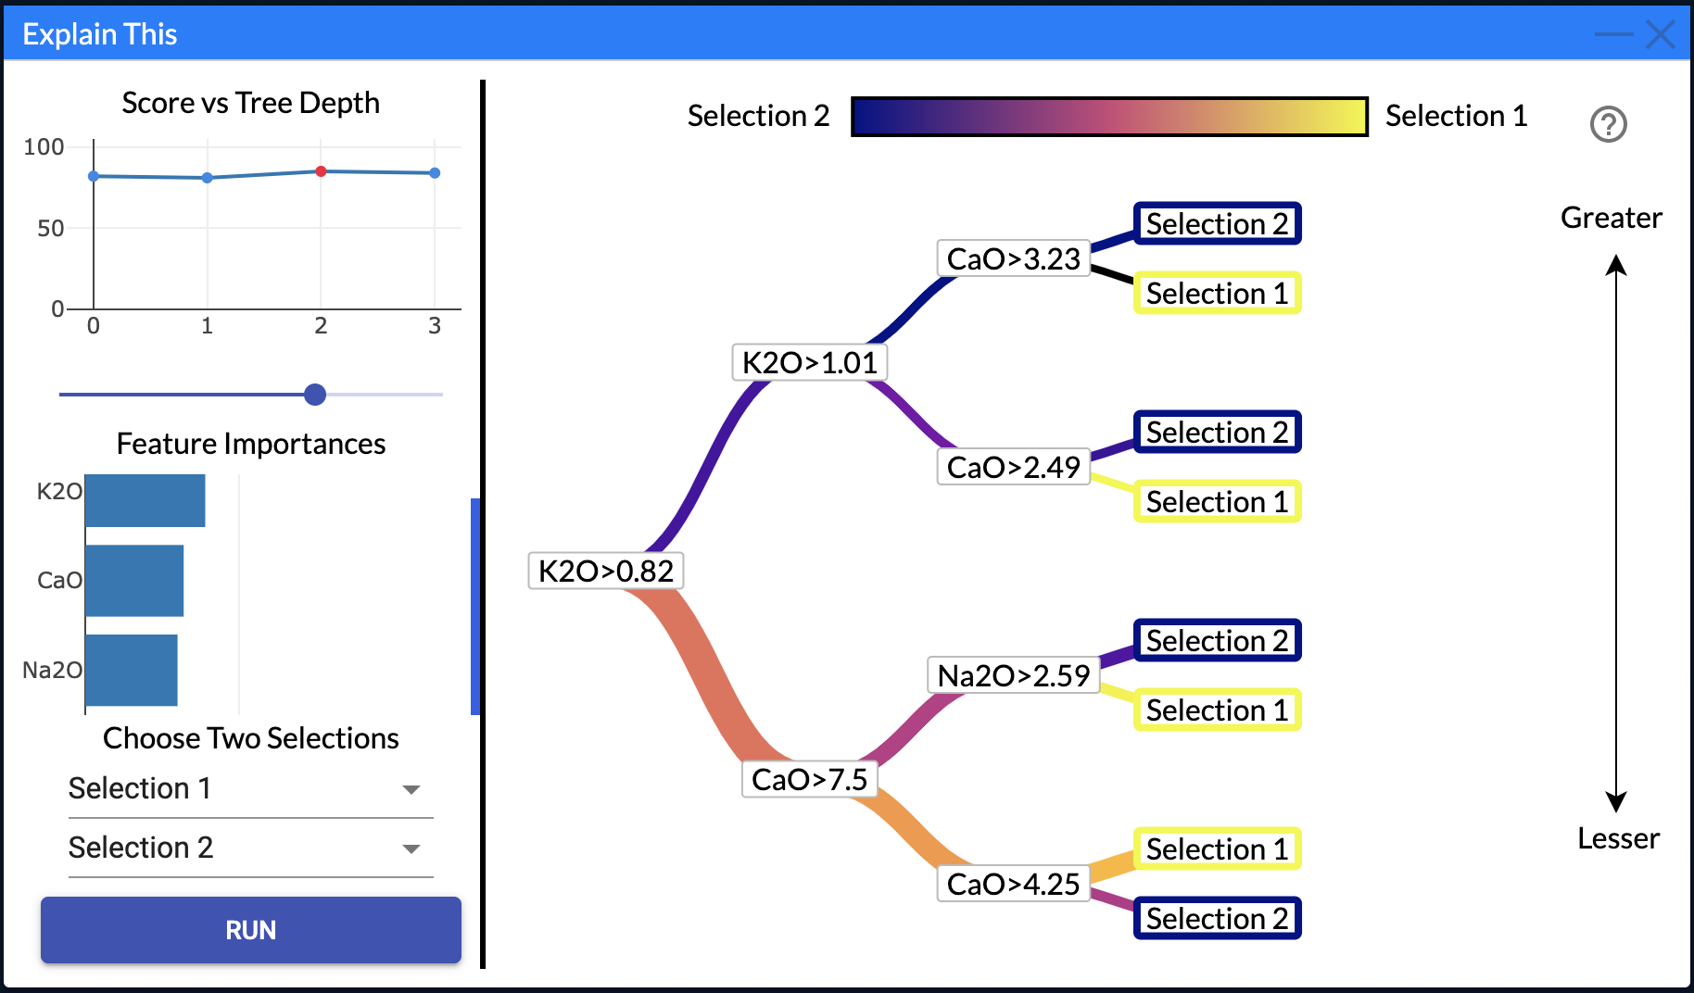
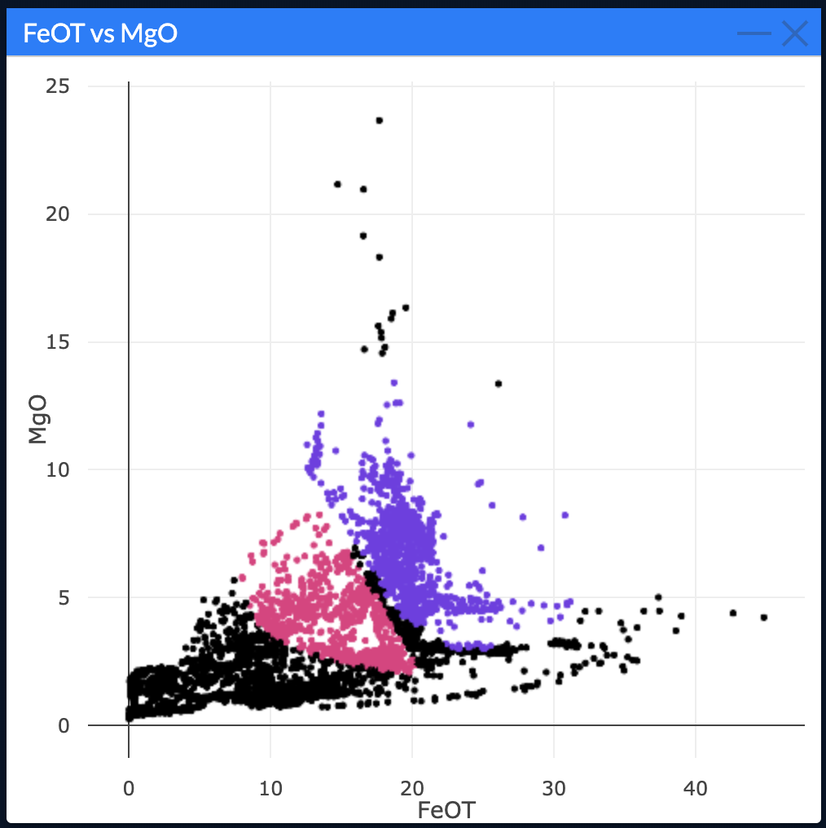

Slide 28
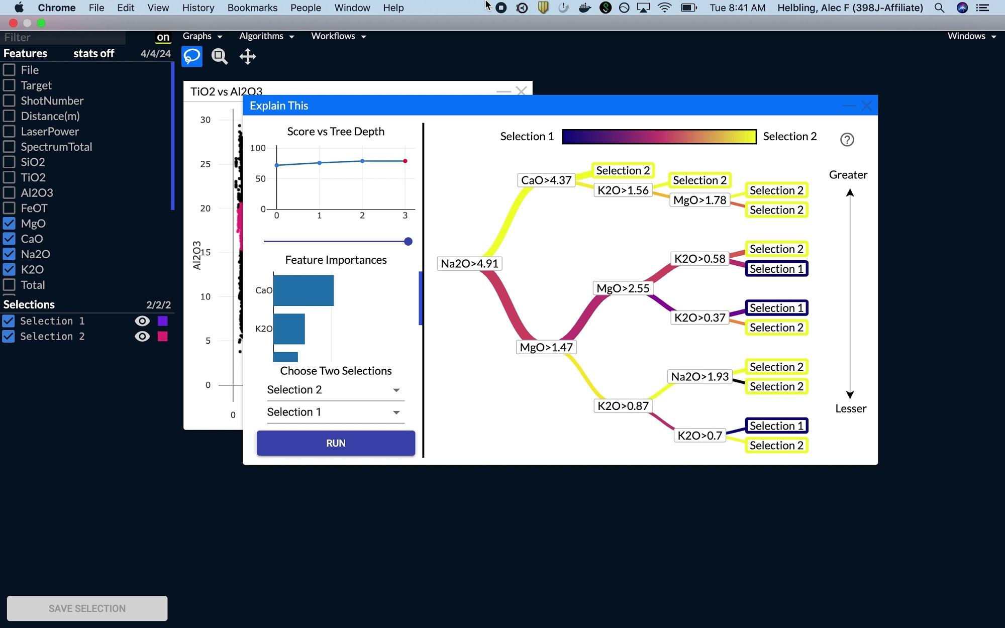

Slide 29
Acknowledgements
Jack Lightholder
Josh Rodriguez
Rob Tapella
Patrick Kage
Lukas Mandrake

Slide 30
Questions?

