Slide 1
973 MMR November 2020
AMMOS Technology
Instrument Ops
Rob Tapella
Nov 10, 2020

Slide 2
Instrument Ops
CODEX Schedule
ID | WBS | Task Name | % Com-plete | Dura-tion | Planned Start | Actual Start | Planned Finish
436 | N.1.05.3.01.10 | Formalize user-facing data-science and ML content: guidance, interface optimizations, simple deployment/installation | 50% | 33 d | 10/1/20 | 10/1/20 | 11/19/20
437 | N.1.05.3.01.10 | Data scaling to allow broad views of large data sets and detailed analysis of smaller subsets | 10% | 23 d | 11/23/20 | 10/1/20 | 1/4/21
438 | N.1.05.3.01.10 | Use selections to restrict the scope of analysis (“this is good data”) | 0% | 17 d | 1/5/21 |  | 2/1/21
439 | N.1.05.3.01.10 | Selection- and Feature-math | 0% | 17 d | 2/2/21 |  | 3/1/21
440 | N.1.05.3.01.10 | ML to anticipate upcoming problems based on unusual new time-series trends using active labeling (“More like this”) | 0% | 59 d | 3/2/21 |  | 6/1/21
441 | N.1.05.3.01.10 | Linking between algorithms and plots (e.g., 1. find correlation 2. use those correlations to visualize unusual events in a time series plot) | 0% | 38 d | 6/2/21 |  | 8/2/21
442 | N.1.05.3.01.10 | Improved regression with sensitivity analysis | 0% | 20 d | 8/3/21 |  | 9/1/21
443 | N.1.05.3.01.10 | Improved understanding through Feature importance | 0% | 14 d | 9/2/21 |  | 9/23/21

Slide 3
Instrument Ops
CODEX Installation and Deployment
To prepare for broader deployment with early users, we fixed some installation problems that caused “random” bugs across installations

Slide 4
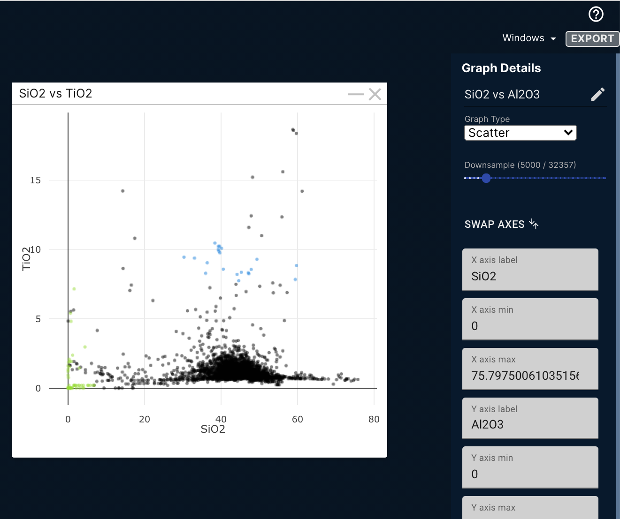
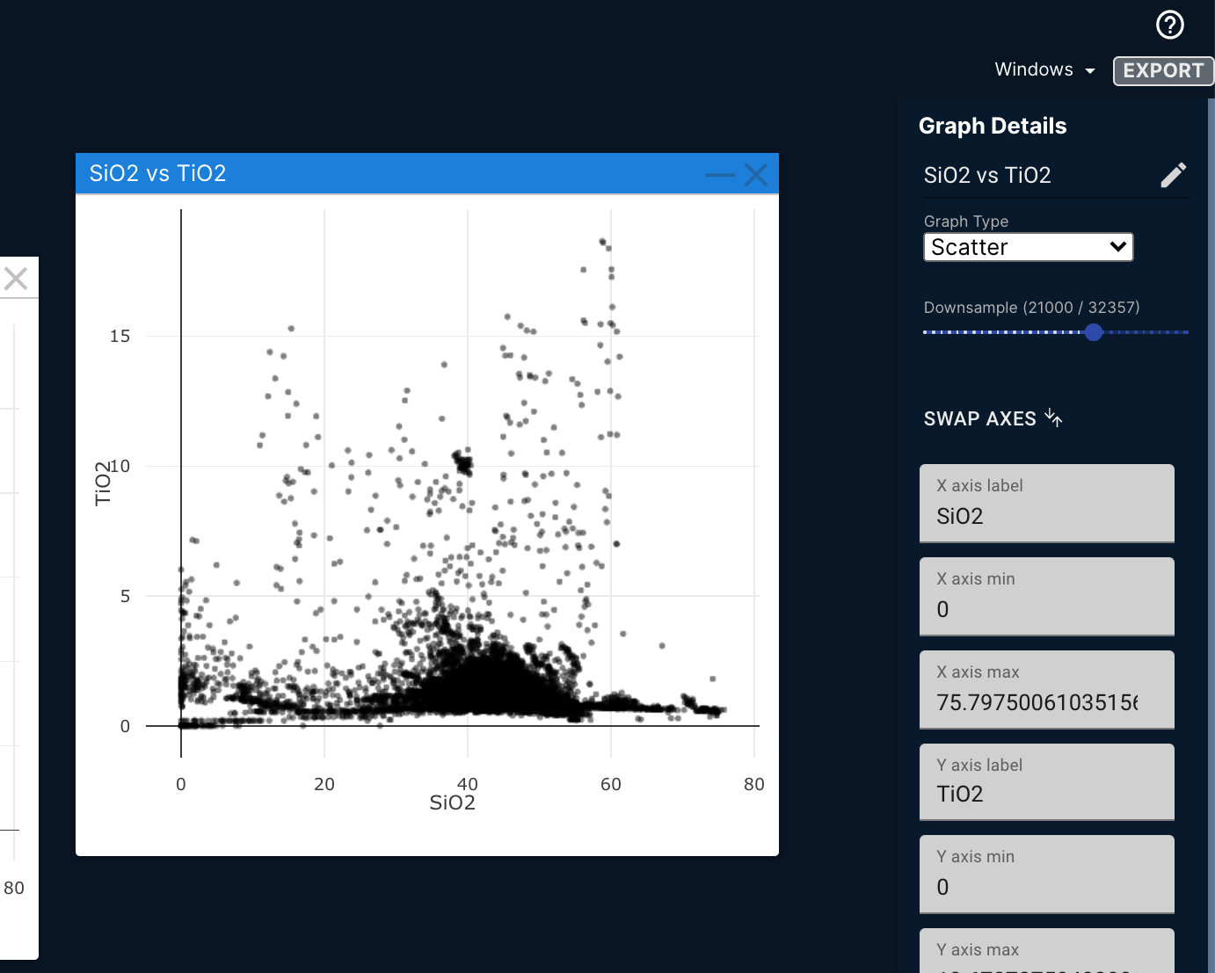
Instrument Ops
CODEX Data Scaling
Initial pass at data scaling to handle plotting of larger data sets
Scaling needs better integration between tools and a more dynamic approach based on zoom level

Slide 5
Instrument Ops
Infusion Status
Working with a few data scientists who are interested in the app
These users have helped make sure that our installation improvements are working
Infusion investigations
Contemplating how to work with operations teams
Investigating relevance to 398 Unity project (could be useful for SDS monitoring or scientist end-users)

Slide 6
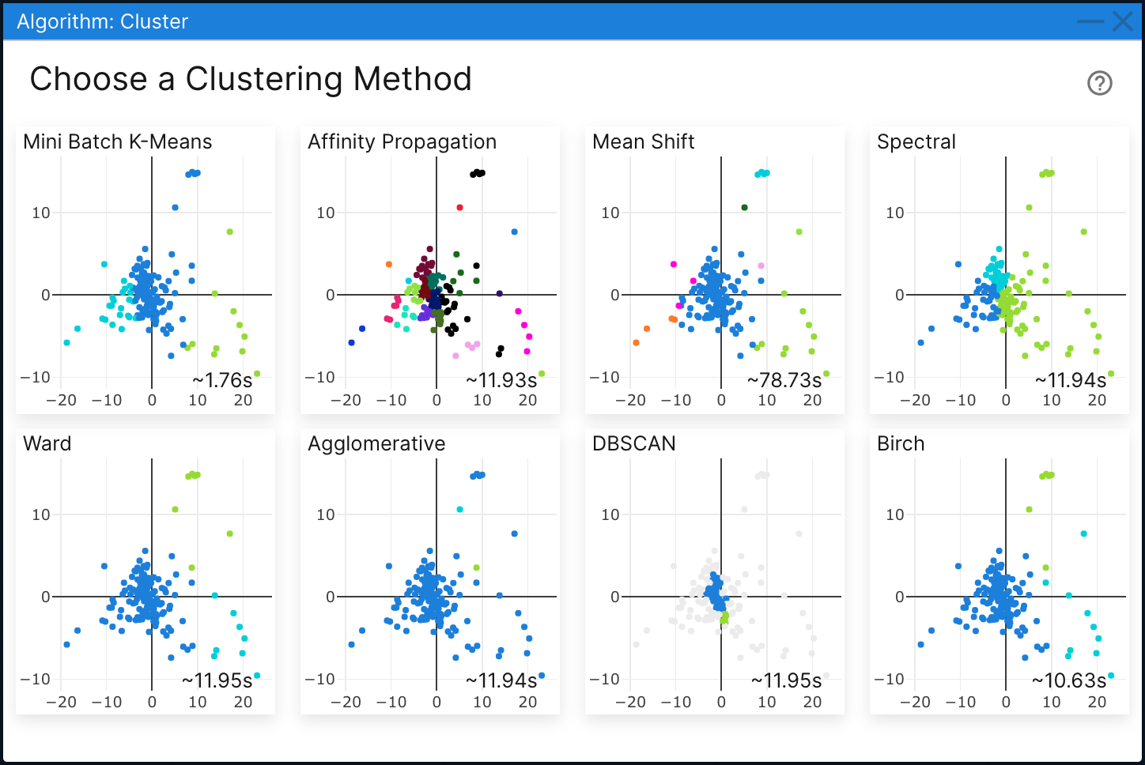
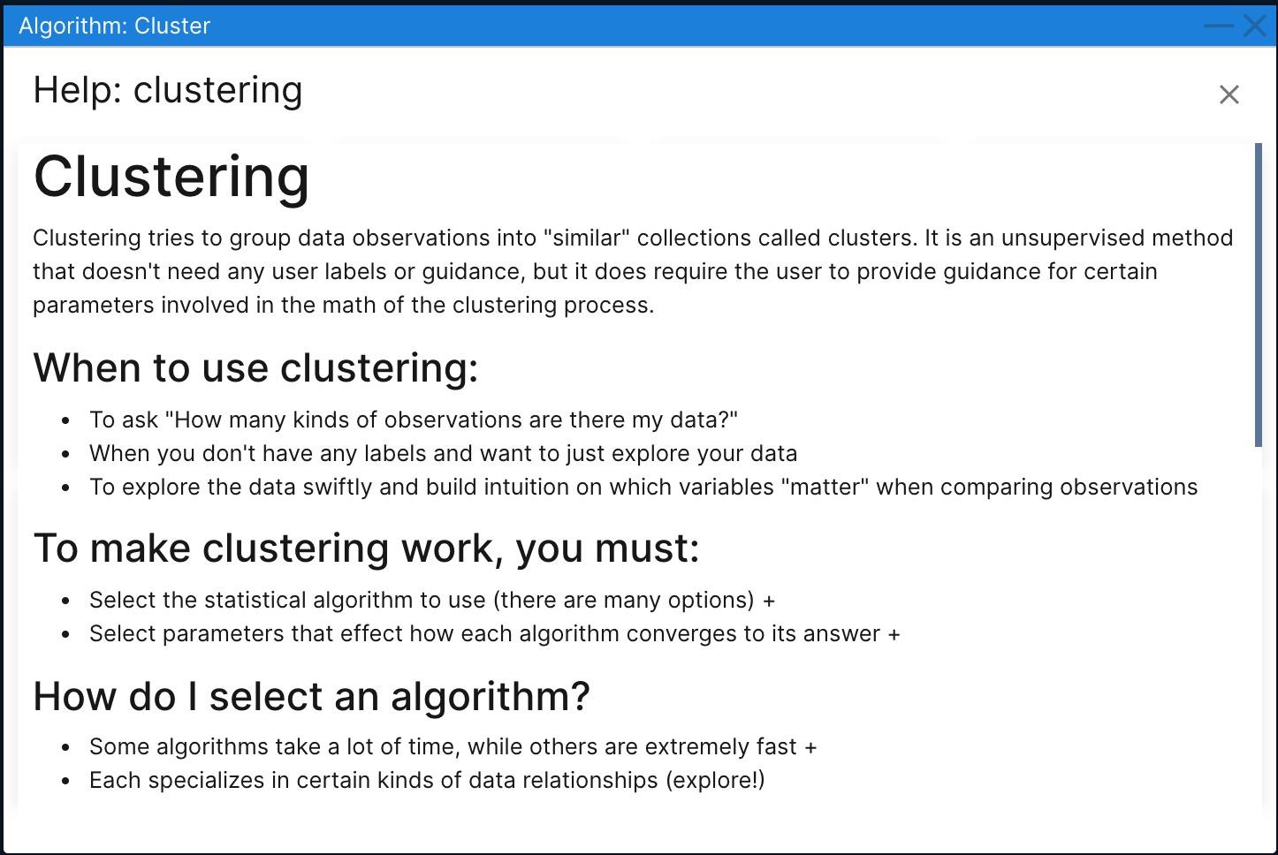
Instrument Ops
Plans for Next Month
Focus on more server stability
Expand built-in help to provide more contextual information that will help users select which algorithms are most appropriate
May start to address additional Data Scaling needs

Slide 7
Instrument Ops
Issues and Concerns
Resource competition with M2020
There is currently enough resource to make the planned progress, but it is expected to be unevenly distributed in time in the lead up to Mars landing

Slide 8
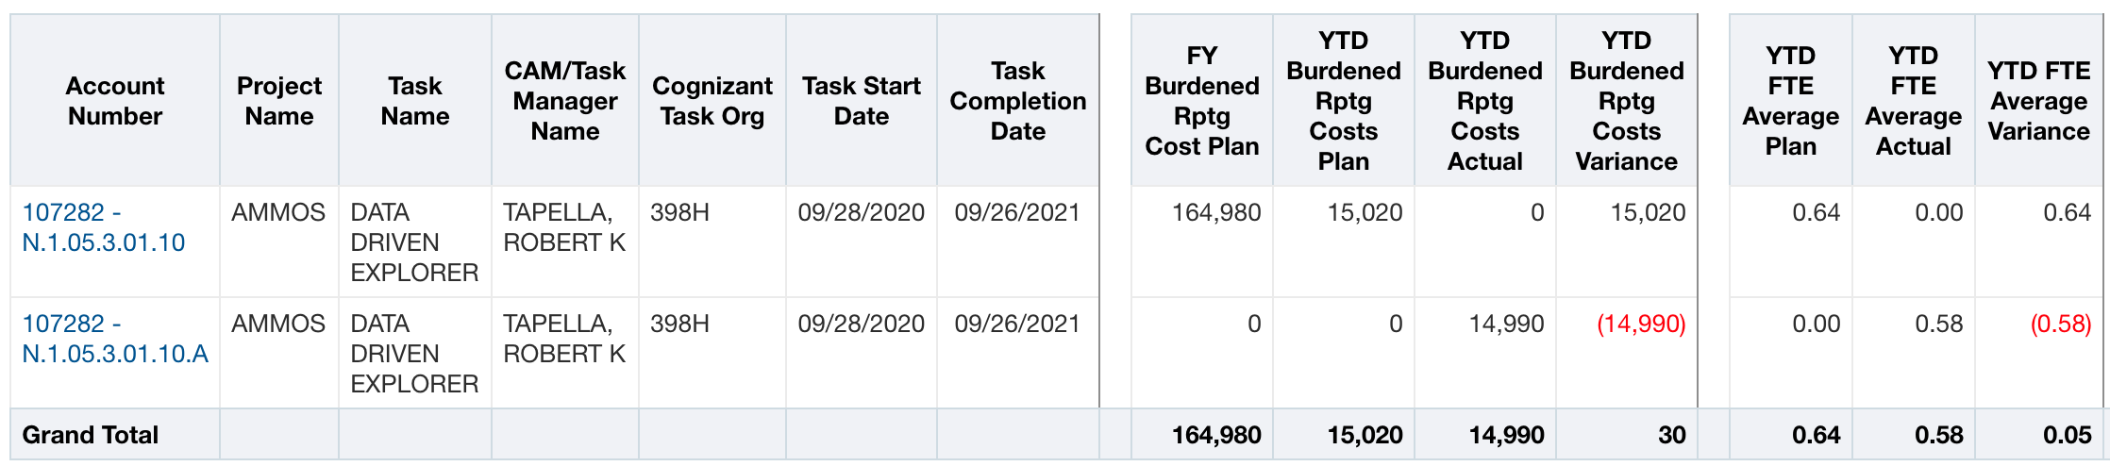
Instrument Ops
CODEX Financial Status
Costs are on-plan
Variance to plan is $30

