Slide 1
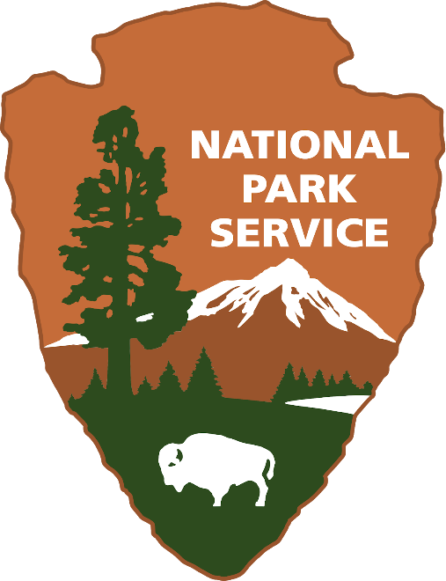
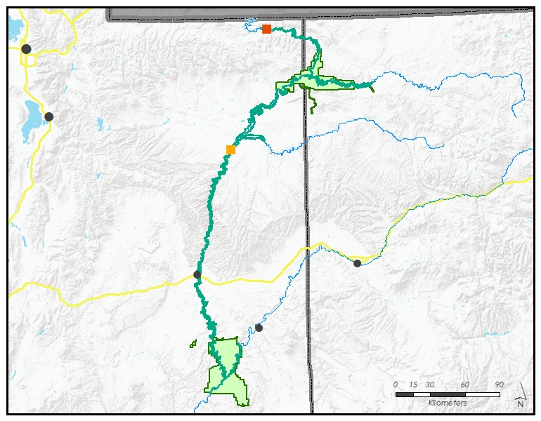
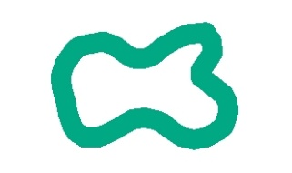



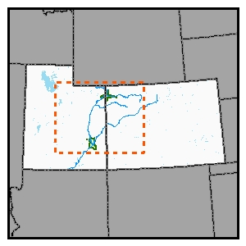
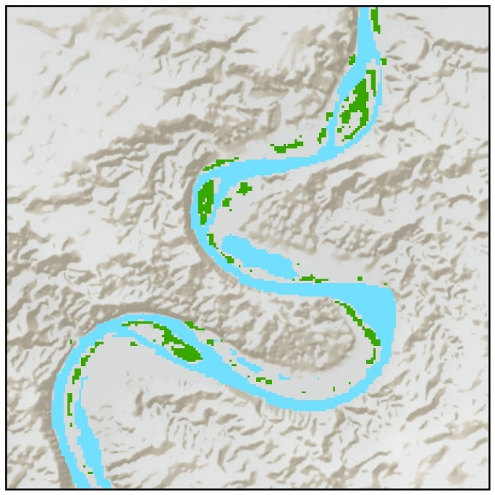
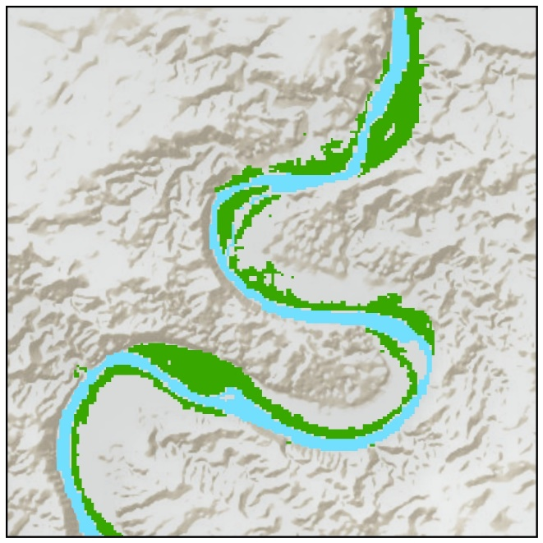
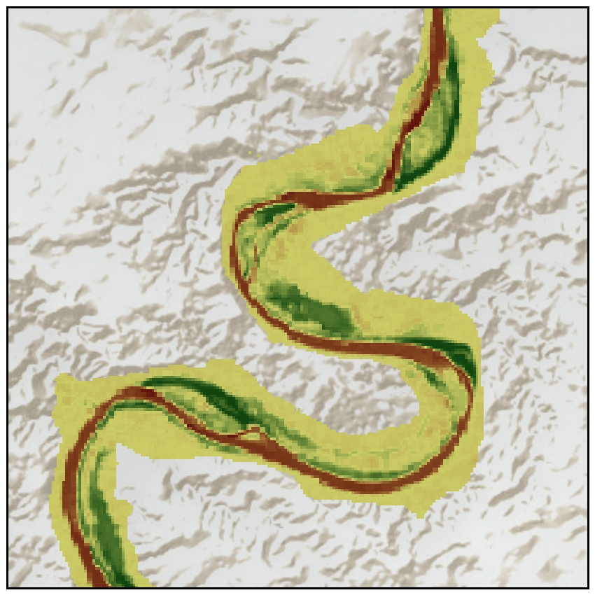
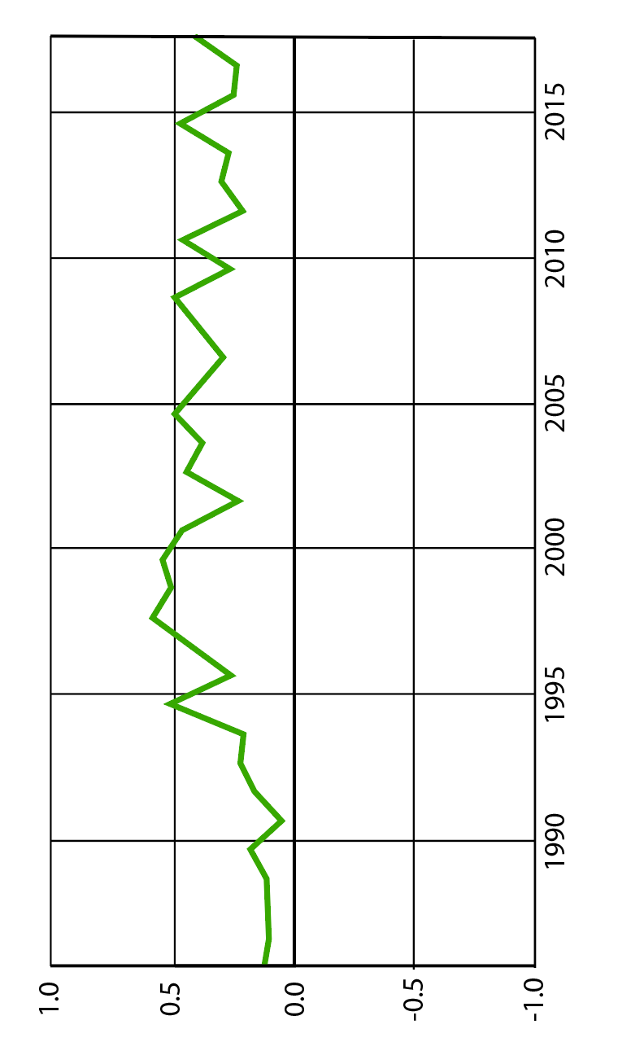
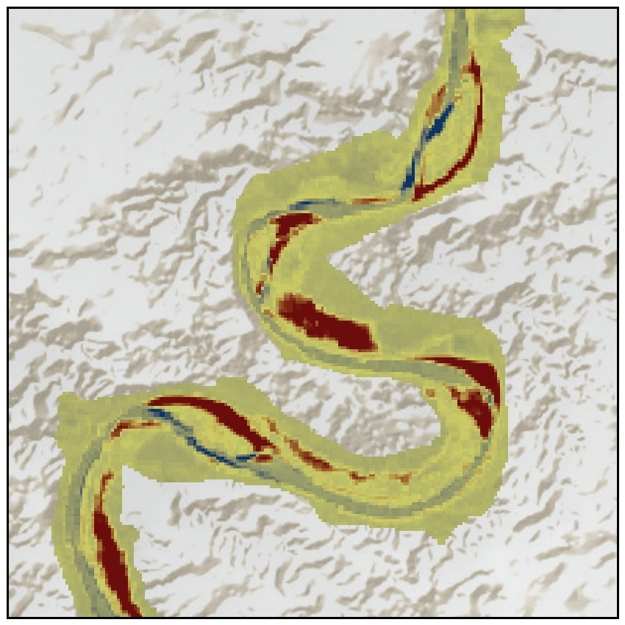
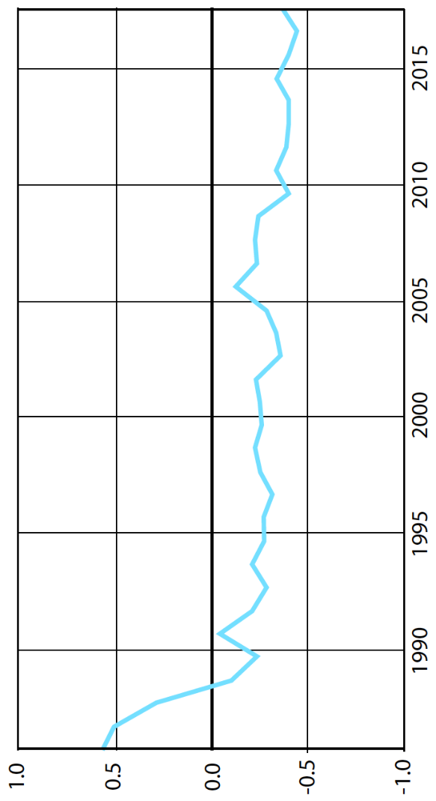
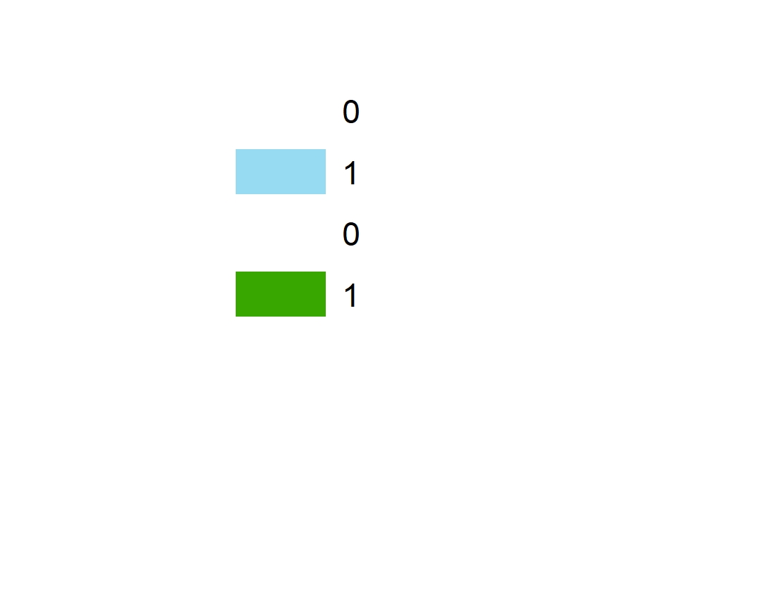


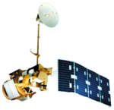
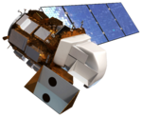
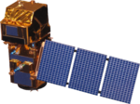
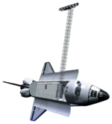


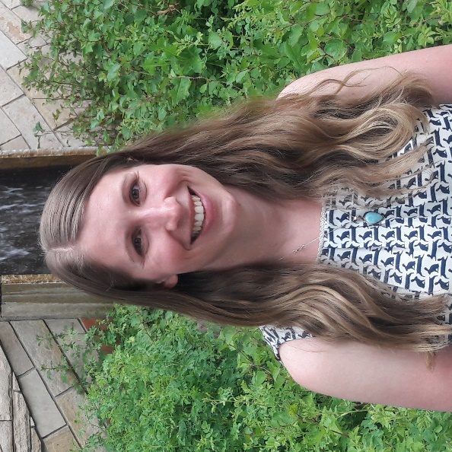

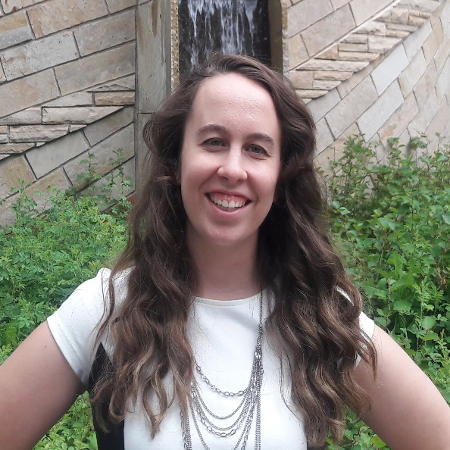

Designing a Modeling User Interface Incorporating Landsat to Monitor Changes in Riparian Vegetation and Endangered Fish Habitat
Abstract
Objectives
Since the completion of the Flaming Gorge Dam in 1964, artificial flow releases along the Green River have promoted channel narrowing and encouraged non-native vegetation encroachment into the active stream channel. These changes in the Green River’s flow regime have reduced the backwater habitat of four native endangered fish species: the Colorado Pikeminnow (Ptychocheilus lucius), Razorback Sucker (Xyrauchen texanus), Humpback Chub (Gila cypha), and Bonytail (Gila elegans). To promote population recovery, this project developed the River Morphology Evaluation Toolbox (RMET), a Google Earth Engine (GEE) tool, to more efficiently and cost-effectively monitor changes in vegetation and hydrology across large spatial and temporal scales. Using imagery collected from Landsat 5 Thematic Mapper (TM), Landsat 7 Enhanced Thematic Mapper Plus (ETM+), Landsat 8 Operational Land Imager (OLI) and Thermal Infrared Sensor (TIRS), Shuttle Radar Topography Mission (SRTM), and Sentinel-2 Multi Spectral Instrument (MSI) satellites, the team used the normalized difference vegetation index (NDVI), soil adjusted vegetation index (SAVI), modified normalized difference water index (MNDWI), and normalized difference water index (NDWI) to detect landcover changes. Trends in spectral index changes over user-selected focal years and the magnitudes of those changes were isolated and visualized through RMET. The project partners at the National Park Service and the Upper Colorado River Endangered Fish Recovery Program will use RMET to identify potential sites where changes in riparian vegetation and the active stream channel may have reduced fish habitat to make more informed recommendations for flow releases from the Flaming Gorge Dam.
Test the feasibility of detecting river geomorphology change and vegetation encroachment using NASA Earth observations
Create a model which uses vegetation and water spectral indices to create binary presence/absence maps
Develop an interactive Google Earth Engine (GEE) tool and accompanying tutorial
Project Partners
National Park Service, Water Resources Division
National Park Service, Inventory & Monitoring Division,
Northern Colorado Plateau Network
Upper Colorado River Endangered Fish Recovery Program
Methodology
Study Area
NASA Earth Observations
Landsat 5, 7, 8
SRTM
Sentinel-2
Google Earth Engine
Salt Lake City
Flaming
Gorge Dam
Dinosaur Nat’l
Monument
Study Area
Study Area Map
Our study area covers about 872 kilometers of riparian corridors in the Upper Colorado River Basin.
The time frame for our study was from 1984 to 2017.
To better illustrate our findings, we focused on Snider Bottom because it appears vegetation has encroached into the active stream channel, the channel has narrowed, and endangered species habitat has potentially been reduced in this area.
Yampa River
Rivers
Change Detection GUI
Provo
Snider
Bottom
White River
National Park
Service Land
V-BET
NHD
ArcMap
UTAH
Green River
COLORADO
Interstate
Green River
Colorado River
Area Enlarged
Grand
Junction
Sensor Input
Data
Software
Output
Canyonlands Nat’l Park
Moab
1
2
3
4
Results
Snider Bottom Landcover Change
Snider Bottom NDVI Change: 1984 - 2017
NDVI
Snider Bottom MNDWI Change: 1984 - 2017
1984
2017
MNDWI
Increase
Greener
Wetter
Vegetation
Water
Less Green
Drier
Earth Observations
Team Members
Landsat 5 TM
Landsat 7 ETM+
Landsat 8 OLI
Sentinel-2 MSI
SRTM
Margaret Mulhern
Project Lead
Daniel Carver
Geoinformatics Fellow
Kristen Dennis
Nathaniel Penrod
Conclusions
Acknowledgements
RMET via Google Earth Engine enables rapid detection of changes which have occurred in riparian vegetation distribution and hydrology features along the Green, Yampa, White, and Colorado Rivers since 1984. This enhances our project partners’ ability to identify areas of potential endangered fish habitat loss and determine locations for more intensive field studies.
Spectral index change maps support the well-documented phenomenon of stream channel narrowing and vegetation encroachment into the active stream channel.
Dr. Paul Evangelista (Colorado State University, Natural Resource Ecology Laboratory)
Nicholas Young (Colorado State University, Natural Resource Ecology Laboratory)
Tony Vorster (Colorado State University, Natural Resource Ecology Laboratory)
Brian Woodward (Colorado State University, Natural Resource Ecology Laboratory)
Utah and Colorado Water Resources
Colorado – Fort Collins| Summer 2018

