Slide 1
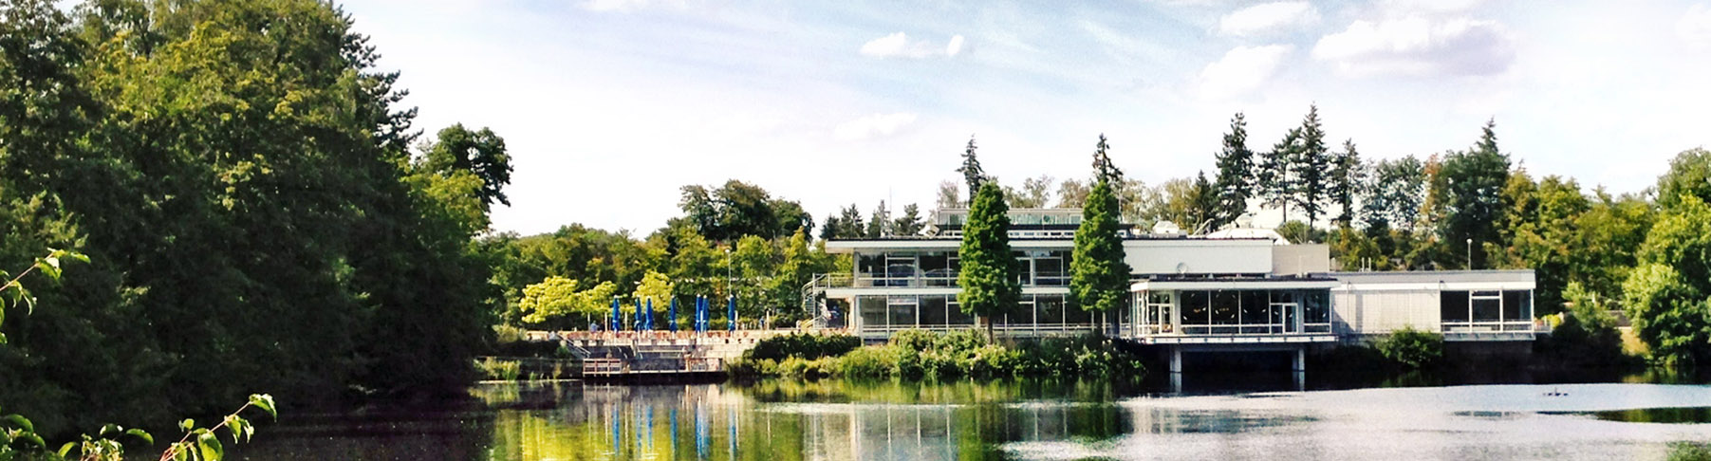
Leveraging HPC for EO applications
Jülich Supercomputing Centre – Forschungszentrum Jülich
Dr. Rocco Sedona

Slide 2

Content
1. Remote sensing (for EO)
1. Deep learning (for EO)
3. Distributed deep learning
4. Is HPC needed for deep learning in EO?

Slide 3
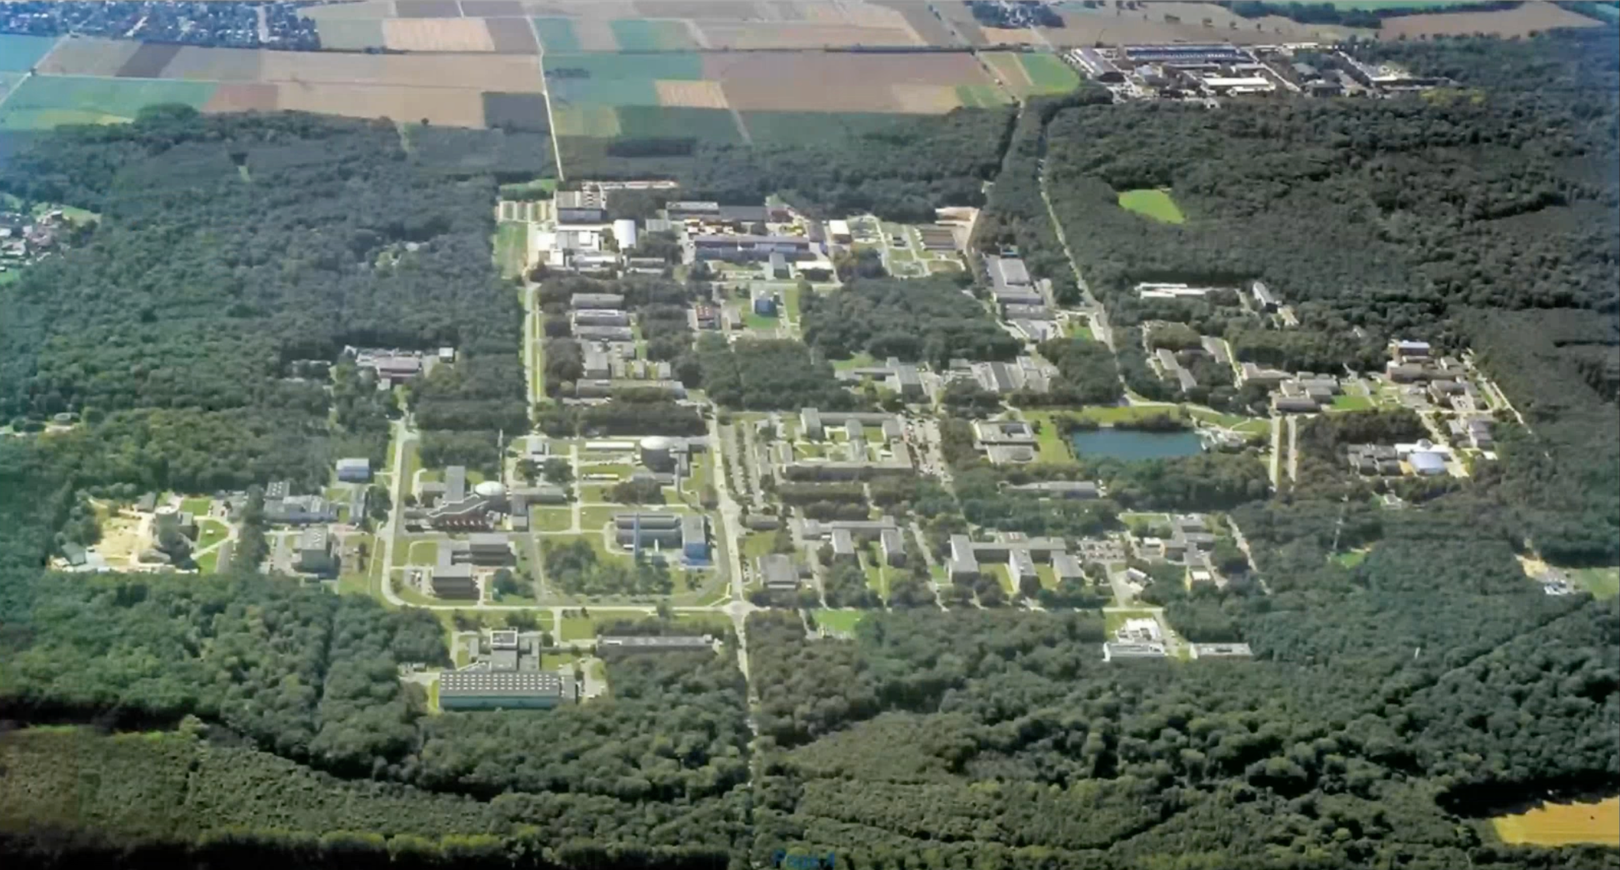
Forschungszentrum Jülich
SDL AI and ML for Remote Sensing
Jülich Supercomputing Centre
https://www.fz-juelich.de/en/ias/jsc/about-us/structure/simulation-and-data-labs/sdl-ai-ml-remote-sensing
20 June2025

Slide 4
High-performance computing
3 August 2025
Page

Slide 5
HPC
Node
Node
Node
What is HPC?
High number of compute nodes
Vast amounts of memory
High-speed interconnects
HPC == tightly coupled parallel workloads
Node
Node
Node
Node
Node
Node
Node
https://www.esa.int/ESA_Multimedia/Images/2019/05/ESA-developed_Earth_observation_missions
3 August 2025
Page

Slide 6
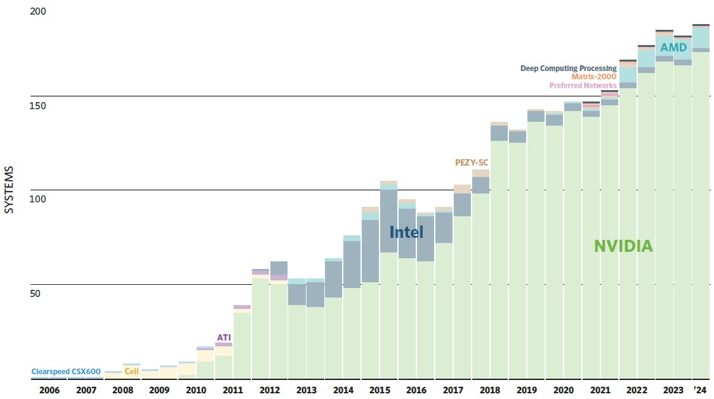
HPC
And inside a node?
https://www.nextplatform.com/2024/05/13/top500-supers-this-is-peak-nvidia-for-accelerated-supercomputers/
3 August 2025
Page

Slide 7
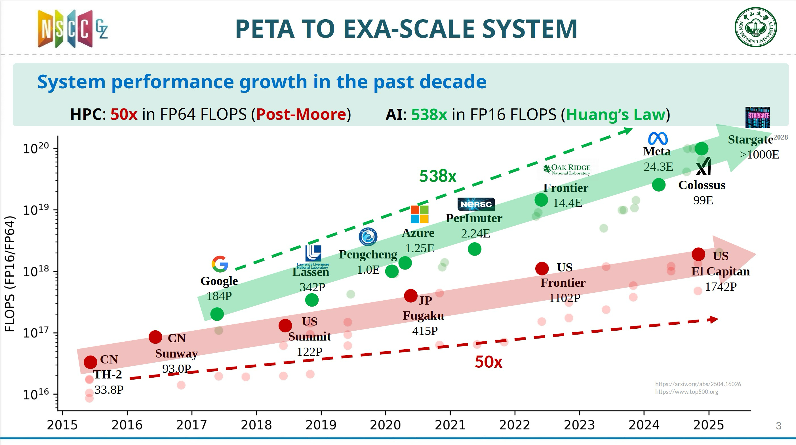
Post-moore era
Yutong Lu, "Closing Keynote: Tackling Fragmentation in Exascale Supercomputing and Beyond", ISC High Performance 2025, https://isc-hpc.com/ https://arxiv.org/abs/2504.16026 https://www.top500.org
3 August 2025
Page

Slide 8
HPC and cloud
Cloud-native inside the datacentre. JARVIS (“JUPITER Advanced Research Vehicle for Inference Services”) is a cloud-based AI-inference module that will sit alongside JUPITER’s training-oriented Cluster + Booster, exposing REST/GRPC endpoints for multi-tenant model serving.
Modular Supercomputing Architecture (MSA). Jülich’s long-running MSA concept couples heterogeneous modules via a high-speed network so workloads hop seamlessly from simulation to AI training to inference.
Cloud learns from HPC. Hyperscalers are rolling out HPC-grade instances—e.g., Google Cloud’s 192-core H4D with 400 Gb/s fabric—so researchers can burst out of on-prem systems without losing performance.
HPC learns from Cloud. Earlier systems such as JUSUF already combined an HPC partition with an IaaS cloud partition; JARVIS deepens that model by offering AI services to SMEs and the public sector via the “AI Factory”.
Take-away: The boundary is blurring—cloud principles (APIs, containers, elastic tenancy) are moving into supercomputers, while cloud providers import HPC hardware and networking. The result is faster time-to-solution and broader accessibility for advanced AI workloads.
Yutong Lu, "Closing Keynote: Tackling Fragmentation in Exascale Supercomputing and Beyond", ISC High Performance 2025, https://isc-hpc.com/ https://arxiv.org/abs/2504.16026 https://www.top500.org
3 August 2025
Page

Slide 9
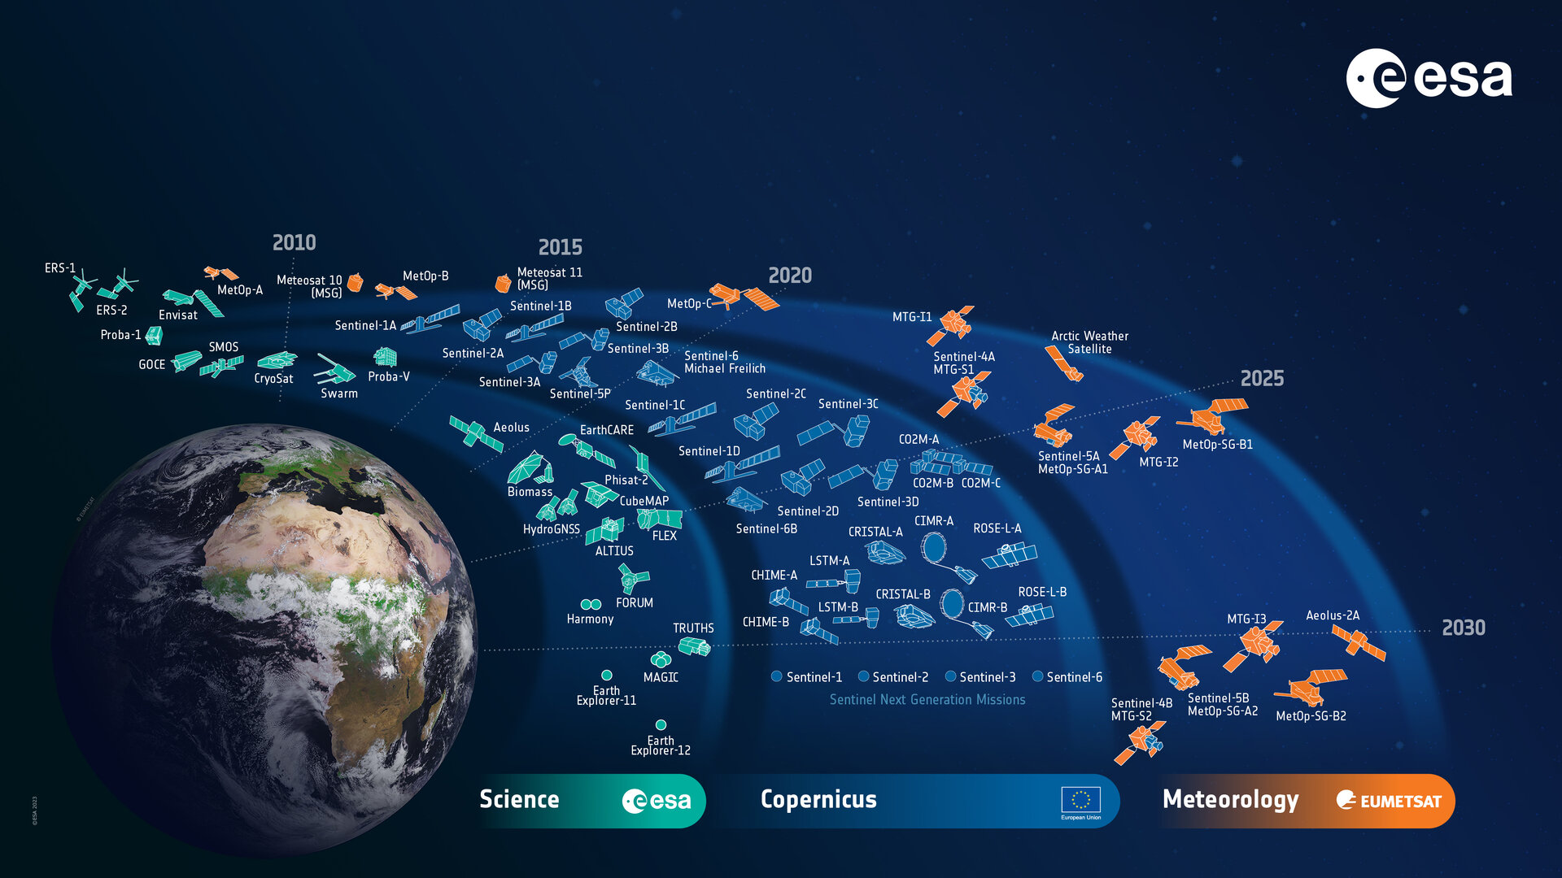
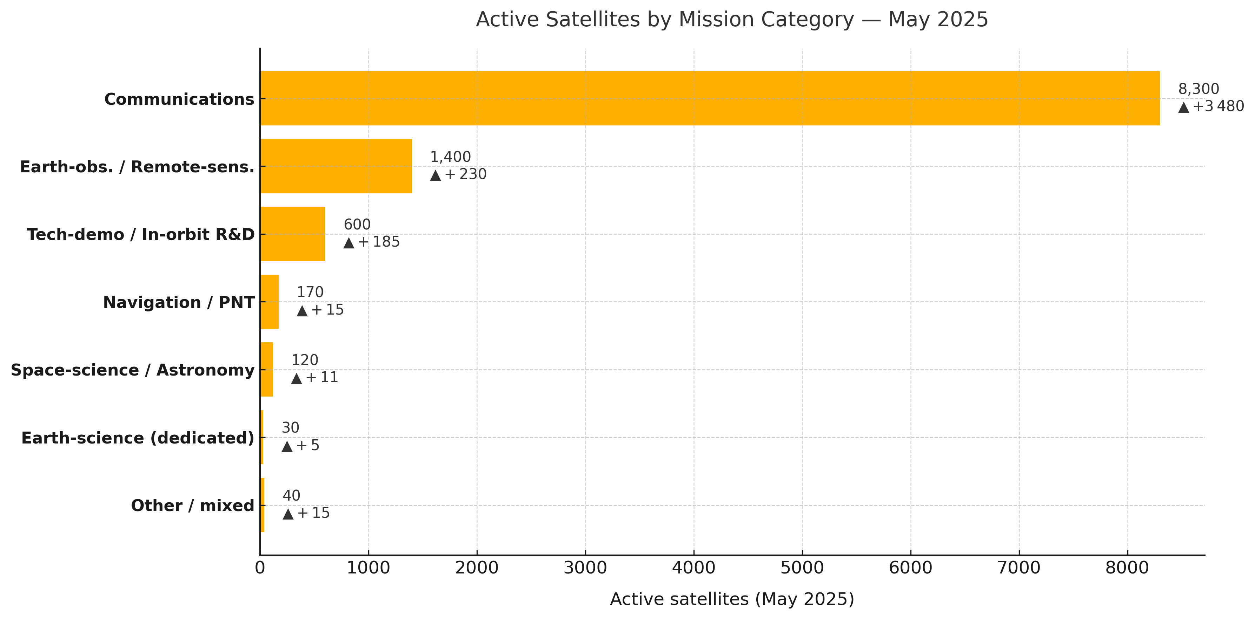
Earth-orbiting satellites
https://www.esa.int/ESA_Multimedia/Images/2019/05/ESA-developed_Earth_observation_missions
[1]: https://www.livescience.com/space/space-exploration/how-many-satellites-could-fit-in-earth-orbit-and-how-many-do-we-really-need "How many satellites could fit in Earth orbit? And how many do we really need? | Live Science"
[2]: https://www.androidauthority.com/starlink-satellites-in-orbit-3337267/?utm_source=chatgpt.com "How many Starlink satellites are in orbit in 2025? - Android Authority"
[3]: https://interactive.satellitetoday.com/via/january-february-2025/how-space-based-data-will-drive-the-digital-economy?utm_source=chatgpt.com "How Space-Based Data Will Drive the Digital Economy - Via Satellite"
[4]: https://www.brycetech.com/reports/report-documents/smallsats-2025/BryceTech_Smallsats-by-the-Numbers-2025.pdf
3 August 2025
Page

Slide 10
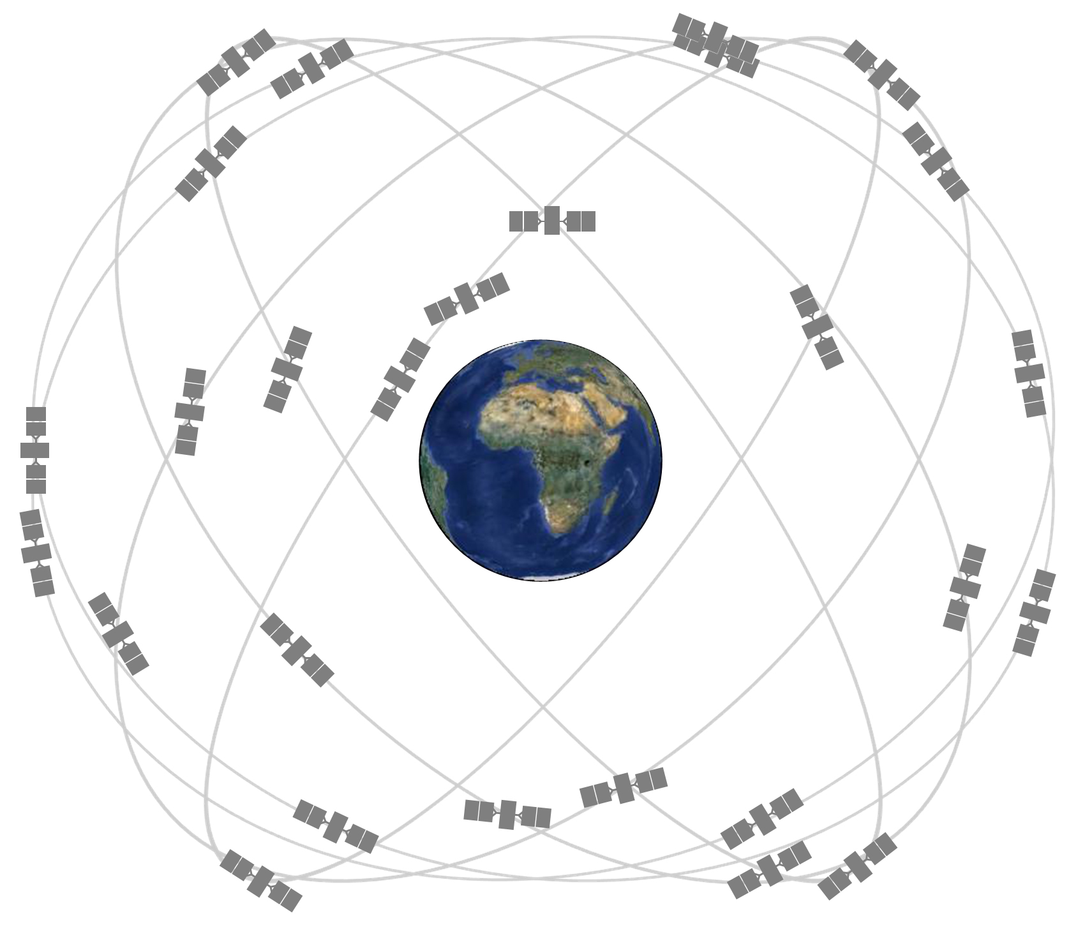
Data volume
Heterogeneity -> Multimodality
Snapshot (-mid 2025)
Commercial constellations – Planet’s 200-plus Doves/SuperDoves, Maxar’s WorldView + fresh Legion birds, and ~40 small-SAR craft (ICEYE, Capella, Umbra) already put ≈ 250 satellites in orbit and pump out ≈ 130 TB of raw imagery every day – a little over two-thirds of all civilian EO data.
Institutional & government fleets – Europe’s Copernicus Sentinels, NASA’s Landsat & wider EOS instruments, and NOAA’s weather satellites total ≈ 35 operational spacecraft and account for ≈ 50 TB day-¹, the remaining third.
by the late-2020s, daily EO downlink may cross 300 TB—with ~80 % originating from private constellations—forcing ground networks, cloud pipelines and analytics teams to scale just as aggressively as the satellites themselves.
https://www.gps.gov/multimedia/images/constellation.jpg
Large data volume
3 August 2025
Page
Notes:
Why the real figure is probably higher
Undisclosed national systems – China’s rapidly growing Jilin-1/Gaofen constellations and Russia’s Resurs/Kosmos programmes almost certainly add tens of terabytes more, but no public data-rate numbers are available.
Emerging mega-constellations – ICEYE, Capella, Umbra, BlackSky, Spire, AxelSpace, Satellogic and others are all in fleet-expansion phases; their combined flow is rising by several TB every few months.
Next-gen science missions – NASA’s SWOT & NISAR pair alone are expected to stream ≈ 100 TB day-1 once both are fully operational .
Processed products – Level-2/3 analytics, cloud-optimised formats and duplicate mirror-sites roughly triple the storage footprint once data land. The 1 TB day-1 Landsat raw feed, for example, becomes ~3 TB day-1 in the USGS archive .
A reasonable “all-in” envelope for mid-2025 (civil + commercial, but still excluding most classified systems) is therefore ≈ 0.2–0.3 PB of new Earth-observation data every 24 hours.
Industry analysts looking further ahead (and assuming hundreds more high-rate satellites) forecast > 200 PB day-1 by the early 2030s , but that figure reflects ambitious launch manifests and aggressive on-orbit laser-downlink plans rather than today’s capacity.

Slide 11
deep learning (for eo)
3 August 2025
Page

Slide 12
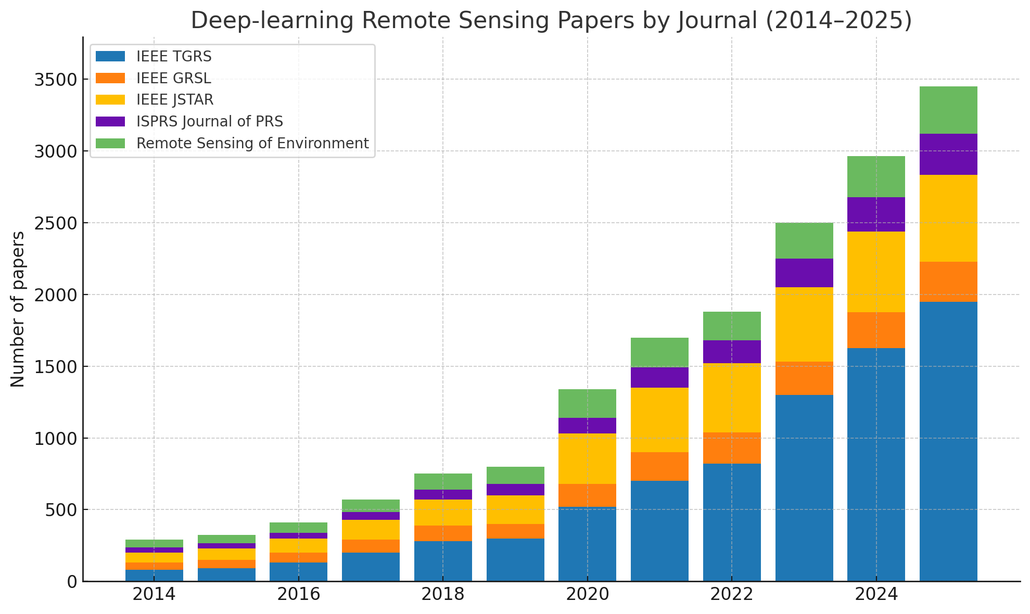
ML/DL for eo
*Estimate
3 August 2025
Page

Slide 13
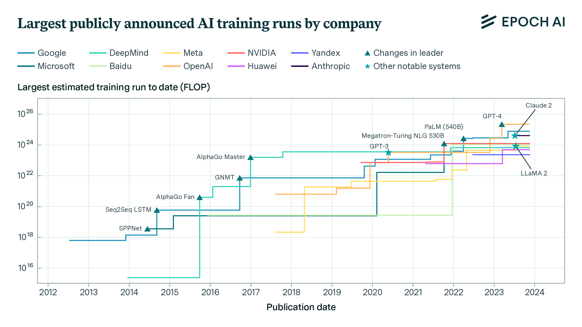
Model size growth
Emergent abilities arise past scale thresholds (e.g., chain‑of‑thought, imagenet‑level vision)
Data efficiency now trumps sheer size; more tokens → bigger gains.
Compute & algorithmic improvements double effective performance every ≈ 8 months.
Multimodal convergence: unified text‑vision models.
https://epoch.ai/blog/who-is-leading-in-ai-an-analysis-of-industry-ai-research
3 August 2025

Slide 14
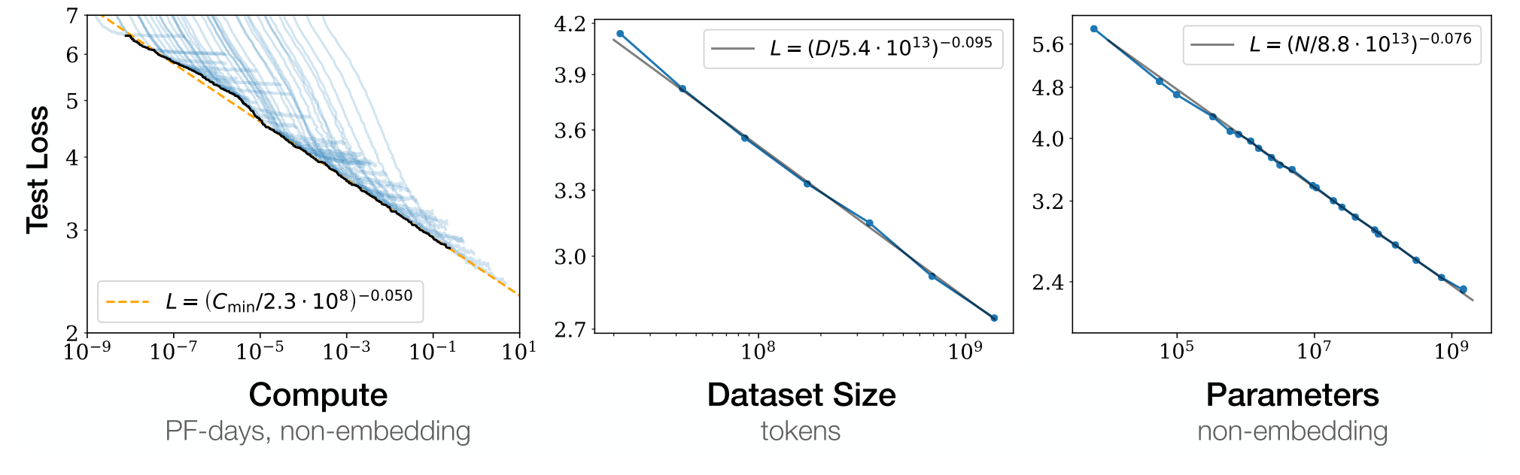
Scaling laws
Power‑law drop in loss with ↑ parameters, data, compute
Text: L ≈ (N/8.8·10¹³)^‑0.076, (D/5.4·10¹³)^‑0.095
Vision: Error ≈ (N/1.3·10⁹)^‑0.15, (D/1.1·10⁹)^‑0.17
Compute‑optimal sweet spot → tokens ≈ 20 × parameters ("Chinchilla" rule)
Same slopes hold over 7+ orders of magnitude
Kaplan, J., McCandlish, S., Henighan, T., Brown, T. B., Chess, B., Child, R., Gray, S., Radford, A., Wu, J., & Amodei, D. (2020, January 23). Scaling laws for neural language models (arXiv:2001.08361). arXiv.
3 August 2025

Slide 15
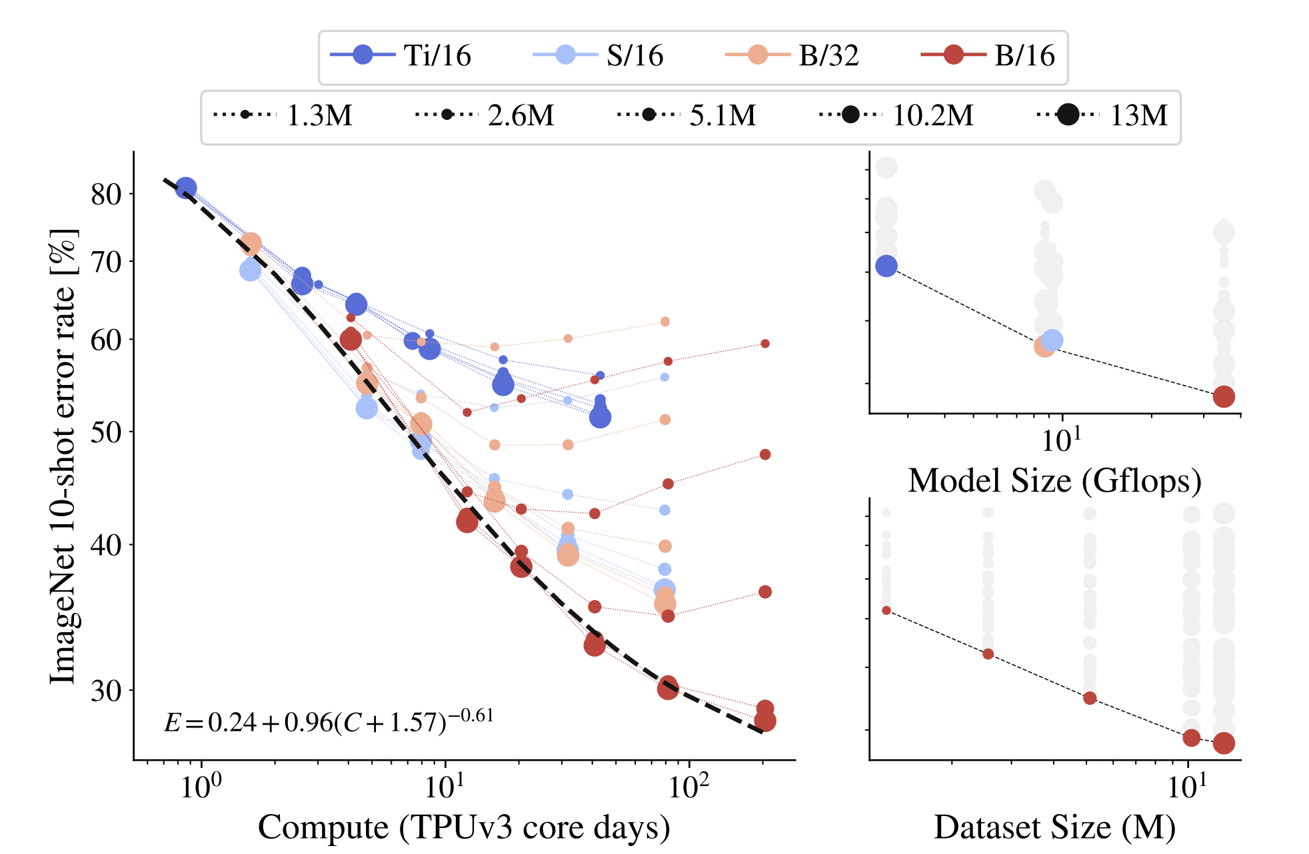
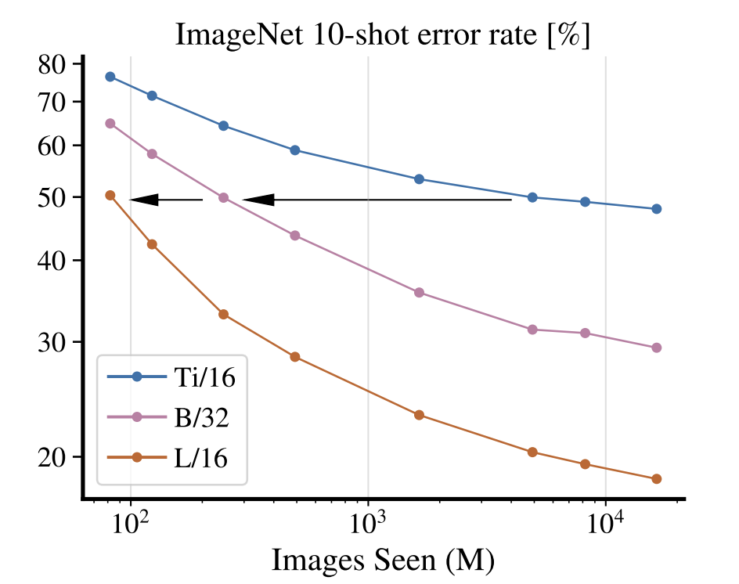
Scaling laws: vision
Zhai, X., et al. (2021). Scaling Vision Transformers (Version 2). arXiv. https://doi.org/10.48550/ARXIV.2106.04560
3 August 2025

Slide 16
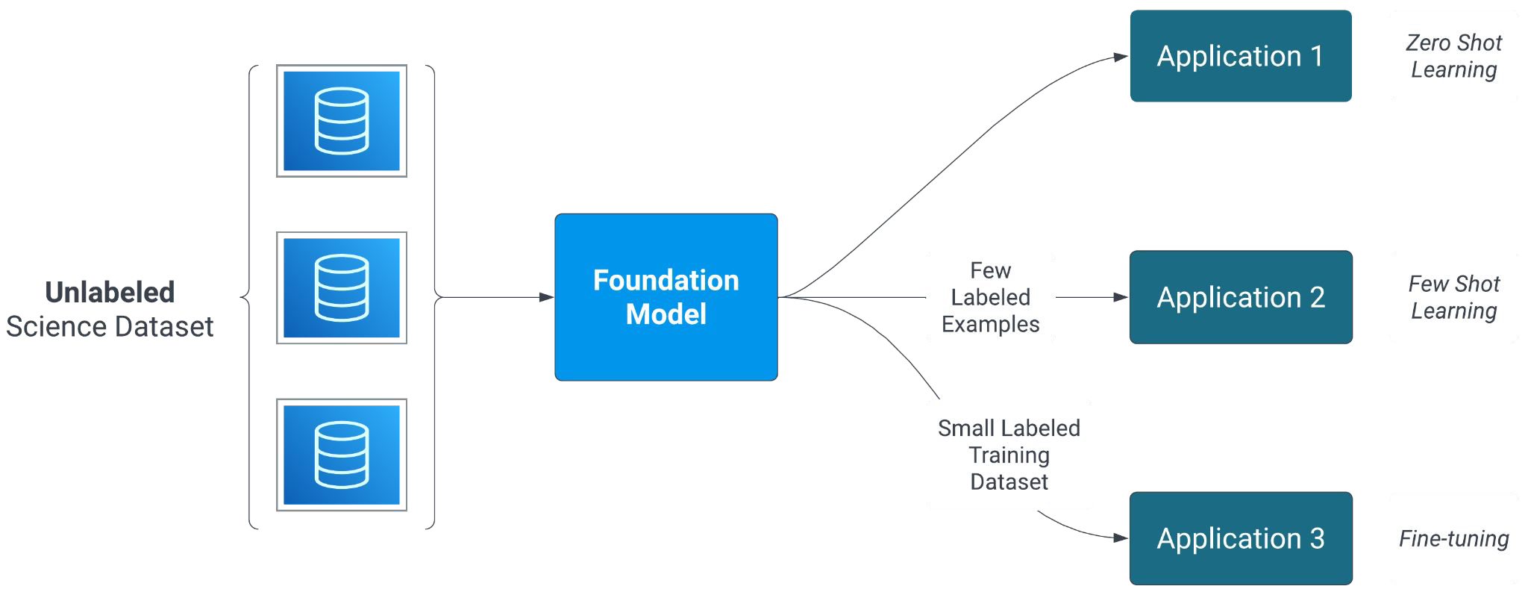
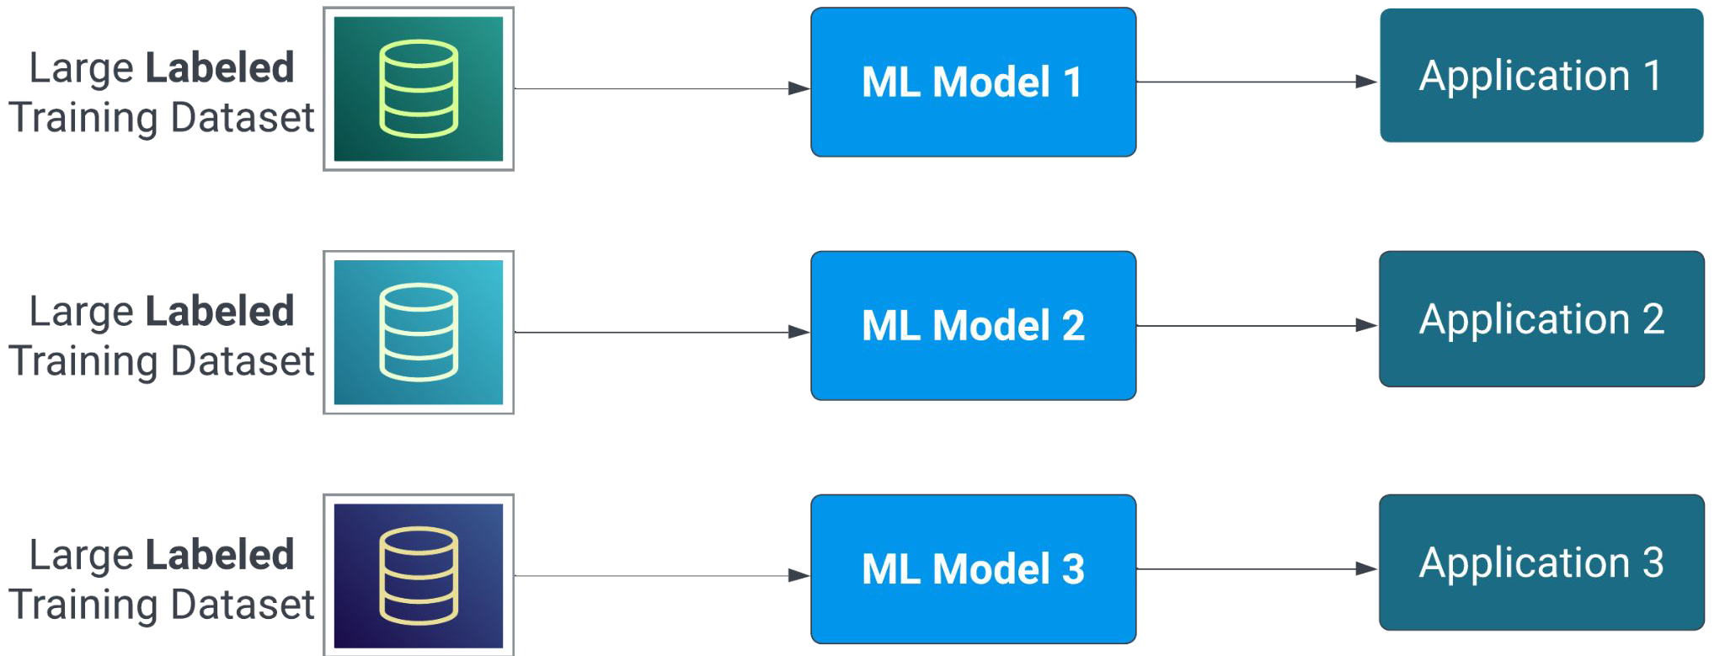
FOundation models
Traditional Supervised Learning Approach
Foundation Model Approach
Credit: Manil Maskey (NASA MSFC & NASA SMD/HQ)
3 August 2025
Page

Slide 17
Distributed deep learning
3 August 2025
Page

Slide 18
Distributed deep learning: Data parallelism
Large models (higher parameter count)
Need for parallelization!
Kaplan, J., McCandlish, S., Henighan, T., Brown, T. B., Chess, B., Child, R., Gray, S., Radford, A., Wu, J., & Amodei, D. (2020, January 23). Scaling laws for neural language models (arXiv:2001.08361). arXiv.
3 August 2025
Page

Slide 19
Distributed deep learning
Replica of the same model on all GPUs
Data-Parallel Training Flow
GPU-0
Data-0
Fwd-1
Fwd-2
Fwd-3
Bwd-3
Bwd-2
Bwd-1
Update
A-R
A-R
A-R
GPU-1
Data-1
Fwd-1
Fwd-2
Fwd-3
Bwd-3
Bwd-2
Bwd-1
Update
A-R
A-R
A-R
GPU-2
Data-2
Fwd-1
Fwd-2
Fwd-3
Bwd-3
Bwd-2
Bwd-1
Update
A-R
A-R
A-R
GPU-3
Data-3
Fwd-1
Fwd-2
Fwd-3
Bwd-3
Bwd-2
Bwd-1
Update
A-R
A-R
A-R
https://pytorch.org/tutorials/intermediate/ddp_tutorial.html
3 August 2025
Page

Slide 20
Distributed deep learning: model parallelism
Pipelining
Pipe-Parallel Training Flow
GPU-0
Data-0
Fwd-1
Fwd-2
Bwd-2
Bwd-1
Update
GPU-1
Fwd-3
Bwd-3
Update
Model split across GPUs
Pipe-Parallel Training Flow
GPU-0
Data-0
Fwd-1
Fwd-2
IDLE
Bwd-2
Bwd-1
Update
GPU-1
IDLE
Fwd-3
Bwd-3
IDLE
Update
3 August 2025
Page

Slide 21
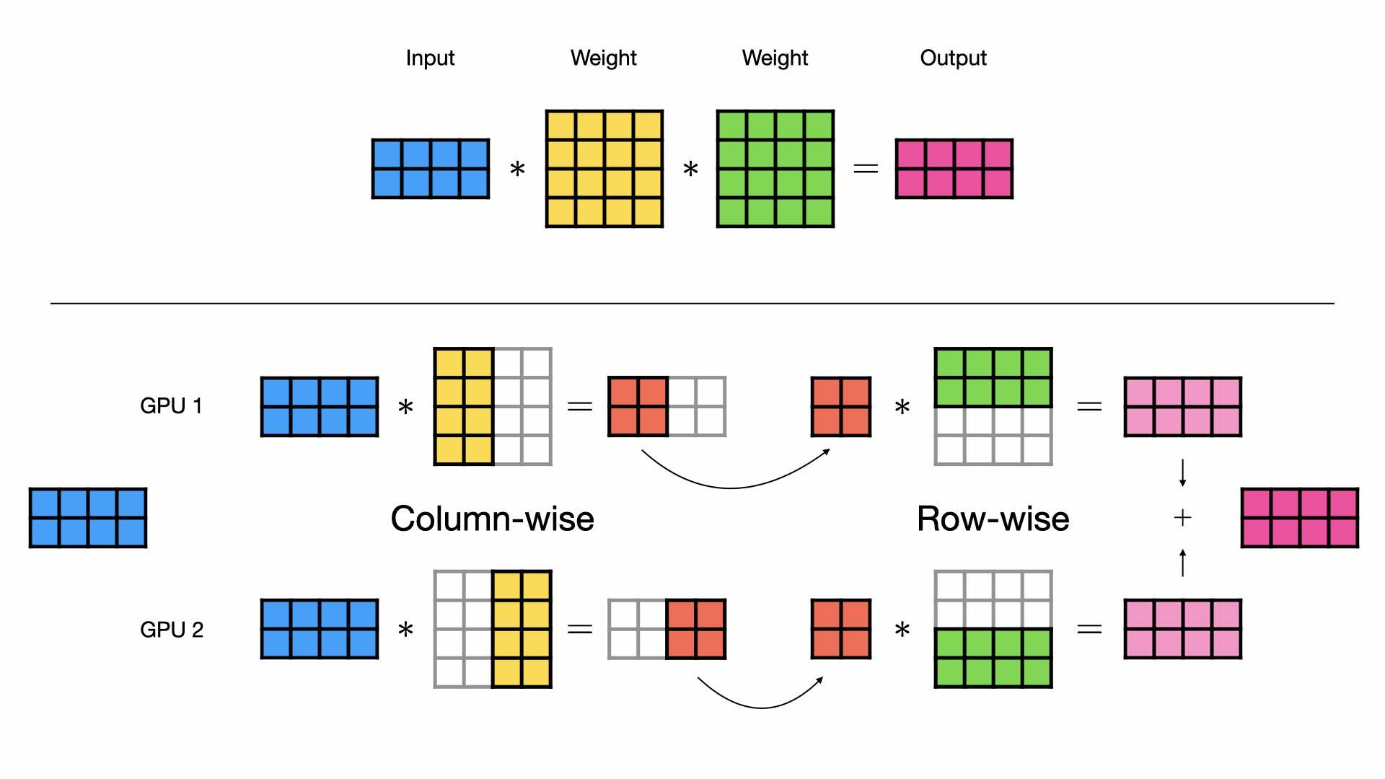
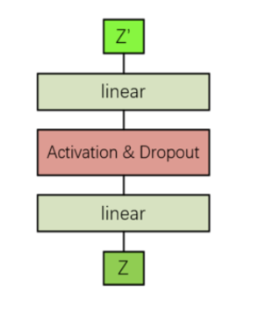
Distributed deep learning: model parallelism
Tensor Parallelism
Row-wise TP
Col-wise TP
Matrix multiplication split across GPUs
3 August 2025
Page
https://lightning.ai/lightning-ai/studios/tensor-parallelism-supercharging-large-model-training-with-pytorch-lightning

Slide 22
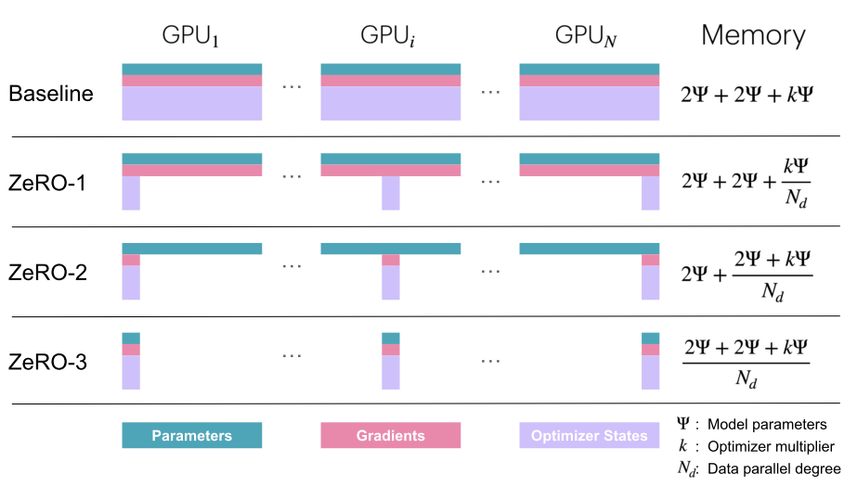
Distributed deep learning: zero (redunduncy)
PyTorch FSDP is based on ZeRO
Activations are not distributed!
https://huggingface.co/spaces/nanotron/ultrascale-playbook?section=zero-1:_partitioning_optimizer_states
3 August 2025
Page

Slide 23


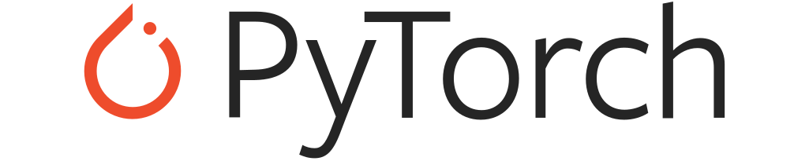

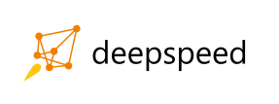


TOOLs for Distributed deep learning
2013 – DistBelief (Google) first large‑scale parameter‑server architecture
2015 – TensorFlow PS & SyncReplicas standardised PS + all‑reduce hybrids
2016 – MXNet KVStore flexible data/model parallel key‑value store
2017 – Horovod (Uber) ring‑allreduce over MPI/NCCL; drop‑in for TF & Keras
2018 – PyTorch DDP gradient bucketing; NCCL backend becomes default
2019 – Megatron‑LM (NVIDIA) tensor & pipeline model‑parallelism for >10B‑param LMs
2020 – DeepSpeed (Microsoft) ZeRO optimizer sharding, 8‑bit optimisers
2021 – PyTorch FSDP fully‑sharded data‑parallel; near‑linear scaling
2022 – Alpa / Colossal‑AI automatic 3‑D parallel + memory optimisation
2023 – Ray Train 2.x elastic autoscaling clusters; heterogeneous resources
2024 – vLLM / Paginated KV‑cache inference‑oriented distributed serving
3 August 2025

Slide 24



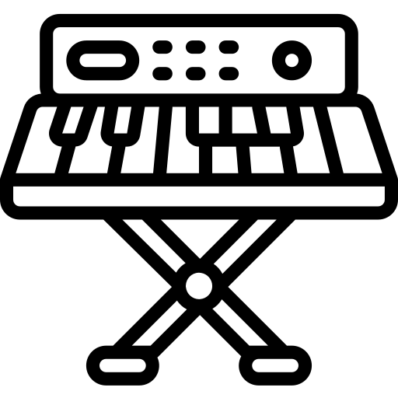

Distributed deep learning: Is that all?
Parallelism techniques (expert parallelism, ...)
Flash Attention
Kernel Fusion
Hyperparameter Optimization
Inference & deployment
3 August 2025
Page
Notes:
Drummer = Expert Parallelism (keeps all parts in sync)
Guitarist named “Flash” = Flash Attention (lightning riffs)
Bassist named “Kernel” = Kernel Fusion (fuses low-level riffs)
Keyboardist = Hyperparam (constantly tweaking the sound)
Lead Singer = Inference & Deployment (engaging the audience).

Slide 25
Distributed deep learning: memory optimization
Memory ⇄ Compute ⇄ Communication trade‑off
Every scaling trick pushes stress along triangle
Memory
Communication
Compute
3 August 2025
Page

Slide 26
Is HPC needed for deep learning in EO?
3 August 2025
Page

Slide 27
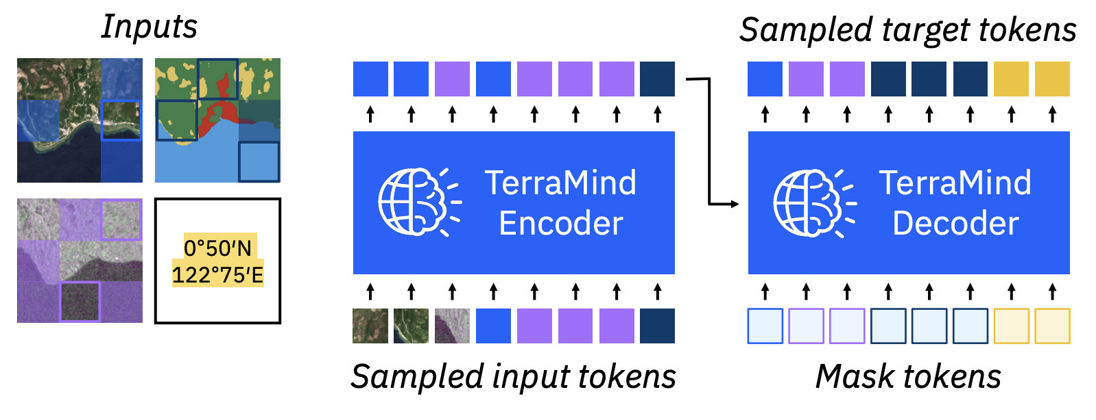
Geospatial foundation models
Geospatial Foundation Models (GFMs) are pretraned models that exhibit good transferability on a variety of downstream tasks
Pretrained on large datasets ( > millions of images)
Data and compute-hungry
Pretraining TerraMind: Jakubik, J., et al. (2025). TerraMind: Large-Scale Generative Multimodality for Earth Observation. https://doi.org/10.48550/ARXIV.2504.11171
2019
2020
2021
2022
2023
2024
2025
Distributed training for EO
Larger dataset: e.g., BigEarthNet
SSL4EO
Prithvi-EO
Multimodality
DOFA, TerraMind
Beginning of FMs in EO
Benchmarking: GEO-Bench, PANGEA
3 August 2025
Page

Slide 28

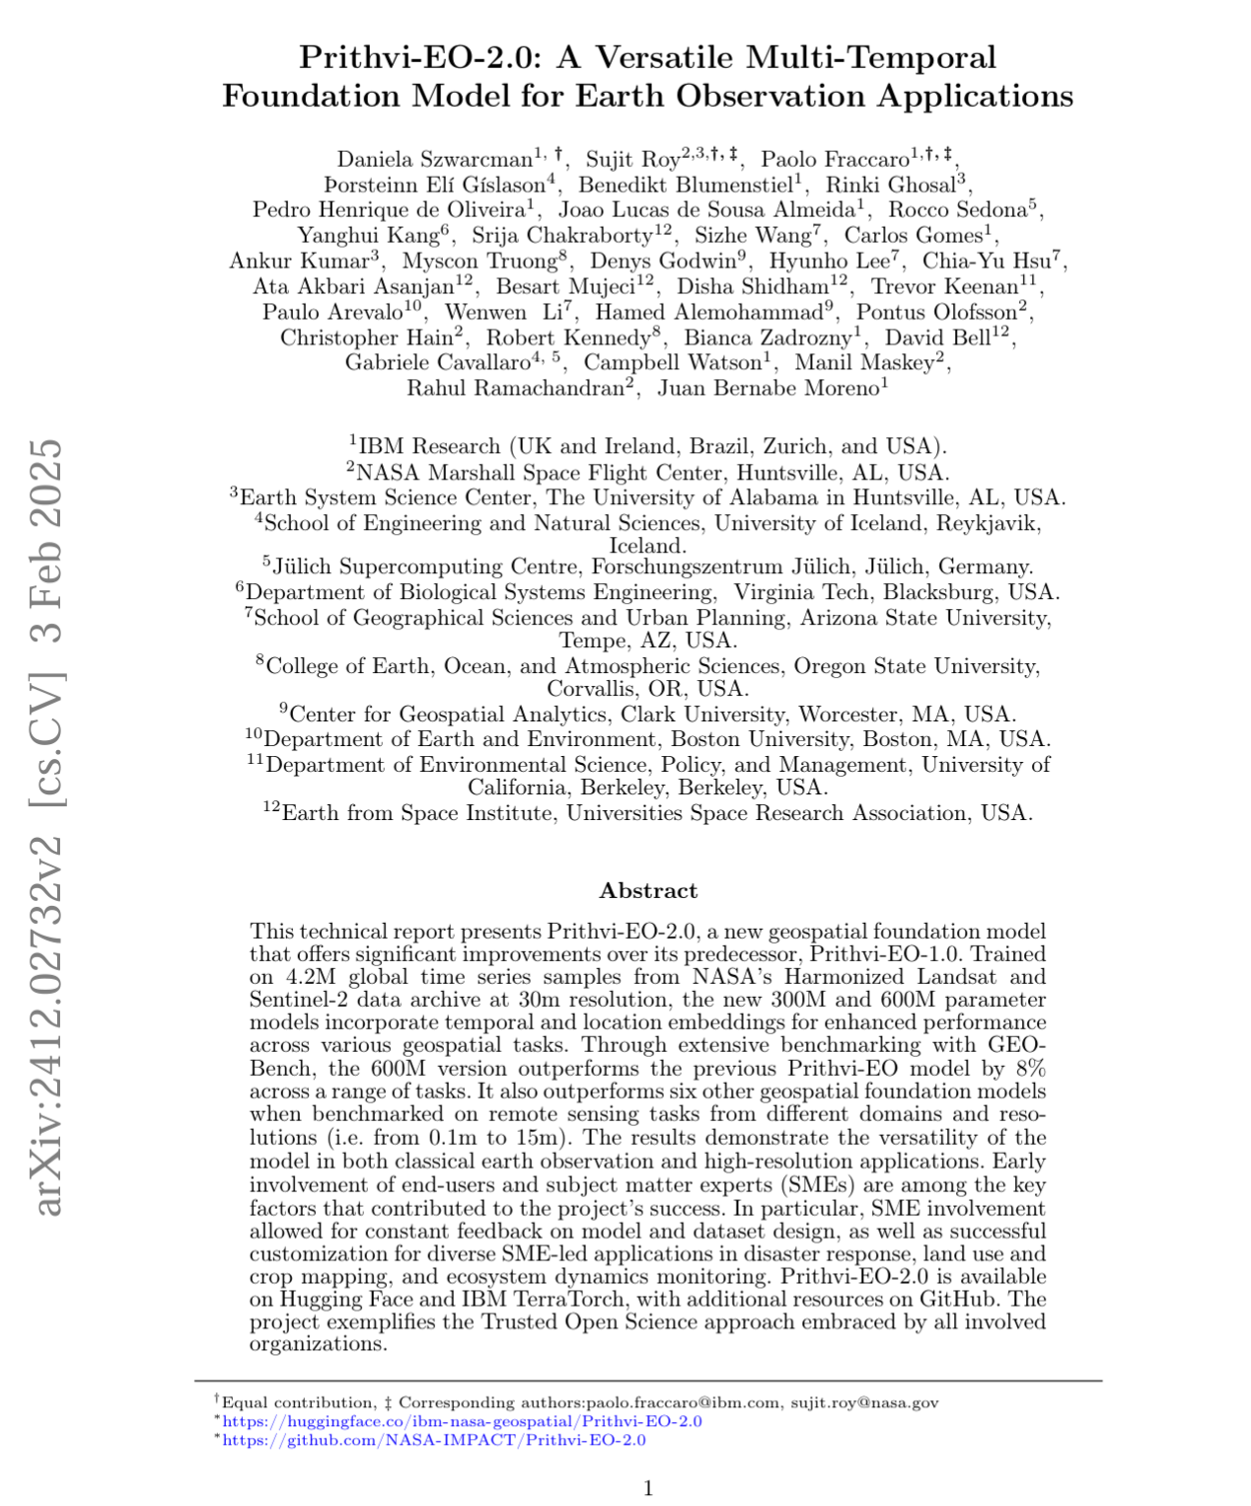
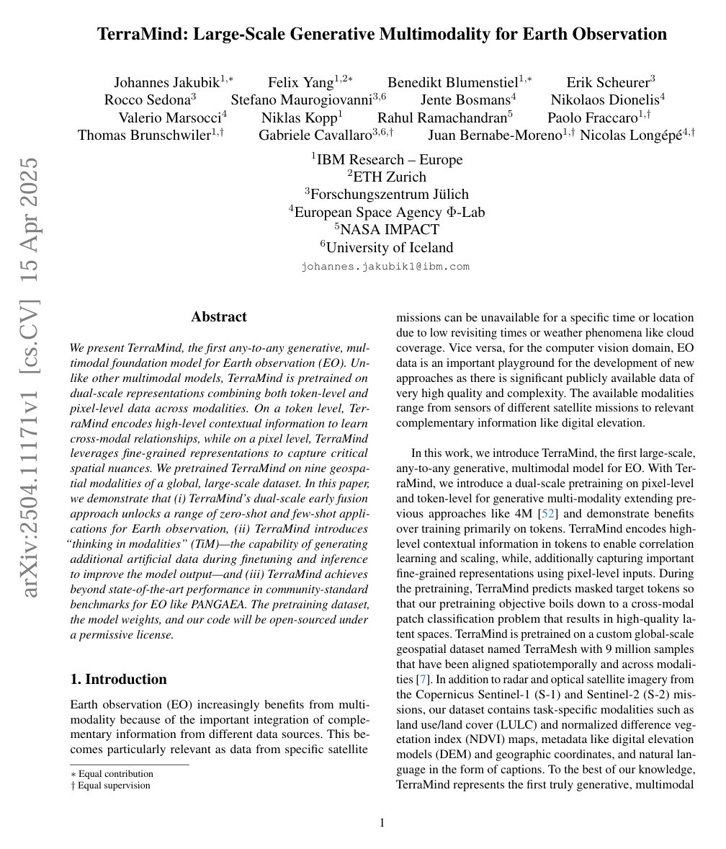



Prithvi-Eo and terramind
Community Effort for GFMs
3 August 2025
Page
Notes:
Fine-tuning here used 100x energy compared to inference.
CodeCarbon library.
OMBRIA dataset, Supervised Flood Mapping.

Slide 29
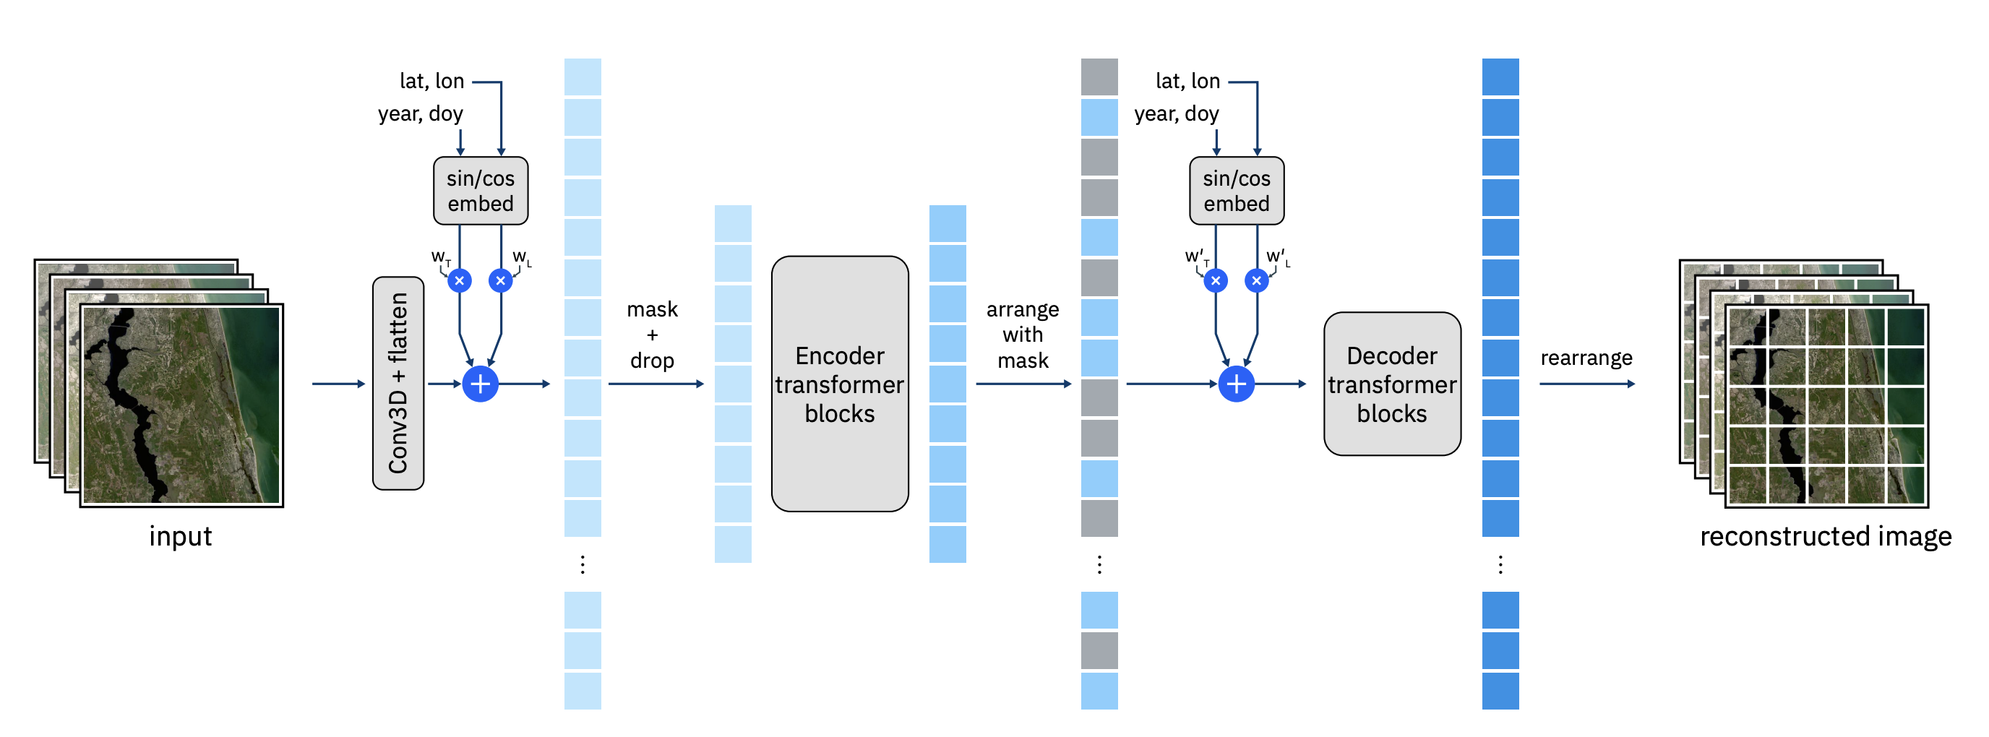
Prithvi-eo-2.0
Masked AutoEncoder (MAE) pretraining
Multimodality
Szwarcman, D., Roy, S., Fraccaro, P., Gíslason, Þ. E., Blumenstiel, B., Ghosal, R., de Oliveira, P. H., Almeida, J. L. de S., Sedona, R., Kang, Y., Chakraborty, S., Wang, S., Gomes, C., Kumar, A., Truong, M., Godwin, D., Lee, H., Hsu, C.-Y., Asanjan, A. A., … Moreno, J. B. (2024). Prithvi-EO-2.0: A Versatile Multi-Temporal Foundation Model for Earth Observation Applications (Version 2). arXiv. https://doi.org/10.48550/ARXIV.2412.02732
20 June 2025
Page

Slide 30
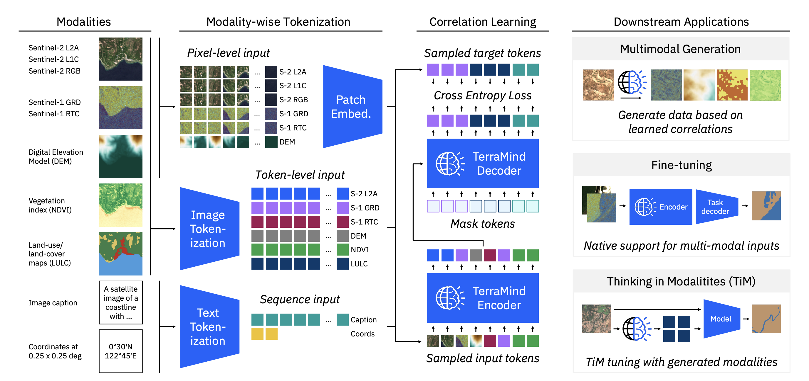
terramind
Dual-scale representations combining both token-level and pixel-level
Multimodality
Jakubik, J., Yang, F., Blumenstiel, B., Scheurer, E., Sedona, R., Maurogiovanni, S., Bosmans, J., Dionelis, N., Marsocci, V., Kopp, N., Ramachandran, R., Fraccaro, P., Brunschwiler, T., Cavallaro, G., Bernabe-Moreno, J., & Longépé, N. (2025). TerraMind: Large-Scale Generative Multimodality for Earth Observation (Version 2). arXiv. https://doi.org/10.48550/ARXIV.2504.11171
3 August 2025
Page

Slide 31
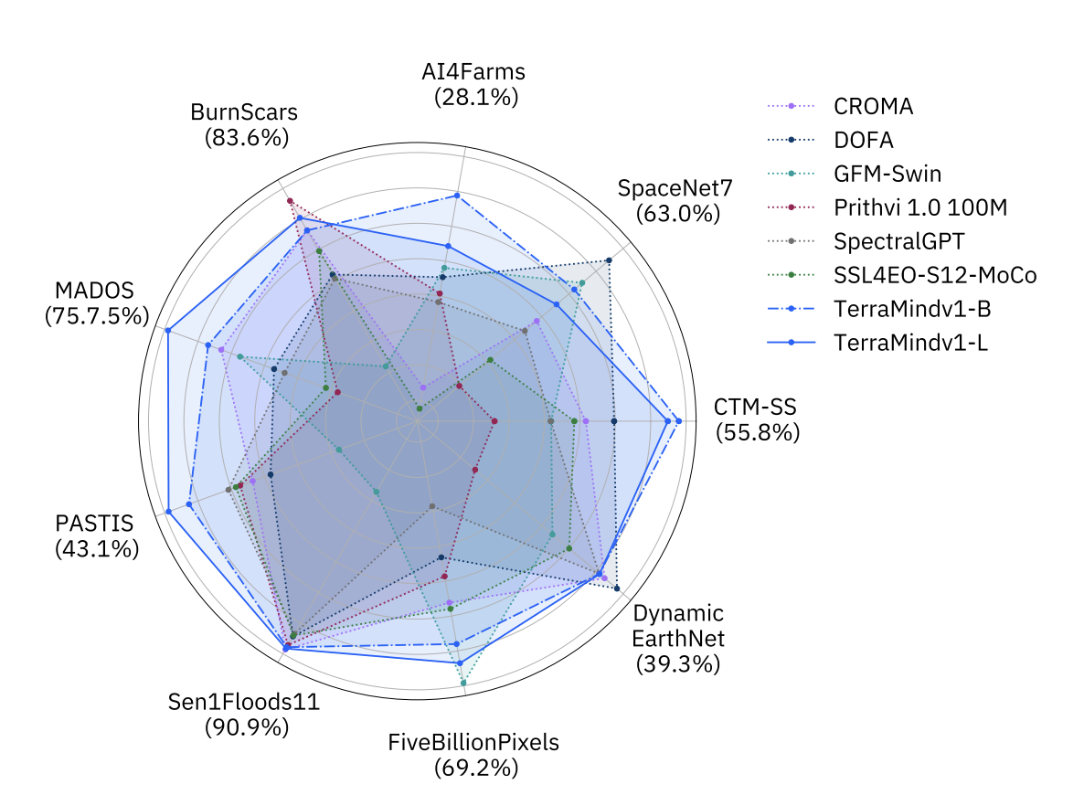
benchmarking
Open Science
Standardized evaluation
Leaderboard tracks
Accuracy on downstream tasks (e.g., GeoBench, PANGEA).
Downstream accuracy of TerraMind: https://arxiv.org/pdf/2504.11171
3 August 2025
Page

Slide 32
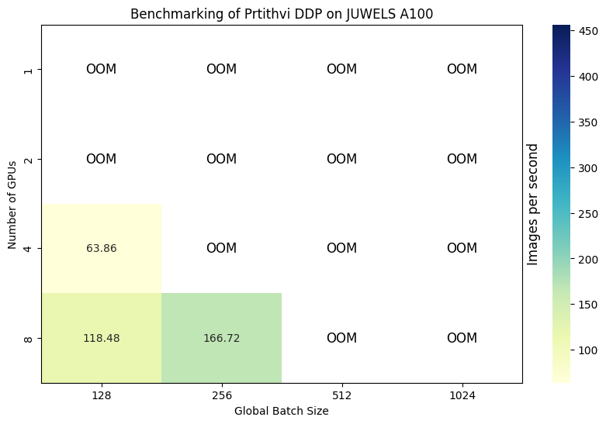
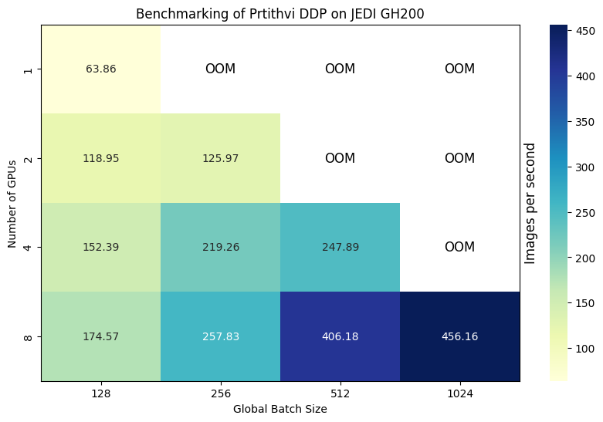
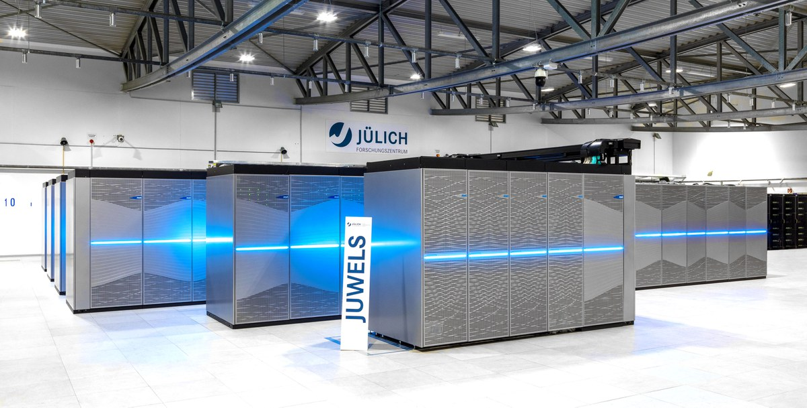
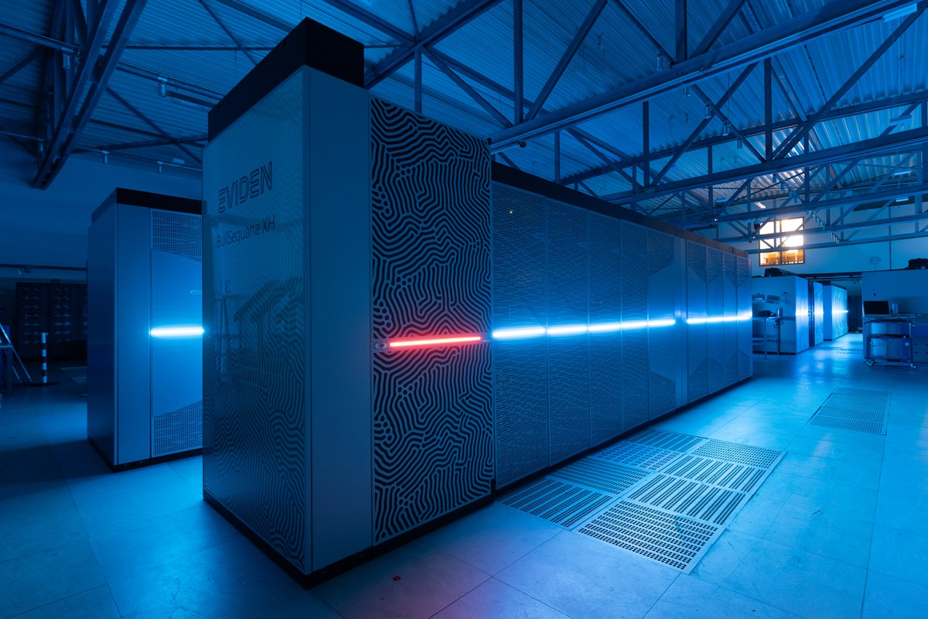
benchmarking: pytorch DDP
Distributed training with data parallelism (with Pytorch DDP)
Nvidia GH200 allows larger batch sizes and processing up to twice data compared to Nvidia A100
JUWELS
Nvidia A100 GPUs
Model: Vision Transformer Large with 300 million parameters
JEDI
Nvidia GH200 GPUs
JUPITER Exascale Development Instrument (JEDI), Jülich Supercomputing Centre, https://www.fz-juelich.de/en/ias/jsc/systems/supercomputers/jedi
Jülich Wizard for European Leadership Science (JUWELS), Jülich Supercomputing Centre, https://www.fz-juelich.de/en/ias/jsc/systems/supercomputers/juwels
PyTorch, Getting Started with Distributed Data Parallel, https://pytorch.org/tutorials/intermediate/ddp_tutorial.html
3 August 2025
Page

Slide 33
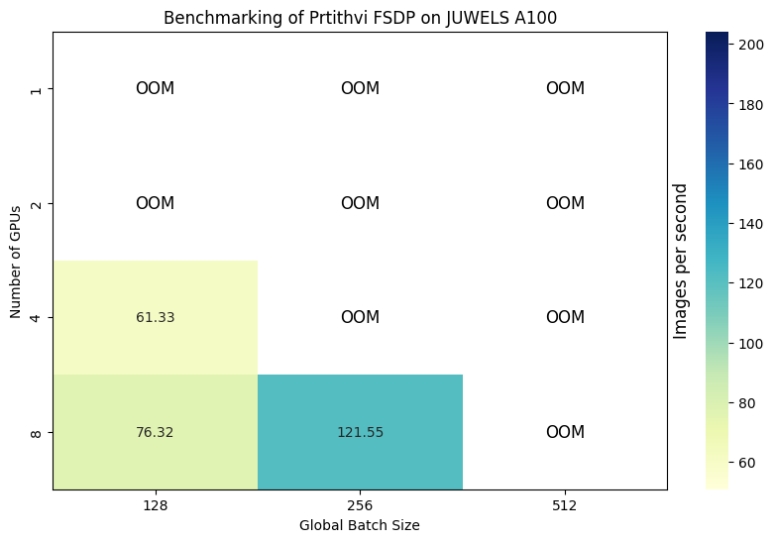
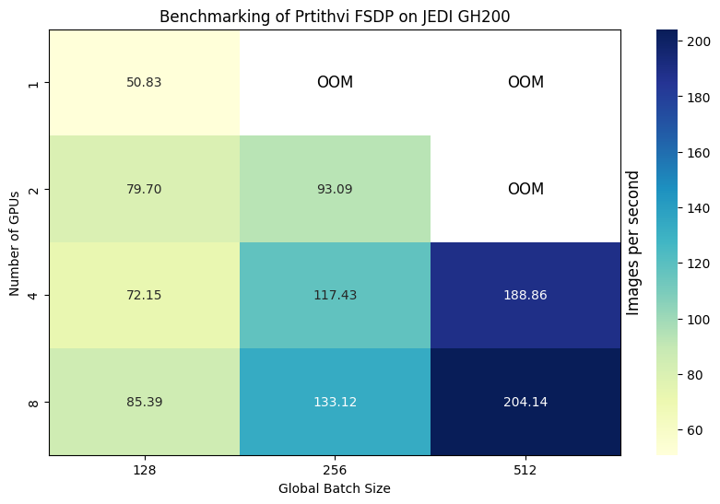
benchmarking: pytorch FSDP
PyTorch FSDP enables larger models or batch sizes on the device
More communication volume, lowering Nvidia GH200 efficiency compared to Nvidia A100 with FSDP
JUWELS
Nvidia A100 GPUs
Model: Vision Transformer Large with 300 million parameters
JEDI
Nvidia GH200 GPUs
JUPITER Exascale Development Instrument (JEDI), Jülich Supercomputing Centre, https://www.fz-juelich.de/en/ias/jsc/systems/supercomputers/jedi
Jülich Wizard for European Leadership Science (JUWELS), Jülich Supercomputing Centre, https://www.fz-juelich.de/en/ias/jsc/systems/supercomputers/juwels
PyTorch, Getting Started with Distributed Data Parallel, https://pytorch.org/tutorials/intermediate/ddp_tutorial.html
3 August 2025
Page

Slide 34
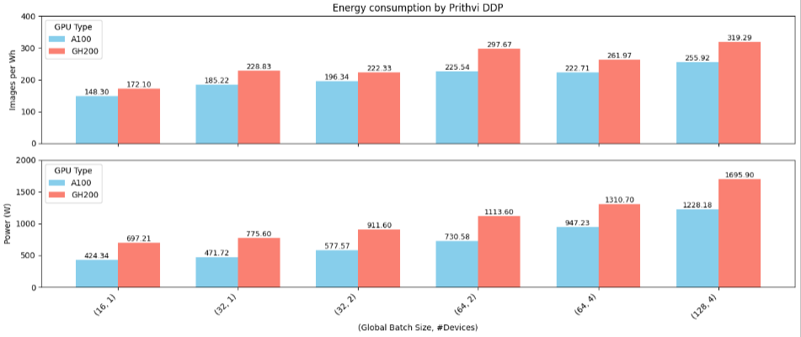
benchmarking: pytorch DDP
Energy efficiency, memory footprint, lantency.
Energy efficiency of Prithvi-EO-2.0 (300M) on Nvidia A100s using PyTorch DDP
3 August 2025
Page

Slide 35
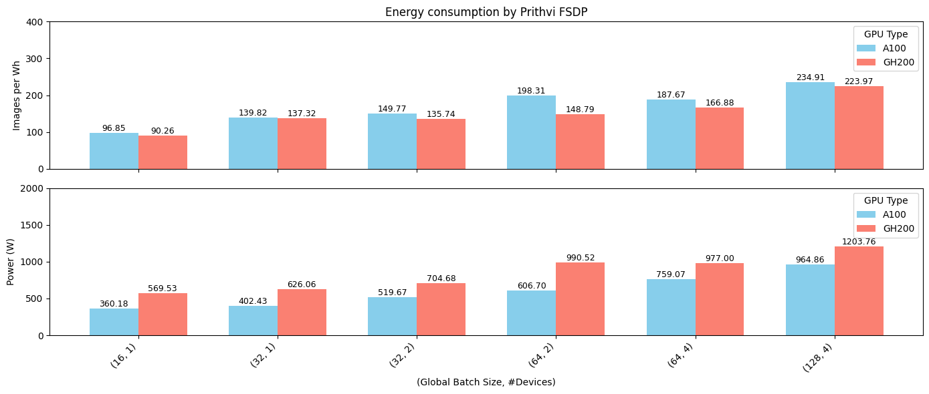
Benchmarking: pytorch FSDP
With FSDP, in this case, we are less efficient (255 images/Wh with DDP vs 234 images/Wh with FSDP using NVIDIA A100)
Energy efficiency of Prithvi-EO-2.0 (300M) on Nvidia A100s using PyTorch FSDP
3 August 2025
Page

Slide 36
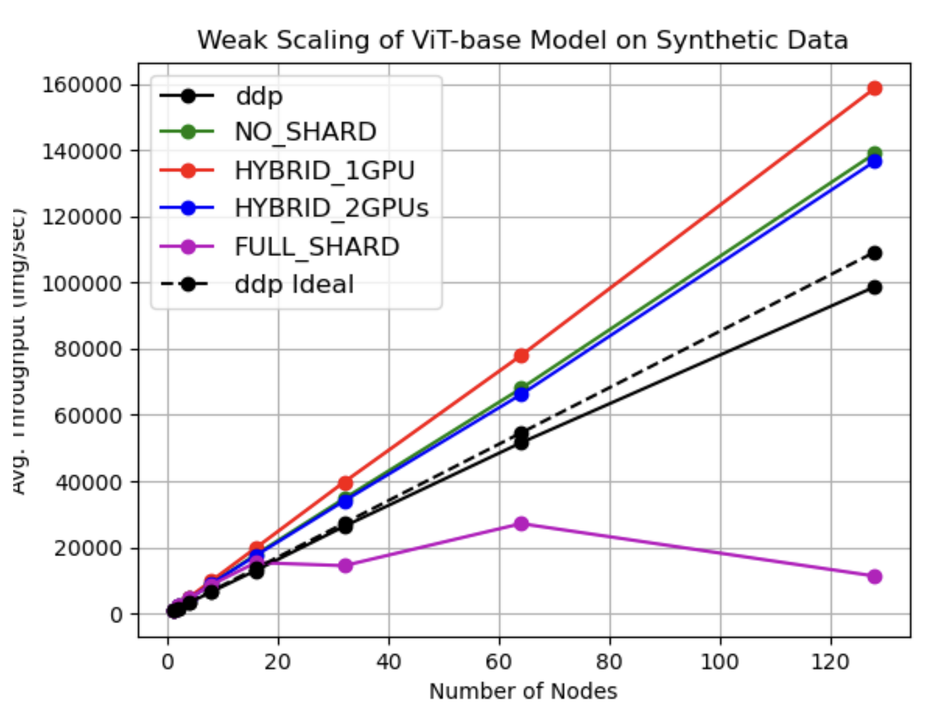
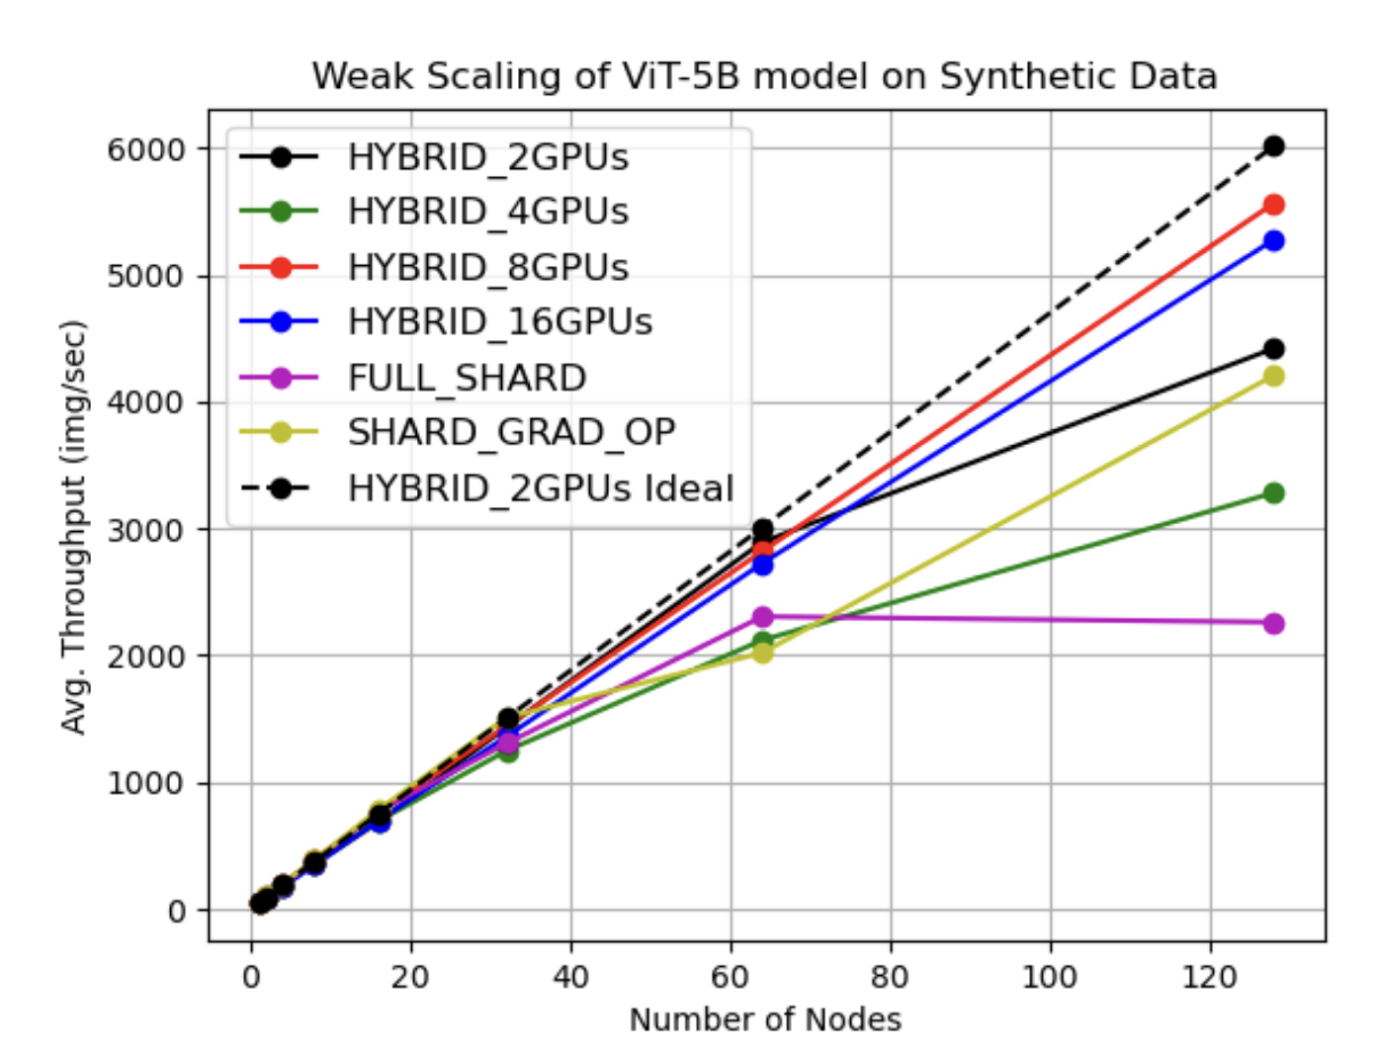
benchmarking: Pytorch Hybrid fSDP
FULL_SHARS is standard FSDP
Sharding model parameters, optimizers states and gradient on a subset of the GPUs
FMs
Wang, X., et al.. (2024). ORBIT: Oak Ridge Base Foundation Model for Earth System Predictability. In Proceedings of SC 2024: International Conference for High Performance Computing, Networking, Storage and Analysis (International Conference for High Performance Computing, Networking, Storage and Analysis, SC). IEEE Computer Society. https://doi.org/10.1109/SC41406.2024.00007
3 August 2025
Page

Slide 37


Is HPC needed?
PRETRAINING
FINE-TUNING
INFERENCE
HEAVY WORKLOADS
PYTORCH DDP, FSDP
LIGHTER-WEIGHT WORKLOADS
PARAMETER-EFFICIENT TUNING
NOT RESOURCE-HUNGRY
DEPLOYMENT AT SCALE
EDGE COMPUTING
HPC is
NEEDED
USEFUL
3 August 2025
Page

Slide 38
Resources for Prototyping, hyperparameter optimization and pretreaining
1 million GPU-hours used last year for Prithvi-EO-2.0 and TerraMind on JUWELS-Booster, JURECA and JEDI (Nvidia A100, H100 and GH200)
114 years using a single GPU, 1 year using 100 GPUs
Commercially, computing time worth 3-6 M Euros
https://www.fz-juelich.de/en/ias/jsc/systems/supercomputers/juwels
3 August 2025
Page
Notes:
Fine-tuning here used 100x energy compared to inference.
CodeCarbon library.
OMBRIA dataset, Supervised Flood Mapping.

Slide 39
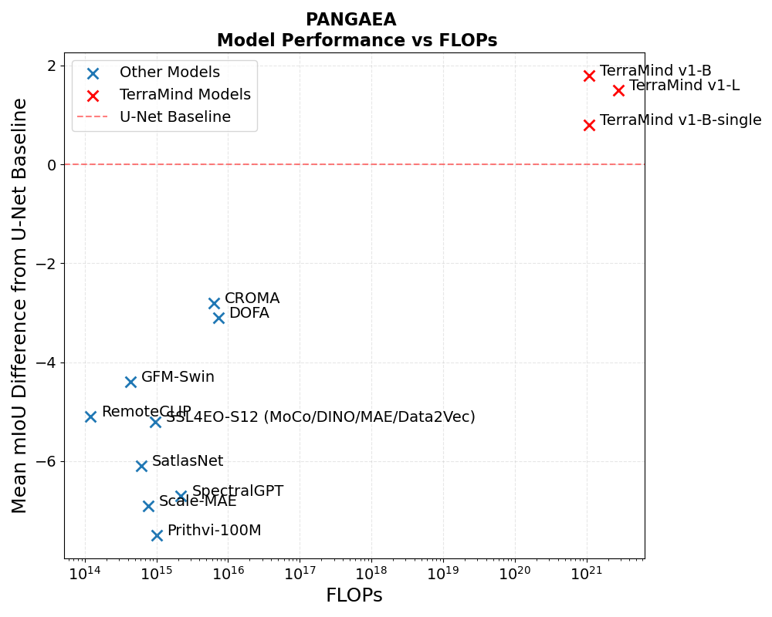
Should we scale then?
Our newest models
More compute
https://christopherren.substack.com/p/geospatial-foundational-disappointments
3 August 2025
Page
Notes:
Fine-tuning here used 100x energy compared to inference.
CodeCarbon library.
OMBRIA dataset, Supervised Flood Mapping.

Slide 40
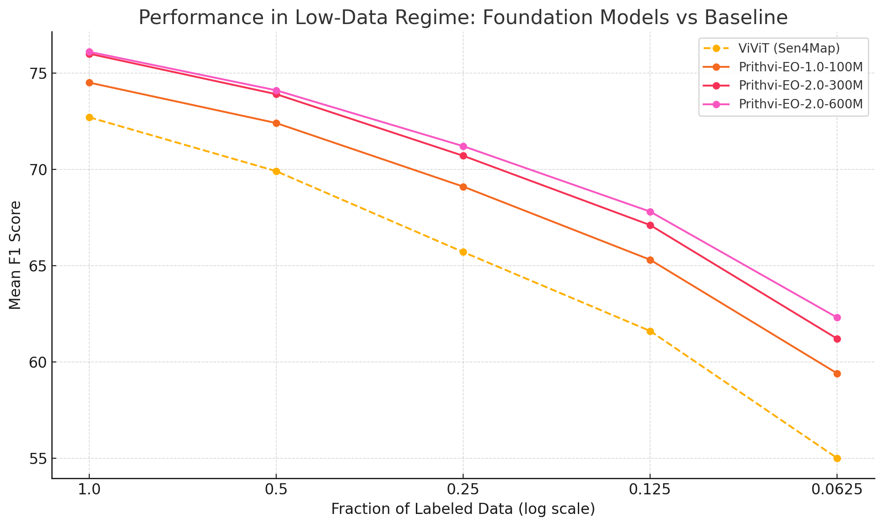
Geospatial foundation model: downstream
Is pretraining worth it?
GFMs perform better in data scarce regime than supervised baseline
3 pt
Less data on downstream task
7 pt
Land cover classification accuracy, adapted from https://arxiv.org/pdf/2412.02732
3 August 2025
Page

Slide 41
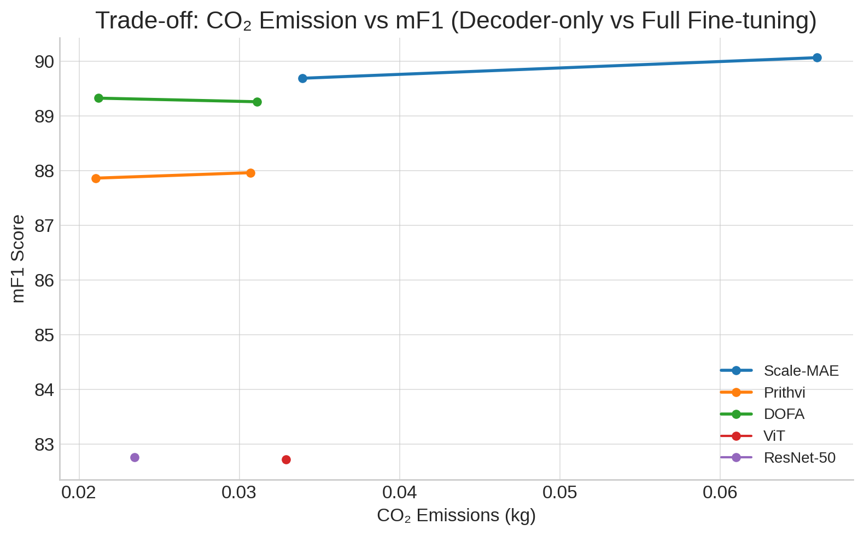
TrAde-off cost vs accuracy
Is pretraining worth it?
Computing costs (energy consumption, CO2 emissions too) are relatively low for fine-tuning and inference GFMs
Derived from Ghamisi, P., et al.. (2025). Geospatial Foundation Models to Enable Progress on Sustainable Development Goals (Version 1). arXiv. https://doi.org/10.48550/ARXIV.2505.24528
3 August 2025
Page
Notes:
Fine-tuning here used 100x energy compared to inference.
CodeCarbon library.
OMBRIA dataset, Supervised Flood Mapping.

Slide 42

Additional Material and courses
Courses on HPC offered at JSC: https://www.fz-juelich.de/en/ias/jsc/news/events/training-courses/2025
Great guide on distributed deep learning, there’s also a widget to check memory for parameters, activation, etc.:
https://huggingface.co/spaces/nanotron/ultrascale-playbook
Courses at JSC
3 August 2025
Page
Notes:
Pretraining at Scale: Pretraining geospatial models necessitates substantial computational resources, handling the vast data volumes..
Efficient Fine-Tuning: Post-pretraining, these models can be fine-tuned for specific tasks with relatively modest computational demands. Techniques like parameter-efficient fine-tuning (PEFT) allow for adapting large models to new tasks without the need to retrain the entire network.
Scalable Inference: Deploying fine-tuned models for inference across large datasets or in real-time applications benefits from HPC infrastructures. Optimized deployment frameworks facilitate high-throughput and low-latency inference.

Slide 43
Conclusions
While the initial pretraining of GeoFMs is resource-intensive (HPC is needed!), fine-tuning and inference are not so resource-hungry.
HPC can be used for deployment at scale!
Need to balances the high upfront computational costs of GeoFMs with scalable and efficient deployment (HPC can help).
Benchmarking provides insights for operating GeoFMs efficiently.
3 August 2025
Page
Notes:
Pretraining at Scale: Pretraining geospatial models necessitates substantial computational resources, handling the vast data volumes..
Efficient Fine-Tuning: Post-pretraining, these models can be fine-tuned for specific tasks with relatively modest computational demands. Techniques like parameter-efficient fine-tuning (PEFT) allow for adapting large models to new tasks without the need to retrain the entire network.
Scalable Inference: Deploying fine-tuned models for inference across large datasets or in real-time applications benefits from HPC infrastructures. Optimized deployment frameworks facilitate high-throughput and low-latency inference.

Slide 44


Thank you!
The Alchymist, in Search of the Philosopher's Stone (1771)
by Joseph Wright of Derby

