Slide 1
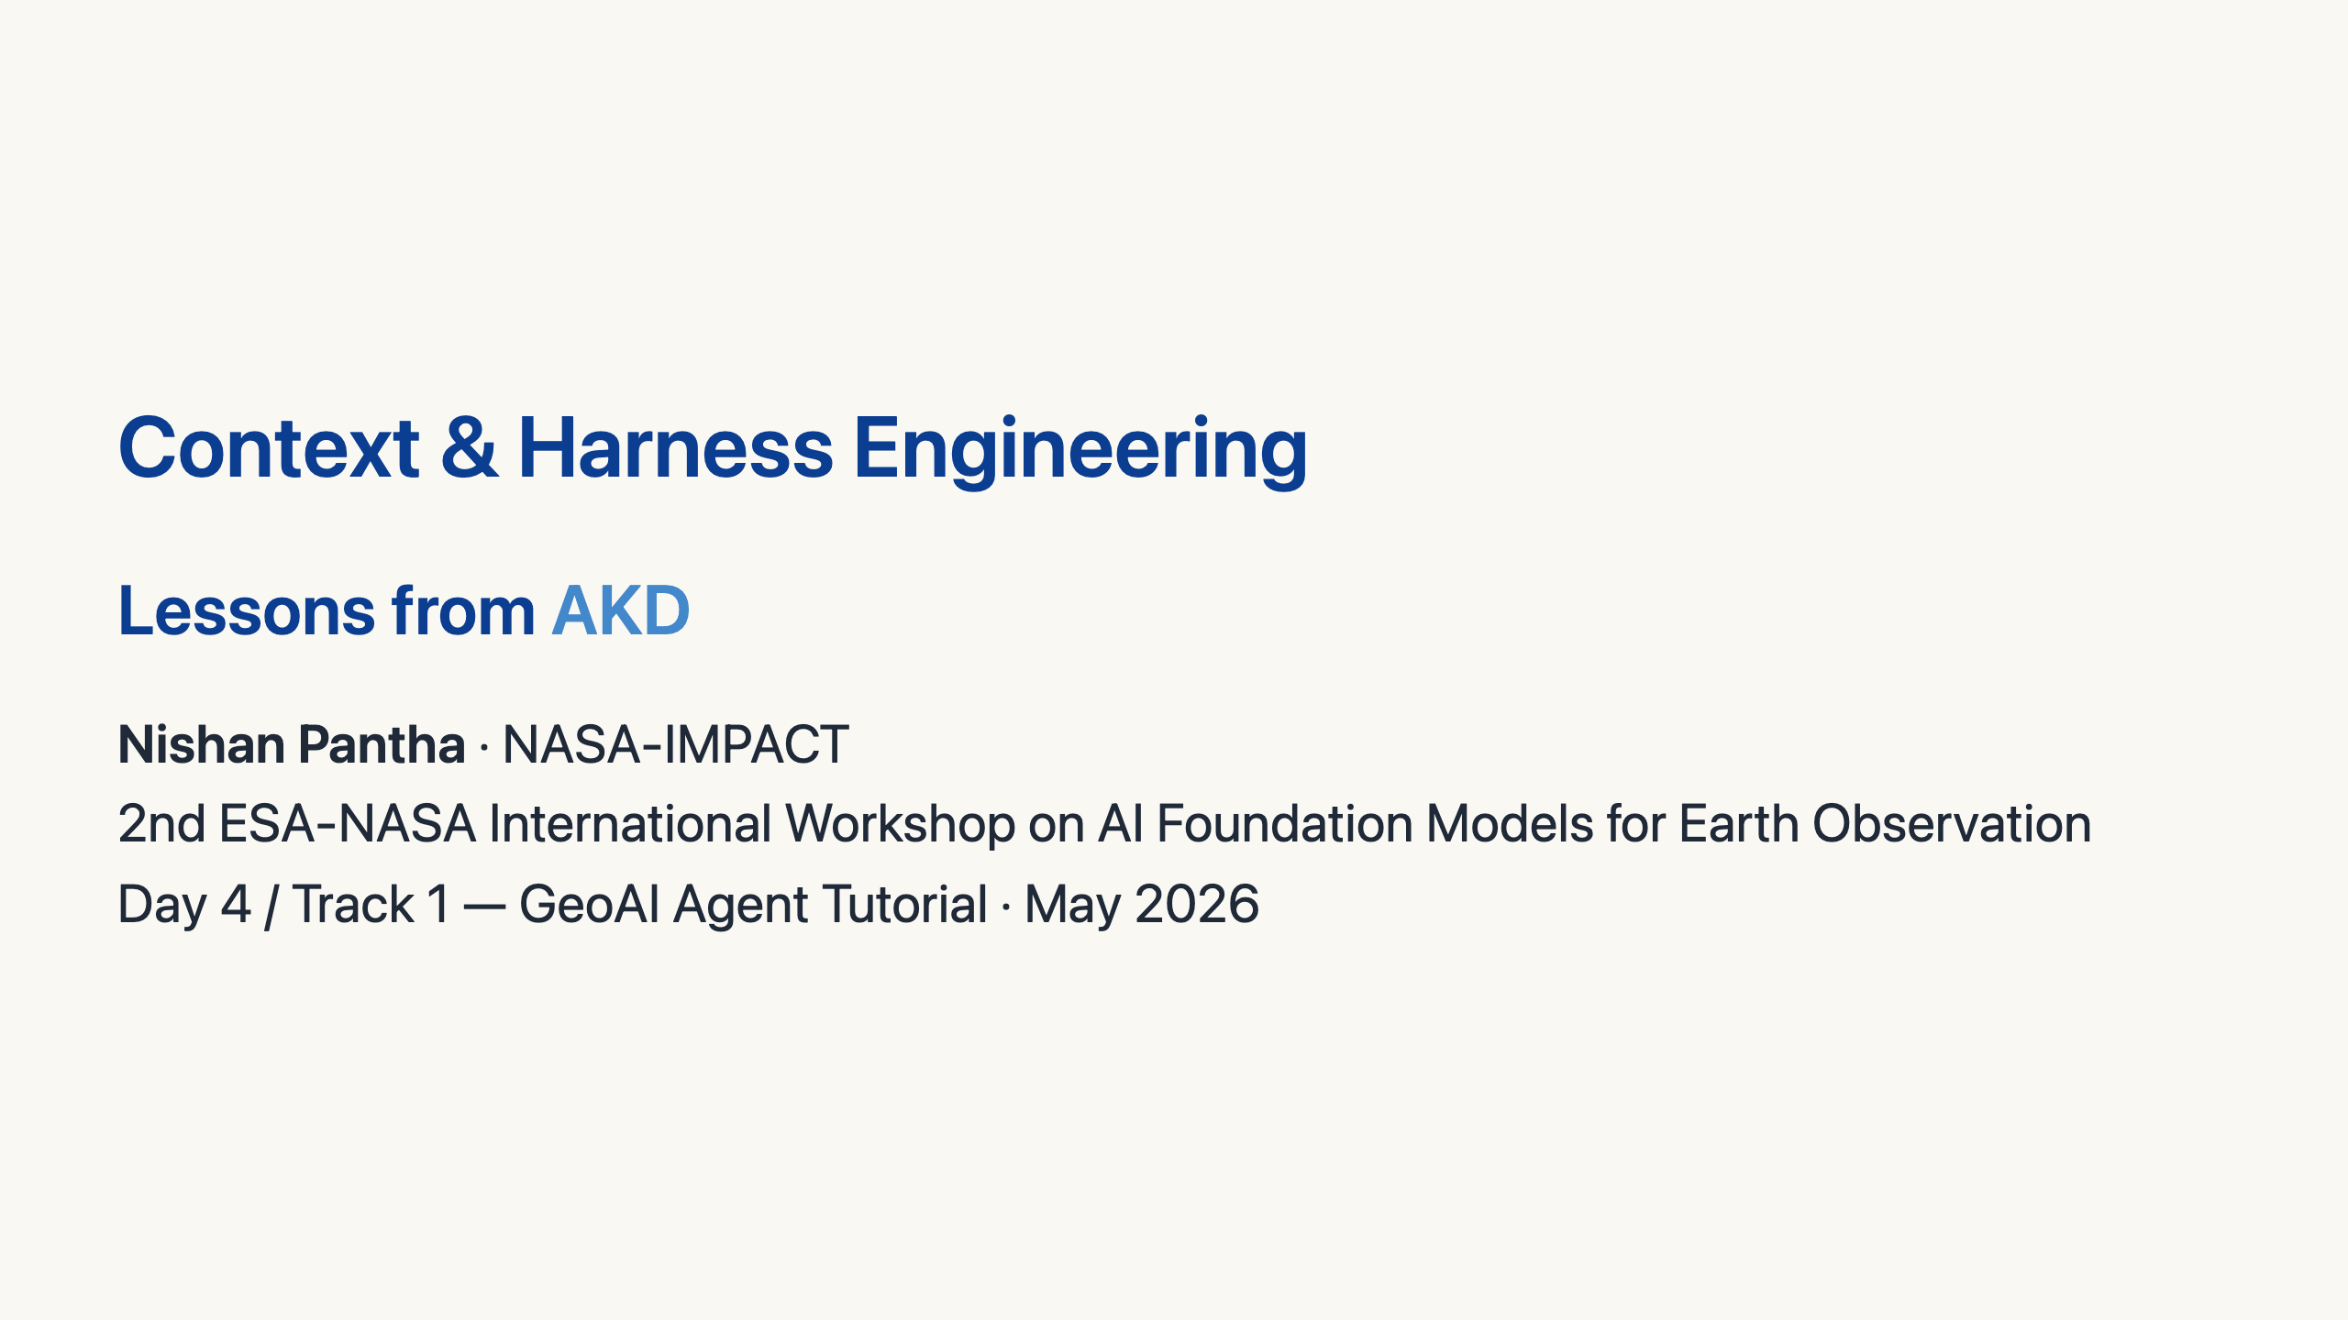
Notes:
Hi everyone. Quick framing for the hands-on you're about to do. We'll spend ~15 minutes on the *vocabulary* that's reshaping production agent systems — context engineering and harness engineering — and then I'll show how AKD applies these ideas. The agent artifact you'll run in the notebook uses the same patterns.

Slide 2
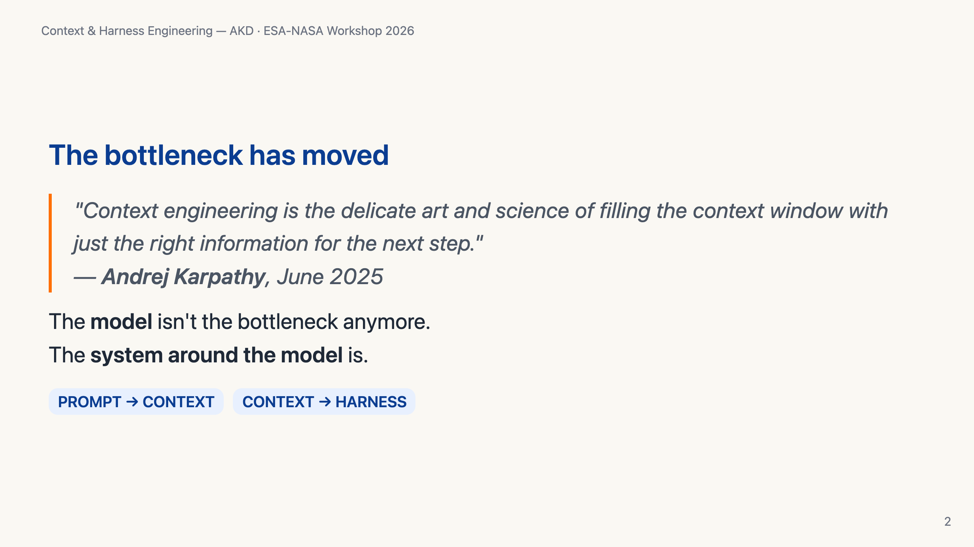
Notes:
Three years ago, "make the prompt better" was the lever. Today, frontier models are roughly interchangeable for most tasks — the differentiator is what you put in front of them and how you wrap the loop around them. That's the topic of this talk.

Slide 3
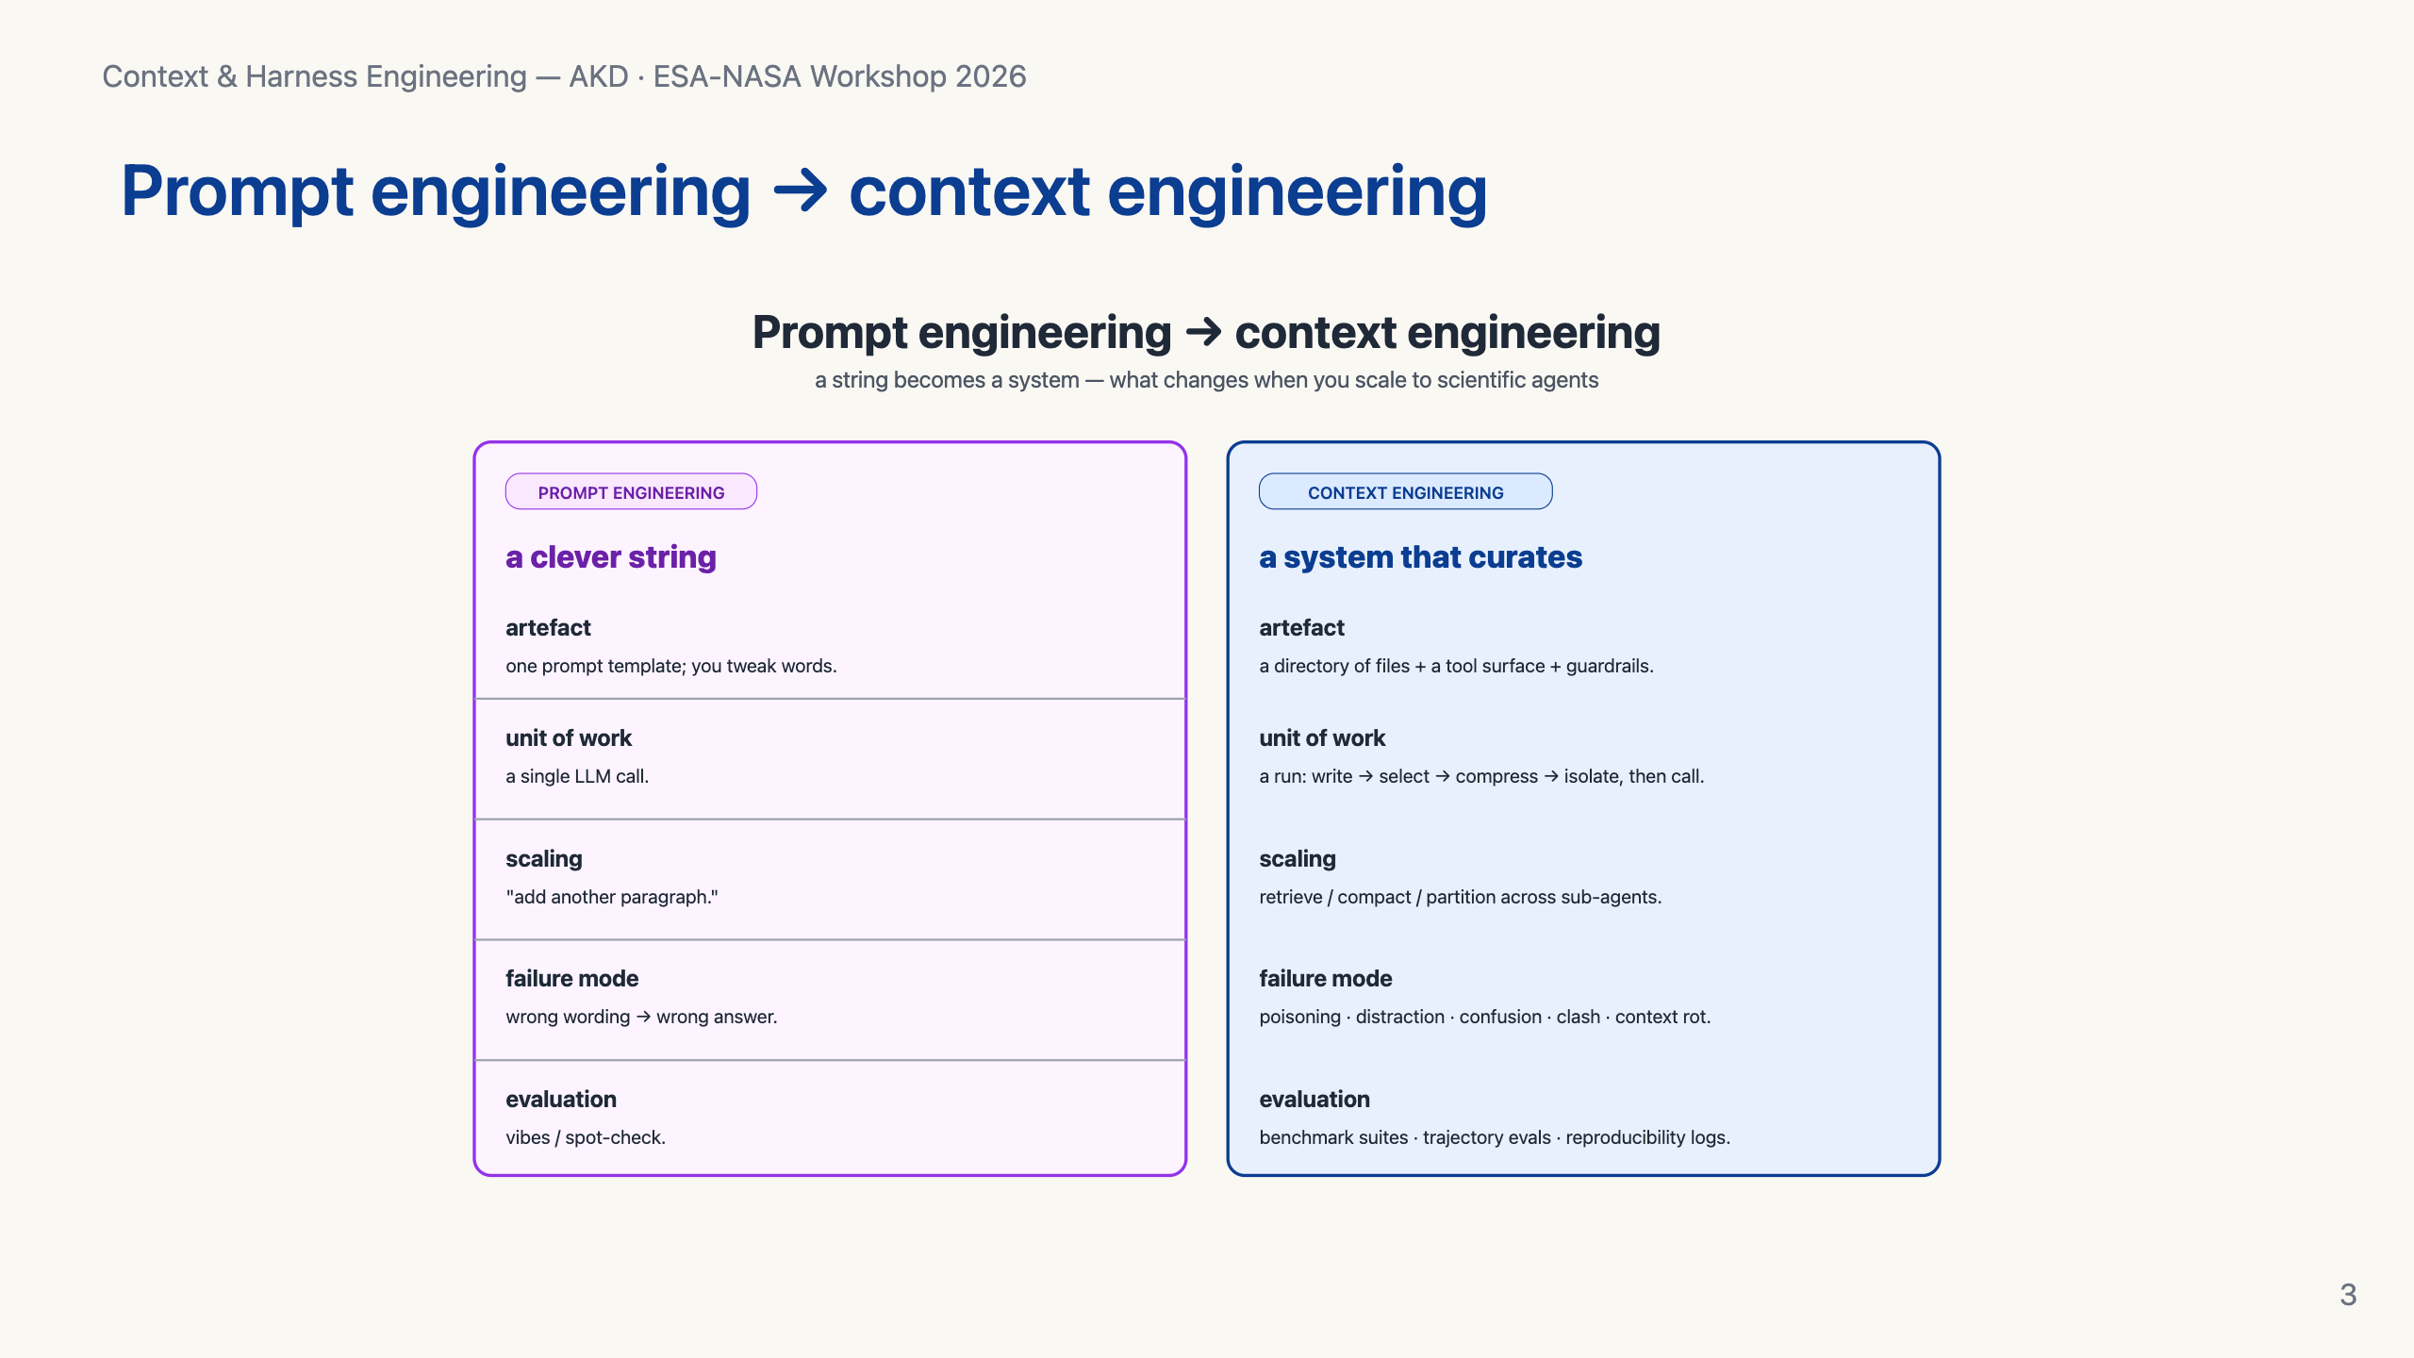
Notes:
Prompt engineering: a clever string. Context engineering: a system that decides, at every step, what goes in the window. Walden Yan at Cognition calls it "effectively the #1 job of engineers building AI agents." Anthropic codified it in their September 2025 piece "Effective context engineering for AI agents."

Slide 4
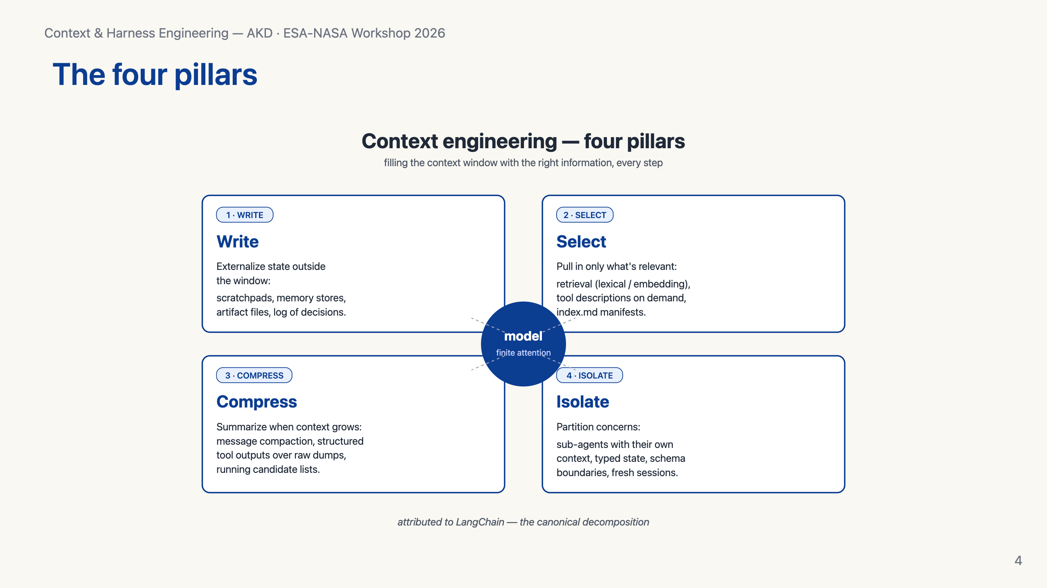
Notes:
LangChain's framing — write, select, compress, isolate. Externalize state outside the window. Pull in only what's relevant. Summarize when it grows. Partition across sub-agents. Remember these four words — every other slide hangs off them.

Slide 5
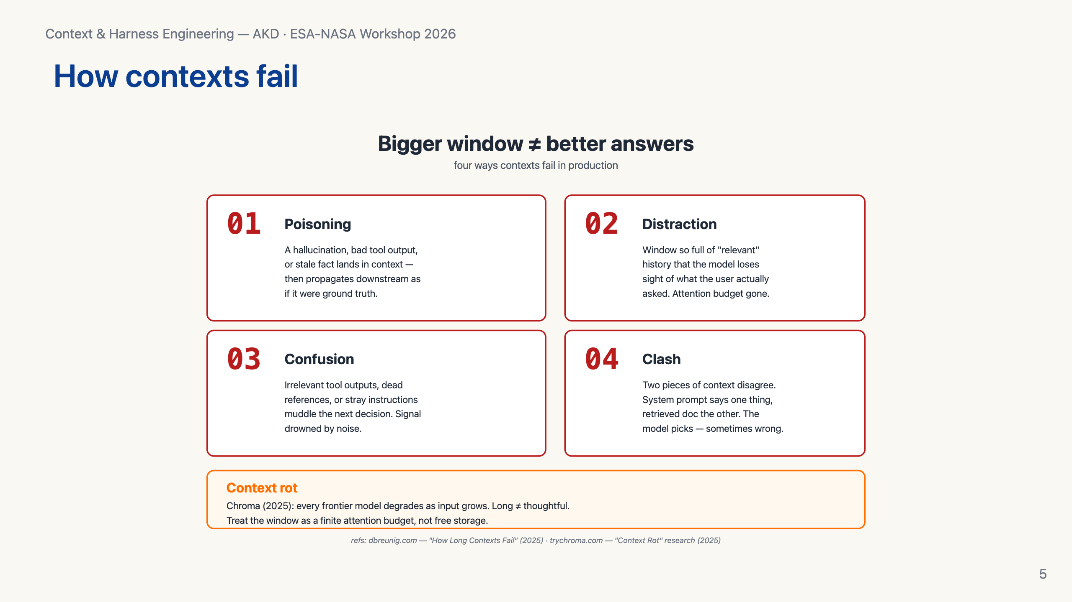
Notes:
The four ways contexts fail — poisoning, distraction, confusion, clash. Plus Chroma's "context rot" research: every frontier model degrades as input grows. The lesson: more tokens isn't more capability. Treat the window as a finite attention budget, not free storage.

Slide 6
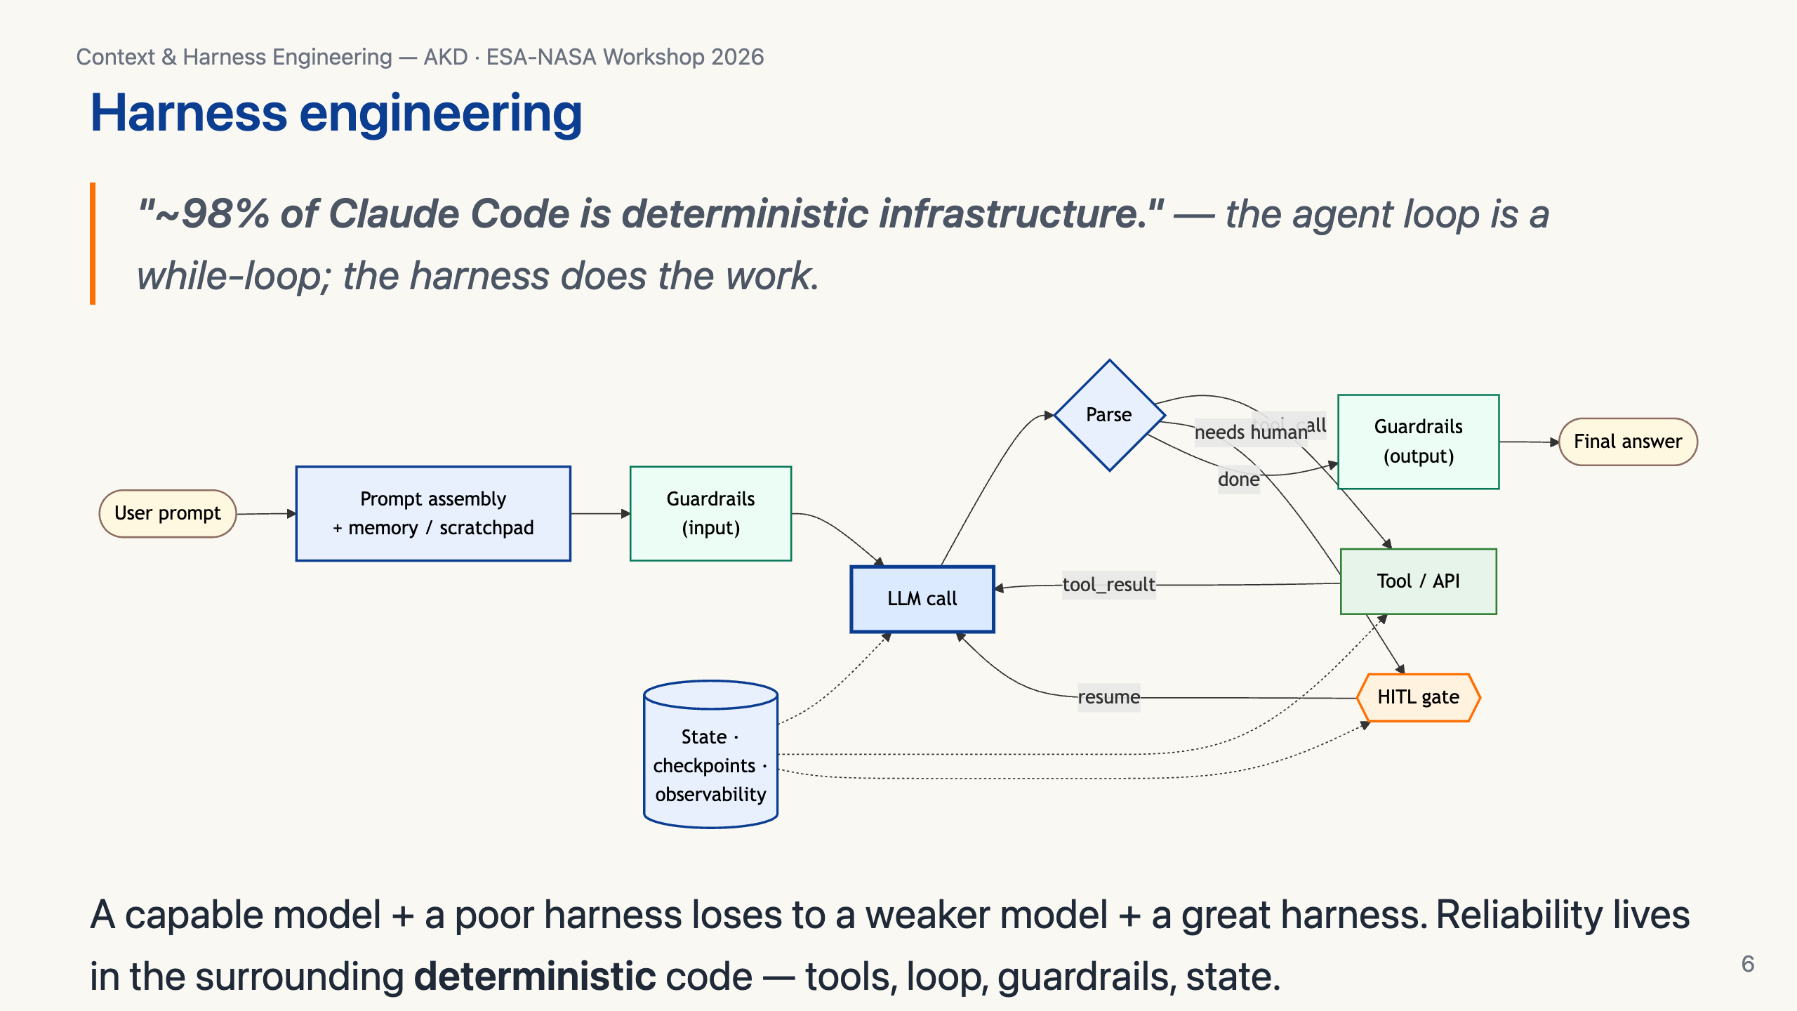
Notes:
Coined recently by OpenAI and Anthropic. The shorthand from analyses of Claude Code: ~98% of the system is deterministic infrastructure — only ~2% is "the agent." Permissions, context management, tool routing, recovery — that's the harness.

Slide 7
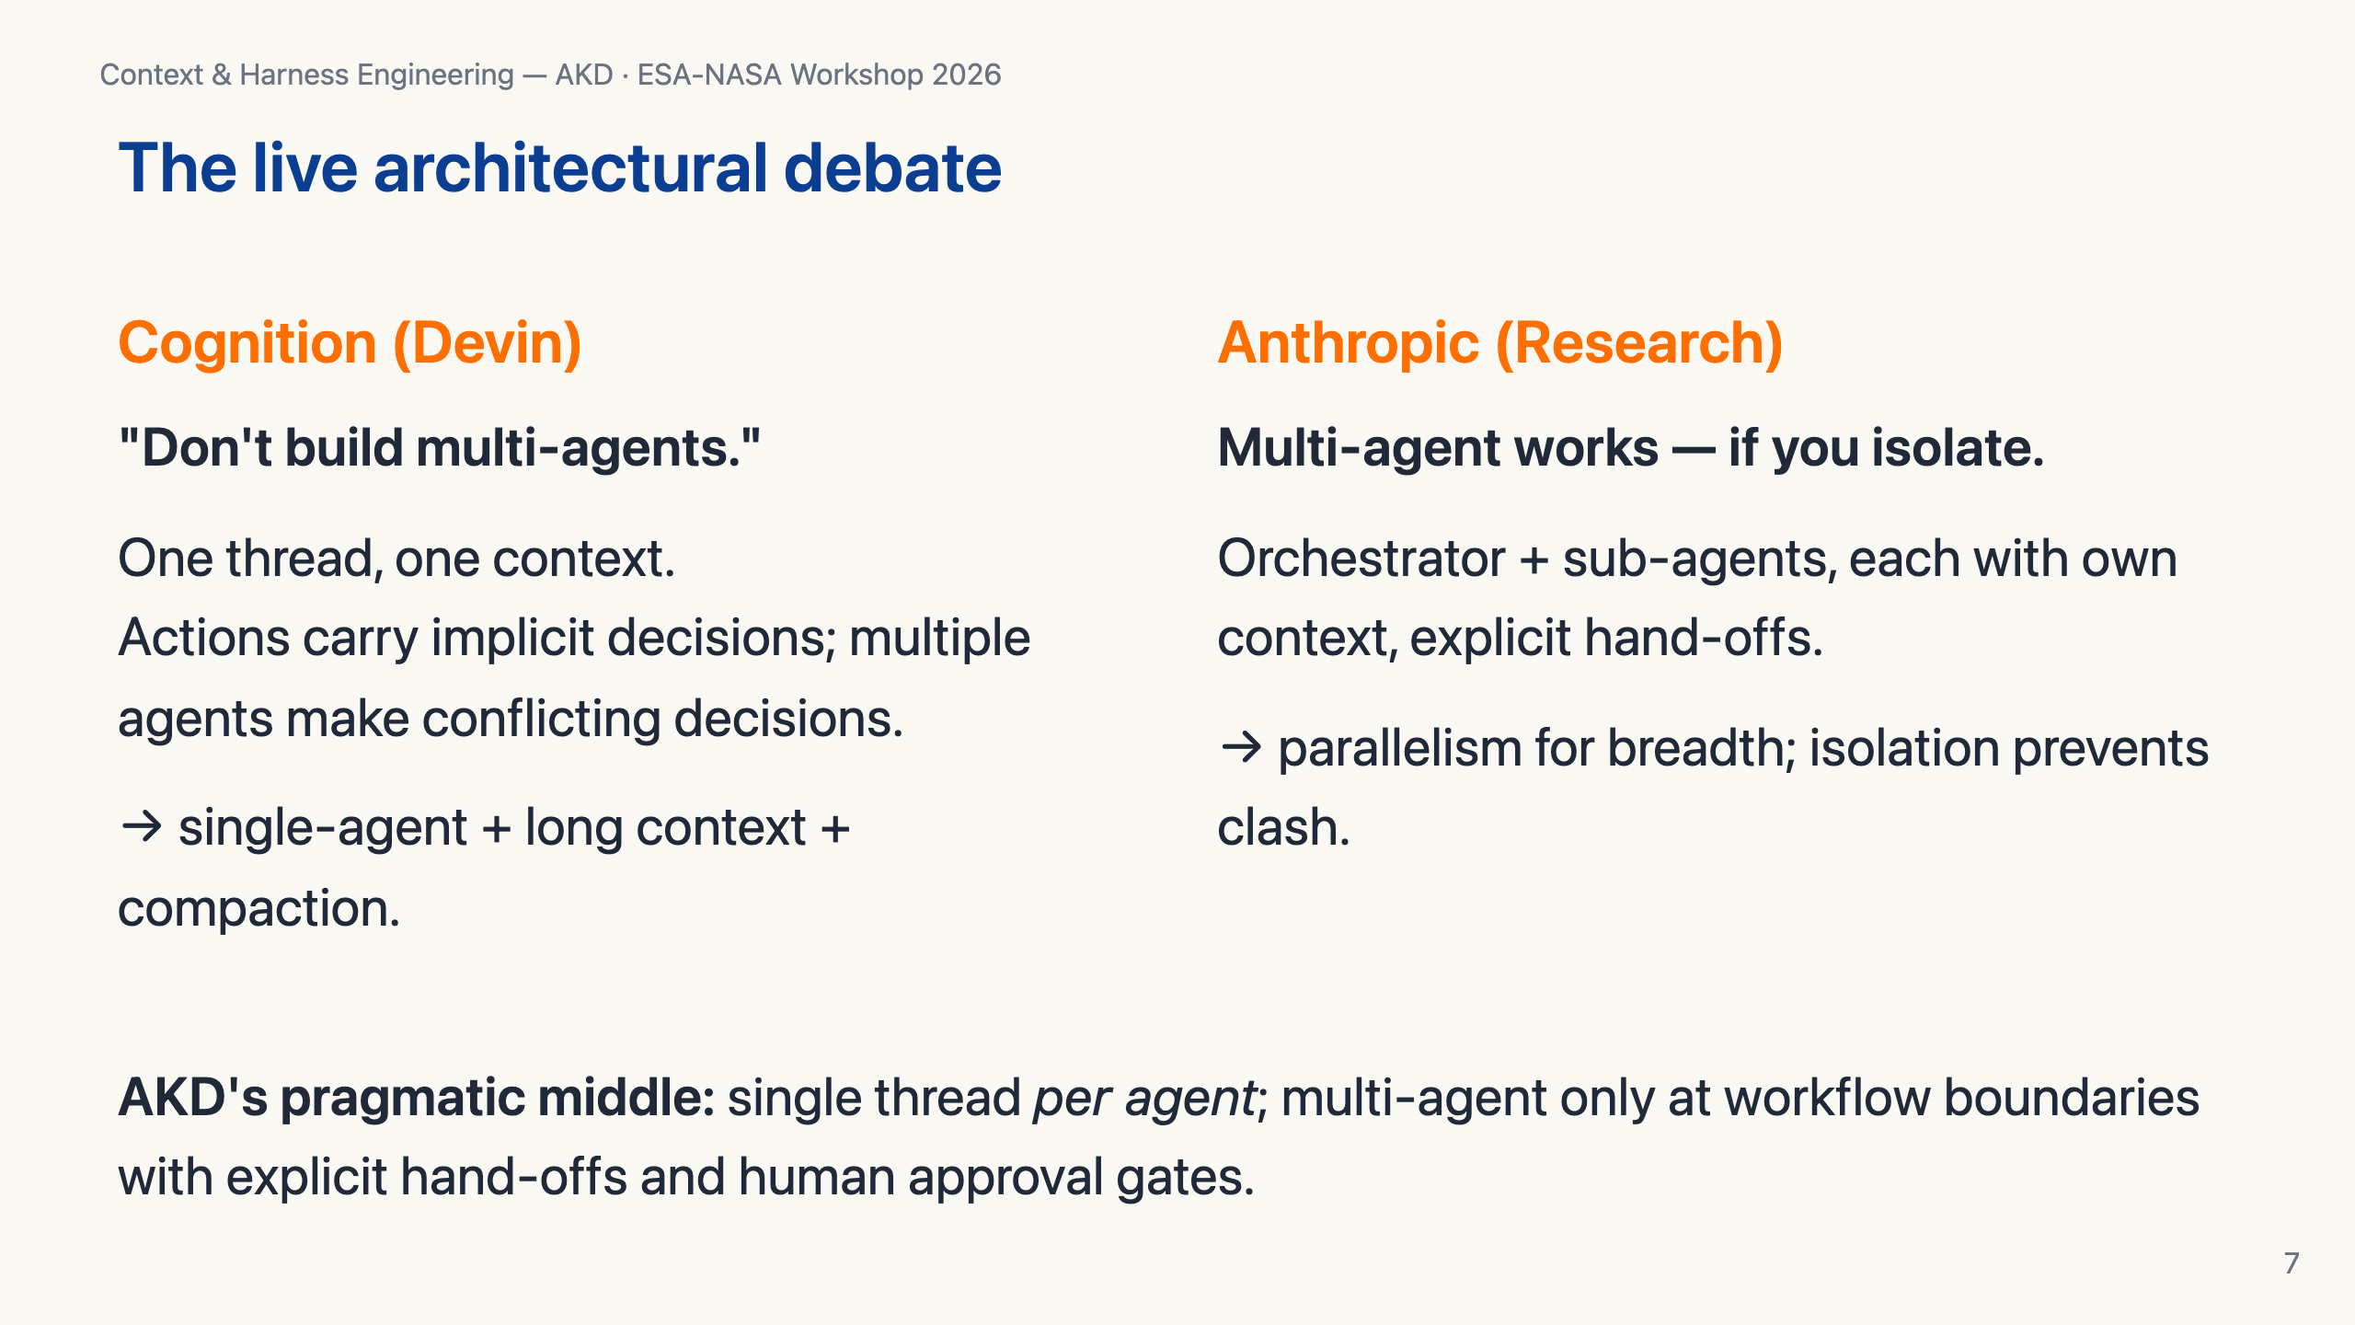
Notes:
This is *the* live debate. Cognition wrote "Don't build multi-agents" — they argue actions carry implicit decisions and parallel agents conflict. Anthropic published their research multi-agent system showing it works when sub-agents are isolated. AKD doesn't pick a side dogmatically — single thread per agent, multi-agent only at the workflow level.

Slide 8
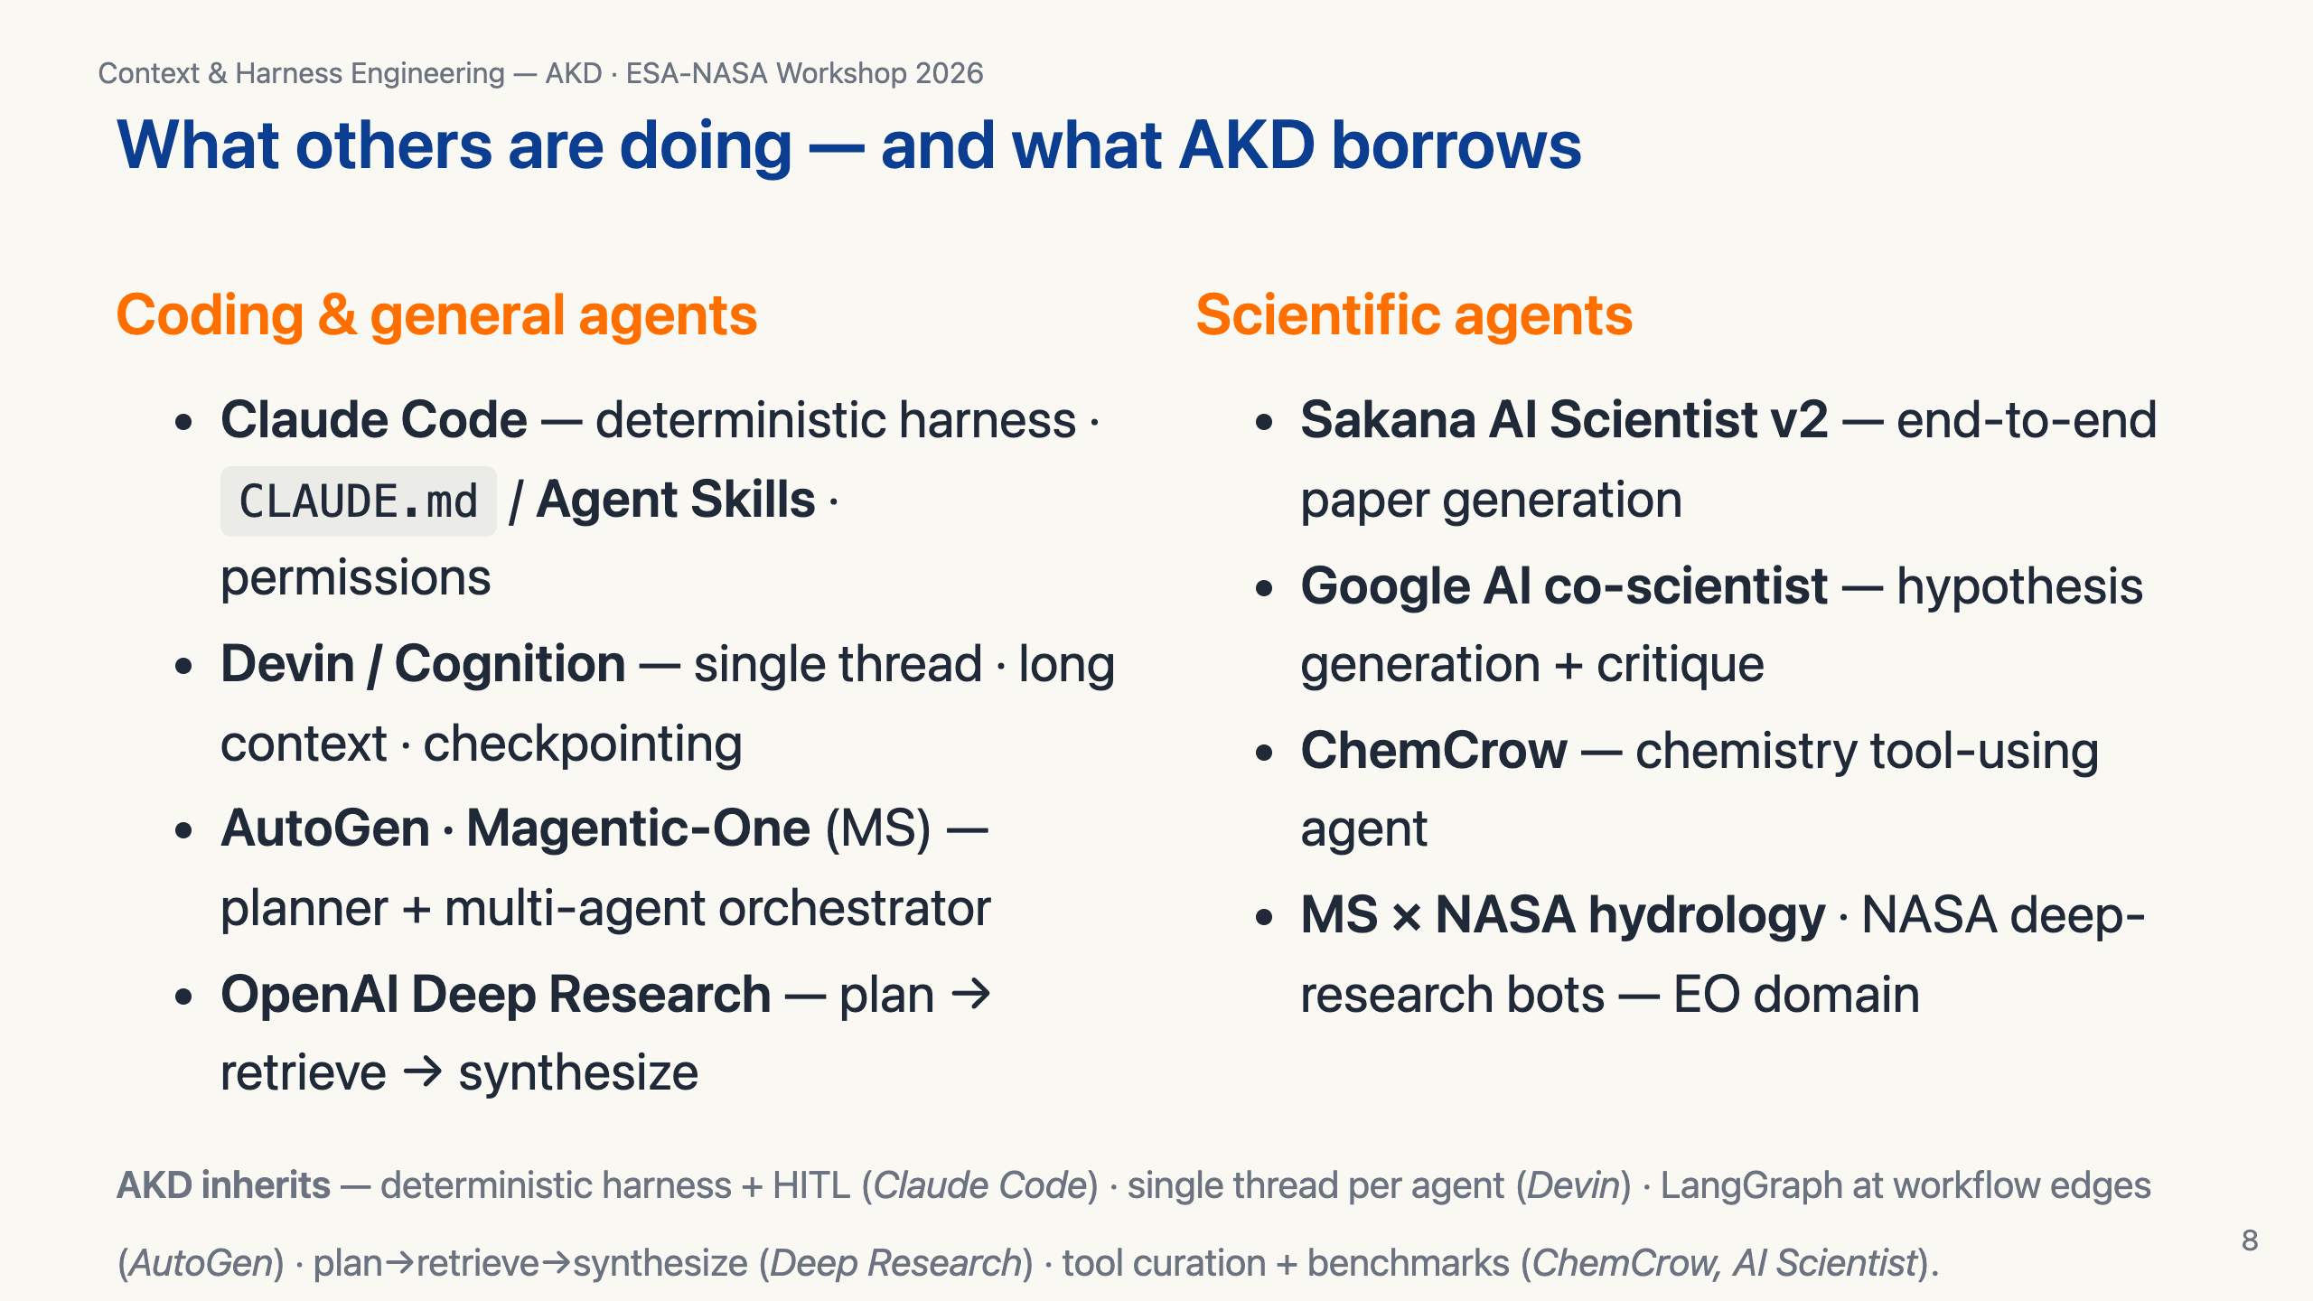
Notes:
Quick landscape. Top-left, the general-purpose harnesses people are building today — Claude Code is the cleanest reference because Anthropic published their patterns. Top-right, what the scientific-agent community is doing — Sakana, Google co-scientist, ChemCrow, STORM, the Microsoft NASA hydrology work. AKD isn't inventing these patterns; it's *adapting* them to NASA SMD. The bottom line shows the specific lineage — every AKD design choice maps to a precedent.

Slide 9
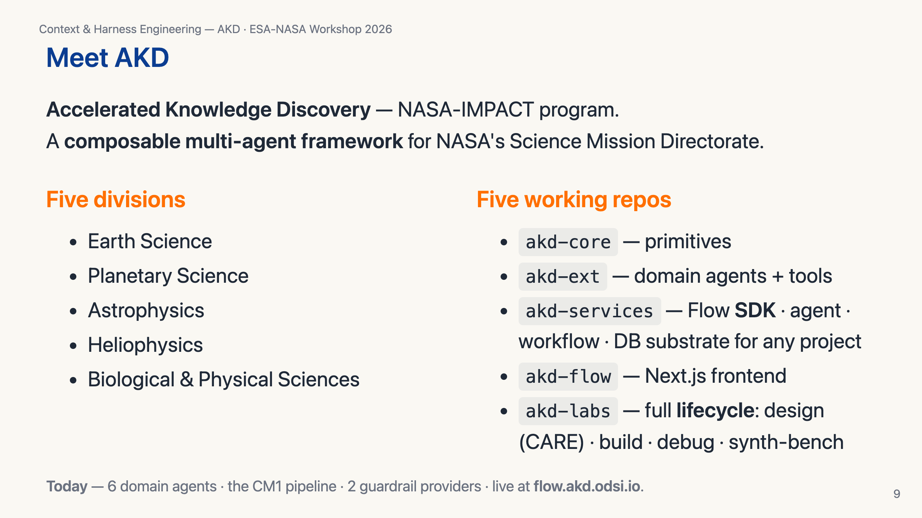
Notes:
30-second pitch. NASA-IMPACT's program for AI-augmented scientific knowledge discovery. Not a single product — a layered ecosystem. Today there are domain agents for the major NASA data systems, a closed-loop atmospheric simulation pipeline, framework-level guardrails, and two web products (Flow and Labs).

Slide 10
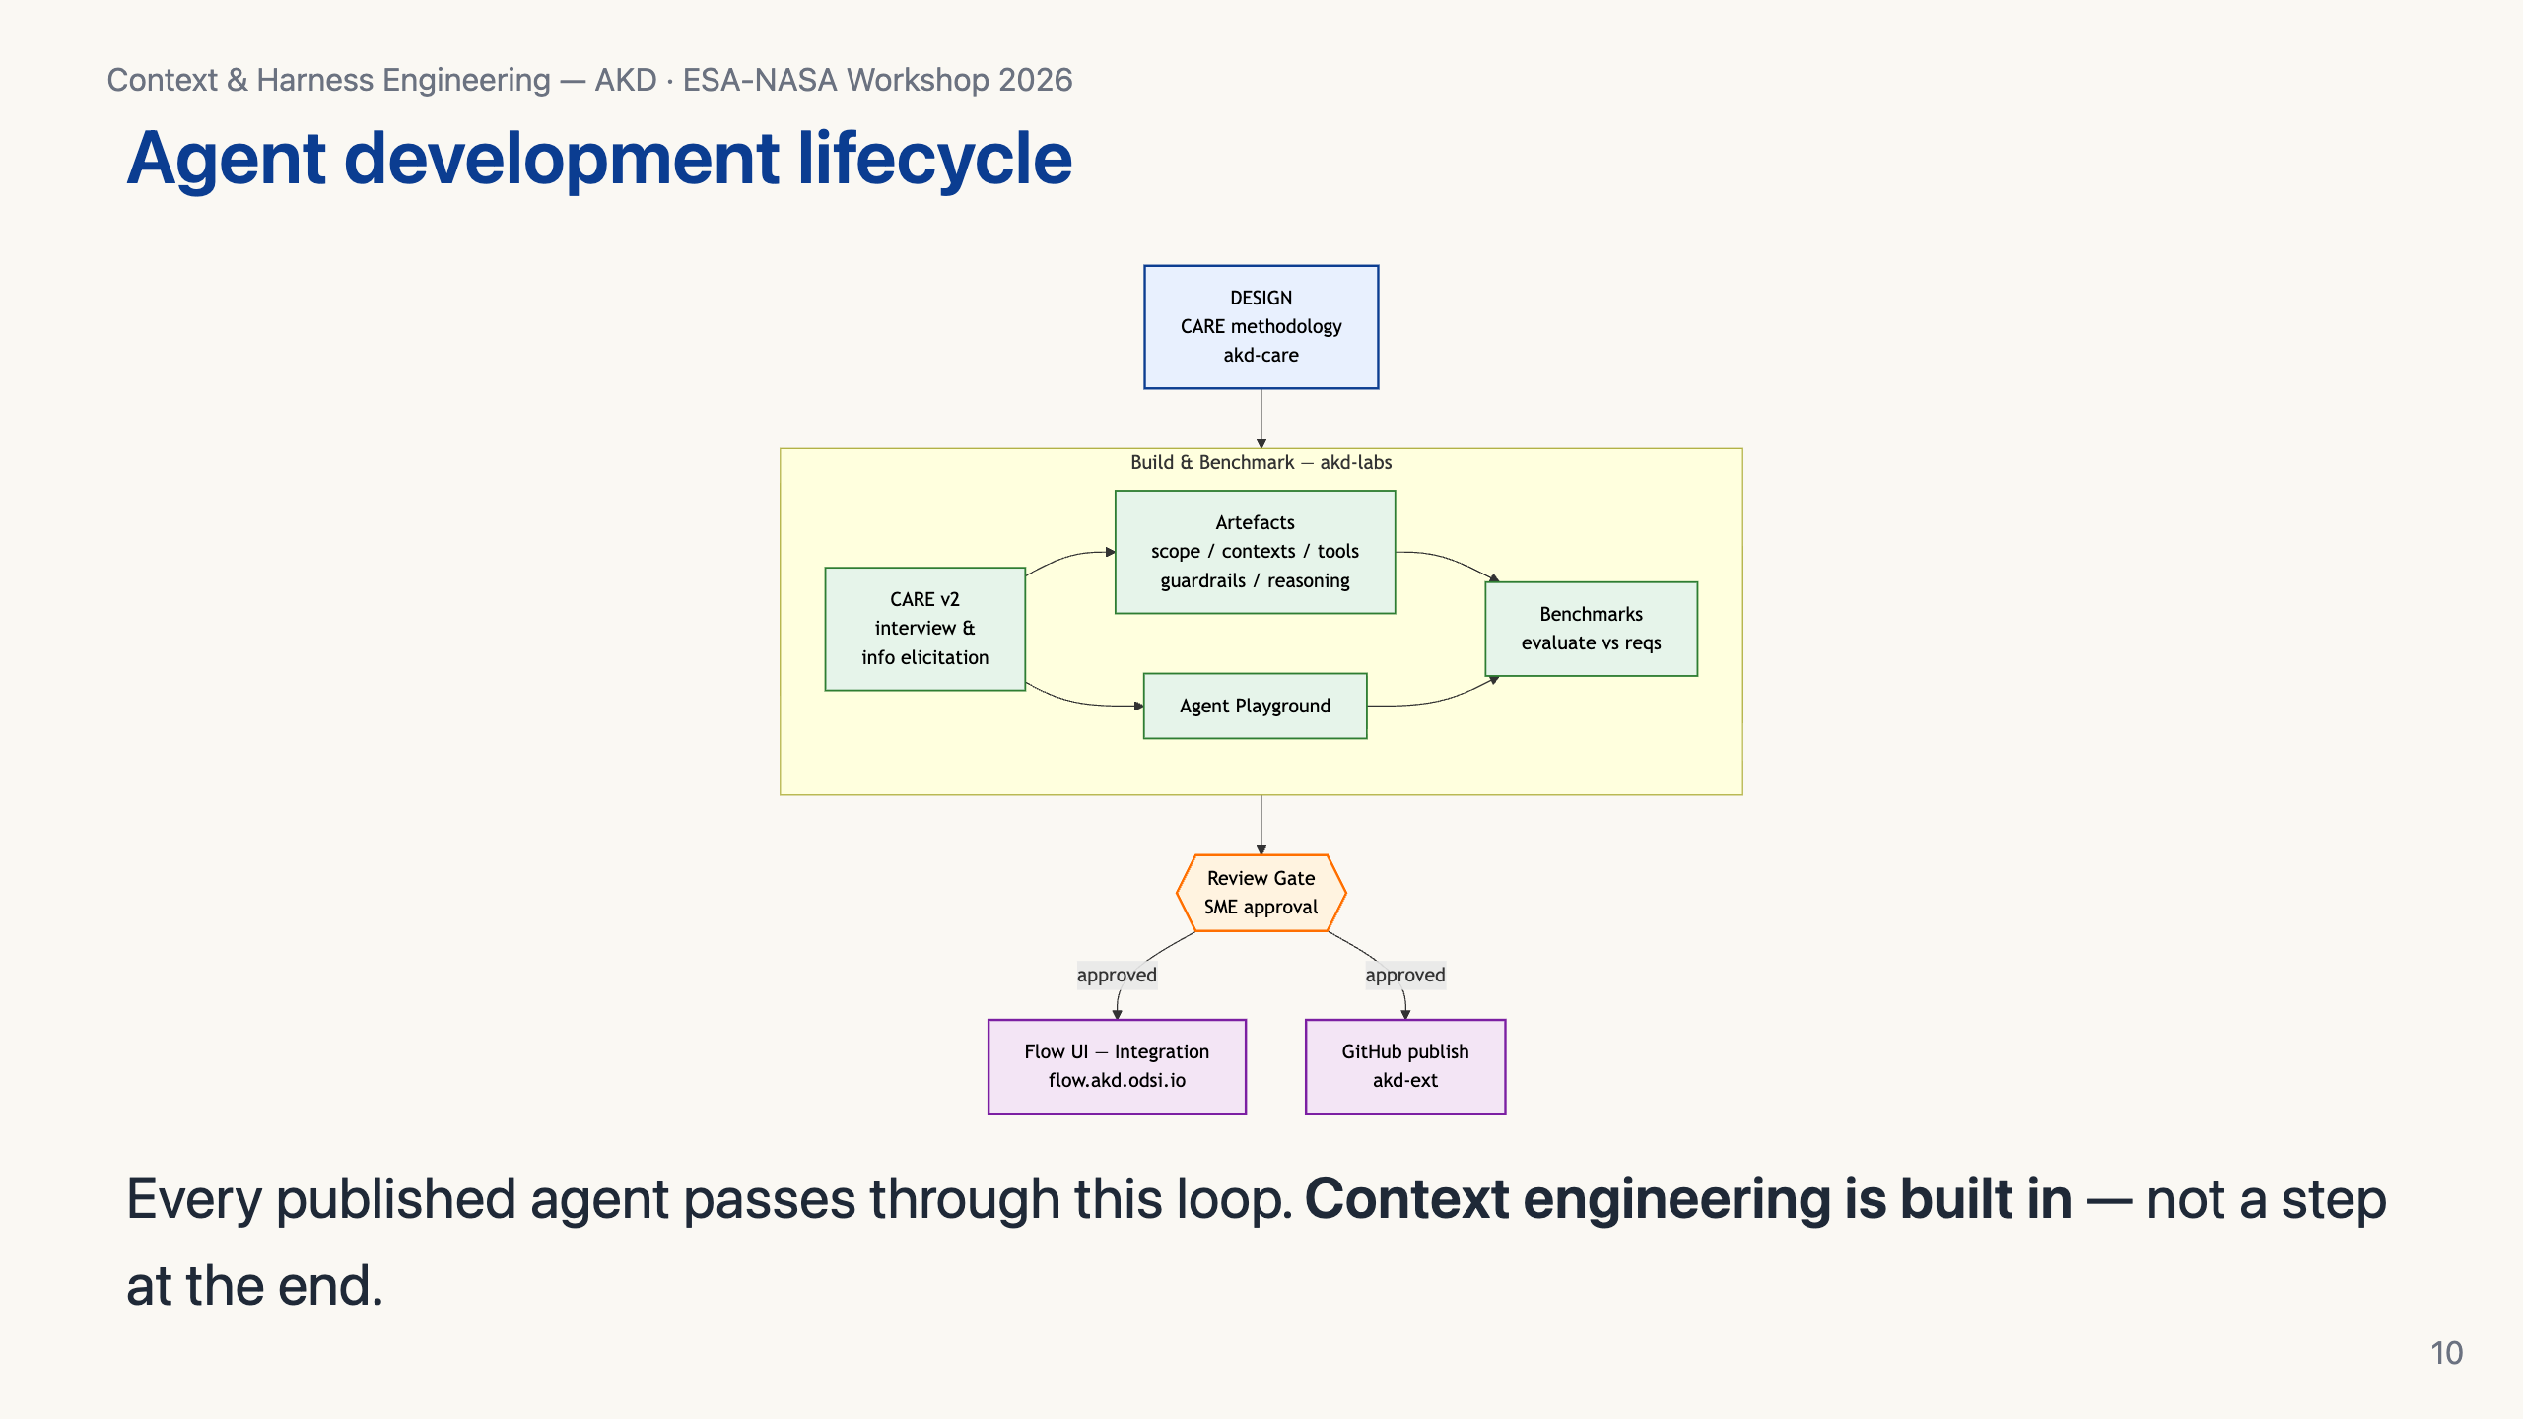
Notes:
This is the AKD agent-development-lifecycle. Design uses the CARE methodology — I'll show that next. Build & benchmark happens in Labs. There's an explicit review gate where an SME signs off. Only then does an agent go to Flow or GitHub. The point: context engineering is *not* "tweak the prompt at the end" — it's the discipline that runs end-to-end.

Slide 11
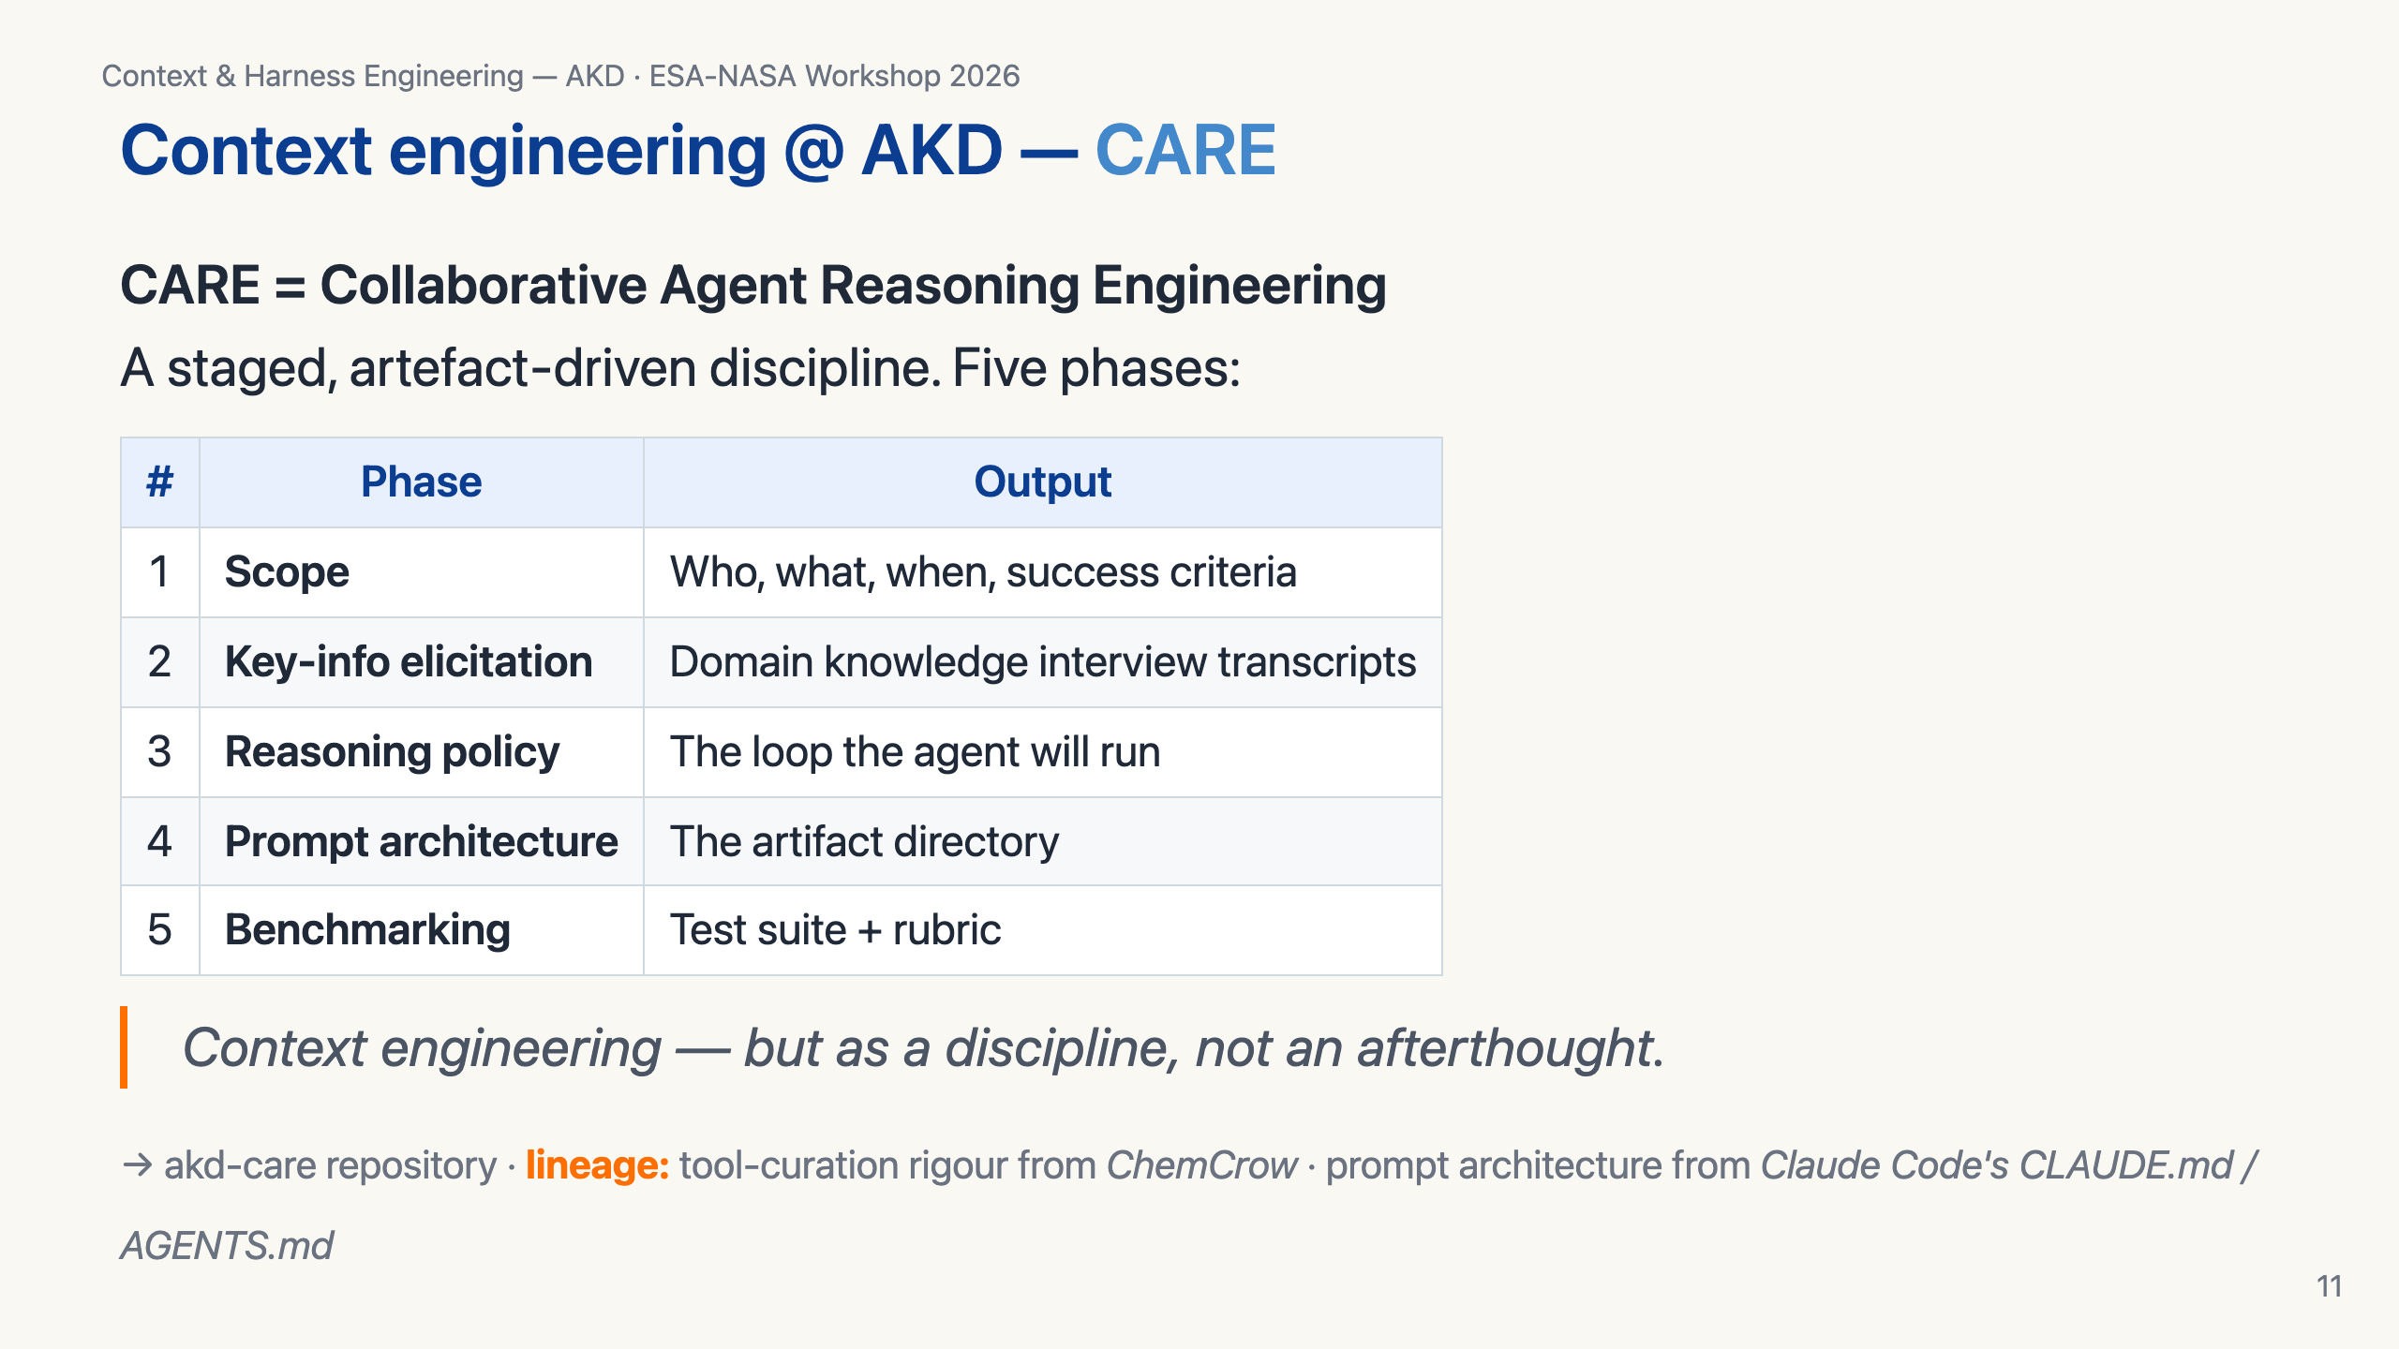
Notes:
CARE is AKD's methodology for designing an agent. Five phases, each producing a concrete artifact. Notice what's missing: code. The first four phases don't write Python — they write markdown. The agent doesn't exist as a class until phase 4-5; before that, it's a documented intent.

Slide 12
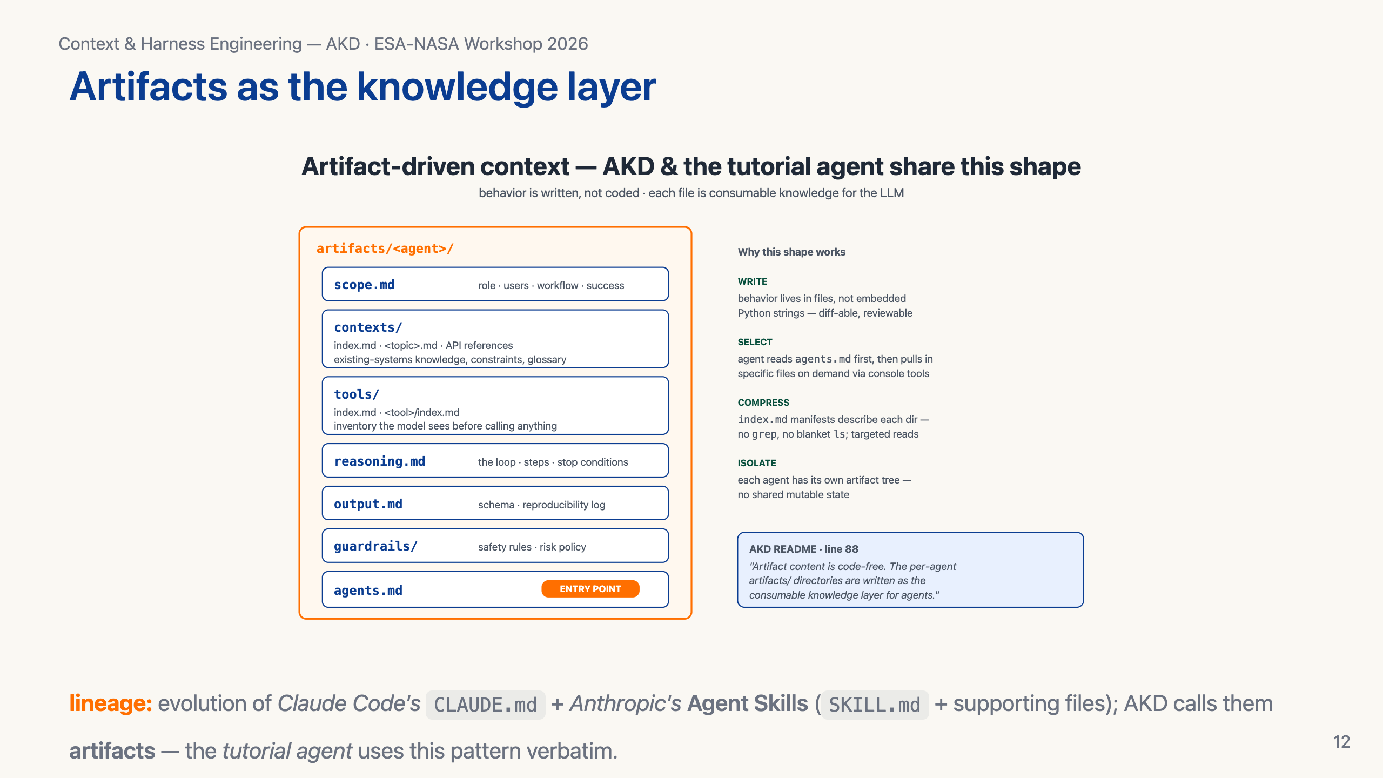
Notes:
Here's the artifact shape AKD agents use. And — this is the punchline — it's the *same* shape as the Prithvi agent you're about to run in the tutorial. scope, contexts, tools, guardrails, reasoning, output, agents.md as the entry point. The agent reads agents.md, then pulls in specific files on demand through its console tools. The notebook code doesn't stitch files together; the *agent* navigates its own knowledge base.

Slide 13
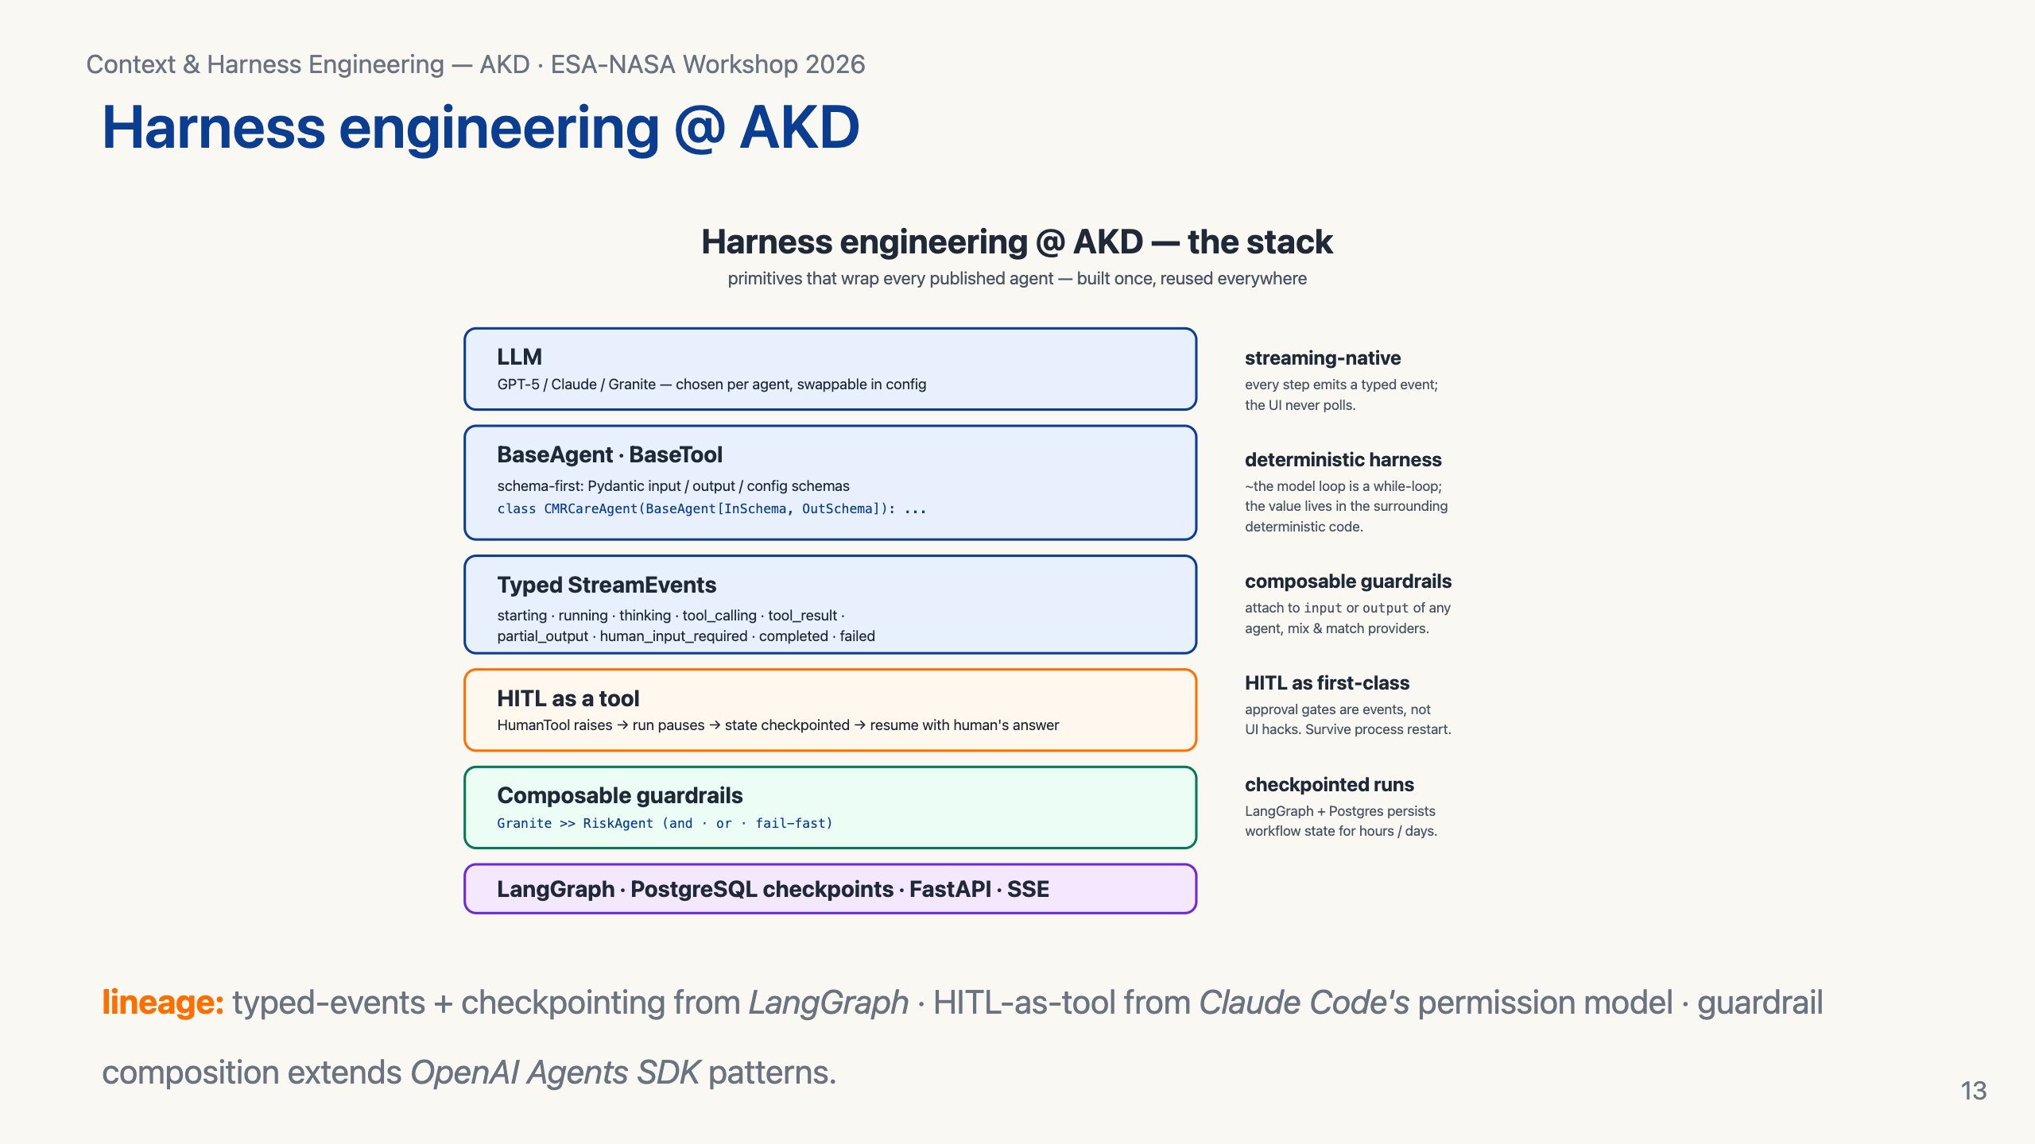
Notes:
The AKD harness in one picture. Schema-first BaseAgent and BaseTool — Pydantic in, Pydantic out. Typed StreamEvents — every step emits an event, the UI never polls. HITL as a tool — the HumanTool raises an exception, the run pauses with state persisted in Postgres via LangGraph checkpoints, resumes when the human answers. Composable guardrails — `granite >> risk_agent` with fail-fast semantics. All of this is built once in akd-core and reused by every agent.

Slide 14
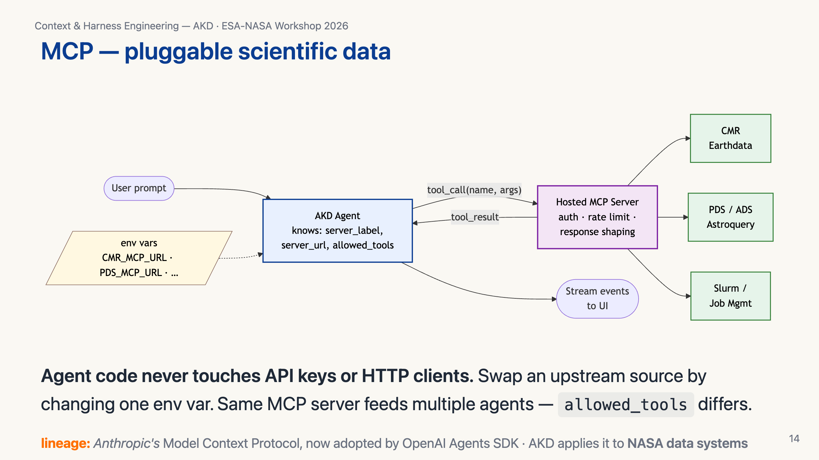
Notes:
Every AKD agent that needs external data does it through MCP. The agent knows three things: server label, server URL (from an env var), and the whitelist of allowed tool names. The MCP server handles auth, rate limiting, response shaping. This means the agent stays small and reasoning-focused, and the same MCP server can be wired into multiple agents.

Slide 15
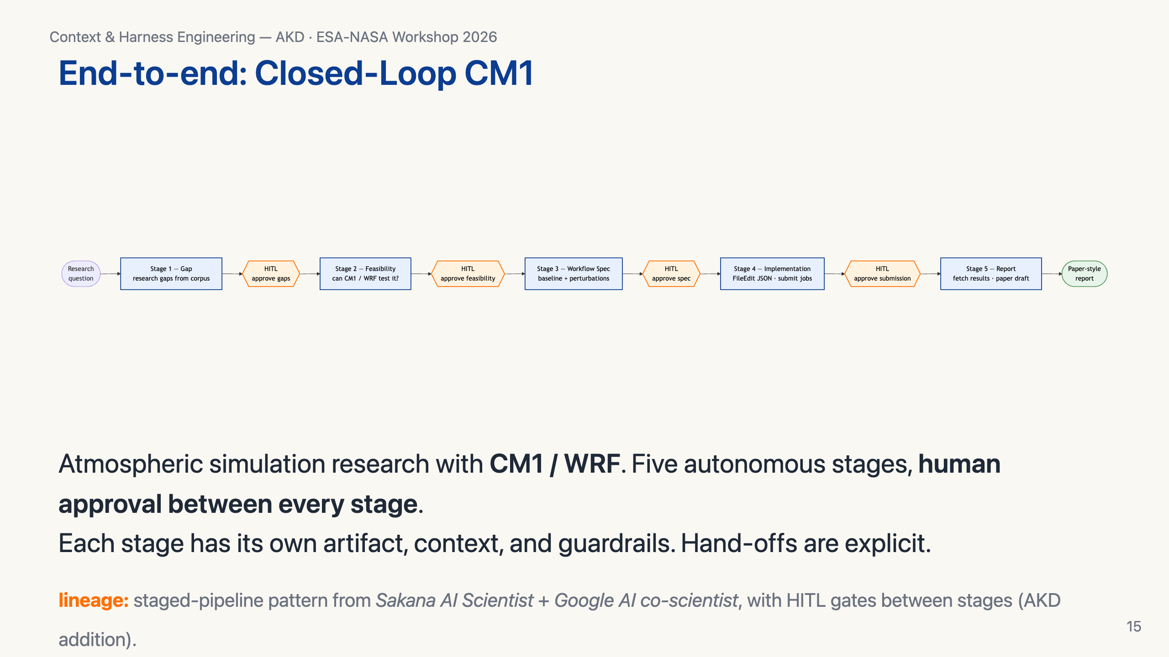
Notes:
Concrete example. The CM1 closed-loop pipeline takes a researcher from a question to a paper-style report. Five stages: gap analysis, feasibility against CM1/WRF + the cluster, workflow specification, implementation as actual job submissions, report generation. Human approval at every gate. This is what AKD's harness + context engineering looks like at workflow scale — and it's deployed today.

Slide 16
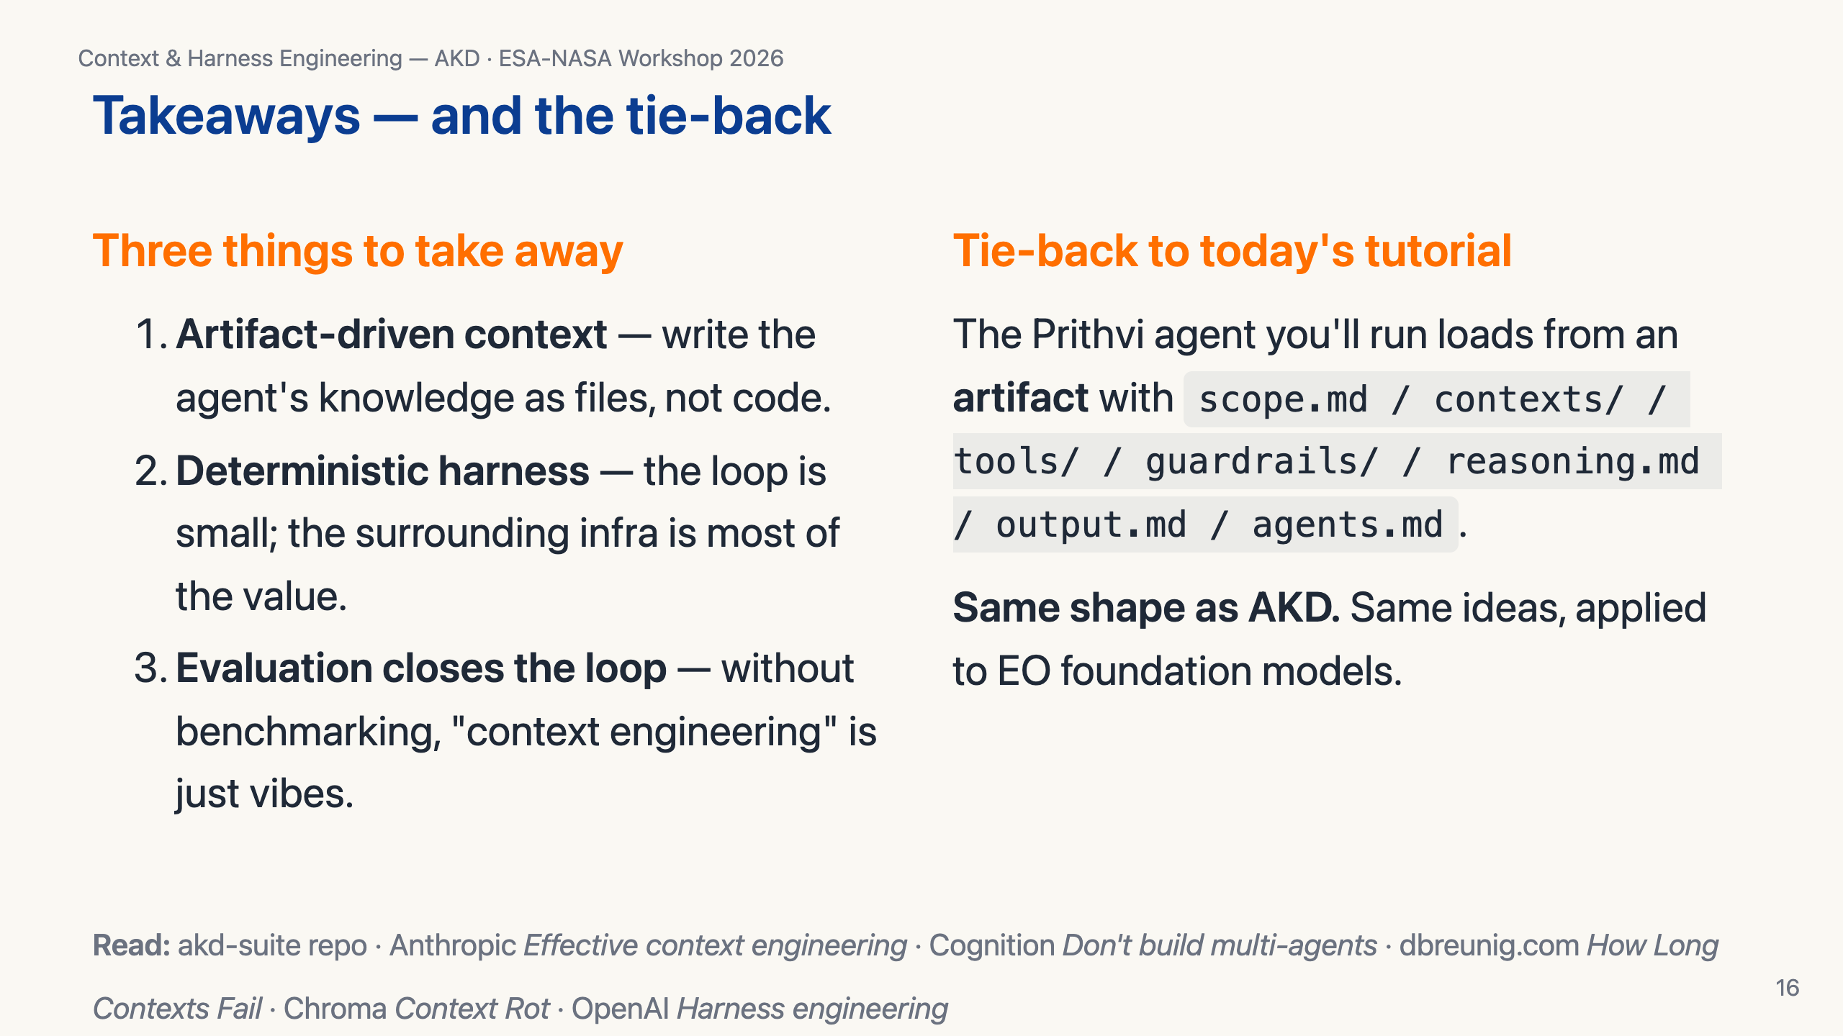
Notes:
Three takeaways. One: write context as files, not code. Two: most of the value is in the deterministic harness. Three: evaluation is what makes context engineering a discipline rather than a vibe. And the tie-back — the agent you're about to run in the next 90 minutes uses the same artifact shape AKD uses across NASA SMD. Take the patterns home. Thanks.

