Slide 1

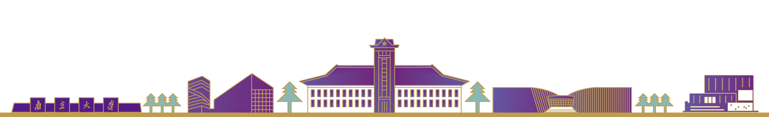


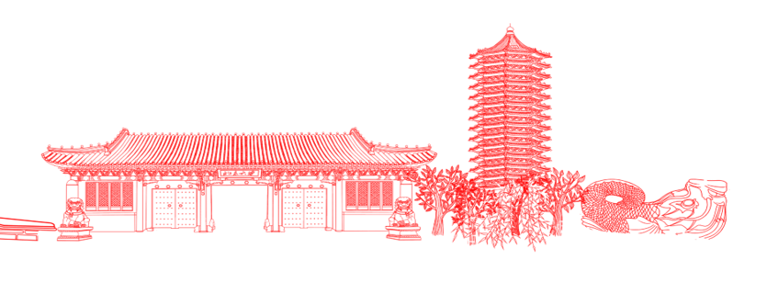
FlyMon: Enabling On-the-Fly Task Reconfiguration for Network Measurement
Hao Zheng, Chen Tian, Tong Yang, Huiping Lin, Chang Liu
Zhaochen Zhang, Wanchun Dou, Guihai Chen

Slide 2
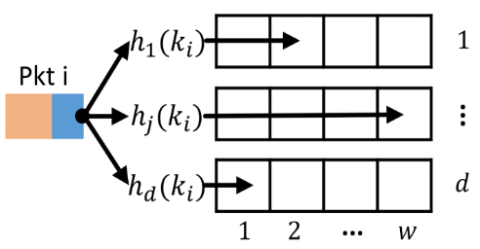



Network Measurement is Important
Many management tasks rely on real-time traffic events/statistics sensed by underlying measurements.
Management Decisions
(e.g., Routing or ACL Rules, QoS,...)
Network
Measurement
Management
Data Center Network
Wide Area Network
...
Heavy Hitters
Cardinality Jitters
DDoS Victims ...
Traffic Engineering
Performance Diagnosis
Security ...
Packets
Statistics
Events

Slide 3
Diverse Measurement Tasks
At a high level, a measurement task composes of a flow key and a flow attribute.
Heavy Hitters
DDoS Victims
Key : 5-tuples – Attr: Frequency(1 or pkt_len)
Key : DstIP – Attr: Distinct(SrcIP)
Sketches are popular schemes for measuring flow attributes due to their memory efficiency and accuracy.
Diverse
Measurement Task!
Diverse Flow Key
Attribute | Measurement Task
Frequency | per-flow size, heavy hitters, flow size distribution, ...
Distinct | DDoS victims, super spreaders flow cardinality, ...
Max | congestion, head of line, maximum inter-arrival time, ...
 | ...
SrcIP/24
SrcIP
SrcIP-DstIP
5-Tuple
···
×
＝
?
?

Slide 4
Diverse Measurement Tasks
At a high level, a measurement task composes of a flow key and a flow attribute.
Heavy Hitters
DDoS Victims
Key : 5-tuples – Attr: Frequency(1 or pkt_len)
Key : DstIP – Attr: Distinct(SrcIP)
Sketches are popular for measuring flow attributes due to their memory efficiency and accuracy.
Diverse
Measurement Task!
Diverse Flow Key
Distinct
MV Sketch
BeauCoup*
Existence
SrcIP/24
SrcIP
SrcIP-DstIP
5-Tuple
···
HLL
BloomFilter
Linear Counting
×
UnivMon
＝
Counter Braids
Others
CountMin
Elastic
CocoSketch*
?
Max
SuMax
FCM Sketch
MRAC
Frequency
Diverse Sketches (Part)

Slide 5
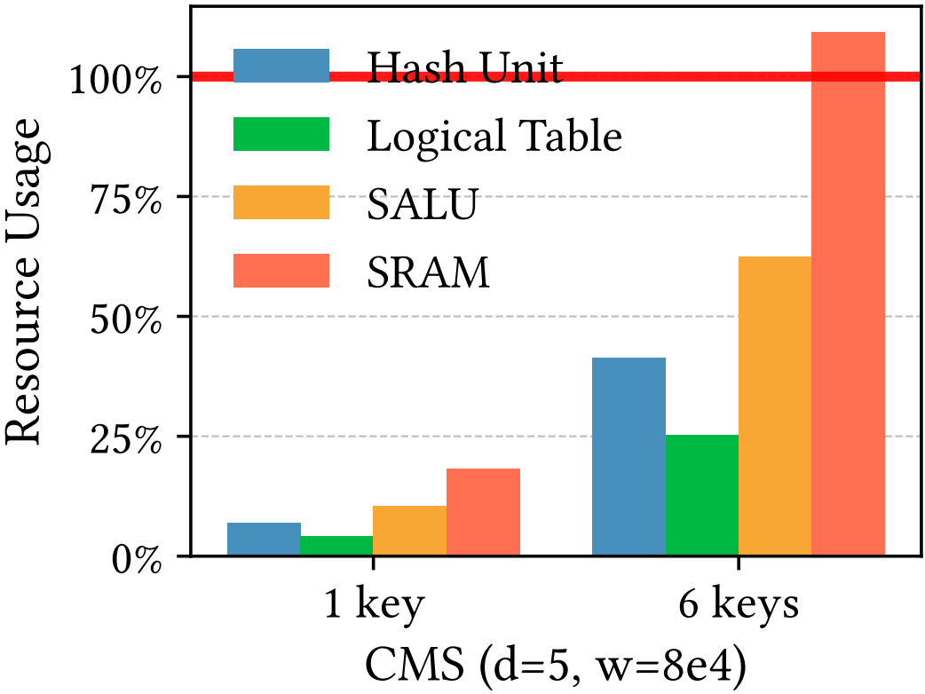

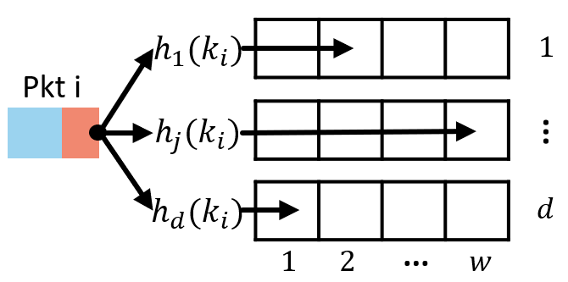



Limited Task Capacity in Hardware
Conventional implementation of sketches occupies exclusive hardware resources on programmable switches.
Fixed Key
Fixed Memoy
SrcIP
Hash
32-bit
DstIP
index=2
$$+p_{i}$$
$$∙∙∙$$
ADD
Count-min Sketch
PHV
SALU
SRAM
Fixed Operation
Conventional implementation of a count-min sketch (CMS).
A switch accommodates less than 6 sketches in a common case.
Limited Task Capacity. It is impossible to configure all needed tasks in hardware switches.

Slide 6
Measurement Reconfiguration is Necessary
Case#1. To cope with changing measurement demands of tenants or applications.
Task Capacity = 4
Task Capacity = 4
Task Capacity = 4
t1
t2
t3
Time
Tenant | Action
A | ADD Task
B | ADD Task
Tenant | Action
B | ADD Task
Tenant | Action
A | DEL Task
A | ADD Task

Slide 7
Measurement Reconfiguration is Necessary
Case#1. To cope with changing measurement demands of tenants or applications.
Task Capacity = 4
Task Capacity = 4
Task Capacity = 4
t1
t2
t3
Time
Tenant | Action
A | ADD Task
B | ADD Task
Tenant | Action
B | ADD Task
Tenant | Action
A | DEL Task
A | ADD Task
Measurement Task Reconfiguration can timely and accurately meet the changing measurement demands.

Slide 8



Measurement Reconfiguration is Necessary
Case#2. To fast locate the root cause of ongoing network anomalies.
High drop rate!
High latency!
Please wait...
We are trying!
User
Operator
Measurement Task Reconfiguration brings more visibility of the network by giving more statistics.

Slide 9
State of the Art
Solution#1. Design general or versatile sketches to support multiple measurement tasks simultaneously.
Multi-Attribute Algorithm: UnivMon (SIGCOMM’16), Elastic (SIGCOMM’18), SuMax (NSDI’20),...
Multi-Key Algorithm: BeauCoup(SIGCOMM’20), CocoSketch (SIGCOMM’21).
It’s hard to design a full-key and full-attribute sketch!
Solution#2. Leverage compile-phase programmability of RMT switches to change hardware functions.

Slide 10


State of the Art
Solution#1. Design general or versatile sketches to support multiple measurement tasks simultaneously.
Multi-Attribute Algorithm: UnivMon (SIGCOMM’16), Elastic (SIGCOMM’18), SuMax (NSDI’20),...
Multi-Key Algorithm: BeauCoup(SIGCOMM’20), CocoSketch (SIGCOMM’21).
Solution#2. Leverage compile-phase programmability of RMT switches to change hardware functions.
HLL
.p4
Count-Min
d=3
w=32768
HyperLogLog
w=4096
Traffic Interrupt！
It will interrupt running network traffic to reload the data-plane codes.

Slide 11

FlyMon Design
On-the-Fly Task Reconfiguration
Dynamic
Key
+
Dynamic
Attribute(sketch)
+
Dynamic
Memory
Runtime
Rules
Runtime
Rules
Control Plane
Data Plane
Key-selection
Attribute-oper.
Addr Translation
M | A
M | A
M | A
M | A
M | A
M | A
PHV
Hash
Unit
SALU
SRAM
Basic Idea: dynamically compose a task implementation with Match Action Tables.

Slide 12
FlyMon Design
On-the-Fly Task Reconfiguration
Dynamic
Key
+
Dynamic
Attribute(sketch)
+
Dynamic
Memory
Runtime
Rules
Runtime
Rules
Control Plane
Data Plane
Key-selection
Attribute-oper.
Addr Translation
Composable Measurement Unit
(CMU)
M | A
M | A
M | A
M | A
M | A
M | A
PHV
Hash
Unit
SALU
SRAM
Basic Idea: dynamically compose a task implementation with Match Action Tables.

Slide 13



Key-selection Phase
Basic Implementation. Dynamically select an input key (e.g., by masking) for Hash Units through a match-action table.
Candidate Keys
Dynamic Key
SrcIP
DstIP
$$∙∙∙$$
$$∙∙∙$$
PHV
Select Key
Hash Unit
SrcIP
DstIP
IP-Pair
$$∙∙∙$$
Address

Slide 14
Key-selection Phase
Basic Implementation. Dynamically select an input key (e.g., by masking) for Hash Units through a match-action table.
Candidate Keys
Dynamic Key
SrcIP
DstIP
$$∙∙∙$$
DstIP
$$∙∙∙$$
PHV
PHV Copy
Select Key
Hash Unit
SrcIP
DstIP
IP-Pair
$$∙∙∙$$
Address
Challenge: PHV Copy.
It needs to statically allocate extra PHV memory and copy the original header fields to this memory. For example, taking 5-tuple as a key needs additional 104 PHV bits for each SALU.

Slide 15







Key-selection Phase
Main Optimization: Less-copy Strategy.
Perform one-way compressions (i.e., the fingerprints of candidate keys) with several hash units.
Candidate Keys
Dynamic Key
Address
SrcIP
DstIP
$$∙∙∙$$
$$C\left(k_{2}\right)$$
PHV
M1
Hash Unit
$$C(k_{1})$$
Select Key
M2
Hash Unit
$$C(k_{2})$$
$$C\left(k_{1}\right)$$
$$C\left(k_{2}\right)$$
$C(k_{1})$⊕$C(k_{2})$
“Compressed” Keys
(e.g., 104 bit to 24-bit fingerprints)
Shared by multiple CMUs

Slide 16






Key-selection Phase
Main Optimization: Less-copy Strategy.
Perform one-way compressions (i.e., the fingerprints of candidate keys) with several hash units.
Candidate Keys
Dynamic Key
Address
SrcIP
DstIP
$$∙∙∙$$
$$C\left(k_{2}\right)$$
One-way Compressions
Decide which keys to hash in the control plane with the dynamic hashing feature of RMT hardware (i.e., Tofino)
PHV
M1
Hash Unit
$$C(k_{1})$$
Select Key
1
M2
Hash Unit
$$C(k_{2})$$
$$C\left(k_{1}\right)$$
$$C\left(k_{2}\right)$$
$C(k_{1})$⊕$C(k_{2})$
“Compressed” Keys
(e.g., 104 bit to 24-bit fingerprints)
Shared by multiple CMUs
Notes:
Firstly, we generate several compressed keys with hash units.
We can decide which keys to compress in the control plane with the dynamic hashing feature of RMT hardware.

Slide 17




Key-selection Phase
Main Optimization: Less-copy Strategy.
Perform one-way compressions (i.e., the fingerprints of candidate keys) with several hash units.
Candidate Keys
Dynamic Key
Address
SrcIP
DstIP
$$∙∙∙$$
$$C\left(k_{2}\right)$$
PHV
Select one of the
“Compressed” keys
XOR between keys is supported.
M1
Hash Unit
$$C(k_{1})$$
Select Key
M2
Hash Unit
$$C(k_{2})$$
$$C\left(k_{1}\right)$$
$$C\left(k_{2}\right)$$
$C(k_{1})$⊕$C(k_{2})$
2
“Compressed” Keys
(e.g., 104 bit to 24-bit fingerprints)
Shared by multiple CMUs
Deploy ~5x CMUs when the candidate key size reaches 360 bits.

Slide 18
Attribute-operation Phase
Basic Implementation. Select a pre-loaded operation through a match-action table.
Operation Capacity = 4
Various Sketches
Select Operation*
Distinct
MV Sketch
Linear Counting
ADD
OR
?
?
Existence
BeauCoup*
HyperLogLog
Bloom Filter
UnivMon
Counter Braids
Others
CountMin
CocoSketch*
Elastic
SALU
SRAM
Max
SuMax
MRAC
FCM Sketch
Address
ADD
Frequency
Challenge: Limited Stateful Operations.
It is challenging to support various sketching algorithms with the limited SALU operations (e.g., only 4 for each SALU in Tofino).

Slide 19
Attribute-operation Phase
Built-in Algorithms. We only try to support simple but dedicated measurement algorithms to cover common flow attributes.
Main Optimization: A Reduced Operation Set
Built-in Algorithms
Decomposition
Aggregation
CMS
MRAC
Decomposion. Sketches can share some joint operations.
Aggregation. Some operations can be aggregated into a single stateful action.
TowerSketch
Reduced
Operation Set
Frequency
SuMax(Sum)
UnCond-ADD
Counter Braids
Cond-ADD
Cond-ADD
Max
SuMax(Max)
MAX
MAX
Distinct
HyperLogLog
OR
AND-OR
Linear Counting
FlyMon uses 3 stateful actions to implement at least 10 sketches.
BeauCoup
AND
Reserved Operation
Exist.
Bloom Filter
XOR/MIN/...
Generation process of the reduced operation set.
(See implementation details in the paper)

Slide 20
Dynamic Memory Management
Unit-level Dynamic Memory with runtime reconfigurable CMUs.
CMU 0
CMU 1
CMU 2
Task 0
Task 1
Unused
Challenge: Limited SALUs (i.e., CMUs)
Coarse-grained memory allocations
Limited Concurrent Measurement Tasks.
Subunit-level Dynamic Memory with Address Translation Mechanism.
CMU 0
CMU 1
CMU 2
Task 0
T1
T2
Task 0
T1
T2
Task 3
Task 4

Slide 21
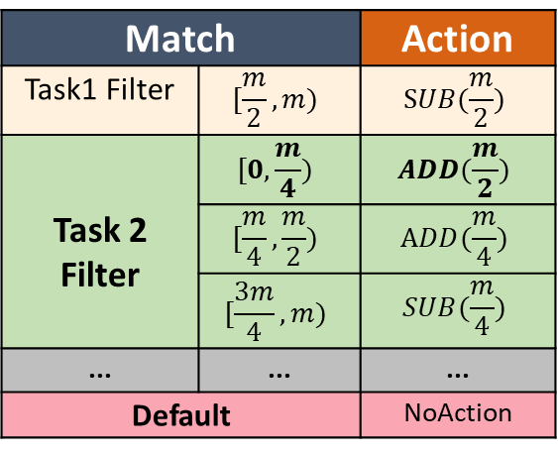






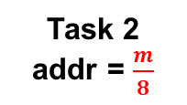
Dynamic Memory Management
Address Translation Mechanism: maps a selected key to the memory range of the task to be performed.
TCAM-based Translation can complete address translation in one MAU stage.
Shift-based Translation (see details in the paper).
Match |  | Action
Task1 Filter | $$[\frac{m}{2},m)$$ | $$SUB(\frac{m}{2})$$
Task 2 Filter | $$[0,\frac{m}{4})$$ | $$ADD(\frac{m}{2})$$
 | $$[\frac{m}{4},\frac{m}{2})$$ | $$ADD(\frac{m}{4})$$
 | $$[\frac{3m}{4},m)$$ | $$SUB(\frac{m}{4})$$
... | ... | ...
Default |  | NoAction
SRAM
Task 1
$$0$$
$$\frac{m}{4}$$
Task 2
addr = $\frac{m}{8}$
addr = $\frac{5m}{8}$
$$\frac{m}{2}$$
Task 2
$$\frac{3m}{4}$$
…
$$m$$
TCAM-based Translation

Slide 22




CMUs in RMT Pipeline
Based on the optimizations, here is a complete view of CMUs in the RMT pipeline.
Compression
Composable Measurement Unit
HASH 1
Initialization
Preparation
Operation
M
1
$$C(k_{1})$$
Set
Key
Address
Translation
SRAM
M
2
HASH 2
$$C(k_{2})$$
…
Set
Params
Params
Processing
SALU
HASH $x$
M
X
$$C(k_{x})$$
The logical view of a CMU in RMT pipeline
Address
Translation
Each CMU has 4 types of stages:
Compression Stage
Initialization Stage
Preparation Stage
Operation Stage
Key-selection
Phase
C
Attribute-oper.
Phase
P
I
O

Slide 23









CMUs in RMT Pipeline
Based on the optimizations, here is a complete view of CMUs in the RMT pipeline.
CMU Group is a set of CMUs
share a compression stage.
deployed in parallel
Composable Measurement Unit
Compression
Composable Measurement Unit
Initialization
Preparation
Operation
Cross-stacked CMU Groups
Increase the number of deployed CMU Groups in given MAU stages (see details in the paper).
HASH 1
M
1
$$C(k_{1})$$
Set
Key
Address
Translation
SRAM
M
2
HASH 2
$$C(k_{2})$$
…
Set
Params
Params
Processing
SALU
HASH $x$
S1 | S2 | S3 | S4 | S5 | S6 | ...
 |  |  |  |  |  | ...
 |  |  |  |  |  | ...
 |  |  |  |  |  | ...
M
X
$$C(k_{x})$$
$$C_{0}$$ | $$I_{0}$$ | $$P_{0}$$ | $$O_{0}$$
$$C_{3}$$ | $$I_{3}$$
Composable Measurement Unit
$$C_{1}$$ | $$I_{1}$$ | $$P_{1}$$ | $$O_{1}$$
$$C_{4}$$
$$C_{2}$$ | $$I_{2}$$ | $$P_{2}$$ | $$O_{2}$$
The logical view of a CMU Group in RMT pipeline
Cross-stacking view of CMU Groups

Slide 24
Algorithm Implementation with CMUs
With CMUs, we can dynamically configure hardwares to various sketching algorithms with reconfigurable memory spaces.
Algorithm Case#1:
Count Min Sketch
Algorithm Case#2:
SuMax (Sum)
Algorithm Case#3:
HyperLogLog
Algorithm Case#4:
BloomFilter
Cond-ADD: perform ADD operation when Param 2 larger than the value in the memory.
Set parameter 2 to infinity and treat conditional addition as unconditional addition.
Count-min Sketch (d=3)

Slide 25
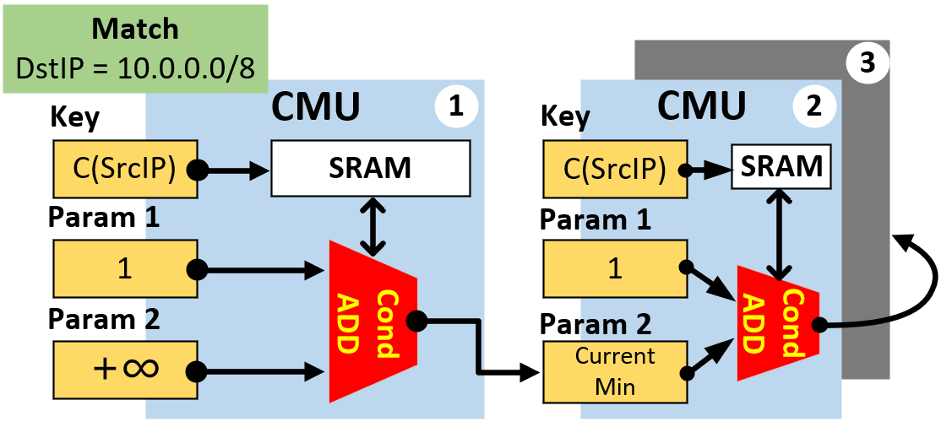
Algorithm Implementation
With CMUs, we can dynamically configure hardwares to various sketching algorithms with reconfigurable memory spaces.
Algorithm Case#1:
Count Min Sketch
Algorithm Case#2:
SuMax (Sum)
Algorithm Case#3:
HyperLogLog
Algorithm Case#4:
BloomFilter
SuMax (Approximate Conservative Updating, d=3)
Set Param2 as the Current Minimum Counter (CMC) and ‘Cond-ADD’ will only update the counter if the counter is smaller than the CMC.

Slide 26
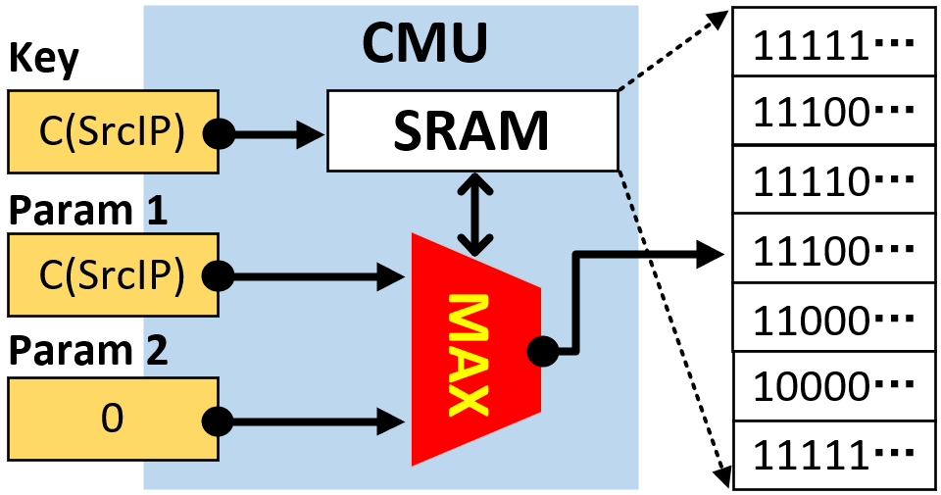




Algorithm Implementation
With CMUs, we can dynamically configure hardwares to various sketching algorithms with reconfigurable memory spaces.
Algorithm Case#1:
Count Min Sketch
Algorithm Case#2:
SuMax (Sum)
Algorithm Case#3:
HyperLogLog
Algorithm Case#4:
BloomFilter
Hash($k_{1}$)= 10 0101
3
Original
HLL
Hash($k_{2}$)= 00 0001
2
Hash($k_{3}$)= 11 0101
1
Hash($k_{4}$)= 01 0011
1
Simulate the tracking of leading '0' with the Max operation
FlyMon
HLL
Equivalent to ‘0’ tracking

Slide 27
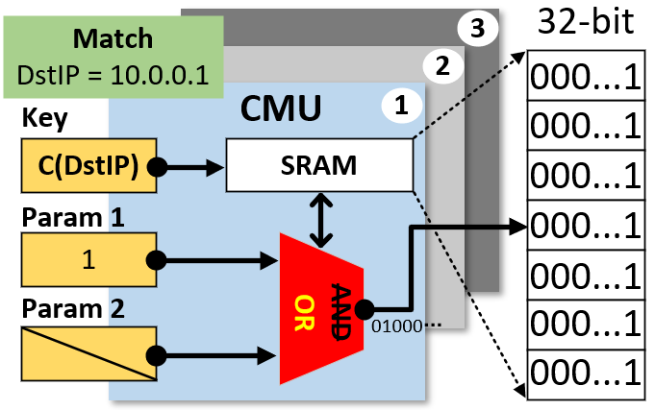
Algorithm Implementation
With CMUs, we can dynamically configure hardwares to various sketching algorithms with reconfigurable memory spaces.
Algorithm Case#1:
Count Min Sketch
Algorithm Case#2:
SuMax (Sum)
Algorithm Case#3:
HyperLogLog
Algorithm Case#4:
BloomFilter
31/32 of the memory are wasted!

Slide 28
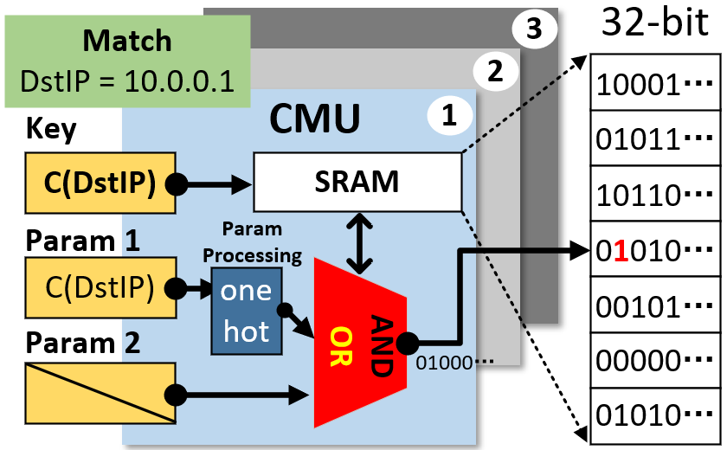
Algorithm Implementation
With CMUs, we can dynamically configure hardwares to various sketching algorithms with reconfigurable memory spaces.
Algorithm Case#1:
Count Min Sketch
Algorithm Case#2:
SuMax (Sum)
Algorithm Case#3:
HyperLogLog
Algorithm Case#4:
BloomFilter
Param Processing
Match (Param 1) | One Hot
00000… | 00…001
00001… | 00…010
... | ...
11111… | 100…000
Optimized BF implementation w/
the preparation stage

Slide 29

Implementation and Evaluation
We Implement FlyMon based on a Wedge-100BF Tofino-based programmable switch.
Implementation:
Data Plane
P4-16, ~5700 LOC
9 CMU Groups (27 CMUs)
Control Plane
Python, ~2800 LOC
Built-in Algorithms
Other essential components
Accuracy Simulation
C++ , ~3000 LOC
Built-in Algorithms
FlyMon Task Manager
Algorithm
Implementation
Resource
Management
Data
Collection
Algorithm
Simulations
RMT Runtime Interfaces
Runtime Rules
Control Plane
Data Plane
Key-selection
Phase
Attribute-oper
Phase
Address
Translation
Grouped Deployed
(CMU Groups)
Composable Measurement Unit (CMU)
RMT
RMT-based Hardware Switch

Slide 30
Implementation and Evaluation
We Implement FlyMon based on a Wedge-100BF Tofino-based programmable switch.
Implementation:
Data Plane
P4-16, ~5700 LOC
9 CMU Groups (27 CMUs)
Control Plane
Python, ~3000 LOC
Reconfigure built-in Algorithms
Other essential components
Accuracy Simulation
C++ , ~3000 LOC
Test built-in Algorithms
FlyMon Task Manager
Algorithm
Implementation
Resource
Management
Data
Collection
Algorithm
Simulations
RMT Runtime Interfaces
Runtime Rules
Control Plane
Data Plane
Key-selection
Phase
Attribute-oper
Phase
Address
Translation
Grouped Deployed
(CMU Groups)
Composable Measurement Unit (CMU)
RMT
RMT-based Hardware Switch

Slide 31
Implementation and Evaluation
We Implement FlyMon based on a Wedge-100BF Tofino-based programmable switch.
Implementation:
Data Plane
P4-16, ~5700 LOC
9 CMU Groups (27 CMUs)
Control Plane
Python, ~2800 LOC
Reconfigure built-in Algorithms
Other essential components
Accuracy Simulation
C++ , ~3000 LOC
Test built-in Algorithms
FlyMon Task Manager
Algorithm
Implementation
Resource
Management
Data
Collection
Algorithm
Simulations
RMT Runtime Interfaces
Runtime Rules
Control Plane
Data Plane
Key-selection
Phase
Attribute-oper
Phase
Address
Translation
Grouped Deployed
(CMU Groups)
Composable Measurement Unit (CMU)
RMT
RMT-based Hardware Switch

Slide 32
Implementation and Evaluation
We Implement FlyMon based on a Wedge-100BF Tofino-based programmable switch.
Implementation:
Data Plane
P4-16, ~5700 LOC
9 CMU Groups (27 CMUs)
Control Plane
Python, ~2800 LOC
Reconfigure built-in Algorithms
Other essential components
Accuracy Simulation
C++ , ~3000 LOC
Test built-in Algorithms
FlyMon Task Manager
Algorithm
Implementation
Resource
Management
Data
Collection
Algorithm
Simulations
RMT Runtime Interfaces
Runtime Rules
Control Plane
Data Plane
Key-selection
Phase
Attribute-oper
Phase
Address
Translation
Grouped Deployed
(CMU Groups)
Composable Measurement Unit (CMU)
RMT
RMT-based Hardware Switch

Slide 33
Implementation and Evaluation
We Implement FlyMon based on a Wedge-100BF Tofino-based programmable switch.
Evaluation:
Functionality
Resource Usage
Accuracy (see details in the paper)

Slide 34
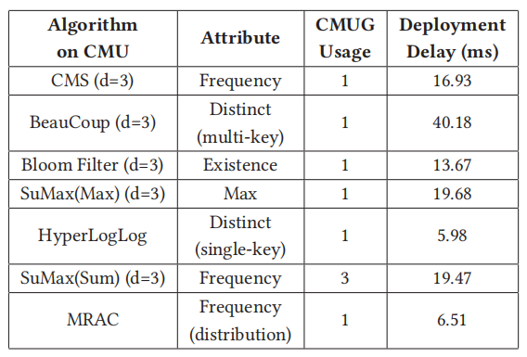
Implementation and Evaluation
We Implement FlyMon based on a Wedge-100BF Tofino-based programmable switch.
Evaluation:
Functionality
Millisecond-level delay: less than 100 ms.
Good expressiveness: supports at least 4 flow attributes and 10 algorithms.
Task Deployment Delay and CMU Group Usage

Slide 35
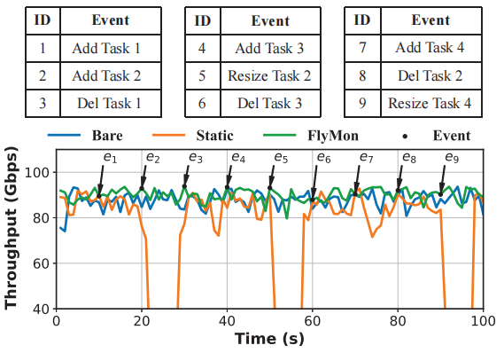
Implementation and Evaluation
We Implement FlyMon based on a Wedge-100BF Tofino-based programmable switch.
Evaluation:
Functionality
Millisecond-level delay: less than 100 ms.
Good expressiveness: supports at least 4 flow attributes and 10 algorithms.
No negative impact on traffic forwarding.
*
Impact on Traffic forwarding

Slide 36
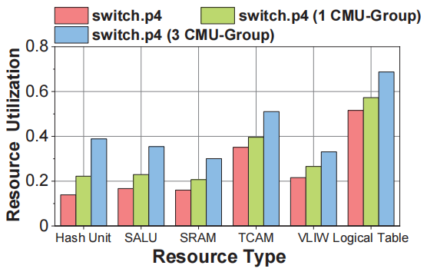
Implementation and Evaluation
We Implement FlyMon based on a Wedge-100BF Tofino-based programmable switch.
Evaluation:
Functionality
Resource Usage
More than 3 CMU Groups can be integrated into the Tofino baseline switch project.
A CMU Group costs up to 8.334% of hardware resources (Tofino, 12 MAUs).
Integrate CMU Groups to switch.p4

Slide 37
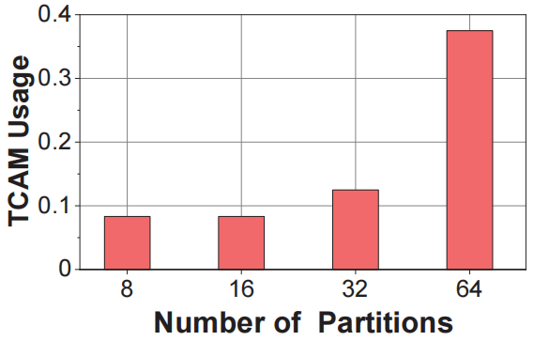
Implementation and Evaluation
We Implement FlyMon based on a Wedge-100BF Tofino-based programmable switch.
Evaluation:
Functionality
Resource Usage
More than 3 CMU Groups can be integrated into the Tofino baseline switch project.
A CMU Group costs up to 8.334% of hardware resources (Tofino, 12 MAUs).
Dynamic memory: The TCAM cost of 32 memory divisions is less than 13% of one MAU Stage.
TCAM Usage of Address Translation

Slide 38
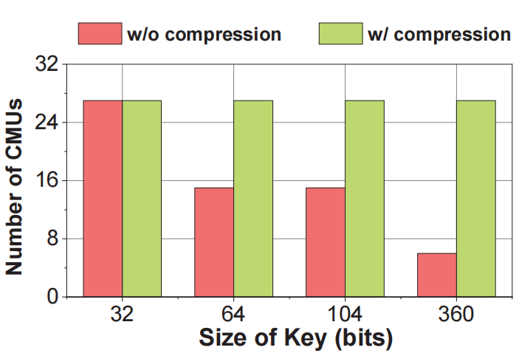
Implementation and Evaluation
We Implement FlyMon based on a Wedge-100BF Tofino-based programmable switch.
Evaluation:
Functionality
Resource Usage
More than 3 CMU Groups can be integrated into the Tofino baseline switch project.
A CMU Group costs up to 8.334% of hardware resources (Tofino, 12 MAUs).
Dynamic memory: The TCAM cost of 32 memory divisions is less than 13% of one MAU Stage.
Less copy: More CMU deployments.
The number of deployable CMUs

Slide 39

Conclusion
FlyMon achieves on-the-fly reconfiguration of sketch-based measurement tasks.
Supports on-the-fly configures measurement tasks at the millisecond level.
Supports at least 4 common flow attributes and 10 algorithms.
Supports dynamic memory management.
Our reference implementation of FlyMon is available at: https://github.com/NASA-NJU/FlyMon
Thanks!

